Slide 1
Human Factors in Manufacturing:
Introduction, Purpose and Scope
Brian Peacock
for
Singapore Technologies (ST) Kinetics

Slide 2

Prescott Arizona

Slide 3
Course Objectives
To train product / process / manufacturing / industrial engineers in the applications of Ergonomics and Human Factors foundations, tools and techniques to vehicle manufacturing and maintenance.

Slide 4
Structure
The course will comprise six 3 hour sessions consisting of lectures, demonstrations, case studies, small group discussions and classroom exercises.

Slide 5
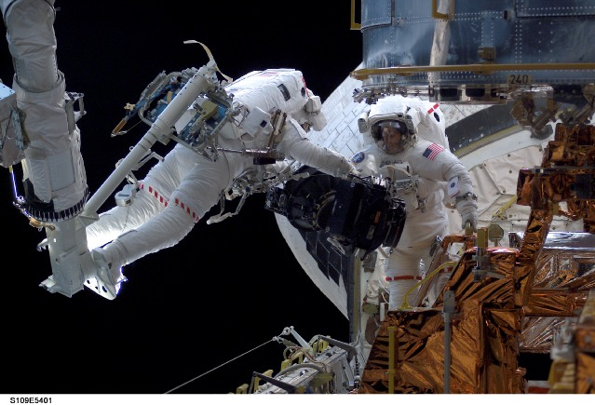
EasyErgoLab
  Class members as subjects
  Materials and artefacts in the classroom
  Materials and artefacts brought by the class members
  Workplace equipment, processes and tools
  Pictures and videos
  Systems and Processes in the environment
  Web based artefacts
Participation
Please bring pictures, sketches, descriptions, problems of your jobs

Slide 6
    The Purposes of Ergonomics
Ease of Use
Effectiveness
Efficiency
Elegance
Safety
Security
Satisfaction
To be Reliable – these outcomes will continue over the life cycle of the process or system of interest
E4S3
+R&R
Often there will be TRADEOFFS
To be Resilient these outcomes will continue during intended use and conditions and possible misuse and under extreme conditions

Slide 8


The Six Us of Usability
Utility
  Is the system useful?
Users and misusers
  Who are the users?
  What kind of misusers are possible?
Usage and Misusage
  How is the system used?
  What is the normal context?
  What possible extreme contexts may be predicted
Utilization
  How often and by how many people?
Usability
  Is the system easy to use or misuse?
User Error
  What kinds of error can be made, how frequently and what are the consequences?
6Us

Slide 9
Scope of Ergonomics
The Analysis of
Human Physical, Sensory, Cognitive, Social, Integrated Characteristics, Capabilities, Limitations, Requirements
Applied to
  Design, Evaluation, Usability testing, Accident investigation
  In any human domain such as manufacturing, aerospace, agriculture, consumer products, health care and so on

Slide 10
If it isn’t applied to the design of something it isn’t Ergonomics
(but it might be one of the related basic sciences – psychology, physiology, biomechanics etc)

Slide 11
Interfaces, Interdependencies Interactions, Interferences and Integration
The Environment
The Operational and Temporal Contexts
The
Users
The
Systems
Physical
Cognitive
Emotional

Slide 12
The Challenge of Design
Control and Resilience
Will your system design inputs make the process resilient to uncontrollable factors?
Feed forward
Uncontrollable Factors
Inputs
The Process
Outputs
Feedback

Slide 13
Activities of Ergonomists
Feed forward / Anticipation
Analysis
Design
Usability Testing
Outcome Investigation
Feedback

Slide 14
Design Requirements - Voice Of the Customers
Who is the customer?
  End user?
  Maintainer?
  Procurement department?
  Shareholders?
  Manufacturing employees?
  Your manager?
  Others?
What are their requirements?
Different customers have different requirements!
E4S3
+R&R
6Us

Slide 15
Human Physical Characteristics,
Capabilities and Limitations
Size
Strength
Stamina
Skill

Slide 16

People vary

Slide 17
Cognitive Factors
Attending
Perceiving
Understanding
Calculating
Sensing
Deciding
Forgetting
Planning
Remembering
Controlling
Communicating
Learning

Slide 18
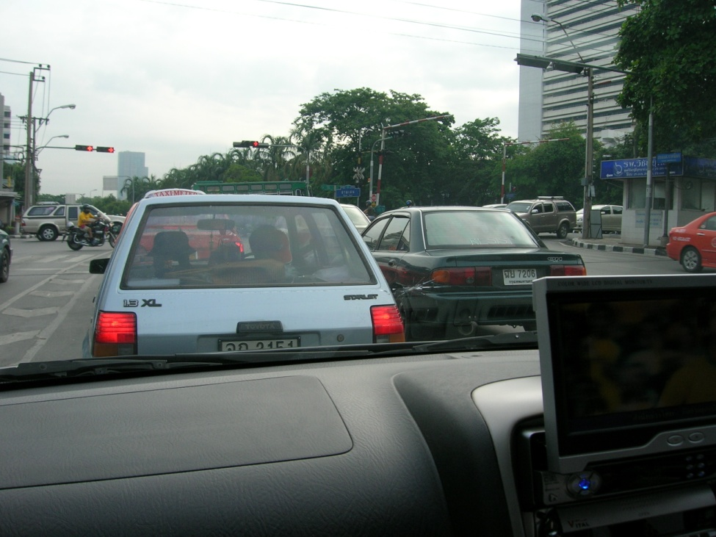
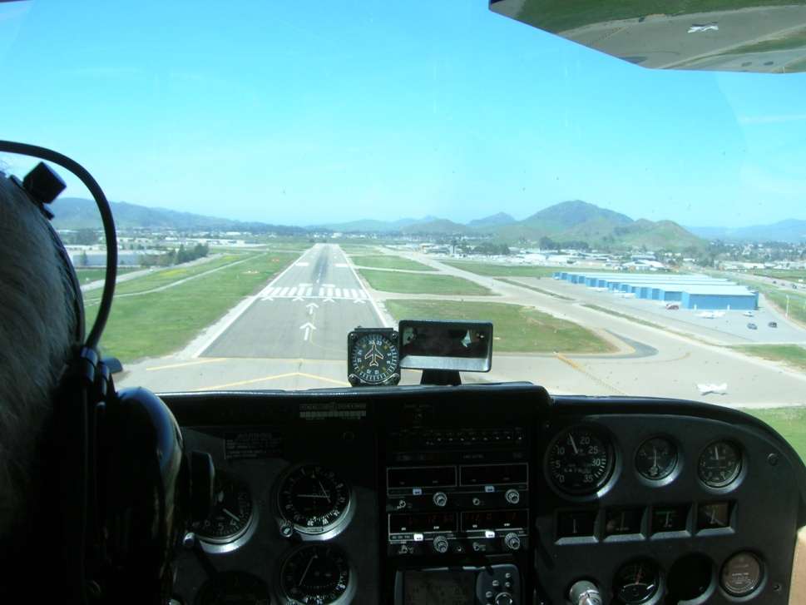
Mental Workload
Mental Workload = Information / (Time * Training)
People vary
Stress is important

Slide 19
Environmental Factors
Acoustic
Communication
Hearing loss
Thermal
Heat
Humidity
Cold
Air movement
Light and Dark
Vision
Contrast
Color
Vibration
Hand / Arm
Whole body

Slide 20


Environmental Factors

Slide 21
Social Factors
Roles
Jobs
Supervision
Language
and
Jargon
Communication
Groups
and
Teams
Cooperation
Customers
Competition
Hierarchies
Businesses and Companies

Slide 22
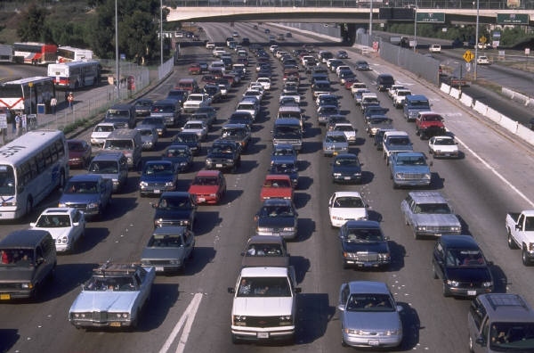
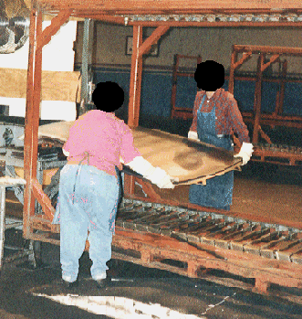
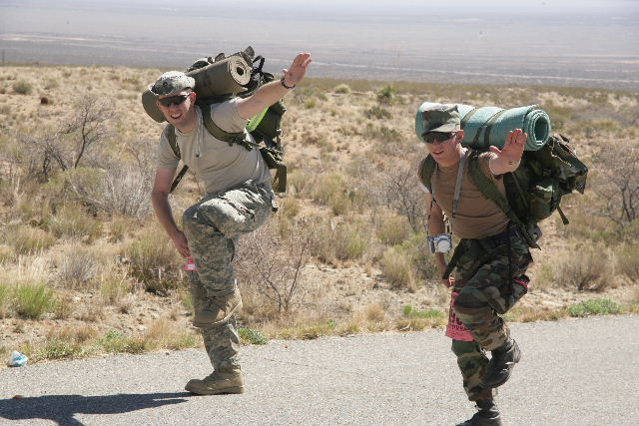
Social Factors

Slide 24
Time Factors
Time Pressure
Fatigue
Vigilance
Learning
Aging
Forgetting
Reaction time
MT = a + b log₂ (2A/W) Fitts Law
where:
MT = Movement Time
a, b = Individual and Situational Constants
A = Amplitude of Movement
W = Width of Target
2A/W = Index of Difficulty (ID)

Slide 25
The Design Problem
Who and what are these?
Feed Forward
External Factors and Customers
What are the tradeoffs?
How?
E4S3
Design
The System
+R&R
Feedback
How?

