Slide 1
Human Information Processing and
Cognitive Task Analysis

Slide 2
Human Machine System Model Interfaces
This model shows the addition of controls and displays to enhance human performance
Memory
Sensing
Cognition
Effectors
Physical Cognitive
and
Affective
Interfaces
Displays
Systems
Controls
Output
Products
Context
Energy
Materials

Slide 3
Describe 5 human – machine interaction situations
Identify each of the boxes and links
1
2
3
4
5
Memory
Sensing
Cognition
Effectors
Physical Cognitive
and
Affective
Interfaces
Displays
Systems
Controls
Output
Products
Context
Energy
Materials

Slide 4
A Control Model of Human Performance
Prediction (Probabilistic)
Uncontrollable
External
Input
Output - Time,
Accuracy and
Consequences
Input
Process
Feedback
Control
Knowledge
Novice
Landmark
Adaptive
Control
Rules
Trainee
Route
Progress of Skill Acquisition
Learning
Control
Skills
Expert
Survey

Slide 5
Controlling
Prediction
(Probabilistic)
External Factors
Output
Time, Error and Consequences
Cognition
Input
Controls
System
Feedback
Adaptation
Learning
Senses
Displays

Slide 6
Describe 5 Control Situations
1
2
3
4
5
Prediction (Probabilistic)
Uncontrollable
External
Input
Output - Time,
Accuracy and
Consequences
Input
Process
Feedback
Control
Knowledge
Novice
Landmark
Adaptive
Control
Rules
Trainee
Route
Progress of Skill Acquisition
Learning
Control
Skills
Expert
Survey

Slide 7
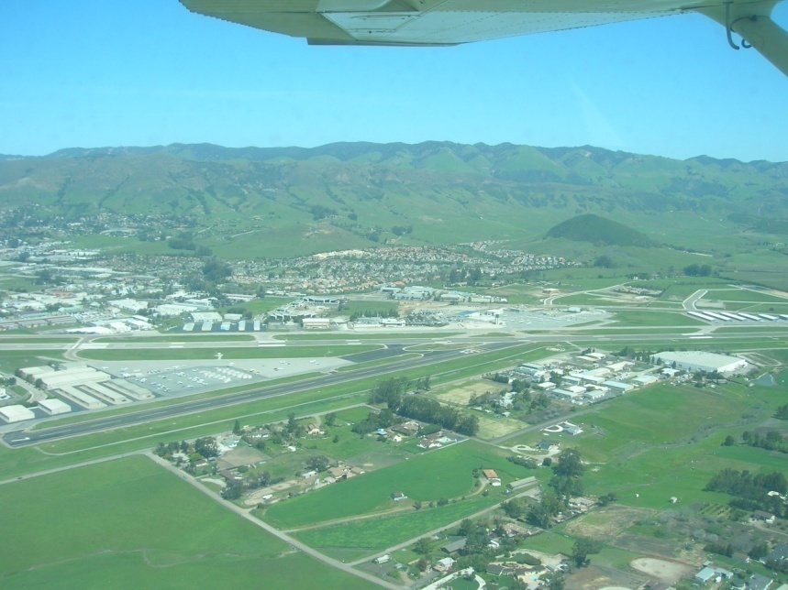
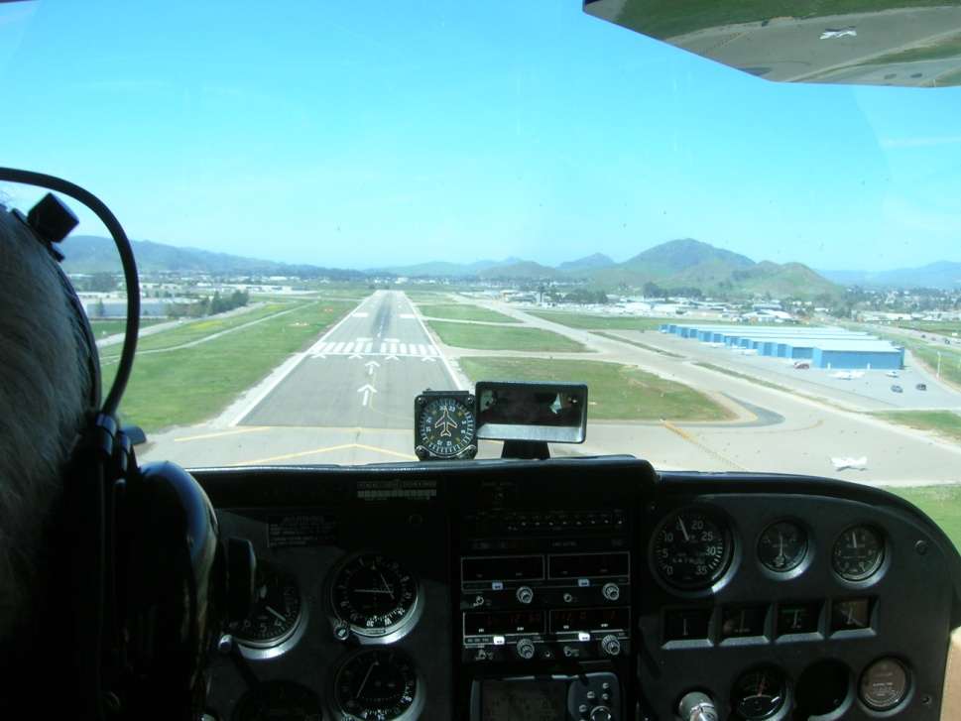
Landing an Airplane
Lots of Information – Attitude, Altitude, Heading and Airspeed
Plus ATC, Radio, ILS, DME, VOR, GPS, AWAS and Synthetic Vision etc. etc.
Too much information for the novice, usually OK for the expert
There’s the runway
Final approach
Fuzzy Awareness
7

Slide 8
Emergency Approach and Landing
DESCRIPTION
The airplane is maneuvered power-off to the best available landing site.
OBJECTIVE
To develop the skill and proficiency necessary to accomplish a power-off emergency approach and landing at the best available site.
PROCEDURES
1. Establish the best glide speed.
2. Select the best available landing site within glide range considering wind, obstructions and field conditions.
3. Complete the appropriate emergency checklist, time and altitude permitting.
4. Maneuver to a high-key position.
NOTE
A high key position should allow a descending spiral over the intended landing point to keep it in view, assess the wind conditions, and arrive at the low-key position. The low-key position is downwind abeam the intended spot of landing at an altitude that allows a 180° descending turn (or base and final legs) to arrive at the intended spot of landing.
5. Squawk 7700 and declare and emergency on frequency 121.5 (or the ATC frequency appropriate if in radio contact with ATC).

Slide 9

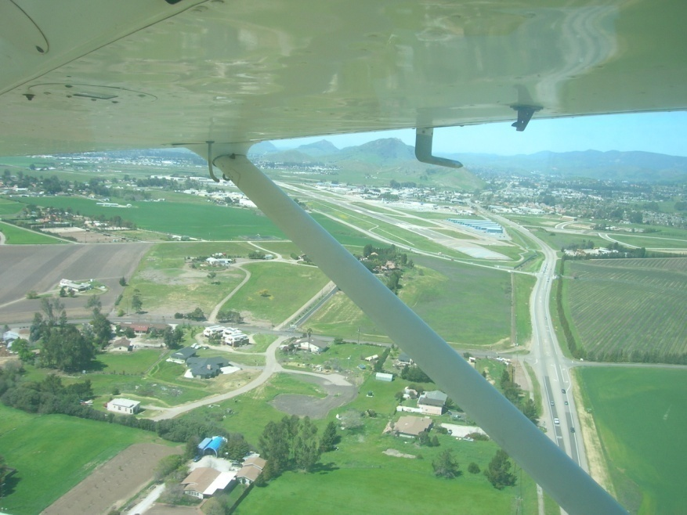
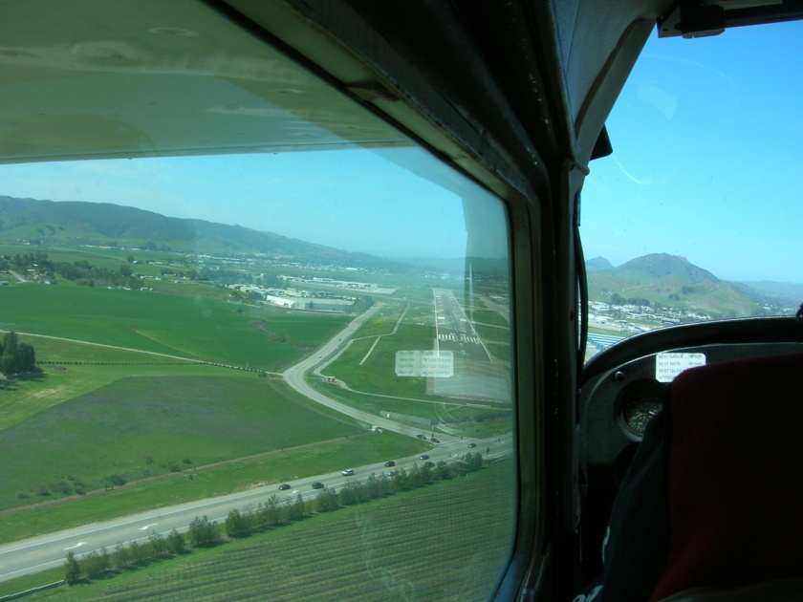

Slide 10

Emergency Approach and Landing
Secondary task
5400
Subtract the Rows and Columns
5300
5000
549 | 276
87 | 261
E
5200
Finish
5100
F
27R
D
5000
27L
Touch Down
Alpha 3
360
5600
Alternately track (draw pencil lines) along the Blue (Heading) and Green (Altitude) segments
B
5700
360
090
090
090
C
6000
6000
5900
Write Down
29.90
27L
SW @ 25, G 30
ALPHA 3
118.7
7700
Secondary task
5800
Add the Rows and Columns
Measure your time with a stop watch
Write down the stage times (ABCDEF)
Count the tracking errors
728 | 515
39 | 244
Start
A
6000

Slide 11
Communication Model
Concept
Semantic Coding
Physical Coding
Noise
Gained Information
Compare
Transmission
Concept
Lost Information
Consolidation
Semantic Decoding
Physical Decoding

Slide 12
Communicating
Idea
Semantic Encoding
Physical Encoding
Feedback
Transmission
Memory
Semantic Decoding
Physical Decoding
Lost / Forgotten Information
Noise / Added Information

Slide 13
Describe 5 familiar communication situations, Identify typical breakdown opportunities
1
2
3
4
5
Concept
Semantic Coding
Physical Coding
Noise
Gained Information
Compare
Transmission
Concept
Lost Information
Consolidation
Semantic Decoding
Physical Decoding

Slide 14
Communicating Games
Provide instructions for driving to the nearest airport
  Check the errors following “read back”
IKEA: “Some assembly required”
Provide instructions for Cardiopulmonary Resuscitation
Provide instructions for bicycle (or other piece of equipment) maintenance
  Develop procedures for maintaining the International Space Station

Slide 15
A Generic Educational Process
Customer Requirements
Refinement
Design Specifications
Course and Examination Content and Process Development
Study
Consolidate
Teachers
Technology Materials
Contexts Processes Facilities Support Staff
Examination
materials
Validation
Applied and Creative Work
Verification
Examinations
Delivery
Students
Students
Outcome Based Assessment
Study
Consolidate

Slide 16
Describe 5 Teaching Situations
1
2
3
4
5
Customer Requirements
Refinement
Design Specifications
Study
Consolidate
Teachers
Course and Examination Content and Process Development
Technology Materials
Contexts Processes Facilities Support Staff
Examination
materials
Validation
Applied and Creative Work
Verification
Examinations
Delivery
Students
Students
Outcome Based Assessment
Study
Consolidate

Slide 17
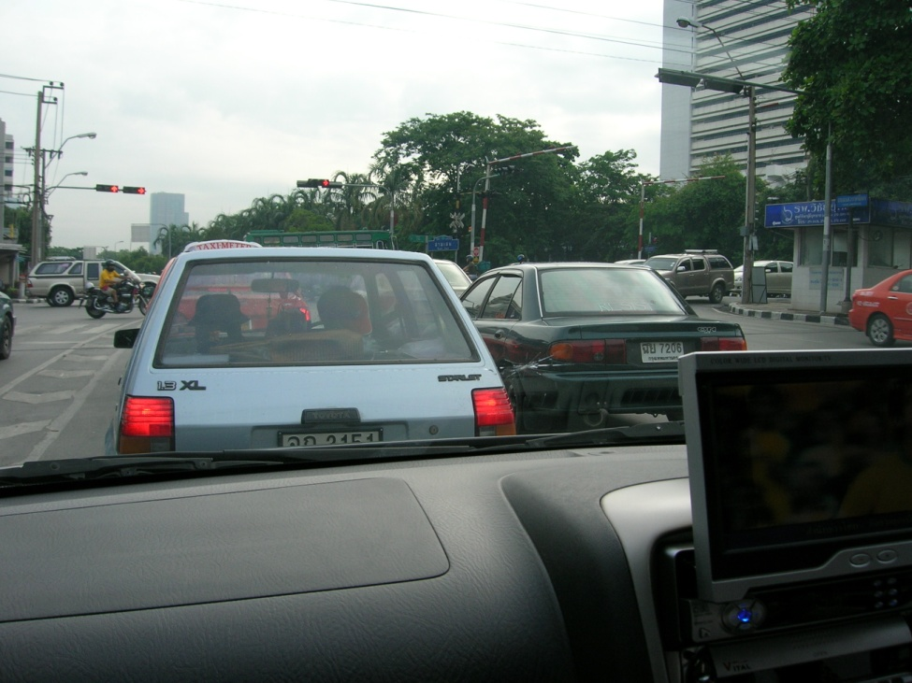
Noise and Distractions are Everywhere
Driving through Bangkok while watching the World Cup on the TV

Slide 18
But what if the airport has no tower, the engine, flight instruments or radios malfunction, the pilot brought the wrong chart or checklist, there is a low cloud base, a family of coyotes is walking up the runway, the landing is at an unfamiliar airport, there is a substantial crosswind, or the student is on his or her first solo cross country flight?

Slide 19
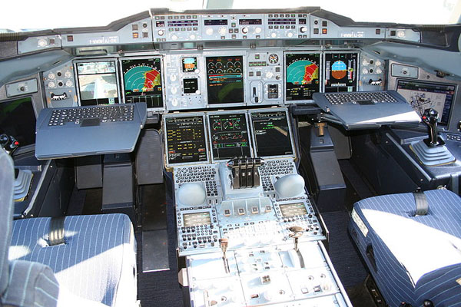
The Airbus A-380
A lot more information
A place for experts
Fuzzy Awareness
19

Slide 20
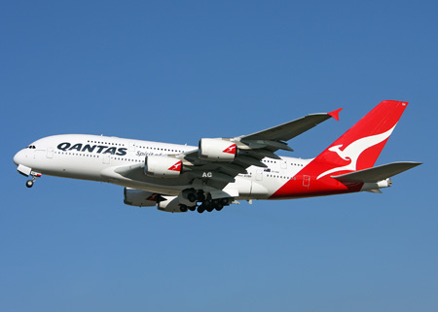

When things go Right
Airbus A380 Emergency Landing in Singapore
It took 5 pilots on the flight deck to solve the technology induced problems
The flight instruments gave misleading information
Fuzzy Awareness
20

Slide 21
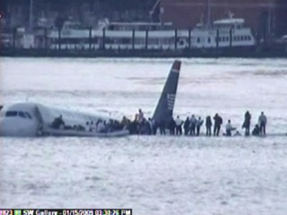
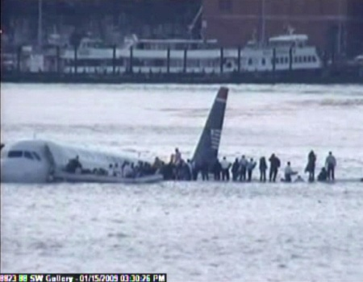
When things go right
US Airways Flight 1549
These pilots had just six minutes to solve this problem when both engines failed due to a bird strike
Fuzzy Awareness
21

Slide 22
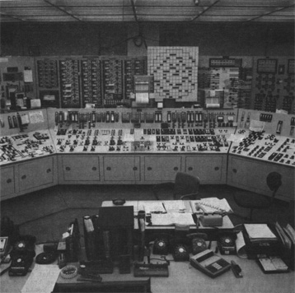
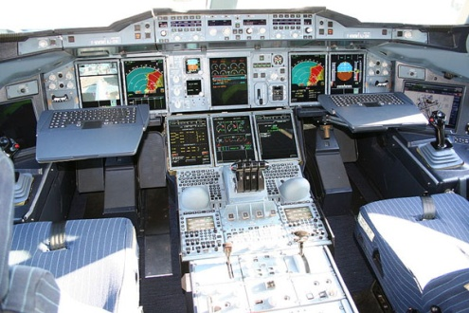
When Things go Wrong
Three Mile Island
More than 90 warnings went off in this nuclear power plant
Looks similar?
Fuzzy Awareness
22

Slide 23
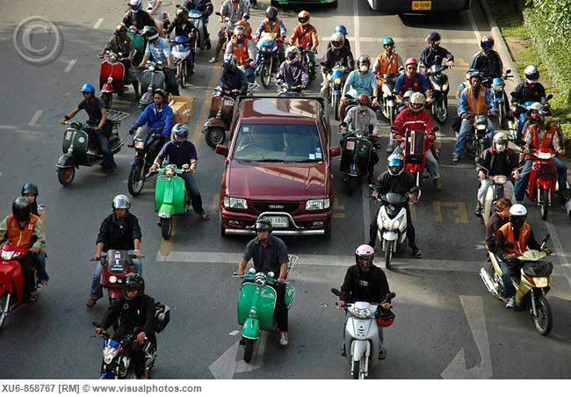
Control is Dynamic and Uncertain
Training
View out of the Window
Distractions
Memory
Predictions
Decisions
Plan
Perception
Understanding
Actions
Attention
Instruments
Instructor
Outcomes
Feedback
23

Slide 24
Describe 5 Vehicle Control Situations
1
2
3
4
5
Training
View out of the Window
Distractions
Memory
Perception
Understanding
Predictions
Decisions
Actions
Plan
Attention
Instruments
Instructor
Outcomes
Feedback

Slide 25
Traditional Human Information Processing Model
Human error can result from a failure or overload at any stage
Long Term Memory
Prediction
Attention
Operational
Memory
Perception
Senses
Cognition
Learning
Effectors
Management
Effectors
System Feedback
Environment
Fuzzy Awareness
25

Slide 26
Describe 5 human information processing situations
1
2
3
4
5
Long Term Memory
Prediction
Attention
Operational
Memory
Perception
Senses
Cognition
Learning
Effectors
Management
System Feedback
Effectors
Environment

Slide 27
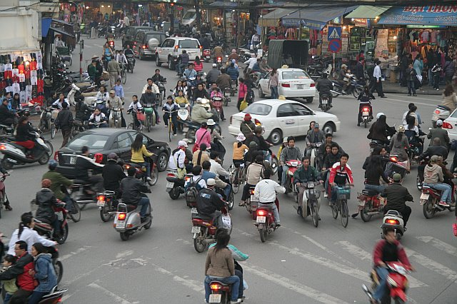
The Key to Attention is Strategic Selection

Slide 28
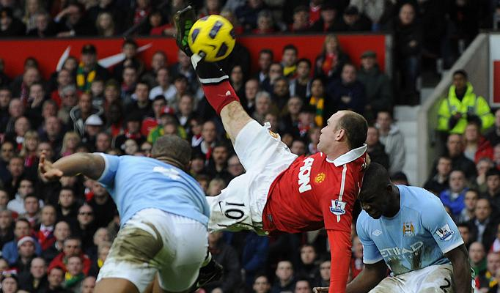
Attention
Where is the exit?
Watch this space
Can you smell something burning?
Focused attention
Selective attention
Divided attention
Overt and covert attention
Attention span
Switching attention
Who is sitting next to you?
Are you listening to me?
What will you have for dinner?
Can you hear the air conditioning?
Watch this space
There’s a gorilla in the room
Is your seat too hard?
Do you like the taste of chilli?
Is your right hand above your left?
What color are your shoes? Tie?
Where is your car parked?

Slide 29
Give 2 Examples of each type of Attention
Focused attention
Divided attention
Selective attention
Overt and covert attention
Attention span
Switching attention

Slide 30
Think of Operational Memory as a Bucket with Limited Capacity – if new stuff comes in older stuff will be kicked out.
Fuzzy Awareness
30

Slide 31
Operational Memory
Iconic Memory
Rehearsal
Primary Memory
Prospective Memory
Operational Memory
Forgetting
Semantic Memory
Episodic Memory
Procedural Memory
A Key to Effective Operational Memory is Efficient Forgetting
Long Term Permanent Memory / Learning
Fuzzy Awareness
31

Slide 32
Describe 5 situations that involve Operational Memory
1
2
3
4
5
Iconic Memory
Primary Memory
Rehearsal
Prospective Memory
Operational Memory
Forgetting
Semantic Memory
Episodic Memory
Procedural Memory
Long Term Permanent Memory / Learning

Slide 33
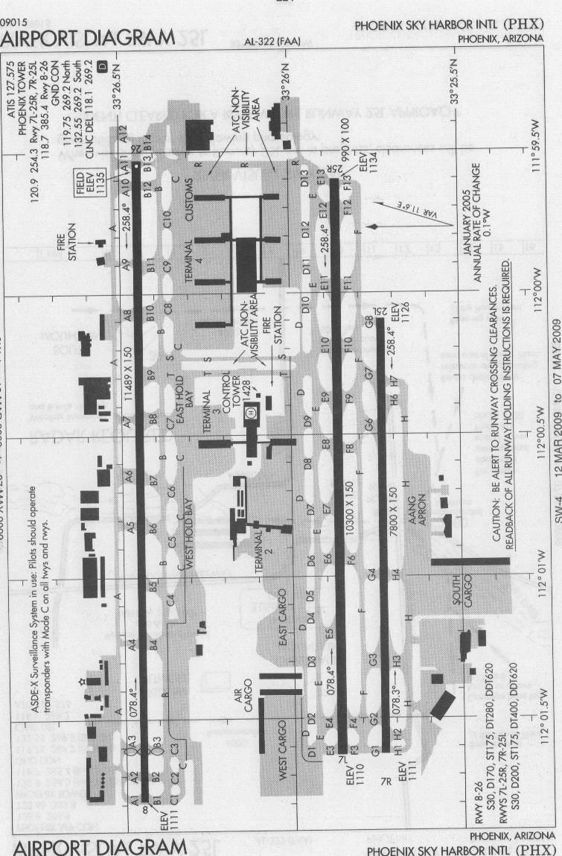
Welcome to Phoenix Sky Harbor
Taxi via Golf 8, Foxtrot, Foxtrot 12, HOLD SHORT of 25R
wait for further instructions
then proceed along Echo 12, Echo, Delta, Tango, Bravo, Charlie 9 to Terminal 4
The pilot will read back these instructions
An experienced pilot will know the route “off by heart”.
Sometimes pilots have read back the instructions and then forgot to HOLD SHORT!!

Slide 34
Which is easier to remember?
A “chunk” can be as big as a house!
42874695
  or
59 46 87 24
CAT DOG RAT COW
  or
TGA AOC WOA CTR

Slide 35
Miller’s Law of Operational Memory
7 + / - 2 chunks
The Magical Number Seven, Plus or Minus Two: Some Limits on Our Capacity for Processing Information
by George A. Miller
The Psychological Review, 1956, vol. 63, pp. 81-97
…….the probability of recall is greater when a "chunking" strategy is used, but what is a chunk?
Fuzzy Awareness
35

Slide 36
Factors Affecting Operational Memory
Read the two sets of numbers:
783962541
859476231
Close your eyes and repeat the FIRST set to yourself
Open your eyes and check your mistakes
Now group the digits and try again.
Interference
  Retroactive – information interpolated during the retention period
  Proactive – information presented before the item to be remembered
Primacy and recency
  items at the beginning and end of a list are more likely to be remembered than those in the middle
Rehearsal
  it is possible to maintain retention by rehearsing it

Slide 37
The Real World is full of Relevant Information, Noise and Distractions, and Individual and Situational Differences
Perception
Understanding
Prediction
Fuzzy Awareness
37

Slide 38
Cognitive Factors
Attending
Perceiving
Understanding
Calculating
Sensing
Deciding
Forgetting
Planning
Remembering
Controlling
Communicating
Learning

Slide 39
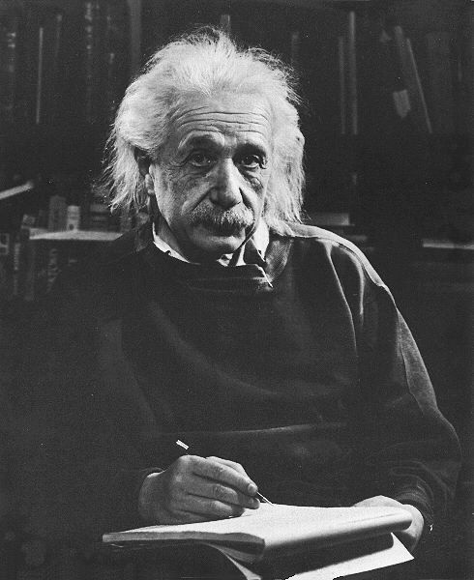
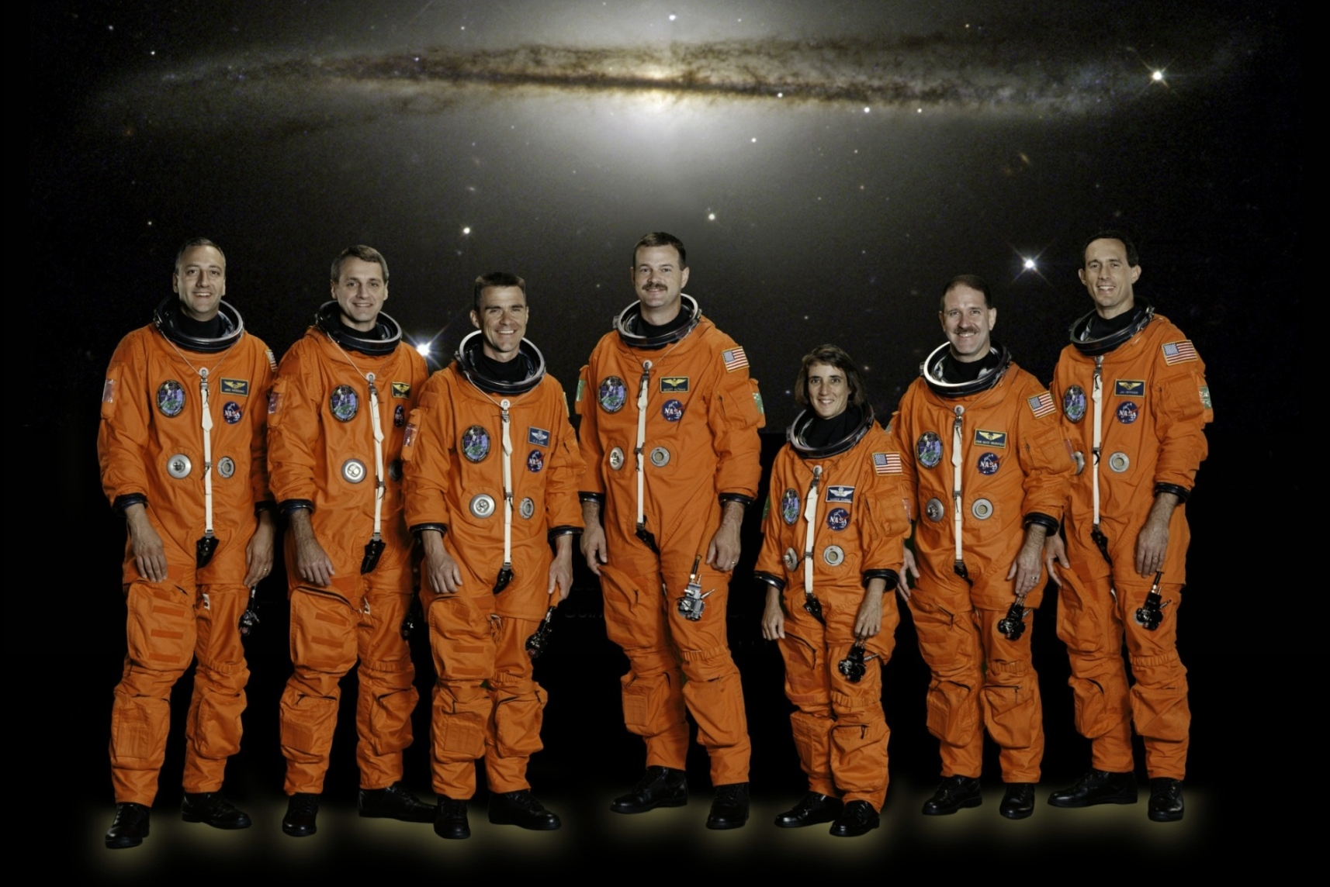

People Vary
Fuzzy Awareness
39

Slide 40
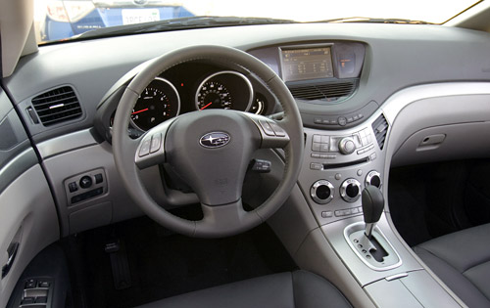
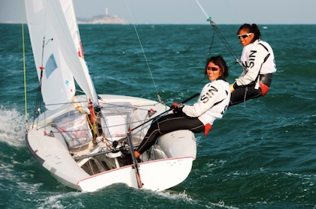
Situations Vary

Slide 41
Describe a situation that involves each of these cognitive functions
Attending
Perceiving
Understanding
Calculating
Sensing
Deciding
Forgetting
Planning
Controlling
Remembering
Communicating
Learning

Slide 42
Cognition is complex
More opportunities for success or failure
Understanding
Diagnosing
Analyzing
Judging
Cognition
Learning
Synthesizing
Deciding
Problem Solving
Planning
Investigating
Evaluating
Interpolating and Extrapolating
Predicting
Fuzzy Awareness
42

Slide 43
The pilot in command of the (6 minute) US Airways 1549 was was 57-year-old Capt. Chesley B. "Sully" Sullenberger
Turns, Height above ground to begin the flare
Engine failure causes
Safe landing
Communications jargon
Goals
Judging
Understanding
Wind strength and direction
Flaps?
Diagnosing
Expertise
Analyzing
Deciding
Cognition
Synthesizing
Planning
Problem Solving
Approach
Adapting the mental model
Evaluating
Investigating
Predicting
Interpolating and Extrapolating
Pitch effects
Use of pitch and flaps without power
Touch down point
Apply the rules
Improvise
Time and altitude constraints
Fuzzy Awareness
43

Slide 44
Describe a complex situation that involves each of these Cognitive Functions
Understanding
Diagnosing
Analyzing
Judging
Cognition
Learning
Synthesizing
Deciding
Problem Solving
Planning
Evaluating
Investigating
Predicting
Interpolating and Extrapolating

Slide 45
A Fuzzy Model of Human Control
Strategy
Tactics
Knowledge
Long Term Memory
Noise
Planning
Mental
Simulation
Expertise
Distraction
Operational Memory
Attending
Learning
Deciding
Situation Awareness
Controlling
Adapting
Perceiving
Feedback
Predicting
Responding
Understanding
Fuzzy Awareness
45

Slide 46
Describe a complex human control operation that involves all of these human information processing functions
Knowledge
Strategy
Tactics
Long Term Memory
Planning
Noise
Mental
Simulation
Expertise
Distraction
Operational Memory
Attending
Learning
Deciding
Situation Awareness
Controlling
Adapting
Feedback
Perceiving
Predicting
Responding
Understanding

Slide 47
Select a common HIP operation and Discuss how “human error” can be caused by a failure of each of these HIP functions
Knowledge
Strategy
Tactics
Long Term Memory
Planning
Noise
Mental
Simulation
Expertise
Distraction
Operational Memory
Attending
Learning
Deciding
Situation Awareness
Controlling
Adapting
Feedback
Perceiving
Predicting
Responding
Understanding

Slide 48
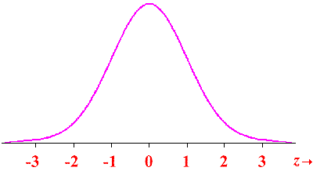
Fuzzy Awareness
With all this Information, Noise, Distraction and Uncertainty no wonder we make
Errors Slips
Violations and Mistakes
Knowledge
Strategy
Tactics
Long Term Memory
Noise
Mental
Simulation
Planning
Expertise
Distraction
Operational Memory
Attending
Learning
Deciding
Situation Awareness
Uncertainty
And
Variability
Controlling
Feedback
Perceiving
Predicting
Adapting
Responding
Understanding
Fuzzy Awareness
48

Slide 49
How Can Technology Help?
What people do
  Attending
  Sensing
  Perceiving
  Remembering
  Understanding
  Predicting
  Deciding
  Controlling
  Communicating
Ergonomics
vs
Darwin
(aided by Technologists)

Slide 50
How Can ErgoTechnology Help?
Mobile IT
Intelligent Chunking
Displays
Intelligent Strategic Selection (Google, Facebook)
Expertise will always be needed, but mere mortals can do much more with ErgoTechnology
Knowledge
Strategy
Tactics
Objective Risk Analysis
Long Term Memory
Noise
Mental
Simulation
Planning
Expertise
Attending
Distraction
Operational Memory
Learning
Deciding
User friendly portable simulators / simulations
Situation Awareness
Controlling
Adapting
Feedback
Perceiving
Predicting
Understanding
Responding
Automation with supervisory friendly Interfaces
Non Linear Predictive Displays
Sensing / perceiving Technology
Fuzzy Awareness
50

Slide 51
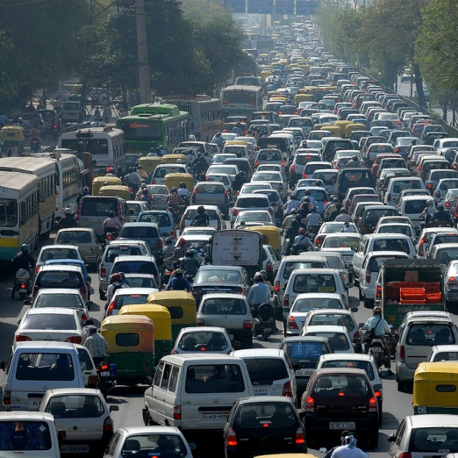
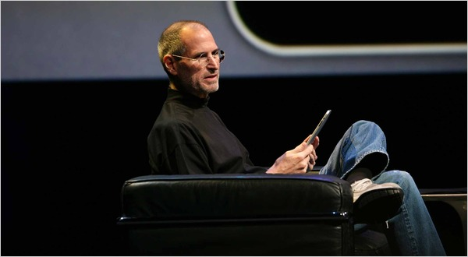
The Car of the Future

Slide 52
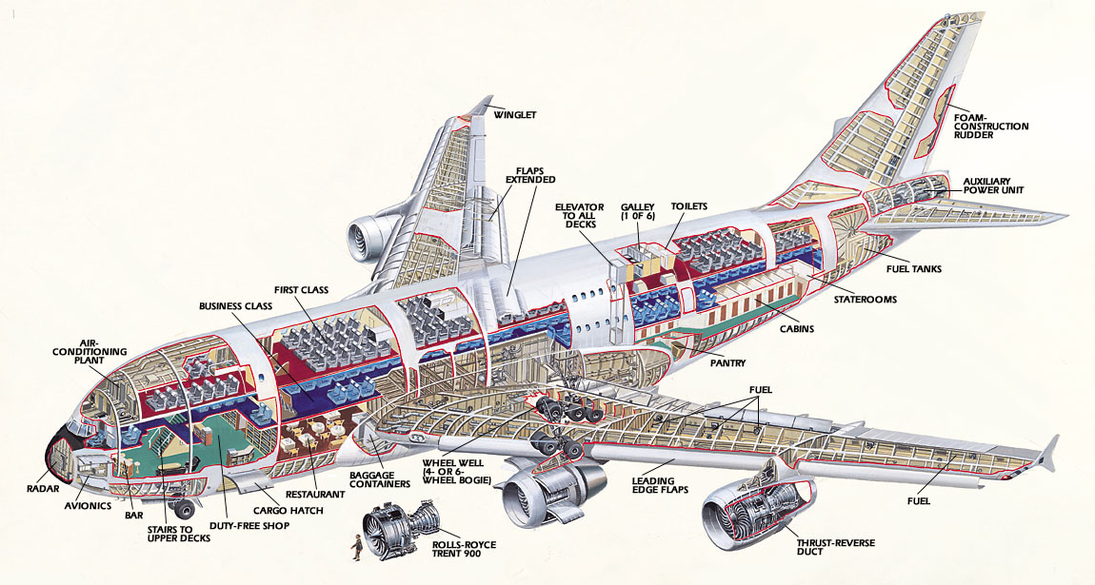
The Airplane of the Future
Look, no Pilot!

Slide 53

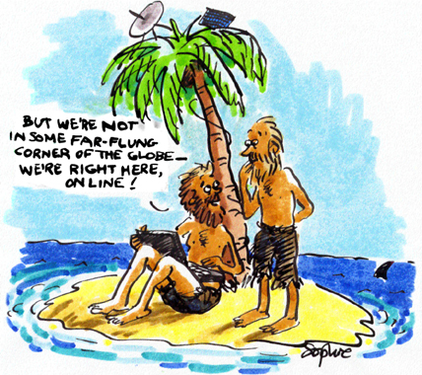
The Student of the Future

Slide 54
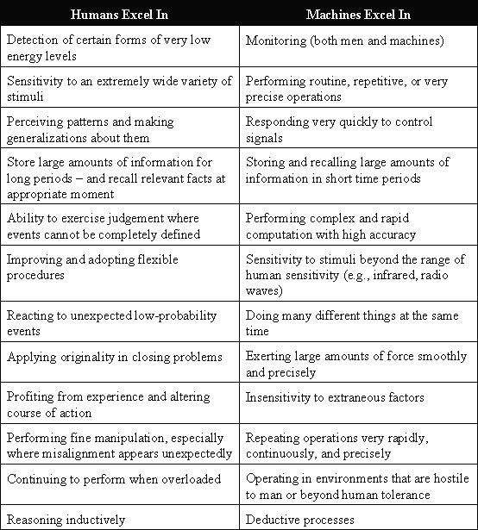
Does Fitts List need Reevaluating in the light of Contemporary Information Technology?
Allocation of Function between People and Machines

Slide 55
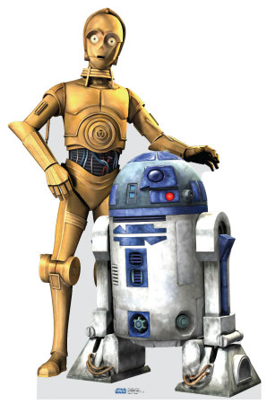
Machines (computers) are:
People are flexible, fallible and funny
Very focused, strong, precise, quick
Insensitive to noise, harsh environments and distraction
Don’t fluctuate and get tired
Rule based (deductive reasoning)
  Have enormous computing power
  Some rules may be quite complex
  Rule may mimic / learn human behaviors based on history
    Google and Facebook know your preferences and habits
Objective
  Have enormous breadth and depth
Make nonlinear predictions
Computers don’t laugh

Slide 56
Develop a new “Fitts List”
People | Machines

Slide 57
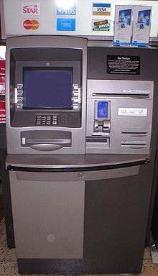
Managing your Money
- “it ate my card!”

Slide 58
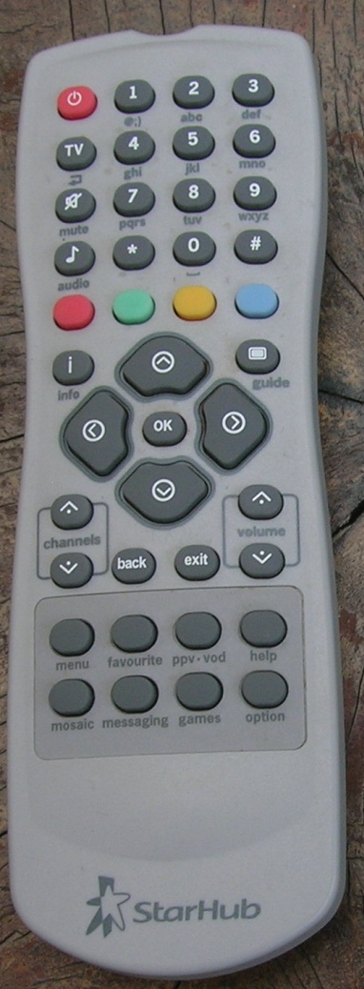
Controlling the TV
- in the dark

Slide 59
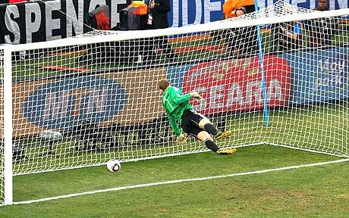
Football
Can technology help referees?
In soccer, possession of the ball changes every 30 seconds – the game is full of “errors”

Slide 60
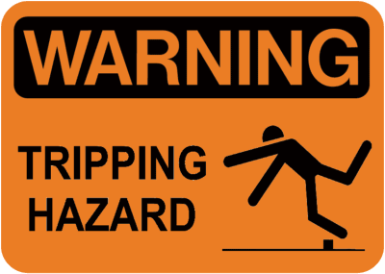
Slips, trips and falls are the commonest form of accident (many people die from a slip, trip or fall)
Some people avoid the hazard, others recover their balance before they fall

Slide 61
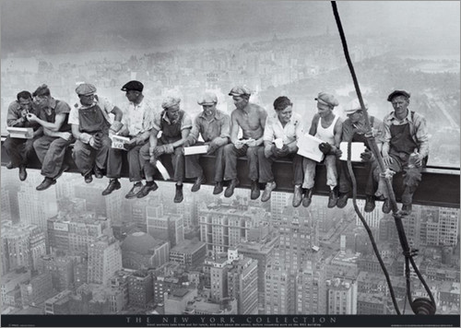
Safety?

Slide 62
Safety Practice
Design, Isolate, Operate, Mitigate
WIND
Unsafe Acts
Unsafe Conditions
Unsafe Supervision
Unsafe Organization
Hazards
Barriers
Safety Nets
Remove them by Design
Designed in Defenses
HFACS Analysis HFIXES
Engineered and Human Resilience
Proactive
Reactive

Slide 63
More Serious Errors
What if I hit the accelerator instead of the brake pedal?
  It happens frequently (Audi, Toyota)
What if there is no recovery / mitigation action?
  What if I pour coolant into the oil filler while maintaining my car
  What if a surgeon amputates the wrong leg?
  What if I decide to go rather than stop when the traffic light is amber?
To err is human – we do it all the time
To prevent or mitigate the effects of errors needs forgiving systems designed on human factors principles

Slide 64

Landing an Airplane
pitch, roll, yaw and speed

Slide 65
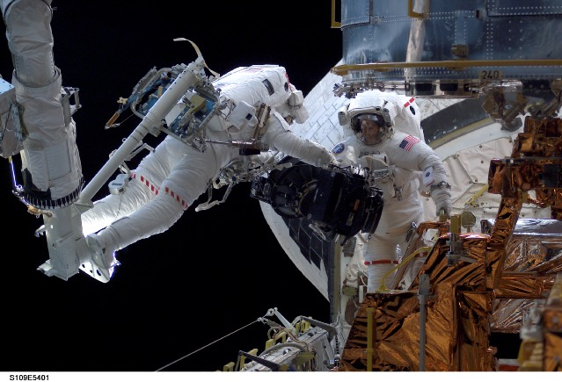
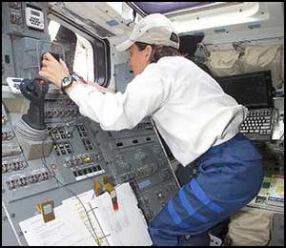
Controlling a 6 Degree of Freedom Robotic arm on the Space Shuttle

Slide 66
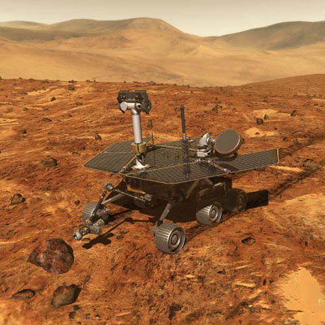
Controlling the Mars Rover with a time a lag of between 3 and 20 minutes

Slide 67
Three Mile Island
Lots of warnings went off in a short time period

Slide 68
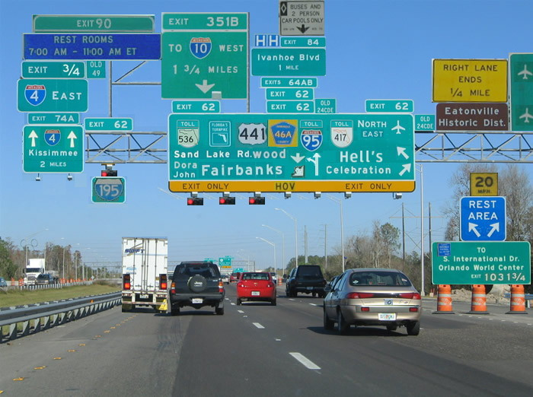
Which way should I go?
Visual search at 100km/s

Slide 69
A near mid air collision -wrong number
FAA probes FedEx near-miss
Planes were much too close; may be worst local error in 10 years
Federal investigators are studying a near-miss between two FedEx planes over Memphis last Thursday that likely is the most serious air traffic control error here in 10 years.
Officials say both the pilot and controller believed the other had transposed numerals in the flight number. Because the crew did not read the number back as it was heard -- which is standard procedure -- the tower issued directions meant for another plane, putting flights 527 and 257 within 100 feet of each other vertically and less than a mile apart laterally.
The latest incident in Memphis happened shortly before 4p.m. Feb. 21 as FedEx flights 527 and 257 were preparing for simultaneous takeoff on parallel runways.
Controllers say the margin for error was increased because the pilot called in on the wrong radio frequency.
"Westbound FedEx 257 crew checked in on the frequency for the east departure controller,”
The east departure controller, who had just seen data on eastbound 527 on his screen, thought the pilot had transposed the numbers and told FedEx 527 to turn left and climb.
"FedEx 257 hears this and answers to it,” - the crew read-back on the flight number was unintelligible.
"This is where our controller makes the mistake, he didn't catch the erroneous read-back."

Slide 70
Accident: Avoidance, Prevention, Analysis, Mitigation
WIND
Risks
Errors
Unsafe Acts
Hazards
Barriers
Safety Nets
Remove them
Designed in Defenses
Task Analysis
Engineered and human resilience

Slide 71
Safety Management - The Hierarchy of Controls
Process substitution – remove the hazard
Process isolation – use barriers
Personal protective equipment – protect the individual
Instructions and Warnings – advise the operator to avoid the hazard
Selection and Training – Train the operator to recognize and manage the hazard
Discuss situations where this hierarchy makes sense and provide examples of where the reverse order may be appropriate

Slide 72
Human Information Processing
HIM

Slide 73
Human Information Management
Long Term Memory
Prediction
Attention
Operational
Memory
Senses
Perception
Cognition
Effectors
Management
Effectors
System Feedback
Environment

Slide 74
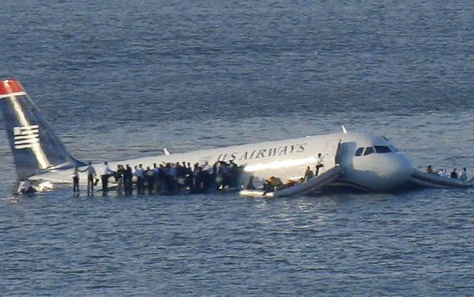

We measure human control performance outcomes in terms of Time, Error and Consequences

Slide 75
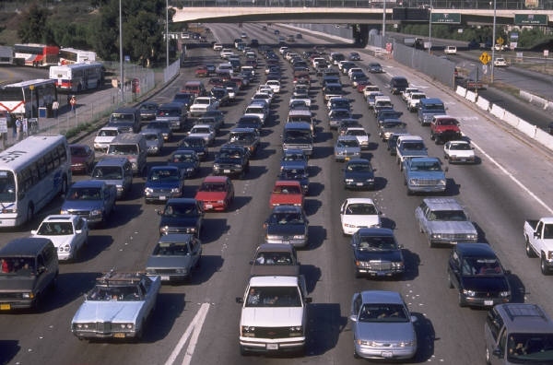
Why Feedback Control Doesn’t Work
If you wait for the brake lights on the car in front of you it’s already too late!!

Slide 76
We add Displays and Controls (Physical Interfaces) to help us with the Control Task

Slide 77
Human – Machine System
External Factors
Prediction
Output:
Time, Error and Consequences
Cognition
Input
Controls
System
Senses
Feedback
Feedback
Displays
Interfaces

Slide 78
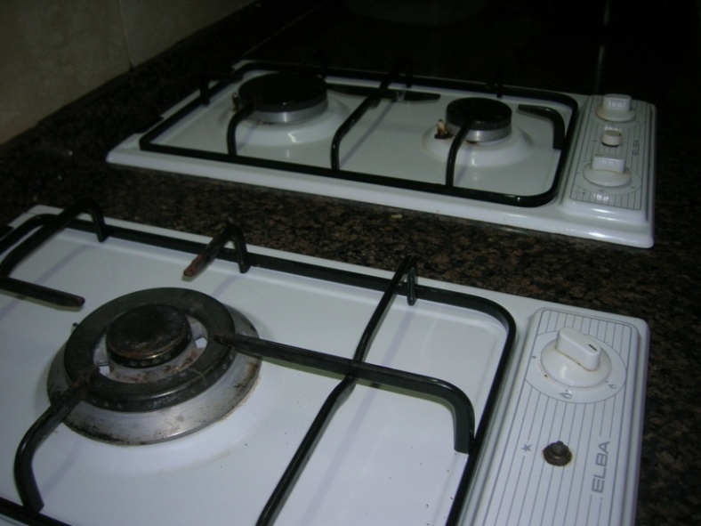
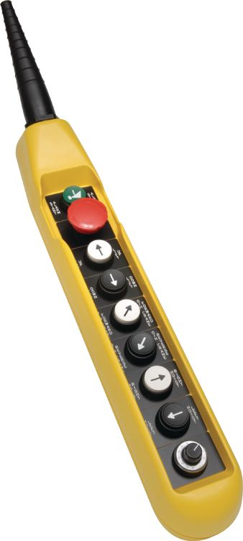
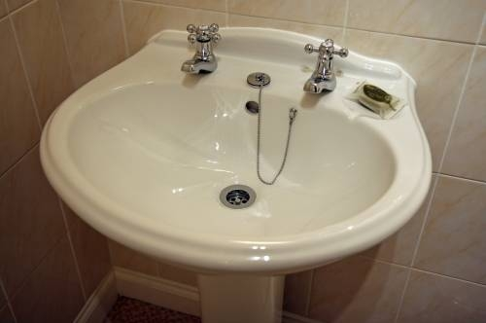
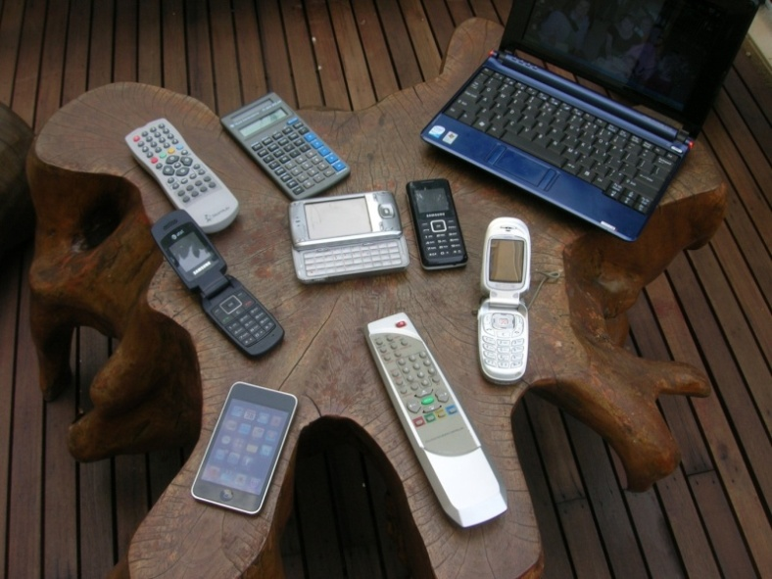
Expectancy – Prediction – Population Stereotypes

Slide 79
Human Sensory Variability
Genetic differences
  color deficiency, myopia
Deteriorates with Age
  vision, hearing
May be affected by Disease
  Cataracts, ear infection

Slide 80
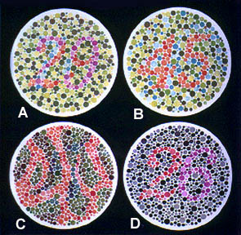
1. Normal Color Vision: A: 29, B: 45, C: --, D: 26
2. Red-Green Color-Blind: A: 70, B: --, C: 5, D: --
3. Red Color-blind: A: 70, B: --, C: 5, D: 6
4. Green Color-Blind: A: 70, B: --, C: 5, D: 2

Slide 81
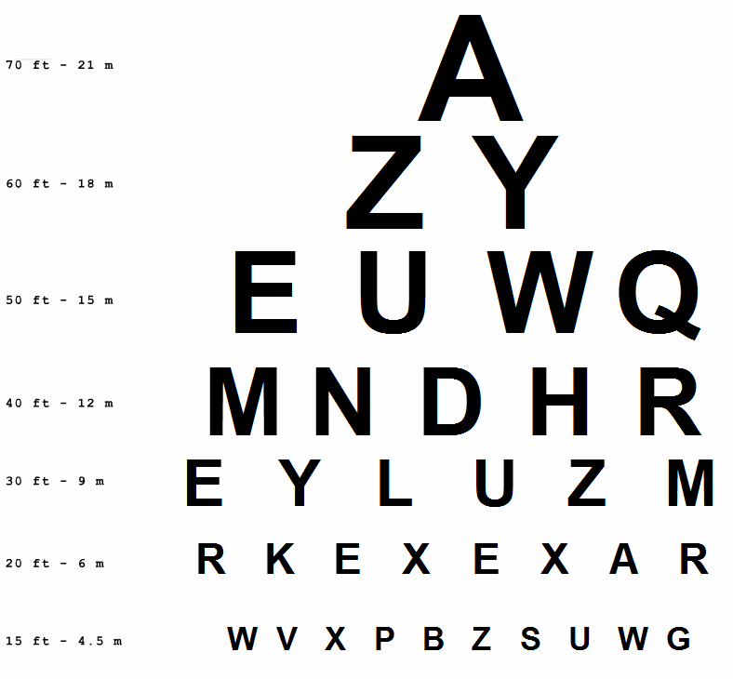
Can you read this?

Slide 82
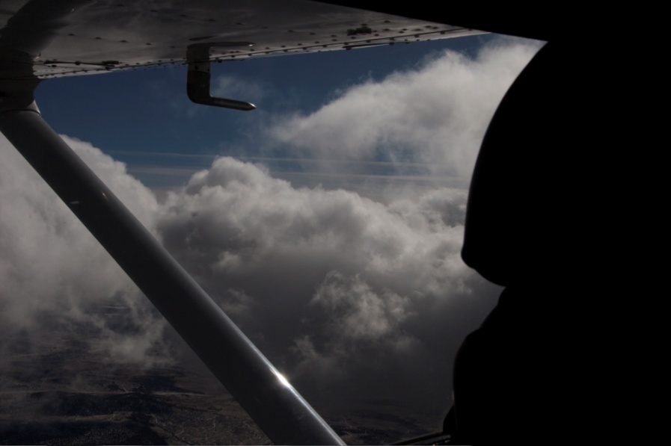
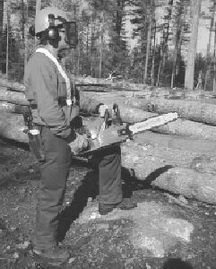
Focused Attention
Driving – cars, trucks, boats, airplanes etc
Industrial inspection
Listening to lecture
Security surveillance
Medical residents
Forestry and foundries (chain saws and chipping hammers)

Slide 83

Divided Attention
Multi-tasking
  The every day job of a manager
Driving and using a cell phone
Texting during a lecture

Slide 84
Vigilance Decrement
“Federal officials are investigating why two Northwest Airlines-Delta pilots overshot the Minneapolis-St. Paul airport this week, on a flight from San Diego. Controllers lost contact with the pilots during the flight. The pilots say they missed the airport because they were in a heated argument, but there are also questions of whether they might have fallen asleep.”
“A passenger train in the Indian state of Bihar zoomed past two railway stations - after the driver apparently fell asleep at the controls.”
"You don't need kindergarten to know that a resident working a 36-hour shift is in no condition to make any kind of judgment call -- forget about life-and-death."
In boring tasks vigilance may deteriorate rapidly in the first 20 minutes!

Slide 85
Response and Decision Times and Accuracy
Expectancy, Anticipation, Prediction
Warning, Stimulus, Response
Simple Reaction Time
Choice Reaction Time
  Number of choices
  Difficulty of choices
  Hyman Hick’s Law
Practice
Attention, Distraction
Demonstrations
  Catch a dollar bill
  Sort a deck of cards
  Clap hands on the signal
  Stop when the light turns red (orange?)
The stimulus – response process is fundamental to all kinds
of human activity
The speed – accuracy tradeoff is a reflection of cognitive activity

Slide 86
Reaction Time - Demonstration
I
E
P
On the signal everyone clap their hands

Slide 87
Reaction Time - Games
I
E
P
Take out a business card
Turn to a partner
Have them hold their finger and thumb ready to catch the card
Without warning drop the card
Give a warning – 1,2,3
Repeat with two cards – one for each hand
Hold the cards with hands wide apart
Use distraction

Slide 88
Reaction Time – Question
I
E
P
Should Formula I cars have brake lights?

Slide 89
Cognition

Slide 91
Computation, Communication and Control
Long Term Memory
Prediction
Attention
Operational
Memory
Senses
Perception
Cognition
Learning
Effectors
Management
Effectors
System Feedback
Environment

Slide 92
Cognition is complex
Goals
Understanding
Diagnosing
Analyzing
Judging
Cognition
Learning
Synthesizing
Deciding
Problem Solving
Planning
Investigating
Evaluating
Interpolating and Extrapolating
Predicting

Slide 93
Operational
Landmark
Short Term
Working
Route
Long Term
Transient
Survey
Rehearsal
Literal
Consolidation
Semantic
Iconic
Sensory
Memory
Is complicated
Capacity
Millers 7+/- 2
Recall
Recognition
Primacy
Tactile
Kinesthetic
Recency
Interference
Von Restorf
Decay

Slide 94
The Bucket Model
Memory
Operational memory has a limited capacity. Rehearsal can keep information for extended times.
Interference (proactive and retroactive) causes items to be lost.
Primacy and Recency effects cause first and last items in a list to be recalled more reliably.
Chunking and linking (mnemonics) help retention.

Slide 95
Spatial Memory Drift
I
E
P
Draw a line
Close your eyes
Draw ten lines the same length as the “standard”
How often should an inspector be “calibrated”?

Slide 96
Numeric Memory
I
E
P
Card counting
Shuffle a deck of playing cards
Show 3,4,5,6,7,8,9 cards
Recall the suit and number
Ignore picture cards
How are set length and error related?

Slide 97
Can you remember this?
Welcome to Phoenix Sky Harbor
Taxi via Golf 8, Foxtrot, Foxtrot 12, Hold short of 25R, then proceed along Echo 12, Echo, Delta, Tango, Bravo, Charlie 9 to Terminal 4
What is wrong with these instructions?

Slide 98

Decisions
Opinions
  Pepsi or Coke
  Democrat or Republican
  American Idol
Decisions
  Common cold or pneumonia?
  Stop or go when the light turns amber?
  Which is the correct test answer?

Slide 99
Judging - Psychophysics
Distance, size, height, weight, color, sound, money, etc.
Weber – Fechner Law
JNDs: Just Noticeable Differences
Larger differences are easier to notice (logarithmic scale)
Context and experience cause the standard to “drift”
This is why we use measurement instruments where accuracy and precision are important

Slide 100
Near Mid Air Collisions (NMAC)

Slide 101
Complex Judgments
Complex judgments on multiple dimensions (or from multiple judges) require systematic weighting and consensus processes
  False consensus must be avoided by independent voting
Which is the best football team, gymnast, car, mobile phone, food, student etc.?
A simple statistical manipulation of the data can remove the empirical bias

Slide 102
Expertise
Attained by mimicking the thought processes of experts
  The information they seek
  The weightings they assign to different items of information
  The logic / inductive reasoning they use
  The conclusions they reach
Compared with novices
  Errors of omission and commission in the information they seek
  Over / under weight the importance of some information sources
  Use incorrect / inadequate logic, deductive reasoning
  Converge on wrong conclusions and make wrong decisions

Slide 103
Guessing and Bias
Judgment is an educated guess
Judgments lead to decisions and predictions which are the basis of planning
Guesses, judgments and (many) decisions are usually based on incomplete or insufficient information
Guesses, judgments and decisions are influenced by objective and subjective evidence
The risk of being wrong is balanced by the benefit of being right
Bias occurs when the subjective evidence outweighs the objective evidence
People are good at judgment, consensus helps, but computers can help to remove the biases
(see appendix: norm based scoring)

Slide 104

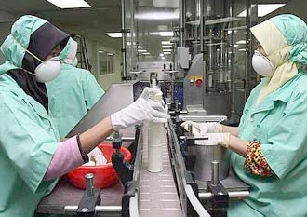

Sensory Motor Skills

Slide 105
Applications of Motor Skill Learning:
De Jongs Law
Ball games coaching
Learning to fly
Controlling the Robotic arm in the Shuttle
Assembly tasks
Filling out forms
Dentists
Performance
Times and accuracy
Practice (many cycles)

Slide 106
Fitts Law
Movement Time is a function of Target Size and Distance Moved
  Actual targets may differ from prescribed targets

Slide 107
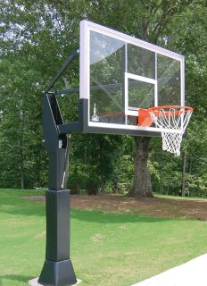
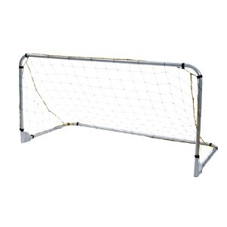
Actual Targets
3 Point shot
Placing stampings in a rack or welding jig
Should soccer goals be larger?

Slide 108
Some Aviation and HF Slides

Slide 109
Landing an Airplane
pitch, roll, yaw and speed

Slide 110
--------or flying the Airbus 380?

