Slide 1
Fuzzy Awareness and
ErgoTechnology
Brian Peacock, Chai Kah Hin
Department of Industrial and Systems Engineering
National University of Singapore

Slide 2
Agenda
Read the stuff in the yellow ovals and look at the pictures
Human Information Processing
Cognition
Operational Memory
Attention
Situation Awareness
Fuzziness and Complexity
Why do we make mistakes?
Why are experts better than novices?
Why are simple models insufficient?
How can Technology help with Knowledge Awareness?
You can read the handouts later

Slide 3
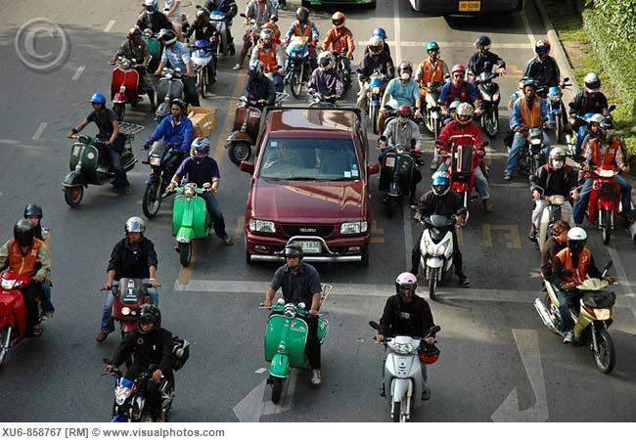
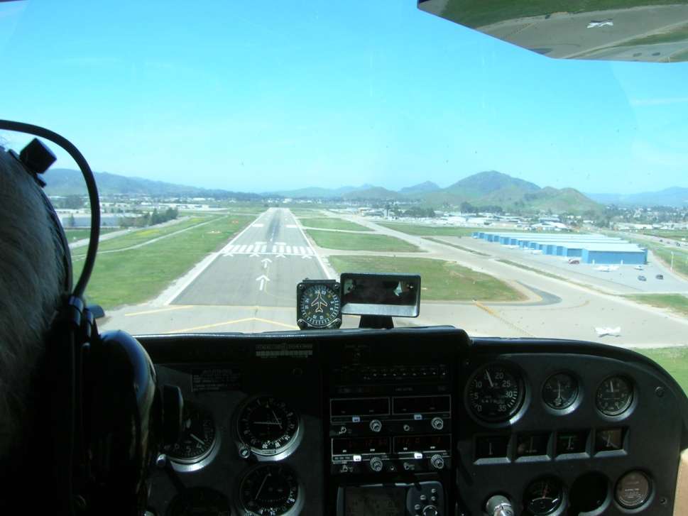
Control is Dynamic and Uncertain
Training
View out of the Window
Distractions
Memory
Predictions
Decisions
Plan
Perception
Understanding
Actions
Attention
Instruments
Instructor
Outcomes
Feedback
Fuzzy Awareness
3

Slide 4
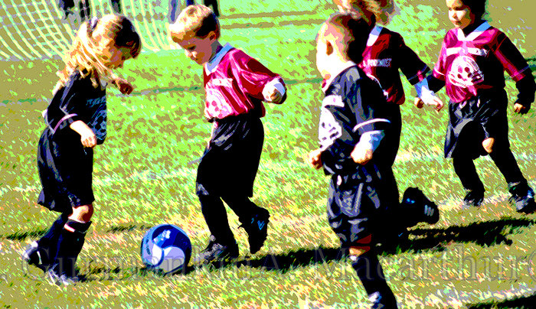
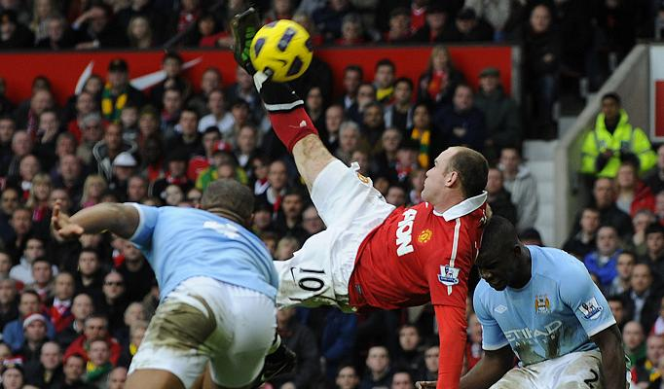
Operational Definitions
Data
  The ocean of stuff out there all competing for attention
Information
  Data organized for a particular purpose
Knowledge
  The processes involved in using information
Skill
  The knowledge difference between novices and experts
Novices and Experts

Slide 5
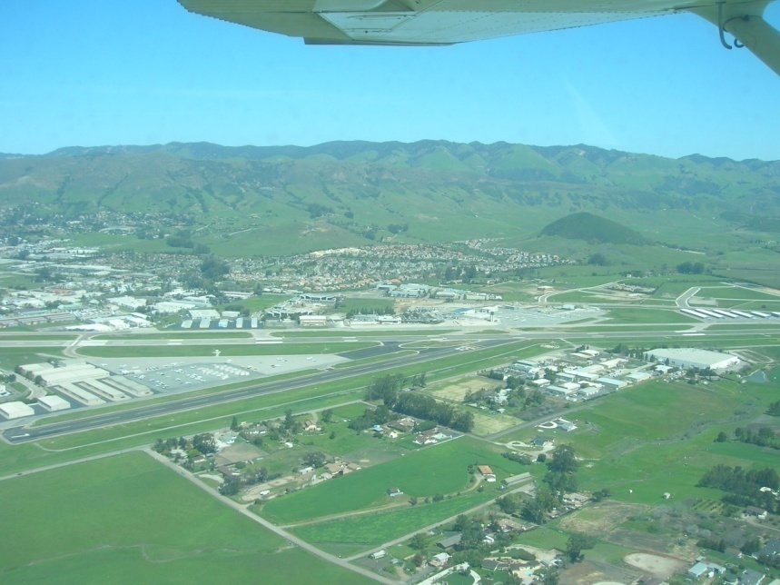
Landing an Airplane
Lots of Information – Attitude, Altitude, Heading and Airspeed
Plus ATC, Radio, ILS, DME, VOR, GPS, AWAS and Synthetic Vision etc. etc.
Too much information for the novice, usually OK for the expert
There’s the runway
Final approach
Fuzzy Awareness
5

Slide 6
But what if the airport has no tower, the engine, flight instruments or radios malfunction, the pilot brought the wrong chart or checklist, there is a low cloud base, a family of coyotes is walking up the runway, the landing is at an unfamiliar airport, there is a substantial crosswind, or the student is on his or her first solo cross country flight?

Slide 7
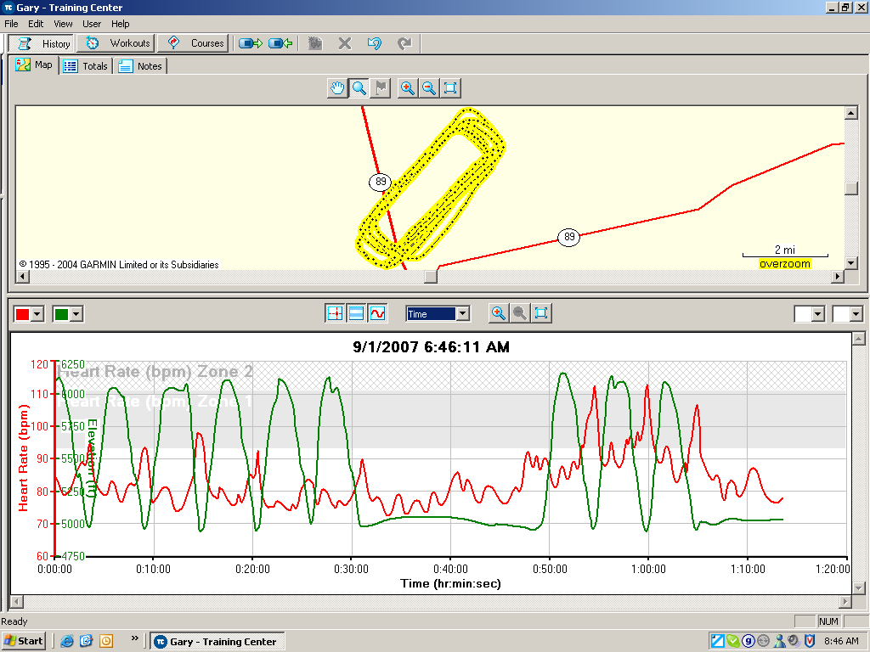
A novice on his first solo flight
Flight path
The last three landings were solo – look at that heart rate!
Altitude
Heart Rate
Go around practice

Slide 8
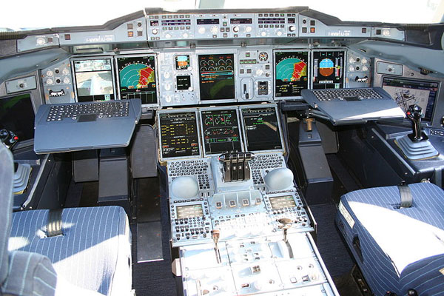
The Airbus A-380
A lot more information
A place for experts
Fuzzy Awareness
8

Slide 9


When things go wrong
Airbus A380 Emergency Landing in Singapore
It took 5 pilots on the flight deck to solve the technology induced problems
The flight instruments gave misleading information
Fuzzy Awareness
9

Slide 10
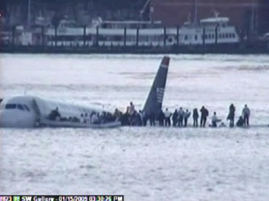
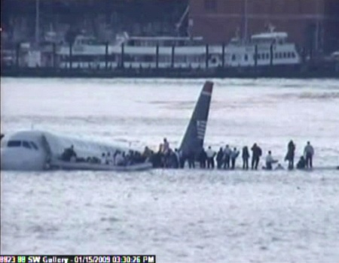
US Airways Flight 1549
These pilots had just six minutes to solve this problem when both engines failed due to a bird strike
Fuzzy Awareness
10

Slide 11
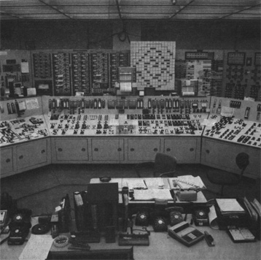
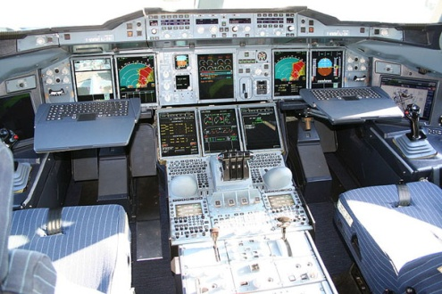
Three Mile Island
More than 90 warnings went off in this nuclear power plant
Looks similar?
Fuzzy Awareness
11

Slide 12
Traditional Human Information Processing Model
Human error can result from a failure or overload at any stage
Long Term Memory
Prediction
Attention
Operational
Memory
Perception
Senses
Cognition
Learning
Effectors
Management
Effectors
System Feedback
Environment
Fuzzy Awareness
12

Slide 13
Cognition is complex
More opportunities for success or failure
Understanding
Diagnosing
Analyzing
Judging
Cognition
Learning
Synthesizing
Deciding
Problem Solving
Planning
Investigating
Evaluating
Interpolating and Extrapolating
Predicting
Fuzzy Awareness
13

Slide 14
The pilot in command of the (6 minute) US Airways 1549 was was 57-year-old Capt. Chesley B. "Sully" Sullenberger
Turns, Height above ground to begin the flare
Engine failure causes
Safe landing
Communications jargon
Goals
Judging
Understanding
Wind strength and direction
Flaps?
Diagnosing
Expertise
Analyzing
Deciding
Cognition
Synthesizing
Planning
Problem Solving
Approach
Adapting the mental model
Evaluating
Investigating
Predicting
Interpolating and Extrapolating
Pitch effects
Use of pitch and flaps without power
Touch down point
Apply the rules
Improvise
Time and altitude constraints
Fuzzy Awareness
14

Slide 15
Miller’s Law of Operational Memory
7 + / - 2 chunks
The Magical Number Seven, Plus or Minus Two: Some Limits on Our Capacity for Processing Information
by George A. Miller
The Psychological Review, 1956, vol. 63, pp. 81-97
…….the probability of recall is greater when a "chunking" strategy is used, but what is a chunk?
Fuzzy Awareness
15

Slide 16
Which is easier to remember?
A “chunk” can be as big as a house!
42874695
  or
59 46 87 24
CAT DOG RAT COW
  or
TGA AOC WOA CTR

Slide 17
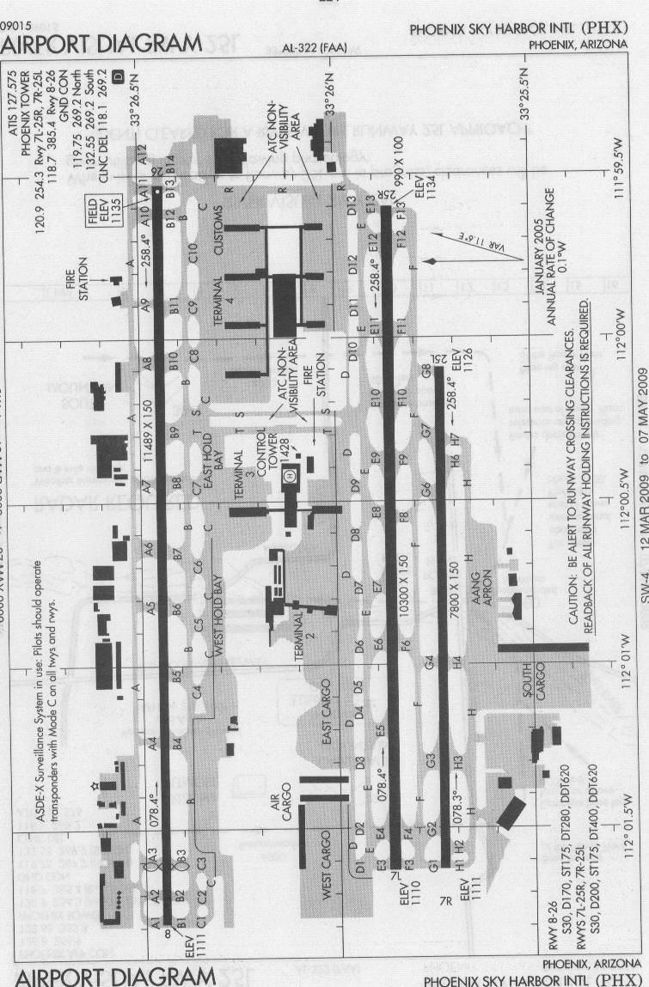
Welcome to Phoenix Sky Harbor
Taxi via Golf 8, Foxtrot, Foxtrot 12, HOLD SHORT of 25R
wait for further instructions
then proceed along Echo 12, Echo, Delta, Tango, Bravo, Charlie 9 to Terminal 4
The pilot will read back these instructions
An experienced pilot will know the route “off by heart”.
Sometimes pilots have read back the instructions and then forgot to HOLD SHORT!!

Slide 18
Think of Operational Memory as a Bucket with Limited Capacity – if new stuff comes in older stuff will be kicked out.
Fuzzy Awareness
18

Slide 19
Factors Affecting Operational Memory
Read the two sets of numbers:
783962541
859476231
Close your eyes and repeat the FIRST set to yourself
Open your eyes and check your mistakes
Now group the digits and try again.
Interference
  Retroactive – information interpolated during the retention period
  Proactive – information presented before the item to be remembered
Primacy and recency
  items at the beginning and end of a list are more likely to be remembered than those in the middle
Rehearsal
  it is possible to maintain retention by rehearsing it

Slide 20
Attention
Where is the exit?
Watch this space
Can you smell something burning?
Focused attention
Selective attention
Divided attention
Overt and covert attention
Attention span
Switching attention
Who is sitting next to you?
Are you listening to me?
What will you have for dinner?
Can you hear the air conditioning?
Watch this space
There’s a gorilla in the room
Is your seat too hard?
Do you like the taste of chilli?
Is your right hand above your left?
What color are your shoes? Tie?
Where is your car parked?

Slide 21
Situation Awareness Model
SA is a widely used method of describing human performance in complex situations such as aviation and process plant operation
Context
Responses
Decisions
Situation Awareness
Stage 1
Perception
Stage 2
Understanding
Stage 3
Projection
Fuzzy Awareness
21

Slide 22
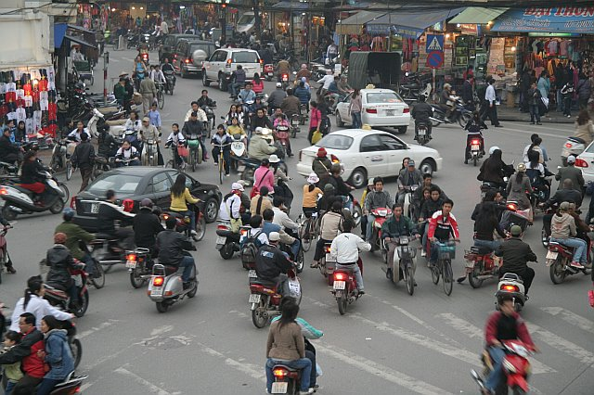
The Real World is full of Relevant Information, Noise and Distractions, and Individual and Situational Differences
Perception
Understanding
Prediction
Fuzzy Awareness
22

Slide 23
Human Machine System Model Interfaces
This model shows the addition of controls and displays to enhance human performance
Memory
Sensing
Cognition
Effectors
Direct
Direct
Cognitive
Affective
Displays
Systems
Controls
Products
Materials

Slide 24
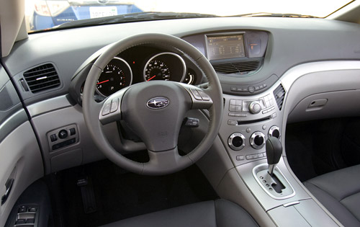
Vehicle Interfaces
Enhanced Cognition?
Controls
Displays

Slide 25
A Control Model of Human Performance
Prediction (Probabilistic)
Uncontrollable
External
Input
Output - Time,
Accuracy and
Consequences
Input
Process
Feedback
Control
Knowledge
Novice
Landmark
Adaptive
Control
Rules
Trainee
Route
Progress of Skill Acquisition
Learning
Control
Skills
Expert
Survey

Slide 26

Control and Team Communication
Uncontrollable external forces – the wind
Perception, Understanding, Prediction, Coordination
Asian Games - Rachel Lee and Cecilia Low won gold in the Double Handed Dinghy 420.

Slide 27
These compartmentalized models do not capture the human and situational variability and FUZZINESS that pervade every day activities
Prediction (Probabilistic)
Uncontrollable
External
Input
Long Term Memory
Prediction
Output - Time,
Accuracy and
Consequences
Input
Process
Attention
Operational
Memory
Perception
Senses
Cognition
Learning
Effectors
Management
Feedback
Control
Novice
System Feedback
Effectors
Adaptive
Control
Trainee
Environment
Learning
Control
Expert
Memory
Sensing
Cognition
Effectors
Context
Responses
Decisions
Situation Awareness
Displays
Systems
Controls
Stage 1
Perception
Stage 2
Understanding
Stage 3
Projection
Products
Materials

Slide 28
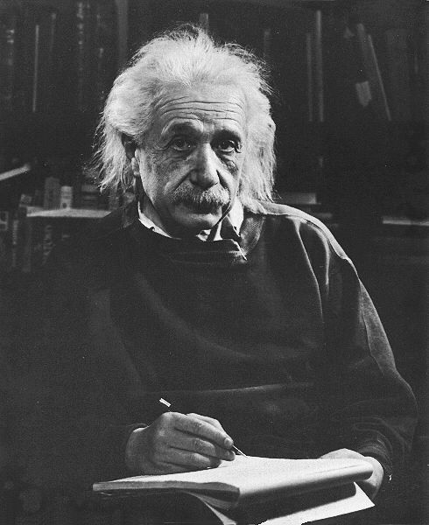
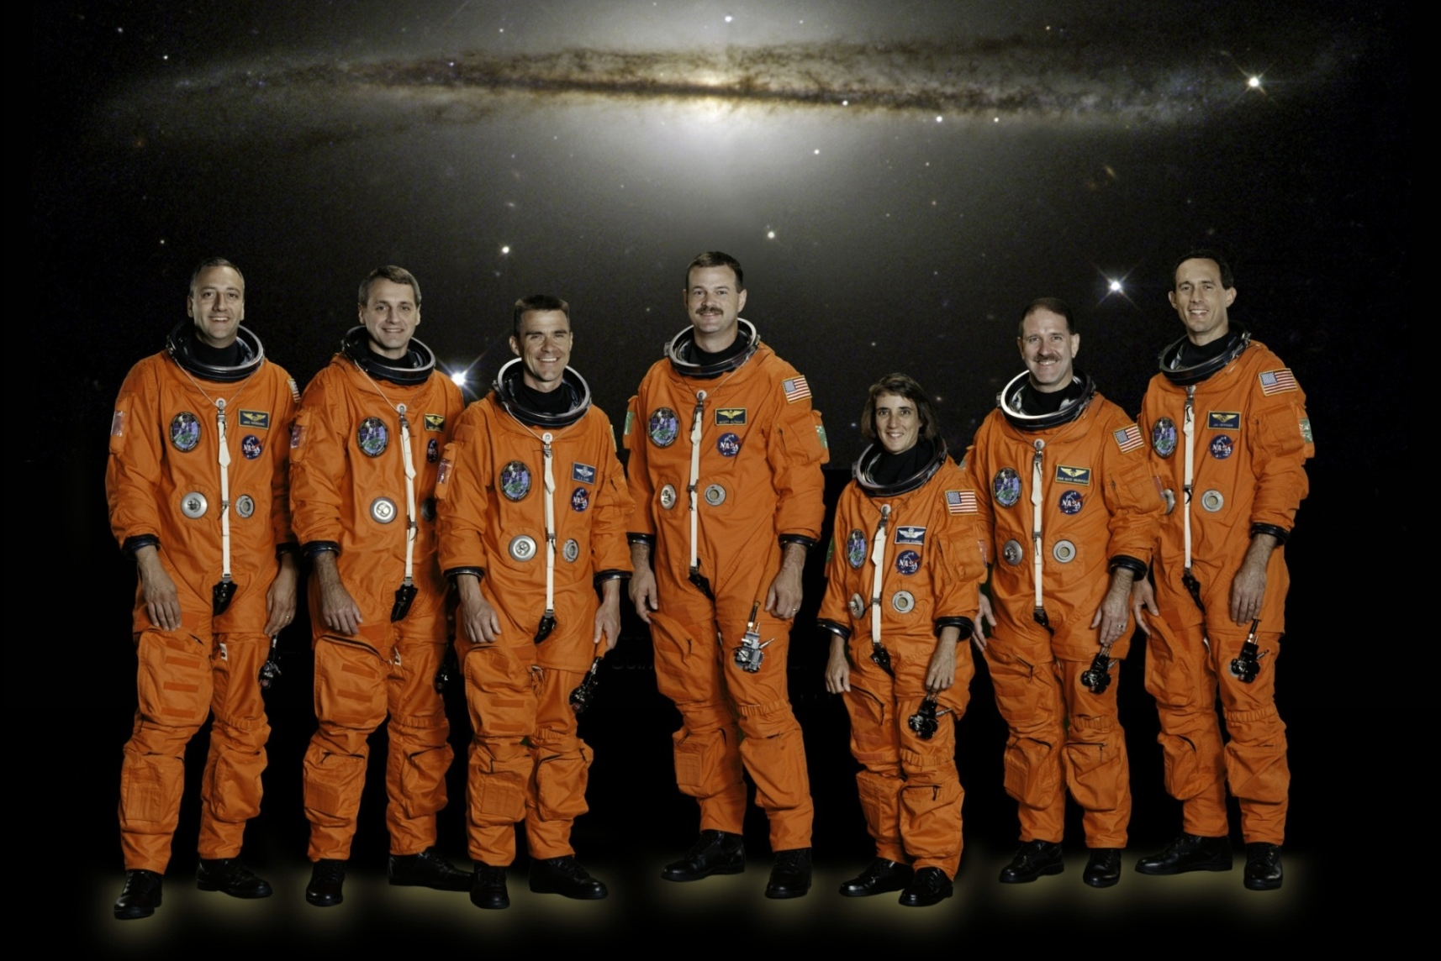

People Vary
Fuzzy Awareness
28

Slide 29
Situations Vary

Slide 30
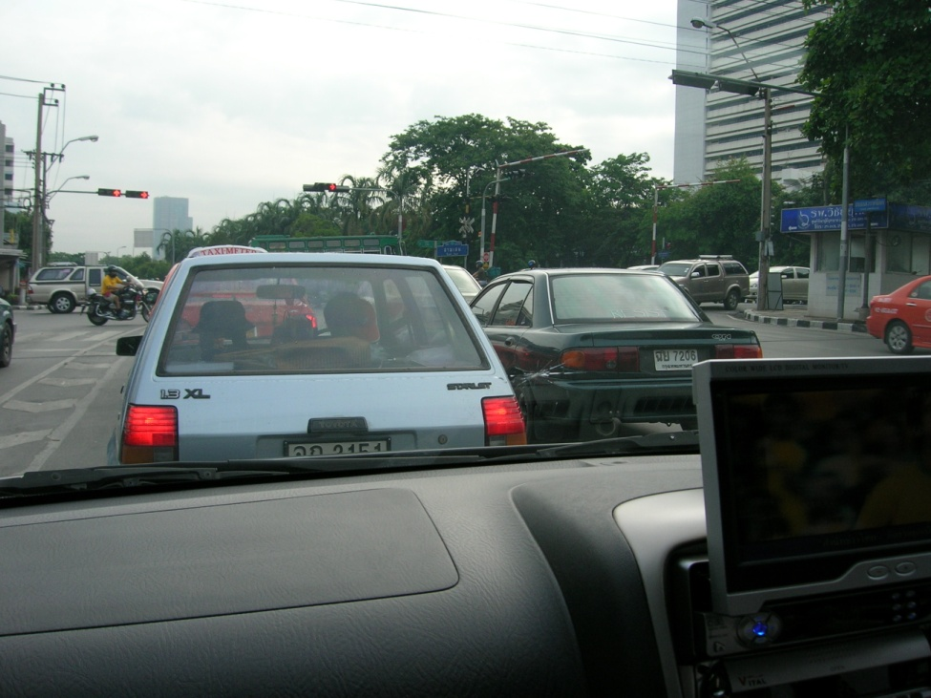
Noise and Distractions are Everywhere
Driving through Bangkok while watching the World Cup on the TV

Slide 31
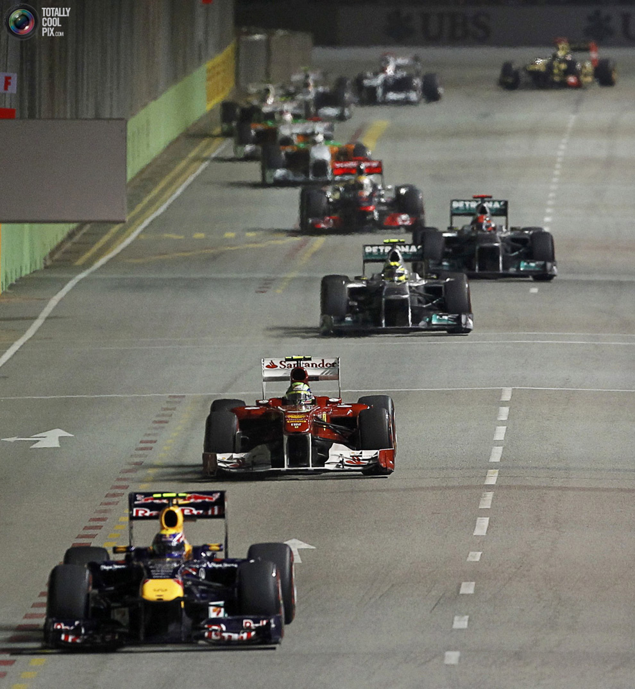
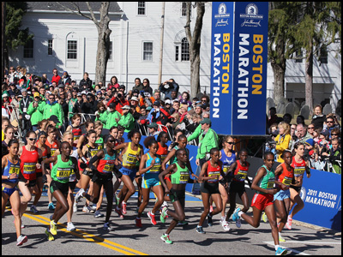
Life is Dynamic

Slide 32
A Fuzzy Model of Human Control
Strategy
Tactics
Knowledge
Long Term Memory
Noise
Planning
Mental
Simulation
Expertise
Distraction
Operational Memory
Attending
Learning
Deciding
Situation Awareness
Controlling
Adapting
Perceiving
Feedback
Predicting
Responding
Understanding
Fuzzy Awareness
32

Slide 33
Failure can occur at any stage and during any interaction between stages / resources
Knowledge
Strategy
Tactics
Long Term Memory
Planning
Noise
Mental
Simulation
Expertise
Distraction
Operational Memory
Attending
Learning
Deciding
Situation Awareness
Controlling
Adapting
Perceiving
Feedback
Predicting
Responding
Understanding
Fuzzy Awareness
33

Slide 34
A small mistake at any stage of human information processing can result in catastrophic failure
For Want of a Nail
For want of a nail the shoe was lost.
For want of a shoe the horse was lost.
For want of a horse the rider was lost.
For want of a rider the message was lost.
For want of a message the battle was lost.
For want of a battle the kingdom was lost.
And all for the want of a horseshoe nail.
Knowledge
Strategy
Tactics
Long Term Memory
Noise
Mental
Simulation
Planning
The story associated with the proverb, describing the unhorsing of King Richard during battle, would place the proverb's origin after the Battle of Bosworth on 22 August 1485.
Expertise
Attending
Distraction
Operational Memory
Learning
Deciding
Situation Awareness
Controlling
Adapting
Feedback
Perceiving
Predicting
Understanding
Responding

Slide 35
This fuzzy model of cognition highlights
Interfaces and Interactions
Interdependencies and Integration
Uncertainty and variability
Knowledge
Strategy
Tactics
Long Term Memory
Planning
Noise
Mental
Simulation
Expertise
Distraction
Operational Memory
Attending
Learning
Deciding
Situation Awareness
Controlling
Feedback
Perceiving
Predicting
Adapting
Responding
Understanding
Fuzzy Awareness
35

Slide 36
How do human and situational variability affect each of these stages?
Knowledge
Strategy
Tactics
Long Term Memory
Planning
Noise
Mental
Simulation
Expertise
Distraction
Operational Memory
Attending
Learning
Deciding
Situation Awareness
Adapting
Controlling
Feedback
Perceiving
Predicting
Responding
Understanding
Fuzzy Awareness
36

Slide 37
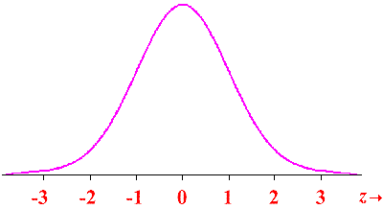
Fuzzy Awareness
With all this Information, Noise, Distraction and Uncertainty no wonder we make
Errors Slips
Violations and Mistakes
Knowledge
Strategy
Tactics
Long Term Memory
Noise
Mental
Simulation
Planning
Expertise
Distraction
Operational Memory
Attending
Learning
Deciding
Situation Awareness
Uncertainty
And
Variability
Controlling
Feedback
Perceiving
Predicting
Adapting
Responding
Understanding
Fuzzy Awareness
37

Slide 38
Operational Memory
Iconic Memory
Rehearsal
Primary Memory
Prospective Memory
Operational Memory
Forgetting
Semantic Memory
Episodic Memory
Procedural Memory
A Key to Effective Operational Memory is Efficient Forgetting
Long Term Permanent Memory / Learning
Fuzzy Awareness
38

Slide 39
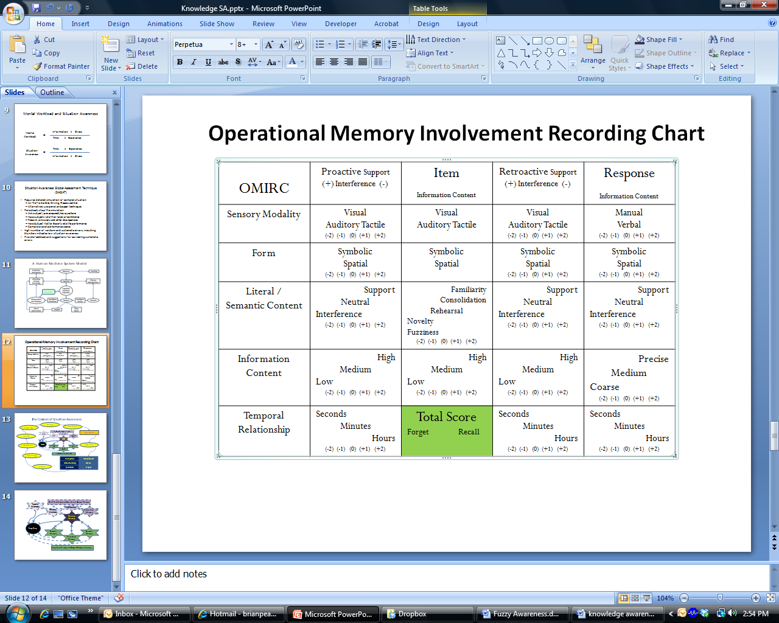
Operational Memory Recording Chart
Forgetting can be predicted by analyzing the task
Fuzzy Awareness
39

Slide 40
The Key to Attention is Strategic Selection

Slide 41
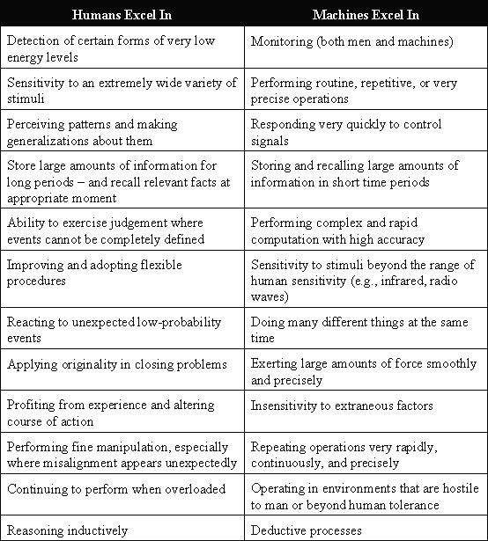
Does Fitts List need Reevaluating in the light of Contemporary Information Technology?
Allocation of Function between People and Machines

Slide 42
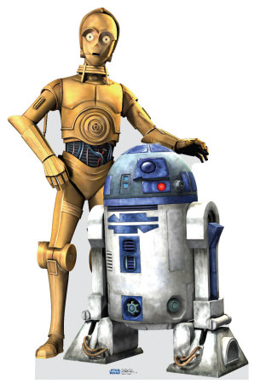
Machines (computers) are:
People are flexible, fallible and funny
Very focused, strong, precise, quick
Insensitive to noise, harsh environments and distraction
Don’t fluctuate and get tired
Rule based (deductive reasoning)
  Have enormous computing power
  Some rules may be quite complex
  Rule may mimic / learn human behaviors based on history
    Google and Facebook know your preferences and habits
Objective
  Have enormous breadth and depth
Make nonlinear predictions
Computers don’t laugh

Slide 43
How Can Technology Help?
What people do
  Attending
  Sensing
  Perceiving
  Remembering
  Understanding
  Predicting
  Deciding
  Controlling
  Communicating
Ergonomics
vs
Darwin
(aided by Technologists)

Slide 44
How Can ErgoTechnology Help?
Mobile IT
Intelligent Chunking
Displays
Intelligent Strategic Selection (Google, Facebook)
Expertise will always be needed, but mere mortals can do much more with ErgoTechnology
Knowledge
Strategy
Tactics
Objective Risk Analysis
Long Term Memory
Noise
Mental
Simulation
Planning
Expertise
Attending
Distraction
Operational Memory
Learning
Deciding
User friendly portable simulators / simulations
Situation Awareness
Controlling
Adapting
Feedback
Perceiving
Predicting
Understanding
Responding
Automation with supervisory friendly Interfaces
Non Linear Predictive Displays
Sensing / perceiving Technology
Fuzzy Awareness
44

Slide 45
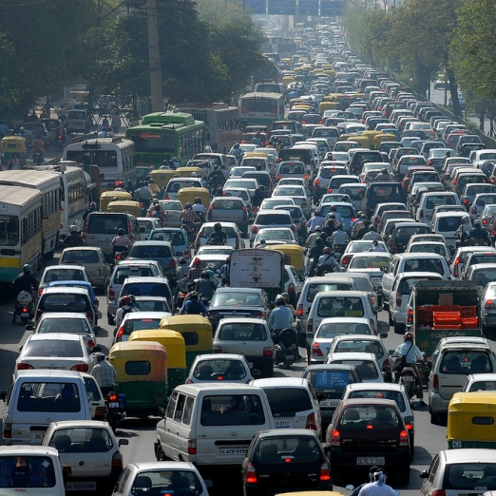
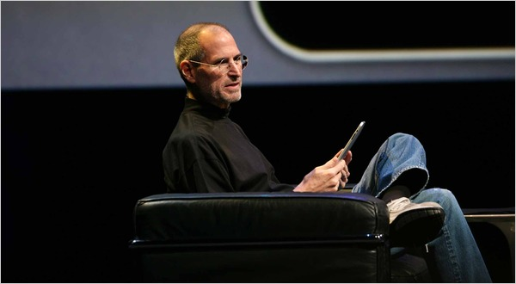
The Car of the Future

Slide 46
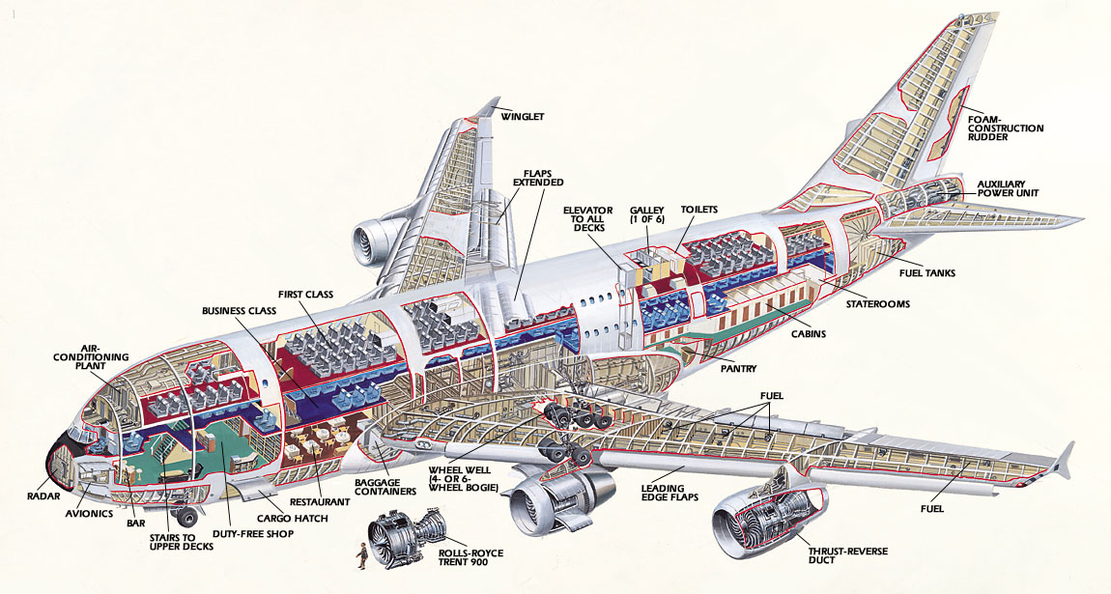
The Airplane of the Future
Look, no Pilot!

Slide 47

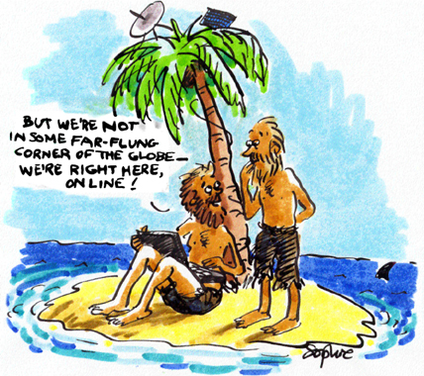
The Student of the Future

Slide 48
Knowledge Awareness needs ErgoTechnology to defeat Fallible Fuzziness
Knowledge
Strategy
Tactics
Long Term Memory
Planning
Noise
Mental
Simulation
Expertise
Distraction
Operational Memory
Attending
Learning
Deciding
Situation Awareness
Controlling
Adapting
Perceiving
Feedback
Predicting
Responding
Understanding
Fuzzy Awareness
48

