Slide 1
Cognitive Task Analysis and Human Error Reduction
Brian Peacock
SIM University, Singapore

Slide 2
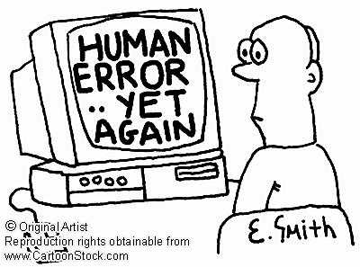
Human Errors usually have a Cognitive Cause and a Physical Result

Slide 3
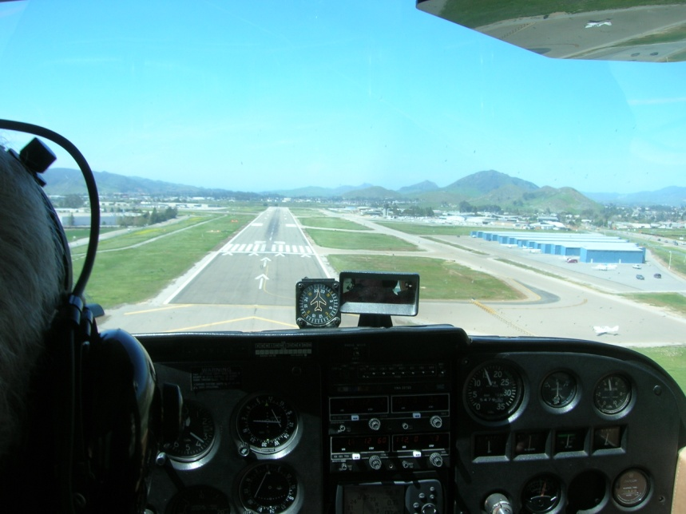
Human Information Processing Models
Human – Machine Interfaces
Human Information Processing
Memory
Attention
Cognition
Control
Communication
Fuzzy Awareness
Education
Revise all these models with reference to common situations and human errors
How do these models help you to understand and explain human information processing and how errors may occur?

Slide 4
Human Error
Human errors occur all the time
Human error is important for learning
It’s the consequence of the error that usually matters
Whatever the cause an error is a failure to achieve one or more of the system purposes
Ease of Use
Effectiveness
Efficiency
Elegance
Safety
Security
Satisfaction
Sustainability
Reliability
Resilience
E4S4

Slide 5
Multiple Purposes of Design
E4S4
Effectiveness
Meets functional requirements
“quality”
Efficiency
Optimal use of resources
“productivity”
Ease of Use
Intended users
Comfort and Convenience
Prevention of misuse
Elegance
Esthetic / emotional appeal
Affective Design
Safety and Health
Prevention or mitigation of system failures
For participants and third parties
Security
Inadvertent or malicious misuse
Satisfaction
Of ALL customers and stakeholders
Sustainability
Reliability
Under intended contexts over the life cycle
Resilience
Under unintended, unexpected and harsh conditions
There WILL be tradeoffs

Slide 6
Some Examples of Human Control Performance Challenges and Human Error Opportunities
Discuss the errors and possible remedies

Slide 7
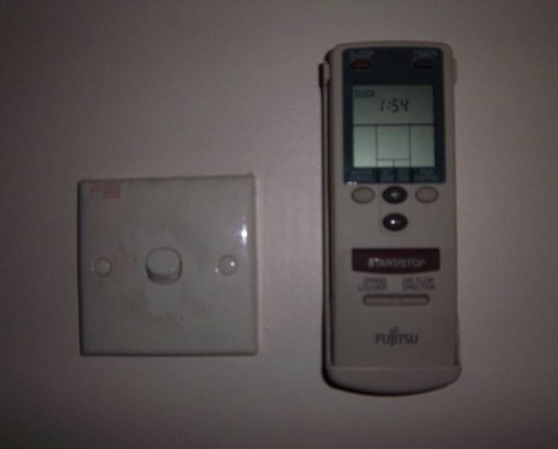
A Simple Error
As I walked out of my office to take a break from writing this presentation I reached out to turn off the room air conditioner and hit the light switch instead
The two switches were side by side but very distinct in design
A wall switch and a button on a remote A/C control
Why did I make this simple, easily recoverable mistake?
I didn’t look after the initiation of the reaching movement
I use light switches much more frequently
We make similar, unimportant errors all the time

Slide 8
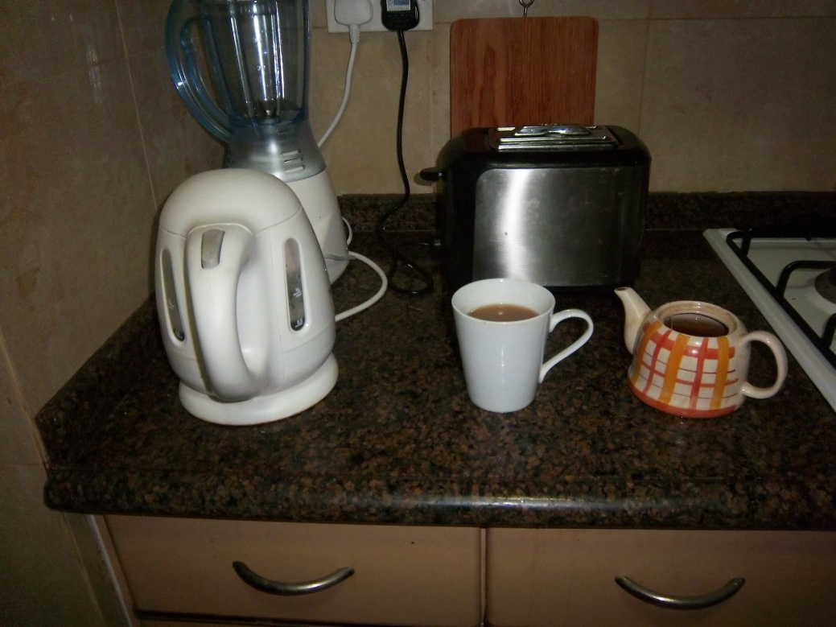
Another Error
This morning I poured the water from the kettle into the mug instead of into the teapot where I had just placed a teabag
Sometimes I put the teabag into the mug

Slide 9
Physical & Cognitive Task Analysis

Slide 10
Task Analysis
Physical Task Analysis addresses human overt behaviors – the flow of Energy – Actions
Cognitive Task Analysis addresses the flow of Information between (and within) the Task and the Operator
Job Analysis – Psycho-social

Slide 11
Uses of Task Analysis
What is the goal or purpose
What should be done
What should not be done
Who should do what, and when and where
How things should be done
How tasks should be designed
How tasks should be assigned
How people should be selected, trained and assigned
How procedures should be designed
How equipment should be designed
How facilitators should be designed

Slide 12
Physical Task Analysis
Henry Ford
Frederick Taylor
Lillian Gilbreth
MTM (Methods Time Measurement)
Work Factor
Charting and Timing (in seconds)
Pick
Carry
Place
Fasten
Inspect
Walk
10
20
10
30
10
10

Slide 13
Physical Task Analysis (with Physical Ergonomics)
Effort / Force / Posture
Place
10
Fasten
30
Carry
20
Walk
10
Pick
10
Inspect
10
Time
Where is the value added work?

Slide 14
Cognitive Task Analysis
Task Related Thoughts
Analyze the Task Demands
Semantic Encoding
Physical Encoding
Observe the Activity
Secondary Tasks
Articulation
Transmission / Implementation
Record Physiological Electrical Activity
Record Cortical Electrical Activity
Verbal Protocol Analysis
Record Eye Movements
Real Time
Asynchronous
Observe Effects on Primary and Secondary Tasks

Slide 15
Cognitive Task Analysis
CTA
Cognitive Task Analysis is the collective name for a set of methods that describe the thought processes used by novices and experts to control simple or complex systems
Cognitive Task Analysis distinguishes between knowledge, rule and skill based control of systems
People who operate in a knowledge based way are restricted by the information available
People who act in a rule based way do not seek additional information, but rely on deductive processes
People with a high level of skill are adaptable and able to apply inductive reasoning to problem solving

Slide 16
CTA Methods
CTA
Cooke (1994) identified three broad families of techniques:
observation and interviews: watching experts and talking with them.
More informal. Allow knowledge elicitator more flexibility during knowledge elicitation.
process tracing: capture an expert’s performance of a specific task via either a think-aloud protocol or subsequent recall.
More formal and structured. Some analysis decisions are left to the elicitor.
conceptual techniques: produce structured, interrelated representations of relevant concepts within a domain
Conceptual techniques are well-specified and formal with few judgments on the part of the elicitor.
Requires more training
Notes:
Cooke (1994) conducted one of the more extensive reviews of CTA. She identified three broad families of techniques:

Slide 17
CTA procedure
CTA
Most of the dominant CTA methods are performed in the following sequence:
Collect preliminary knowledge
Identify knowledge representations
Apply focused knowledge elicitation methods
Analyze and verify data acquired
Format results for the intended application
Clark, et al (2006), “Cognitive Task Analysis”

Slide 18
CTA procedure
CTA
1. Collect preliminary knowledge
Sequence of tasks that will become the focus of the CTA are analysed
Analysts attempt to become generally familiar with the knowledge domain and identify experts to participate in the knowledge elicitation process. Knowledge analysts should be generally familiar with the content, system, or procedures being analyzed.
Interview 2-3 subject matter experts, separately to avoid premature consensus regarding the knowledge and skills necessary for effective performance.
Techniques typically used during this phase include document analysis,
observation, and interviews (structured or unstructured).
The analyst uses the results of this stage to identify the knowledge types and structures involved in performing the tasks.
Clark, et al (2008), “Cognitive Task Analysis”

Slide 19
CTA procedure
CTA
2. Identify knowledge representations
Using information collected during the preliminary stage, examine
each task to identify sub-tasks and types of knowledge required to perform it.
Most CTA approaches are organized around knowledge representations appropriate for the task, such as concept maps, flow charts, semantic nets, and so forth. These representations provide direction and order to latter stages in the CTA process because knowledge elicitation methods map directly to knowledge types.
Some are best used to elicit procedural knowledge, while others are more successful for capturing declarative knowledge (Chipman et al., 2000).
A learning hierarchy is one example of a method to organize the types of knowledge required to perform a task.
Clark, et al (2008), “Cognitive Task Analysis”
Notes:
A learning hierarchy analysis represents the content
of skills ordered from more complex problem solving skills at the top to simpler forms of
learning (Jonassen et al., 1999). So for example, problem solving is followed by rule
learning, which is followed by concepts. Thus, the basic idea is that people can only learn
rules if they have already mastered prerequisite concepts necessary to learn the rules.
Analyzing a learning hierarchy begins by identifying the most complex (highest) learning
outcome and then determining the underlying skills that must be mastered to achieve the
target outcome. A hierarchy of skills is represented as a chart of tasks for each intellectual
skill that is acquired to progress to increasingly complex skills.
The learning hierarchy constructed at this stage of the CTA process provides the
guide to structure the next stage of knowledge elicitation by identifying the information
that must be captured from the SMEs. Thus, it reflects the reiterative nature of the CTA
process, in which the details of the knowledge, skills, and cognitive strategies necessary
for complex learning are revealed, refined, and confirmed.

Slide 20
CTA procedure
CTA
3. Apply focused knowledge elicitation methods
the analyst applies various techniques to collect the knowledge identified in the prior stage.
choose methods appropriate to the targeted knowledge type as determined by the knowledge representations identified for each task.
Knowledge elicitation methods include:
Structured or semi-structured interviews
Verbal Protocol analysis
Critical Decision Method (Gary Klein)
Applied Cognitive Task Analysis (ACTA) (Militello and Hutton)
Clark, et al (2008), “Cognitive Task Analysis”
Notes:
A learning hierarchy analysis represents the content
of skills ordered from more complex problem solving skills at the top to simpler forms of
learning (Jonassen et al., 1999). So for example, problem solving is followed by rule
learning, which is followed by concepts. Thus, the basic idea is that people can only learn
rules if they have already mastered prerequisite concepts necessary to learn the rules.
Analyzing a learning hierarchy begins by identifying the most complex (highest) learning
outcome and then determining the underlying skills that must be mastered to achieve the
target outcome. A hierarchy of skills is represented as a chart of tasks for each intellectual
skill that is acquired to progress to increasingly complex skills.
The learning hierarchy constructed at this stage of the CTA process provides the
guide to structure the next stage of knowledge elicitation by identifying the information
that must be captured from the SMEs. Thus, it reflects the reiterative nature of the CTA
process, in which the details of the knowledge, skills, and cognitive strategies necessary
for complex learning are revealed, refined, and confirmed.

Slide 21
CTA procedure
CTA
4. Analyze and Verify Data Acquired
Analyst code and format the results for verification, validation, and applicability for use in their intended application.
Transcripts may be coded to summarize, categorize, and/or synthesize the collected data.
Formatted output is presented to the participating SMEs for
verification, refinement, and revision to ensure that the representations of tasks and their underlying cognitive components are complete and accurate.
The analyst should compare these with the output of other experts to validate that the results accurately reflect the desired knowledge representation.
Clark, et al (2008), “Cognitive Task Analysis”
Notes:
A learning hierarchy analysis represents the content
of skills ordered from more complex problem solving skills at the top to simpler forms of
learning (Jonassen et al., 1999). So for example, problem solving is followed by rule
learning, which is followed by concepts. Thus, the basic idea is that people can only learn
rules if they have already mastered prerequisite concepts necessary to learn the rules.
Analyzing a learning hierarchy begins by identifying the most complex (highest) learning
outcome and then determining the underlying skills that must be mastered to achieve the
target outcome. A hierarchy of skills is represented as a chart of tasks for each intellectual
skill that is acquired to progress to increasingly complex skills.
The learning hierarchy constructed at this stage of the CTA process provides the
guide to structure the next stage of knowledge elicitation by identifying the information
that must be captured from the SMEs. Thus, it reflects the reiterative nature of the CTA
process, in which the details of the knowledge, skills, and cognitive strategies necessary
for complex learning are revealed, refined, and confirmed.

Slide 22
CTA procedure
CTA
5. Format Results for the Intended Application
The results of some highly structured CTA methods (e.g., cognitive modeling) are readily applied to expert systems or computer-assisted tutoring applications.
For less formal CTA methods, the results must be translated into models that reveal the underlying skills, mental models, and problem solving strategies used by experts when performing highly complex tasks.
Clark, et al (2008), “Cognitive Task Analysis”
Notes:
A learning hierarchy analysis represents the content
of skills ordered from more complex problem solving skills at the top to simpler forms of
learning (Jonassen et al., 1999). So for example, problem solving is followed by rule
learning, which is followed by concepts. Thus, the basic idea is that people can only learn
rules if they have already mastered prerequisite concepts necessary to learn the rules.
Analyzing a learning hierarchy begins by identifying the most complex (highest) learning
outcome and then determining the underlying skills that must be mastered to achieve the
target outcome. A hierarchy of skills is represented as a chart of tasks for each intellectual
skill that is acquired to progress to increasingly complex skills.
The learning hierarchy constructed at this stage of the CTA process provides the
guide to structure the next stage of knowledge elicitation by identifying the information
that must be captured from the SMEs. Thus, it reflects the reiterative nature of the CTA
process, in which the details of the knowledge, skills, and cognitive strategies necessary
for complex learning are revealed, refined, and confirmed.

Slide 23
Cognitive Task Analysis Landing an airplane
I
E
P
Get weather and runway information
Observe the Activity
Talk to ATC
Enter and fly the traffic pattern
Check power, air speed, altitude, attitude, configuration, approach, other traffic, wind and runway
Adjust power, attitude and configuration
Remember the rules and apply the skills
Decide whether to land or go around

Slide 24
Verbal Protocol Analysis
I
E
P
Use verbal protocol analysis to develop procedures, instructions, checklists and improvisations
Tie your shoelace or tie
Navigate a sharp bend while driving
Take a penalty kick
Cook a meal
Using your mobile phone for web surfing

Slide 25
Transaction Analysis
A transaction is a well defined repeated task involving a purpose, operator, equipment, materials, energy a context and information such as:
Making a sandwich
Landing an airplane
Driving a car through an intersection
Using an ATM machine
Buying a product through a web page
The transaction takes a variable amount of time
The outcome of a transaction may be success or failure or some degree in between

Slide 26
Transaction Analysis (contd.)
Analysis will involve both the physical elements and the flow of information
Initiation
Establish of purpose, recall procedure
Search for information from equipment, context, materials and operator
Anticipate input / external factor effects and process outcome
Plan activity including contingency plan, Evaluate risks and benefits, Decide to proceed
Control
Make control input / communication action
Monitor process, perceive feedback,
Modify input
Outcome analysis
Perceive system state
Compare with anticipated outcome
Store observations for future use

Slide 27
Transaction Analysis Example – Parking a car
Arrive at destination
Initiation
Search for parking space, Observe obstructions
Judge that space is sufficient
Recall procedure, plan actions
Control
Operate vehicle controls
Monitor progress, judge separations
Terminate procedure
Outcome Analysis
Observe vehicle status, observe context status, compare with plan
Store location
Store transaction record for future use
Cognitive sources of Success or Failure
Sensory input
Prediction, hazard assessment
Recall procedure
Planning trajectory / timing
Attention to hazard areas
Perceive clearances
Decisions to continue, adjust, abort
Motor control – disturbed posture, tactile assessment of pedal location

Slide 28
Practical Cognitive Task Analysis
Purpose | Parallel parking, no contact with other vehicles or objects
Activities | See task description
Cognitive processes | Planning, predicting, diagnosing, sensing, attending, judging, deciding, problem solving, controlling, communicating, analyzing, synthesizing, evaluating, anticipating, predicting, investigating, extrapolating, understanding
Information Resources | Direct outside vision, mirrors, hearing??, memorized procedures, operational memory
Failure modes | Not enough space to park Contact with front / rear fender Inaccurate positioning
Simulation | Table top model Walk / talk through sensory, cognitive, motor activities
Simulator | Empty parking lot using cones to demarcate the target

Slide 29
Mental Workload
MWL
SA
“ Mental workload is the amount of mental work or effort necessary for a person or group to complete a task over a given period of time.”
Xie and Salvendy 2000

Slide 30
Mental Workload and Situation Awareness
Information
X
Stress
Mental Workload
=
Time
X
Experience
Time
X
Experience
Situation
Awareness
=
Information
X
Stress

Slide 31
Mental Workload Measurement Device Criteria
Sensitive to task difficulty and cognitive resource demand
Diagnostic – capable of identifying the resources used
Selective – separates mental workload from other sources of stress
Reliable and Resilient – performs well consistently and under complex conditions
Unobtrusive - does not interfere with primary task
Uncomplicated and economical - does not require complex expensive equipment
Acceptable to the operator / subject

Slide 32
Mental Workload Measurement
Primary and secondary task behavior and performance measures
Subjective rating scales, usually retrospectively
Psycho physiological
Heart rate, heart rate variation, Eye blink and pupil monitoring, EEG
External (expert) observer
Simulation methods (MICRO-SAINT)

Slide 33
Primary Tasks Measures
Assess operator’s capability to perform the primary task or system functions of interest
Time and accuracy / error
Central tenet: performance deteriorates as one is subjected to higher MWL.
Common measure of primary task PERFORMANCE:
Time taken for task completion (Speed)
Accuracy (no. of errors made)
Reaction/ response time
Difficulties
Not sensitive to level of expertise
Not sensitive to variable stress accommodated by the operator
Notes:
Central tenet: performance deteriorates as one is subjected to higher MWL.

Slide 34
Dual Task Methods
I
E
P
Car diving – primary control task, navigation, instruments, entertainment and communication (cell phone)
Divided attention
Conversations stop at intersections
Case study – Top Gun movie
Flying – Aviation, navigation, communication
“Sterile cockpit” – only essential communications
Essential communications completed early during stable flight phases
Communications quality deteriorates with flying and navigational stress
Workload reduced by rule based activities

Slide 35
Secondary task measures
Add another task to the primary task.
If you can perform well in your secondary task, then the workload on the primary task is low , and you still have spare resource capacity.
2 methods:
Subsidiary task paradigm:
Maintain performance of primary task
Loading task paradigm
Maintain performance of secondary task

Slide 36
Secondary Task Example
I
E
P
Driving on a closed slalom circuit with speed controlled by investigator
Rhythmic foot tapping – secondary task
Primary task focus
Secondary (tapping) task varied with speed and course / vehicle handling (tire pressure) difficulty
Secondary task focus
Primary (steering) task varied with speed and course / vehicle handling difficulty

Slide 37
Secondary Tasks
Mental arithmetic
Card sorting
Choice reaction time
Recitation / reading
Recognition
Ancillary instruments
Size differences
Short term memory
Monitoring
Problem solving
Anything that can be reliably measured and that may share some of the sensory, attention, cognitive, memory or motor resources with the primary task

Slide 38
Secondary task measures: Problems
Validity
Introduction of secondary task changes nature of the primary task – therefore contaminating workload measure
High level of intrusion
Interfere and disrupt performance of primary task. Dangerous if primary task is flying or driving – diverted attention to secondary task may lead to an accident.
Important to allow for self-pacing – abort secondary task if necessary.
Using artificial laboratory based task:
Operator may not be willing to perform secondary task considered to be artificial and bothersome
Instrumentation required to introduce task into the operation environment

Slide 39
Secondary task measures: Problems
Not sensitive if the two tasks require separate types of resources
If you are required to drive (a manual task) and repeat a series of digit (a verbal task) – you will not find any decrement in primary task.
Hence, look at the different resource dimensions – if primary task consists of a verbal processing task with no spatial components, don’t use a spatial secondary task measure.
Very sensitive to tasks requiring similar resources – where time sharing is difficult.
Notes:
Competing for resources will present the best situation to watch decrement in primary task performance. BUT it is also the most intrusive.

Slide 40
Subjective Measures
Strength of self-report measures is their subjectivity. Enjoy highest face validity.
"The operator's awareness of increasing effort being used, even before any performance degradation occurs, should give subjective [self-report] measures a special role to play"
No one is able to provide a more accurate judgment with respect to experienced mental load than the person concerned.
.

Slide 41
Subjective Measures
Most popular and frequently used measures of workload
Research in subjective measures produced rating scale techniques dedicated to workload assessment shown capable to reflect variations in demand across a variety of different tasks
Rating Scale Mental Effort (Zijlstra)
Modified Cooper Harper (Wierwille and Casali, 1983)
Bedford (Ellis and Roscoe,1982)
NASA TLX
Subjective Workload Assessment Technique (SWAT) (Reid & Nygren, 1988)

Slide 42
NASA TLX
Multi-dimension subjective workload rating technique
Workload defined as “cost incurred by human operators to achieve specific level of performance.”
Overall score is based on the weighted average of rating on 6 subscales

Slide 43
Name
Task
Date
TASK LOADING INDEX
Mental Demand: How mentally demanding was the task?
Very Low
Very High
Physical Demand: How physically demanding was the task?
Very Low
Very High
Temporal Demand: How hurried or rushed was the pace of the task?
Very Low
Very High
Performance: How successful were you in accomplishing what you were asked to do?
Perfect
Failure
Effort: How hard did you have to work to accomplish your level of performance?
Very Low
Very High
Frustration: How insecure, discouraged, irritated and annoyed were you?
Very Low
Very High

Slide 44
Modified Cooper Harper scale
Original Cooper Harper scale was for assessment of aircraft handling characteristics
Long tradition of use for workload associated with psychomotor tasks
2 versions:
Modified Cooper Harper (Wierwille and Casali, 1983)
Bedford (Ellis and Roscoe,1982)
Both versions retained the 9 or 10 point decision tree format
Decision tree makes the rating easier by allowing sequential decisions and the rating is very time economic.

Slide 45
Modified Cooper Harper (MCH) by Wierwille and Casali, 1983

Slide 46
Bedford Workload Scale

Slide 47
Psychophysiological Measurements
Provide continuous measurements and data collection:
Pick up transient changes in MWL
(Possibly) Not obtrusive to primary task
Subjects do not need to perform secondary tasks, or fill up forms
Methods:
Heart rate and HR Variability
Pupil Diameter
Visual Scanning
EEG

Slide 48
Heart Rate
Studies shown HR of pilots flying actual flights is higher than flying simulated flights (within subjects study)
Used in other non aviation studies:
race car drivers – 150 to 180 bpm b4 race starts. HR 180 to 210 bpm during race
race boat drivers: Change from while waiting 142bpm to 192bpm during race.
Telemarketer: HR increase during work cf resting condition
However, heart rate is affected both by physical and psychological load
Sensitive measure, but lacks diagnosticity

Slide 49
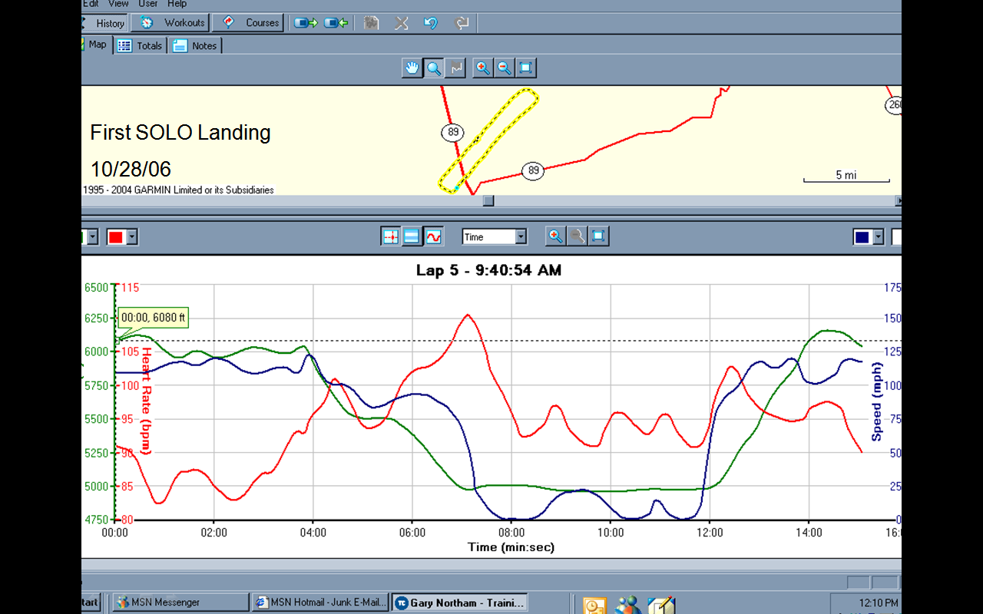

Slide 50
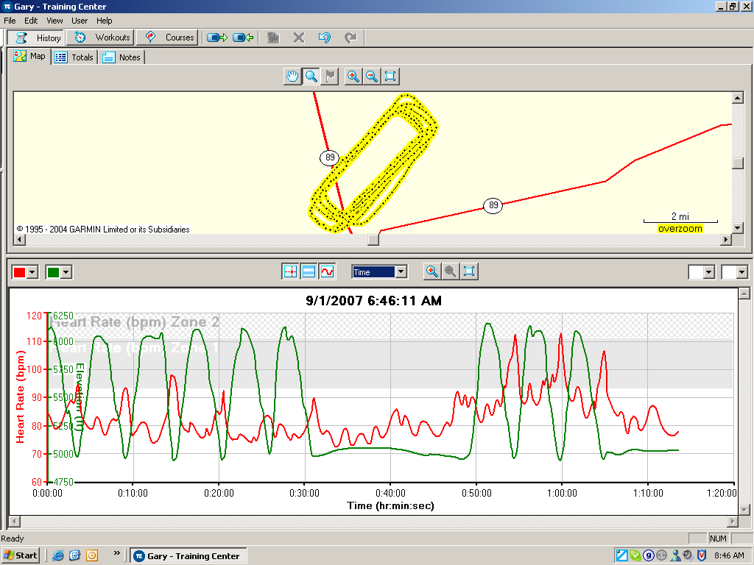
Workload and Stress
The last three landings were solo
Go around practice

Slide 51
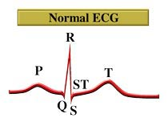
Heart Rate Variability
Found to be a more sensitive measure than HR
Heart rate affected by both physical and cognitive activities
Notes:
Measure R-R variablility in ECG.

Slide 52
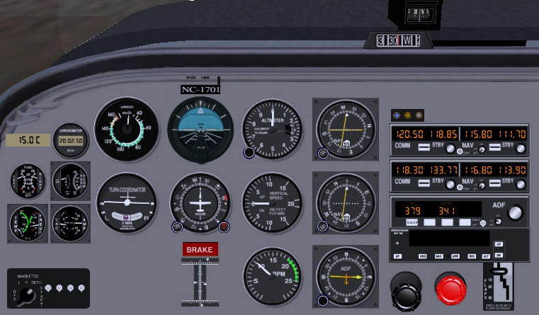
Eye movements / focus
Instrument scan patterns in driving or flying is not random:
Frequency of fixation indicates importance of instrument
Pattern of movement indicates individual source relationships
Length of fixation indicate the difficulty in obtaining or interpreting information from that instrument

Slide 53
Eye Movements
Problems
Interpretation of eye gaze data can be very difficult
Eye fixations will fill up the available time regardless of the task
In Head up Display – not sure if operator is looking at objects or at the outside world
Eye tracking equipment is expensive and difficult to set up
Also use EOG

Slide 54
Eyeblink Activity
Blink rate
Shown relationship to visual workload in driving and flight environments
Decreases under conditions of high workload (e.g. driving in city vs highway)
Novice chopper pilots showed decreased in blink rates over time in flight. Expert pilots showed no changes during same flight.
Lower blink rates found during weapons delivery cf pre-flights briefings. Also in landing and bombing range segments of flights

Slide 55
Blink Patterns
Blink duration (closure duration)
Decrease during increased visual attention demand
When fatigued, operator’s blink duration increase (close their eyes longer per blink)
Blink rate and duration sensitive for measuring visual input load (or visual information processing demand), but not for auditory or cognitive workload.

Slide 56
Pupil Diameter
Pupil diameter correlates closely with resource demands of different cognitive activities:
Mental arithmetic (Kahneman, et al, 1967)
Short term memory load (Beatty & Kahneman, 1966)
ATC monitoring load (Jornal, 1997)
Logical problem solving (Bradshaw, 1968, Beatty, 1982)
Sensitive but lacks diagnosticity
Many possible causes
Ambient lighting
Variations in emotional arousal
Requires very precise measurement

Slide 57
Pschophysiological Measurements
Costs
Physically obtrusive – leads, wires.
Expensive - Need specialized equipment
Not easy to analyze data: need technical expertise

Slide 58
Human Error Reduction
Mental Workload Planning
Carry out cognitive task analysis
Eliminate / delegate secondary tasks
Use all available resources – Crew Resource Management
Provide sufficient warning
Prepare appropriate tools
Charts, tables, memory aids
Provide scenario based training
Provide simulator based training

Slide 59
Reduce Mental Workload
Human Error Reduction
Mental Workload = (Information x Stress) / (Time * Experience)
Information load – Present / select only pertinent and timely information, reduce the need for calculations, reduce the operational memory load, clarify response options
Allocate duties among operations team
Stress – Implement redundancy and mitigation procedures to prevent or reduce the severity of an unwanted outcome
Time – Increase the time available for information handling, plan ahead, use checklists / procedures to manage decision processes
Experience – provide part, scenario and team based training

Slide 60
Situation Awareness
Situation Awareness is the capacity to COMPREHEND, ASSESS and PROJECT information in order to CONTROL a situation in a TIMELY manner.
Situation awareness is a characteristic of individual or a team and is aided by appropriate use of technology and training

Slide 61
Situation Awareness Model SA is a widely used method of describing human performance in complex situations such as aviation and process plant operation
Context
Responses
Decisions
Situation Awareness
Stage 1
Perception
Stage 2
Understanding
Stage 3
Projection
Fuzzy Awareness
61

Slide 62
SART – Situation Awareness Rating Technique
Demand | Instability | Sudden situation changes | 1 2 3 4 5 6 7
 | Variability | Number of changing variables | 1 2 3 4 5 6 7
 | Complexity | Situation complexity | 1 2 3 4 5 6 7
Supply | Arousal, Concentration | Readiness, expectation | 1 2 3 4 5 6 7
 | Spare Mental Capacity | Capacity for new variables | 1 2 3 4 5 6 7
 | Divided Attention | Rate / amount of attention switching | 1 2 3 4 5 6 7
Understanding | Information Quantity | Information received and understood | 1 2 3 4 5 6 7
 | Information Quality | Reliability of information | 1 2 3 4 5 6 7
 | Familiarity | Experience with similar situations | 1 2 3 4 5 6 7
Taylor (1990)
Subjective method
Shows good diagnosticity in Rule and Knowledge based activities

Slide 63
Situation Awareness Global Assessment Technique (SAGAT)
Requires detailed simulation of complex situation
Air Traffic Control, Driving, Process control
Alternatively use pencil and paper techniques
Periodically stop the simulation
Ask subject (pre-prepared) key questions
Have subjects rate their levels of confidence
Record, omissions and other discrepancies
Have Subject Matter Experts rate the performance
Compile overall performance scores
High number of random and systematic errors, including blunders indicates low situation awareness
Provide feedback and suggestions for correcting systematic errors

Slide 64
SAGAT for Web Page Navigation
Set up standard problem scenarios on the web site
Order a pizza, transfer money, pay a bill, buy a computer, seek out some technical literature etc.
Use Verbal Protocol Technique to track subject’s understanding
Observe navigation decisions and errors
Alternatively
Interpolate navigation questions within a navigation task
Record and rate subjects level of situation awareness

Slide 65
Situation Awareness
Human Error Reduction
Display pertinent and timely information
Avoid naïve realism
Use Annunciators sparingly
Use procedure based information scanning
Display panel layout
Importance, sequence
Use alternative sensory channels
Vision, hearing, touch
Use scenario based training for off normal / emergency situations
Increase time / human resources

Slide 66
Human Quality Assurance
HQA

Slide 67
Human Quality Assurance
HQA
The last line of defense
Design in redundancy
Design failure mitigation processes – parachutes
Develop EXPERTISE

Slide 68
Human Quality Assurance
HQA
A broad approach to system design that addresses comprehension of normal system performance over time as well as the unexpected contexts that may disrupt the system
HQA addresses technological, operational, environmental, temporal and human factors

Slide 69
HQA Process
HQA
Use CTA to analyze the thought processes of experts and the errors made by novices
Use facilitators to guide the novice
Instructions, Warnings, Labels, Procedures, Checklists
Use selection, training and practice to replace the facilitators
Part task training
Simulator training
Scenario based training
Use testing and CTA to assess the changes in thought processes, behaviors and performance

