Slide 1
The Purposes, Scope and Practice of Ergonomics in Complex Systems
Brian Peacock
June 2016

Slide 2
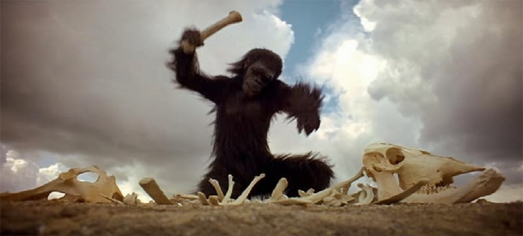
The History of Ergonomics
Tools
2001 A Space Odyssey

Slide 3
Scope of Human Factors
Human Characteristics, Capabilities and Limitations
Affective
Motor
Physical
Integration
Social
Sensory
Cognitive
System Failure may be due a failure of any one or more of these human subsystems as they interact with Technology, Procedures and Context

Slide 4

People vary

Slide 5

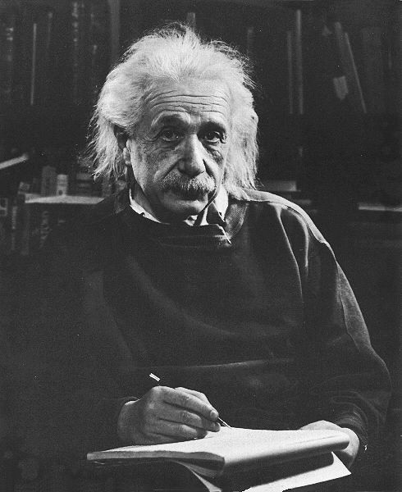
People vary

Slide 6


Affective Factors
Esthetics
Elegance
Emotion
Motivation
Excitement
Mood
Attitude

Slide 7
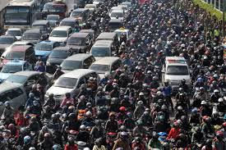
Context is important

Slide 8
Ergonomics Practice Requirements
Knowledge of human characteristics, capabilities and limitations
Domain Knowledge
Measurement, analysis and design tools

Slide 9
The Grammar of Design
A System is a collection of elements such as machines, people or organizations
  Systems are specified by nouns and quantified by adjectives.
  System designs can be verified
A Process is the interaction of two or more systems with a defined purpose.
  Processes are described by verbs and quantified by adverbs
  Process requirements can be validated
The Context or Conditions of a process will use other linguistic conventions such as conjunctions and prepositions
Notes:
More definitions
We can expand the use of grammatical concepts beyond nouns, adjectives, verb and adverbs to things that describe context – on, at, in, after, before. We can also use different kinds of quantitative and qualitative adjectives and adverbs. We can define interactions by the use of Boolean concepts – and, or, not and, not or etc.

Slide 10
Verification and Validation
Design Specifications
  adjectives
  can be verified
Performance Requirements
  adverbs
  can be validated

Slide 11
Ergonomics Complexity
serves many PURPOSES
supports many CUSTOMERS
surrounded by VARIABILITY
swamped by CONTEXT
complicated by INTERACTIONS
contends with SPACE, FORCE and TIME
driven by INFORMATION and AFFECT
deals with BENEFITS, RISKS and TRADEOFFS

Slide 12
Ergonomics Tools
Complexity and Statistics
SHEL
E4S4
6U2M
HFACS
Common currency
Fault Tree Analysis
Human Reliability Analysis
Indices
BRISK

Slide 13
Complexity
Following Edwards SHELL Model
Procedures
(Facilitators, Rules, Instructions)
Technology
(Hardware and Software)
Integration
Interfaces
Interactions
Intra-actions Interferences
Interdependencies
Humans
(Selection, Training, Assignment)
Context
(Physical, Social, Technological, Operational, Temporal)
Variability is everywhere

Slide 14
Structures, Processes and Outcomes after Oman
  Structures - Things that can be designed – nouns with adjectives
  Processes – Interactions among structures leading to outcomes – verbs and adverbs
  Outcomes - multiple with tradeoffs

Slide 15
Multiple Purposes and Outcomes of Design
Effectiveness
  Meets functional requirements
  “quality”
Efficiency
  Optimal use of resources
  “productivity”
Ease of Use
  Intended users
  Comfort and Convenience
  Prevention of misuse
Elegance
  Esthetic / emotional appeal
  Affective Design
Safety and Health
  Prevention or mitigation of system failures
  For participants and third parties
Security
  Inadvertent or malicious misuse
Satisfaction
  Of ALL customers and stakeholders
Sustainability
  Reliability
    Under intended contexts over the life cycle
  Resilience
    Under unintended, unexpected and harsh conditions
E4S4
There WILL be tradeoffs

Slide 16
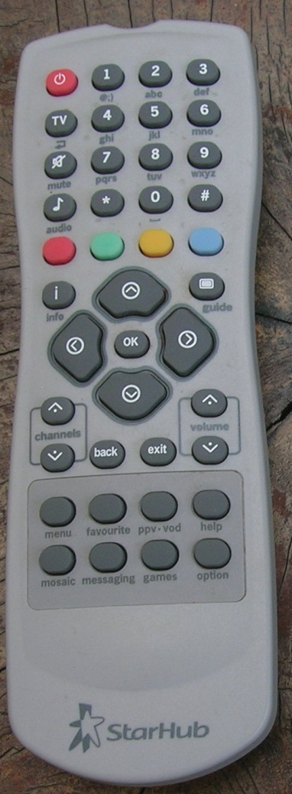
6Us and 2Ms
Utility
  Is the system useful?
Usage and Misusage
  How and in what context will the system be used?
  What possible extreme contexts may be predicted
Usability
  Is the system easy to use or misuse?
Utilization
  How often and by how many people is the system used?
Users and Misusers
  Who are the users and possible misusers?
User Error
  What kinds of error can be made, when and how will they be made, how frequently and what are the possible consequences?

Slide 17
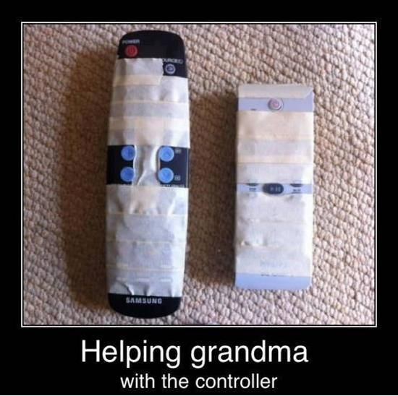

Slide 18
Human Reliability Analysis – Swain 1969
Enduring features of THERP (Techniques for Human Error Rate Prediction) in subsequent HRA methods
• Error identification
  • Task analysis approach
  • Human failure events
  • Performance shaping factors
• Quantification
  • Nominal HEP (Human Error Probabilities) and error factor
  • Basic HEP: Adjustment for PSFs (Performance Shaping Factors)
  • Conditional HEP: Adjustment for dependence
• PRA (Probabilistic Risk Assessment) Integration
  • HRA (Human Reliability Analysis) event tree designed for integration into PRA
  • Recovery
  • Pre- and post-initiating events
Boring 2012

Slide 19
Icebergs
Collision
p= .0076359 = 8/1000 = 8 x 10⁻³
p= .0031949 = 3/1000 = 3 x 10⁻³
OR
First mate does not
respond
Captain does not
respond
p=.00315
p=.0045
p=.000045
AND
AND
Radar not
Working
First mate does not
recognize problem
Intercom
not Working
p=.315
p=.1
p=.1
AND
Radar not
Working
Captain
Degraded
Iceberg
Present
Captain
On Duty
p=.1
p=.1
p=.001
p=.9
p=.5
First mate
Untrained
First mate
on Duty
Iceberg
Present
p=.7
p=.5
p=.9
Notes:
This sample fault tree demonstrates the multiple contributions process safety of task assignment, hazardous conditions, trained, untrained and incapacitated crew members and the availability of technology (radar, intercom) to extend human capabilities to detect and evaluate hazards.

Slide 20
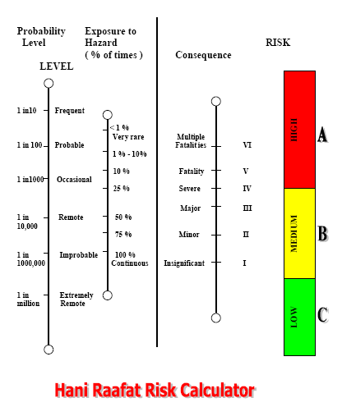

Slide 21
Swiss Cheese Model of Latent System Failures
Organization
Accidents are caused by a sequence / hierarchy of failure pathways
Supervision
Preconditions
Unsafe Acts
The “base event”
Reason

Slide 22
System Failure – The HFACS model (Shappell and Weigmann)
Unsafe act – Human variability, limitations, error
Unsafe conditions – Technology, facilitators, context
Unsafe supervision – Implementation management
Unsafe management –priorities (E4S4)

Slide 23
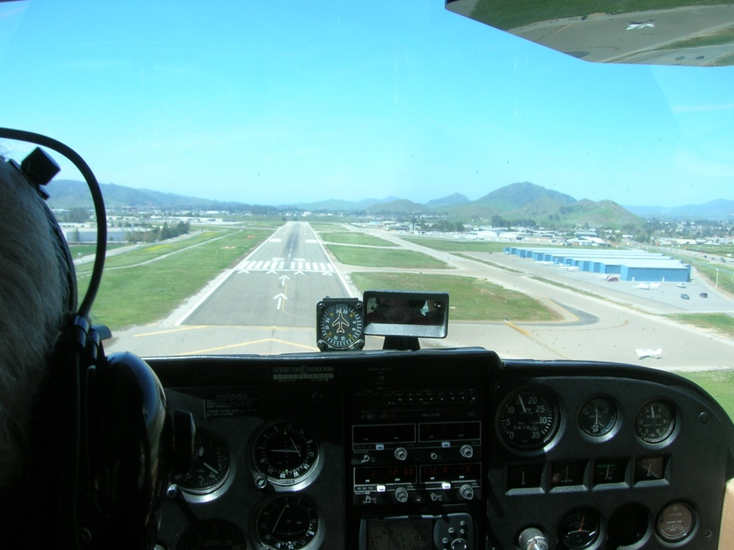
The moment of truth

Slide 24
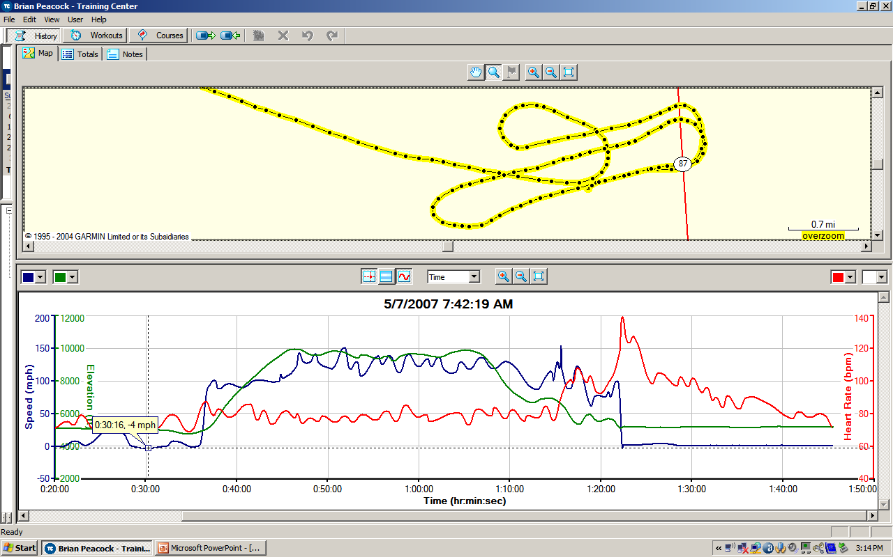
What happened here? Why?

Slide 25
BRISK
Probability of Failure p Failures / Transaction
Exposure
Task, Transactions / Day T
Number of People Exposed N
Benefits of Process or Change
Functional Process Value $V $ / day
Personal Advantage $A $/ day
Value of Intervention / Change $C $ / day
Cost of Intervention / Change
Manpower + Training $M $ / day
System (Capital, Repair) Costs $S $/day
Cost of Adverse Outcome (Failure)
Environmental $E $/day
Human $H $/day
System Down Time $D $/day
Other Economic Costs $O $/day
Spread all capital costs over 1000 days and divide by 1000 to get $/day

Slide 26


Ergonomics Practice
Stakeholders, opinions, bosses, decisions

Slide 27
When and Where
Ergonomics Works
Research
Analysis
Design
Evaluation
Outcome Investigation
Simulation
Laboratory
Success
Ergonomics Projects need some or all these Skills
Failure
Field

Slide 28
Stakeholders - Product Life Cycle
Requirements
Feedforward
Concept
Development
Many Stakeholders
(including the shareholders)
Concept Selection
Specifications
Tooling
Many Requirements
Production
Feedback, Technical Memory
Marketing
Design Team
Use and
Misuse
Maintenance
Disposal

Slide 29
The Ergo Cop Problem
Calling the designer’s baby ugly!
Ergonomics
Evaluation
The Ergocop
Performance
Requirements
Design
Specifications
Design
Performance
Review
(waivers by management)
Clear
Performance
Requirements
Precise
Design
Specifications
Design
Performance
Review
Time to
Market
Ergonomics
Support

Slide 30
The Process of Ergonomics
Measurement and Analysis
Screening
In depth Research
$
Decisions
Benefits, Costs,
Risks, Tradeoffs
Outcomes
Quality
Productivity
Health, Safety
Ease of Use
Security
Satisfaction
Sustainability
Design
Tools, Equipment, Workplaces, Tasks, Procedures, Assignments.
The Job
Contexts
Spatial, Physical, Mechanical, Chemical, Biological, Geographical, Social, Political, Economic

Slide 31
Design Decisions
TRADEOFFS!
Policy
Science
Consensus:
  HF Experts
  Engineers
  Managers
  Customers
Design
Requirements
and
Specifications
Implementation
Experience
Data
History
6U
2M
Predictions
Evaluation
  Verification
  Validation
E4S4
Notes:
Design around the table
Paper airplane design
Use different hats in the design meeting

Slide 32
Common Currency
Rating Response
Not Applicable
Adequate Accept
Marginal Investigate
Intolerable Reject / Modify
Unthinkable Unacceptable
This scale provides a sufficient level of resolution.
0
1
2
3
It facilitates comparisons and prioritization
4
5
6
7
8 - 10

Slide 33
Policy Decisions
Common Currency
Outcome Scale
1
2
3
4
5
6
7
Policy Statements
Unacceptable
Range
7
6
5
4
3
2
1
Region of Interactions and Continuous Improvement
Ideal Range
Engineering Variable or Composite Index

Slide 34
Example

Slide 35
Complex Decisions
 | Overhead |  |  |  |  | E4S4 Analysis
 |  |  | Effectiveness | Efficiency | Ease of Use | Elegance | Safety | Security | Satisfaction | Sustainability |  |  | Counts
 |  | Weights | 1 | 1 | 1 | 1 | 1 | 1 | 1 | 1 | 1
 | Stake Holders |  |  |  |  |  |  |  |  | Reliability | Resilience | 0 | 1 | 2 | 3
 | Designers | 1 | 3 | 3 | 2 | 1 | 1 | 2 | 3 | 3 | 1 | 0 | 3 | 2 | 4
 | Manufacturers | 1 | 1 | 0 | 1 | 2 | 0 | 3 | 0 | 2 | 3 | 3 | 2 | 2 | 2
 | Installers | 1 | 3 | 2 | 2 | 1 | 2 | 2 | 3 | 2 | 3 | 0 | 1 | 5 | 3
 | Operators | 1 | 1 | 3 | 0 | 3 | 0 | 1 | 3 | 3 | 3 | 2 | 2 | 0 | 5
 | Commercial Customers | 1 | 3 | 0 | 1 | 3 | 3 | 3 | 0 | 2 | 2 | 2 | 1 | 2 | 4
 | Private Customers | 1 | 0 | 2 | 3 | 1 | 1 | 1 | 2 | 2 | 1 | 1 | 4 | 3 | 1
 | Maintainers | 1 | 0 | 2 | 3 | 0 | 2 | 1 | 3 | 1 | 3 | 2 | 2 | 2 | 3
 | Disposers | 1 | 3 | 1 | 3 | 3 | 1 | 0 | 0 | 2 | 2 | 2 | 2 | 2 | 3
 |  |  |  |  |  | Counts |  |  |  |  |  | 12 | 17 | 18 | 25
0 | Not Applicable |  | 2 | 2 | 1 | 1 | 2 | 1 | 3 | 0 | 0 | 12
1 | Acceptable |  | 2 | 1 | 2 | 3 | 3 | 3 | 0 | 1 | 2 | 17 |  | Score
2 | Marginal |  | 0 | 3 | 2 | 1 | 2 | 2 | 1 | 5 | 2 | 18 |  | 1.78
3 | Unacceptable |  | 4 | 2 | 3 | 3 | 1 | 2 | 4 | 2 | 4 | 25
 | Underground |  |  |  |  | E4S4 Analysis
 |  |  | Effectiveness | Efficiency | Ease of Use | Elegance | Safety | Security | Satisfaction | Sustainability |  |  | Counts
 |  | Weights | 1 | 1 | 1 | 1 | 1 | 1 | 1 | 1 | 1
 | Stake Holders |  |  |  |  |  |  |  |  | Reliability | Resilience | 0 | 1 | 2 | 3
 | Designers | 1 | 1 | 3 | 1 | 1 | 1 | 0 | 0 | 2 | 3 | 2 | 4 | 1 | 2
 | Manufacturers | 1 | 1 | 2 | 2 | 1 | 1 | 1 | 3 | 0 | 0 | 2 | 4 | 2 | 1
 | Installers | 1 | 1 | 1 | 0 | 1 | 0 | 3 | 0 | 1 | 0 | 4 | 4 | 0 | 1
 | Operators | 1 | 3 | 0 | 1 | 1 | 0 | 1 | 2 | 2 | 0 | 3 | 3 | 2 | 1
 | Commercial Customers | 1 | 1 | 1 | 3 | 2 | 0 | 1 | 1 | 0 | 0 | 3 | 4 | 1 | 1
 | Private Customers | 1 | 0 | 2 | 1 | 3 | 3 | 3 | 1 | 1 | 0 | 2 | 3 | 1 | 3
 | Maintainers | 1 | 2 | 0 | 0 | 0 | 2 | 1 | 0 | 2 | 1 | 4 | 2 | 3 | 0
 | Disposers | 1 | 2 | 1 | 1 | 3 | 1 | 3 | 1 | 3 | 1 | 0 | 5 | 1 | 3
 |  |  |  |  |  | Counts |  |  |  |  |  | 20 | 29 | 11 | 12
0 | Not Applicable |  | 1 | 2 | 2 | 1 | 3 | 1 | 3 | 2 | 5 | 20
1 | Acceptable |  | 4 | 3 | 4 | 4 | 3 | 4 | 3 | 2 | 2 | 29 |  | Score
2 | Marginal |  | 2 | 2 | 1 | 1 | 1 | 0 | 1 | 3 | 0 | 11 |  | 1.21
3 | Unacceptable |  | 1 | 1 | 1 | 2 | 1 | 3 | 1 | 1 | 1 | 12

Slide 36
System Design
Concurrent Engineering
Mission Design
Stage Reviews
Process Design
System Design
Process Integration
Sequential paper or computer models (“walls”) of the development status
Operations Design
Operations Implementation
Feedback / Lessons learned
Notes:
Within the GM Systems Engineering function
Concurrent engineering, Lean / Agile manufacturing
Stage reviews
Wall Worksheet

Slide 37
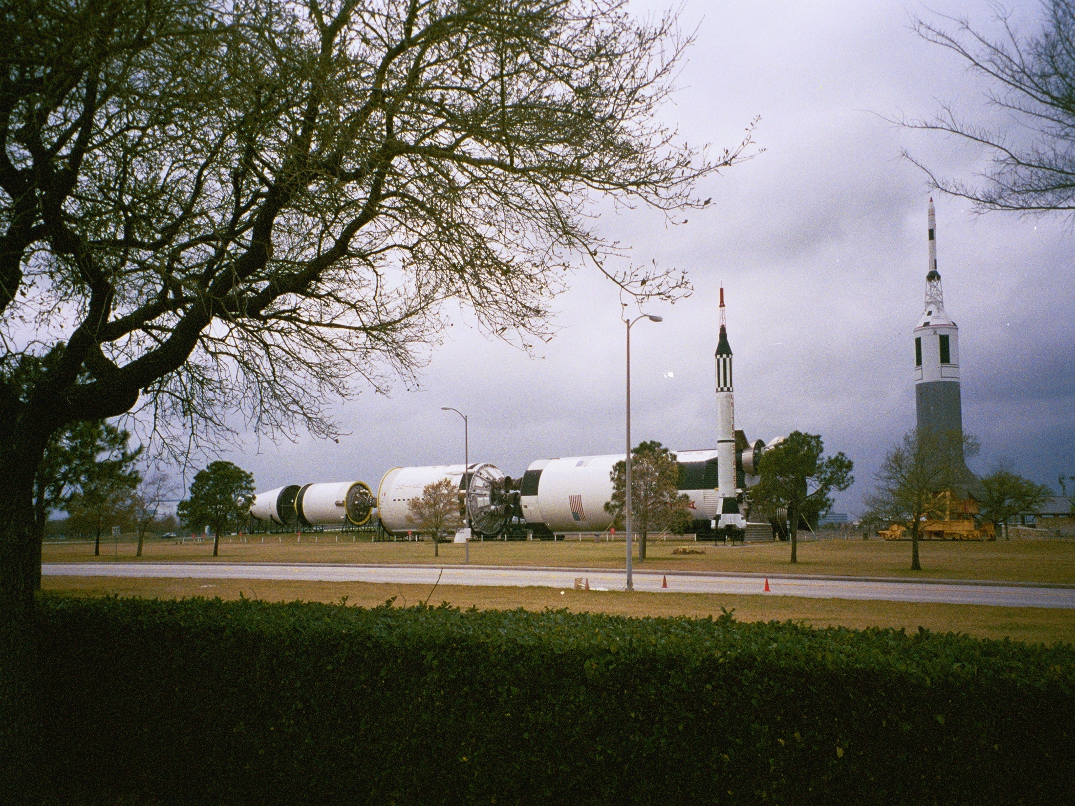
Difficult Design
Requirements
Carry astronauts to the moon

Slide 38
Going to Mars
Concurrent Engineering
Mission Design
Manned Mars Mission
Time to
Market
Process Design
Navigating, Launching, Eating, Exercising, Landing, Modeling
Propulsion, Biomass Production Equipment, Communications Equipment, Robots
System Design
Process Integration
Time, Resource and Activity Planning, Modeling
Operations Design
E4S4
Analogs, Modeling
Operations Implementation
Feedback / Lessons learned
Monitoring, Anticipating, Responding
Notes:
A more detailed look at the design process identifies multiple overlapping stages. The term “concurrent” is somewhat optimistic in practice. Given the vision of putting a man on Mars, there are distinct, but interdependent phases that must be addressed. The first phase is a function identification – launching, navigating, eating etc. each with their own purposes that are characterized by “quality”, “productivity”, “safety” etc. Next comes the realization of these functions through the design and construction of the appropriate hardware, software, “humanware” and “organizationware”. The process integration phase focuses on interactions, interdependencies and interfaces. Of course the advantages of concurrent engineering are particularly evident here as, for example, the human and hardware systems must be compatible. The penultimate phase of operations design really addresses the time element. In the Mars mission example it is critical that various supplies (food, water, oxygen, shelter etc.) would be on the planet before the human’s arrive. another good example is to be found in automobile production – it is one thing to design and build a car, but to produce 1000 cars a day presents altogether new operational challenges, not the least of which is just in time materials delivery. Finally there is operations implementation, which has its own local objectives and its contribution to the next mission.

Slide 39
Mars? > 360 Days, No Resupply
6
5
4
3
2
1
 | 1 | 2 | 3 | 4 | 5
2
4
5
Habitability
Physical
Cognitive
Training
Team
Integration
Risk
1
3
Outcome

Slide 40
Human Factors Duty
Procedures
Technology
Integration
Interfaces
Interactions Interferences
Interdependencies
People
Give the design engineer a number
Or at least a “loss function”
Context
E4S4
Loss
6U 2M
Design Deviation

Slide 41
Ergonomics in Complex Systems
Design and Intervention
Describe the System Lifecycle and Stakeholders
Establish a design team
Discuss the Complexity (People, Technology, Process and Context) factors and their Interactions
Perform a 6U2M analysis
Consider human and situational variability
Describe the desirable and undesirable Outcomes, Purposes and Constraints (E4S4)
Identify the opportunities for engineering (Technology and Context) or Administrative (Processes) changes
Carry out a BRISK analysis
Simulate
Choose nd apply alternative tools for complex system analysis
Design and Implement
Evaluate

Slide 42
Case Studies
Book Binding
Rehabilitation
Health Care Information Systems
Textiles
Oilwell Drilling Instrumentation
Transportation of LNG
Redesign of Service and Office Systems
Mass Transit Railway Design
Shift Work
Space operations
Automobile Design
Manufacturing System Design
Sport

Slide 43
Case Studies
Problems
Interventions
Facilitators
Technology
Outcomes
E4S4
Stakeholders
Context
6U2M

Slide 44
Case Study:
Job Redesign in the Bindery
Hong Kong university library
Hard covers on journals and books
10 people
Continuous work flow
  Batches within stages
The problems
  Access to library material, work in progress
  Equipment bottlenecks
  Physical environment
  Social context
  Productivity and job satisfaction

Slide 45
The Binding Process
Receiving and planning
  Full binding – new cover
  Original cover - laminated, flush (no rounding) and perfect binding (no sewing)
Sewing
  Removing old covers, sewing sets of pages
Forwarding
  Cutting cards and cloth, making covers
Lettering
  Highly skilled, top job
Casing in
  Final assembly
Checking and documentation

Slide 46
Materials Management
2 weeks after delivery journals sent to bindery
Documentation by accessions department
Stored on trolleys (60 volumes) – congestion
6 months work in progress
Access to wip and binding priority based on level of influence

Slide 47
The Bindery and the Binders
The bindery
  Congested, raw materials and journals / books
  Bottlenecks, equipment shortages (presses)
  Layout not functional
  ]Noise and radiant heat
The binders
  1 senior, 4 binders, 5 assistants all at least 5 years
  Blue collar job in white collar environment
  Job security, no turnover, low status
  Narrow job assignments based on seniority
Many complaints

Slide 48
The Objectives
Make readable material accessible
Reduce work in progress
Improve productivity
  Reduce backlog
Improve morale and job satisfaction of the book binders

Slide 49
The Changes
Redesign storage of periodicals waiting to be bound
Introduce cardex system for production control
Introduce small batch system with semi autonomous teams
Introduce job rotation and enlargement
Purchase new equipment, window blinds, task lighting, sound isolation
Rearrange the layout for functional flow
Review salary structure
Use some subcontracting for less skillful work
Protect the boss from the customers

Slide 50
The Results
(2 year follow up)
Better production control and accounting
Increased productivity
Removal of the backlog
Improved physical environment
Much happier customers
  Interface between the team and the customers
Improved job satisfaction
  Hawthorne effect?

Slide 51
Rehabilitation
Problems
Interventions
Treatment Plans
Motivators
Therapy Equipment
Work Simulations
Effectiveness
Efficiency
Safety
Satisfaction
Patient
Therapist
Managers
Employers
Hospital Bed
Individual TT
Gymnasium
Pre Work Group

Slide 52
Healthcare Information Systems
Problems
Interventions
Diagnosis Protocols
Treatment Protocols
Patients
General Practitioners
Specialists
Managers
Researchers
Medical Records
Transcription
Computers
The S Card
Recording, Transcription, Communication Errors
Overwhelming Demand
Cost
Small Medical Units

Slide 53
Bookbindery
Problems
Interventions
CARDX Reference Systems
Team Structure
Mostly manual with Hand Tools
Job Satisfaction
Productivity
Library Materials Access
Bookbinders
Managers
Library Users
Demand for Timely Access to Journal Material

Slide 54
Data processing offices
Problems
Team Structures
New Computers
Organization Design
Computer systems
Morale
Productivity
Public
Managers
Large open plan office

Slide 55
Mass Transit Design
Problems
Interventions
Entry Exit Rules
Seats
Grab Rails
Temperature
Efficiency
Safety
Public
Company
Very High Demand

Slide 56
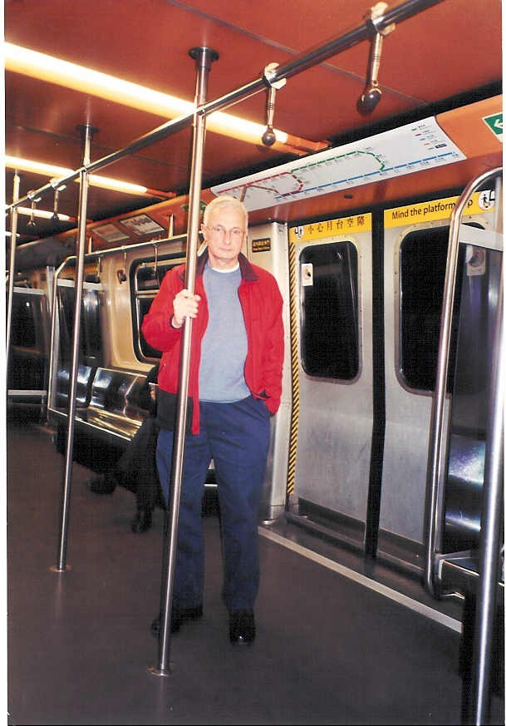
Hong Kong MRT

Slide 57
Police Shift Work
Problems
Interventions
12 hour 8 day rotation
Communications
Fatigue
Morale
Effectiveness
Policemen
Management
Public
Variable demand
Physical environment

Slide 58
Gas and Oil Transportation from Arctic Canada
Problems
Regulation
Larger crews
Long Shift Hours
Boredom
Ice Breaking Tankers
Fatigue
Safety
Tanker Crew
Alcohol
Icebergs

Slide 59
Icebergs
Collision
p= .0076359 = 8/1000 = 8 x 10⁻³
p= .0031949 = 3/1000 = 3 x 10⁻³
OR
First mate does not
respond
Captain does not
respond
p=.00315
p=.0045
p=.000045
AND
AND
Radar not
Working
First mate does not
recognize problem
Intercom
not Working
p=.315
p=.1
p=.1
AND
Radar not
Working
Captain
Degraded
Iceberg
Present
Captain
On Duty
p=.1
p=.1
p=.001
p=.9
p=.5
First mate
Untrained
First mate
on Duty
Iceberg
Present
p=.7
p=.5
p=.9
Notes:
This sample fault tree demonstrates the multiple contributions process safety of task assignment, hazardous conditions, trained, untrained and incapacitated crew members and the availability of technology (radar, intercom) to extend human capabilities to detect and evaluate hazards.

Slide 60
Automobile Design
Problems
Interventions
Early share a ride concepts
100+ design changes
Comfort convenience and Safety
Attractiveness
Old People
Very large market
Different Journey Types

Slide 61
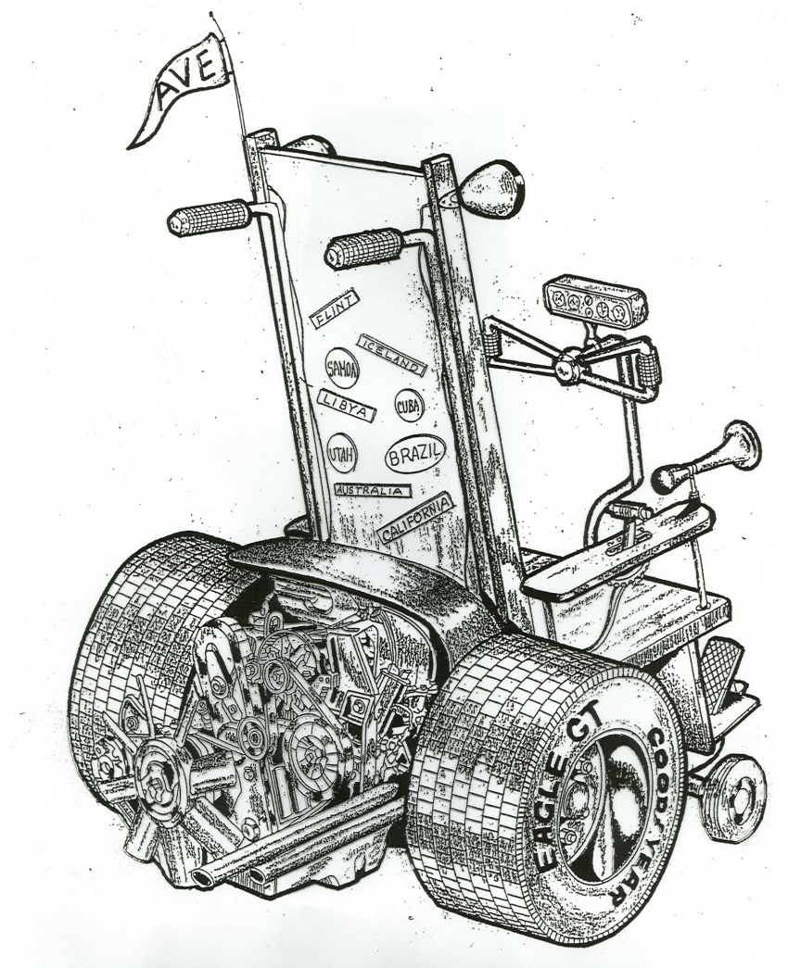
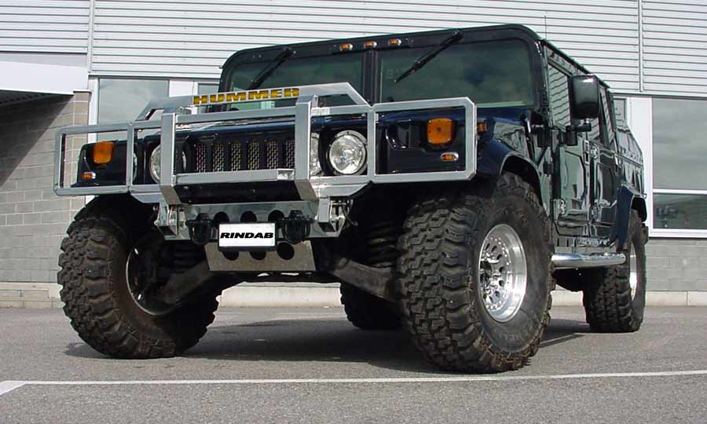

The GM Access Car
6U
2M
Design for an ageing population - Which will you drive when you are 80?
Notes:
Methods
Focus groups
Formal experimentation
Clinics
Traditional HF rules based analysis
Mock ups
Comparative vehicle analysis
Many universities
Many engineers

Slide 62
Heavy and Light Manufacturing
Problems
Interventions
Team Structures
DFM / DFA Mechanical Assists
Robots
Outcomes
E4S4
Operators
Company
Public
High demand

Slide 63
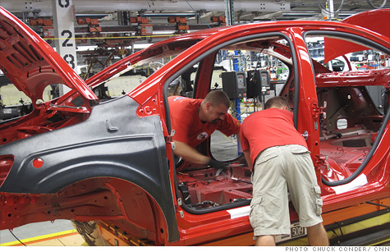
Car Assembly

Slide 64
Space Operations
Problems
Interventions
Facilitators
Technology
Outcomes
E4S4
Stakeholders
Context

Slide 65
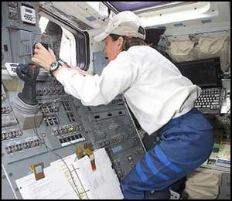
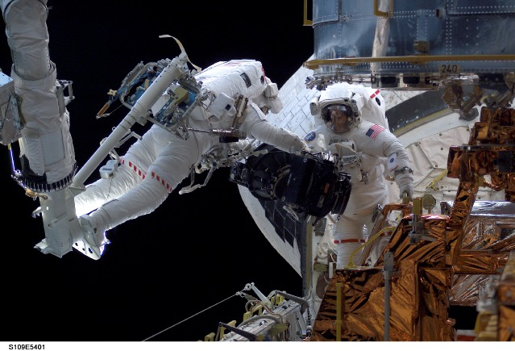
Three Dimensional Driving
(by an ergonomics specialist)

Slide 66
Aviation Safety
Problems
Interventions
Facilitators
Technology
Outcomes
E4S4
Stakeholders
Context

Slide 67
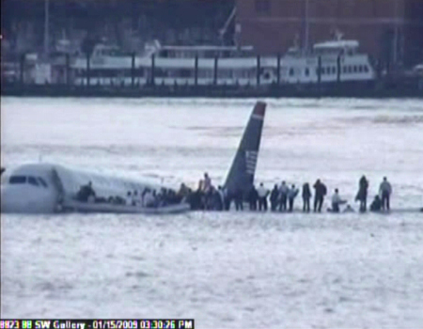
When the context is rough get a good pilot

Slide 68
Sport
Problems
Time Constraints
Buying Time
Replay
Decision Accuracy
Players and Referees
Selection and Training
Dynamic
High Stakes
Interventions

Slide 69
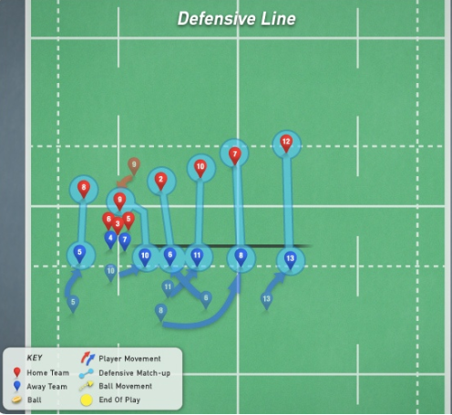
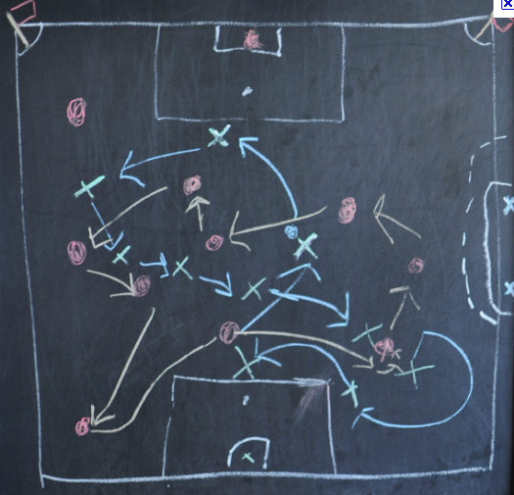
Rugby and Soccer Strategies
Stafford Beer – Cybernetics and Management – The best counter for a complex offense is an intelligent defense

Slide 70
Oilwell Drilling
Problems
Interventions
Shift Work
Dynamic Drilling Displays
Blow out
Company
Operators
Harsh weather

Slide 71
Additional Slides

Slide 72
Processes with
Humans in the Loop
Communicating
Seeing
Planning
Performing
Adjusting
Deciding
Controlling
Translating
Remembering
Reaching
Managing
Processes have Requirements - Adverbs

Slide 73
Oxygen
Systems for
Humans in the Loop
Life Support
Computers
Cameras
Tools
Procedures
Robots
Windows
Machines
Controls
Displays
Lighting
Organizations
Operators
Restraints
Systems need Specifications - Adjectives

Slide 74
Systems
Chaotic
Deterministic
Emergent
Complex
Complicated
Probabilistic
Simple
A continuum

Slide 75

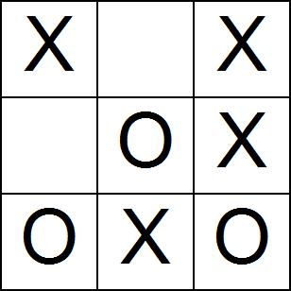
Simple Systems

Slide 76
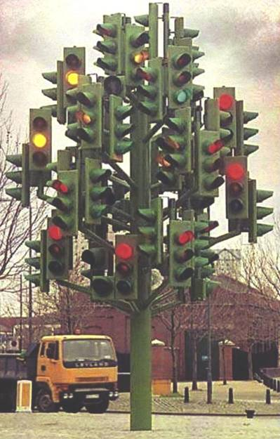

Complicated Systems

Slide 77

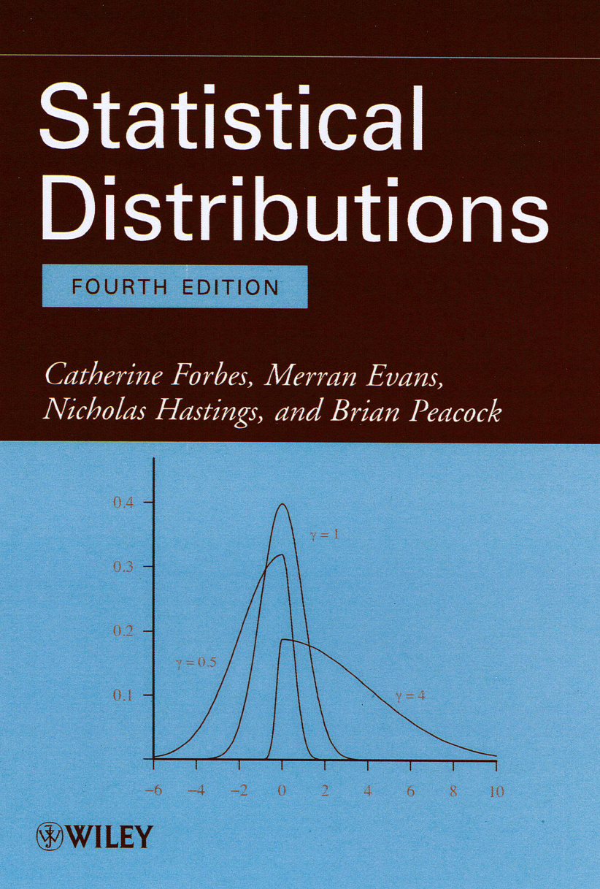

Probabilistic Systems

Slide 78
Complex Systems

Slide 79
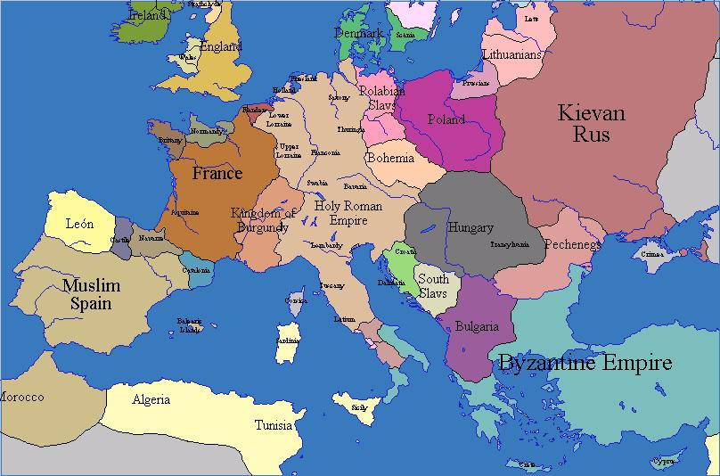
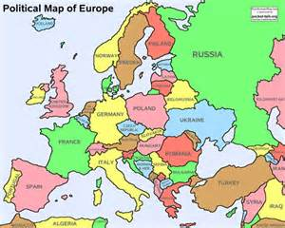
Emergent Systems

Slide 80

Chaotic Systems
“The scientific notion of chaos does not describe disorderliness or randomness at all - it describes unpredictability. A chaotic system is characterized by having exponential error growth (also often described with the phrase sensitive dependence on initial conditions AKA the butterfly effect)”
http://www.joakimlinde.se/java/chaoticPendulum/index.php

Slide 81
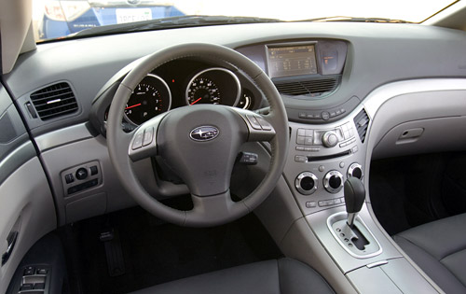
Familiar Human Machine Systems

Slide 82
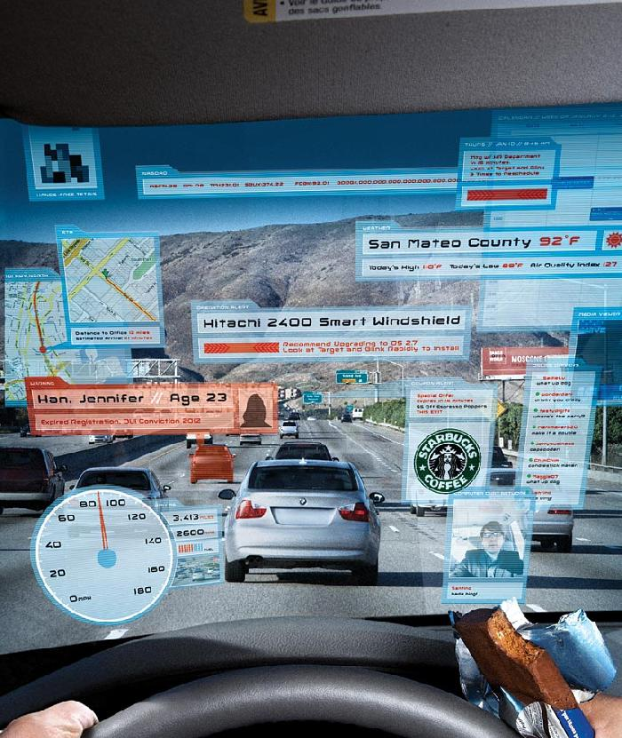
HUDs – THE HF Answer?

Slide 83
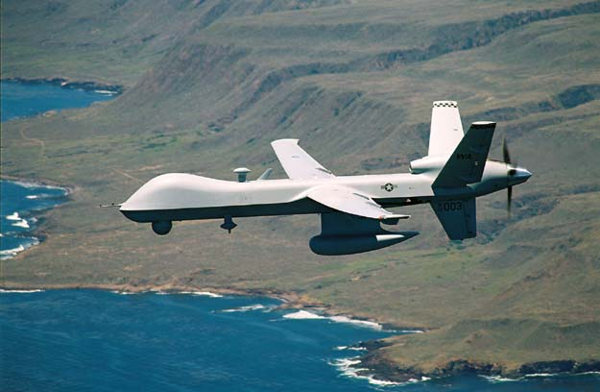
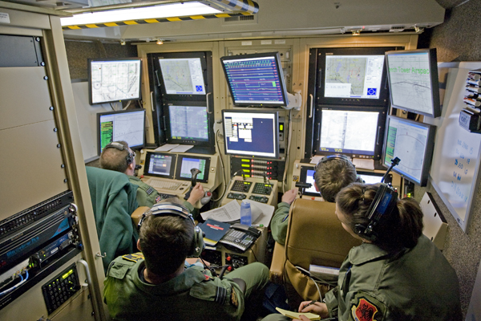
Complex Human Machine Systems

Slide 84

Agriculture

Slide 85
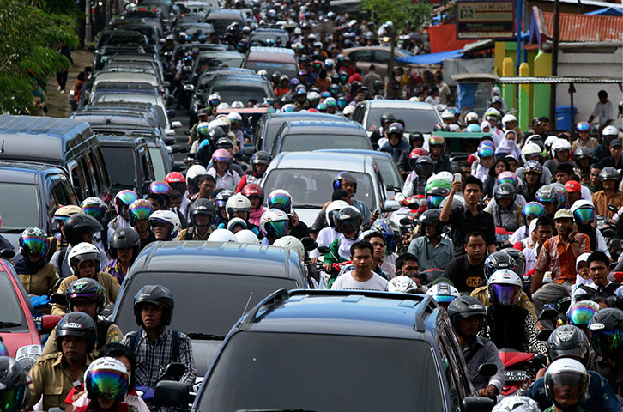
Context is Important!

Slide 86
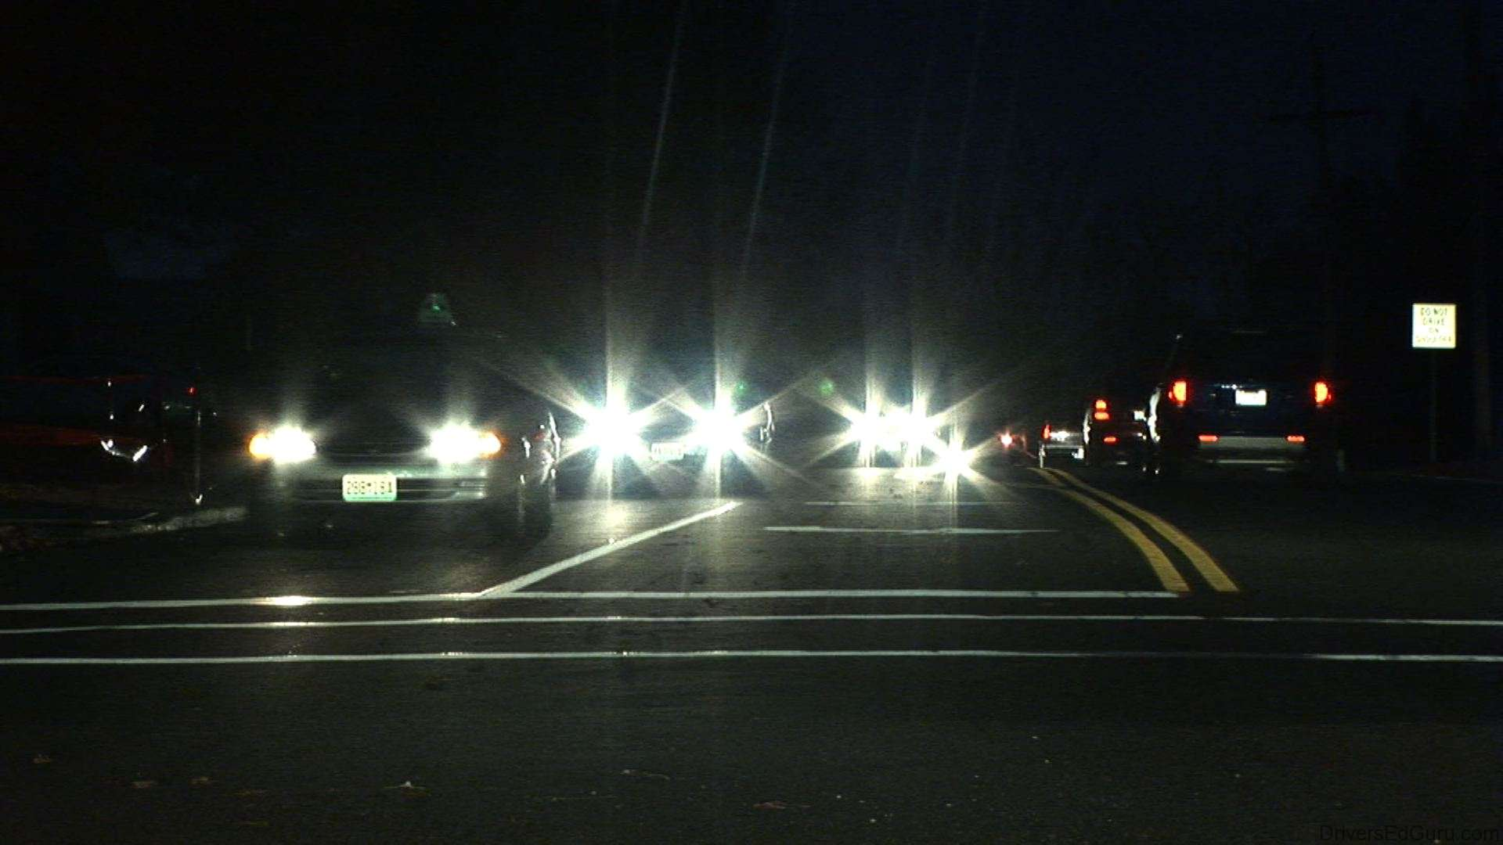
Driving – Do you need cataract surgery?

Slide 87
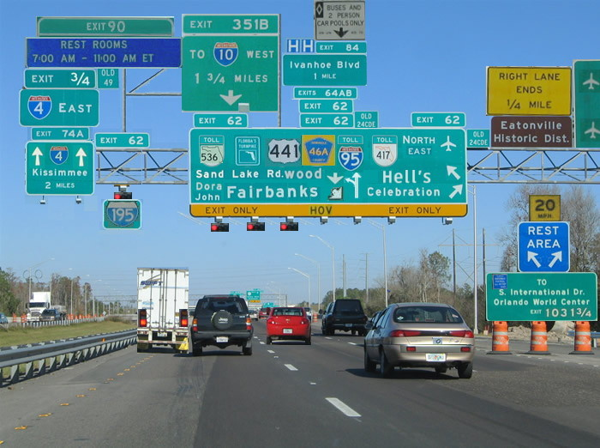

Slide 88
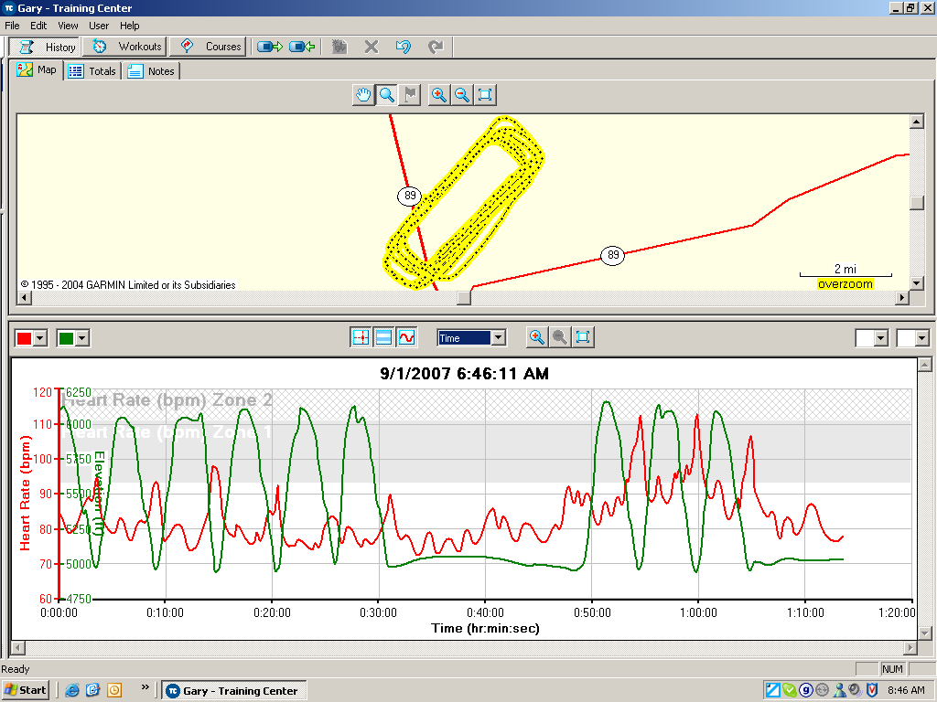
Workload and Stress
The last three landings were solo
Go around practice

Slide 89
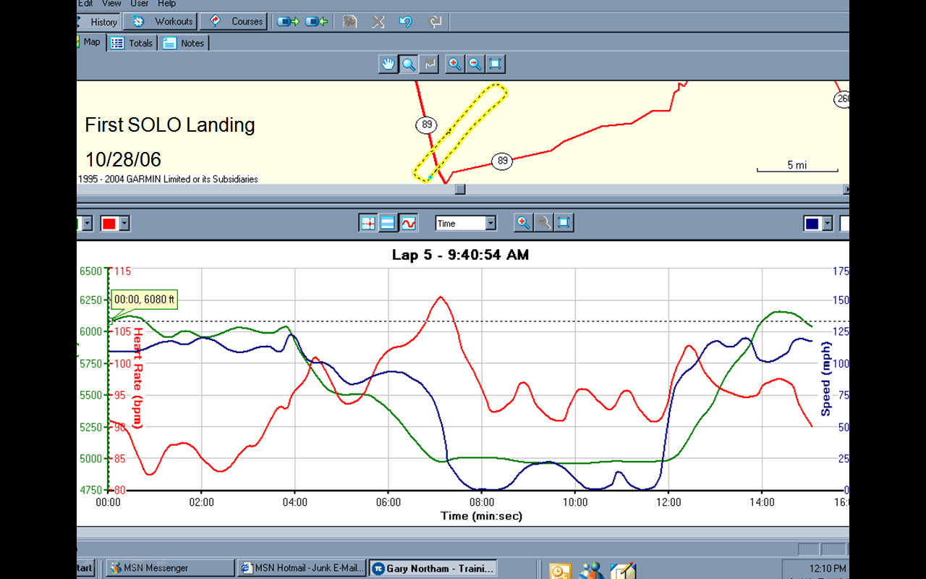

Slide 90
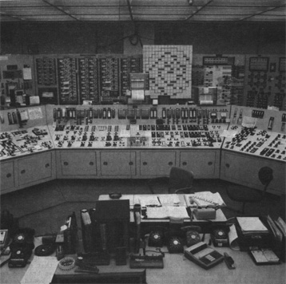
Where things go wrong TMI

Slide 91
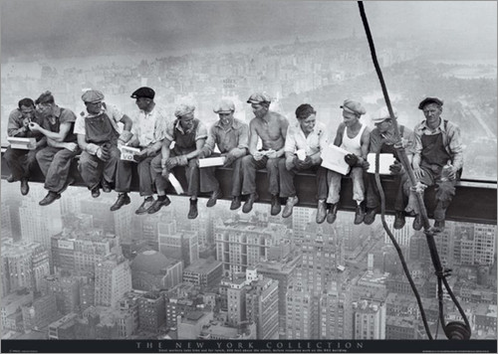
Great view!

Slide 92
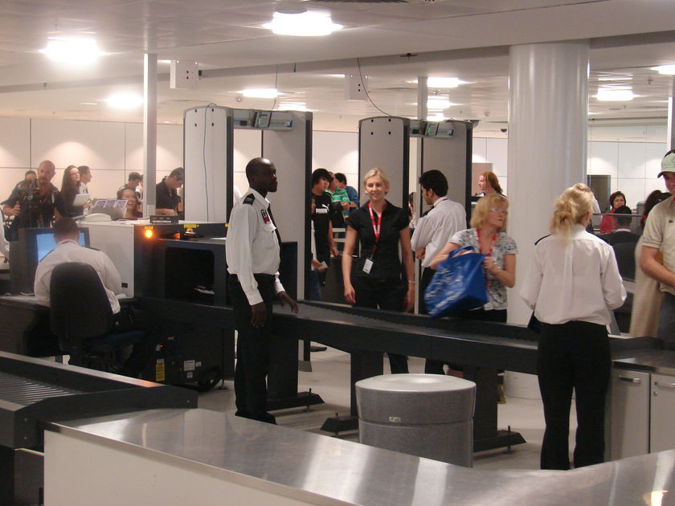
Vigilance, Attention and Performance?

Slide 93

Design for who?
6U
2M

Slide 94
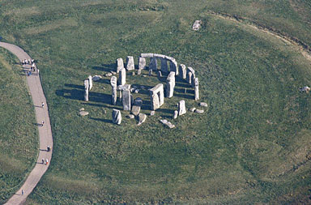
Design for Manufacturing?

Slide 95
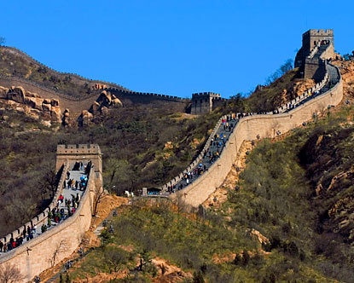
Design for Tourists?

Slide 96
How Do You Compare Tents, Motor homes, Workshops, Fitness Centers, Apartments, Houses, Offices, Restaurants, Ships, Submarines, Palaces and Space Vehicles?
How do you compare the separate aspects of an accident or design? In flight safety how do you compare aircraft design airport design, weather, pilot training, communications, etc?
Operational Context, and Frequency, Duration and Type of Activity make a big difference.
How do you compare Apples and Oranges, Chalk and Cheese?
In monetary terms, that’s how!
Or we develop INDICES

Slide 97
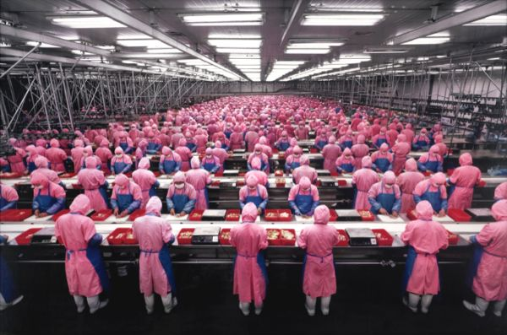
Disassembly

Slide 98
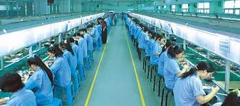
Manufacturing

