Slide 1
Setting Compliable and Enforceable Ergonomics Standards
Brian Peacock, Chui Yoon Ping, Liu Shuli, Samuel Low, Phang Chun Kai
SIM University
October 2013

Slide 2
Ergonomics Complexity
Social
Variability
Outcomes
Cognitive
Affective
Sensory
Physical
People
Energy
Physical
Environment
Technology
Interfaces
Interactions
Contexts
Information
Operational
Environment
Time
Frequency
Sequence
The outcomes of any situation may be affected by any one or more of these factors and their interfaces and interactions
Duration

Slide 3
Analysis and Intervention
You can only measure / change one dimension at a time
Social
Variability
Cognitive
Affective
Outcomes
Sensory
Physical
Energy
People
Physical
Environment
Technology
Interfaces
Interactions
Contexts
Information
Time
Operational
Environment
Frequency
Sequence
Duration

Slide 4
Multiple Purposes / Outcomes of Design
Standards must consider all these purposes
Effectiveness
  Meets functional requirements
  “Quality”
Efficiency
  Optimal use of resources
  Time Money, People, Materials
  “Productivity”
Ease of Use
  Intended users
  Comfort and Convenience
  Prevention of misuse
Elegance
  Esthetic / emotional appeal
  Affective Design
Safety and Health
  Prevention or mitigation of system failures
  For participants and third parties
Security
  Inadvertent or malicious misuse
Satisfaction
  Of ALL customers and stakeholders
Sustainability
  Reliability
    Under intended contexts over the life cycle
  Resilience
    Under unintended, unexpected and harsh conditions
E4S4
There WILL be tradeoffs

Slide 5
A Familiar Tradeoff
Safety
Efficiency
Safety Standards in isolation are likely to face non-compliance because of the competition with productivity

Slide 6
Safety and Health
Safety usually implies the prevention of acute injuries
Acute accidents are usually due to a cognitive failure (with a physical result)
  Errors in attention, perception, memory, comprehension, judgment, decisions etc
Health usually implies the prevention of cumulative illnesses
Cumulative / chronic illnesses are often due to excessive, repeated, or extended exposure to physical, mechanical, chemical or biological stressors
  E.g. Work related musculo skeletal disorders
    Cumulative trauma disorders
    Repetitive strain injury
Prevention through Compliance and Enforcement may require different approaches

Slide 7
Words and Meanings
Specifications
Verification
Rules
Enforcement
Standards
Compliance
Laws
Guidelines
Requirements
Validation

Slide 8
Compliance and Enforcement
Compliance – individuals and companies perceive, understand, behave and perform (design and operations) as intended
Enforcement – authorities (managers, government agencies) – observe, measure and impose fines or sanctions for non compliance

Slide 9
Life Cycle Compliance and Enforcement Opportunities
During Product Design
During Operations (Process)Design
During Use
  Accident and incident investigation
  Routine audits
Design or Intervention?
Proactive or Reactive?

Slide 10

Design for One or Design for Many?
Adjustability
Meeting the challenge of human variability and workplace, equipment and task adjustability

Slide 11
Some Existing Ergonomics Standards
ILO / IEA Ergonomics Checkpoints
ISO / TC 159 Ergonomics
ISO 13.108: Ergonomics
IEA Ergonomics Guidelines
MOM Ergonomics Guidelines

Slide 12
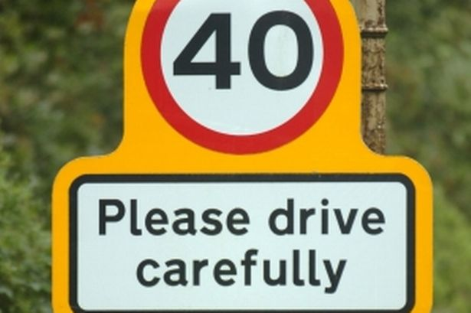
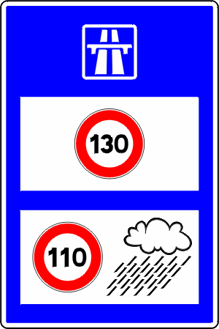

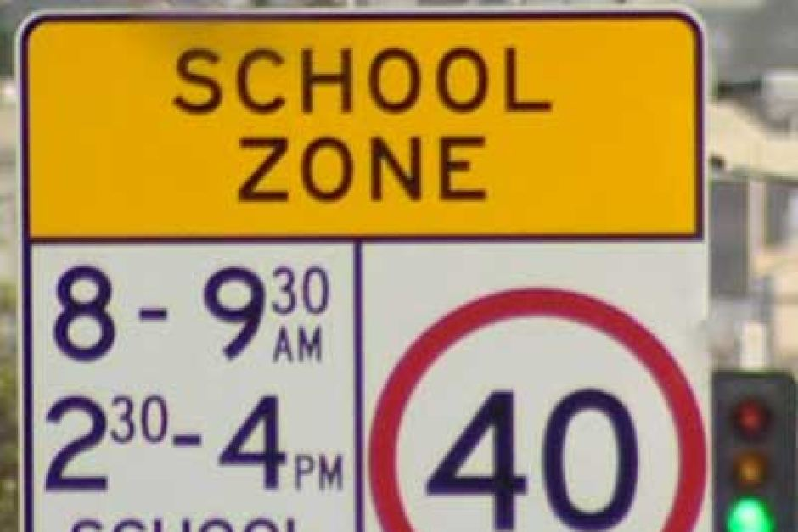
Speed Limits: Compliable and Enforceable?
What does “carefully” mean?
What is a truck?
How hard should it be raining?
Compliable and Enforceable

Slide 13
Compliable? Enforceable?
“ Provide good chairs of correct height (with both feet placed on the floor) and with a good backrest”

Slide 14
Singapore Airlines (extract)
Compliable and Enforceable?
Weight allowances for checked baggage are as follows:
First Class: 40 kg (88 lb)
Business Class: 30 kg (66 lb)
Economy Class: 20 kg (44 lb)
Occupational health and safety rules require that the checked baggage weight for passengers travelling to/from Australia, Brunei, Italy, New Zealand, South Africa, Sri Lanka, United Arab Emirates and the United Kingdom does not exceed 32 kg (70 lb) per piece. Any bags weighing more than 32 kg (70 lb) must be broken down such that each piece weighs less than 32 kg (70 lb).
First / Business Class
The sum of the greatest outside linear dimensions of each bag cannot exceed 158 cm (62 in).
The weight of each piece is limited to 23 kg (50 lb).
Economy Class
The sum of the greatest outside linear dimensions of the two pieces measured together does not exceed 273 cm (107 in), provided that the outside linear dimensions of each bag do not exceed 158 cm (62 in).
Practical?

Slide 15
Driver Limits (Singapore):
Compliable and Enforceable?
Procedural challenges
Specification:
“The prescribed legal limit is a blood alcohol content of 80mg per 100ml of blood, or breath alcohol content of 35μg per 100ml of breath.”
Guideline:
“However, even if drivers’ alcohol content in their blood or breath do not exceed the legal limit, they can still be charged for drink driving if they are found to be unable to control their vehicle properly.”
Expert Judgment?

Slide 16
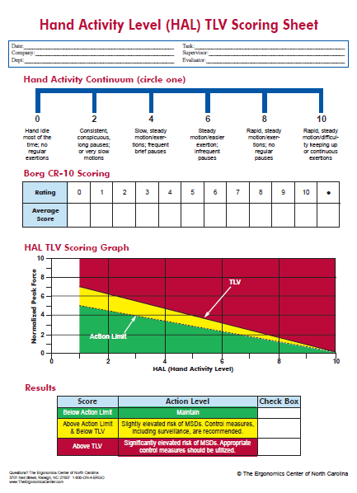
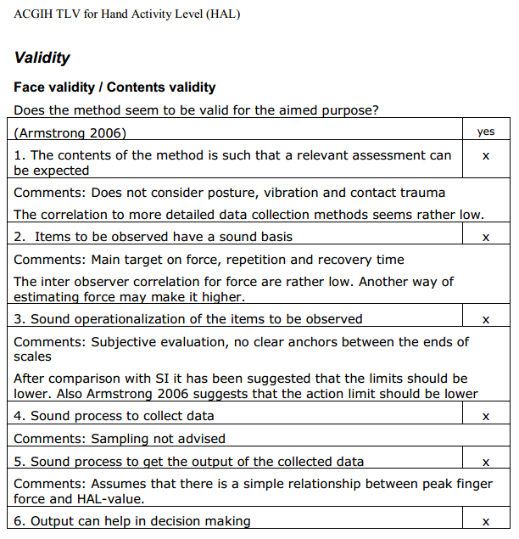
ACGIH Hand Activity Level Evaluation
Compliable and Enforceable

Slide 17
Depth of Ergonomics Analysis
In Depth Investigation
Analysis Tools
Checklists
Time consuming, requires expert knowledge
Require trained technicians
Quantitative
Qualitative
Should be simple and unequivocal

Slide 18
The Process of Ergonomics
Measurement and Analysis
Screening
Analysis
In depth Research
$
Decisions
Benefits, Costs,
Risks, Tradeoffs
Outcomes
Quality
Productivity
Health, Safety
Ease of Use
Security
Satisfaction
Sustainability
E4S4
Design
Tools, Equipment, Workplaces, Tasks, Procedures, Assignments.
The Job
Contexts
Spatial, Physical, Mechanical, Chemical, Biological, Geographical, Social, Political, Economic

Slide 19
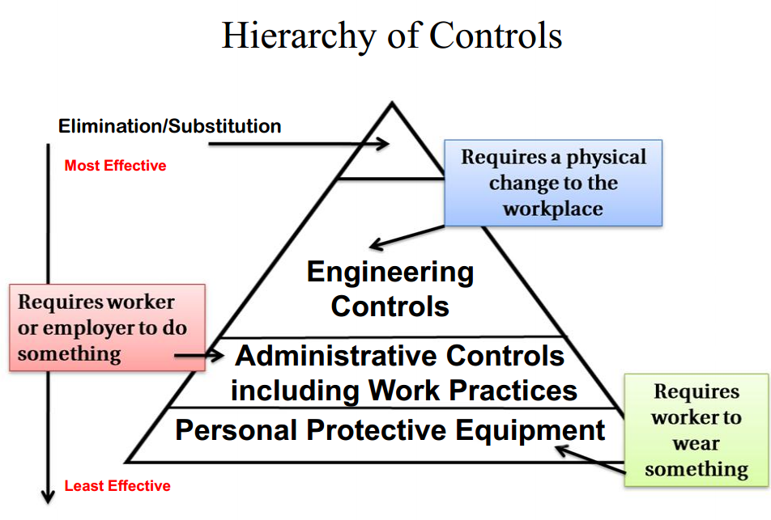
https://www.osha.gov/

Slide 20
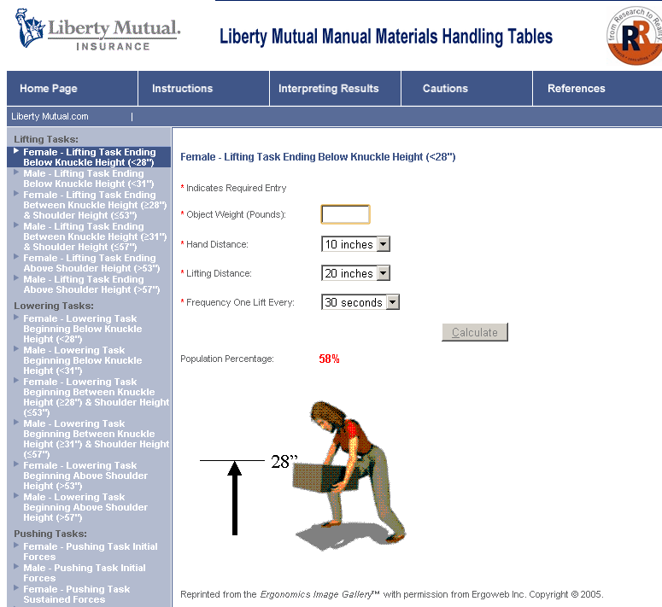
Psychophysical approach: Liberty Mutual Tables
50% (of which population)

Slide 21
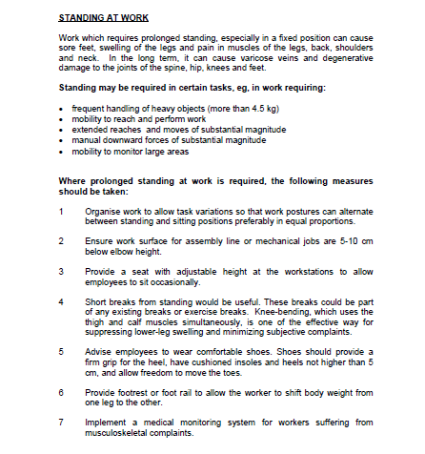
MOM Guideline for Standing Work
The guideline is certainly accurate and maybe useful.
Compliance is left to the judgment of the individual, the supervisor or the person responsible for designing the workplace.
Enforcement is likely to be elusive.

Slide 22
Discounting (the NIOSH Lift Equation is an Example)
Discounting models for task design
Brian Peacock, National Space Biomedical Research Institute / Baylor College of Medicine
Applied Ergonomics Conference, Orlando, March 2004
Abstract
Ergonomics deals with the prediction of human performance on the tasks they are given and the contexts in which those tasks are carried out. Think of grandad driving, in the fog, in a hurry, on a crowded freeway; or think of a real Buck Rogers getting out of his space vehicle, in a pressurised suit and working on the unfriendly surface of Mars; or think of a soldier, with a seventy pound load, tired and hungry, in the hot desert. The problem is that tasks, contexts and people vary, so performance is not always easily predictable. One ergonomics approach to this challenge is to use a discounting model to create the boundaries of expected performance, in which the hoped for 100% task performance is eroded by introducing encumbrances, contexts and individual differences. This approach has precedents - from the prediction of athletic performance to the design of manual materials handling tasks (the NIOSH Lifting Equation). This presentation describes a general approach to task design that can be applied to many operational situations.

Slide 23
The ErgoCop Problem
Time to
Market
Ergonomics
Evaluation
The ErgoCop
Performance
Requirements
Design
Specifications
Design
Performance
Review
(waivers)
Clear
Performance
Requirements
Precise
Design
Specifications
Design
Performance
Review
Ergonomics
Proactive
Support

Slide 24
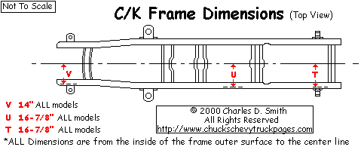
Apply Tools Early
“Concurrent Engineering”
Impact
Cost
Changes
Time to Market - Years
Research – Design - Production - Deployment

Slide 25
Precedent – The General Motors Wall Worksheet
The Wall Work Sheet was developed at the request of the product and manufacturing engineering communities to establish proactive design specifications rather than leave reactive evaluation to the judgment of unknowledgeable and perhaps biased observers
“Give the engineer a number”
These design tools may be applied proactively and reactively
The cut off numbers are assigned by a consensus of stakeholders
Variants of this original tool have been developed for special applications

Slide 28
Design Rules - Consensus
Policy
Science
Consensus:
  HF Experts
  Engineers
  Managers
  Customers
Design
Rule
Rule
Implementation
Experience
Data
History
Evaluation
  Verification
  Validation
  Sensitivity
Predictions
Technical
Memory

Slide 29
Mapping - Policy Decisions
Policy Statements
Red
Orange
Yellow
Green
Region of Interactions and Continuous Improvement
Unacceptable
Range
Ideal Range
Engineering Variable or Composite Index

Slide 30
The Proposed Workability Index
The principles outlined above have led to the design of a task analysis tool that can be applied or adapted for:
  special populations, such as elderly Singaporeans,
  special situations, such as different work activities and industries

Slide 31
Workability Index – Spatial Factors
Date |  |  |  |  |  |  |  | Job Description
Analyst
Survey Reference / Times
 |  |  |  |  |  |  |  | Orange and Red ratings may warrant in depth or specialist investigation regarding importance and feasibility of redesign / intervention | Where feasible all red ratings must be addressed / changed by engineering controls. Orange ratings should be addressed by engineering or administrative controls to reduce exposure
 | Place a small "x" in the appropriate rating cell | N/A | Green | Yellow | Orange | Red | Operational Factor Interactions H/M/L | Descriptions / Quantifications / Comments / Justifications | Notes / Guidelines / Criteria
Spatial Factors
 | Access |  |  |  |  |  |  |  | Clearances, obstructions, doors, barriers
 | Fit |  |  |  |  |  |  |  | Head room, Knee / Foot room, Width
 | Reach |  |  |  |  |  |  |  | Box, 50 cm reach curves
 | Postures |  |  |  |  |  |  |  | Sitting, Standing, Squatting, Middle, Outer, Inner ranges
 | Movements |  |  |  |  |  |  |  | Range, speed
 | Task surface orientation |  |  |  |  |  |  |  | Front, above, below, behind
 | Ramps |  |  |  |  |  |  |  | Slope, length
 | Stairs |  |  |  |  |  |  |  | Number, height
 | Counts |  |  |  |  |  |  |  | Refer to HF Specialist, manufacturing engineer for interventions

Slide 32
Manual Materials Handling and Manipulation
Manual Materials Handling
 | Lifting |  |  |  |  |  |  |  | Weights, forces, coupling, sizes
 | Carrying |  |  |  |  |  |  |  | Weights, forces, coupling, sizes
 | Holding |  |  |  |  |  |  |  | Weights, forces, coupling, sizes
 | Pulling |  |  |  |  |  |  |  | Weights, forces, coupling, sizes
 | Pushing |  |  |  |  |  |  |  | Weights, forces, coupling, sizes
 | Twisting, bending |  |  |  |  |  |  |  | Vertical and horizontal task locations
 | Interfaces, coupling |  |  |  |  |  |  |  | Good, sharp
 | Counts |  |  |  |  |  |  |  | Refer to NIOSH Lifting Equation and Snook Tables
Manipulation
 | Shoulder, Elbow |  |  |  |  |  |  |  | Mid, Outer, Inner ranges, forces
 | Hand, Wrist, Fingers |  |  |  |  |  |  |  | Mid, Outer, Inner ranges, forces, coupling, interfaces
 | Targets |  |  |  |  |  |  |  | Target sizes and tolerances
 | Precision |  |  |  |  |  |  |  | Fine, coarse
 | Counts |  |  |  |  |  |  |  | Use Hand activity level TLVs

Slide 33
Environmental and Information Factors
Environmental Factors
 | Heat, Cold |  |  |  |  |  |  |  | Air Temperature, Humidity, Radiant heat, Air movement
 | Glare |  |  |  |  |  |  |  | Location, intensity, contrast, window and local lighting
 | Dark |  |  |  |  |  |  |  | Interference with visual demands
 | Noise Intensity |  |  |  |  |  |  |  | Task, Ambient, Sound Level, Frequency, Variability
 | Vibration |  |  |  |  |  |  |  | Whole body, hand arm
 | Accelerations |  |  |  |  |  |  |  | Pounding, jerks
 | Slip, trip, fall |  |  |  |  |  |  |  | Work context hazards, visibility, barriers
 | Chemical |  |  |  |  |  |  |  | Refer to OH
 | Radiation |  |  |  |  |  |  |  | Refer to OH
 | Counts |  |  |  |  |  |  |  | Refer to OH, Safety or Engineering for intervention
Information Factors
 | Visual |  |  |  |  |  |  |  | Visual acuity, discrimination demands, importance
 | Acoustic |  |  |  |  |  |  |  | Hearing acuity, discrimination demands, importance
 | Attentional |  |  |  |  |  |  |  | Sustained and divided attention demands
 | Memory |  |  |  |  |  |  |  | Operational memory span, interferences
 | Cognitive |  |  |  |  |  |  |  | Calculations, planning, analyses
 | Decisions |  |  |  |  |  |  |  | Number of choices, ambiguity, risk
 | Communication |  |  |  |  |  |  |  | Frequency, variability, importance
 | Control |  |  |  |  |  |  |  | Precision, feedback, prediction
 | Situation awareness |  |  |  |  |  |  |  | Importance, distractions
 | Mental workload |  |  |  |  |  |  |  | Information and time demands, training, stress
 | Outcomes |  |  |  |  |  |  |  | Consequences of human error
 | Counts |  |  |  |  |  |  |  | Refer to HF specialist for intervention

Slide 34
Operational (Time) Factors
Operational factors such as shift length, job cycle length, repetitions and pacing interact with the other stressors; this leads to a need for a two dimensional analysis:
> 20
R
R
R
R
R
10-20
O
O
O
R
R
Frequency (Movements / Hour)
5-10
Y
Y
O
O
R
1-5
G
G
Y
O
R
<1
W
G
Y
O
R
<10
10-15
15-20
20-30
> 30
Weight
Two dimensional analysis

Slide 35
Organizational Factors
Organizational factors also interact with job design:
  Span of responsibility
  Team structures
  Participatory processes
  Technical support
  Training
  Acclimatization
  Special populations
Ordinal measurement is feasible

Slide 36
Compliable and Enforceable Standards
Laws and Requirements – General outcome based intentions for Health and Safety
Guidelines – General design statements for interpretation by stakeholders
Rules and Specifications – agreed upon standards by stakeholders
Weight allowances for checked baggage are as follows:
First Class: 40 kg (88 lb)
Business Class: 30 kg (66 lb)
Economy Class: 20 kg (44 lb)

Slide 37
Conclusions
“If you can’t / don’t measure it you can’t manage it!”
The stress level assignments are made by consensus
The tool requires minimal training
This is a proven approach to deal with ergonomics complexity.
Policy Statements
Red
Orange
Yellow
Green
Region of Interactions and Continuous Improvement
Unacceptable
Range
Ideal Range
Engineering Variable or Composite Index
Policy
Science
Consensus:
HF Experts
Engineers
Managers
Customers
Experience
Design
Rule
Rule
Implementation
Social
Data
Variability
Cognitive
Affective
Outcomes
History
Sensory
Physical
Predictions
Evaluation
Verification
Validation
Sensitivity
Energy
People
Physical
Environment
Technology
Interfaces
Interactions
Contexts
Technical
Memory
Information
Time
Operational
Environment
Frequency
Sequence
Duration

