Slide 1
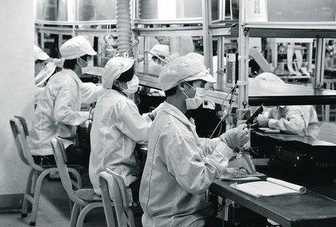
The Ergonomics of Production Lines
Measurement and Interventions from the
Factory to the Office
Brian Peacock
SIM University
National University of Singapore

Slide 2
Some Interesting Articles by Dr Chen
"A Fuzzy Sets Modeling Approach for Ergonomic Workload Stress Analysis", International Journal of Industrial Ergonomics (1994)
"A Computer Assisted System for Physical Ergonomics Analysis", Computers in Industrial Engineering (1991)
"An Observational Technique for Physical Work Stress Analysis", International Journal of Industrial Ergonomics, No.3 (1989)
"A Database Management System for Ergonomics Information Analysis,“ Trends in Ergonomics/Human Factors V, Elsevier (1988)
"Prototype Expert System for Physical Work Stress Analysis“ Trends in Ergonomics/Human Factors IV (1987)
"EVA Suit Glove Design." Space Tech '85 Conference, Anaheim, California (1985)
"An Interactive Biomechanical Lifting Model,“ Mid Central Human Factors/Ergonomics Conference, West Lafayette, Indiana (1985)

Slide 3
Most of the World
Ergonomics = Human Factors
HFE
USA

Slide 4
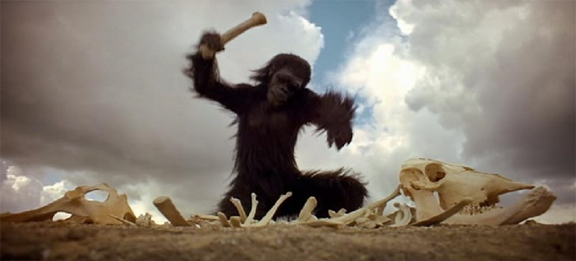
The History of Ergonomics
Tools

Slide 5
Human Factors Engineering / Ergonomics
Analysis
and
Design
with People in Mind

Slide 6
Human Factors in Technology Integration Perspective
Complexity
People
Technology
Interactions
Rules and Regulations
Context
Adapted from Edwards’ SHEL Model

Slide 7
The Design Cycle
E4S4
Guidelines
and
Constraints
Decisions
Policy
Money
Analysis
Requirements
Outcomes
Analysis
Analysis
Tools
Analyses
The Process,
Job, Task,
Transaction
or Simulation
Specifications
Design
Equipment
Context
Humans
Operations
6U
2M
Uncontrollable
Conditions / Context
Prediction
Rules and Regulations
S
Technology
H
Integration
Interfaces
Interactions
Intra actions Interferences
Interdependencies
People
L
Context
(Environment)
E

Slide 8
Many Responsibilities
Affect
Satisfaction
Information
Time
Industrial Engineer
Product Engineer
B
P
E
Force
Space
Packaging Engineer
Manufacturing Engineer

Slide 9
Big Picture Ergonomics
Purposes
B
P
E
E4S4
Effectiveness Quality
Efficiency Productivity
Ease of Use Comfort and Convenience
Emotional Appeal Pleasant job and context
Safety/Health Acute Injuries and Chronic Illnesses
Security Malicious Third Parties
Satisfaction Of ALL concerned
Sustainability Reliability AND Resilience
If you can’t / don’t measure it you can’t manage it
There will be tradeoffs

Slide 10
The Purposes of Ergonomics
Contributing to the Multiple Purposes of Design
Helping with the tradeoffs
E4S4
Safety
Productivity

Slide 11
The 6Us and 2Ms of Usability
Utility
  Is the system useful?
Usage and Misusage
  How and in what context will the system be used?
  What possible extreme contexts may be predicted
Usability
  Is the system easy to use or misuse?
Utilization
  How often and by how many people is the system used?
Users and Misusers
  Who are the users and possible misusers?
User Error
  What kinds of error can be made, when and how will they be made, how frequently and what are the possible consequences?
6U
2M

Slide 12
When Ergonomics Works
RASDEI
Research
Analysis
Design
Evaluation
Outcome Investigation
Simulation
Success
Ergonomics Projects need some or all these Skills
Failure

Slide 13
Product Life Cycle
Feedforward (Anticipation)
Many Requirements
Requirements
Concept
Development
Concept
Selection
Many Customers
(including the shareholders)
Specifications
Tooling
Feedback, Technical Memory
Production
Marketing
Use and
Misuse
Design Team
Maintenance
Disposal

Slide 14
The Process of Ergonomics
Measurement and Analysis
Screening
In depth Research
$
Decisions
Benefits, Costs,
Risks, Tradeoffs
Outcomes
Quality
Productivity
Health, Safety
Ease of Use
Security
Satisfaction
Sustainability
Design
Tools, Equipment, Workplaces, Tasks, Procedures, Assignments.
The Job
Contexts
Spatial, Physical, Mechanical, Chemical, Biological, Geographical, Social, Political, Economic

Slide 15
Human Factors Applications Need
Knowledge of human characteristics, capabilities and limitations
Domain Knowledge
Measurement and analysis tools

Slide 16
The Ergo Cop Problem
Calling the designer’s baby ugly!
Ergonomics
Evaluation
The Ergocop
Performance
Requirements
Design
Specifications
Design
Performance
Review
(waivers by management)
Clear
Performance
Requirements
Precise
Design
Specifications
Design
Performance
Review
Time to
Market
Ergonomics
Support

Slide 17
The Broad Scope of Ergonomics
Physical
Sensory
Cognitive
Social
Affective
Environmental
Temporal

Slide 18
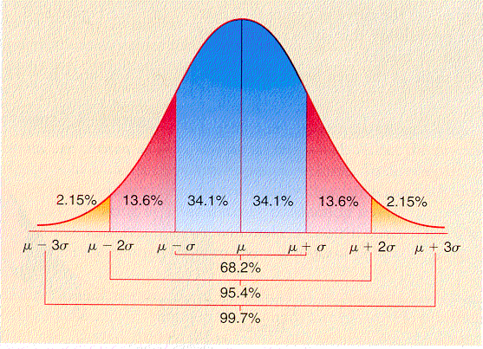
Variability
Temporal
Cognitive
Affective
Sensory
Social
Physical
Context
Ergonomics Purpose and Achilles' Heel

Slide 19
Physical Ergonomics
Shape
Size
Strength
Skill
Stamina
Speed

Slide 20

People vary in Shape and Size

Slide 21
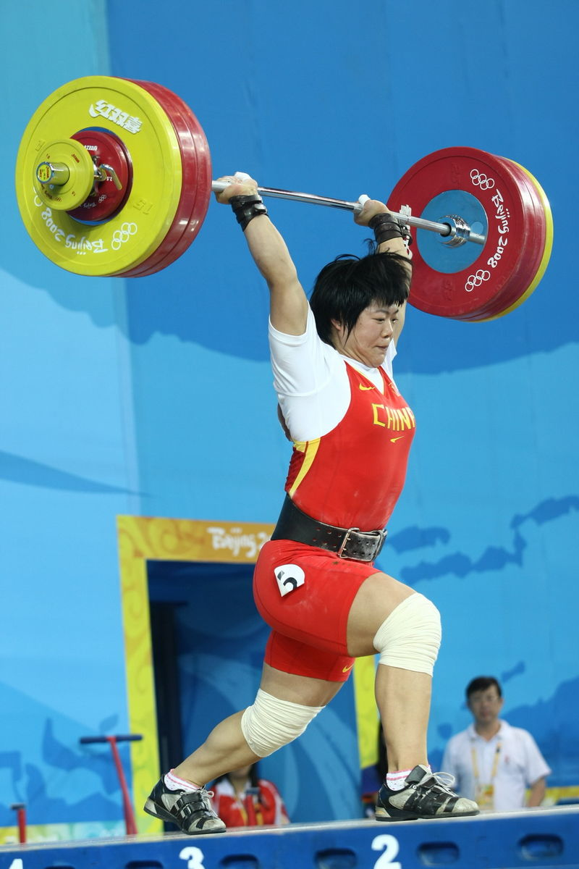
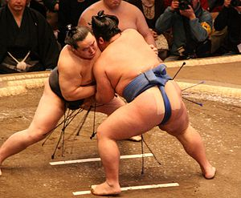
People vary in their Strength

Slide 22
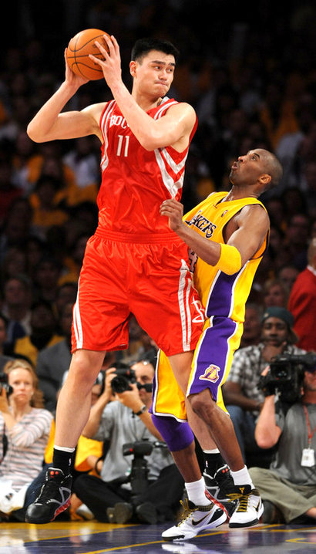

People Vary in their Skills

Slide 23
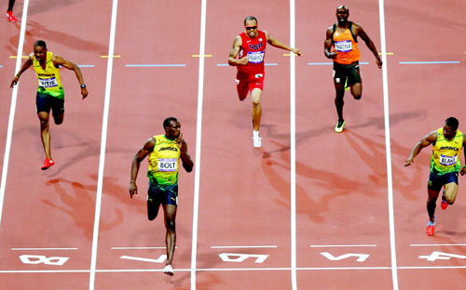
People vary in their Speed

Slide 24
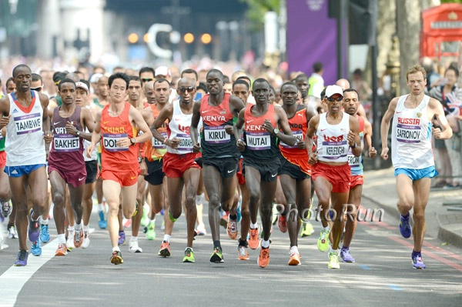
People vary in their Stamina

Slide 25
Sensory Factors
Taste
Hearing
Proprioception
Touch
Vision
Smell

Slide 26
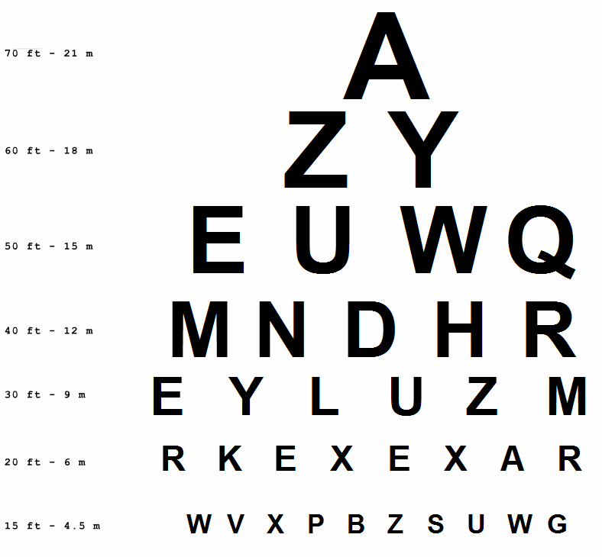
What happens when you grow old?

Slide 27
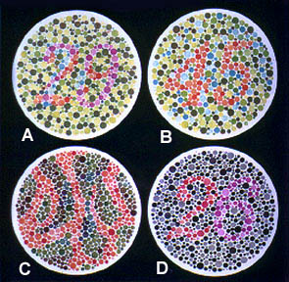
Are you Colorblind?
1. Normal Color Vision: A: 29, B: 45, C: --, D: 26
2. Red-Green Color-Blind: A: 70, B: --, C: 5, D: --
3. Red Color-blind: A: 70, B: --, C: 5, D: 6
4. Green Color-Blind: A: 70, B: --, C: 5, D: 2

Slide 28
Cognition is complex
Goals
Understanding
Diagnosing
Analyzing
Judging
Cognition
Learning
Synthesizing
Deciding
Problem Solving
Planning
Investigating
Evaluating
Interpolating and Extrapolating
Predicting

Slide 29

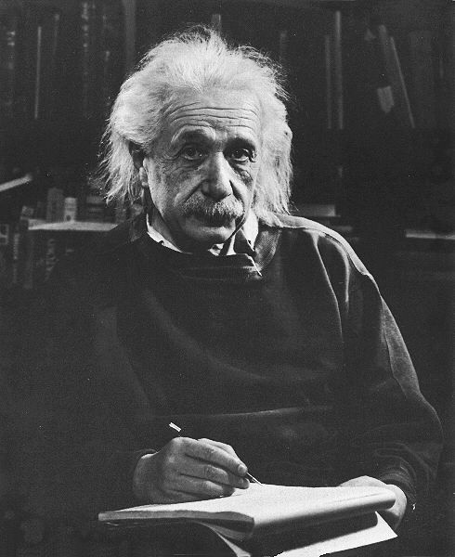
People vary in their Cognitive abilities

Slide 30
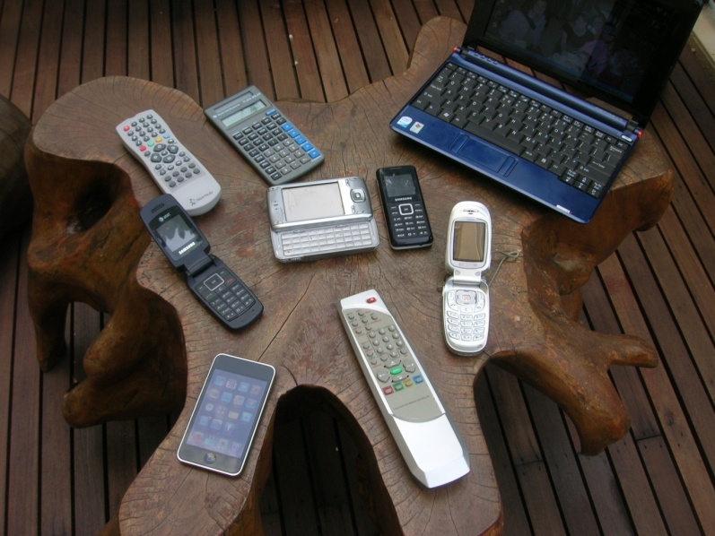
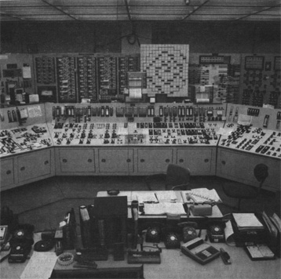
Cognition is Complex

Slide 31
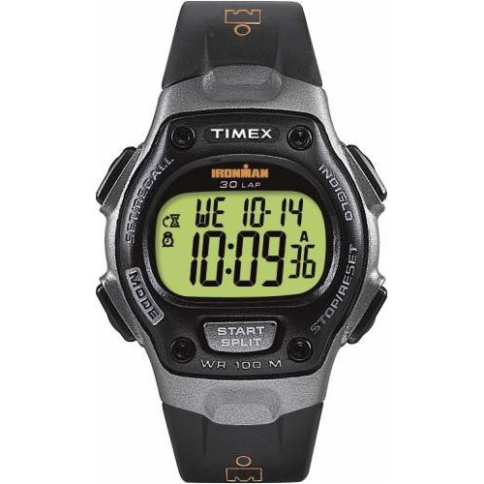

Affective Factors
Esthetics
Elegance
Emotion
Motivation
Excitement
Mood
Attitude

Slide 32
Environmental Factors
Gravitational
Space
Chemical and Biological
Pressure
Under Water
Altitude
Thermal
Heat
Humidity
Cold
Air movement
Acoustic
Communication
Hearing loss
Light and Dark
Vision
Contrast
Color
Vibration
Hand / Arm
Whole body

Slide 33
Environmental Design - Lighting
Provide natural lighting
Provide sufficient lighting
Avoid glare
Provide special purpose lighting to emphasize task features

Slide 34
Environmental Design - Noise
Reduce damaging / distracting / interfering noise
  At source
  By barriers
  By PPE
  By exposure reduction (rotation)
Enable task information, communications and alarms distinct from ambient noise
Allow / provide music if it doesn’t interfere with task or colleagues

Slide 35
Environmental Design - Heat
Maintain air temperature between 22⁰ C – 26⁰ C
  For sedentary work (cooler for physical work)
  Allow some fluctuation
Maintain relative humidity necessary for process
  generally between 30% – 50%
Enable air movement
  Avoid drafts
Address / control radiant heat / cold sources

Slide 36
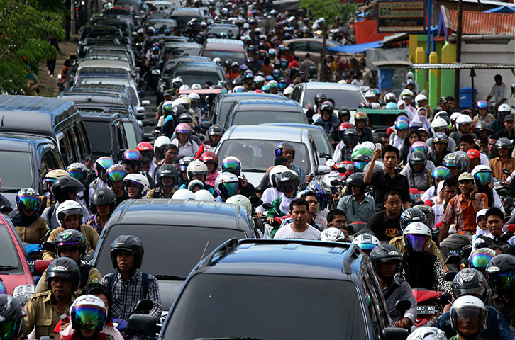
Social Context
Organizational
Design
Infrastructure
Roles
Jobs
Supervision
Laws
Rules and Regulations
Traditions
Language
and
Jargon
Communication`
Groups
and
Teams
Suppliers
Customers
Cooperation
Managers
Politics
Competition
Hierarchies
Businesses and Companies
Religions
Employees
Economics

Slide 37
Time Factors
Age
Velocity
Circadian Rhythms
History
Task Pacing
Acceleration
Decision Time
Psychological Refractoriness
Mental Workload
Job Cycle Time
Shift Length
Reaction Time
Duty Cycle
Fatigue
Movement Time
Timing
Remembering
Vigilance

Slide 38
Workplace Ergonomics
Space - layout, furniture, postures
Force - materials handling, strength, postures
Time – productivity, fatigue, shiftwork
Information – training, quality
Affect – motivation, behaviors
Context – physical and organizational

Slide 39

Workplaces

Slide 40
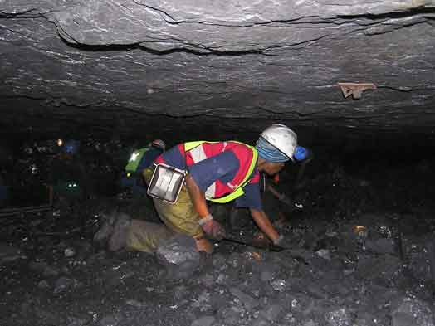
Postures and Environments

Slide 41

Physical Workloads

Slide 42
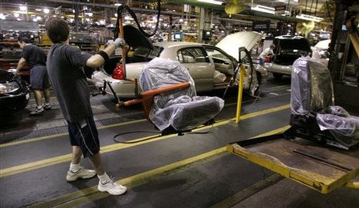
Standard Times (measured in seconds)

Slide 43
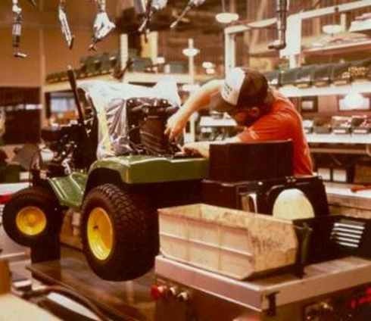
Awkward Postures

Slide 44
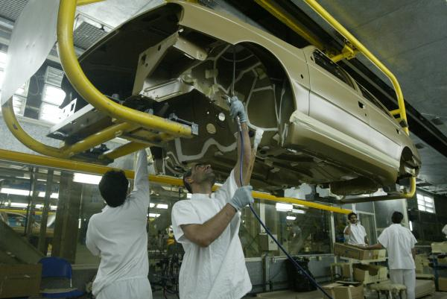
Overhead Work

Slide 45
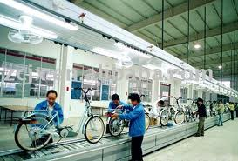
Bicycle Assembly

Slide 46
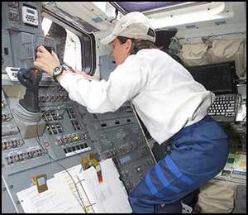
Workplaces and Postures

Slide 47
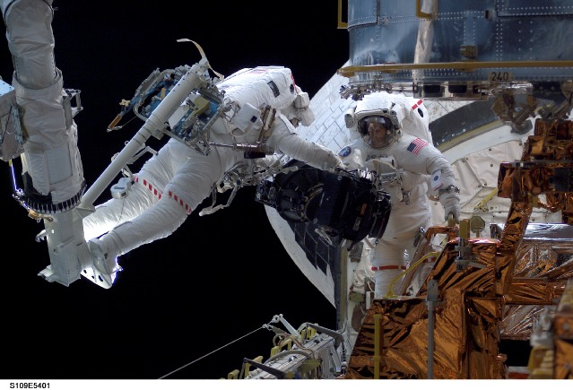
Assembly Work

Slide 48
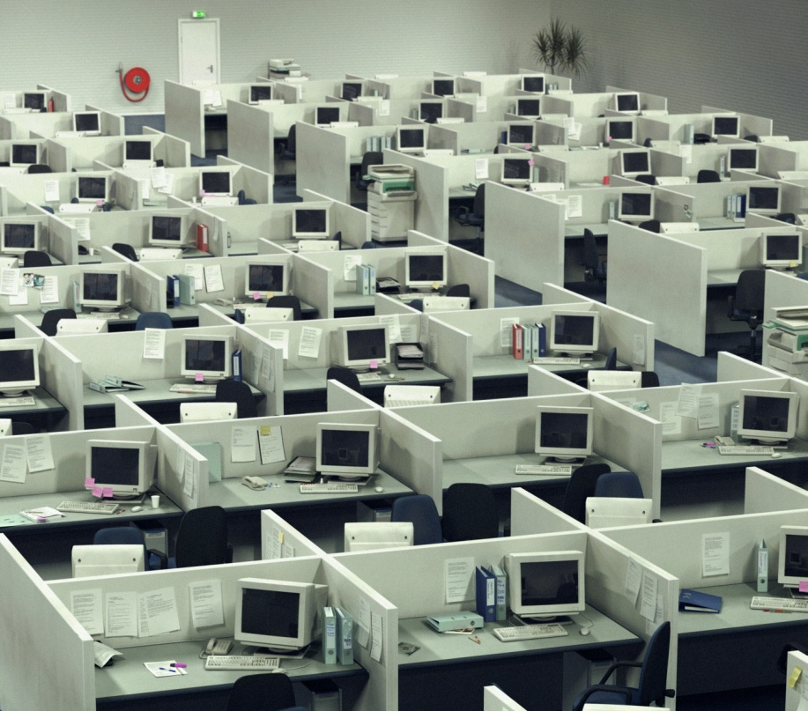
The Office

Slide 49
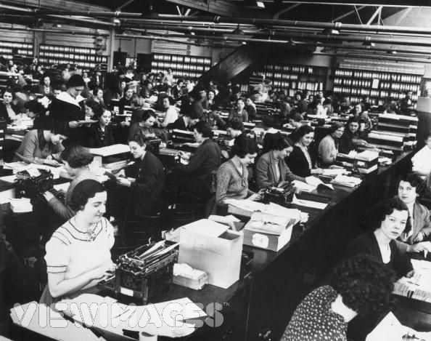
The Typing Pool

Slide 50
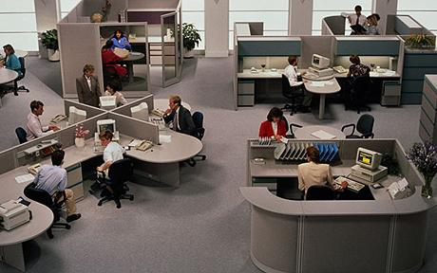
The Office

Slide 51
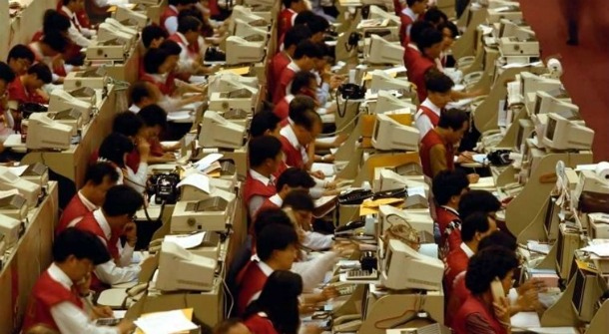
Call Centers

Slide 52
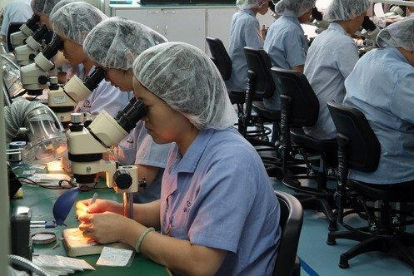
Assembly Operations

Slide 53

Mobile

Slide 54
The History of Assembly Lines

Slide 55
I love Lucy, Chocolate wrapping line.
https://www.youtube.com/watch?v=8NPzLBSBzPI
http://www.google.com/url?sa=t&rct=j&q=lucy%20chocolate%20factory&source=web&cd=2&cad=rja&ved=0CCkQtwIwAQ&url=http%3A%2F%2Fwww.youtube.com%2Fwatch%3Fv%3DFGfplQ1FUFs&ei=_eJWULi3IYHNrQf28oCYBw&usg=AFQjCNHkkfIbZobjKqrGwXuspX-A1XPfVQ
http://lloyddeleon.multiply.com/video/item/4/I_Love_Lucy_--_at_chocolate_factory

Slide 56
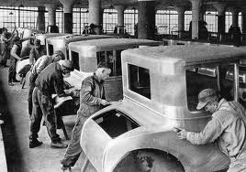
Henry Ford – Work Simplification

Slide 57
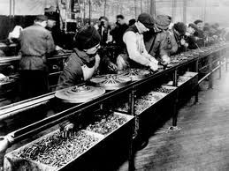
Bring the Work to the Worker

Slide 58
Frederick Winslow Taylor - “Taylorism”
Scientific Management
Managers Manage, Workers Work
Prescriptive work methods

Slide 59
Lillian and Frank Gilbreth
Time, Motion and Fatigue Studies
Micro motion – “Therbligs”

Slide 60
Therbligs
Reach
Grasp
Move
Hold
Release
Use
Pre-position
Position
Assemble
Disassemble
Search
Select
Plan
Inspect
Unavoidable Delay
Avoidable delay
Rest

Slide 61
Hawthorne Studies
Employees motivated by the attention given to them rather than impersonal change in working conditions (lighting)

Slide 62
Tavistock Institute
Coal Mining
Human Centered Design

Slide 63

MTM
Methods-Time Measurement is a procedure for improving methods and establishing time standards by recognizing, classifying, and describing the motions used or required to perform a given operation and assigning pre-determined time standards to these motions.
The foundation of modern Work Measurement and Industrial Engineering

Slide 64
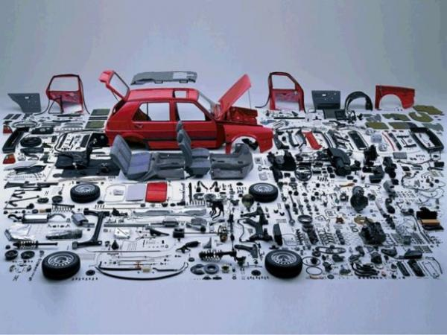
Lots of Components
Lots of savings by removing none value added activities

Slide 65
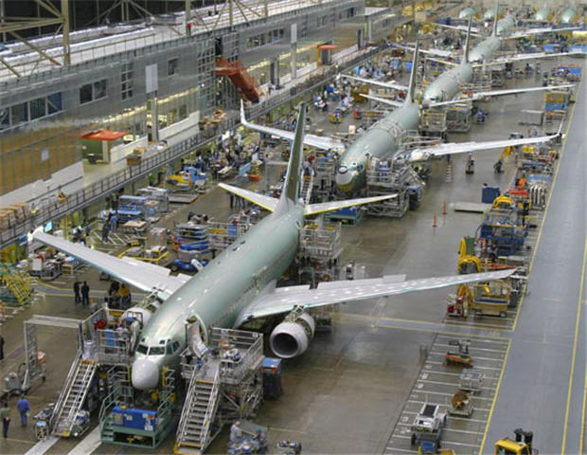
Boeing Assembly Line

Slide 66
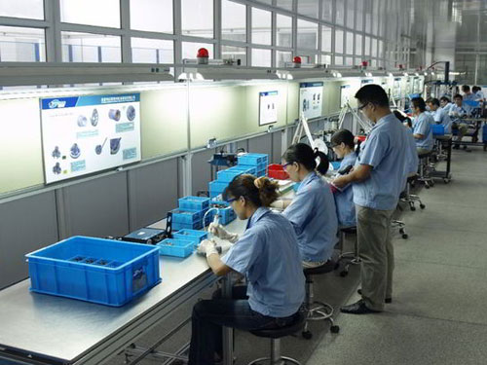
Electronics

Slide 67
Electronics

Slide 68
Production lines brought enormous improvement in Productivity by the removal of Non Value added work and the improvement of Process consistency / Quality
But at what cost?

Slide 69
Work Measurement
Puropses
  Productivity
  Quality
Micro motion analysis
Remove non value added activities
  Searches, decisions, movements, (checks)
Work simplification
  Reduce the job cycle
    Shortens learning time
    Improves Productivity and Quality?

Slide 70
Industrial Engineering
The Job Cycle
Attach
Transport
Inspect
Grasp
Return
Time

Slide 71
The Job Cycle
(varies between a few seconds, a few minutes and even a few hours)
Force
*
Posture
Position
Attach
Transport
Return / Rest
Grasp
Reach
Check
Cycle Time

Slide 72
The Industrial Engineering Solution
Cut off the peaks of Force and Posture,
Reduce Non value Added work and
Fill up the Job Cycle
Force
*
Posture
Attach
Position
Transport
Return / Rest
Grasp
Reach
Check
Cycle Time

Slide 73
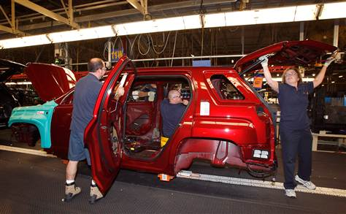
Postures

Slide 74
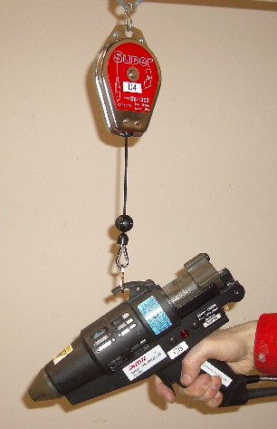
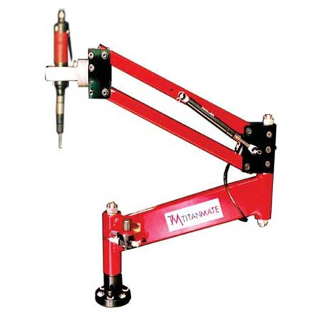
Tool balancers

Slide 75
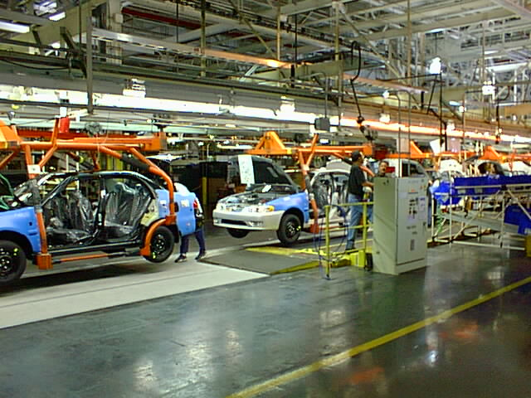
Doors Off

Slide 76
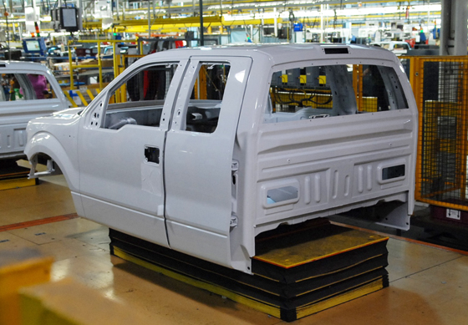
Skillets – Work height adjustment

Slide 77
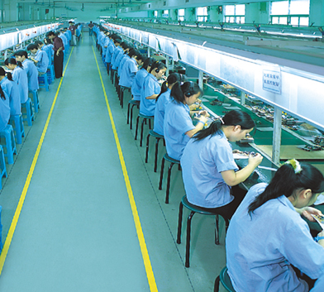
Assembly Lines

Slide 78
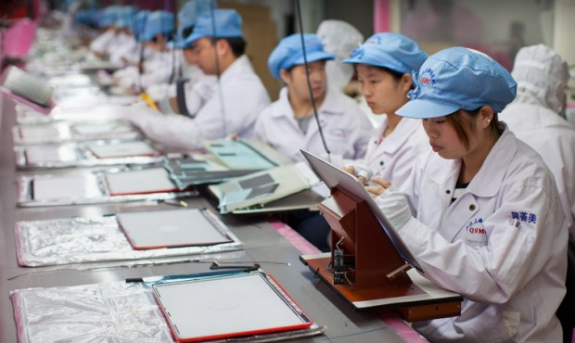
Tilt the Task

Slide 79
The Results
Improved Productivity But increased Static Work
Force
*
Posture
Line Balance
Grasp
Transport
Attach
Grasp
Transport
Attach
Grasp
Transport
Attach
Cycle Time

Slide 80
The $64,000 Question?
Does (pseudo) Ergonomics cause Illness and Injury?
“Ergonomic / Iatrogenic Disease”
Long durations, low forces, near neutral postures, high repetitions

Slide 81
The CTD Epidemic
Repetitive motion strain
Occupational overuse syndrome
Meatpacking
Nursing homes
Automobile manufacturing
Parcel handling
Electronics manufacturing
Textiles
Food processing
Textiles
Checkout counters
etc
Years of Contentious / Combative dialog
among Government (NIOSH / OSHA)
Business (NAM, COT), and Unions (UAW)
providing many opportunities for
Ergonomics Researchers, Professionals, Practitioners and Product developers

Slide 82
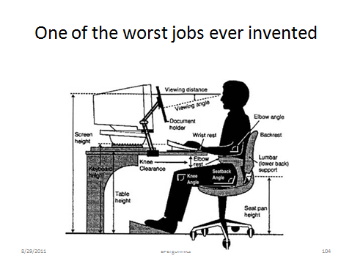
Sedentary Work leads to metabolic disorders – obestity, circulatory disease, diabetes
X
Ergonomic

Slide 83
Sedentary, Static and Repetitive Work lead to:
Repetitive Strain Injury
  Musculo skeletal disorders
Metabolic disorders
  Obesity, circulatory disorders, diabetes
Cognitive dullness
  Lack of flexibility
Job dissatisfaction
  Absenteeism
  Industrial unrest
Operational deterioration
  Productivity, quality

Slide 84
Intervention Opportunities
Engineering Interventions
  Robotics
  Mechanical assists to reduce
    Force
    Extreme Postures
Administrative Interventions
  Time
    Job Enlargement
    Job Rotation
    Decoupled assembly lines
    Work Cells
    Vertical Job Enlargement
    Work Teams
    Participation
Time

Slide 85
The Job Cycle
Force
*
Posture
Position
Attach
Transport
Return / Rest
Grasp
Reach
Check
Cycle Time

Slide 86
The Rest Pause Question
Are frequent short breaks “better than” less frequent long breaks?
The “Psycho-Social” Answer - No
  People invariably “work ahead” to increase “discretionary time”
The Physiological Answer – Maybe
Rest pauses need managing

Slide 87
Administrative Interventions
Job Design
Job Enlargement
Job Rotation
Decoupled assembly lines
Work Cells
Vertical job enlargement
Team structures
Participation
“Andon Chords”

Slide 88
Decoupling
Separate cells by buffers so that teams are self rather than line paced
Allows for flexible response to variable conditions
Allows work to continue if there is a problem up or down the line

Slide 89
Horizontal Enlargement
Increase the cycle time, put more (different) functions into the job cycle
Varied Force and Posture
Increased Cycle Time
(Load up to 90%)

Slide 90
Horizontal Job Enlargement
Examples
NUMMI
  Joint Venture between GM – Toyota
  Selected work force
  Team structure
  Participation
  5 minute job cycle
Lansing Craft Center
  Very long cycles
  Non valued added components handling

Slide 91
Job Rotation
Rotate every ½ , 1, 2 hours or on different days or even weeks
Task
1
Task
2
Task
3

Slide 92
The Hidden Advantages of Horizontal Job Enlargement and Rotation
Adds more knowledge and skills to the individual worker
Creates greater flexibility in job assignment
Resolves line balance problems due to absenteeism
Creates greater understanding of manufacturing quality issues

Slide 93
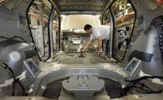
Pay for Knowledge
CAMI – Joint GM – Suzuki venture
Add incremental rewards to operators who learn more skills
When a operator learns all the operations in his / her work group he / she
  can be promoted to the role of utility or repair worker
  can fill in for absent operator without line disruption

Slide 94
“Line Unbalance”
Strategy in Mexican components plants due to high employee turnover
With large turnover training problems increase
Assign fewer work elements to new workers
Increase gradually to full “experienced worker standard”
Experienced Worker Standard
Operations
New Employee
Time
Fixed Job Cycle length

Slide 95
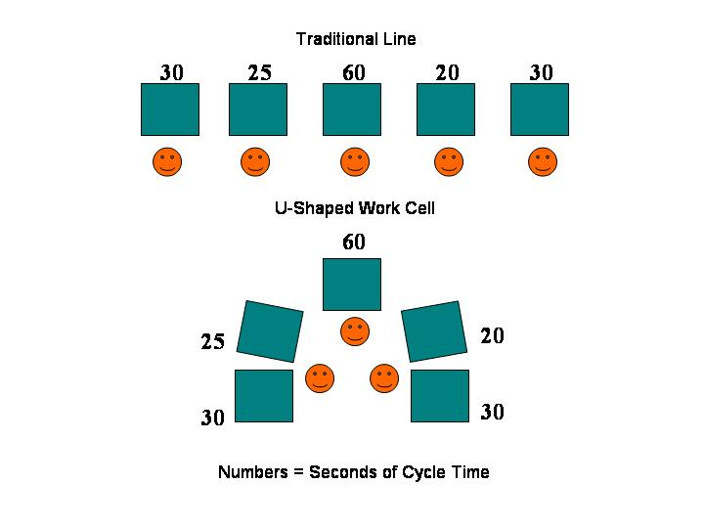
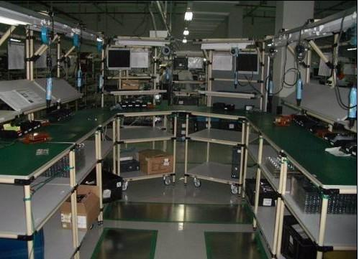
Work Cells
The traditional assembly line can be inefficient, inflexible and uncomfortable
Group tasks in work cells
  5 to 8 operators
Allow personalization of work area
  Team identity, spirit
Reduce between operation transfers by equipment layout
  Non value added time
Use batch transfer between cells
Provide (controlled)buffers
  Allows flexibility

Slide 96
Kitting
Typically components are presented in separate batches
“Kitting” groups sets of components to support a particular assembly sequence
Reduces non value added part selection and transfer time
Supports work cell and task enlargement arrangements
Requires up front kitting function perhaps at the component plant

Slide 97
Vertical Job Enlargement
Vertical job enlargement adds managerial responsibilities to an individual’s operational responsibilities
  Quality, Productivity, Health and Safety responsibilities
Both operational and motivational improvements
Removes one layer of supervision
Utility workers fill in
Team members manage different support responsibilities

Slide 98
Self Directed Work Teams
A natural progression of Administrative Controls such as rotation and enlargement is the creation of self directed work teams.
Self directed work teams can arrange assignments, rotations enlergements etc
They are also collectively responsible for quality, productivity, health, safety and satisfaction
Create “ownership” of total product
They also remove the need for first line supervisors
They will prevent the formation of bottom up informal “complaints” groups

Slide 99
The Saturn Plant
Created in the 1980s with a greenfield plant, a brand new different product and a collaborative, participating union
Adopted self directed work teams
Used job rotation
Vertical enlargement – all the way up to the shared plant managers office
The process failed in the late 1990s due to poor product performance (design and engineering causes) and infiltration by the national Union with its traditional combative approach.

Slide 100
Participation
Participation – “Vertical Job Enlargement” works
The people doing the job have the best knowledge of the causes of poor quality, productivity and health and safety.
Install ANDON Chord procedure
  Anyone can stop the line any time
This knowledge should be captured by the company and used to make improvements.

Slide 101
Quality Management

Slide 102
The Quality “Control” Myth
Measuring quality is like shutting the barn door after the horse has bolted
Quality is determined by PROCESS
If the PROCESS is managed then Quality will follow.
But it is still important to measure quality to observe trends
Quality charts should be used as described by Deming
  Do not interfere with “Common Causes”
  Only react to “Special Causes”
The Production Team usually has the knowledge to manage the PROCESS
PRODUCT QUALITY = COMPONENT QUALITY + PROCESS QUALITY

Slide 103
The Toyota Production System
W Edwards Deming
Outcome measurement
Statistical Quality Control
The honest worker
Prescriptive operations
Simple TOOLs

Slide 104
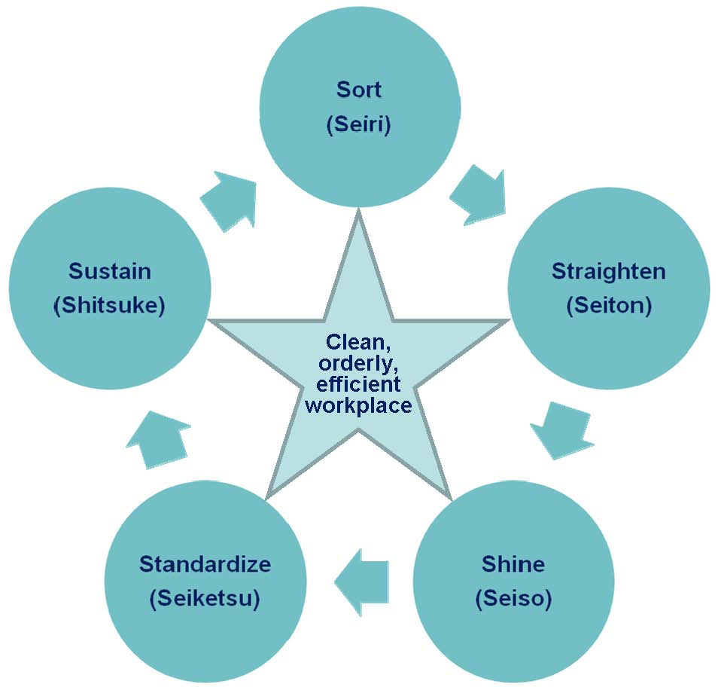
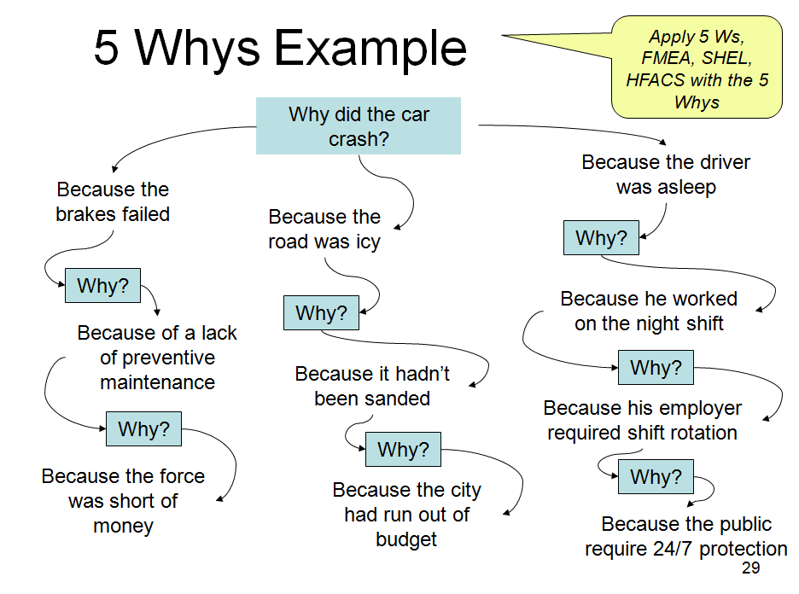
5S, 5Whys etc.

Slide 105
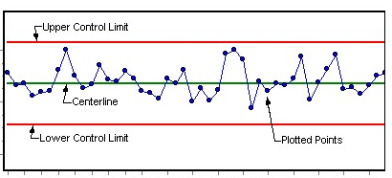
Visual Controls
Plot Quality, Productivity, Health and Safety measurements over appropriate time scales
Post the charts in the work area
Use Statistical Quality Control Methods

Slide 106
Use “Loss Functions” rather than “Tolerances”
Target Dimension
Loss Function
“Good Enough”
Tolerances
The principle of Continuous Improvement:
Kaizen Engineering
Target Specification

Slide 107
Toyota Production System
Simple Tools
5S – Tidy workplaces
Ishikawa Charts (6M)
5 Whys
Statistical process control
Participation
Quality Circles
Quality
Productivity
Principles
Eliminate waste
Visual controls
Standard processes
Quality circles(participation)
Kaizen - Continuous improvement
Lean
Agile

Slide 108
Socio Technical Systems
Macro Ergonomics
Big Picture Ergonomics
B
P
E

Slide 109
Frederick Herzberg
Intrinsic motivation and Hygiene (dissatisfiers) factors
Job Enrichment
Herzberg, F. 1968, "One more time: how do you motivate employees?", Harvard Business Review, vol. 46, iss. 1, pp. 53–62

Slide 110
MacroErgonomics
Hendrick
1990s
Socio Technical Systems revisited
Big Picture Ergonomics with micro ergonomics details
B
P
E

Slide 111
Case Study:
Job Redesign in the Bindery
Hong Kong university library
Hard covers on journals and books
10 people
Continuous work flow
  Batches within stages
The problems
  Access to library material, work in progress
  Equipment bottlenecks
  Physical environment
  Social context
  Productivity and job satisfaction

Slide 112
The Changes
Redesign storage of periodicals waiting to be bound
Introduce cardex system for production control
Introduce small batch system with semi autonomous teams
Introduce job rotation and enlargement
Purchase new equipment, window blinds, task lighting, sound isolation
Rearrange the layout for functional flow
Review salary structure
Use some subcontracting for less skillful work
Protect the boss from the customers

Slide 113
The Results
(2 year follow up)
Better production control and accounting
Increased productivity
Removal of the backlog
Improved physical environment
Much happier customers
  Interface between the team and the customers
Improved job satisfaction
  Hawthorne effect?

Slide 114
Case Study
Organization and Job Design in Medicare Data Processing
200, mostly female clerical workers
High specialization
Open plan, functional zones, cubicles, noisy, untidy
Inefficiencies, backlogs, errors
New computer system
Low morale, threatened with takeover by subcontractor

Slide 115
The Organizational Problems
Repetitive specialized work, electronic performance monitoring
System breakdowns
Noise, housekeeping – piles of paper
Low productivity, high costs
Low morale, conflict

Slide 116
Solutions
Discussions of job enlargement with management
Introduction of pilot team”
  Selection of 6 volunteers, with broad background
  Team to take full batch through the whole process, except disbursements
Team responsible for layout of own department and allocation of duties
Carpeted the whole floor and isolated noisy printers
Talked to all the groups

Slide 117
Results
Acceleration phase
  Physical layout and equipment installation
  Some learning and cross training
Productivity way up, errors down
High team morale
  Envy from the rest of the organization
Everybody liked the new carpet
Organization taken over by subcontractor

Slide 118
Micro Ergonomics and Design
Workplace Design
  Access, Fit, Reach, Postures
Manual Materials Handling
  Lifting, Holding, Carrying, Pulling, Pushing
Manipulation
  Assembly work
Information Design
  Controls, Displays, Tools
Environment Design
  Light, Heat, Noise
Operations Design
  Tasks, Variety
Job Design
  Control, Breaks, Shifts, Supervision, Teams
Macro
+
Micro

Slide 119
Workplace Design
What can be Changed?
Space
  Reach, fit, postures, support
Force
  Moments and levers
  Pressure points
  Interfaces
  Mechanical assists
Time
  Static – dynamic balance
  Work rest schedules
  Shift work

Slide 120
You can only change posture by changing the workPlace Layout but even then behaviors will differ

Slide 121
The Box or the Ball
Work (hand) placement for most of the time
Sitting
High Sitting
Leaning
Standing
Shoulder Height
5th Percentile
Elbow Width
95th Percentile
Arm Length
5th Percentile
Arm Length
5th Percentile
Elbow Height
50th Percentile
Hand Height
95th Percentile

Slide 122
Visual, Light and Heavy Work
Shoulder Height
5th Percentile
Elbow Width
95th Percentile
Arm Length
5th Percentile
Arm Length
5th Percentile
+ / - 20 cm
Elbow Height
50th Percentile
Hand Height
95th Percentile

Slide 123
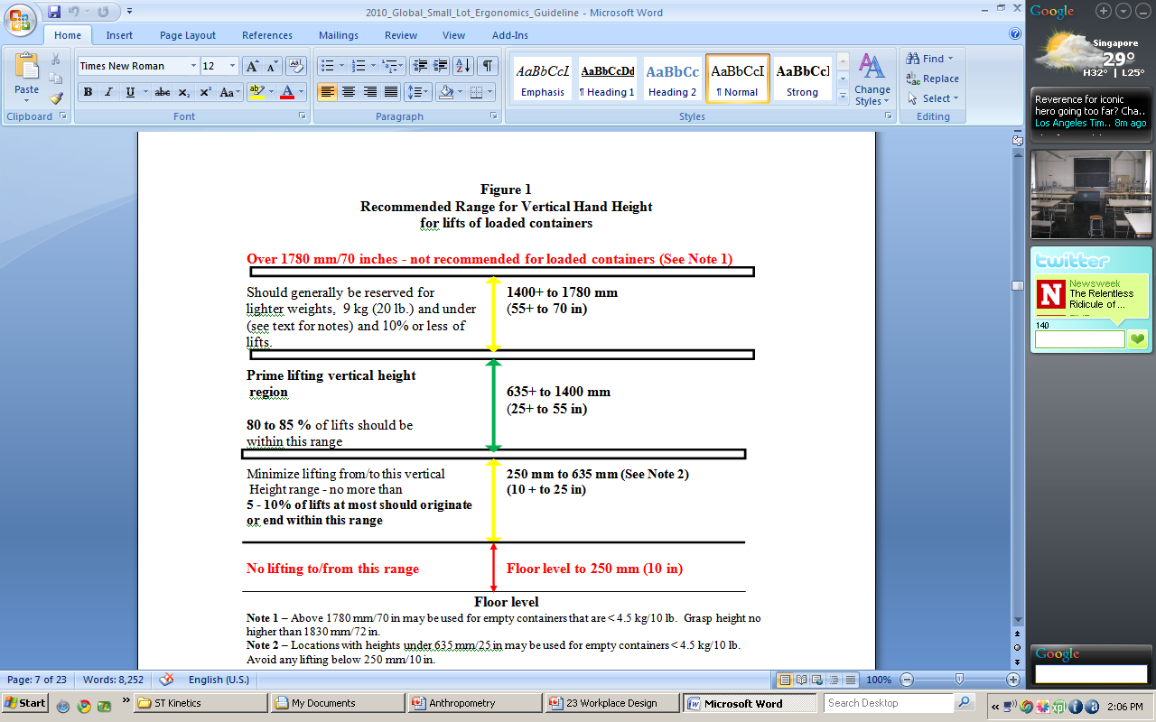
Storage Rack Guidelines (North America)

Slide 124
Adjustability and Flexibility
Where possible make workplaces adjustable to individual preference and allow / encourage change

Slide 125
Manual Materials Handling
Major cause of back injuries
Measurement
  RULA
  NIOSH Lift Equation – Lifting
  Snook Tables – Pushing, Pulling
Change the task?
  Automation
  Mechanical assists
  Change the elements
    Load, Location, Frequency, Duration
Change the method?
  Lifting training

Slide 126
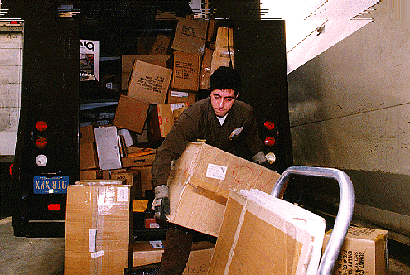
Manual Materials Handling

Slide 127
Lifting
Don’t put things on the floor!!
  Put them in the “Box” or “Ball”
Face the object
Move as close as possible to the object CG
Bend hips and knees
Keep back straight
Get a good grip
Don’t twist or jerk, lift smoothly

Slide 128
MMH Measurement
NIOSH Lift Equation
Liberty Mutual (Snook) Tables

Slide 129
1991 Version
RWL = LC x HM x VM x DM x AM x FM x DM x CM
Lift Index = LOAD / RWL
A Discounting Equation
Who is responsible for which intervention?

Slide 130
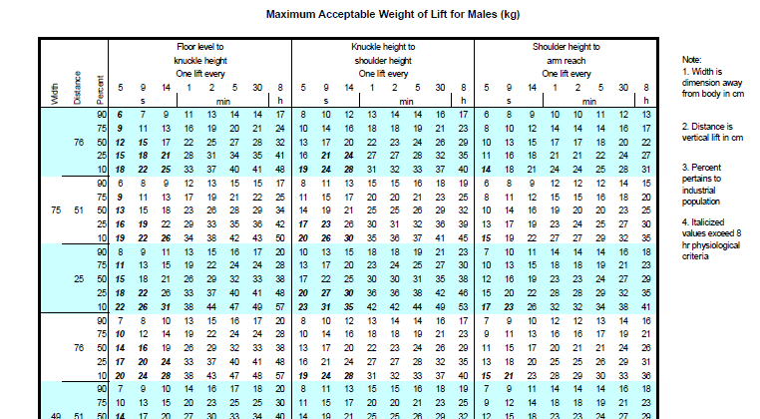
Snook Tables

Slide 131
Sources on the Internet
http://www.cdc.gov/niosh/docs/94-110/
http://www.emcins.com/losscontrol/quick_links/employee_safety_health/ergonomicsNIOSH.aspx
http://www.ergoweb.com/news/detail.cfm?id=566
http://www.ccohs.ca/oshanswers/ergonomics/niosh/calculating_rwl.html

Slide 132
Manipulation / Assembly Tasks
Task requirements
  Visual, cognitive and motor
  Repetition
Outcomes
  Product quality and productivity issues due to
  Hand and arm pathology
  Postural strain – shoulder, neck
  Motion strain – shoulder, elbow, wrist, hand, thumb and fingers
Causes (and opportunities for intervention)
  Force, posture, movement, frequency, duration
Measurement
  Hand Activity Level
  Postural analysis
  Micro motion analysis
Interventions
  Remove, reduce or replace non value added work
  Task / Target Design
  Enlarge or rotate to reduce frequency

Slide 133

Grasping and Manipulating
Fingers have postures too
How big are your hands?
How big should handles be?
How bent should handles be?
Length, Width, Circumference, Shape
Avoid pressure points

Slide 134
Tight Targets Take Time

Slide 135
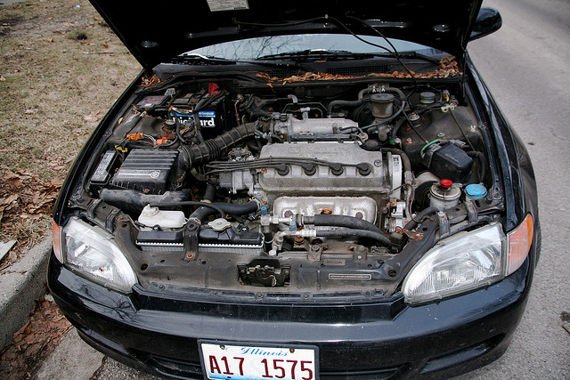



The assembler had to deal with poorer ACCess and many more components

Slide 136
Two Automobile Plants
Part Insertion Time
  6.3 secs
  3.9 secs
Target size, orientation ?

Slide 137
Targets
A
B
Which Targets are Easier?
Design for Assembly!

Slide 138
Fitts Law(1954)
MT = a + b log₂ (2A/W)
where:
MT = Movement Time
a, b = Individual and Situational Constants
A = Amplitude of Movement
W = Width of Target
2A/W = Index of Difficulty (ID)

Slide 139
Case Study
Barbie Dolls
How long does it take to assemble and pack a set of clothes for a Barbie Doll?
How many assemblies per day?
How many workers are needed?
TARGETS!!!

Slide 140
Target Rules
Increase Target Size Percentage
  Access, Adjustment, Finesse
Consider Effect of Part Weight
Consider Effect of Part Size
Large time and postural stress savings by targeting the targets

Slide 141


A compromise between user styling requirements and design for manufacturability, even robots have a hard time with TIGHT Targets
“Thin is in” for the customer, but what about the assembler?

Slide 142
Simplify
Choices
Choices Take Time and may be Wrong

Slide 143
Choices Exercise
  Hick’s Law MT = a + b log₂n
  where: n = number of choices
Hold a pack of playing cards face down
Sort them into 2 piles
Sort them into 4 piles
Sort them into RED and BLACK
Sort them into H, C, D, S
Measure the Times, Observe the Errors and Hesitations

Slide 144
Arms, Wrists and Fingers have Postures too
Orient the part
Bend the tool not the wrist
Increase the size of the handle to reduce pressure and force requirements and increase leverage

Slide 145

Wrists have Postures too

Slide 146

Sewing Lines

Slide 147

Small Components Assembly

Slide 148
Bend the Tool not the Wrist

Slide 149







Use the right Handle

Slide 150


Orient the job

Slide 151


Slide 152


Slide 153
Job and Operations Design
The Time factor

Slide 154
Operations Design
The key to productivity is the removal of non value added work
  Long or frequent transfers
  Search for components or target
  Reorienting the component / product
Use belts / gravity for transfers, components
Place tools / components in the operations sequence
Use belt / gravity for finished goods

Slide 155
Job Design
Taylorism
  Job simplification
  Managers manage workers work
But workers are able to master many tasks
Workers do have insight into quality, productivity and health and safety issues
Workers do not like to be bored
  Vigilance decrement may be a problem
  Local and general fatigue will be a problem
Therefore design job variety

Slide 156
Shift Work
Avoid one week rotations
Implement permanent shifts
Implement short cycle shift schedules
  2 – 3 days
  Use forward rotation: Day – Evening – Night – Off
Limit shift durations
  8 is better than 10 and 12 is the limit
  4 crew 3 shift or 3 crew 2 shift arrangements
Provide one long and many short relief breaks for assembly work
  Walking for at least 5 minutes every hour

Slide 157

Singapore MOM ergo@work app
Postures, stretches, breaks

Slide 158
Physical Work Stress Index
(PWSI)
Addressing the TIME Dimension

Slide 159
PWSI
The Physical Work Stress Index (PWSI) is a simple, robust physical activity measurement system that indicates an optimal level of workload between high static and high dynamic demands.
It uses an activity sampling approach which can be applied to regular (cyclic) work and irregular work over short or long time periods.
The PWSI may be developed as a manual assessment tool or through the use of a spreadsheet

Slide 160
Physical Stress and Strain
People respond well to optimal levels of physical (and cognitive) variety
Strain
Stress

Slide 161
History
The PWSI was first developed as a student project at the University of Hong Kong in 1976 (Brian Peacock, Janet Liu)
It was further developed at the University of Oklahoma through undergraduate and graduate projects during the early 1980s (Susan Cheatwood, Jacob Chen)
A description of the process was published by Chen, Peacock, and Schlegel in 1989 in the International Journal of Industrial Ergonomics

Slide 162
Activity Sampling
A random or regular sampling scheme is developed depending on the periodicity of the work activity.
  For regular, machine paced work, a random sample is recommended.
  For irregular work, a regular sampling process is both convenient and valid.
The ordinal mappings from values of each of these major elements are recorded at each sampling instant
Generally it is appropriate to gather data from about 10 samples but greater precision can be achieved by increasing the number of observations

Slide 163
The Box or the Ball
Work (hand) placement for most of the time
Sitting
High Sitting
Leaning
Standing
Shoulder Height
5th Percentile
Elbow Width
95th Percentile
Arm Length
5th Percentile
Arm Length
5th Percentile
Elbow Height
50th Percentile
Hand Height
95th Percentile

Slide 164
The Best Posture is the Next Posture

Slide 165
Walkie-Talkies
Require all employees to walk and talk every hour for 5 minutes
  Walking provides physical relief
  Talking provides social relief
  Walking and talking provide attention relief
  Productivity will not suffer

Slide 166
Stretching
Systematically and slowly move every joint through its full range
  Move, hold for 3 seconds, relax
Standing (hold on to the back of the chair)
  Move knee up then push leg back
  Move leg across the body, away from the body and in big circles
Sitting
  Bend forward, back, side to side, and twist
  Move shoulders and shoulder girdles in big circles
  Move wrist and hands through full range
  https://itunes.apple.com/sg/app/ergo-work/id556877197?mt=8

Slide 167
The Usain Bolt fitness test
10 – 100 – 1000 - 10000
Distance (m) | World Record (sec) | Your Time (secs) | Your %
10 | 1 | 5 | 20
100 | 10 | 40 | 25
1000 | 130 | 400 | 43
10000 | 1600 | 4000 | 40
Participants should walk or run 10, 100, 1000, 10000 meters, measure their times and calculate their percentage score against the world record.

Slide 168
Workability Index
Addresses
  Spatial factors
  Manual materials handling
  Manipulation
  Environmental factors
  Information factors
  Operational factors

Slide 169
Workability Index
Date |  |  |  |  |  |  |  |  |  |  | Job Description
Analyst
Survey Reference / Times
Job Survey Ratings |  |  |  |  |  |  |  |  |  |  | Orange and Red ratings may warrant in depth or specialist investigation regarding importance and feasibility of redesign / intervention | Where feasible all red ratings must be addressed / changed by engineering controls. Orange ratings should be addressed by engineering or administrative controls to reduce exposure
 | Place a small "x" in the appropriate rating cell | N/A | Green |  | Yellow |  | Orange |  | Red | Operational Factor Interactions H/M/L | Descriptions / Quantifications / Comments / Justifications | Notes / Guidelines / Criteria

Slide 170
Policy Decisions
Common Currency
Outcome Scale
1
2
3
4
5
6
7
Policy Statements
Unacceptable
Range
7
6
5
4
3
2
1
Region of Interactions and Continuous Improvement
Ideal Range
Engineering Variable or Composite Index

Slide 171
Design Rules - Consensus
Policy
Science
Consensus:
  HF Experts
  Engineers
  Managers
  Customers
Design
Rule
Rule
Implementation
Experience
Data
History
Predictions
Evaluation
  Verification
  Validation
  Sensitivity
Technical
Memory

Slide 172
Spatial Factors
Place a small "x" in the appropriate rating cell | N/A | Green | Yellow | Orange | Red | Operational Factor Interactions H/M/L | Descriptions / Quantifications / Comments / Justifications | Notes / Guidelines / Criteria
Access |  |  |  |  |  |  |  | Clearances, obstructions, doors, barriers
Fit |  |  |  |  |  |  |  | Head room, Knee / Foot room, Width
Reach |  |  |  |  |  |  |  | Box, 50 cm reach curves
Postures |  |  |  |  |  |  |  | Sitting, Standing, Squatting, Middle, Outer, Inner ranges
Movements |  |  |  |  |  |  |  | Range, speed
Task surface orientation |  |  |  |  |  |  |  | Front, above, below, behind
Ramps |  |  |  |  |  |  |  | Slope, length
Stairs |  |  |  |  |  |  |  | Number, height
Counts |  |  |  |  |  |  |  | Refer to HF Specialist, manufacturing engineer for interventions

Slide 173
Manual Materials Handling
 |  |  |  |  |  |  | Orange and Red ratings may warrant in depth or specialist investigation regarding importance and feasibility of redesign / intervention | Where feasible all red ratings must be addressed / changed by engineering controls. Orange ratings should be addressed by engineering or administrative controls to reduce exposure
Place a small "x" in the appropriate rating cell | N/A | Green | Yellow | Orange | Red | Operational Factor Interactions H/M/L | Descriptions / Quantifications / Comments / Justifications | Notes / Guidelines / Criteria
Lifting |  |  |  |  |  |  |  | Weights, forces, coupling, sizes
Carrying |  |  |  |  |  |  |  | Weights, forces, coupling, sizes
Holding |  |  |  |  |  |  |  | Weights, forces, coupling, sizes
Pulling |  |  |  |  |  |  |  | Weights, forces, coupling, sizes
Pushing |  |  |  |  |  |  |  | Weights, forces, coupling, sizes
Twisting, bending |  |  |  |  |  |  |  | Vertical and horizontal task locations
Interfaces, coupling |  |  |  |  |  |  |  | Good, sharp
Counts |  |  |  |  |  |  |  | Refer to NIOSH Lifting Equation and Snook Tables

Slide 174
Manipulation
 |  |  |  |  |  |  | Orange and Red ratings may warrant in depth or specialist investigation regarding importance and feasibility of redesign / intervention | Where feasible all red ratings must be addressed / changed by engineering controls. Orange ratings should be addressed by engineering or administrative controls to reduce exposure
Place a small "x" in the appropriate rating cell | N/A | Green | Yellow | Orange | Red | Operational Factor Interactions H/M/L | Descriptions / Quantifications / Comments / Justifications | Notes / Guidelines / Criteria
Shoulder, Elbow |  |  |  |  |  |  |  | Mid, Outer, Inner ranges, forces
Hand, Wrist, Fingers |  |  |  |  |  |  |  | Mid, Outer, Inner ranges, forces, coupling, interfaces
Targets |  |  |  |  |  |  |  | Target sizes and tolerances
Precision |  |  |  |  |  |  |  | Fine, coarse
Counts |  |  |  |  |  |  |  | Use Hand activity level TLVs

Slide 175
Environmental Factors
 |  |  |  |  |  |  | Orange and Red ratings may warrant in depth or specialist investigation regarding importance and feasibility of redesign / intervention | Where feasible all red ratings must be addressed / changed by engineering controls. Orange ratings should be addressed by engineering or administrative controls to reduce exposure
Place a small "x" in the appropriate rating cell | N/A | Green | Yellow | Orange | Red | Operational Factor Interactions H/M/L | Descriptions / Quantifications / Comments / Justifications | Notes / Guidelines / Criteria
Heat, Cold |  |  |  |  |  |  |  | Air Temperature, Humidity, Radiant heat, Air movement
Glare |  |  |  |  |  |  |  | Location, intensity, contrast, window and local lighting
Dark |  |  |  |  |  |  |  | Interference with visual demands
Noise Intensity |  |  |  |  |  |  |  | Task, Ambient, Sound Level, Frequency, Variability
Vibration |  |  |  |  |  |  |  | Whole body, hand arm
Accelerations |  |  |  |  |  |  |  | Pounding, jerks
Slip, trip, fall |  |  |  |  |  |  |  | Work context hazards, visibility, barriers
Chemical |  |  |  |  |  |  |  | Refer to OH
Radiation |  |  |  |  |  |  |  | Refer to OH
Counts |  |  |  |  |  |  |  | Refer to OH, Safety or Engineering for intervention

Slide 176
Information Factors
 |  |  |  |  |  |  | Orange and Red ratings may warrant in depth or specialist investigation regarding importance and feasibility of redesign / intervention | Where feasible all red ratings must be addressed / changed by engineering controls. Orange ratings should be addressed by engineering or administrative controls to reduce exposure
Place a small "x" in the appropriate rating cell | N/A | Green | Yellow | Orange | Red | Operational Factor Interactions H/M/L | Descriptions / Quantifications / Comments / Justifications | Notes / Guidelines / Criteria
Visual |  |  |  |  |  |  |  | Visual acuity, discrimination demands, importance
Acoustic |  |  |  |  |  |  |  | Hearing acuity, discrimination demands, importance
Attentional |  |  |  |  |  |  |  | Sustained and divided attention demands
Memory |  |  |  |  |  |  |  | Operational memory span, interferences
Cognitive |  |  |  |  |  |  |  | Calculations, planning, analyses
Decisions |  |  |  |  |  |  |  | Number of choices, ambiguity, risk
Communication |  |  |  |  |  |  |  | Frequency, variability, importance
Control |  |  |  |  |  |  |  | Precision, feedback, prediction
Situation awareness |  |  |  |  |  |  |  | Importance, distractions
Mental workload |  |  |  |  |  |  |  | Information and time demands, training, stress
Outcomes |  |  |  |  |  |  |  | Consequences of human error
Counts |  |  |  |  |  |  |  | Refer to HF specialist for intervention

Slide 177
Operational Factors
 |  |  |  |  |  |  | Orange and Red ratings may warrant in depth or specialist investigation regarding importance and feasibility of redesign / intervention | Where feasible all red ratings must be addressed / changed by engineering controls. Orange ratings should be addressed by engineering or administrative controls to reduce exposure
Place a small "x" in the appropriate rating cell | N/A | Green | Yellow | Orange | Red | Operational Factor Interactions H/M/L | Descriptions / Quantifications / Comments / Justifications | Notes / Guidelines / Criteria
 |  |  |  |  |  |  | Operational factors will usually interact with some or all of the other factors | Intervention through administrative and / or operational controls
Job cycle duration |  |  |  |  |  | Engineering issues |  | Operations per hour, job cycle time
Static posture duration |  |  |  |  |  |  |  | % job cycle, % day
Repetitions, frequencies |  |  |  |  |  |  |  | Frequency per hour of same or similar task
Job pacing |  |  |  |  |  |  |  | Self paced, Piece Rate, Machine paced, Supervisor
Span of responsibility |  |  |  |  |  | Operational Issues |  | Product quality, other colleagues, autonomy
Team structures |  |  |  |  |  |  |  | Job rotations
Participatory processes |  |  |  |  |  |  |  | Do employees participate in work design decisions
Technical support |  |  |  |  |  |  |  | Availability, supervision
Training, Acclimatization |  |  |  |  |  |  |  | Level of experience, adaptation to task
Special Populations |  |  |  |  |  |  |  | Are eldely or disabled persons employed with accommodations?
Counts |  |  |  |  |  |  |  | Refer to HF Specialist / Management for intervention

Slide 178
Overall Counts
 |  |  | Job Survey Ratings |  |  |  |  |  | Orange and Red ratings may warrant in depth or specialist investigation regarding importance and feasibility of redesign / intervention | Where feasible all red ratings must be addressed / changed by engineering controls. Orange ratings should be addressed by engineering or administrative controls to reduce exposure
 | Place a small "x" in the appropriate rating cell |  | N/A | Green | Yellow | Orange | Red | Operational Factor Interactions H/M/L | Descriptions / Quantifications / Comments / Justifications | Notes / Guidelines / Criteria
Overall Counts 1 |  |  |  |  |  |  |  |  | Notes | Engineering Controls
 |  | 2 |  |  |  |  |  |  | Jobs should be analysed before and after interventions
 |  | 3 |  |  |  |  |  |  | The worksheet may also be used repeatedly over a day to analyse the variability of work demands | Administrative Controls
 |  | 4 |  |  |  |  |  |  | Consensus quantitative anchors may be added to the rating scales to improve their consitency
 |  | 5 |  |  |  |  |  |  | Basic training (1 day) in the use of this worksheet should be required of all ergonomics monitors (CEM Level 1)

Slide 179


Slide 180
Conclusions – How Ergonomics Works

Slide 181
Ergonomics Addresses
B
P
E
human, technological, contextual and operational complexity and variability
tradeoffs among many job outcomes
Temporal
Cognitive
Affective
Sensory
Social
Physical
Context
Rules and Regulations
S
Macro
+
Micro
E4S4
Technology
H
Integration
Interfaces
Interactions
Intra actions Interferences
Interdependencies
People
L
Context
(Environment)
E

