Slide 1
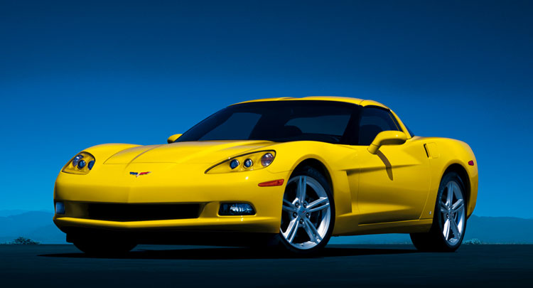
Human Systems Integration
The Grammar of Design
Better Interpretation of Customer Requirements
Brian Peacock

Slide 2
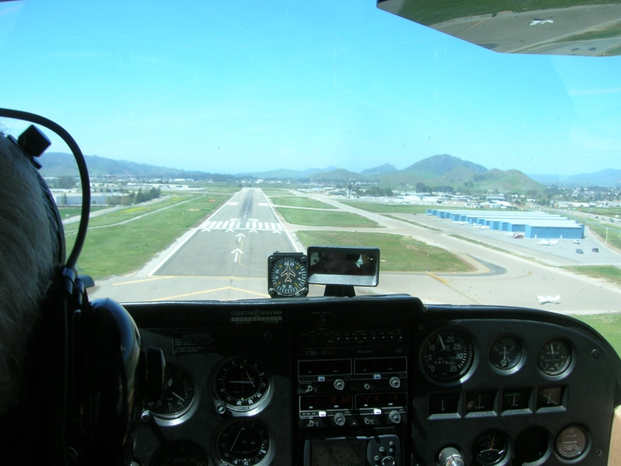


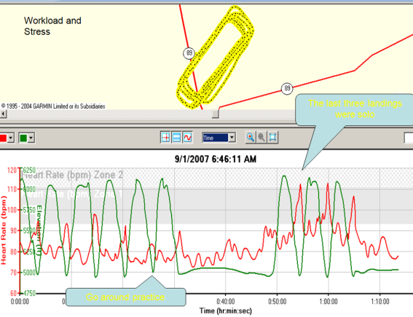
Chinese Proverb ++
“Tell me and I'll forget; show me and I may remember; involve me and I'll understand.”
Test me and you will know if I understand

Slide 3
Most of the World
USA
Ergonomics = Human Factors
HFE / HSI

Slide 4
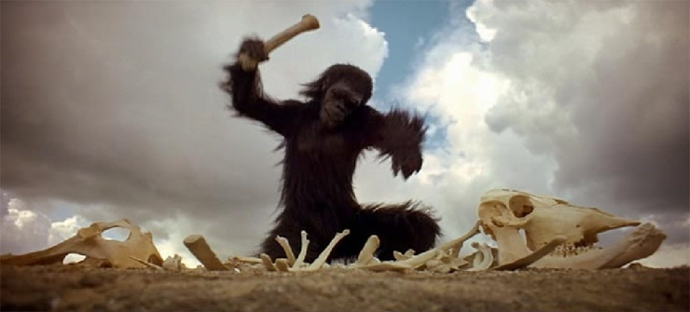
The History of Ergonomics
Weapons, Tools and Environment

Slide 5
Systems
Chaotic
Emergent
Deterministic
Complex
Probabilistic
Complicated
Simple
Operations
(Time)
Equipment
(Technology)
Integration
Interfaces
Interactions Interferences
Interdependencies
Humans
(Training)
Context
(Environment)
(Tide)
ECHO I I I I I

Slide 6

Simple Systems

Slide 7
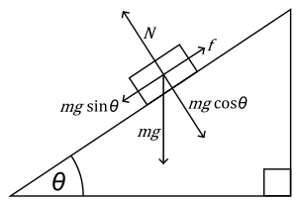
Deterministic Systems

Slide 8
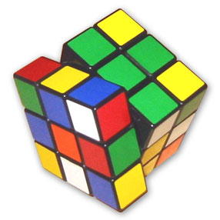
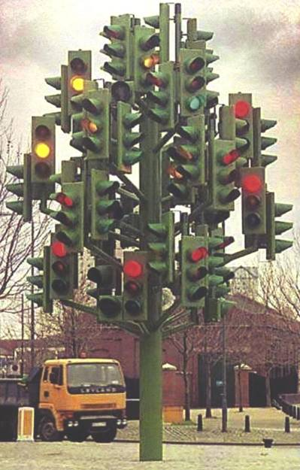
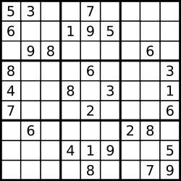
Complicated Systems

Slide 9

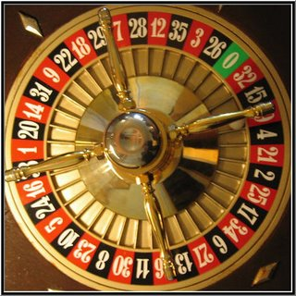
Probabilistic Systems

Slide 10
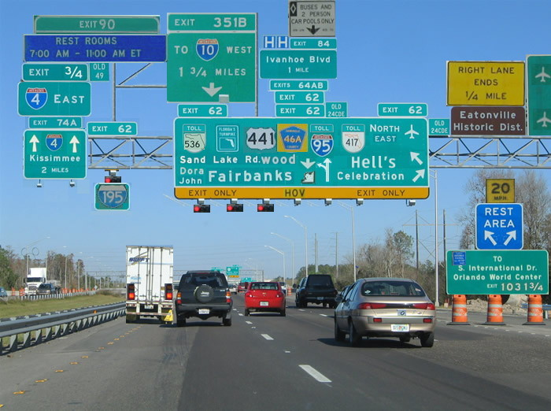


Slide 11
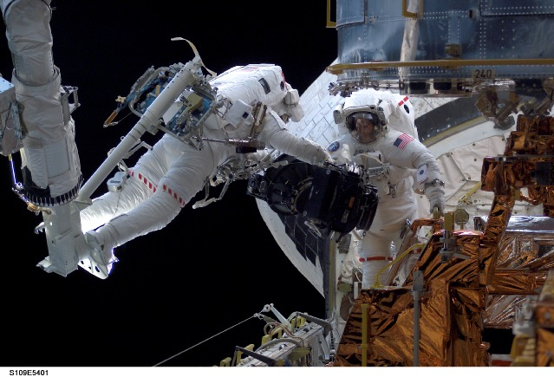
Complex Systems

Slide 12

Emergent Systems

Slide 13
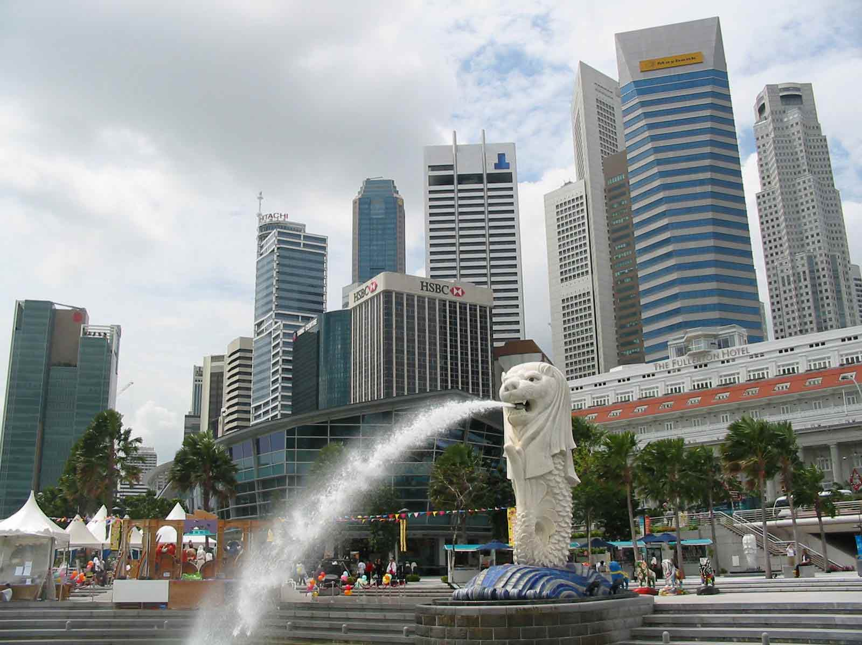
Emergent System

Slide 14

Chaotic Systems
“The scientific notion of chaos does not describe disorderliness or randomness at all - it describes unpredictability. A chaotic system is characterized by having exponential error growth (also often described with the phrase sensitive dependence on initial conditions AKA the butterfly effect)”
http://www.joakimlinde.se/java/chaoticPendulum/index.php

Slide 15
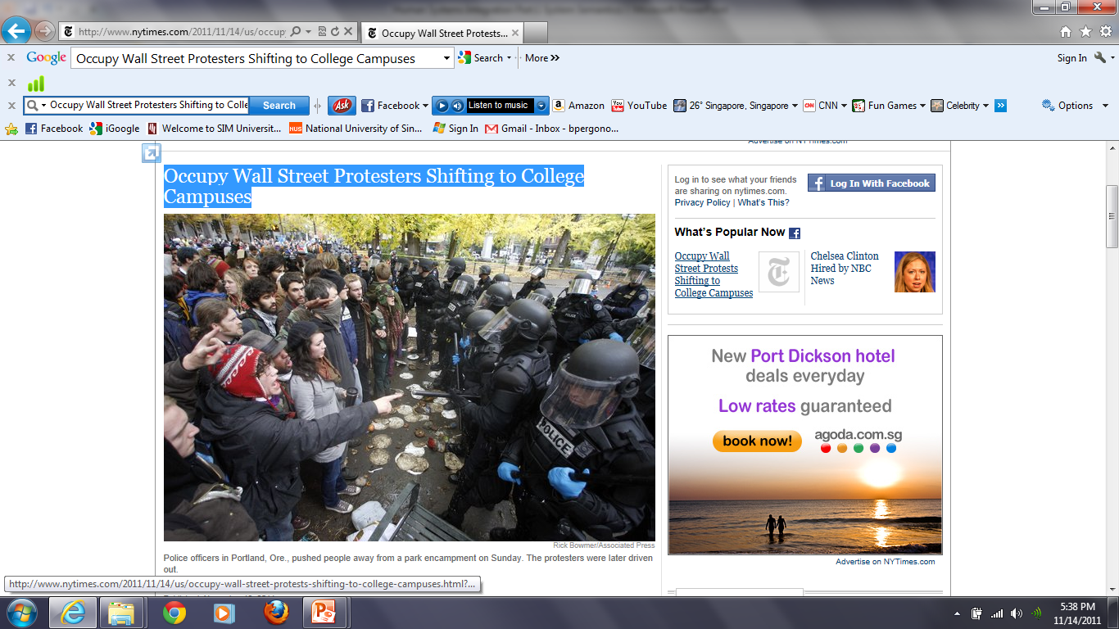
Emergent or Chaotic System?

Slide 16
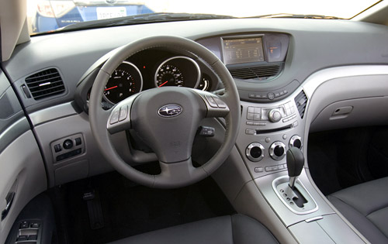
Human Machine Systems

Slide 17
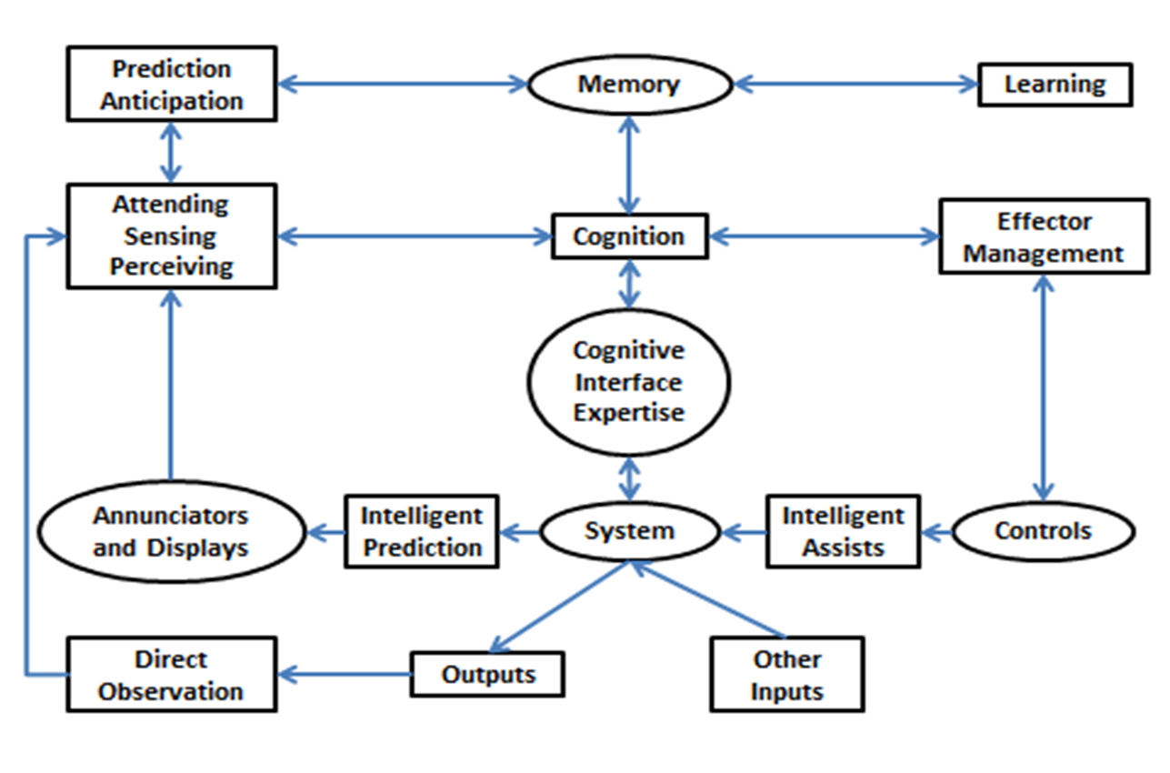
A Human Machine System Model
Simulation

Slide 18

Human Machine Systems

Slide 19
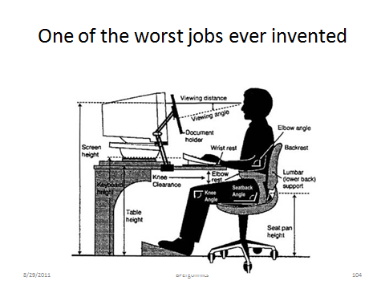
Obesity, Diabetes, Heart Disease, etc. etc. etc.
X
Ergonomic System?

Slide 20
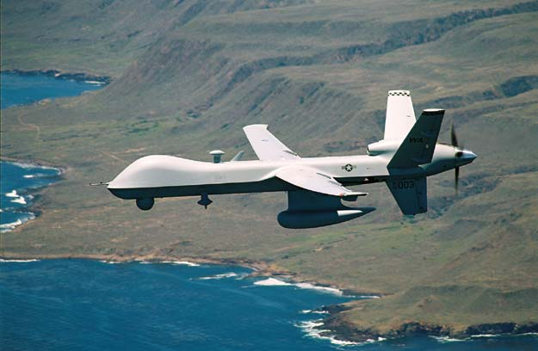
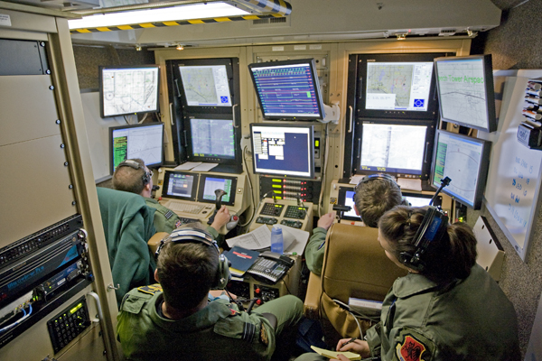
Human Machine Systems

Slide 21
Multiple Purposes of Design
E4S4
Effectiveness
  Meets functional requirements
  “quality”
Efficiency
  Optimal use of resources
  “productivity”
Ease of Use
  Intended users
  Comfort and Convenience
  Prevention of misuse
Elegance
  Esthetic / emotional appeal
  Affective Design
Safety and Health
  Prevention or mitigation of system failures
  For participants and third parties
Security
  Inadvertent or malicious misuse
Satisfaction
  Of ALL customers and stakeholders
Sustainability
  Reliability
    Under intended contexts over the life cycle
  Resilience
    Under unintended, unexpected and harsh conditions
There WILL be tradeoffs

Slide 22
Performance Requirements
Design for:
  Expected USE
  Foreseeable MISUSE
  Abnormal use
For all intended users and foreseeable misusers and in unexpected contexts
6U
2M
E4S4
Notes:
Who are the users?
Who are the misusers?
What are the contexts of use?
How do you do testing?

Slide 23
Design to Prevent Human Error - Wrong Number
$10 Million For Contras Wound Up In Wrong Bank Account
May 13, 1987|By KNT News Service
WASHINGTON — In one of the more bizarre twists in the Iran-contra affair, congressional investigators Tuesday revealed that a missing $10 million contribution from the sultan of Brunei to the Nicaraguan rebels has been found in the bank account of a Swiss shipping magnate.
The mistake apparently occurred because Marine Lt. Col. Oliver North -- asked where to deposit the money -- provided the wrong Swiss bank account number in August 1986. Investigators said North, the fired National Security Council aide, gave an account with the numbers 368 instead of the correct 386.

Slide 24
Design for Ease of Use
ACCESS
Physical, Sensory, Cognitive, Social, Temporal
Comfort and Convenience
Usability

Slide 25
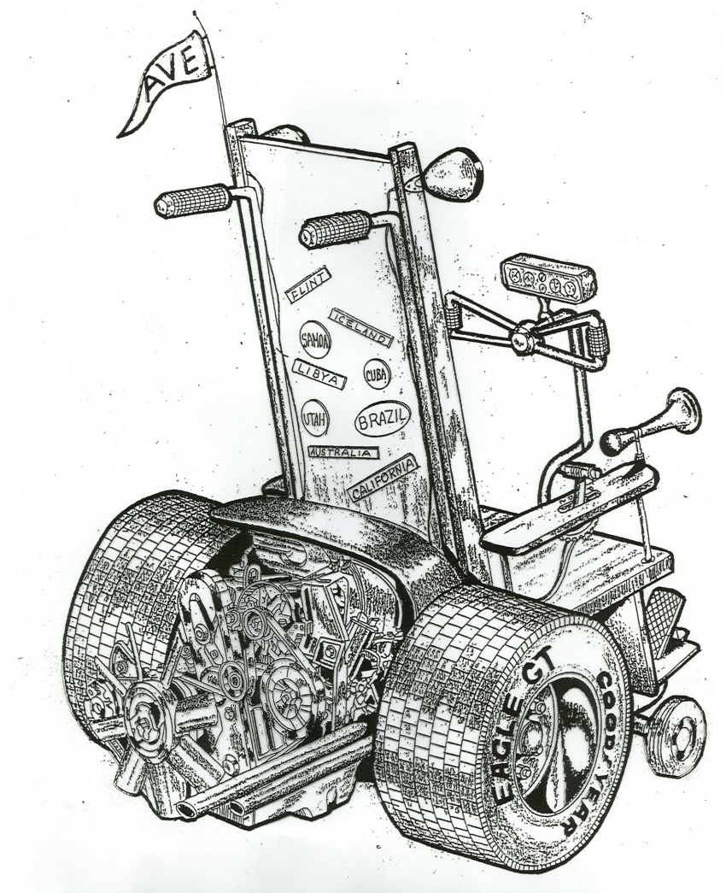
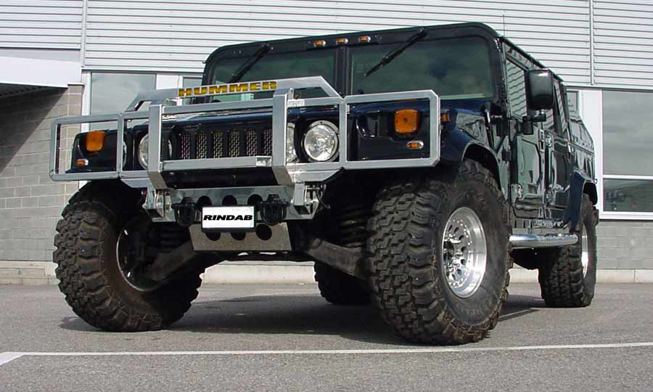

The GM Access Car
Design for an ageing population - Which will you drive when you are 80?
Notes:
Methods
Focus groups
Formal experimentation
Clinics
Traditional HF rules based analysis
Mock ups
Comparative vehicle analysis
Many universities
Many engineers

Slide 26
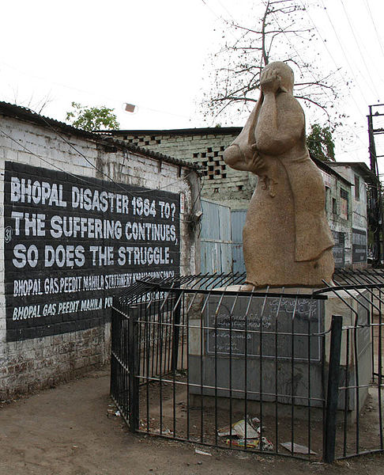
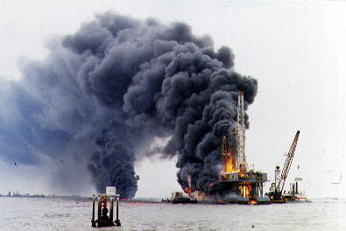
Design for Safety

Slide 27
Design for Security
E4S4
(just in case you thought that this wasn’t a contemporary challenge of design)

Slide 28
Car Hack
“With a modest amount of expertise, computer hackers could gain remote access to someone’s car — just as they do to people’s personal computers — and take over the vehicle’s basic functions, including control of its engine, according to a report by computer scientists from the University of California, San Diego and the University of Washington.
Although no such takeovers have been reported in the real world, the scientists were able to do exactly this in an experiment conducted on a car they bought for the purpose of trying to hack it. Their report, delivered last Friday to the National Academy of Sciences’ Transportation Research Board, described how such unauthorized intrusions could theoretically take place.”

Slide 29
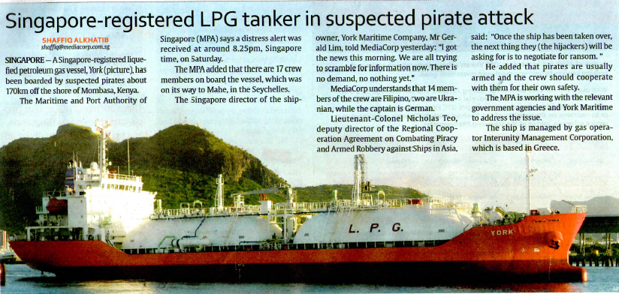
Oil Tanker Pirates

Slide 30
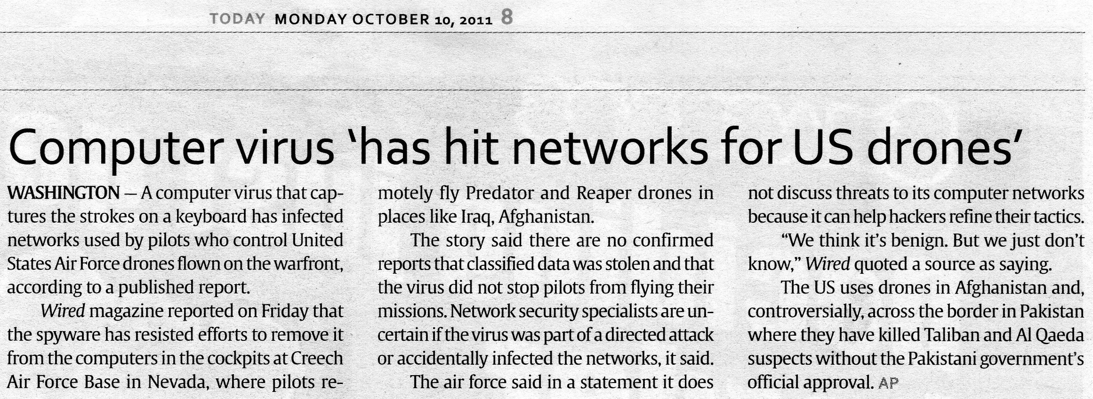
UAV Hackers

Slide 31
Design for Sustainability
E4S4
Effectiveness
  Meets functional requirements
  “quality”
Efficiency
  Optimal use of resources
  “productivity”
Ease of Use
  Intended users
  Comfort and Convenience
  Prevention of misuse
Elegance
  Esthetic / emotional appeal
  Affective Design
Sustainability
  Reliability
    Under intended contexts over the life cycle
  Resilience
    Under unintended, unexpected and harsh conditions
Safety and Health
  Prevention or mitigation of system failures
  For participants and third parties
Security
  Inadvertent or malicious misuse
Satisfaction
  Of ALL customers and stakeholders
There WILL be tradeoffs

Slide 32
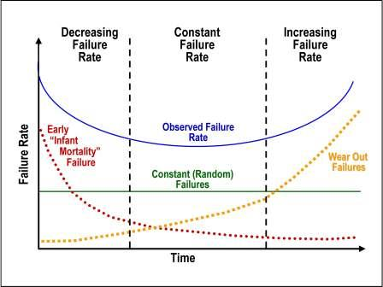
Reliability

Slide 33

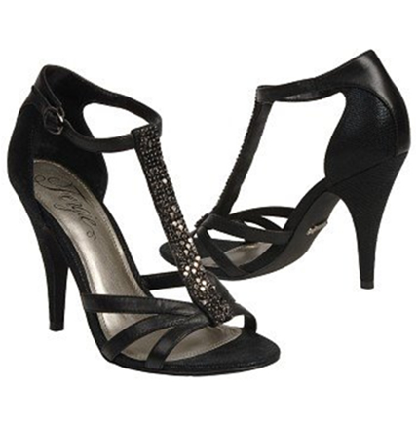
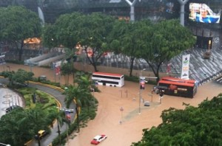
Shoes in the rain:
Resilience?
Elegance?

Slide 34
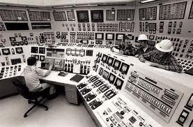
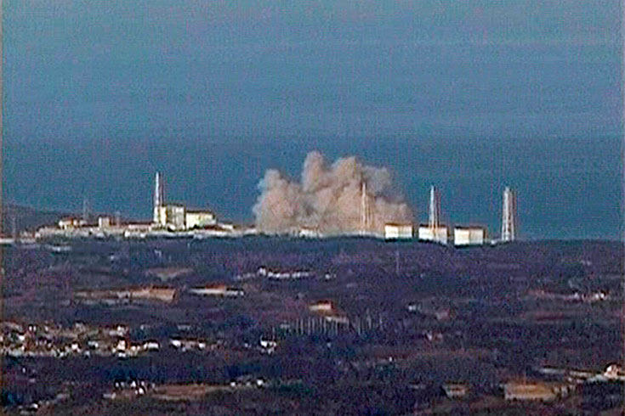
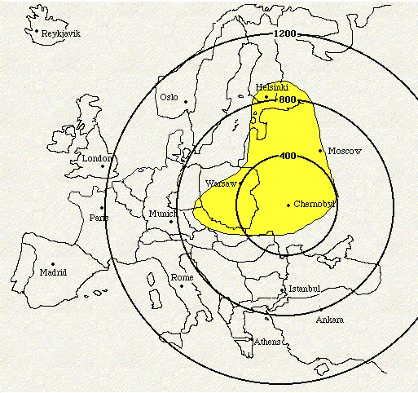
Resilience? - Fukushima, 3 Mile Island, Chernobyl
Is Singapore resilient in terms of food, water, energy, nuclear power, flood resistance etc?

Slide 35
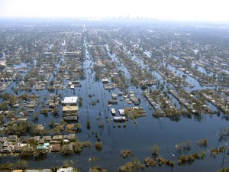

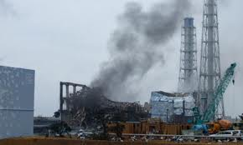
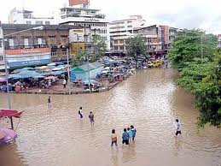
Sustainability
Reliability
  Under intended contexts over the life cycle
Resilience
  Under unintended, unexpected and harsh conditions
Consider the life of a car, nuclear power plant, political party or a city

Slide 36
Use to address these Government Agencies
E4S4
Ministry Of Community Development, Youth And Sports (MCYS) Website
Ministry Of Defence (MINDEF) Website
Ministry Of Education (MOE) Website
Ministry Of Finance (MOF) Website
Ministry Of Foreign Affairs (MFA) Website
Ministry Of Health (MOH) Website
Ministry Of Home Affairs (MHA) Website
Ministry Of Information, Communications And The Arts (MICA) Website
Ministry Of Law (MINLAW) Website
Ministry Of Manpower (MOM) Website
Ministry Of National Development (MND) Website
Ministry Of The Environment And Water Resources (MEWR) Website
Ministry Of Trade And Industry (MTI) Website
Ministry Of Transport (MOT) Website

Slide 37
ECHO IIIII
An adaptation of the SHEL model
Operations
(Time)
ECHO I I I I I
Equipment
(Technology)
Integration
Interfaces
Interactions Interferences
Interdependencies
Humans
(Training)
Context
(Environment)
(Tide)
Time and Tide wait for no man, Technology and Training continuously improve

Slide 38
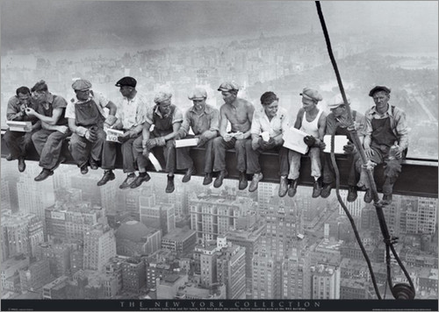
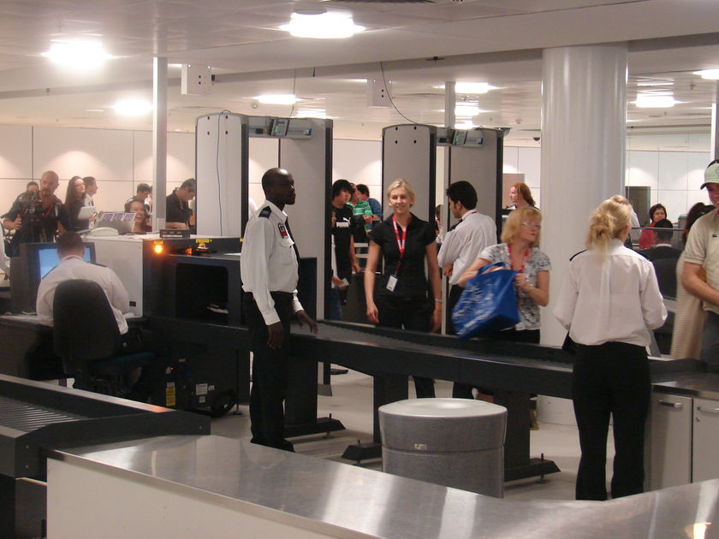
  Discuss the success or failure of an airport security process or a fatal fall on a construction site.
ECHO I I I I I
Operations
(Time)
Equipment
(Technology)
Integration
Interfaces
Interactions
Interferences
Interdependencies
Humans
(Training)
Context
(Environment)
(Tide)

Slide 39
The 6Us and 2Ms of Usability
Utility
  Is the system useful?
Usage and Misusage
  How and in what context will the system be used?
  What possible extreme contexts may be predicted
Usability
  Is the system easy to use or misuse?
Utilization
  How often and by how many people is the system used?
Users and Misusers
  Who are the users and possible misusers?
User Error
  What kinds of error can be made, when and how will they be made, how frequently and what are the possible consequences?
6U
2M

Slide 40
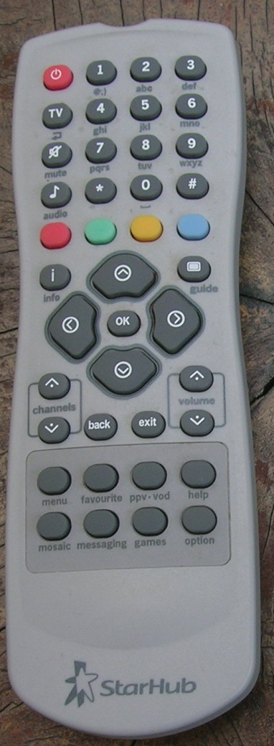
6U
2M
Utility
  Is the system useful?
Usage and Misusage
  How and in what context will the system be used?
  What possible extreme contexts may be predicted
Usability
  Is the system easy to use or misuse?
Utilization
  How often and by how many people is the system used?
Users and Misusers
  Who are the users and possible misusers?
User Error
  What kinds of error can be made, when and how will they be made, how frequently and what are the possible consequences?
Take Home Test

Slide 41
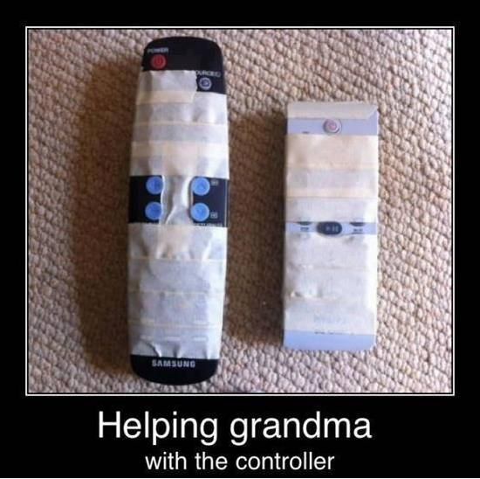

Slide 42
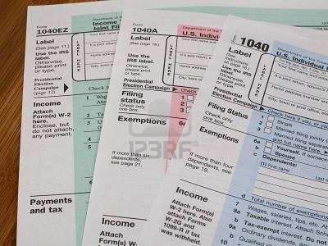
Tax Forms
6U
2M

Slide 43
Swiss Cheese Model of Latent System Failures
Organization
Accidents are caused by a sequence / hierarchy of failure pathways
Supervision
Preconditions
Unsafe Acts
The “base event”
Reason

Slide 44
HFACS
Human Factors Analysis and Classification System
  Developed mainly for aircraft accident investigation
  May be modified for many other accident investigation and system design scenarios
  Developed from Reason’s “Swiss Cheese” model of accident causation
The Human Factors Analysis and Classification System (HFACS) Scott Shappell and Douglas Weigmann, DOT/FAA/AM-00/7, office of Aviation Medicine, Washington, DC

Slide 45
Unsafe Acts
Errors
Violations
Skill based Errors
Decision Errors
Perceptual Errors
Routine
Exceptional
Hands and Eyes
Speeding
Drinking
Bending the rules
One off acts- low flying
Problem Solving
Procedures
Poor Choices
Degraded Inputs

Slide 46
Preconditions
Social
Environmental
Personnel
Physical
Technological
Crew Resource
Management
Personal
Interfaces
Facilitators
Condition of
Operators
Communications
Teamwork
Weather
Noise
Rest
Medication
Adverse
Mental
States
Adverse
Physiological
States
Physical / Mental
Limitations
Fatigue
Hypoxia
Intoxication
Senses
Aptitude
Experience
Stress
Vigilance
Distraction

Slide 47
Unsafe Supervision
Inadequate
Supervision
Planned
Inappropriate
Operations
Failure to
Correct
Problem
Supervisory
Violations
Training
Assignments
Monitoring
Untrained Supervisor
Assignments
Workload
Uncorrected hazard
Uncorrected behavior
Unauthorized assignments
Procedure violation
Fraud

Slide 48
Organizational
Influences
Resource
Management
Organizational
Climate
Organizational
Process
Priorities
Productivity
Cost cutting
Training
Unofficial rules
Ill defined policies
Cronyism
Communications
Assignments
Schedules
Procedures

Slide 49
6U
2M
E4S4
The Design Process
Notes:
What is the purpose of product (or service) design?
A product can be thought of as something tangible / physical
A service is a kind of product and often involves physical products
Going to the doctor (medical service)
Going to the store (retail service)
Going to the CPA (financial service)
Going to church (spiritual service)

Slide 50
The Grammar of Design
A System is a collection of elements such as machines, people or organizations
  Systems are specified by nouns and quantified by adjectives.
  System designs can be verified
A Process is the interaction of two or more systems with a defined purpose.
  Processes are described by verbs and quantified by adverbs
  Process requirements can be validated
The Context or Conditions of a process will use other linguistic conventions such as conjunctions and prepositions
Notes:
More definitions
We can expand the use of grammatical concepts beyond nouns, adjectives, verb and adverbs to things that describe context – on, at, in, after, before. We can also use different kinds of quantitative and qualitative adjectives and adverbs. We can define interactions by the use of Boolean concepts – and, or, not and, not or etc.

Slide 51
Verification and Validation
Design Specifications
  adjectives
  can be verified
Performance Requirements
  adverbs
  can be validated

Slide 52
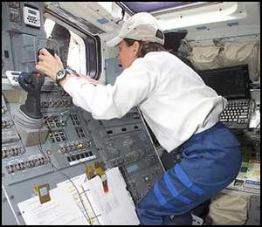
Processes with
Humans in the Loop
Communicating
Seeing
Planning
Performing
Adjusting
Deciding
Controlling
Translating
Remembering
Reaching
Managing
Processes have Requirements - Adverbs

Slide 53
Oxygen
Systems for
Humans in the Loop
Life Support
Computers
Cameras
Tools
Procedures
Robots
Windows
Machines
Controls
Displays
Lighting
Organizations
Operators
Restraints
Systems need Specifications - Adjectives

Slide 54
Requirements and Specifications
Outcome
Requirements
The mapping challenge
Common
Currency
Design Specifications
(Engineering measures)
Notes:
How do we do the mapping
A method for interactions – Counting or adding
Weighting
ERAU risk analysis sheet

Slide 55

The Designer’s Language
(with interactions)
Adverb
-
Vehicle Speed
Aerodynamic
Big and Heavy
Adjective - Engine Size

Slide 56
Corvette Customer Requirements (or Specifications?)
I agree that the C7Z if there is one should be the more performance oriented car, but I'm not sure you will get them to radically change the interior from other models. There is a cost of having a totally different interior. I would hope though that they offer a 1LZ that makes sense that does not add a lot of extras which also adds weight, but you should probably keep in mind that the majority of Z06s do have a 3LZ package. So, it seems like we might be in the minority here...
For those of you "performance first" Corvette guys/gals, let's talk about what should be expected from the next generation Z06. I propose we assume the Z06 is the "track" or "street legal race car" version of the Corvette with MAXIMZED PERFORMANCE PER DOLLAR.
Specs, I'd love to see:
front mounted 555 bhp NA engine mounted even further back and lower than the C6Z
2700 - 2900 lbs curb weight
adjustable coilovers
"bullet proof" dry sump system
RWD with performance traction management system
To minimize weight and cost (that would eat up the "performance budget") the C7Z interior should be minimalist, similar to a Lotus Elise: http://www.zcars.com.au/images/lotus...-interior1.jpg
The C7Z should also not have a convertible or targa option to remain light and stiff.
http://forums.corvetteforum.com/c7-general-discussion/2550321-c7z06-customer-requirements-thread.html

Slide 57
Corvette Engine Specifications
 | 2008 Corvette Coupe | 2008 Corvette Z06 | 2008 Corvette C6.R
Displacement (L / ci) | 6.2 / 376 | 7.0 / 427 | 7.0 / 427
Horsepower | 430 @ 5900 rpm | 505 @ 6300 rpm | 590 @ 5400 rpm
Torque (lb-ft) | 424 @ 4400 rpm | 470 @ 4800 rpm | 640 @ 4600 rpm
Bore diameter (mm / in) | 103.25 / 4.06 | 104.8 / 4.125 | 106.2 / 4.180
Crankshaft stroke (mm / in) | 92 / 3.62 | 101.6 / 4 | 98.42 / 3.875
Deck height (mm / in) | 235 / 9.24 | 235 / 9.24 | 235 / 9.24
"V" angle (deg) | 90 | 90 | 90
Cylinder bore spacing (mm / in) | 111.7 / 4.40 | 111.7 / 4.40 | 111.7 / 4.40
Valvetrain | pushrod with overhead steel valves | pushrod with overhead titanium valves | pushrod with overhead titanium valves
Valves per cylinder | 2 | 2 | 2
Camshaft drive | chain | chain | chain
Cylinder case material | aluminum | aluminum | aluminum
Cylinder liners | dry iron | dry iron | none
Cylinder head material | aluminum | aluminum, CNC ported | aluminum, CNC ported
Lubrication system | wet sump | dry sump | dry sump
Fuel system | sequential EFI | sequential EFI | sequential EFI
Throttle system | throttle body | throttle body | individual runner
Fuel | premium unleaded gasoline recommended | premium unleaded gasoline required | E85 ethanol (85 percent ethanol, 15 percent gasoline
http://www.corvetteracing.com/cars/c6r/engine_specs.shtml

Slide 58

Make a list of Requirements and Specifications for your Office

Slide 59
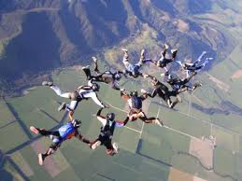
Risk
ECHO I I I I I

Slide 60
> 360 Days, No Resupply
6
5
4
3
2
1
 | 1 | 2 | 3 | 4 | 5
2
4
5
Habitability
Physical
Cognitive
Training
Team
Integration
Risk
1
3
Outcome

Slide 61
Risk Analysis Components
Likelihood of system failure
  On a single “transaction”
Consequence of system failure
Exposure – frequency / number of people exposed, number of transactions
Number / variety of failure modes
Costs and utility of alternative interventions
Risk indices based on many failure modes

Slide 62
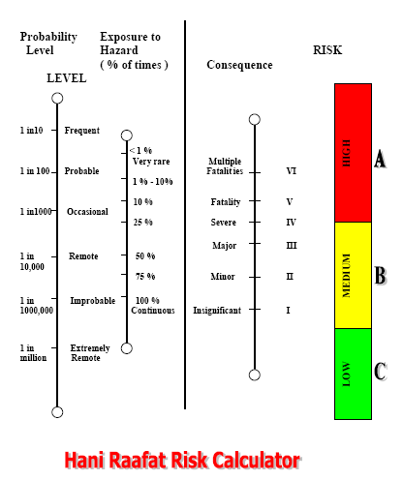

Slide 63
Risk Benefit Data Measures
Probability of Failure p Failures / Transaction
Exposure
Task, Transactions / Day T
Number of People Exposed N
Benefits of Process or Change
Functional Process Value $V $ / day
Personal Advantage $A $/ day
Value of Intervention / Change $C $ / day
Cost of Intervention / Change
Manpower + Training $M $ / day
System (Capital, Repair) Costs $S $/day
Cost of Adverse Outcome (Failure)
Environmental $E $/day
Human $H $/day
System Down Time $D $/day
Other Economic Costs $O $/day
Spread all capital costs over 1000 days and divide by 1000 to get $/day

Slide 64
Indices
Getting your arms around complexity

Slide 65
Common Currency
Rating Response
Not Applicable
Adequate Accept
Marginal Investigate
Intolerable Reject / Modify
Unthinkable Unacceptable
This scale provides a sufficient level of resolution.
0
1
2
3
It facilitates comparisons and prioritization
4
5
6
7
8 - 10

Slide 66
Policy Decisions
Common Currency
Outcome Scale
1
2
3
4
5
6
7
Policy Statements
Unacceptable
Range
7
6
5
4
3
2
1
Region of Interactions and Continuous Improvement
Ideal Range
Engineering Variable or Composite Index

Slide 67
Complex Decisions
 | Overhead |  |  |  |  | E4S4 Analysis
 |  |  | Effectiveness | Efficiency | Ease of Use | Elegance | Safety | Security | Satisfaction | Sustainability |  |  | Counts
 |  | Weights | 1 | 1 | 1 | 1 | 1 | 1 | 1 | 1 | 1
 | Stake Holders |  |  |  |  |  |  |  |  | Reliability | Resilience | 0 | 1 | 2 | 3
 | Designers | 1 | 3 | 3 | 2 | 1 | 1 | 2 | 3 | 3 | 1 | 0 | 3 | 2 | 4
 | Manufacturers | 1 | 1 | 0 | 1 | 2 | 0 | 3 | 0 | 2 | 3 | 3 | 2 | 2 | 2
 | Installers | 1 | 3 | 2 | 2 | 1 | 2 | 2 | 3 | 2 | 3 | 0 | 1 | 5 | 3
 | Operators | 1 | 1 | 3 | 0 | 3 | 0 | 1 | 3 | 3 | 3 | 2 | 2 | 0 | 5
 | Commercial Customers | 1 | 3 | 0 | 1 | 3 | 3 | 3 | 0 | 2 | 2 | 2 | 1 | 2 | 4
 | Private Customers | 1 | 0 | 2 | 3 | 1 | 1 | 1 | 2 | 2 | 1 | 1 | 4 | 3 | 1
 | Maintainers | 1 | 0 | 2 | 3 | 0 | 2 | 1 | 3 | 1 | 3 | 2 | 2 | 2 | 3
 | Disposers | 1 | 3 | 1 | 3 | 3 | 1 | 0 | 0 | 2 | 2 | 2 | 2 | 2 | 3
 |  |  |  |  |  | Counts |  |  |  |  |  | 12 | 17 | 18 | 25
0 | Not Applicable |  | 2 | 2 | 1 | 1 | 2 | 1 | 3 | 0 | 0 | 12
1 | Acceptable |  | 2 | 1 | 2 | 3 | 3 | 3 | 0 | 1 | 2 | 17 |  | Score
2 | Marginal |  | 0 | 3 | 2 | 1 | 2 | 2 | 1 | 5 | 2 | 18 |  | 1.78
3 | Unacceptable |  | 4 | 2 | 3 | 3 | 1 | 2 | 4 | 2 | 4 | 25
 | Underground |  |  |  |  | E4S4 Analysis
 |  |  | Effectiveness | Efficiency | Ease of Use | Elegance | Safety | Security | Satisfaction | Sustainability |  |  | Counts
 |  | Weights | 1 | 1 | 1 | 1 | 1 | 1 | 1 | 1 | 1
 | Stake Holders |  |  |  |  |  |  |  |  | Reliability | Resilience | 0 | 1 | 2 | 3
 | Designers | 1 | 1 | 3 | 1 | 1 | 1 | 0 | 0 | 2 | 3 | 2 | 4 | 1 | 2
 | Manufacturers | 1 | 1 | 2 | 2 | 1 | 1 | 1 | 3 | 0 | 0 | 2 | 4 | 2 | 1
 | Installers | 1 | 1 | 1 | 0 | 1 | 0 | 3 | 0 | 1 | 0 | 4 | 4 | 0 | 1
 | Operators | 1 | 3 | 0 | 1 | 1 | 0 | 1 | 2 | 2 | 0 | 3 | 3 | 2 | 1
 | Commercial Customers | 1 | 1 | 1 | 3 | 2 | 0 | 1 | 1 | 0 | 0 | 3 | 4 | 1 | 1
 | Private Customers | 1 | 0 | 2 | 1 | 3 | 3 | 3 | 1 | 1 | 0 | 2 | 3 | 1 | 3
 | Maintainers | 1 | 2 | 0 | 0 | 0 | 2 | 1 | 0 | 2 | 1 | 4 | 2 | 3 | 0
 | Disposers | 1 | 2 | 1 | 1 | 3 | 1 | 3 | 1 | 3 | 1 | 0 | 5 | 1 | 3
 |  |  |  |  |  | Counts |  |  |  |  |  | 20 | 29 | 11 | 12
0 | Not Applicable |  | 1 | 2 | 2 | 1 | 3 | 1 | 3 | 2 | 5 | 20
1 | Acceptable |  | 4 | 3 | 4 | 4 | 3 | 4 | 3 | 2 | 2 | 29 |  | Score
2 | Marginal |  | 2 | 2 | 1 | 1 | 1 | 0 | 1 | 3 | 0 | 11 |  | 1.21
3 | Unacceptable |  | 1 | 1 | 1 | 2 | 1 | 3 | 1 | 1 | 1 | 12

Slide 68
Another View of the Human Factors Design Process
Definition of Purposes (E4S4)
There will be tradeoffs
Description of Constraints
Environmental, Social, Financial, Temporal
Definition and Exploration of Functions
Simulation
Allocation of Functions
Between People and Technology
Definition / Development of Systems
Design
Technological Systems
Development
Human Systems
6Us Selection, Training, Assignment
Operational Systems
Times, Rules
Development of Interfaces
Technological-Human-Operational-Contextual
Construction and Verification of Systems
Testing, Quality Management
Implementation and Validation of Processes
Evaluation, Investigation
Continuous Improvement
Research, Analysis

Slide 69
Product Life Cycle Model
Many Requirements
Feedforward (Anticipation)
Requirements
Concept
Development
Concept
Selection
Many Customers
(including the shareholders)
Specifications
Tooling
Feedback, Technical Memory
Production
Marketing
Use and
Misuse
Design Team
Maintenance
Disposal

Slide 70

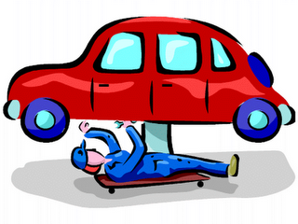
The Voice of the Customer
Which Customer?

Slide 71
System Design
Concurrent Engineering
Mission Design
Stage Reviews
Process Design
System Design
Process Integration
Sequential paper or computer models (“walls”) of the development status
Operations Design
Operations Implementation
Feedback / Lessons learned
Notes:
Within the GM Systems Engineering function
Concurrent engineering, Lean / Agile manufacturing
Stage reviews
Wall Worksheet

Slide 72
Going to Mars
E4S4
Concurrent Engineering
Mission Design
Manned Mars Mission
Time to
Market
Process Design
Navigating, Launching, Eating, Exercising, Landing, Modeling
Propulsion, Biomass Production Equipment, Communications Equipment, Robots
6U
2M
System Design
Process Integration
Time, Resource and Activity Planning, Modeling
Operations Design
I
E
P
Analogs, Modeling
Operations Implementation
Feedback / Lessons learned
Monitoring, Anticipating, Responding
Notes:
A more detailed look at the design process identifies multiple overlapping stages. The term “concurrent” is somewhat optimistic in practice. Given the vision of putting a man on Mars, there are distinct, but interdependent phases that must be addressed. The first phase is a function identification – launching, navigating, eating etc. each with their own purposes that are characterized by “quality”, “productivity”, “safety” etc. Next comes the realization of these functions through the design and construction of the appropriate hardware, software, “humanware” and “organizationware”. The process integration phase focuses on interactions, interdependencies and interfaces. Of course the advantages of concurrent engineering are particularly evident here as, for example, the human and hardware systems must be compatible. The penultimate phase of operations design really addresses the time element. In the Mars mission example it is critical that various supplies (food, water, oxygen, shelter etc.) would be on the planet before the human’s arrive. another good example is to be found in automobile production – it is one thing to design and build a car, but to produce 1000 cars a day presents altogether new operational challenges, not the least of which is just in time materials delivery. Finally there is operations implementation, which has its own local objectives and its contribution to the next mission.

Slide 73
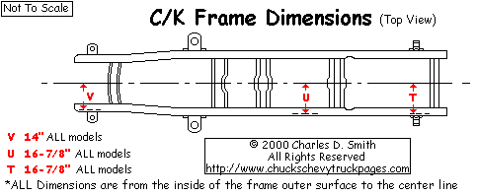
Apply Tools Early
“Concurrent Engineering”
Impact
Cost
Changes
Time to Market - Years
Research – Design - Production - Deployment

Slide 74
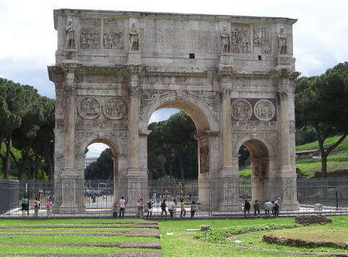
Design and Manufacturing Timelines
Rome wasn’t built in a day

Slide 75
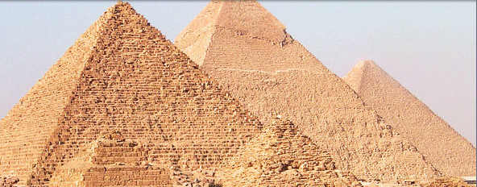
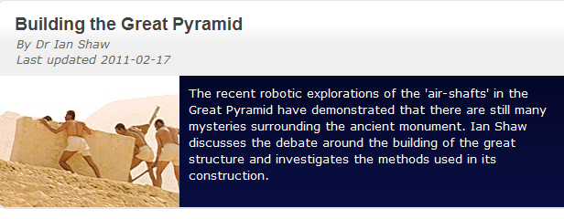
Design for Construction

Slide 76
Design for who?
6U
2M

Slide 77
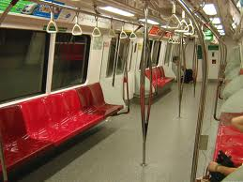
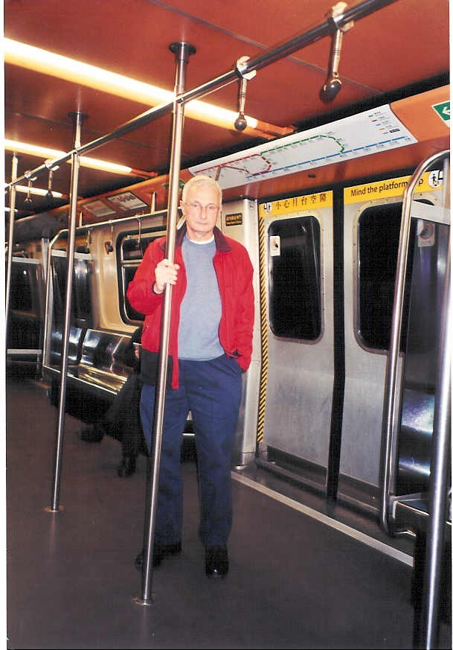
Design
for
Crowds
Singapore MRT
Hong Kong MTR

Slide 78
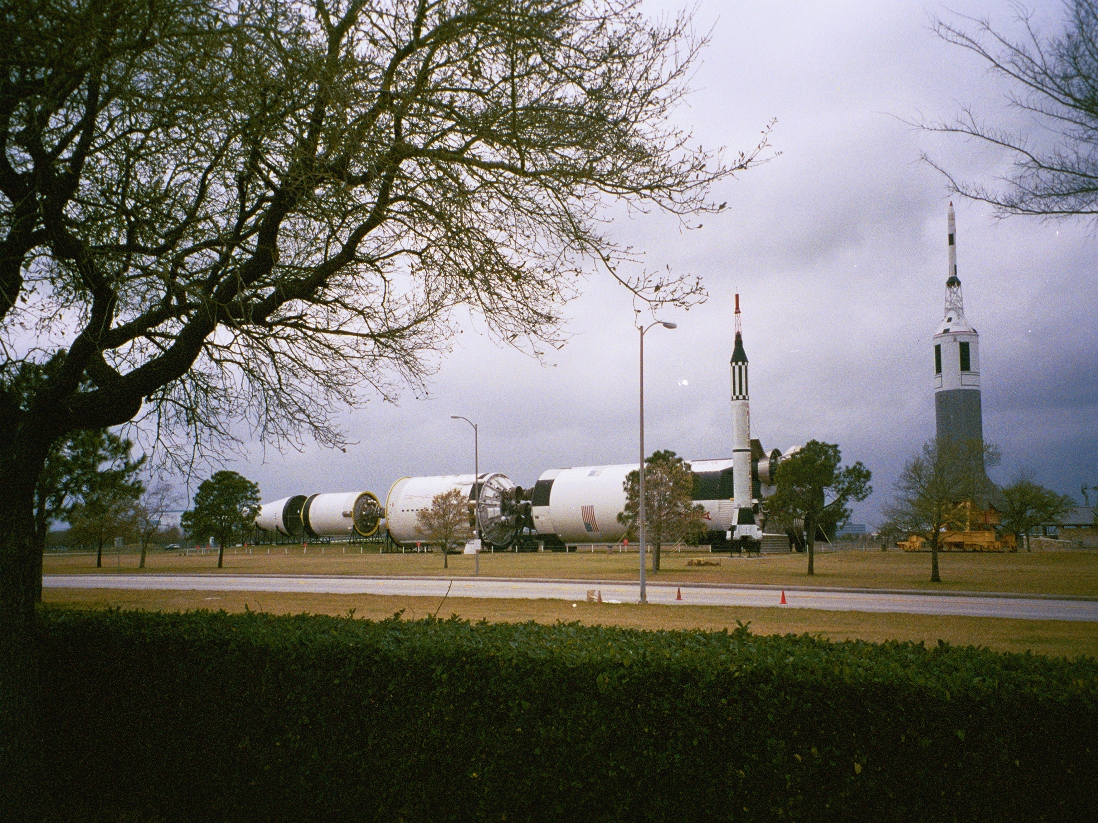
Difficult Design
Requirements
Carry astronauts to the moon
 | GTO Payload* (27 degree inclination) | GSO Payload* (0 degree inclination) | Estimated Launch Price | Configuration | Launch Mass
Atlas V 401 | 11,000 lb 5,000 kg | --- | US $90 M | Common Core + Centaur (1x RL-10A-4-1) | 734,850 lb 334,045 kg
Atals V 501 | 9,000 lb 4,100 kg | 1,500 lb 3,300 kg | US $85 M | Common Core + Centaur (1x RL-10A-4-2) | 741,165 lb 336,895 kg
Atals V 511 | 10,800 lb 4,900 kg | 3,900 lb 1,750 kg | US $90 M | Common Core + 1 SRB + Centaur (1x RL-10A-4-2) | 831,180 lb 377,805 kg
Atlas V 521 | 13,200 lb 6,000 kg | 4,900 lb 2,200 kg | US $95 M | Common Core + 2 SRB's + Centaur (1x RL-10A-4-2) | 921,200 lb 418,725 kg
Atlas V 531 | 15,200 lb 6,900 kg | 6,600 lb 3,000 kg | US $100 M | Common Core + 3 SRB's + Centaur (1x RL-10A-4-2) | 1,011,220 lb 459,545 kg
Atlas V 541 | 16,700 lb 7,600 kg | 7,500 lb 3,400 kg | US $105 M | Common Core + 4 SRB's + Centaur (1x RL-10A-4-2) | 1,101,230 lb 500,365 kg
Atlas V 551 | 18,080 lb 8,200 kg | 8,200 lb 3,750 kg | US $110 M | Common Core + 5 SRB's + Centaur (1x RL-10A-4-2) | 1,191,250 lb 541,195 kg
Atlas V Heavy ++ | 30,000 lb 13,605 kg | 13,000 lb 5,900 kg | US $130 M | Common Core + 2 Common Core Boosters + Centaur (1x RL-10A-4-2) | 2,120,000 lb 961,451 kg

Slide 79
The GM Access Car
6U
2M
Design for an ageing population - Which will you drive when you are 80?
Notes:
Methods
Focus groups
Formal experimentation
Clinics
Traditional HF rules based analysis
Mock ups
Comparative vehicle analysis
Many universities
Many engineers

Slide 80
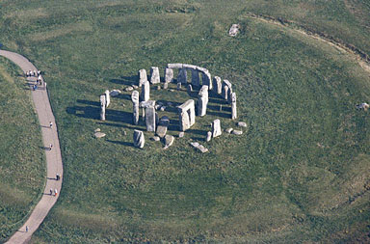
Design for Manufacturing?

Slide 81

Design for Tourists?

Slide 82
The Design Cycle
E4S4
Guidelines
and
Constraints
Decisions
Policy
Money
Analysis
Requirements
Outcomes
Analysis
Analysis
Tools
Analyses
The Process,
Job, Task,
Transaction
or Simulation
Specifications
Design
Equipment
Context
Humans
Operations
6U
2M
Uncontrollable
Conditions / Context
Prediction
ECHO I I I I I

Slide 83
Design Decisions
TRADEOFFS!
Policy
Science
Consensus:
  HF Experts
  Engineers
  Managers
  Customers
Design
Requirements
and
Specifications
Implementation
Experience
Data
History
6U
2M
Predictions
Evaluation
  Verification
  Validation
E4S4
Notes:
Design around the table
Paper airplane design
Use different hats in the design meeting

Slide 84
Human Factors Engineering / Ergonomics
Analysis
and
Design
with People in Mind

Slide 85
If it isn’t applied to the design of something it isn’t Ergonomics
(but it might be one of the related basic sciences – psychology, physiology, biomechanics etc)

Slide 86
The Scope of Human Factors
Human Factors Engineering addresses human physical, cognitive, affective and social characteristics, capabilities and limitations as they interact with contextual and operational (time) factors.

Slide 87
Physical
Size
Social
Strength
Roles
Jobs
Supervision
Skill
Language
and
Jargon
Stamina
Speed
Communication
Groups
and
Teams
Cooperation
Customers
Hierarchies
Competition
Businesses and Companies
Temporal
Cognitive
Attending
Perceiving
Understanding
Calculating
Sensing
Deciding
Forgetting
Environmental
Planning
Controlling
Remembering
Thermal
Heat
Humidity
Cold
Air movement
Acoustic
Communication
Hearing loss
Communicating
Learning
Affective
Light and Dark
Vision
Contrast
Color
Elegance
Vibration
Hand / Arm
Whole body
Esthetics
Emotion
Motivation
Excitement
Mood
Attitude

Slide 88
Human Physical Characteristics,
Capabilities and Limitations
Size
Strength
Skill
Stamina
Speed

Slide 89

People vary

Slide 90
Design Exercise
3H
Is there a “Golden Triangle?”
Eye Ellipse
Hand Point
Seat Back Tilt
Range of
Movement
Vertical
Adjustment
Horizontal Adjustment
Z = 0
Y = 0
X = 0
Range of
Movement
Heel Point
“H” Point

Slide 91


How heavy should a Suitcase be?

Slide 92

How long does it take a soldier to run 26 miles up hills, in the heat, through sand with a 20 kg back pack?

Slide 93
Bataan Death March Marathon Results
 |  | MFH | MMH | MFL | MML | CFH | CMH | CFL | CML
 |  | 7:47:34 | 5:32:58 | 6:00:44 | 4:24:06 | 8:16:12 | 5:28:31 | 4:05:10 | 3:32:04
MFH | 7:47:34 | 100 | 71 | 77 | 56 | 106 | 70 | 52 | 45
MMH | 5:32:58 | 140 | 100 | 108 | 79 | 149 | 99 | 74 | 64
MFL | 6:00:44 | 130 | 92 | 100 | 73 | 138 | 91 | 68 | 59
MML | 4:24:06 | 177 | 126 | 137 | 100 | 188 | 124 | 93 | 80
CFH | 8:16:12 | 94 | 67 | 73 | 53 | 100 | 66 | 49 | 43
CMH | 5:28:31 | 142 | 101 | 110 | 80 | 151 | 100 | 75 | 65
CFL | 4:05:10 | 191 | 136 | 147 | 108 | 202 | 134 | 100 | 87
CML | 3:32:04 | 220 | 157 | 170 | 125 | 234 | 155 | 116 | 100
Table 1. Relative percentages of average times of the top ten finishers in each status (Military, Civilian)), sex (Male, Female) and load carried (Heavy, Light)
Statistical prediction of physical performance with encumbrance

Slide 94

Skills - Tight Targets Take Time

Slide 95
Skills - Fitts Law(1954)
MT = a + b log₂ (2A/W)
where:
MT = Movement Time
a, b = Individual and Situational Constants
A = Amplitude of Movement
W = Width of Target
2A/W = Index of Difficulty (ID)

Slide 96
Environmental Factors
Acoustic
Communication
Hearing loss
Thermal
Heat
Humidity
Cold
Air movement
Light and Dark
Vision
Contrast
Color
Vibration
Hand / Arm
Whole body

Slide 97



Environmental Factors

Slide 98
Environmental Factors
Extremes cause performance failure
Sub extremes require extra effort to maintain performance levels
Low levels of environmental stress and variation may stimulate and enhance performance
Thermal
Heat
Humidity
Cold
Air movement
Acoustic
Communication
Hearing loss
Vibration
Hand / Arm
Whole body
Light and Dark
Vision
Contrast
Color

Slide 99
Cognitive Factors
Attending
Perceiving
Understanding
Calculating
Sensing
Deciding
Forgetting
Planning
Remembering
Controlling
Communicating
Learning

Slide 100


People vary

Slide 101

What happens when you grow old?

Slide 102

Are you Colorblind?
1. Normal Color Vision: A: 29, B: 45, C: --, D: 26
2. Red-Green Color-Blind: A: 70, B: --, C: 5, D: --
3. Red Color-blind: A: 70, B: --, C: 5, D: 6
4. Green Color-Blind: A: 70, B: --, C: 5, D: 2

Slide 103

Eye movements / focus
Instrument scan patterns in driving or flying is not random:
  Frequency of fixation indicates importance of instrument
  Pattern of movement indicates individual source relationships
  Length of fixation indicate the difficulty in obtaining or interpreting information from that instrument

Slide 104
Human Information Processing
Long Term Memory
Prediction
Attention
Operational
Memory
Perception
Senses
Cognition
Learning
Effectors
Management
Effectors
System Feedback
Environment

Slide 105
Cognition is complex
Goals
Understanding
Diagnosing
Analyzing
Judging
Cognition
Learning
Synthesizing
Deciding
Problem Solving
Planning
Investigating
Evaluating
Interpolating and Extrapolating
Predicting

Slide 106

Attention

Slide 107

Divided Attention
Multi-tasking
  The every day job of a manager
Driving and using a cell phone
Texting during a lecture

Slide 108
Vigilance Decrement
“Federal officials are investigating why two Northwest Airlines-Delta pilots overshot the Minneapolis-St. Paul airport this week, on a flight from San Diego. Controllers lost contact with the pilots during the flight. The pilots say they missed the airport because they were in a heated argument, but there are also questions of whether they might have fallen asleep.”
“A passenger train in the Indian state of Bihar zoomed past two railway stations - after the driver apparently fell asleep at the controls.”
"You don't need kindergarten to know that a resident working a 36-hour shift is in no condition to make any kind of judgment call -- forget about life-and-death."
In boring tasks vigilance may deteriorate rapidly in the first 20 minutes!

Slide 109


Perception: Computers are invading your life using ICONS as weapons

Slide 110

Context and Perception - Expectancy

Slide 111
Memories are made of this!
Iconic memory
  Sensory store
Primary memory
  Words to make a sentence, about 4 items
Working memory
  Retention and manipulation of data
  Limited capacity
Semantic memory
  What
  general, knowledge, concepts
Episodic / event memory
  Who, when, where
  May be very long term, specific, detailed
  Personal, emotional link
Procedural memory
  How
  Ride a bike, cook a meal, knit, drive a car
Prospective memory
  Prediction, when do I have to…..?
Recognition is often better than Recall

Slide 112

Iconic Memory
Short Term Temporary Operational Dynamic Memory
Rehearsal
Primary Memory
Prospective Memory
Working Memory
Forgetting
Semantic Memory
Episodic Memory
Procedural Memory
Long Term Permanent Damped Memory / Learning

Slide 113
The Bucket Model
Operational
Memory
Operational memory has a limited capacity. Rehearsal can keep information for extended times.
Interference (proactive and retroactive) causes items to be lost.
Primacy and Recency effects cause first and last items in a list to be recalled more reliably.
Chunking and linking (mnemonics) help retention.

Slide 114
The Context of Situation Awareness
Strategy
Knowledge
Simulation
Iconic Memory
Short Term Temporary Operational Dynamic Memory
Operations
Learning
Primary Memory
Rehearsal
Prospective Memory
Working Memory
Forgetting
Attention
Adaptation
Semantic Memory
Episodic Memory
Procedural Memory
Monitoring
Long Term Permanent Damped Memory / Learning
Perception
Comprehend
Understanding
Assess
Output
Prediction
Project

Slide 115

Can you remember this?
Welcome to Phoenix Sky Harbor
Taxi via Golf 8, Foxtrot, Foxtrot 12, Hold short of 25R, then proceed along Echo 12, Echo, Delta, Tango, Bravo, Charlie 9 to Terminal 4
What is wrong with these instructions?

Slide 116
Mental Workload
“ Mental workload is the amount of mental work or effort necessary for a person or group to complete a task over a given period of time.”
Xie and Salvendy 2000

Slide 117
Situation Awareness
Situation Awareness is the capacity to COMPREHEND, ASSESS and PROJECT information in order to CONTROL a situation in a TIMELY manner.
Situation awareness is a characteristic of individual or a team and is aided by appropriate use of technology and training
Perceive – Understand – Predict – Act - Evaluate

Slide 118
Mental Workload and Situation Awareness
Information
X
Stress
Mental Workload
=
Time
X
Experience
Time
X
Experience
Situation
Awareness
=
Information
X
Stress

Slide 119


Mental Workload and Situation Awareness

Slide 120



Slide 121
Cognitive Task Analysis – Emergency Landing
Turns, Height above ground to begin the flare
Engine failure causes
Safe landing
Communications jargon
Goals
Judging
Understanding
Wind strength and direction
Flaps?
Diagnosing
Analyzing
Deciding
Cognition
Synthesizing
Planning
Problem Solving
Approach
Adapting the mental model
Evaluating
Investigating
Predicting
Interpolating and Extrapolating
Pitch effects
Use of pitch and flaps without power
Touch down point
Apply the rules
Improvise
Time and altitude constraints

Slide 122
NASA TLX
Multi-dimension subjective workload rating technique
Workload defined as “cost incurred by human operators to achieve specific level of performance.”
Overall score is based on the weighted average of rating on 6 subscales

Slide 123
Name
Task
Date
TASK LOADING INDEX
Mental Demand: How mentally demanding was the task?
Very Low
Very High
Physical Demand: How physically demanding was the task?
Very Low
Very High
Temporal Demand: How hurried or rushed was the pace of the task?
Very Low
Very High
Performance: How successful were you in accomplishing what you were asked to do?
Perfect
Failure
Effort: How hard did you have to work to accomplish your level of performance?
Very Low
Very High
Frustration: How insecure, discouraged, irritated and annoyed were you?
Very Low
Very High

Slide 124
Heart Rate
Studies shown HR of pilots flying actual flights is higher than flying simulated flights (within subjects study)
Used in other non aviation studies:
  race car drivers – 150 to 180 bpm b4 race starts. HR 180 to 210 bpm during race
  race boat drivers: Change from while waiting 142bpm to 192bpm during race.
  Telemarketer: HR increase during work cf resting condition
However, heart rate is affected both by physical and psychological load
Sensitive measure, but lacks diagnosticity

Slide 125


Slide 126

Workload and Stress
The last three landings were solo
Go around practice

Slide 127

What happened here? Why?

Slide 128
Cognition Homework
I
E
P
Load Google Earth on to your computer
Select Tools >>Enter Flight Simulator
Choose Airport and Airplane
Choose Help>>Keyboard Shortcuts
Fly a traffic pattern (look out for other traffic)
  A (Talk to Tower) Full Throttle
  B Rotate at about 60 knots
  C Turn right at 1000’ AGL on to Cross Wind leg
  D Turn Right onto Downwind, Talk to Tower
  E Do a 360º turn to increase separation from other traffic
  F Reduce power to 66%, add 1 notch of flaps, pitch down (a little)
  G Turn Right onto Base Leg, add more flaps
  H Turn Right onto Final, add last lot of flaps
  I Cut Power, gently pull the nose up – flare and touch down at A
Report
Describe your cognitive experience
  Sensing
  Perception
  Understanding
  Planning
  Decision making
  Memory
  Judgment
  Motor control
  Learning
  Mental work load
  Situation awareness
  Describe your errors
E
D
F
G
C
B
A
I
H

Slide 129
Social Factors
Roles
Jobs
Supervision
Language
and
Jargon
Communication
Groups
and
Teams
Cooperation
Customers
Competition
Hierarchies
Businesses and Companies

Slide 130


Social Factors

Slide 131
Socio Technical System Design
Macro Ergonomics
Human Centered Design
Participation
People usually work in Groups / Teams
The Motivation to Work
  Taylorism – “Scientific Management”
  Hawthorne effect
  Tavistock Institute
  Herzberg
  Quality of Work Life

Slide 132
Affective Factors
Elegance
Esthetics
Motivation
Emotion
Mood
Excitement
Attitude
Less easily measured
Kansei engineering
Often dominate behavior

Slide 133


Both will tell you the time!!

Slide 135
Ageing - Stamina and Speed
Marathon Records
How fast will you run when you are 80?

Slide 136
Time Factors
Fatigue
Rohmerts Law

Slide 137

Human Decision and Control Time
Hick’s Law – complex decisions take time
Card Sorting Demonstration / Exercise

Slide 138
Some System Failure Opportunities

Slide 139

Slips Trips and Falls
A human information processing failure with a physical outcome
  Sensing
  Attention
  Perception
  Deciding
  Recognizing
  Balancing

Slide 140
Slips, Trips and Falls (UK HSE)
Did you know?
Slips and trips are the most common cause of major injuries at work and can happen almost anywhere. 95% of major slips result in broken bones and they can also be the initial cause for a range of other types of accident such as a fall from height.
Slips and trips are responsible for, on average:
  over a third of all reported major injuries
  20% of over-3-day injuries to employees
  2 fatalities per year
  50% of all reported accidents to members of the public that happen in workplaces
cost to employers £512 million per year (lost production and other costs)
cost to health service £133 million per year
incalculable human cost
more major injuries in manufacturing and in the service sectors than any other cause.
Many of you will die because of a slip, trip or fall!!

Slide 141

Ordering a Pizza

Slide 142

Booking an Airline Ticket

Slide 143

Money Management

Slide 144

Hand held devices

Slide 145
Multiple Purposes of Design
E4S4
Effectiveness
  Meets functional requirements
  “quality”
Efficiency
  Optimal use of resources
  “productivity”
Ease of Use
  Intended users
  Comfort and Convenience
  Prevention of misuse
Elegance
  Esthetic / emotional appeal
  Affective Design
Safety
  Prevention or mitigation of system failures
  For participants and third parties
Security
  Inadvertent or malicious misuse
Satisfaction
  Of ALL customers and stakeholders
Sustainability
  Reliability
    Under intended contexts over the life cycle
  Resilience
    Under unintended, unexpected and harsh conditions
There WILL be tradeoffs

Slide 146
ECHO IIIII
An adaptation of the SHEL model
Operations
(Time)
ECHO I I I I I
Equipment
(Technology)
Integration
Interfaces
Interactions Interferences
Interdependencies
Humans
(Training)
Context
(Environment)
(Tide)
Time and Tide wait for no man, Technology and Training continuously improve

Slide 147
The 6Us and 2Ms of Usability
Utility
  Is the system useful?
Usage and Misusage
  How and in what context will the system be used?
  What possible extreme contexts may be predicted
Usability
  Is the system easy to use or misuse?
Utilization
  How often and by how many people is the system used?
Users and Misusers
  Who are the users and possible misusers?
User Error
  What kinds of error can be made, when and how will they be made, how frequently and what are the possible consequences?
6U
2M

Slide 148
Human Factors
Physical
Social
Size
Strength
Roles
Jobs
Supervision
Skill
Stamina
Speed
Language
and
Jargon
Communication
Groups
and
Teams
Cooperation
Customers
Hierarchies
Competition
Businesses and Companies
Temporal
Cognitive
Attending
Perceiving
Understanding
Calculating
Sensing
Deciding
Planning
Forgetting
Environmental
Remembering
Thermal
Heat
Humidity
Cold
Air movement
Acoustic
Communication
Hearing loss
Controlling
Communicating
Learning
Affective
Vibration
Hand / Arm
Whole body
Light and Dark
Vision
Contrast
Color
Elegance
Esthetics
Emotion
Motivation
Excitement
Mood
Attitude

Slide 149
The Design Problem
How?
Who and what are these?
6Us
Predict
Anticipate
Feedforward
External Factors and Customers
E4S4
Design
The System
Feedback
What are the tradeoffs?
How?

Slide 150
there is always a need to study a problem in sufficient depth and with sufficient data and sophistication
Industrial and systems engineering offers many tools and techniques that can be applied to the design and evaluation of complex systems and processes.
Two simple tools are the 5 Ws and the 5 Whys – ask who, what, where, when and how; then ask “why?” 5 times along any analytical avenue and you will probably find the root causes of success or failure.
Human Factors Engineering knowledge, methods and evidence can be applied in any industrial, commercial or service domain, such as manufacturing, banking and health care.
Examine the roles and successes / failures of people in airport baggage handling, call centers and taxi driving. What are the forms, frequencies and causes of failure (or success?) How can reliable data be obtained? Apply “Murphy’s Law” (If a system can fail then someone will cause it to fail.” Bring to bear all the (Human Factors and Industrial Engineering) tools of analysis and design to improve the experience of all concerned.

Slide 151
Design Rules - Consensus
Policy
Science
Consensus:
  HF Experts
  Engineers
  Managers
  Customers
Design
Rule
Rule
Implementation
Experience
Data
History
Predictions
Evaluation
  Verification
  Validation
  Sensitivity
Technical
Memory

Slide 152
Human Factors Duty
Operations
(Time)
Equipment
(Technology)
Integration
Interfaces
Interactions Interferences
Interdependencies
Humans
(Training)
Give the design engineer a number
Or at least a “loss function”
Context
(Environment)
(Tide)
E4S4
Loss
6U
2M
Design Deviation

