Slide 1
Ergonomics for Equipment Design
Brian Peacock
for
Pitney Bowes Inc

Slide 2
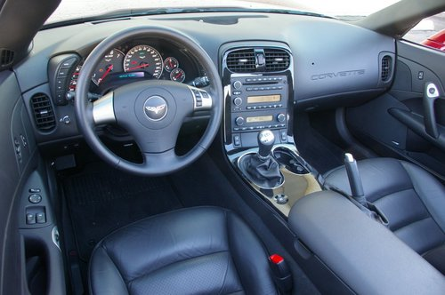
Purpose
To present ergonomics guidelines for equipment design with the purpose of reducing transaction times, errors, and operator injury and discomfort.

Slide 3
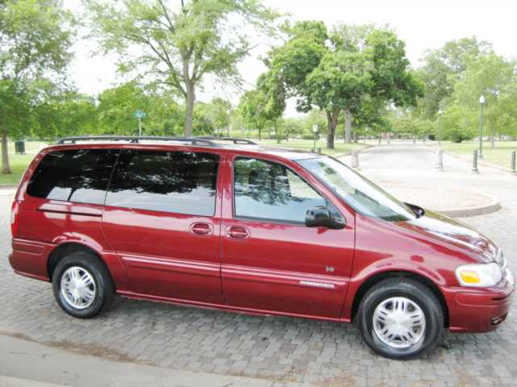
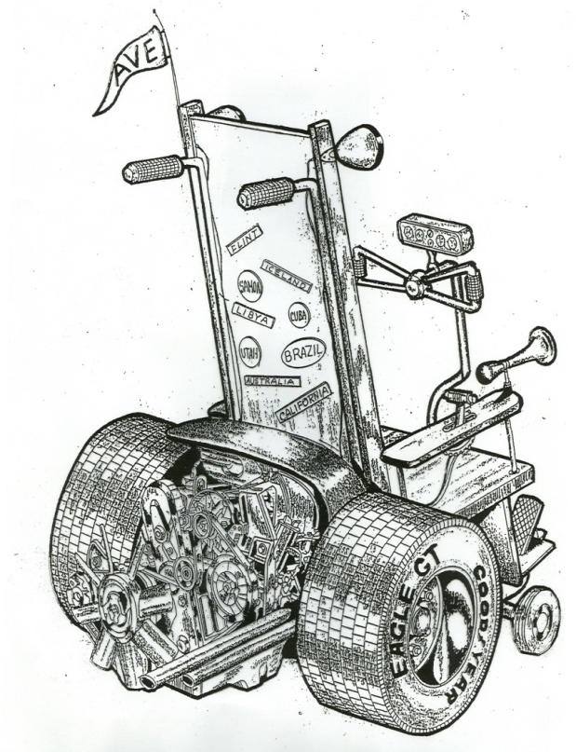
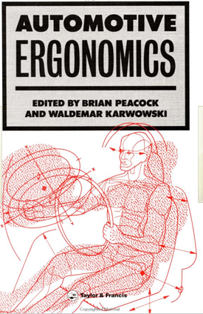
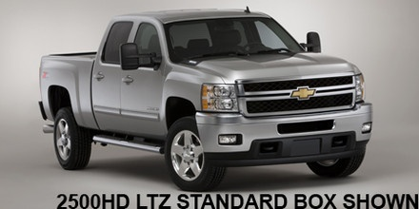
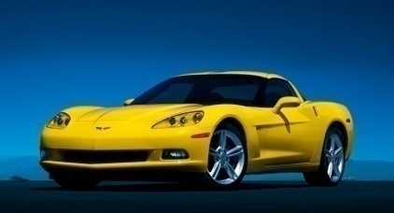
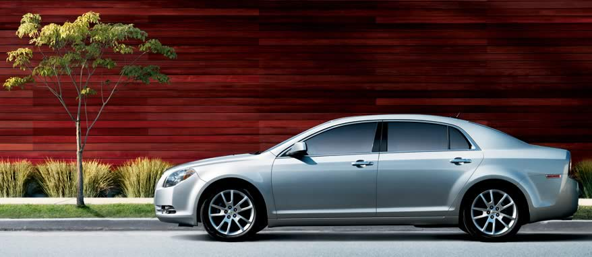
Automobile Design
ACCESS Car

Slide 4
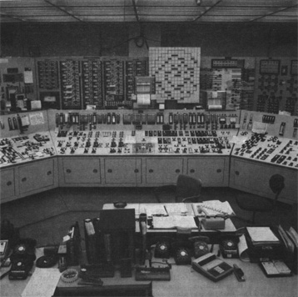
Equipment Characteristics
Powered or non-powered mechanical or electronic devices
Functions, alternatives, design opportunities (adjectives)
Workplace
  Physical arrangement of equipment and operators
  Physical and operational environment
Human Interfaces
  Controls and displays
  Physical and cognitive interfaces
Process and tasks (operations)
  Transactions
  Set up, operation, maintenance, calibration

Slide 5
Exercise on Human-Machine System Analysis
Consider the following human-machine systems
  car/driver/roadway
  welding equipment
  powered hand tool
  TV Remote
Describe the systems and system components
Describe the process purpose(s) and constraints

Slide 6
    The Purposes of Design
To be Reliable – these outcomes will continue over the life cycle of the process or system of interest
Ease of Use
Effectiveness
Efficiency
Elegance
Safety
Security
Satisfaction
E4S4
Often there will be TRADEOFFS
To be Resilient these outcomes will continue during intended use and conditions and possible misuse and under extreme conditions

Slide 7
Exercise on Task (process) Analysis
Chose one of the human - machine systems from the previous exercise
Describe the process (task) purpose
Describe the activities (transactions)
Describe the physical and operational environment
Describe the measurable outcomes
Describe the opportunities for change (system adjectives)

Slide 8
People Variables
Physical
  Size, Shape, Strength, Stamina, Reach, Fit, Variability
Vision
  Monocular and binocular vision cones, obstructions
Cognition
  Attention, perception, memory, decision making, problem solving
Knowledge
  System dynamics, error implications
Training
  Motor control, dexterity
  Operational and error mode experience
Behavior
  Habits, risk taking

Slide 9
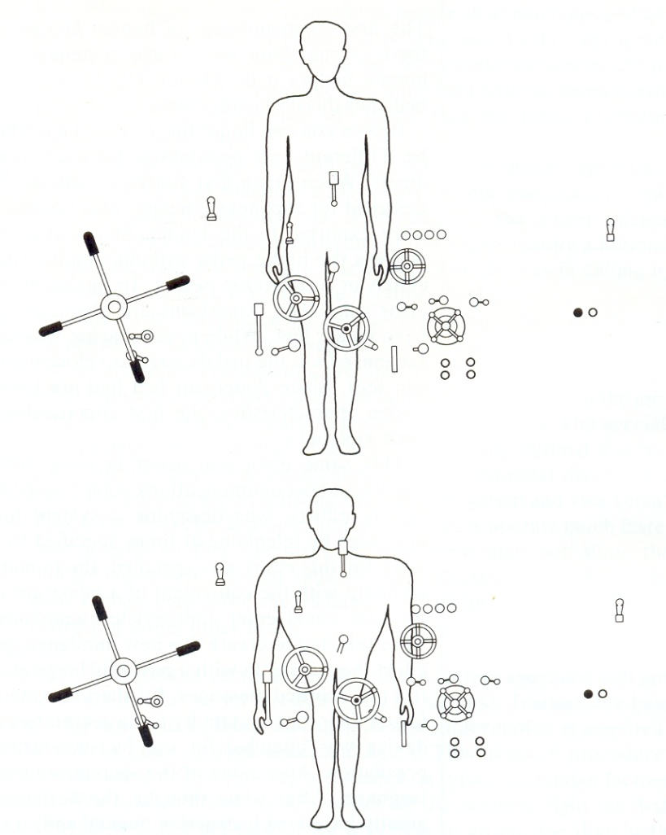
Physical Arrangement of Workplaces
Key anthropometric variables
  Reach curves
  Eye height
  Vision cones
  Accommodation principles
Workplace design principles
  Task analysis
  Visibility
  Reach, Access, Fit
  Base postures
  Fixed and adjustable workstations

Slide 10
Biomechanical and Physiological Factors
  Can the operator perform the expected manipulations under all usual and unusual operational and environmental conditions?
Strength
  Controls, Maintenance tools
Stamina
  Repeated and long duration activities
Skill
  Precise manipulations

Slide 11
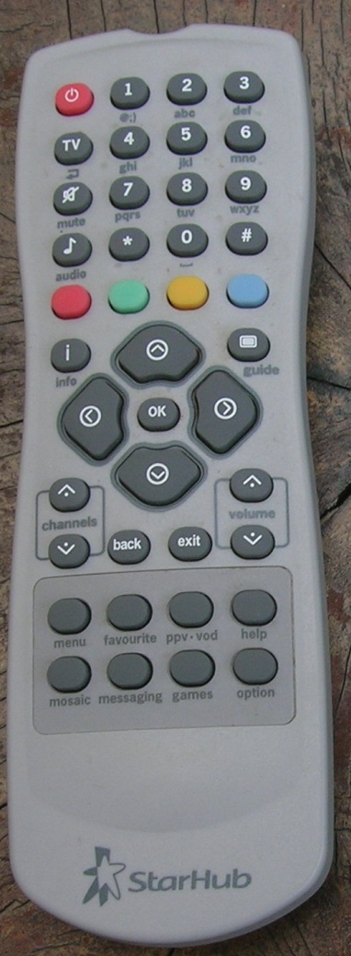
Cognitive Factors in Control and Display Design
Sensory access
  Can the operator see the control or display from all expected operational locations and conditions?
Attention
  Is the operator’s attention drawn to key system-status values
  Are there sources of distraction either in the equipment or workplace
Understandability
  Can the operator understand the status of the control or display and the implication of deviant values?
Memory for target values
  Does the operator have clear knowledge of target values or ranges
Motor skills
  Can the operator reach, grasp and manipulate the controls effectively?
Feedback
  Is timely feedback provided regarding the effect of a control input?
Error types and implications
  Is the operator familiar with error possibilities and their implications?

Slide 12
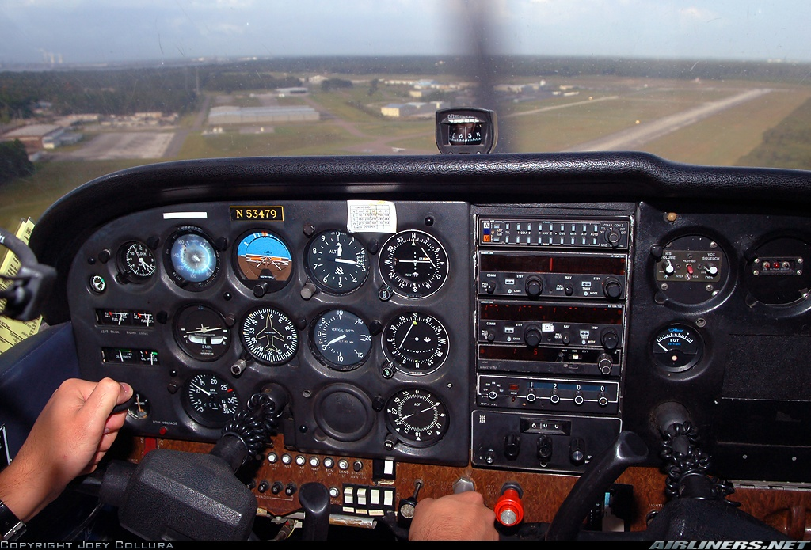
Display Types
Discrete
Static
Symbolic
Verbal
Analog
Digital
Representational
Video
Audio
Annunciators

Slide 13
Display Design Criteria
Visibility
  Can the operator see the display from all expected operational locations?
Accuracy
  Does the display provide accurate information?
Resolution
  Does the display have the appropriate level of resolution?
Importance
  How important is the display in the broad context of the normal and maintenance and emergency operations?
Frequency
  How often is the display used?
Sequence
  What is the operational sequence of the display?

Slide 14
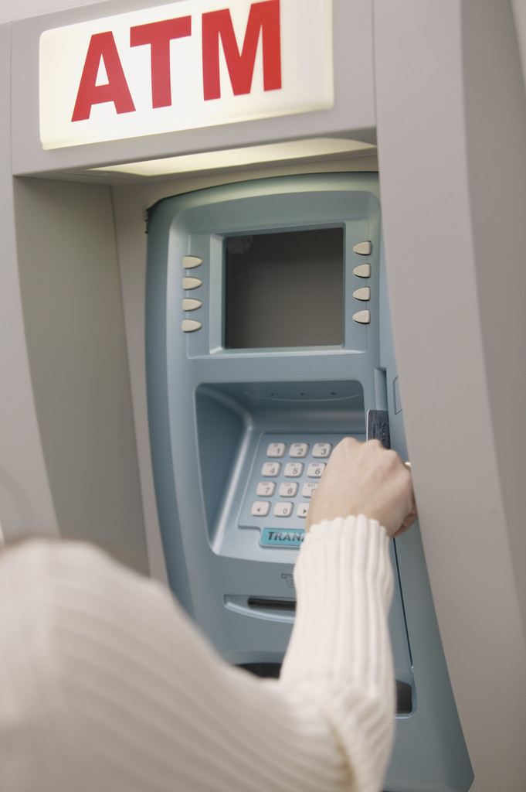
  Can the operator understand the status and implications of deviations of the display under all operational and environmental conditions?
Understandability

Slide 15
The Scope of Human Factors / Ergonomics
Interfaces, Interactions, Interdependencies, Interferences, Integration
Context
The Users
Physical
Cognitive
Emotional
The Systems

Slide 16
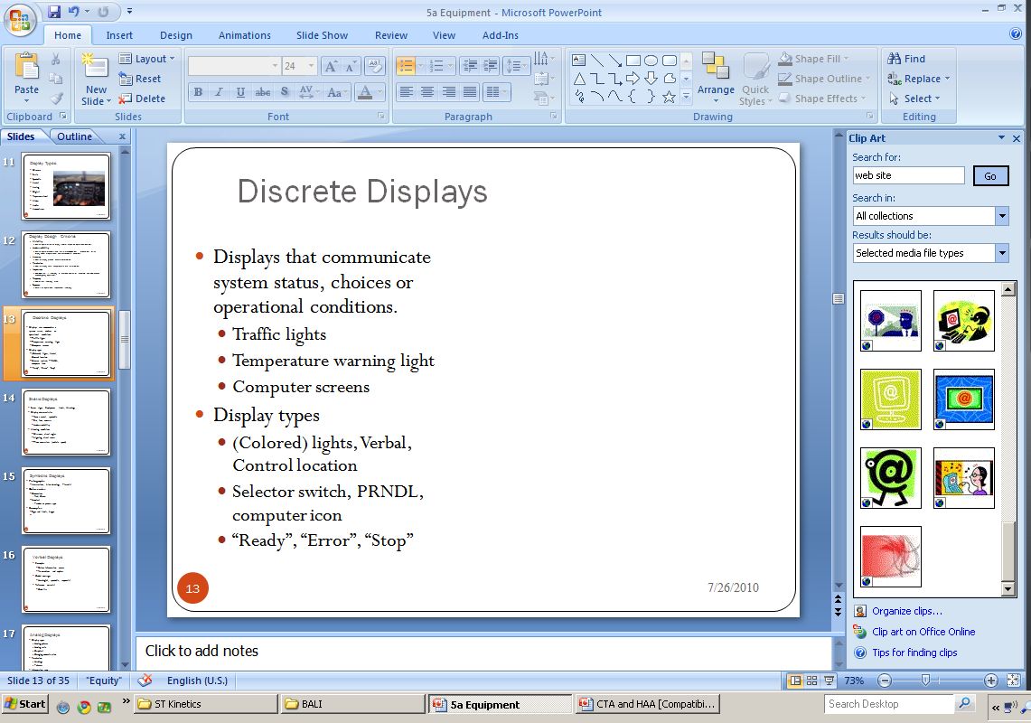
Discrete Displays
Displays that communicate system status, choices or operational conditions.
  Traffic lights
  Temperature warning light
  Computer screens
Display types
  (Colored) lights, Verbal, Control location
  Selector switch, PRNDL, computer icon
  “Ready”, “Error”, “Stop”

Slide 17
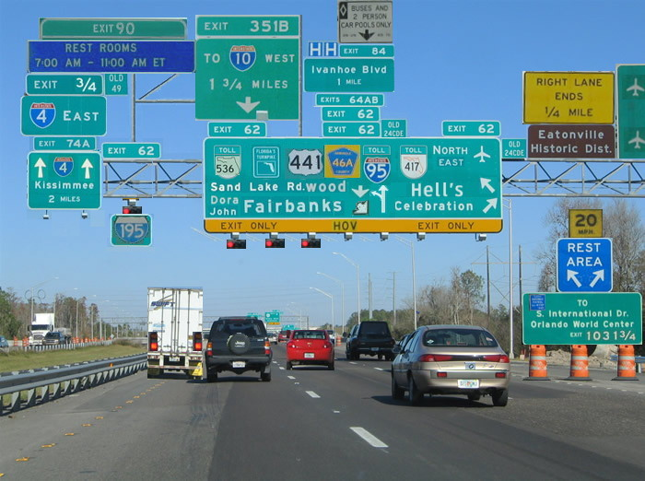
Static Displays
Street signs, Equipment labels, Warnings
Display characteristics
  Form - verbal, symbolic
  Size, font, contrast
  Understandability
Viewing conditions
  Distances, visual angles
  Lighting, visual access
  Time constraints

Slide 18
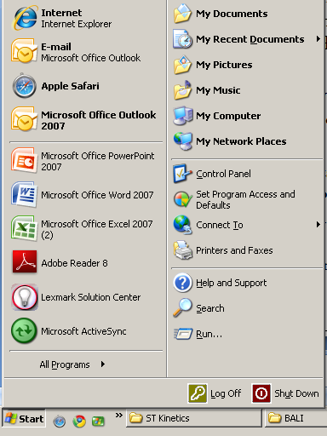
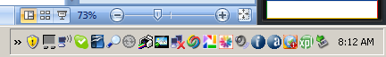
Symbolic Displays
Pictographs, icons
  Abstractions, Line drawings, Pictorial
Color codes
  Conventions
    Red, Green
  Nominal
    Product or process type

Slide 19
Analog Displays
Display types
  Moving pointer
  Moving scale
  Graphical
  Changing numeric value
Resolution
  Markings
  Pointers
Information type
  Location
  Discrete value, zone
  Rate of change

Slide 20
Digital Displays
Best for discrete readings
Comparison with numeric standard
Good for slow rate of change
Examples
  Time, speed
  Distance, fuel
  Temperature, pressure
  Radio frequency

Slide 21
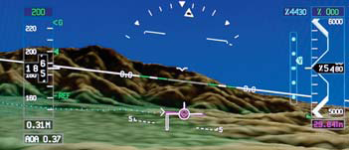
Representational Displays
Maps
Examples
  Electrical circuits
  Road systems
  Component part relationships
Mixed format
  Shape, color, location, direction, verbal, symbols, video

Slide 22
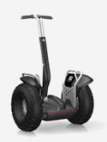
Audio Displays
Warnings and reminders
Ancon cords
Sirens, horns
Confirmations, feedback
Electric buses, cars and bicycles

Slide 23
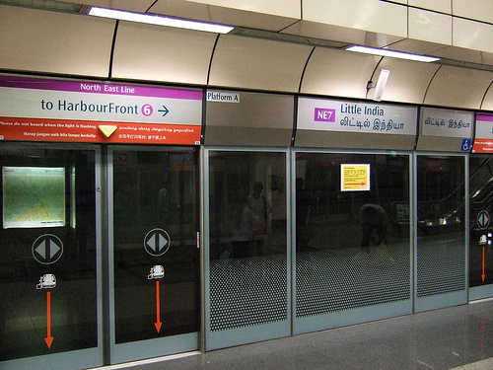
Annunciators
To attract attention
  Sufficient intensity to overcome background “noise”
    Audible
      Variable intensity and pitch
    Visual
      Central field of view
      Variable intensity
      Flashing
    Vibration
      Military aviation
      Cell phone
  Indicates the degree of importance / urgency
    Car sounds
    Singapore MRT door closing
  Indicates where to look for more information

Slide 24
Control Types
Discrete controls
  Buttons, switches, rotary selectors
Analog controls
  Knobs, handwheels, cranks, levers
  Foot pedals
Computer input devices
  Keyboards, mice, trackballs, pen, touch screen

Slide 25
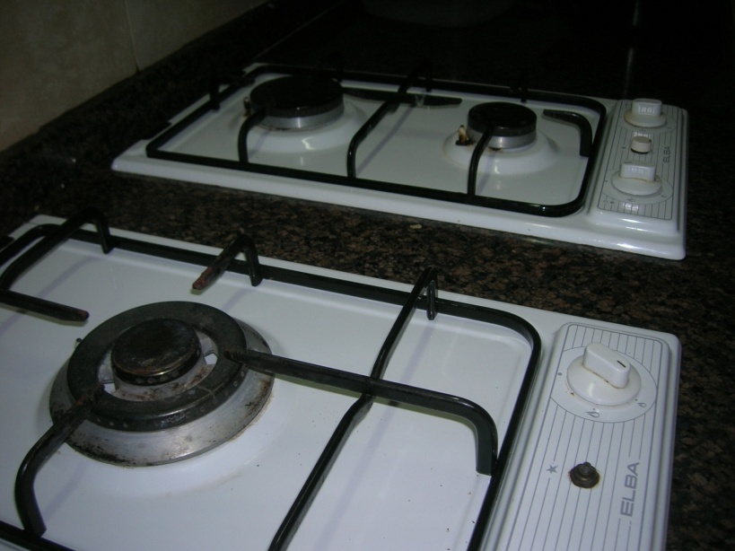
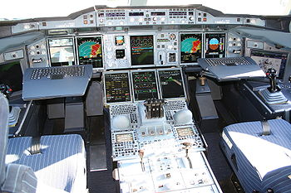
General Arrangement of Controls and Displays
Control and display relationships
  Compatibility
  Functional grouping
  Distinguishable
  Importance, Frequency, Sequence

Slide 26
Panel Design
Compatibility

Slide 27
Checklist for equipment design
Equipment purpose
Set up
Calibration
Maintenance and service
Operations analysis
  Sensory access
  Attention
  Understandability
  Memory for target values
  Motor skills
  Feedback
  Error types and implications
Displays
Type
Design criteria
  Understandability
  Accuracy
  Resolution
  Importance
  Frequency
  Sequence
Physical Environment
  Lighting
  Noise
  Thermal
  Vibration
Facilitators
  Instructions
  Warnings
  Labels
  Memory aids
Controls
Type
Design criteria
  Resolution
  Direction of motion
  Range of motion
Operational Environment
  Speed
  Information
  Error implications
Operator Requirements
  Selection
  Training
  Attention
Workplace
  Visibility
  Reach, Access, Fit
  Base postures
  Adjustability
Panel
  Location
  Panel arrangement
  Grouping
  Location

