Slide 1
Cognitive Task Analysis and Human Error Reduction
APCHI & ERGOFTURE 2010, Bali.
Brian Peacock
Chui Yoon Ping
SIM University, Singapore

Slide 2
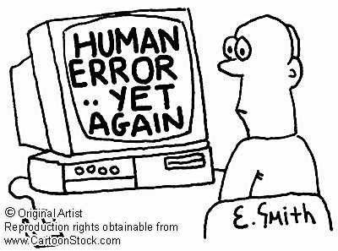
Human Errors usually have a Cognitive Cause and a Physical Result

Slide 3
Participation in Education
I
E
P

Slide 4
I
E
P
Competitions
Simulation
Humor
Discussions
Models
Diagrams
Pictures
Questions
Demonstrations

Slide 5
Human Error
Human errors occur all the time
Human error is important for learning
It’s the consequence of the error that usually matters
Whatever the cause an error is a failure to achieve one or more of the system purposes
Ease of Use
Effectiveness
Efficiency
Elegance
Safety
Security
Satisfaction
Reliability
Resilience
E4S3
+R&R

Slide 6
I
E
P
Some Examples of Human Control Performance Challenges and Human Error Opportunities
Discuss the errors and possible remedies

Slide 7
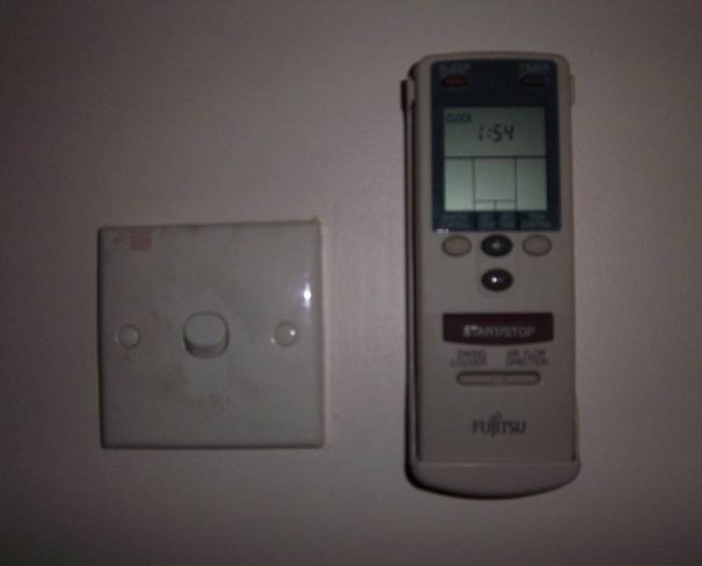
A Simple Error
As I walked out of my office to take a break from writing this presentation I reached out to turn off the room air conditioner and hit the light switch instead
The two switches were side by side but very distinct in design
  A wall switch and a button on a remote A/C control
Why did I make this simple, easily recoverable mistake?
  I didn’t look after the initiation of the reaching movement
  I use light switches much more frequently
We make similar, unimportant errors all the time

Slide 8
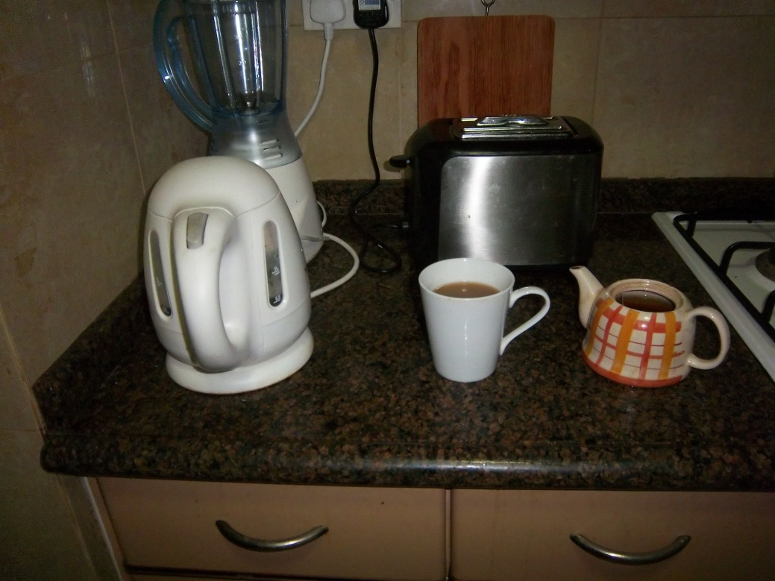
Another Error
This morning I poured the water from the kettle into the mug instead of into the teapot where I had just placed a teabag
Sometimes I put the teabag into the mug

Slide 9
More Serious Errors
What if I hit the accelerator instead of the brake pedal?
  It happens frequently (Audi, Toyota)
What if there is no recovery / mitigation action?
  What if I pour coolant into the oil filler while maintaining my car
  What if a surgeon amputates the wrong leg?
  What if I decide to go rather than stop when the traffic light is amber?
To err is human – we do it all the time
To prevent or mitigate the effects of errors needs forgiving systems designed on human factors principles

Slide 10
Don’t Drink and Drive

Slide 11
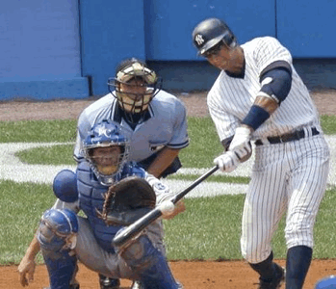
Baseball – hit or strike?

Slide 12
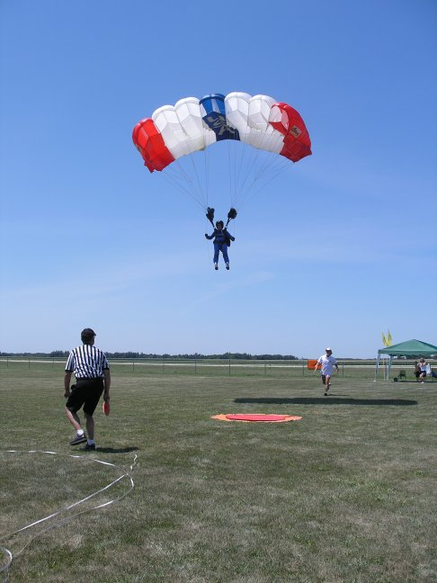
Skydiving Accuracy
Measured in centimeters

Slide 13
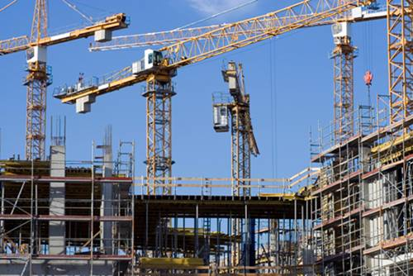
Controlling a load on a crane
I
E
P
– shouting, signaling or walkie-talkie?

Slide 14
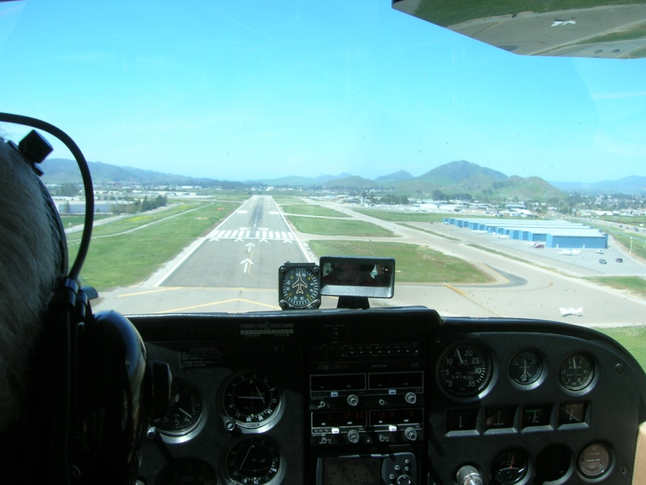
Landing an Airplane
pitch, roll, yaw and speed

Slide 15
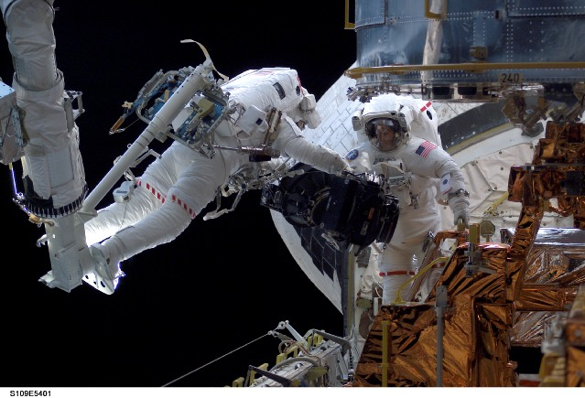
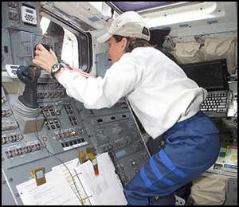
Controlling a 6 Degree of Freedom Robotic arm on the Space Shuttle
  - difficult!

Slide 16
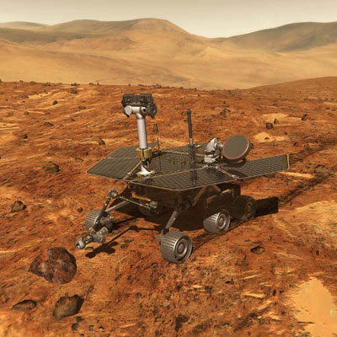
Controlling the Mars Rover with a time a lag of between 3 and 20 minutes

Slide 17
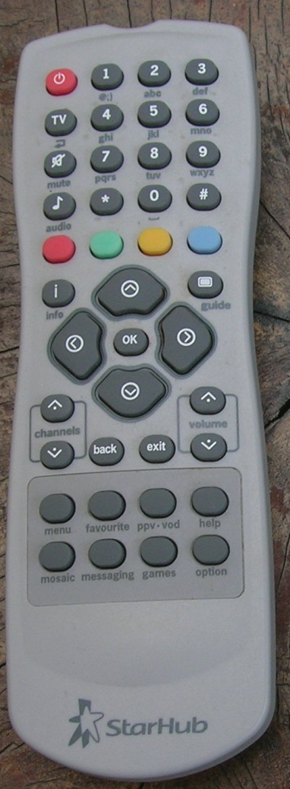
Controlling the TV
- in the dark

Slide 18
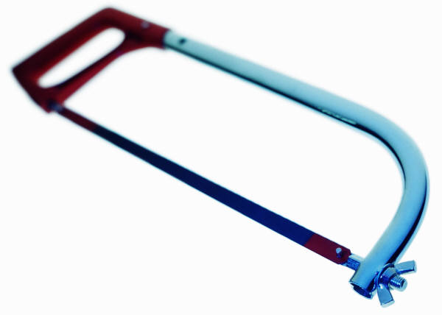
Manual Tasks – errors, errors, errors

Slide 19
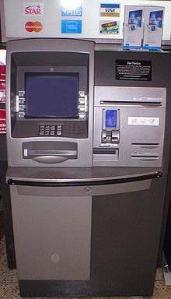
Managing your Money
- “it ate my card!”

Slide 20
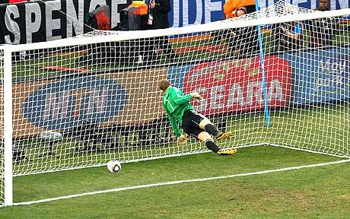
Football
Can technology help referees?
In soccer, possession of the ball changes every 30 seconds – the game is full of “errors”

Slide 21
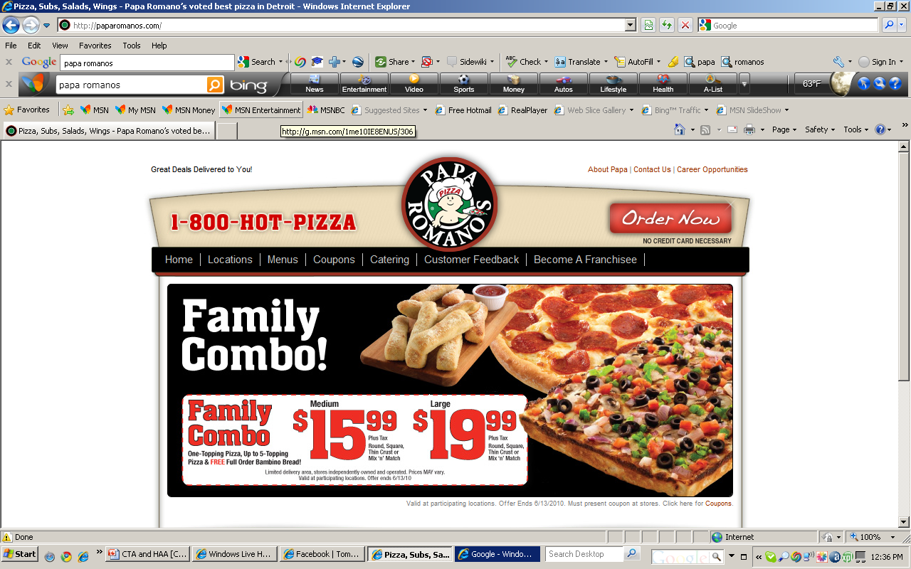
Ordering a Pizza

Slide 22

Booking an Airline Ticket

Slide 23
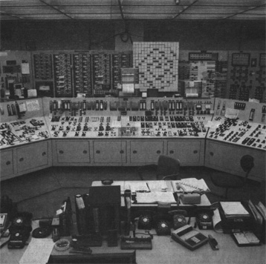
Three Mile Island
Lots of warnings went off in a short time period

Slide 24
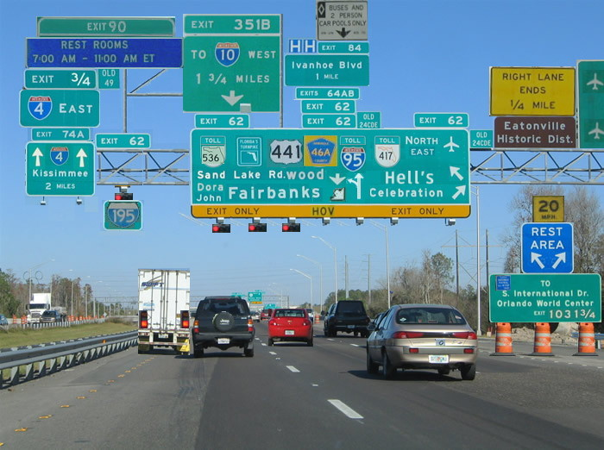
Which way should I go?
Visual search at 100km/s

Slide 25
A near mid air collision -wrong number
FAA probes FedEx near-miss
Planes were much too close; may be worst local error in 10 years
Federal investigators are studying a near-miss between two FedEx planes over Memphis last Thursday that likely is the most serious air traffic control error here in 10 years.
Officials say both the pilot and controller believed the other had transposed numerals in the flight number. Because the crew did not read the number back as it was heard -- which is standard procedure -- the tower issued directions meant for another plane, putting flights 527 and 257 within 100 feet of each other vertically and less than a mile apart laterally.
The latest incident in Memphis happened shortly before 4p.m. Feb. 21 as FedEx flights 527 and 257 were preparing for simultaneous takeoff on parallel runways.
Controllers say the margin for error was increased because the pilot called in on the wrong radio frequency.
"Westbound FedEx 257 crew checked in on the frequency for the east departure controller,”
The east departure controller, who had just seen data on eastbound 527 on his screen, thought the pilot had transposed the numbers and told FedEx 527 to turn left and climb.
"FedEx 257 hears this and answers to it,” - the crew read-back on the flight number was unintelligible.
"This is where our controller makes the mistake, he didn't catch the erroneous read-back."

Slide 26

Slips, trips and falls are the commonest form of accident

Slide 27
Accident : Avoidance, Prevention, Analysis, Mitigation
WIND
Risks
Errors
Unsafe Acts
Hazards
Barriers
Safety Nets
Remove them
Designed in Defenses
Task Analysis
Engineered and human resilience

Slide 28
Safety Management - The Hierarchy of Controls
Process substitution – remove the hazard
Process isolation – use barriers
Personal protective equipment – protect the individual
Instructions and Warnings – advise the operator to avoid the hazard
Selection and Training – Train the operator to recognize and manage the hazard
Discuss situations where this hierarchy makes sense and provide examples of where the reverse order may be appropriate

Slide 29
Applied (Cognitive) Human Factors
Knowledge
Design
HIM
Human
Error
Reduction
CTA
HQA
Analysis
Performance

Slide 30
Knowledge:
Human Information Processing
HIM

Slide 31
Human Information Management (HIM)
Long Term Memory
Prediction
Attention
Operational
Memory
Senses
Perception
Cognition
Effectors
Management
Effectors
System Feedback
Environment

Slide 32

We measure human control performance outcomes in terms of Time, Error and Consequences

Slide 33
Human behavior and performance can be described by a control model
Input
Driving
Outcome
Feedback

Slide 34
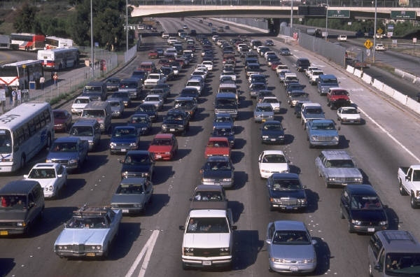
Why Feedback Control Doesn’t Work
If you wait for the brake lights on the car in front of you it’s already too late!!

Slide 35
Effective Control performance depends on
PREDICTION, ADAPTATION and LEARNING
Prediction (Probabilistic)
Uncontrollable
External
Input
Output - Time,
Accuracy and
Consequences
Input
Process
Feedback
Control
Adaptive
Control
Rules
Learning
Control
Cognition

Slide 36
Interfaces, Interdependencies Interactions, Interferences and Integration
The Environment
The Operational and Temporal Contexts
The
Users
The
Systems
Physical
Cognitive
Emotional

Slide 37
Human – Machine System
Prediction
External Factors
Output:
Time, Error and Consequences
Cognition
Input
Controls
System
Senses
Feedback
Displays
Interfaces

Slide 38
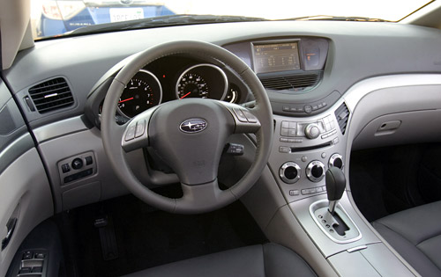
We add Displays and Controls (Physical Interfaces) to help us with the Control Task

Slide 39
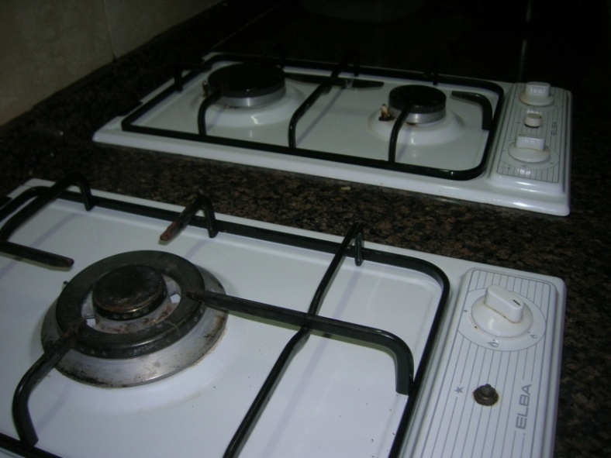
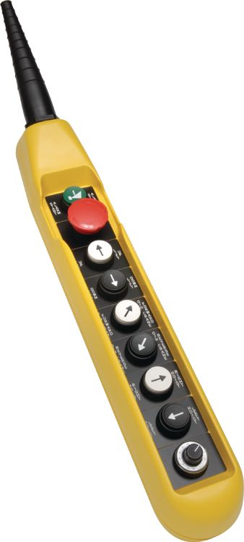
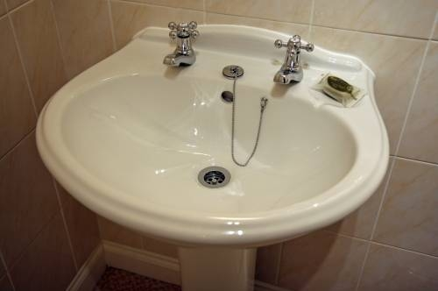
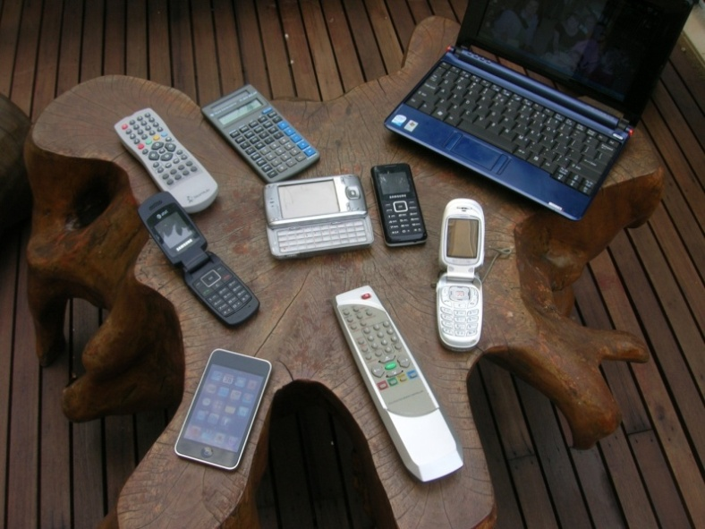
Expectancy – Prediction – Population Stereotypes

Slide 40
Human Sensory Variability
Genetic differences – color deficiency, myopia
Deteriorates with Age – vision, hearing
May be affected by Disease – Cataracts, “head cold”
There is also an enormous amount of within and between person variability in cognitive, behavioral and performance activity.

Slide 41
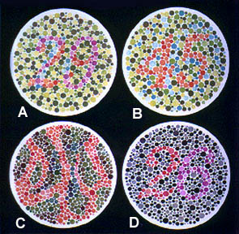
1. Normal Color Vision: A: 29, B: 45, C: --, D: 26
2. Red-Green Color-Blind: A: 70, B: --, C: 5, D: --
3. Red Color-blind: A: 70, B: --, C: 5, D: 6
4. Green Color-Blind: A: 70, B: --, C: 5, D: 2

Slide 42

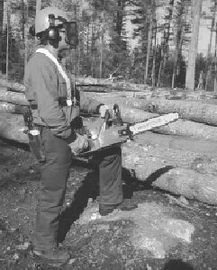
Focused Attention
Driving – cars, trucks, boats, airplanes etc
Industrial inspection
Listening to lecture
Security surveillance
Medical residents
Forestry and foundries (chain saws and chipping hammers)

Slide 43
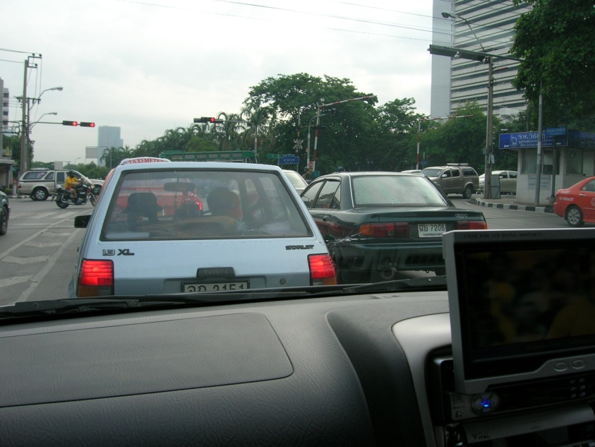
Divided Attention
Multi-tasking
  The every day job of a manager
Driving and using a cell phone
Texting during a lecture

Slide 44
Vigilance Decrement
“Federal officials are investigating why two Northwest Airlines-Delta pilots overshot the Minneapolis-St. Paul airport this week, on a flight from San Diego. Controllers lost contact with the pilots during the flight. The pilots say they missed the airport because they were in a heated argument, but there are also questions of whether they might have fallen asleep.”
“A passenger train in the Indian state of Bihar zoomed past two railway stations - after the driver apparently fell asleep at the controls.”
"You don't need kindergarten to know that a resident working a 36-hour shift is in no condition to make any kind of judgment call -- forget about life-and-death."
In boring tasks vigilance may deteriorate rapidly in the first 20 minutes!

Slide 45
Response and Decision Times and Accuracy
Expectancy, Anticipation, Prediction
Warning, Stimulus, Response
Simple Reaction Time
Choice Reaction Time
  Number of choices
  Difficulty of choices
  Hyman Hick’s Law
Practice
Attention, Distraction
Demonstrations
  Catch a dollar bill
  Sort a deck of cards
  Clap hands on the signal
  Stop when the light turns red (orange?)
The stimulus – response process is fundamental to all kinds
of human activity
The speed – accuracy tradeoff is a reflection of cognitive activity

Slide 46
Reaction Time - Demonstration
I
E
P
On the signal everyone clap their hands

Slide 47
Reaction Time - Games
I
E
P
Take out a business card
Turn to a partner
Have them hold their finger and thumb ready to catch the card
Without warning drop the card
Give a warning – 1,2,3
Repeat with two cards – one for each hand
Hold the cards with hands wide apart
Use distraction

Slide 48
Reaction Time – Question
I
E
P
Should Formula I cars have brake lights?

Slide 49
Psychological Refractoriness
A delay in response to the second of a pair of stimuli as a function of the Inter Stimulus Interval and the Intensity of the first stimulus
The “startle” response
“Freezing”
Unwanted acceleration (Audi, 1980s; Toyota, 2009)
    Pedal errors

Slide 50
Perceiving
Perception is a complex interaction between sensing, expectancy and a mental framework
We perceive changes or contrasts in our sensory environment such as
  Stimulus intensity (light, sound, etc.)
  Contrast with the background (signal to noise ratio)
  Large differences are more readily perceived than small ones – as demonstrated by psychophysics
The perceptual framework becomes more structured with practice
Perceptual mistakes may be due to insufficient sensory information or an inappropriate framework

Slide 51
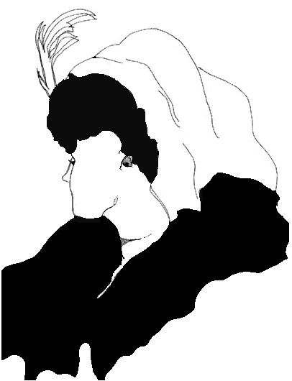
Perceiving: Illusion

Slide 52
As tasks become more complex and contexts become more uncertain, COGNITION becomes more important
External
Context Factors
Prediction
Output
Time, Error and Consequences
Cognition
Input
Controls
System
Senses
Feedback
Displays

Slide 53
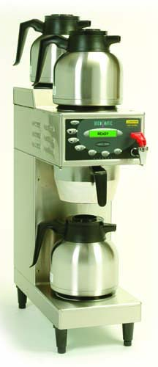
What could be simpler than making coffee?

Slide 54
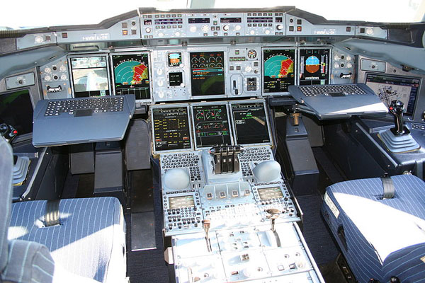
--------or flying the Airbus 380?

Slide 55
Cognition

Slide 56
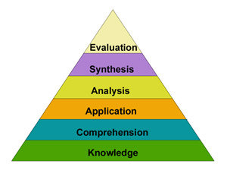
Bloom's Taxonomy of Cognitive Development
Bloom identified six levels within the cognitive domain, from the simple recall or recognition of facts, as the lowest level, through increasingly more complex and abstract mental levels, to the highest order which is classified as evaluation.
(See appendix for more details)

Slide 57
Computation, Communication and Control
Long Term Memory
Prediction
Attention
Operational
Memory
Senses
Perception
Cognition
Learning
Effectors
Management
Effectors
System Feedback
Environment

Slide 58
Cognition is complex
Goals
Understanding
Diagnosing
Analyzing
Judging
Cognition
Learning
Synthesizing
Deciding
Problem Solving
Planning
Investigating
Evaluating
Interpolating and Extrapolating
Predicting

Slide 59
Operational
Landmark
Short Term
Working
Route
Long Term
Transient
Survey
Rehearsal
Literal
Consolidation
Semantic
Iconic
Sensory
Memory
Is complicated
Capacity
Millers 7+/- 2
Recall
Recognition
Primacy
Tactile
Kinesthetic
Recency
Interference
Von Restorf
Decay

Slide 60
The Bucket Model
Memory
Operational memory has a limited capacity. Rehearsal can keep information for extended times.
Interference (proactive and retroactive) causes items to be lost.
Primacy and Recency effects cause first and last items in a list to be recalled more reliably.
Chunking and linking (mnemonics) help retention.

Slide 61
Memory Drift
I
E
P
Draw a line
Close your eyes
Draw ten lines the same length as the “standard”
How often should an inspector be “calibrated”?

Slide 62
Spatial Memory
I
E
P
Close your eyes and draw 3, 4, 5, 6 sided figures
Measure your error
Why?

Slide 63
Numeric Memory
I
E
P
Card counting
Shuffle a deck of playing cards
Show 3,4,5,6,7,8,9 cards
Recall the suit and number
Ignore picture cards
How are set length and error related?

Slide 64
Memory for Instructions'
I
E
P
Taxi back to the ramp

Slide 65
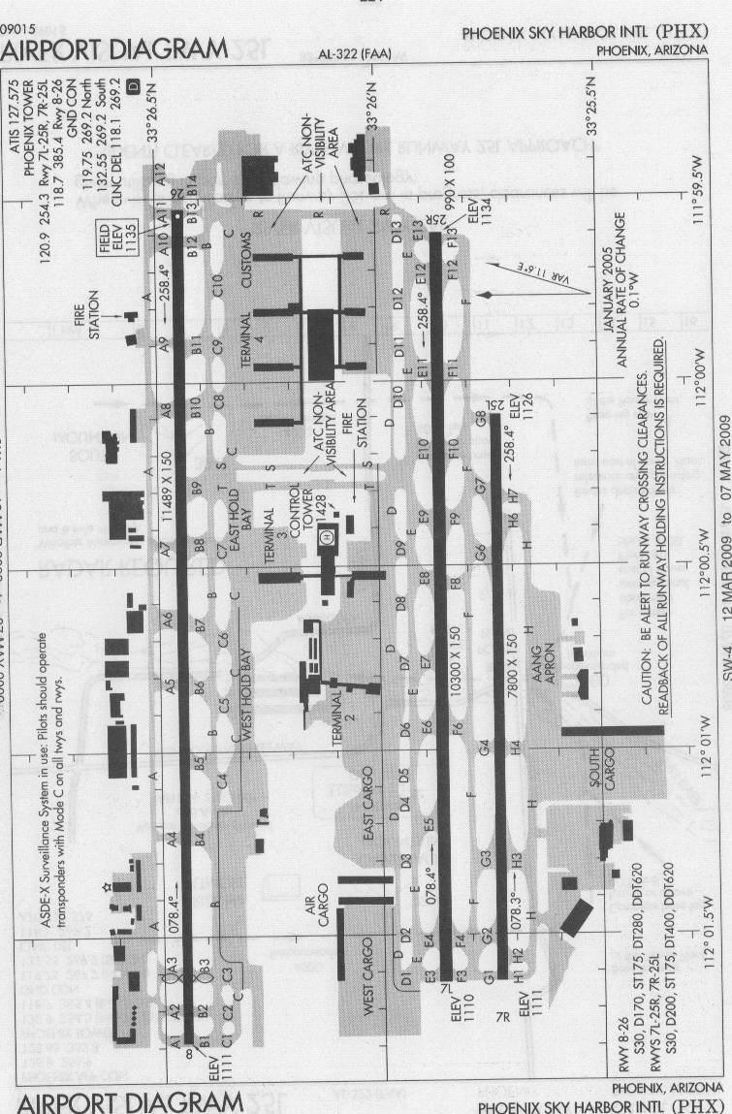
Can you remember this?
Welcome to Phoenix Sky Harbor
Taxi via Golf 8, Foxtrot, Foxtrot 12, Hold short of 25R, then proceed along Echo 12, Echo, Delta, Tango, Bravo, Charlie 9 to Terminal 4
What is wrong with these instructions?

Slide 66
Operational Memory Involvement Recording Chart
 | Proactive Support / Interference | Item | Retroactive Support / Interference | Response
Sensory Modality | Visual Auditory Tactile | Visual Auditory Tactile | Visual Auditory Tactile | Manual Gesture Verbal
Form | Literal Symbolic Spatial | Literal Symbolic Spatial | Literal Symbolic Spatial | Literal Symbolic Spatial
Literal / Semantic Content | Support Neutral Interference | RECALL PARTIAL FORGET | Support Neutral Interference | Support Neutral Interference
Information Content | High Medium Low | High Medium Low | High Medium Low | Precise Medium Coarse
Temporal Relationship | Seconds Minutes Hours |  | Seconds Minutes Hours | Seconds Minutes Hours

Slide 67
OMIRC Example
Welcome to Sky Harbor Airport in Phoenix
Taxi via Golf 8, Foxtrot, Foxtrot 12, Hold short of 25R, then proceed along Echo 12, Echo, Delta, Tango, Bravo, Charlie 9 to Terminal 4
 | Proactive Support Interference | Item | Interpolated Support Interference | Response
Sensory Modality | Visual Auditory Tactile | Visual Auditory Tactile | Visual Auditory Tactile | Manual Gesture Verbal
Form | Literal Symbolic Spatial | Literal Symbolic Spatial | Literal Symbolic Spatial | Literal Symbolic Spatial
Semantic Content | Support Neutral Interference | RECALL PARTIAL FORGET | Support Neutral Interference | Support Neutral Interference
Information Content | High Medium Low | High Medium Low | High Medium Low | Precise Medium Coarse
Temporal Relationship | Seconds Minutes Hours |  | Seconds Minutes Hours | Seconds Minutes Hours

Slide 68
Uncertainty
Predicting
Deciding
Planning
Guessing
Judging

Slide 69
Deciding
Motivation
Information
Experience
Predicted Outcome
Operational Memory
Why should you buy a lottery ticket?
Expected Utility = Probability x Utility
Why do you drive a car?
Risk = Likelihood x Outcome Severity

Slide 70

Decisions
Opinions
  Pepsi or Coke
  Democrat or Republican
  American Idol
Decisions
  Common cold or pneumonia?
  Stop or go when the light turns amber?
  Which is the correct test answer?

Slide 71
Judging - Psychophysics
Distance, size, height, weight, color, sound, money, etc.
Weber – Fechner Law
JNDs: Just Noticeable Differences
Larger differences are easier to notice (logarithmic scale)
Context and experience cause the standard to “drift”
This is why we use measurement instruments where accuracy and precision are important

Slide 72
Near Mid Air Collisions (NMAC)

Slide 73
Complex Judgments
Complex judgments on multiple dimensions (or from multiple judges) require systematic weighting and consensus processes
  False consensus must be avoided by independent voting
Which is the best football team, gymnast, car, mobile phone, food, student etc.?
A simple statistical manipulation of the data can remove the empirical bias

Slide 74
Guessing and Bias
Judgment is an educated guess
Judgments lead to decisions and predictions which are the basis of planning
Guesses, judgments and (many) decisions are usually based on incomplete or insufficient information
Guesses, judgments and decisions are influenced by objective and subjective evidence
The risk of being wrong is balanced by the benefit of being right
Bias occurs when the subjective evidence outweighs the objective evidence
People are good at judgment, consensus helps, but computers can help to remove the biases
(see appendix: norm based scoring)

Slide 75
Prediction
We succeed and fail by prediction
Statistical Methods and Predictive Displays can help
We need to include confidence intervals so that the predictor can weigh the risk
Full
Fuel in Tank
Optimist
Pessimist
Empty
Computer
Miles

Slide 76
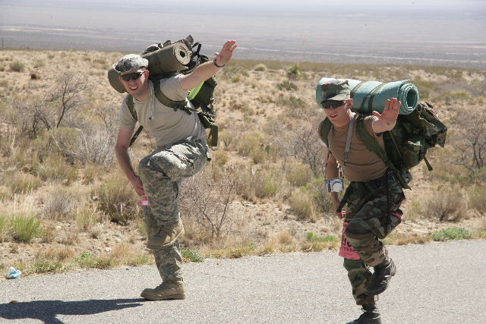
Prediction
How long will it take a soldier with full equipment to travel 10 miles through the desert?

Slide 77
Bataan Death March Marathon Results
 |  | MFH | MMH | MFL | MML | CFH | CMH | CFL | CML
 |  | 7:47:34 | 5:32:58 | 6:00:44 | 4:24:06 | 8:16:12 | 5:28:31 | 4:05:10 | 3:32:04
MFH | 7:47:34 | 100 | 71 | 77 | 56 | 106 | 70 | 52 | 45
MMH | 5:32:58 | 140 | 100 | 108 | 79 | 149 | 99 | 74 | 64
MFL | 6:00:44 | 130 | 92 | 100 | 73 | 138 | 91 | 68 | 59
MML | 4:24:06 | 177 | 126 | 137 | 100 | 188 | 124 | 93 | 80
CFH | 8:16:12 | 94 | 67 | 73 | 53 | 100 | 66 | 49 | 43
CMH | 5:28:31 | 142 | 101 | 110 | 80 | 151 | 100 | 75 | 65
CFL | 4:05:10 | 191 | 136 | 147 | 108 | 202 | 134 | 100 | 87
CML | 3:32:04 | 220 | 157 | 170 | 125 | 234 | 155 | 116 | 100
Table 1. Relative percentages of average times of the top ten finishers in each weight (Heavy, Light), sex (Male, Female) and status (Military, Civilian) categories.
Statistical prediction of physical performance with encumbrance

Slide 78
Planning
Provide sufficient time, information and material resources
Map out input, external context, outcome and feedback alternatives
Do “what if” analysis
Plan for failure
Use simulation methods
Use third party critique

Slide 79
Planning Exercises
Discuss the following planning scenarios with your neighbor
  Pass or dribble in soccer
  Which move in a game of chess
  Planning a workplace layout
  Contingency analysis in case of inclement weather
  Emergency response to catastrophic accident
    Oil well blow out
    Lost engines in air plane
    Security breach

Slide 80

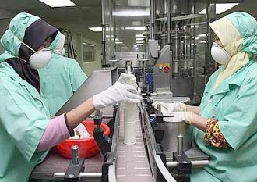

Sensory Motor Skills

Slide 81
Applications of Motor Skill Learning:
De Jongs Law
Ball games coaching
Learning to fly
Controlling the Robotic arm in the Shuttle
Assembly tasks
Filling out forms
Dentists
Performance
Times and accuracy
Practice (many cycles)

Slide 82
Fitts Law
Movement Time is a function of Target Size and Distance Moved
  Actual targets may differ from prescribed targets

Slide 83
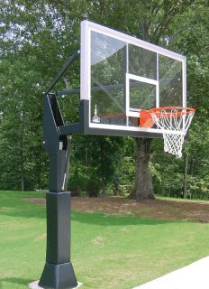
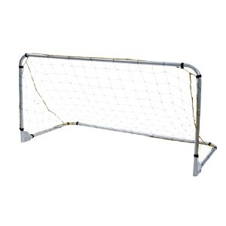
Actual Targets
3 Point shot
Placing stampings in a rack or welding jig
Should soccer goals be larger?

Slide 84
Communicating
Idea
Semantic Encoding
Physical Encoding
Feedback
Transmission
Memory
Semantic Decoding
Physical Decoding
Lost / Forgotten Information
Noise / Added Information

Slide 85
Communicating Games
Provide instructions for driving to the nearest airport
  Check the errors following “read back”
IKEA: “Some assembly required”
Provide instructions for Cardiopulmonary Resuscitation
Provide instructions for bicycle (or other piece of equipment) maintenance
  Develop procedures for maintaining the International Space Station

Slide 86
Controlling
Prediction
(Probabilistic)
External Factors
Output
Time, Error and Consequences
Cognition
Input
Controls
System
Feedback
Adaptation
Learning
Senses
Displays

Slide 87
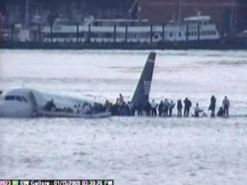
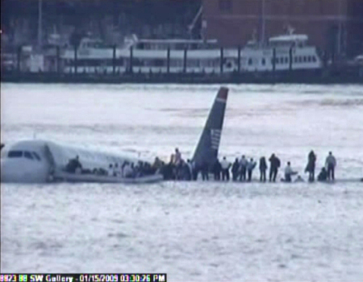

Slide 88
Emergency Approach and Landing
DESCRIPTION
The airplane is maneuvered power-off to the best available landing site.
OBJECTIVE
To develop the skill and proficiency necessary to accomplish a power-off emergency approach and landing at the best available site.
PROCEDURES
1. Establish the best glide speed.
2. Select the best available landing site within glide range considering wind, obstructions and field conditions.
3. Complete the appropriate emergency checklist, time and altitude permitting.
4. Maneuver to a high-key position.
NOTE
A high key position should allow a descending spiral over the intended landing point to keep it in view, assess the wind conditions, and arrive at the low-key position. The low-key position is downwind abeam the intended spot of landing at an altitude that allows a 180° descending turn (or base and final legs) to arrive at the intended spot of landing.
5. Squawk 7700 and declare and emergency on frequency 121.5 (or the ATC frequency appropriate if in radio contact with ATC).

Slide 89
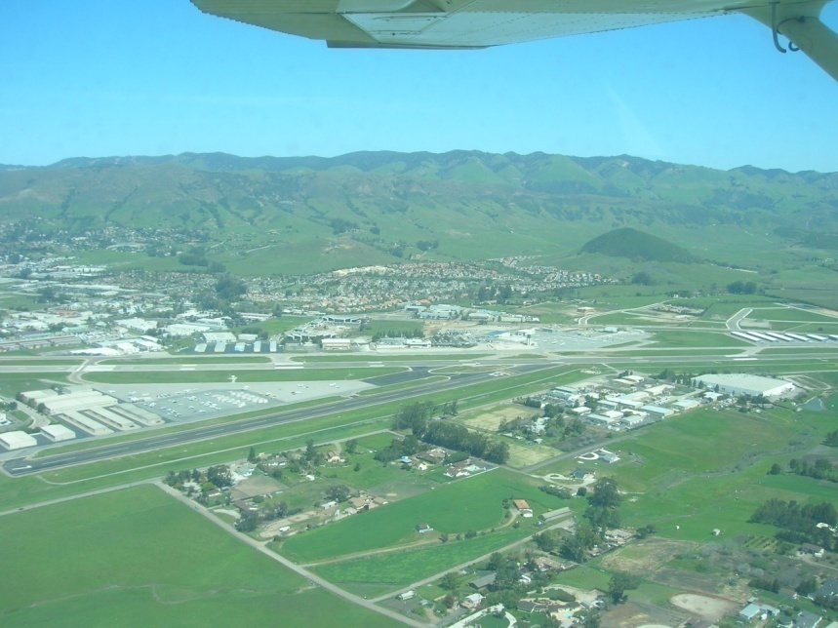


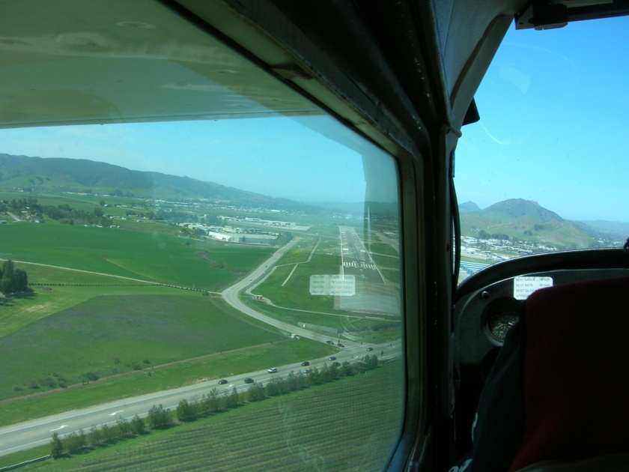

Slide 90
Write down the stage times and count the tracking errors
5400
Add the Rows and Columns
728 | 515
39 | 244
Finish
5200
5000
27L
Write Down
29.90
27L
SW @ 25, G 30
ALPHA 3
118.7
7700
360
5600
Alternately track (draw lines) along the Blue (Heading) and Green (Altitude) segments
5700
360
090
090
090
6000
5900
5800
Start
Add secondary task

Slide 91
Cognitive Task Analysis – Emergency Landing
Turns, Height above ground to begin the flare
Engine failure causes
Safe landing
The communications jargon
Goals
Judging
Understanding
Wind strength and direction
Flaps?
Diagnosing
Analyzing
Deciding
Cognition
Synthesizing
Planning
Problem Solving
Approach
Adapting the mental model
Evaluating
Investigating
Predicting
Interpolating and Extrapolating
Pitch effects
Use of pitch and flaps without power
Touch down point
Apply the rules
Improvise
Time and altitude constraints

Slide 92
Analysis:
Task Analysis & Cognitive Task Analysis
CTA
Mental Workload
Situation Awareness
Resource Management

Slide 93
Task Analysis
Physical Task Analysis addresses human overt behaviors – the flow of Energy – Actions
Cognitive Task Analysis addresses the flow of Information between (and within) the Task and the Operator
Job Analysis – Psycho-social

Slide 94
Uses of Task Analysis
What is the goal or purpose
What should be done
What should not be done
Who should do what, and when and where
How things should be done
How tasks should be designed
How tasks should be assigned
How people should be selected, trained and assigned
How procedures should be designed
How equipment should be designed
How facilitators should be designed

Slide 95

Task Analysis on the Car Assembly Line

Slide 96
Physical Task Analysis
Henry Ford
Frederick Taylor
Lillian Gilbreth
MTM (Methods Time Measurement)
Work Factor
Charting and Timing (in seconds)
Pick
Carry
Place
Fasten
Inspect
Walk
10
20
10
30
10
10

Slide 97
Physical Task Analysis (with Physical Ergonomics)
Effort / Force / Posture
Place
10
Fasten
30
Carry
20
Walk
10
Pick
10
Inspect
10
Time
Where is the value added work?

Slide 98
Cognitive Task Analysis
CTA
Cognitive Task Analysis is the collective name for a set of methods that describe the thought processes used by novices and experts to control simple or complex systems
Cognitive Task Analysis distinguishes between knowledge, rule and skill based control of systems
  People who operate in a knowledge based way are restricted by the information available
  People who act in a rule based way do not seek additional information, but rely on deductive processes
  People with a high level of skill are adaptable and able to apply inductive reasoning to problem solving

Slide 99
CTA Methods
CTA
Cooke (1994) identified three broad families of techniques:
  observation and interviews: watching experts and talking with them.
    More informal. Allow knowledge elicitator more flexibility during knowledge elicitation.
  process tracing: capture an expert’s performance of a specific task via either a think-aloud protocol or subsequent recall.
    More formal and structured. Some analysis decisions are left to the elicitor.
  conceptual techniques: produce structured, interrelated representations of relevant concepts within a domain
    Conceptual techniques are well-specified and formal with few judgments on the part of the elicitor.
    Requires more training
Notes:
Cooke (1994) conducted one of the more extensive reviews of CTA. She identified three broad families of techniques:

Slide 100
CTA Methods
CTA
Fourth family introduced by Wei and Salvendy (2004
  formal models—which use simulations to model tasks in the cognitive domain.

Slide 101
CTA procedure
CTA
Most of the dominant CTA methods are performed in the following sequence:
  Collect preliminary knowledge
  Identify knowledge representations
  Apply focused knowledge elicitation methods
  Analyze and verify data acquired
  Format results for the intended application
Clark, et al (2006), “Cognitive Task Analysis”

Slide 102
CTA procedure
CTA
1. Collect preliminary knowledge
  Sequence of tasks that will become the focus of the CTA are analysed
  Analysts attempt to become generally familiar with the knowledge domain and identify experts to participate in the knowledge elicitation process. Knowledge analysts should be generally familiar with the content, system, or procedures being analyzed.
  Interview 2-3 subject matter experts, separately to avoid premature consensus regarding the knowledge and skills necessary for effective performance.
  Techniques typically used during this phase include document analysis,
  observation, and interviews (structured or unstructured).
  The analyst uses the results of this stage to identify the knowledge types and structures involved in performing the tasks.
Clark, et al (2008), “Cognitive Task Analysis”

Slide 103
CTA procedure
CTA
2. Identify knowledge representations
    Using information collected during the preliminary stage, examine
    each task to identify sub-tasks and types of knowledge required to perform it.
    Most CTA approaches are organized around knowledge representations appropriate for the task, such as concept maps, flow charts, semantic nets, and so forth. These representations provide direction and order to latter stages in the CTA process because knowledge elicitation methods map directly to knowledge types.
    Some are best used to elicit procedural knowledge, while others are more successful for capturing declarative knowledge (Chipman et al., 2000).
    A learning hierarchy is one example of a method to organize the types of knowledge required to perform a task.
Clark, et al (2008), “Cognitive Task Analysis”
Notes:
A learning hierarchy analysis represents the content
of skills ordered from more complex problem solving skills at the top to simpler forms of
learning (Jonassen et al., 1999). So for example, problem solving is followed by rule
learning, which is followed by concepts. Thus, the basic idea is that people can only learn
rules if they have already mastered prerequisite concepts necessary to learn the rules.
Analyzing a learning hierarchy begins by identifying the most complex (highest) learning
outcome and then determining the underlying skills that must be mastered to achieve the
target outcome. A hierarchy of skills is represented as a chart of tasks for each intellectual
skill that is acquired to progress to increasingly complex skills.
The learning hierarchy constructed at this stage of the CTA process provides the
guide to structure the next stage of knowledge elicitation by identifying the information
that must be captured from the SMEs. Thus, it reflects the reiterative nature of the CTA
process, in which the details of the knowledge, skills, and cognitive strategies necessary
for complex learning are revealed, refined, and confirmed.

Slide 104
CTA procedure
CTA
3. Apply focused knowledge elicitation methods
  the analyst applies various techniques to collect the knowledge identified in the prior stage.
  choose methods appropriate to the targeted knowledge type as determined by the knowledge representations identified for each task.
  Knowledge elicitation methods include:
    Structured or semi-structured interviews
    Verbal Protocol analysis
    Critical Decision Method (Gary Klein)
    Applied Cognitive Task Analysis (ACTA) (Militello and Hutton)
Clark, et al (2008), “Cognitive Task Analysis”
Notes:
A learning hierarchy analysis represents the content
of skills ordered from more complex problem solving skills at the top to simpler forms of
learning (Jonassen et al., 1999). So for example, problem solving is followed by rule
learning, which is followed by concepts. Thus, the basic idea is that people can only learn
rules if they have already mastered prerequisite concepts necessary to learn the rules.
Analyzing a learning hierarchy begins by identifying the most complex (highest) learning
outcome and then determining the underlying skills that must be mastered to achieve the
target outcome. A hierarchy of skills is represented as a chart of tasks for each intellectual
skill that is acquired to progress to increasingly complex skills.
The learning hierarchy constructed at this stage of the CTA process provides the
guide to structure the next stage of knowledge elicitation by identifying the information
that must be captured from the SMEs. Thus, it reflects the reiterative nature of the CTA
process, in which the details of the knowledge, skills, and cognitive strategies necessary
for complex learning are revealed, refined, and confirmed.

Slide 105
Verbal Protocol Analysis
I
E
P
Use verbal protocol analysis to develop procedures, instructions, checklists and improvisations
Tie your shoelace or tie
Navigate a sharp bend while driving
Take a penalty kick
Cook a meal
Using your mobile phone for web surfing

Slide 106
CTA procedure
CTA
4. Analyze and Verify Data Acquired
  Analyst code and format the results for verification, validation, and applicability for use in their intended application.
  Transcripts may be coded to summarize, categorize, and/or synthesize the collected data.
  Formatted output is presented to the participating SMEs for
  verification, refinement, and revision to ensure that the representations of tasks and their underlying cognitive components are complete and accurate.
  The analyst should compare these with the output of other experts to validate that the results accurately reflect the desired knowledge representation.
Clark, et al (2008), “Cognitive Task Analysis”
Notes:
A learning hierarchy analysis represents the content
of skills ordered from more complex problem solving skills at the top to simpler forms of
learning (Jonassen et al., 1999). So for example, problem solving is followed by rule
learning, which is followed by concepts. Thus, the basic idea is that people can only learn
rules if they have already mastered prerequisite concepts necessary to learn the rules.
Analyzing a learning hierarchy begins by identifying the most complex (highest) learning
outcome and then determining the underlying skills that must be mastered to achieve the
target outcome. A hierarchy of skills is represented as a chart of tasks for each intellectual
skill that is acquired to progress to increasingly complex skills.
The learning hierarchy constructed at this stage of the CTA process provides the
guide to structure the next stage of knowledge elicitation by identifying the information
that must be captured from the SMEs. Thus, it reflects the reiterative nature of the CTA
process, in which the details of the knowledge, skills, and cognitive strategies necessary
for complex learning are revealed, refined, and confirmed.

Slide 107
CTA procedure
CTA
5. Format Results for the Intended Application
  The results of some highly structured CTA methods (e.g., cognitive modeling) are readily applied to expert systems or computer-assisted tutoring applications.
  For less formal CTA methods, the results must be translated into models that reveal the underlying skills, mental models, and problem solving strategies used by experts when performing highly complex tasks.
Clark, et al (2008), “Cognitive Task Analysis”
Notes:
A learning hierarchy analysis represents the content
of skills ordered from more complex problem solving skills at the top to simpler forms of
learning (Jonassen et al., 1999). So for example, problem solving is followed by rule
learning, which is followed by concepts. Thus, the basic idea is that people can only learn
rules if they have already mastered prerequisite concepts necessary to learn the rules.
Analyzing a learning hierarchy begins by identifying the most complex (highest) learning
outcome and then determining the underlying skills that must be mastered to achieve the
target outcome. A hierarchy of skills is represented as a chart of tasks for each intellectual
skill that is acquired to progress to increasingly complex skills.
The learning hierarchy constructed at this stage of the CTA process provides the
guide to structure the next stage of knowledge elicitation by identifying the information
that must be captured from the SMEs. Thus, it reflects the reiterative nature of the CTA
process, in which the details of the knowledge, skills, and cognitive strategies necessary
for complex learning are revealed, refined, and confirmed.

Slide 108
Expertise
Attained by mimicking the thought processes of experts
  The information they seek
  The weightings they assign to different items of information
  The logic / inductive reasoning they use
  The conclusions they reach
Compared with novices
  Errors of omission and commission in the information they seek
  Over / under weight the importance of some information sources
  Use incorrect / inadequate logic, deductive reasoning
  Converge on wrong conclusions and make wrong decisions

Slide 109
Cognitive Task Analysis
Task Related Thoughts
Analyze the Task Demands
Semantic Encoding
Physical Encoding
Observe the Activity
Secondary Tasks
Articulation
Transmission / Implementation
Record Physiological Electrical Activity
Record Cortical Electrical Activity
Verbal Protocol Analysis
Record Eye Movements
Real Time
Asynchronous
Observe Effects on Primary and Secondary Tasks

Slide 110
Cognitive Task Analysis (a doctor)
I
E
P
Examine Patient
Consult Diagnostic Reference Material
Examine Test Results
Consult Prescription Reference Material
Make Diagnosis
Consult Record Reference Material
Select Treatment
Note that an experienced doctor will carry out these activities in parallel and use his experience and external references to complete the consultation and so save time
Record Data`

Slide 111
Cognitive Task Analysis
Landing an airplane
I
E
P
Get weather and runway information
Observe the Activity
Talk to ATC
Enter and fly the traffic pattern
Check power, air speed, altitude, attitude, configuration, approach, other traffic, wind and runway
Adjust power, attitude and configuration
Remember the rules and apply the skills
Decide whether to land or go around

Slide 112
Secondary Task
I
E
P
Tracking and Mental Arithmetic
Draw sets of concentric circles
Different separations
Measure tracking time and error
Count down from 100 in threes
D

Slide 113
Transaction Analysis
A transaction is a well defined repeated task involving a purpose, operator, equipment, materials, energy a context and information such as:
  Making a sandwich
  Landing an airplane
  Driving a car through an intersection
  Using an ATM machine
  Buying a product through a web page
The transaction takes a variable amount of time
The outcome of a transaction may be success or failure or some degree in between

Slide 114
Transaction Analysis (contd.)
Analysis will involve both the physical elements and the flow of information
  Initiation
    Establish of purpose, recall procedure
    Search for information from equipment, context, materials and operator
    Anticipate input / external factor effects and process outcome
    Plan activity including contingency plan, Evaluate risks and benefits, Decide to proceed
  Control
    Make control input / communication action
    Monitor process, perceive feedback,
    Modify input
  Outcome analysis
    Perceive system state
    Compare with anticipated outcome
    Store observations for future use

Slide 115
Transaction Analysis Example – Parking a car
Arrive at destination
Initiation
  Search for parking space, Observe obstructions
  Judge that space is sufficient
  Recall procedure, plan actions
Control
  Operate vehicle controls
  Monitor progress, judge separations
  Terminate procedure
Outcome Analysis
  Observe vehicle status, observe context status, compare with plan
  Store location
  Store transaction record for future use
Cognitive sources of Success or Failure
Sensory input
Prediction, hazard assessment
Recall procedure
Planning trajectory / timing
Attention to hazard areas
Perceive clearances
Decisions to continue, adjust, abort
Motor control – disturbed posture, tactile assessment of pedal location

Slide 116
Verbal Protocol
I
E
P
Place two chairs to simulate parked cars
Reverse into the gap between the two cars
Use verbal protocol analysis to describe your activities

Slide 117
Practical Cognitive Task Analysis
Purpose | Parallel parking, no contact with other vehicles or objects
Activities | See task description
Cognitive processes | Planning, predicting, diagnosing, sensing, attending, judging, deciding, problem solving, controlling, communicating, analyzing, synthesizing, evaluating, anticipating, predicting, investigating, extrapolating, understanding
Information Resources | Direct outside vision, mirrors, hearing??, memorized procedures, operational memory
Failure modes | Not enough space to park Contact with front / rear fender Inaccurate positioning
Simulation | Table top model Walk / talk through sensory, cognitive, motor activities
Simulator | Empty parking lot using cones to demarcate the target

Slide 118
Mental Workload
MWL
SA
“ Mental workload is the amount of mental work or effort necessary for a person or group to complete a task over a given period of time.”
Xie and Salvendy 2000

Slide 119
Mental Workload and Situation Awareness
Information
X
Stress
Mental Workload
=
Time
X
Experience
Time
X
Experience
Situation
Awareness
=
Information
X
Stress

Slide 120
Mental Workload Measurement Device Criteria
Sensitive to task difficulty and cognitive resource demand
Diagnostic – capable of identifying the resources used
Selective – separates mental workload from other sources of stress
Reliable and Resilient – performs well consistently and under complex conditions
Unobtrusive - does not interfere with primary task
Uncomplicated and economical - does not require complex expensive equipment
Acceptable to the operator / subject

Slide 121
Mental Workload Measurement
Primary and secondary task behavior and performance measures
Subjective rating scales, usually retrospectively
Psycho physiological
  Heart rate, heart rate variation, Eye blink and pupil monitoring, EEG
External (expert) observer
Simulation methods (MICRO-SAINT)

Slide 122
Primary Tasks Measures
Asses operator’s capability to perform the primary task or system functions of interest
  Time and accuracy / error
Central tenet: performance deteriorates as one is subjected to higher MWL.
Common measure of primary task PERFORMANCE:
  Time taken for task completion (Speed)
  Accuracy (no. of errors made)
  Reaction/ response time
Difficulties
  Not sensitive to level of expertise
  Not sensitive to variable stress accommodated by the operator
Notes:
Central tenet: performance deteriorates as one is subjected to higher MWL.

Slide 123
Secondary task measures
Add another task to the primary task.
If you can perform well in your secondary task, then the workload on the primary task is low , and you still have spare resource capacity.
2 methods:
  Subsidiary task paradigm:
    Maintain performance of primary task
  Loading task paradigm
    Maintain performance of secondary task

Slide 124
Secondary Task Example
I
E
P
Driving on a closed slalom circuit with speed controlled by investigator
Rhythmic foot tapping – secondary task
Primary task focus
  Secondary (tapping) task varied with speed and course / vehicle handling (tire pressure) difficulty
Secondary task focus
  Primary (steering) task varied with speed and course / vehicle handling difficulty

Slide 125
Secondary Tasks
Mental arithmetic
Card sorting
Choice reaction time
Recitation / reading
Recognition
Ancillary instruments
Size differences
Short term memory
Monitoring
Problem solving
Anything that can be reliably measured and that may share some of the sensory, attention, cognitive, memory or motor resources with the primary task

Slide 126
Dual Task Methods
I
E
P
Car diving – primary control task, navigation, instruments, entertainment and communication (cell phone)
  Divided attention
  Conversations stop at intersections
  Case study – Top Gun movie
Flying – Flying, navigating, communicating
  “Sterile cockpit” – only essential communications
  Essential communications completed early during stable flight phases
    Communications quality deteriorates with flying and navigational stress
Workload reduced by rule based activities

Slide 127
Secondary task measures: Problems
Validity
  Introduction of secondary task changes nature of the primary task – therefore contaminating workload measure
High level of intrusion
  Interfere and disrupt performance of primary task. Dangerous if primary task is flying or driving – diverted attention to secondary task may lead to an accident.
  Important to allow for self-pacing – abort secondary task if necessary.
Using artificial laboratory based task:
  Operator may not be willing to perform secondary task considered to be artificial and bothersome
  Instrumentation required to introduce task into the operation environment

Slide 128
Secondary task measures: Problems
Not sensitive if the two tasks require separate types of resources
  If you are required to drive (a manual task) and repeat a series of digit (a verbal task) – you will not find any decrement in primary task.
  Hence, look at the different resource dimensions – if primary task consists of a verbal processing task with no spatial components, don’t use a spatial secondary task measure.
  Very sensitive to tasks requiring similar resources – where time sharing is difficult.
Notes:
Competing for resources will present the best situation to watch decrement in primary task performance. BUT it is also the most intrusive.

Slide 129
Subjective Measures
Strength of self-report measures is their subjectivity. Enjoy highest face validity.
"The operator's awareness of increasing effort being used, even before any performance degradation occurs, should give subjective [self-report] measures a special role to play"
Muckler & Seven (1992)
No one is able to provide a more accurate judgment with respect to experienced mental load than the person concerned.
.
(cited in Wickens, 1984)

Slide 130
Subjective Measures
Most popular and frequently used measures of workload
Research in subjective measures produced rating scale techniques dedicated to workload assessment shown capable to reflect variations in demand across a variety of different tasks
  Rating Scale Mental Effort (Zijlstra)
  Modified Cooper Harper (Wierwille and Casali, 1983)
  Bedford (Ellis and Roscoe,1982)
  NASA TLX
  Subjective Workload Assessment Technique (SWAT) (Reid & Nygren, 1988)

Slide 131
Modified Cooper Harper scale
Original Cooper Harper scale was for assessment of aircraft handling characteristics
Long tradition of use for workload associated with psychomotor tasks
2 versions:
  Modified Cooper Harper (Wierwille and Casali, 1983)
  Bedford (Ellis and Roscoe,1982)
Both versions retained the 9 or 10 point decision tree format
  Decision tree makes the rating easier by allowing sequential decisions and the rating is very time economic.

Slide 132
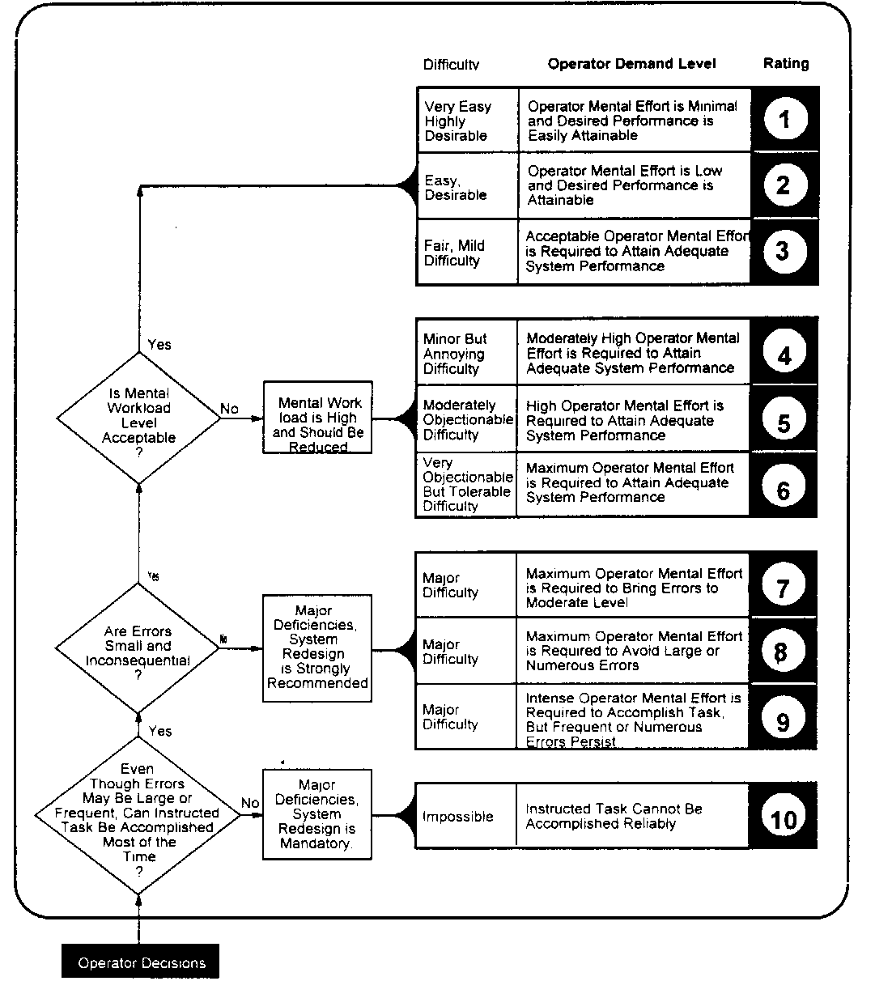
Modified Cooper Harper (MCH) by Wierwille and Casali, 1983

Slide 133
Bedford Workload Scale

Slide 134
NASA TLX
Multi-dimension subjective workload rating technique
Workload defined as “cost incurred by human operators to achieve specific level of performance.”
Overall score is based on the weighted average of rating on 6 subscales

Slide 135
Name
Task
Date
TASK LOADING INDEX
Mental Demand: How mentally demanding was the task?
Very Low
Very High
Physical Demand: How physically demanding was the task?
Very Low
Very High
Temporal Demand: How hurried or rushed was the pace of the task?
Very Low
Very High
Performance: How successful were you in accomplishing what you were asked to do?
Perfect
Failure
Effort: How hard did you have to work to accomplish your level of performance?
Very Low
Very High
Frustration: How insecure, discouraged, irritated and annoyed were you?
Very Low
Very High

Slide 136
Psychophysiological Measurements
Provide continuous measurements and data collection:
  Pick up transient changes in MWL
(Possibly) Not obtrusive to primary task
Subjects do not need to perform secondary tasks, or fill up forms
Methods:
  Heart rate and HR Variability
  Pupil Diameter
  Visual Scanning
  EEG

Slide 137
NASA TLX
I
E
P
Use NASA TLX to describe the stress associated with this workshop
Driving a car?

Slide 138
Heart Rate
Studies shown HR of pilots flying actual flights is higher than flying simulated flights (within subjects study)
Used in other non aviation studies:
  race car drivers – 150 to 180 bpm b4 race starts. HR 180 to 210 bpm during race
  race boat drivers: Change from while waiting 142bpm to 192bpm during race.
  Telemarketer: HR increase during work cf resting condition
However, heart rate is affected both by physical and psychological load
Sensitive measure, but lacks diagnosticity

Slide 139
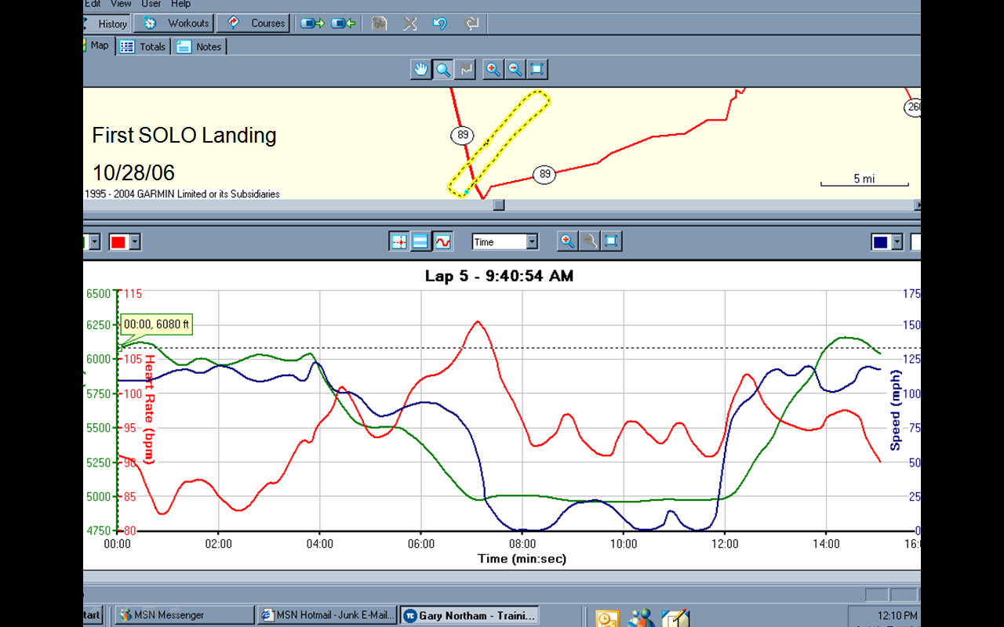

Slide 140
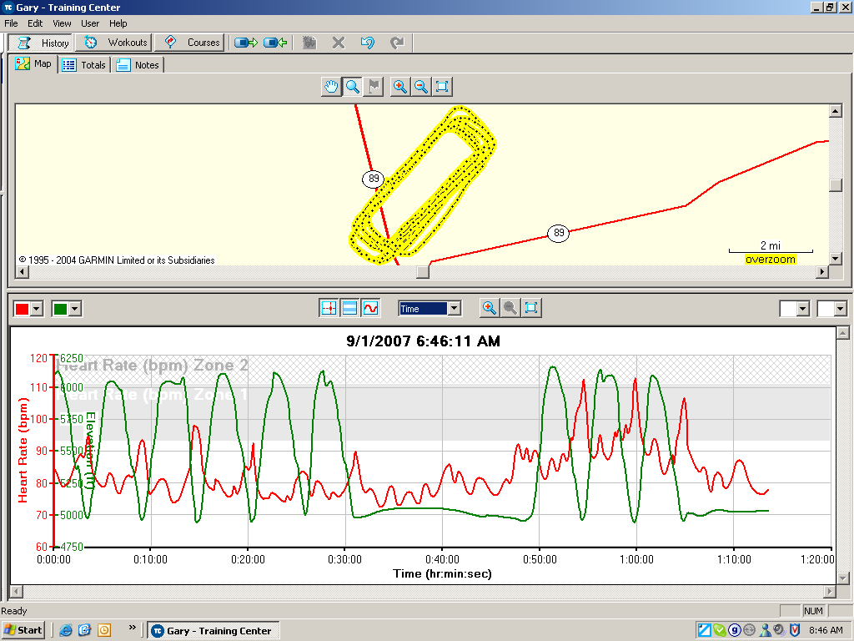
Workload and Stress
The last three landings were solo
Go around practice

Slide 141
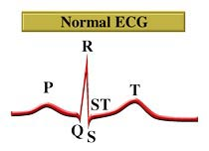
Heart Rate Variability
Found to be a more sensitive measure than HR
  Heart rate affected by both physical and cognitive activities
Notes:
Measure R-R variablility in ECG.

Slide 142
Pupil Diameter
Pupil diameter correlates closely with resource demands of different cognitive activities:
    Mental arithmetic (Kahneman, et al, 1967)
    Short term memory load (Beatty & Kahneman, 1966)
    ATC monitoring load (Jornal, 1997)
    Logical problem solving (Bradshaw, 1968, Beatty, 1982)
Sensitive but lacks diagnosticity
  Many possible causes
    Ambient lighting
    Variations in emotional arousal
Requires very precise measurement

Slide 143
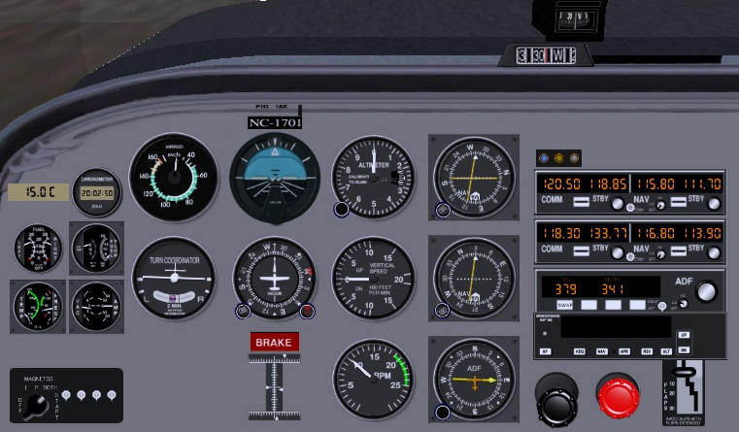
Eye movements / focus
Instrument scan patterns in driving or flying is not random:
  Frequency of fixation indicates importance of instrument
  Pattern of movement indicates individual source relationships
  Length of fixation indicate the difficulty in obtaining or interpreting information from that instrument

Slide 144
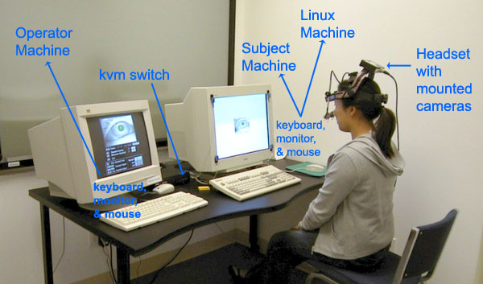
Eye Movements
Problems
  Interpretation of eye gaze data can be very difficult
  Eye fixations will fill up the available time regardless of the task
  In Head up Display – not sure if operator is looking at objects or at the outside world
  Eye tracking equipment is expensive and difficult to set up
  Also use EOG

Slide 145

Eyeblink Activity
Blink rate
  Shown relationship to visual workload in driving and flight environments
  Decreases under conditions of high workload
  (e.g. driving in city vs highway)
  Novice chopper pilots showed decreased in blink rates over time in flight. Expert pilots showed no changes during same flight.
  Lower blink rates found during weapons delivery cf pre-flights briefings. Also in landing and bombing range segments of flights

Slide 146
Blink Patterns
Blink duration (closure duration)
  Decrease during increased visual attention demand
  When fatigued, operator’s blink duration increase (close their eyes longer per blink)
Blink rate and duration sensitive for measuring visual input load (or visual information processing demand), but not for auditory or cognitive workload.

Slide 147
Pschophysiological Measurements
Costs
  Physically obtrusive – leads, wires.
  Expensive - Need specialized equipment
  Not easy to analyze data: need technical expertise

Slide 148
Human
Error
Reduction
Mental Workload Planning
Carry out cognitive task analysis
Eliminate / delegate secondary tasks
Use all available resources – Crew Resource Management
Provide sufficient warning
Prepare appropriate tools
  Charts, tables, memory aids
Provide scenario based training
Provide simulator based training

Slide 149
Reduce Mental Workload
Human
Error
Reduction
Mental Workload = (Information x Stress) / (Time * Experience)
  Information load – Present / select only pertinent and timely information, reduce the need for calculations, reduce the operational memory load, clarify response options
    Allocate duties among operations team
  Stress – Implement redundancy and mitigation procedures to prevent or reduce the severity of an unwanted outcome
  Time – Increase the time available for information handling, plan ahead, use checklists / procedures to manage decision processes
  Experience – provide part, scenario and team based training

Slide 150
Situation Awareness
Situation Awareness is the capacity to COMPREHEND, ASSESS and PROJECT information in order to CONTROL a situation in a TIMELY manner.
Situation awareness is a characteristic of individual or a team and is aided by appropriate use of technology and training

Slide 151
SART – Situation Awareness Rating Technique
Demand | Instability | Sudden situation changes | 1 2 3 4 5 6 7
 | Variability | Number of changing variables | 1 2 3 4 5 6 7
 | Complexity | Situation complexity | 1 2 3 4 5 6 7
Supply | Arousal, Concentration | Readiness, expectation | 1 2 3 4 5 6 7
 | Spare Mental Capacity | Capacity for new variables | 1 2 3 4 5 6 7
 | Divided Attention | Rate / amount of attention switching | 1 2 3 4 5 6 7
Understanding | Information Quantity | Information received and understood | 1 2 3 4 5 6 7
 | Information Quality | Reliability of information | 1 2 3 4 5 6 7
 | Familiarity | Experience with similar situations | 1 2 3 4 5 6 7
Taylor (1990)
Subjective method
Shows good diagnosticity in Rule and Knowledge based activities

Slide 152
Situation Awareness Global Assessment Technique
(SAGAT)
Requires detailed simulation of complex situation
  Air Traffic Control, Driving, Process control
  Alternatively use pencil and paper techniques
Periodically stop the simulation
  Ask subject (pre-prepared) key questions
  Have subjects rate their levels of confidence
  Record, omissions and other discrepancies
  Have Subject Matter Experts rate the performance
  Compile overall performance scores
High number of random and systematic errors, including blunders indicates low situation awareness
Provide feedback and suggestions for correcting systematic errors

Slide 153
Soccer Coaching
I
E
P
Have players play practice game
Periodically blow the whistle and ask (random) offensive or defensive players what is going on, what their options are and what they intend to do next.
Have other players point out the errors in situation awareness and planned strategy
Do not stop play too often, you will irritate the players and lose their attention
Alternatively use video recording of real game and have players in small groups analyze the situations and recommend their next move
  Restart the video and se what the experts did

Slide 154
SAGAT for Web Page Navigation
Set up standard problem scenarios on the web site
  Order a pizza, transfer money, pay a bill, buy a computer, seek out some technical literature etc.
  Use Verbal Protocol Technique to track subject’s understanding
  Observe navigation decisions and errors
Alternatively
  Interpolate navigation questions within a navigation task
  Record and rate subjects level of situation awareness

Slide 155
Situation Awareness
Human
Error
Reduction
Display pertinent and timely information
Avoid naïve realism
Use Annunciators sparingly
Use procedure based information scanning
  Display panel layout
  Importance, sequence
Use alternative sensory channels
  Vision, hearing, touch
Use scenario based training for off normal / emergency situations
Increase time / human resources

Slide 156
Human Quality Assurance (HQA)
HQA

Slide 157
Human Quality Assurance
HQA
The last line of defense
Design in redundancy
Design failure mitigation processes – parachutes
Develop EXPERTISE

Slide 158
Human Quality Assurance
HQA
A broad approach to system design that addresses comprehension of normal system performance over time as well as the unexpected contexts that may disrupt the system
HQA addresses technological, operational, environmental, temporal and human factors

Slide 159
HQA Process
HQA
Use CTA to analyze the thought processes of experts and the errors made by novices
Use facilitators to guide the novice
  Instructions, Warnings, Labels, Procedures, Checklists
Use selection, training and practice to replace the facilitators
  Part task training
  Simulator training
  Scenario based training
Use testing and CTA to assess the changes in thought processes, behaviors and performance

Slide 160
The End
Questions?

Slide 161
Appendices

Slide 162
Norm Based Scoring (enter values in yellow cells only)
Raw Scores |  |  |  |  |  |  |  |  |  | A | 70
Criterion/Judge | A |  | B |  | C |  |  |  |  | B | 60
Weight?? | 10 |  | 30 |  | 60 |  | 100 |  |  | C | 50
Candidate | Score | Rank | Score | Rank | Score | Rank | Total | Rank | Grade | D | 40
1 | 9 | 1 | 25 | 1 | 50 | 5 | 84 | 1 | A
2 | 7 | 2 | 25 | 1 | 51 | 4 | 83 | 2 | A
3 | 5 | 3 | 25 | 1 | 52 | 3 | 82 | 3 | A
4 | 3 | 4 | 25 | 1 | 53 | 2 | 81 | 4 | A
5 | 1 | 5 | 24 | 5 | 54 | 1 | 79 | 5 | A
Mean | 5 |  | 24.8 |  | 52 |  | 81.8
SD | 3.16 |  | 0.45 |  | 1.58 |  | 1.92
 |  |  |  |  |  |  |  |  | Average | SD
Standardized and Weighted Scores (x' = (x - Av(x))/SD* Weight) |  |  |  |  |  |  |  |  | 65 | 10
Criterion/Judge | A |  | B |  | C
Weight | 10 |  | 30 |  | 60
Candidate | Score | Rank | Score | Rank | Score | Rank | Total | Rank | Score | Rank | Grade
1 | 12.65 | 1 | 13.42 | 1 | -75.89 | 5 | -49.83 | 5 | 51.07 | 5 | C
2 | 6.32 | 2 | 13.42 | 1 | -37.95 | 4 | -18.21 | 4 | 59.91 | 4 | C
3 | 0.00 | 3 | 13.42 | 1 | 0.00 | 3 | 13.42 | 2 | 68.75 | 2 | B
4 | -6.32 | 4 | 13.42 | 1 | 37.95 | 2 | 45.04 | 1 | 77.60 | 1 | A
5 | -12.65 | 5 | -53.67 | 5 | 75.89 | 1 | 9.58 | 3 | 67.68 | 3 | B
Mean | 0.00 |  | 0.00 |  | 0.00 |  | 0.00 |  | 65.00
SD | 10.00 |  | 30.00 |  | 60.00 |  | 35.76 |  | 10.00

Slide 163
Bloom's Taxonomy of Cognitive Development
Bloom identified six levels within the cognitive domain, from the simple recall or recognition of facts, as the lowest level, through increasingly more complex and abstract mental levels, to the highest order which is classified as evaluation.
(See appendix for more details)

Slide 164
Knowledge is defined as remembering previously learned material. This may involve the recall, from specific facts to complete theories, but all that is required is the bringing to mind of the appropriate information. Knowledge represents the lowest level of learning outcomes in the cognitive domain. Knowledge is often “literal”
Verbs: arrange, define, duplicate, label, list, memorize, name, order, recognize, relate, recall, repeat, reproduce state.

Slide 165
Comprehension is defined as the ability to grasp the meaning of material (semantics). This may be shown by translating material from one form to another (words to numbers), by interpreting material (explaining or summarizing), and by estimating future trends (predicting consequences or effects). These learning outcomes represent the lowest level of understanding.
Verbs: classify, describe, discuss, explain, express, identify, indicate, locate, recognize, report, restate, review, select, translate.

Slide 166
Application refers to the ability to use learned material in new and concrete situations. This may include the application of such things as rules, methods, concepts, principles, laws, and theories.
Verbs: apply, choose, demonstrate, dramatize, employ, illustrate, interpret, operate, practice, schedule, sketch, solve, use, write.

Slide 167
Analysis refers to the ability to break down material into its component parts so that its organizational structure may be understood. This may include the identification of the parts, analysis of the relationships between parts, and recognition of the organizational principles involved. Analysis requires an understanding of both the content and the structure of the material.
Verbs: analyze, appraise, calculate, categorize, compare, contrast, criticize, differentiate, discriminate, distinguish, examine, experiment, question, test.

Slide 168
Synthesis refers to the ability to put parts together to form a new whole. This may involve the production of a unique communication (theme or speech), a plan of operations (research proposal), or a set of abstract relations (scheme for classifying information). Learning outcomes in this area stress creative behaviors, with major emphasis on the formulation of new patterns or structures.
Verbs: arrange, assemble, collect, compose, construct, create, design, develop, formulate, manage, organize, plan, prepare, propose, set up, write.

Slide 169
Evaluation is concerned with the ability to judge the value of material (statement, novel, equation, research report) for a given purpose. The judgments are to be based on definite criteria. These may be internal criteria (organization) or external criteria (relevance to the purpose). Learning outcomes in this area are highest in the cognitive hierarchy because they contain elements of all the other categories, plus conscious value judgments based on clearly defined criteria.
Verbs: appraise, argue, assess, attach, choose compare, defend estimate, judge, predict, rate, core, select, support, value, evaluate.

Slide 170
Hierarchical Task Analysis
Similar to 6Ms
Purpose
Environment
Information
Operational
Procedures
Technology
People
Time
Resources
Task 2
Task 1
Task 3
Sub Task 21
Sub Task 22
Similar to 5 Whys
Element 211
Element 2121
Element 221
Element 222

Slide 171
The SHEL model (Edwards, 1988)
The Physical and Operational Context
L
Liveware
People
Training
E
Environment
INTERACTIONS
INTERFACES
INTERFERENCES
S
Organizationware
(Software)
H
Hardware
Management
Regulation
Now we must add Software

Slide 172
Swiss Cheese Model
Organization
Accidents are caused by a sequence / hierarchy of failure pathways
Supervision
Preconditions
Unsafe Acts
The “base event”
Reason

Slide 173
HFACS
Human Factors Analysis and Classification System
  Developed mainly for aircraft accident investigation
  May be modified for many other accident investigation and system design scenarios
  Developed from Reason’s “Swiss Cheese” model of accident causation
The Human Factors Analysis and Classification System (HFACS) Scott Shappell and Douglas Weigmann, DOT/FAA/AM-00/7, office of Aviation Medicine, Washington, DC

Slide 174
Unsafe Acts
Cognitive Failures
Errors
Violations
Skill based Errors
Decision Errors
Perceptual Errors
Routine
Habitual
Exceptional
Occasional

Slide 175
Preconditions
Design or Contextual Factors
Social
Environmental
Personnel
Physical
Technological
Crew Resource
Management
Personal
Interfaces
Facilitators
Condition of
Operators
Communications
Teamwork
Weather
Noise
Rest
Medication
Adverse
Mental
States
Adverse
Physiological
States
Physical / Mental
Limitations
Fatigue
Hypoxia
Intoxication
Senses
Aptitude
Experience
Stress
Vigilance
Distraction

Slide 176
Unsafe Supervision
Inadequate
Supervision
Planned
Inappropriate
Operations
Failure to
Correct
Problem
Supervisory
Violations
Training
Assignments
Monitoring
Untrained Supervisor
Assignments
Workload
Uncorrected hazard
Uncorrected behavior
Unauthorized assignments
Procedure violation
Fraud

Slide 177
Organizational
Influences
Resource
Management
Organizational
Climate
Organizational
Process
Priorities
Productivity
Cost cutting
Training
Unofficial rules
Ill defined policies
Cronyism
Communications
Assignments
Schedules
Procedures

