Slide 1
Paper Airplanes
An introduction to
Socio Technical Systems Engineering
B
P
E

Slide 2
Design, make and fly a paper airplane
B
P
E

Slide 3
That was easy, now we shall address the details
B
P
E

Slide 4
The Agenda
Socio Technical Systems Engineering
Paper airplane – the technology
Customers
Requirements and Specifications
Design
Manufacturing and production
Operations
Maintenance
Disposal
Verification and validation
B
P
E

Slide 5
Socio Technical Systems Engineering
Environment
Operations
People
Technology
Purposes
Inextricably
linked
They must work together, otherwise something or somebody will fail
B
P
E

Slide 6
How STSE works - All the “Cs”
Competition
Cooperation
Collaboration
Communication
Complications
Considerations
Customers
Compliance
Companies
Costs
Crowds
Contexts
B
P
E

Slide 7
and some “Is”
Information
Interfaces
Interactions
Interferences
Inspections
Investigations
Interventions
B
P
E

Slide 8
and some Ms
Materials
Machines
Methods
Money
B
P
E

Slide 9
and some Ws
Who
What
When
Where
Why
And a How
B
P
E

Slide 10
and some things to do
Making
Operating
Designing
Measuring
Analyzing
Deciding
B
P
E

Slide 11
and more things to do
Process
Performance
Requirements
Validation
System Design
Specifications
Verification
B
P
E

Slide 12
The People
Shareholders
Managers
Marketers
Designers
Manufacturers
Producers
Inspectors
Servicers
Payload handlers
Pilots
Maintainers
Passengers
Environment
People
Technology
B
P
E

Slide 13
The Environment
Airports
Weather
Schedules
Competitors
Regulators
Environment
People
Technology
Things that generally cannot be changed
B
P
E

Slide 14
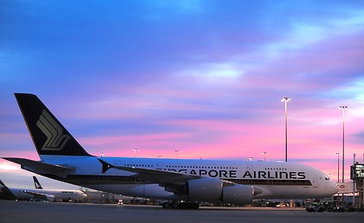
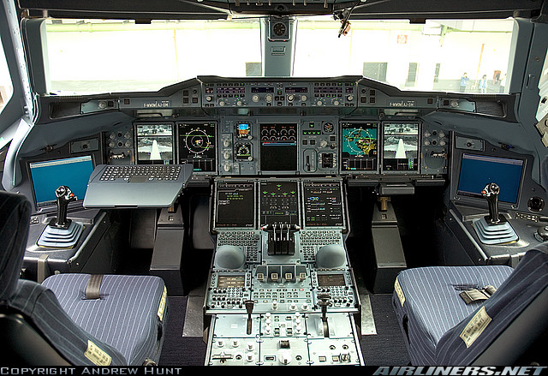
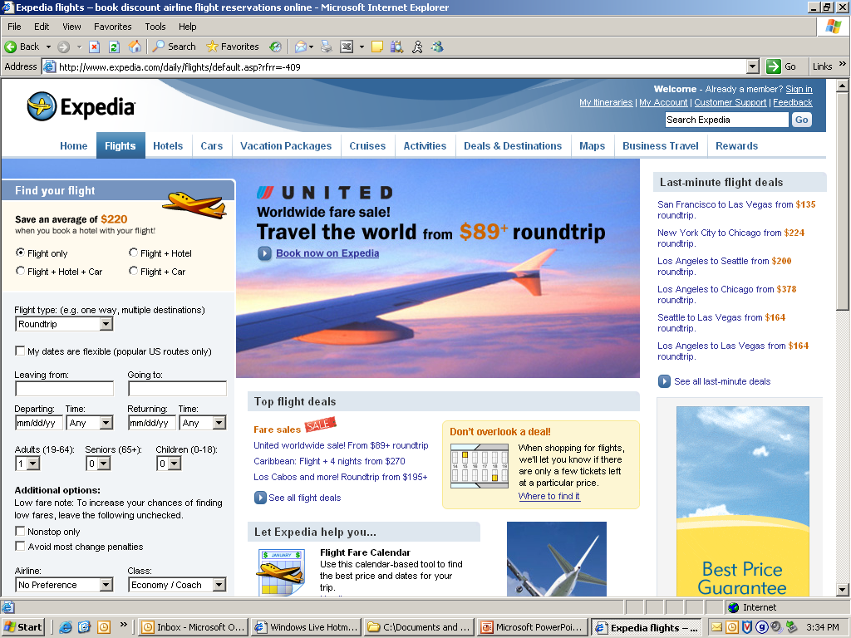
The Technology – often can be changed
Environment
People
Technology
B
P
E

Slide 15
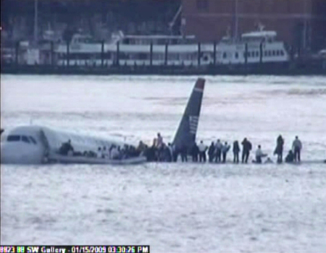
When things go wrong, everybody must be off the airplane in 90 seconds
B
P
E

Slide 16
The Project
Get in groups of three
  Give your company a name
Design, build and fly a paper airplane
Task allocation
  Designer
  Manufacturer
  Customer / Inspector / Manager
B
P
E

Slide 17
Customer Requirements
List the Customer Requirements
Who are the customers?
B
P
E

Slide 18
The Customers
Passengers
Flyers
Maintainers
Manufacturers
Maintainers
Inspectors
Marketers
Managers
Shareholders
May have conflicting requirements
B
P
E

Slide 19
Customer Requirements
Range 5 meters
Navigation Within 1 meter of target
Payload 5 paperclips
Safety Must land flat, no nose landings
Security No malicious interference
Reliability Must not fall apart
Aesthetics Customer opinion
Cost Less than $10 per unit
Disposal Recyclable
You are welcome to change or add requirements
B
P
E

Slide 20
Specifications
List the Manufacturing Specifications
B
P
E

Slide 21
Manufacturing Specifications
Use one sheet of paper any size
Write your name on the paper
Make one fold along mid line of paper
Open up and lay flat
Fold two corners to center line to make nose
Close up the two halves again
Fold each half outwards to make wings
  Where should this fold be? Why?
Place payload / paper clips to assure correct weight and balance
You are welcome to change the specifications
B
P
E

Slide 22
Production
List the production operations requirements
B
P
E

Slide 23
Production Requirements and Constraints
Simple mostly manual operations
  Minimize equipment, materials and labor costs
500 units per day
  Less than one minute to assemble
Less than 10% rejects
  Quality criterion - < 0.5 cm gap / edge mismatch
Costs
  Marketing, Design and Manufacturing (Indirect) $5 per unit
  Materials $1 per unit
  Production $4 per unit
  Labor $10 per hour
B
P
E

Slide 24
Paper Airplane – Production Operations Analysis
Some questions, you may ask more
How many production employees do we need?
What fixtures and equipment do we need?
What tools do we need?
How should we arrange for materials delivery?
  Just in time?
How should we lay out the production line?
  Materials and product flow
How should we manage production operations
  One fold per operator
  Operator completes all folds
How should we deal with selection, training, health and safety?
B
P
E

Slide 25

The Challenge
Prizes:
  First to market
  Largest payload
  Best test score
    Range
    Accuracy
    Quality
    Safety
    Aesthetics
B
P
E

Slide 26
Specifications Verification
Manufacturing Specifications
  Use one sheet of paper any size
  Write your name on the paper
  Make one fold along mid line of paper
  Open up and lay flat
  Fold two corners to center line to make nose
  Close up the two halves again
  Fold each half outwards to make wings
    Where should this fold be? Why?
  Place paper clips to assure correct weight and balance
B
Quality Control – How accurate are the folds?
< 0.5cm gap / edge mismatch
P
E

Slide 27
Requirements Validation
Range 5 meters
Navigation Within 1 meter of target
Payload 5 paperclips
Safety Must land flat, no nose landings
Quality < 0.5 cm gap / edge mismatch
Reliability Must not fall apart
Aesthetics Customer opinion
Cost Construction in less than one minute
Maintenance < 1 minute to take apart and reassemble
Disposal Recyclable (your name is on the plane!)
Have another neighbor (not the designer or manufacturer) carry out a rigorous flight test
B
P
E

Slide 28
3 Flight Tests
 |  | 1 | 2 | 3 | Average
Range | Meters
Navigation | Meters
Payload | Paper clips
Safety | Landing
Quality | <0.05 cm
Reliability | Stays intact
Aesthetics | Time
Cost | Seconds / plane
Maintenance | < 1 minute
Disposal | Y/N
B
P
E

Slide 29
Socio Technical Systems Questions
How did competition affect your behavior?
  Speed to market
  Space in room for all activities (crowds)
How did the team work together? - collaboration
Was communication clear?
  Between design and manufacturing
Who dominated the collaboration?
  marketing, design or manufacturing?
  Who needs management?
Who are the customers?
  Passengers, marketing, design, manufacturing, maintenance, management, shareholders
How would you design an organization to build 5 different models, each with500 units per day, with manufacturing plants in Africa and design changes every month?

Slide 30
Paper Airplane Game
Marketing - Competition
Manufacturing - Communication
First to market gets the prize
Largest payload gets a prize
BUT Quality Rules!
Customer Requirements
  Range 5 meters
  Navigation +/- 1 meter
  Payload ? paperclips
  Safety Land flat
  Aesthetics Customer ratings
Specifications
  One piece of paper
  Make 3 units
    Less than 1 minute to assemble
  Simple operations / folds
Operations – Customers
Fly 3 test flights
Score
  Range
  Navigation accuracy
  Payload
  Safety
  Aesthetics
Maintain - take apart and re-assemble in 30 seconds
Design - Collaboration
Translate Customer, Manufacturing and Maintenance Requirements into Manufacturing Specifications
B
P
E

