Slide 1
Train The Trainer OH Masterclass For Ergonomics: Evaluation and Investigation methods: TA, CTA , MWL and SA Prof. Brian Peacock and A.Prof. Chui Yoon Ping

Slide 2
Task Analysis
Physical Task Analysis addresses human overt behaviors – the flow of Energy – Actions
Cognitive Task Analysis addresses the flow of Information between (and within) the Task and the Operator
Job Analysis addresses the broader psycho-social aspects of an individual’s or group’s activities

Slide 3
Uses of Task Analysis
What is the goal or purpose
What should be done
What should not be done
Who should do what, and when and where
How things should be done
How tasks should be designed
How tasks should be assigned
How people should be selected, trained and assigned
How procedures should be designed
How equipment should be designed
How facilitators should be designed
This is a descriptive approach, but useful
Consider the task of making breakfast or carrying out a safety inspection of a worksite

Slide 4
Task Analysis on the Car Assembly Line
Quality and productivity are the main organizational purposes. How would you analyze these operations?
What systematic methods would you use?

Slide 5
Physical Task Analysis
Henry Ford
Frederick Taylor
Lillian Gilbreth
MTM (Methods Time Measurement)
Work Factor
Charting and Timing (in seconds)
Each individual assembly operation may be broken down into these elements.
Disassemble and reassemble your pen
How long does each element take?
Pick
Carry
Place
Fasten
Inspect
Return
10
20
10
30
10
10

Slide 6
Physical Task Analysis (with Physical Ergonomics)
Effort / Force / Posture
Place
10
Fasten
30
Carry
20
Return
10
Pick
10
Inspect
10
Time
Where is the value added work?
Where can time be saved?

Slide 7
Physical Task Analysis
All production lines are subject to this type of physical task analysis with various levels of detail
Research the history of the production line
Research the history of Industrial Engineering and work measurement
But this is just physical task analysis and thinking also takes time
Discuss the importance of cognitive and social factors and theor affect on E4S4

Slide 8
Cognitive Task Analysis
Cognitive Task Analysis is the collective name for a set of methods that describe the thought processes used by novices and experts to control simple or complex systems
Cognitive Task Analysis distinguishes between knowledge, rule and skill based control of systems
People who operate in a knowledge based way are restricted by the information available
People who act in a rule based way do not seek additional information, but rely on deductive processes
People with a high level of skill are adaptable and able to apply inductive reasoning to problem solving
CTA is appropriate where complex information handling takes place and may affect effectiveness and efficiency (and the rest of E4S4, discuss some examples of such tasks

Slide 9
CTA Methods
Cooke (1994) identified three broad families of techniques:
observation and interviews: watching experts and talking with them.
More informal. Allow knowledge elicitator more flexibility during knowledge elicitation.
process tracing: capture an expert’s performance of a specific task via either a think-aloud protocol or subsequent recall.
More formal and structured. Some analysis decisions are left to the elicitor.
conceptual techniques: produce structured, interrelated representations of relevant concepts within a domain
Conceptual techniques are well-specified and formal with few judgments on the part of the elicitor.
Requires more training
Look, talk and analyze
How would you analyze the job of a car driver, a pilot or your boss?

Slide 10
CTA Methods
Fourth family introduced by Wei and Salvendy (2004
formal models—which use simulations to model tasks in the cognitive domain.
It is now possible to simulate human information processing activity using tools such as MicroSaint.
Develop a model of the information handling activities of parking a car. How is operational success (E4S4) vulnerable at each information processing phase?

Slide 11
CTA procedure
Most of the dominant CTA methods are performed in the following sequence:
Collect preliminary knowledge
Identify knowledge representations
Apply focused knowledge elicitation methods
Analyze and verify data acquired
Format results for the intended application.
Clark, et al (2006), “Cognitive Task Analysis”

Slide 12
CTA procedure
1. Collect preliminary knowledge
Sequence of tasks that will become the focus of the CTA are analysed
Analysts attempt to become generally familiar with the knowledge domain and identify experts to participate in the knowledge elicitation process. Knowledge analysts should be generally familiar with the content, system, or procedures being analyzed.
Interview 2-3 subject matter experts, separately to avoid premature consensus regarding the knowledge and skills necessary for effective performance.
Techniques typically used during this phase include document analysis,
observation, and interviews (structured or unstructured).
The analyst uses the results of this stage to identify the knowledge types and structures involved in performing the tasks.
Clark, et al (2008), “Cognitive Task Analysis”
Consider the car parking example
Why do drivers stop talking while they are parking?

Slide 13
CTA procedure
2. Identify knowledge representations
Using information collected during the preliminary stage, examine
each task to identify sub-tasks and types of knowledge required to perform it.
Most CTA approaches are organized around knowledge representations appropriate for the task, such as concept maps, flow charts, semantic nets, and so forth. These representations provide direction and order to latter stages in the CTA process because knowledge elicitation methods map directly to knowledge types.
Some are best used to elicit procedural knowledge, while others are more successful for capturing declarative knowledge (Chipman et al., 2000).
A learning hierarchy is one example of a method to organize the types of knowledge required to perform a task.
Clark, et al (2008), “Cognitive Task Analysis”
Develop some different charting methods for CTA

Slide 14
CTA procedure
3. Apply focused knowledge elicitation methods
the analyst applies various techniques to collect the knowledge identified in the prior stage.
choose methods appropriate to the targeted knowledge type as determined by the knowledge representations identified for each task.
Knowledge elicitation methods include:
Structured or semi-structured interviews
Verbal Protocol analysis
Critical Decision Method (Gary Klein)
Applied Cognitive Task Analysis (ACTA) (Militello and Hutton)
Clark, et al (2008), “Cognitive Task Analysis”
How will you collect data for the car parking CTA?

Slide 15
Verbal Protocol Analysis
Use verbal protocol analysis to develop procedures, instructions, checklists and improvisations
Tie your shoelace or tie
Navigate a sharp bend while driving
Take a penalty kick
Cook a meal
Using your mobile phone for web surfing
Choose one of these activities and, as you work through the task, describe to your group what you are thinking.

Slide 16
CTA procedure
4. Analyze and Verify Data Acquired
Analyst code and format the results for verification, validation, and applicability for use in their intended application.
Transcripts may be coded to summarize, categorize, and/or synthesize the collected data.
Formatted output is presented to the participating SMEs for verification, refinement, and revision to ensure that the representations of tasks and their underlying cognitive components are complete and accurate.
The analyst should compare these with the output of other experts to validate that the results accurately reflect the desired knowledge representation.
Clark, et al (2008), “Cognitive Task Analysis”
Now compare your analyses with those of other groups. How do they differ? How can the methods be improved?

Slide 17
CTA procedure
5. Format Results for the Intended Application
The results of some highly structured CTA methods (e.g., cognitive modeling) are readily applied to expert systems or computer-assisted tutoring applications.
For less formal CTA methods, the results must be translated into models that reveal the underlying skills, mental models, and problem solving strategies used by experts when performing highly complex tasks.
Clark, et al (2008), “Cognitive Task Analysis”
Create a structure for a computer representation of your CTA.

Slide 18
Expertise
Attained by mimicking the thought processes of experts
The information they seek
The weightings they assign to different items of information
The logic / inductive reasoning they use
The conclusions they reach
Compared with novices
Errors of omission and commission in the information they seek
Over / under weight the importance of some information sources
Use incorrect / inadequate logic, deductive reasoning
Converge on wrong conclusions and make wrong decisions
Novices and Experts are different due to aptitude, training and experience.
Compare some tasks in which you differ in experience with a colleague

Slide 19
Cognitive Task Analysis
Task Related Thoughts
Analyze the Task Demands
Semantic Encoding
Physical Encoding
Observe the Activity
Secondary Tasks
Articulation
Transmission / Implementation
Record Physiological Electrical Activity
Record Cortical Electrical Activity
Verbal Protocol Analysis
Record Eye Movements
Real Time
Asynchronous
Observe Effects on Primary and Secondary Tasks
Consider each of these steps in the car driving context

Slide 20
Cognitive Task Analysis (a doctor)
Examine Patient
Consult Diagnostic Reference Material
Examine Test Results
Consult Prescription Reference Material
Make Diagnosis
Consult Record Reference Material
Select Treatment
Note that an experienced doctor will carry out these activities in parallel and use his experience and external references to complete the consultation and so save time
Record Data`
How would you investigate your child’s headache?

Slide 21
Cognitive Task Analysis Landing an airplane
Describe the activities of the novice pilot. Where and why may things go wrong?
Get weather and runway information
Talk to ATC
Enter and fly the traffic pattern
Check power, air speed, altitude, attitude, configuration, approach, other traffic, wind and runway
Adjust power, attitude and configuration
Decide whether to land or go around

Slide 22
Secondary Task Methods of CTA
Tracking and Mental Arithmetic
Draw sets of concentric circles with different separations
Measure tracking time and error
Repeat while you count down from 100 in sevens
How does the secondary task reflect the workload of the primary task?
D

Slide 23
Car driving and classroom experiments
Drive a car along a slalom course on an empty road
Control the speed automatically
Tap your (right) foot) rhythmically as you drive
Vary the speed and tire pressure
How do the primary task demands affect performance on the secondary task
Classroom experiment – have students listen to a lecture and complete a crossword or Sudoku puzzle at the same time. Measure performance on both tasks. How does the secondary task affect the primary tasks?

Slide 24
Transaction Analysis
A transaction is a well defined repeated task involving a purpose, operator, equipment, materials, energy a context and information such as:
Making a sandwich
Landing an airplane
Driving a car through an intersection
Using an ATM machine
Buying a product through a web page
The transaction takes a variable amount of time
The outcome of a transaction may be success or failure or some degree in between
This is the basic element of CTA
Describe some transactions in the task of a food court cashier.

Slide 25
Transaction Analysis (contd.)
Analysis will involve both the physical elements and the flow of information
Initiation
Establish of purpose, recall procedure
Search for information from equipment, context, materials and operator
Anticipate input / external factor effects and process outcome
Plan activity including contingency plan, Evaluate risks and benefits, Decide to proceed
Control
Make control input / communication action
Monitor process, perceive feedback,
Modify input
Outcome analysis
Perceive system state
Compare with anticipated outcome
Store observations for future use
Think about using an ATM

Slide 26
Transaction Analysis Example – Parking a car
Arrive at destination
Initiation
Search for parking space, Observe obstructions
Judge that space is sufficient
Recall procedure, plan actions
Control
Operate vehicle controls
Monitor progress, judge separations
Terminate procedure
Outcome Analysis
Observe vehicle status, observe context status, compare with plan
Store location
Store transaction record for future use
Cognitive sources of Success or Failure
Sensory input
Prediction, hazard assessment
Recall procedure
Planning trajectory / timing
Attention to hazard areas
Perceive clearances
Decisions to continue, adjust, abort
Motor control – disturbed posture, tactile assessment of pedal location
Repeat the parking CTA

Slide 27
Verbal Protocol
Place two chairs to simulate parked cars
Reverse into the gap between the two cars
Use verbal protocol analysis to describe your activities
Compare the verbal protocol method with other CTA methods
Do subjects accurately describe their thoughts and actions?

Slide 28
Practical Cognitive Task Analysis
Purpose | Parallel parking, no contact with other vehicles or objects
Activities | See task description
Cognitive processes | Planning, predicting, diagnosing, sensing, attending, judging, deciding, problem solving, controlling, communicating, analyzing, synthesizing, evaluating, anticipating, predicting, investigating, extrapolating, understanding
Information Resources | Direct outside vision, mirrors, hearing??, memorized procedures, operational memory
Failure modes | Not enough space to park Contact with front / rear fender Inaccurate positioning
Simulation | Table top model Walk / talk through sensory, cognitive, motor activities
Simulator | Empty parking lot using cones to demarcate the target

Slide 29
Mental Workload
“ Mental workload is the amount of mental work or effort necessary for a person or group to complete a task over a given period of time.”
Xie and Salvendy 2000

Slide 30
Mental Workload and Situation Awareness
Information
X
Stress
Mental Workload
=
Time
X
Experience
Time
X
Experience
Situation
Awareness
=
Information
X
Stress
Discuss these conceptual models

Slide 31
Mental Workload Measurement Device Criteria
Sensitive to task difficulty and cognitive resource demand
Diagnostic – capable of identifying the resources used
Selective – separates mental workload from other sources of stress
Reliable and Resilient – performs well consistently and under complex conditions
Unobtrusive - does not interfere with primary task
Uncomplicated and economical - does not require complex expensive equipment
Acceptable to the operator / subject
A high standard of requirements
How do the CTA methods discussed stand up to these criteria?

Slide 32
Mental Workload Measurement
Primary and secondary task behavior and performance measures
Subjective rating scales, usually retrospectively
Psycho physiological
Heart rate, heart rate variation, Eye blink and pupil monitoring, EEG
External (expert) observer
Simulation methods (MICRO-SAINT)
CTA measures the task demands.
MWM adds in the variable subject.

Slide 33
Primary Tasks Measures
Asses operator’s capability to perform the primary task or system functions of interest
Time and accuracy / error
Central tenet: performance deteriorates as one is subjected to higher MWL.
Common measure of primary task PERFORMANCE:
Time taken for task completion (Speed)
Accuracy (no. of errors made)
Reaction/ response time
Difficulties
Not sensitive to level of expertise
Not sensitive to variable stress accommodated by the operator
How would you assess the task of a bank teller, a cashier, a security guard?

Slide 34
Secondary task measures
Add another task to the primary task.
If you can perform well in your secondary task, then the workload on the primary task is low , and you still have spare resource capacity.
2 methods:
Subsidiary task paradigm:
Maintain performance of primary task
Loading task paradigm
Maintain performance of secondary task
These tasks interact, both emphases are important in MWM
Consider listening to a lecture while talking on your mobile phone

Slide 35
Secondary Task Example
Driving on a closed slalom circuit with speed controlled by investigator
Rhythmic foot tapping – secondary task
Primary task focus
Secondary (tapping) task varied with speed and course / vehicle handling (tire pressure) difficulty
Secondary task focus
Primary (steering) task varied with speed and course / vehicle handling difficulty
Simulate these primary and secondary tasks with a desk top pencil and paper tracking task

Slide 36
Secondary Tasks
Mental arithmetic
Card sorting
Choice reaction time
Recitation / reading
Recognition
Ancillary instruments
Size differences
Short term memory
Monitoring
Problem solving
Anything that can be reliably measured and that may share some of the sensory, attention, cognitive, memory or motor resources with the primary task
Discuss the pros and cons of different secondary tasks

Slide 37
Dual Task Methods
Car driving – primary control task, navigation, instruments, entertainment and communication (cell phone)
Divided attention
Conversations stop at intersections
Case study – Top Gun movie
Flying – Flying, navigating, communicating
“Sterile cockpit” – only essential communications
Essential communications completed early during stable flight phases
Communications quality deteriorates with flying and navigational stress
Workload reduced by rule based activities
Sometimes time sharing is needed among various “primary tasks” . Give some examples

Slide 38
Secondary task measures: Problems
Validity
Introduction of secondary task changes nature of the primary task – therefore contaminating workload measure
High level of intrusion
Interfere and disrupt performance of primary task. Dangerous if primary task is flying or driving – diverted attention to secondary task may lead to an accident.
Important to allow for self-pacing – abort secondary task if necessary.
Using artificial laboratory based task:
Operator may not be willing to perform secondary task considered to be artificial and bothersome
Instrumentation required to introduce task into the operation environment
Discuss the utility and validity of the Secondary task method

Slide 39
Secondary task measures: Problems
Not sensitive if the two tasks require separate types of resources
If you are required to drive (a manual task) and repeat a series of digit (a verbal task) – you will not find any decrement in primary task.
Hence, look at the different resource dimensions – if primary task consists of a verbal processing task with no spatial components, don’t use a spatial secondary task measure.
Very sensitive to tasks requiring similar resources – where time sharing is difficult.
Discuss cognitive resources

Slide 40
Subjective Measures
Strength of self-report measures is their subjectivity. Enjoy highest face validity.
"The operator's awareness of increasing effort being used, even before any performance degradation occurs, should give subjective [self-report] measures a special role to play"
Muckler & Seven (1992)
No one is able to provide a more accurate judgment with respect to experienced mental load than the person concerned. But are their reports accurate?
(cited in Wickens, 1984)

Slide 41
Subjective Measures
Most popular and frequently used measures of workload
Research in subjective measures produced rating scale techniques dedicated to workload assessment shown capable to reflect variations in demand across a variety of different tasks
Rating Scale Mental Effort (Zijlstra)
Modified Cooper Harper (Wierwille and Casali, 1983)
Bedford (Ellis and Roscoe,1982)
NASA TLX
Subjective Workload Assessment Technique (SWAT) (Reid & Nygren, 1988)
Widely used to investigate MWL

Slide 42
Modified Cooper Harper scale
Original Cooper Harper scale was for assessment of aircraft handling characteristics
Long tradition of use for workload associated with psychomotor tasks
2 versions:
Modified Cooper Harper (Wierwille and Casali, 1983)
Bedford (Ellis and Roscoe,1982)
Both versions retained the 9 or 10 point decision tree format
Decision tree makes the rating easier by allowing sequential decisions and the rating is very time economic.
Explore this MWL technique by discussion with colleagues and Internet search

Slide 43
Modified Cooper Harper (MCH) by Wierwille and Casali, 1983

Slide 44
Bedford Workload Scale
Compare with the Cooper Harper approach with reference to the car parking or bank teller tasks

Slide 45
NASA TLX
Multi-dimension subjective workload rating technique
Workload defined as “cost incurred by human operators to achieve specific level of performance.”
Overall score is based on the weighted average of rating on 6 subscales
A relatively easy to use and widely used subjective method
Use the chart to analyze your recreational, occupational, commuting or shopping tasks

Slide 46
Name
Task
Date
TASK LOADING INDEX
Mental Demand: How mentally demanding was the task?
Very Low
Very High
Physical Demand: How physically demanding was the task?
Very Low
Very High
Temporal Demand: How hurried or rushed was the pace of the task?
Very Low
Very High
Performance: How successful were you in accomplishing what you were asked to do?
Perfect
Failure
Effort: How hard did you have to work to accomplish your level of performance?
Very Low
Very High
Frustration: How insecure, discouraged, irritated and annoyed were you?
Very Low
Very High

Slide 47
Psychophysiological Measurements
Provide continuous measurements and data collection:
Pick up transient changes in MWL
(Possibly) Not obtrusive to primary task
Subjects do not need to perform secondary tasks, or fill up forms
Methods:
Heart rate and HR Variability
Pupil Diameter
Visual Scanning
EEG
Now we are getting inside the subject. Intrusive methods may be useful but they can have some disadvantages. Discuss.

Slide 48
Heart Rate
Studies shown HR of pilots flying actual flights is higher than flying simulated flights (within subjects study)
Used in other non aviation studies:
race car drivers – 150 to 180 bpm b4 race starts. HR 180 to 210 bpm during race
race boat drivers: Change from while waiting 142bpm to 192bpm during race.
Telemarketer: HR increase during work cf resting condition
However, heart rate is affected both by physical and psychological load
Sensitive measure, but lacks diagnosticity

Slide 49
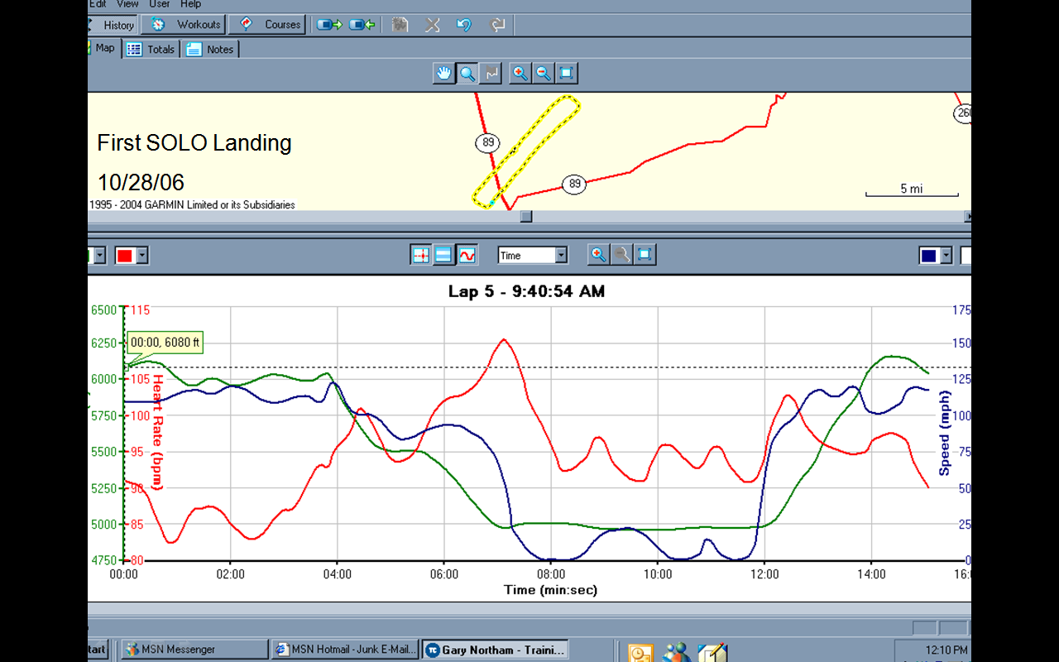
Observe the altitude, airspeed and heart rate during this f(successful) irst solo landing attempt

Slide 50
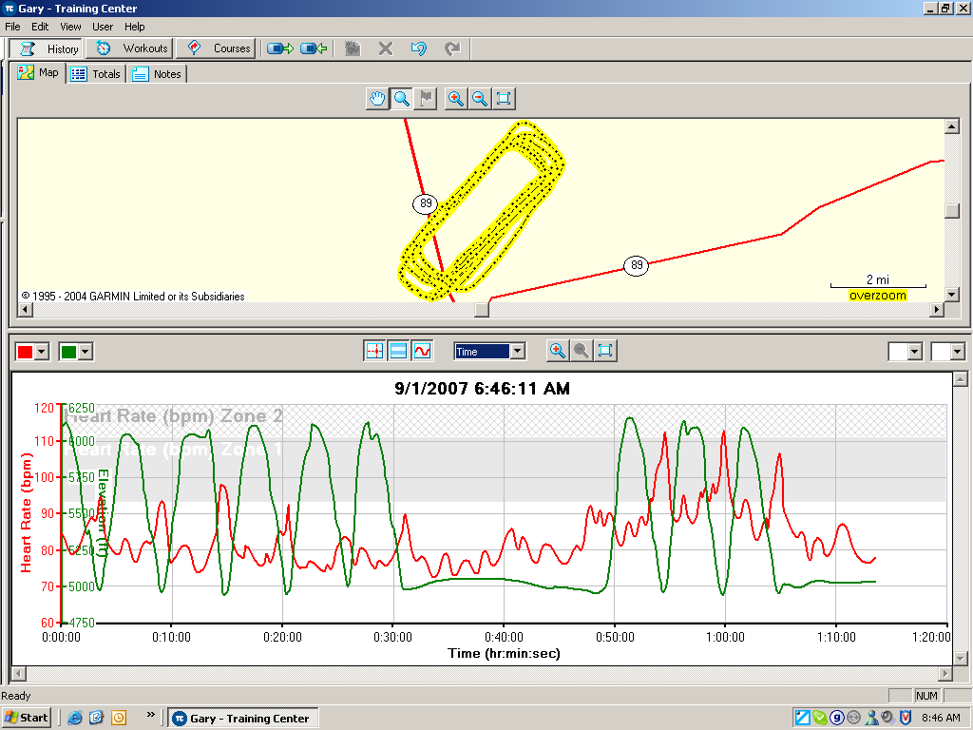
Workload and Stress
The last three landings were solo
Go around practice

Slide 51
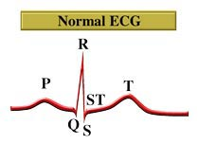
Heart Rate Variability
Found to be a more sensitive measure than HR
Heart rate affected by both physical and cognitive activities
Requires sophisticated analysis
Notes:
Measure R-R variablility in ECG.

Slide 52
Pupil Diameter
Pupil diameter correlates closely with resource demands of different cognitive activities:
Mental arithmetic (Kahneman, et al, 1967)
Short term memory load (Beatty & Kahneman, 1966)
ATC monitoring load (Jornal, 1997)
Logical problem solving (Bradshaw, 1968, Beatty, 1982)
Sensitive but lacks diagnosticity
Many possible causes
Ambient lighting
Variations in emotional arousal
Requires very precise measurement
Can be used successfully along with eye tracking for assessing the cognitive load in human computer interaction

Slide 53
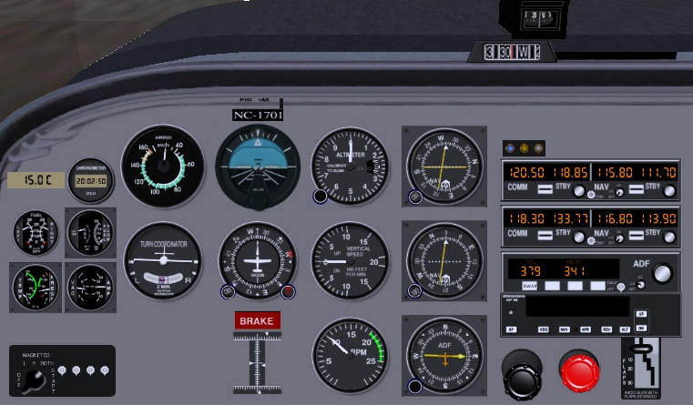
Eye movements / focus
Instrument scan patterns in driving or flying is not random:
Frequency of fixation indicates importance of instrument
Pattern of movement indicates individual source relationships
Length of fixation indicate the difficulty in obtaining or interpreting information from that instrument
A useful method for assessing what the pilot is thinking

Slide 54
Eye Movements
Problems
Interpretation of eye gaze data can be very difficult
Eye fixations will fill up the available time regardless of the task
In Head up Display – not sure if operator is looking at objects or at the outside world
Eye tracking equipment is expensive and difficult to set up
Also use EOG

Slide 55
Eyeblink Activity
Blink rate
Shown relationship to visual workload in driving and flight environments
Decreases under conditions of high workload (e.g. driving in city vs highway)
Novice chopper pilots showed decrease in blink rates over time in flight. Expert pilots showed no changes during same flight.
Lower blink rates found during weapons delivery cf pre-flights briefings. Also in landing and bombing range segments of flights
Can be used with eye movement and pupil diameter methods

Slide 56
Blink Patterns
Blink duration (closure duration)
Decrease during increased visual attention demand
When fatigued, operator’s blink duration increase (close their eyes longer per blink)
Blink rate and duration sensitive for measuring visual input load (or visual information processing demand), but not for auditory or cognitive workload.

Slide 57
Pschophysiological Measurements
Costs
Physically obtrusive – leads, wires.
Somewhat Intrusive
Expensive - Need specialized equipment
Not easy to analyze data: need technical expertise

Slide 58
Mental Workload Planning
Carry out cognitive task analysis
Eliminate / delegate secondary tasks
Use all available resources – Crew Resource Management
Provide sufficient warning
Prepare appropriate tools
Charts, tables, memory aids
Provide scenario based training
Provide simulator based training
Plan your car parking task analysis

Slide 59
Reduce Mental Workload
Mental Workload = (Information x Stress) / (Time * Experience)
Information load – Present / select only pertinent and timely information, reduce the need for calculations, reduce the operational memory load, clarify response options
Allocate duties among operations team
Stress – Implement redundancy and mitigation procedures to prevent or reduce the severity of an unwanted outcome
Time – Increase the time available for information handling, plan ahead, use checklists / procedures to manage decision processes
Experience – provide part, scenario and team based training
How can you improve the quality and efficiency of your car parking or meal preparation tasks?
Plan a h e a d

Slide 60
Situation Awareness
Situation Awareness is the capacity to COMPREHEND, ASSESS and PROJECT information in order to CONTROL a situation in a TIMELY manner.
Situation awareness is a characteristic of individual or a team and is aided by appropriate use of technology and training
Do you know what is going on around you right now with regard to temporal, operational, spatial, contextual and informational factors?
Have you ever watched a small child wander around oblivious of his or her surroundings?
How do you manage to change trains at an MRT station?

Slide 61
SART – Situation Awareness Rating Technique
Demand | Instability | Sudden situation changes | 1 2 3 4 5 6 7
 | Variability | Number of changing variables | 1 2 3 4 5 6 7
 | Complexity | Situation complexity | 1 2 3 4 5 6 7
Supply | Arousal, Concentration | Readiness, expectation | 1 2 3 4 5 6 7
 | Spare Mental Capacity | Capacity for new variables | 1 2 3 4 5 6 7
 | Divided Attention | Rate / amount of attention switching | 1 2 3 4 5 6 7
Understanding | Information Quantity | Information received and understood | 1 2 3 4 5 6 7
 | Information Quality | Reliability of information | 1 2 3 4 5 6 7
 | Familiarity | Experience with similar situations | 1 2 3 4 5 6 7
Rate a road crossing task

Slide 62
Situation Awareness Global Assessment Technique (SAGAT)
Requires detailed simulation of complex situation
Air Traffic Control, Driving, Process control
Alternatively use pencil and paper techniques
Periodically stop the simulation
Ask subject (pre-prepared) key questions
Have subjects rate their levels of confidence
Record, omissions and other discrepancies
Have Subject Matter Experts rate the performance
Compile overall performance scores
High number of random and systematic errors, including blunders indicates low situation awareness
Provide feedback and suggestions for correcting systematic errors
Widely used.. Consider a child crossing the road or a security guard inspecting a simulation

Slide 63
Soccer Coaching
Have players play practice game
Periodically blow the whistle and ask (random) offensive or defensive players what is going on, what their options are and what they intend to do next.
Have other players point out the errors in situation awareness and planned strategy
Do not stop play too often, you will irritate the players and lose their attention
Alternatively use video recording of real game and have players in small groups analyze the situations and recommend their next move
Restart the video and see what the experts did
Fun to do. Can be very informative

Slide 64
SAGAT for Web Page Navigation
Set up standard problem scenarios on the web site
Order a pizza, transfer money, pay a bill, buy a computer, seek out some technical literature etc.
Use Verbal Protocol Technique to track subject’s understanding
Observe navigation decisions and errors
Alternatively
Interpolate navigation questions within a navigation task
Record and rate subjects level of situation awareness
Use this evidence to redesign the web page

Slide 65
Situation Awareness
Display pertinent and timely information
Avoid naïve realism
Use Annunciators sparingly
Use procedure based information scanning
Display panel layout
Importance, sequence
Use alternative sensory channels
Vision, hearing, touch
Use scenario based training for off normal / emergency situations
Increase time / human resources
Design a security check task to improve situation awareness

Slide 66
The Broad Scope of Job Analysis
Social
Cognitive
Affective
Sensory
Physical
People
Energy
Physical
Environment
Technology
Interactions
Contexts
Information
Operational
Environment
Time
Economic
Frequency
Sequence
Organizational
Consider each of these aspects of your job. How is your performance and satisfaction affected by each factor?
Duration
Operational

Slide 67
Job Analysis
 | Human | Technological | Contextual | Temporal
Effectiveness | - 0 + | - 0 + | - 0 + | - 0 +
Efficiency | - 0 + | - 0 + | - 0 + | - 0 +
Ease of Use | - 0 + | - 0 + | - 0 + | - 0 +
Elegance | - 0 + | - 0 + | - 0 + | - 0 +
Safety | - 0 + | - 0 + | - 0 + | - 0 +
Security | - 0 + | - 0 + | - 0 + | - 0 +
Satisfaction | - 0 + | - 0 + | - 0 + | - 0 +
Sustainability | - 0 + | - 0 + | - 0 + | - 0 +
Circle the – 0 + in each cell and add up the rows and columns to identify which interactions between inputs and outputs need attention

Slide 68
All of these performance factors should be considered
Effectiveness
Meets functional requirements
“quality”
Efficiency
Optimal use of resources
“productivity”
Ease of Use
Intended users
Comfort and Convenience
Prevention of misuse
Elegance
Esthetic / emotional appeal
Affective Design
Safety and Health
Prevention or mitigation of system failures
For participants and third parties
Security
Inadvertent or malicious misuse
Satisfaction
Of ALL customers and stakeholders
Sustainability
Reliability
Under intended contexts over the life cycle
Resilience
Under unintended, unexpected and harsh conditions
E4S4
There WILL be tradeoffs
Discuss your job from these outcome viewpoints

Slide 69
Conclusions
Thinking takes time
Most errors and accidents have a cognitive basis
Physical, Cognitive and Job analyses come together in BIG Picture Ergonomics
Do not be narrow in your assessment of human performance and error, consider the cognitive and broader basis
Choose the right tools to analyze the task or job
Design the task or job for success on all the required outcomes

