Slide 1
Cumulative Trauma Disorders
Brian Peacock
for
Pitney Bowes Inc

Slide 2
Occupational Musculoskeletal Disorders
Acute –slips, trips, falls
  strains, sprains, fractures
Chronic – cumulative trauma disorders, repetitive strain injuries, etc.
Work Related Musculoskeletal Disorders (WRMSDs)
Injury
  biomechanical basis
  mechanical disruption of tissues
  results in pain, inflammation and other biological responses
  acute or chronic (overuse, abuse)
    “illness”

Slide 3
Risk Factors for MSDs
Genetic / morphological
  carpal tunnel diameter
  gender
Psychosocial
  pain threshold
  job and work environment factors
    job content
    work organization/supervision
    financial aspects of work
  non-occupational factors
    socioeconomic status
    non-occupational activities
    family status and relations
    personality and psychological factors
  iatrogenesis (cause by the health care system)
    health care system
    work safety analysis
    insurance requires labels

Slide 4
Biomechanical Risk factors
force
repetition
posture (depends on type of disorder)
vibration
inadequate recovery time

Slide 5
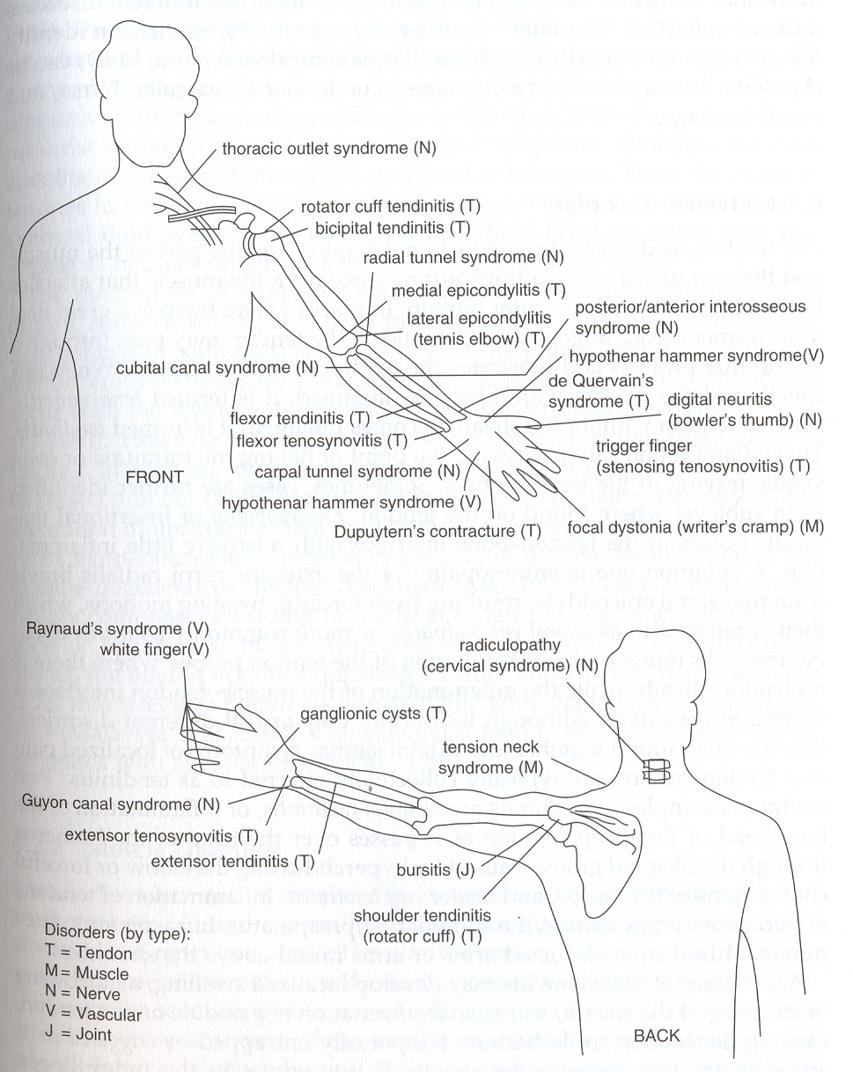
Lot’s of MSDs!

Slide 6
Anatomical Location of MSDs
tendon
muscle
nerve
vascular
bursa
bone/cartilage

Slide 7
Tendon Disorders
Tenosynovitis
  inflammation of tendon and tendon sheath
  may result in either micro- or macrotrauma
  localized swelling (resulting in narrowing or stenosing) of the sheath
  may form nodule on tendon – resulting in tendon entrapment
Tendinitis
  inflammation of tendon alone

Slide 8
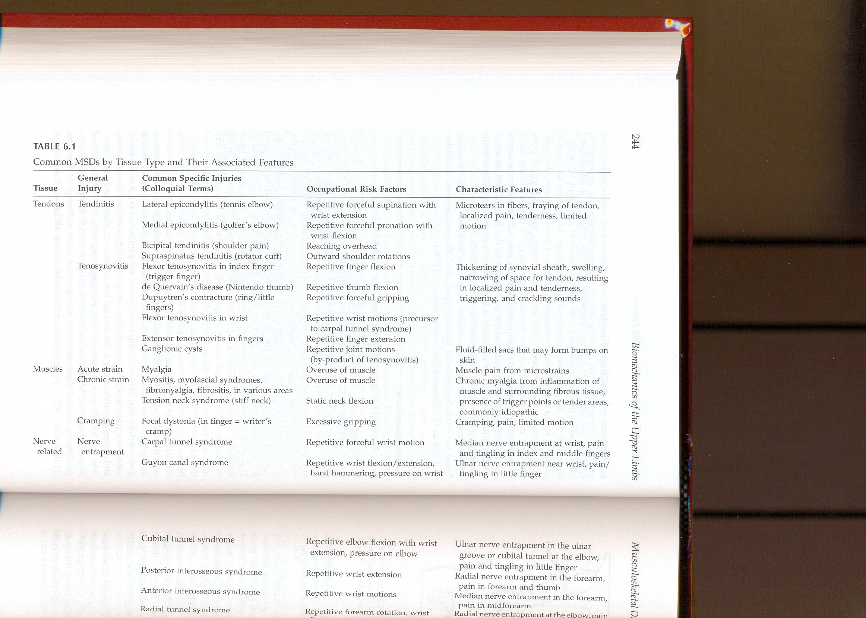

Slide 9
Localized Fatigue
Normal
  Reduced circulation
  Tiredness, discomfort
  Loss of control
  Increased effort
  Decreased strength
Recovers with removal of stress
With insufficient recovery and / or mechanical damage – may lead to cumulative trauma disorder
Sustained and repeated forceful exertions in awkward postures

Slide 11
The Neck
Localized pain, redness and swelling
Muscle spasm / tenderness
Active ROM
  Flex 45
  Extend 55
  Rotate L/R 70
  Side flex 40
Check for radiated pain/ parasthesia down arm
  Cervical nerve root / brachial plexus involvement
Check for arthritis
Sustained posture
  Looking at work / computer screen
Drooping shoulders
Rest, ice / heat, massage
Mobilization exercises
Work place / posture intervention
Frequent rest breaks
Job enlargement and / or rotation

Slide 12
Nerve Disorders
Compression between two other types of tissue (muscle, bone, ligament, etc.)
Direct compression of nerve by contact with an external object
Impedes the transmission of nerve impulse

Slide 13
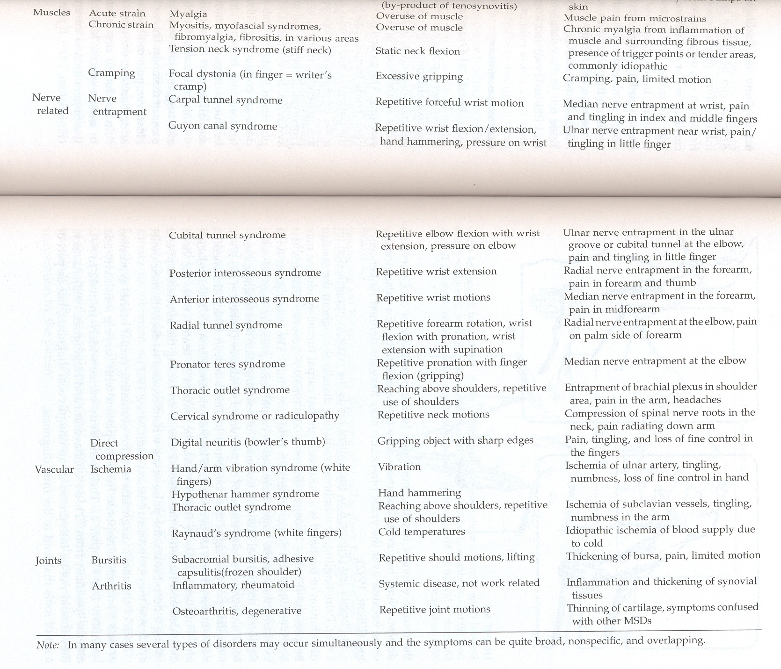

Slide 14
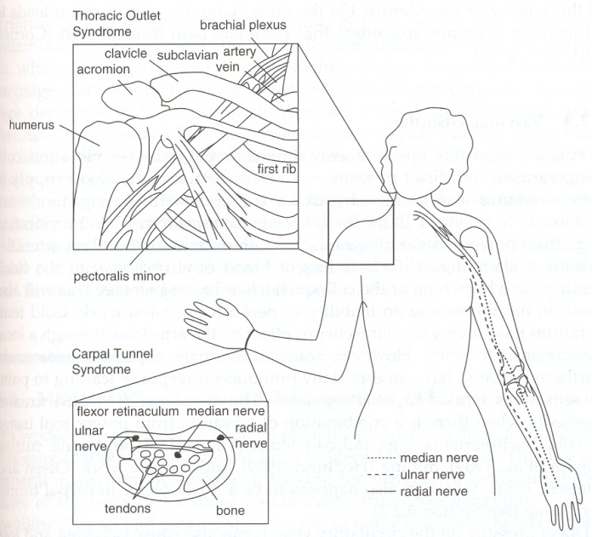
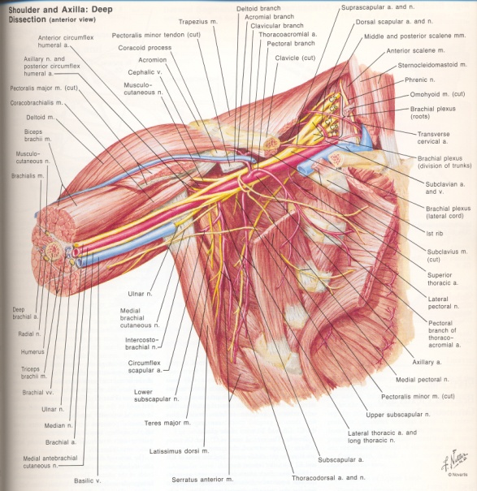
Thoracic Outlet Syndrome
Entrapment of the brachial plexus (nerve roots at C5 through C8)
May occur at several locations, for instance between clavicle and first rib, scalenus muscles in the back of the neck
Overhead work
Also blood vessel compression

Slide 15
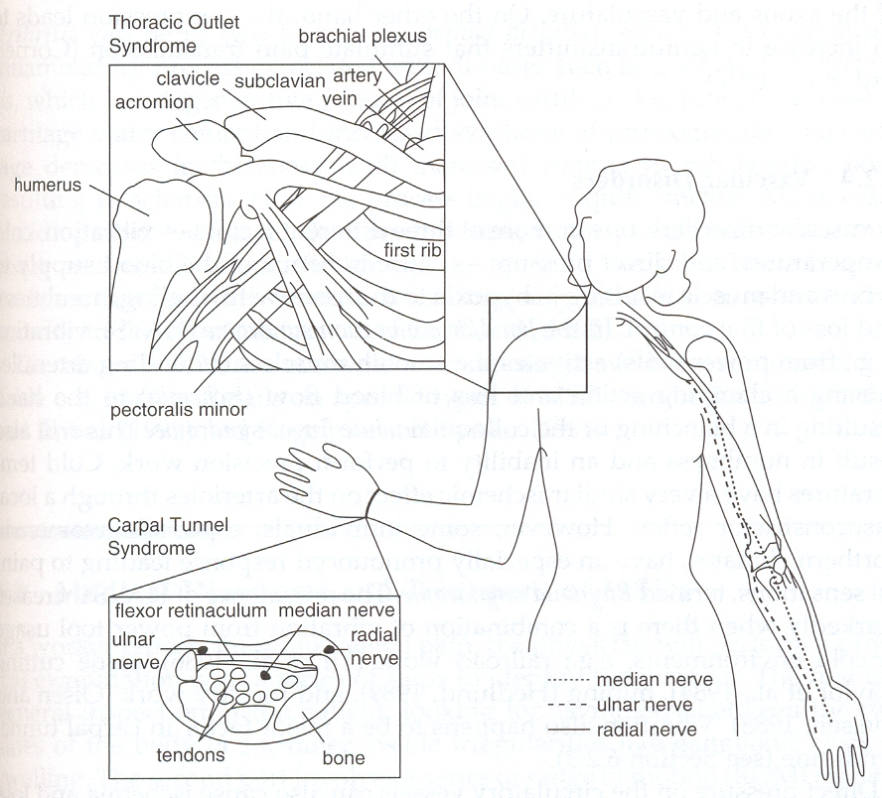

Slide 16
The Shoulder
Very complex, comprises shoulder girdle and shoulder joint
  Large range of motion
  Rotator cuff muscles
  Bursae
  Long head of biceps
    Tendinitis, tenosynovitis
Frozen shoulder
  Multiple inflammatory sites
  Joint capsule
Check for passive ROM
Check for active ROM with and without gravity / resistance
Crepitus
Painful arc
Check for referred pain from neck, cardiac ischemia, diaphragm area etc.

Slide 17
The Shoulder
Degenerative tendinitis
  Calcification, crepitus
Overhead work, repeated and sustained
Medial rotation of the shoulder joint in elevation / abduction
Supraspinatus impingement under the acromion
Exacerbation of acute trauma (throwing)
Heat / ice
Passive mobility exercises
Resisted exercises
  Gravity
  Weights and springs

Slide 18
The Elbow
Flexion / extension (160)
Pronation / supination (+/- 180)
Check passive and resisted ROM

Slide 19
The Elbow
Lateral Epicondylitis (Tennis Elbow)
  Wrist extensor tendon insertion
  Repeated minor strains
  Pinpoint tenderness
  Check resisted wrist extension
Rest
Ice / heat
ROM exercises (note wrist and elbow involvement)
Massage
Ultrasound, local injections (cortisone)

Slide 20
The Elbow
Medial epicondylitis (Golfers elbow, Little league elbow)
  Common flexor tendon
  Localized pain and tenderness
  Resisted writs flexion
Heat / ice
ROM exercises
Massage

Slide 21
Carpal Tunnel Syndrome
Multiple causes
  Anatomy
  Other diseases
Compression of medial nerve as it passes through carpal tunnel
  Transverse carpal ligament / carpal bones
  Nine flexor tendons
  Motor and sensory nerve fibers
Thumb muscles
Thumb, index, middle and radial half of ring finger
  Palmar surface
  Distal dorsal surface of fingers

Slide 22
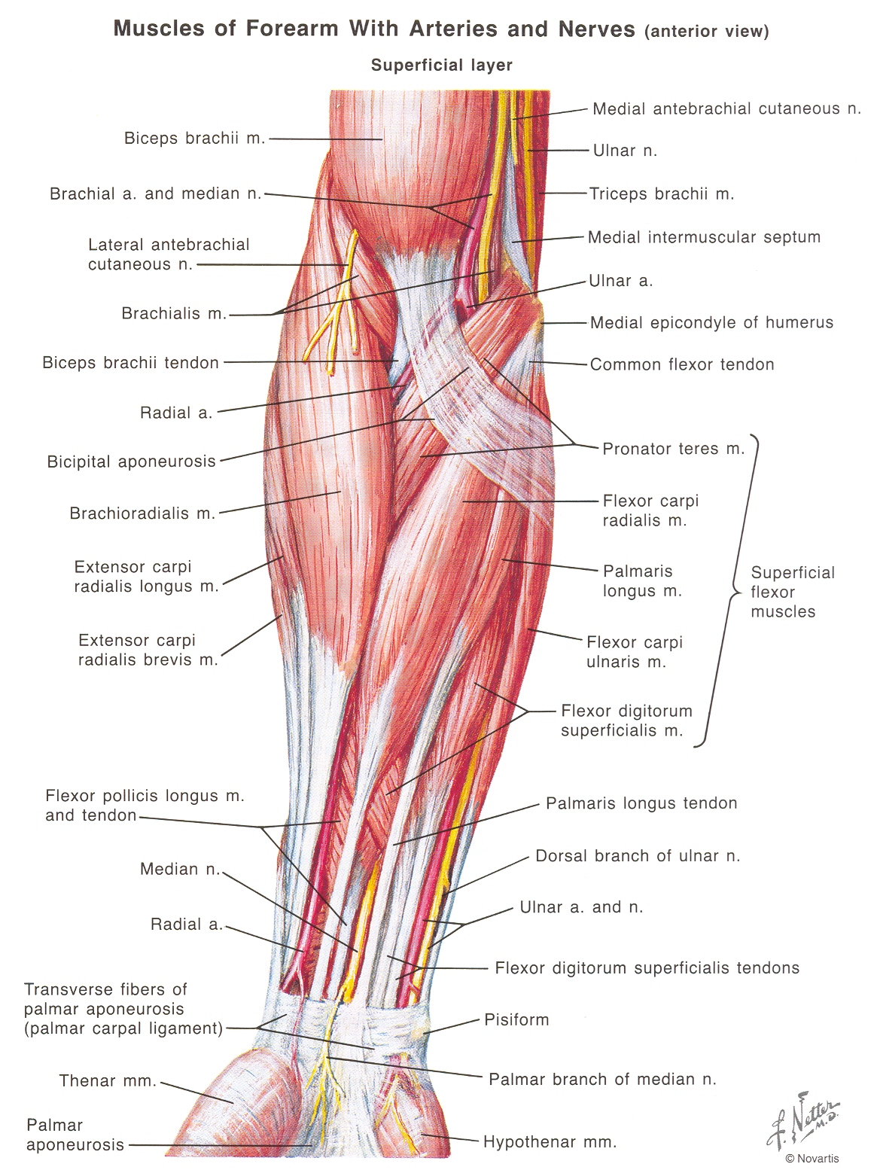

Slide 23
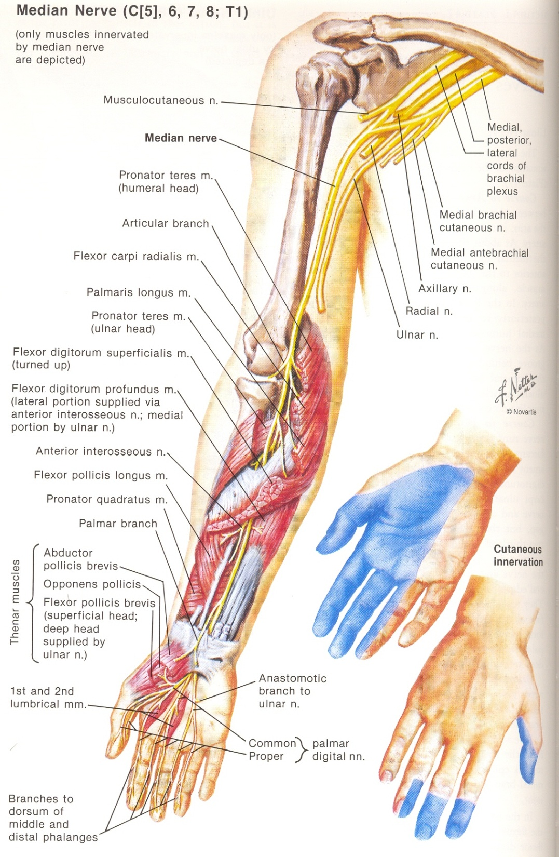

Slide 24
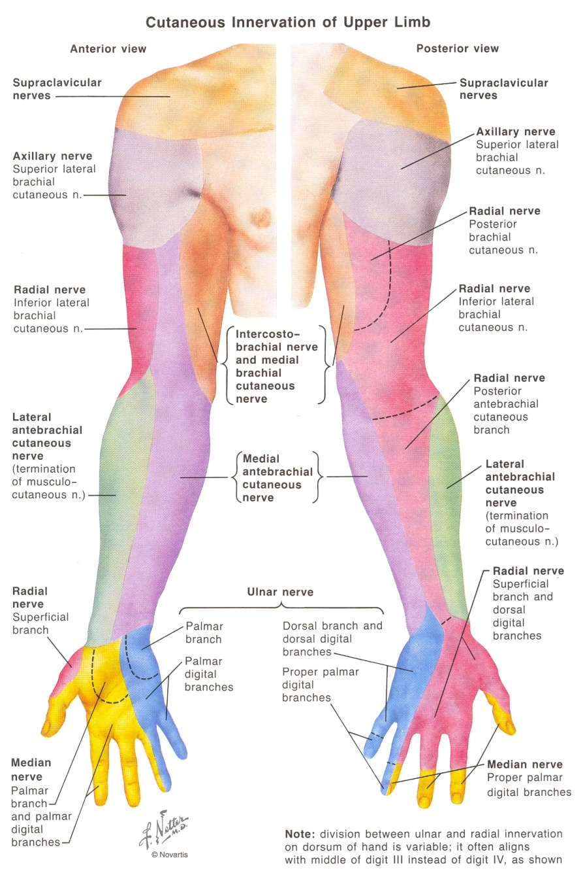
Dermatomes

Slide 25
Carpal Tunnel Syndrome
Tingling, numbness, weakness
Nocturnal parasthesia
Clumsiness
  Thumb muscles
  Thenar eminence atrophy
Tinel’s Sign
  Tapping
Phalen’s test
  Flex wrist for 1 minute
  Parasthesia
Pin prick around distribution of median nerve
Nerve conduction tests with electromyography

Slide 26
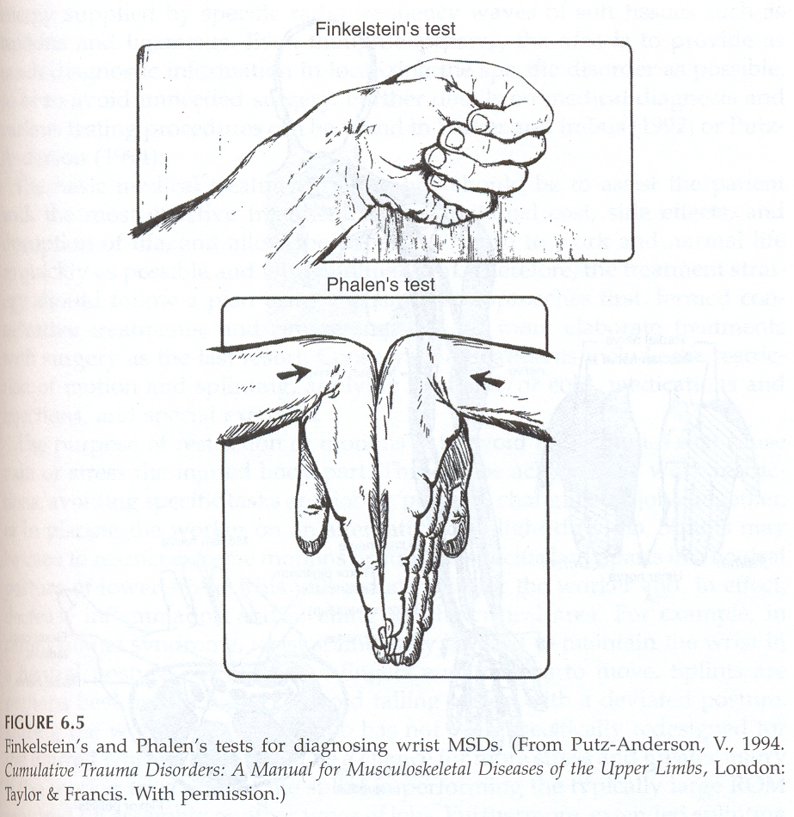
Carpal Tunnel Syndrome
hold position for 1 minute
pain/tingling radiating distally through innervated areas may be a positive test for CTS
Phalen’s test

Slide 27
Carpal Tunnel Syndrome: Tinel’s test
Tapping median nerve
Tingling/pain is positive for CTS
Quality of Phalen’s and Tinel’s tests:
sensitivity – 32% to 89%
specificity – 72% to 84%
not an unequivocal diagnosis
Therefore Nerve Conduction Test
  Not definitive

Slide 28
Carpal Tunnel Syndrome
Ice / Heat
ROM exercises
Job redesign
  No sustained, forceful, repeated, flexion / extension / ulnar deviation of the wrist
Anti inflammatory medication
Night splints
  (Work splints not advised)
Surgery -transverse carpal ligament release

Slide 29
Guyon Canal and Cubital Tunnel Syndrome
Entrapment of the ulnar nerve
  Guyon canal on the medial side of the hand
  hand hammering, flexion/extension at wrist
  cubital tunnel at the elbow (formed by the two heads of the flexor carpi ulnaris)
  results from resting elbows on hard surface or twisting at the elbow

Slide 30
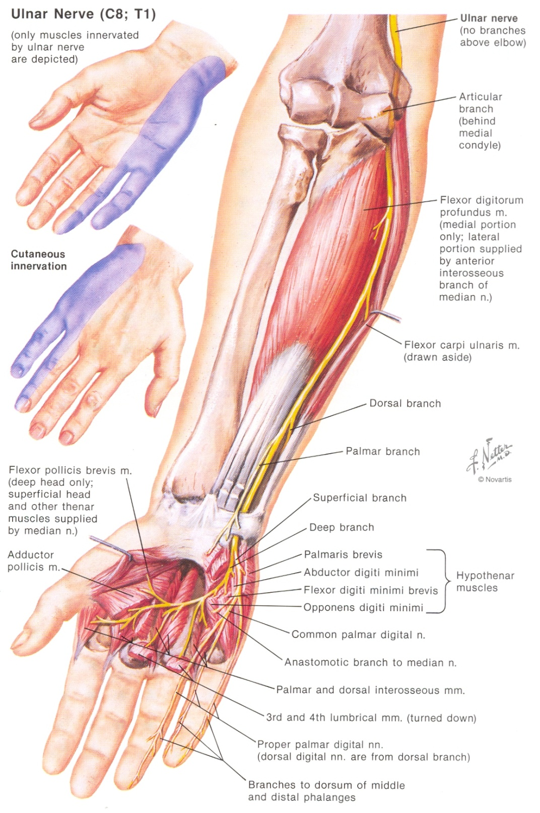

Slide 31
Hypothenar Hammer Syndrome
Repeated forceful pounding with the palm
  Push fasteners
Occlusion of ulnar artery
Nerves of 4th and 5th digits
Tenderness and parasthesia
Hypothenar atrophy
Heat and ice
Gentle exercise
Stop pounding!
“Flat muscle”

Slide 32
Ulnar Nerve Compression
Ulnar nerve
Guyon’s canal
  Pisiform and hook of hamate bones
  Palmaris muscle
Hammering / Pounding
Wrist hyper extension
Prolonged and repetitive full range wrist flexion and extension
Pain, tenderness
Tinel’s sign
Stop hammering
Stop offending wrist movements

Slide 33
Trigger Finger
Swelling and nodule formation of flexor tendons of the digits
  Clicking
  Locking
Pistol type tools
  High force / range trigger
Surgery
Tool design
  Broader / lighter trigger
  Push to start

Slide 34
Ganglions
Tenosynovitis
Digit extensors
Repetitive forceful extension

Slide 35
De Quervain’s Disease
Abductor pollicis longus / extensor pollicis brevis
  Friction
  Tenosynovitis
Repeated thumb activity
  Inter phalangeal joint flexion with proximal joint extension
  Video game thumb
  Repeated hard gripping of oversize handle
Pain
Swelling
Tenderness
Clicking
Finkelstein’s test
  Thumb in palm
  Forced ulnar deviation
  Pain over radial styloid
Stop doing the movement that causes the problem
Heat / ice / massage / gentle ROM activities

Slide 36
Testing for de Quervain’s disease
Finkelstein’s test
positive if position causes pain at the radial styloid and along the thumb extensor tendon

Slide 37
Raynaud’s Syndrome
“White Finger”
  Multiple levels
Circulatory disorder
  Vibration
  Cold
  Occupational / hereditary
Progressive
  Months, years
Chain saws (forestry)
Chipping hammers (foundry)
Gloves
Lighter grip
Padded handles
Vibration absorbing tools
Supported tools
Automation
Job rotation

Slide 38
Low Back Strain
The most common disorder worldwide
  80% population have LBDs at some time
Multiple sites
  Complex anatomy
    Facet joints, intervertebral discs
    Muscles, tendons, ligaments, fascia
      Irritation, inflammation
      Exacerbation of acute strain
    Nerve involvement
      Root compression
      Referred pain
Difficult precise diagnosis

Slide 39
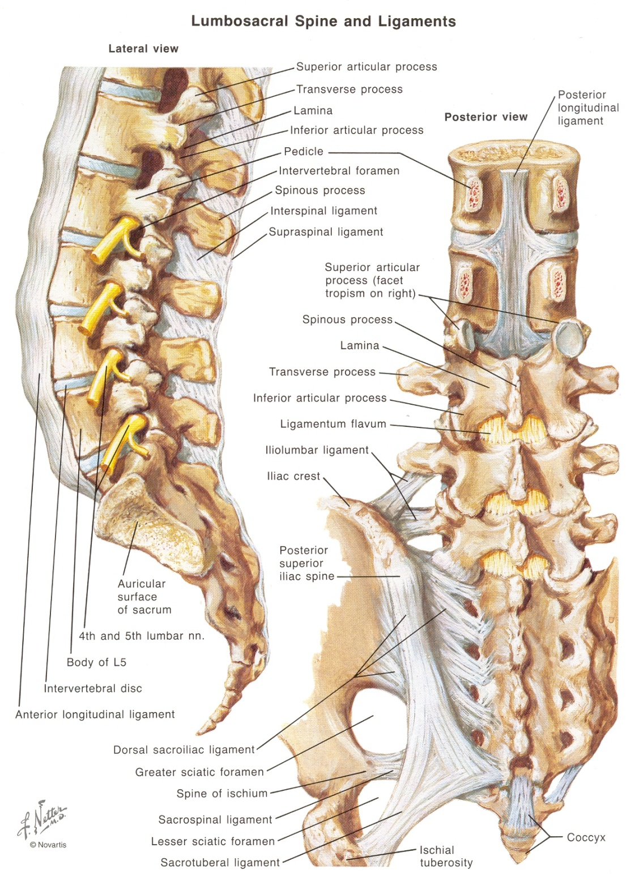

Slide 40
Low Back Disorders
Common causes
  Repeated bending and twisting in outer range of joint movement (flexion, side flexion, rotation)
  Heavy loads
  Large moments
  Rapid / jerky movements
  Long duration sitting
  Note that individual spinal joint motions are controlled by facet joint orientation

Slide 41
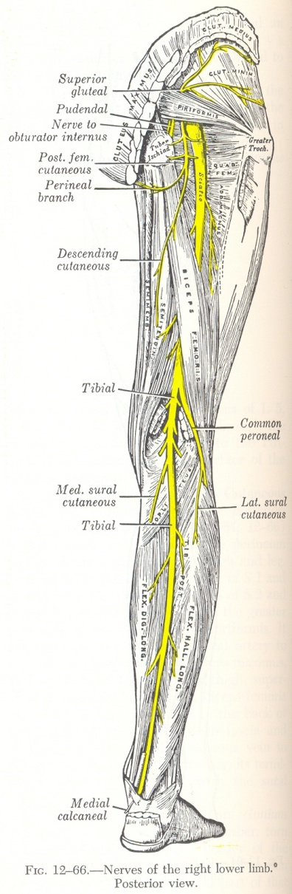
Sciatica
pain radiating down one or both buttocks/legs along the path of innervation of the sciatic nerve
compression at nerve root in spinal canal or in intervertebral canal

Slide 42
Diagnosis
Difficult
Range of motion
  Passive, active, resisted
    Localized pain
    Referred pain
      Parasthesia
      Sciatica
Postural abnormalities
  Scoliosis
  Unequal weight bearing
Tenderness, spasm
Muscle atrophy
Gait abnormalities
Bilateral tendon reflexes (achilles, patellar)
Muscle strength

Slide 43
Treatment of Back Disorders
Bed rest if severe
Ice in acute phase then heat
Gentle ROM exercises
  Passive, active, minimal resistance
Anti inflammatory medication, analgesics, muscle relaxants
Surgery????

Slide 44
Bursitis
Prepatellar bursitis is experienced by carpet layers
Subacromial or subdeltoid bursitis

Slide 45
Osteo Arthritis
Under use and overuse
Degeneration of joint cartilage
May be the result of repeated trauma

