Slide 1
Train The Trainer OH Masterclass For Ergonomics: Situation Awareness Prof. Brian Peacock & A. Prof. Chui Yoon Ping

Slide 2
Situation Awareness is simply…
Knowing what is going on around you
Changing trains / line at an MRT station
Responding to an accident
Visiting a foreign country
Attending a meeting

Slide 3
Situation Awareness
The perception of the elements in the environment within a volume of time and space, the comprehension of their meaning, and the projection of their status in the near future”
Endsley, 1988
Perception
Comprehension
Projection
Noticing events
Understanding
what is
Predicting
what will be
Spatial, technical and procedural factors

Slide 4
Situation Awareness
Perception
Comprehension
Projection
Noticing events
New information
Understanding
what is
Predicting
what will be
Notes:
Rearrange the furniture in your home

Slide 5
Situation Awareness : A working definition
Continuous monitoring of environment, noticing what is going on and detecting changes in the environment.
Forming a good mental picture of the current task and the surrounding work environment.
Result → Quick reaction and adaptation to changing situations.
Riding a bike, driving a car, flying an airplane

Slide 6
Manifestation of Human Error
Failure to notice changes in events
Failure to understand what happened
Failure to provide information
Failure to inform crew members of actions or decisions taken
Failure to resolve conflicting interpretations of information
Lack of assertiveness by subordinate crewmember to question SA of senior co-workers
Consider the activities of the employees in a food stall

Slide 7
Situation Awareness and Safety
Failures of SA:
I didn’t realise that…
I didn’t notice that…
I didn’t hear /see…
I wasn’t aware that…
We were surprised when…
I was so busy attending to…
I was focusing on…
I was confused …
We were convinced that…
Describe and discuss the last time you made a mistake / had an accident

Slide 8
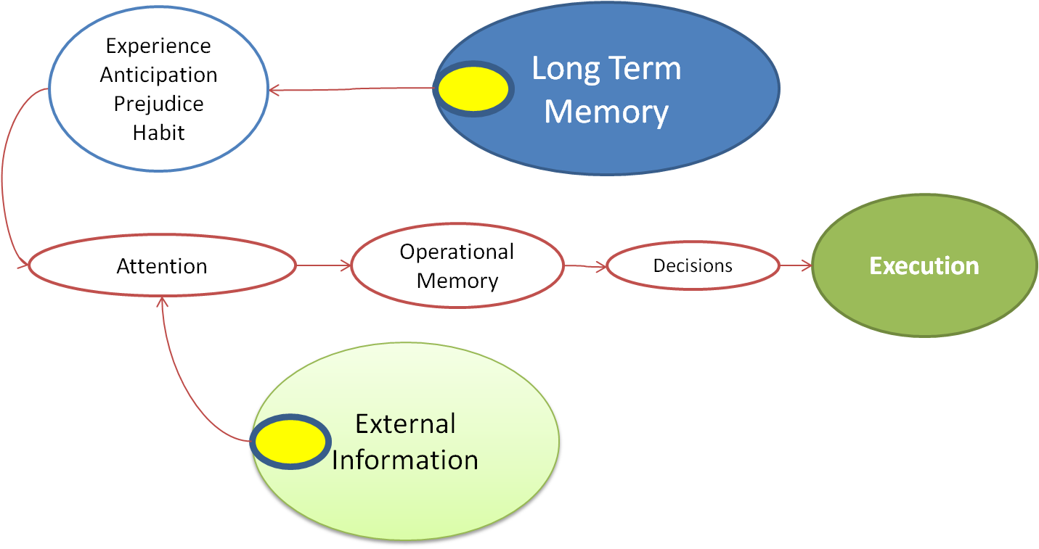
Human Information Processing
Attention
Short term
sensory store
Perceptual
Processor
Cognitive
Processor
Motor
Processor
Senses
Long term
sensory store
Working
Memory
Muscles
Compare these two models
Feedback

Slide 9
Barriers to Situation Awareness
SA: Perception
Perception
Noticing events
Gathering information
Perceptual Problems:
Information not available
Information difficult to see
Failed to observe information
Misperception
Did not recognise key clues
Memory error
Describe and discuss the last time you made a mistake / had an accident. Did you not notice the hazard or did you make a wrong decision?

Slide 10
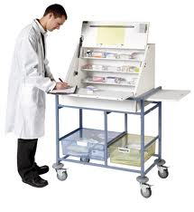
Example of Perceptual Error
A nurse pulls a vial from a medication cart.
Looks at the label, fills the syringe and injects the patient.
The patient receives the wrong drug and dies.
Image from: http://www.medscope.co.uk

Slide 11
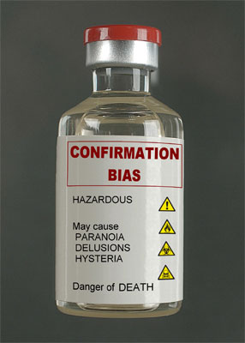
Example of Perceptual Error
Inattentional blindness:
She looks at the label: did she actually read the label?
Confirmation bias:
That medication has always been place in that same specific location – it was moved. She EXPECTS it to be there.
Other factors:
Lighting, size of label, mental workload, fatigue, task interference
Image from: http://sacemaquarterly.com

Slide 12
Barriers to Situation Awareness
What are some of the Perceptual Errors you can think of?
What can we do about them?
Discuss the advantages and disadvantages of vision and hearing as sources of information

Slide 13
Barriers to Situation Awareness
SA: Comprehension
Understanding what is happening
Making sense of situation
Comprehension Problems:
Don’t understand relevance
Cannot connect events together and see relationships
Cannot connect current information with past knowledge
Misinterpret what is going on due to faulty mental model and biases
How would you evaluate a used car prior to purchase?

Slide 14
Barriers to Situation Awareness
What are some of the Comprehension Errors you can think of?
What can we do about them?

Slide 15
Barriers to Situation Awareness
SA : Projection
Predict what is going to happen next
Projection Problems
Projection Problems:
Overload
Inexperience
Limited working memory
What happens when two vehicles (cars, ships, airplanes) collide. How could effective prediction have avoided the action? How could technology help?

Slide 16
Barriers to Situation Awareness
What are some of the Projection Errors you can think of?
What can we do about them?

Slide 17
Mental Model and SA
Mental models:
Mental picture of how system works and understanding of environment
Developed through experience
Mental models:
Direct attention to relevant information
Integrate information for comprehension
Facilitate prediction
What is a mental model? Draw a concept map to describe a slip trip and fall accident.

Slide 18
Mental Model and SA
Problems with MM:
Inaccurate mental model
Misinterpret information
Incorrect understanding of situations
Biases information to attend to:
Confirmation bias
Primacy and Recency effect,
Dissonance reduction,
Framing bias
What does “barking up the wrong tree” mean?
How does a doctor diagnose a heart condition?
Why did the Asiana / SFO accident occur

Slide 19
Other Factors Affecting SA
Physical factors
Noise, heat, vibration
Fatigue, tiredness, boredom
Illness
Psychological factors
Anxiety, fear, uncertainty,
Mental workload, time pressure
Motivation level
Stressors can lead to Cognitive Tunneling
Why do people vary in their behaviors and performance over the day and from day today?

Slide 20
Maintaining SA : Perception
Scan for information – update mental model
Pay attention to critical sources
Pay attention to details
Detect changes
Manage distractions
Manage attention resources
What are the differences between an expert and a novice, give an example

Slide 21
Maintaining SA : Comprehension
Check if you understand what’s going on
Ask if unsure
Look for patterns of occurrences & connect the dots
Connect situations to training or prior knowledge
Evaluate information
Be aware of biases
Know your assumptions
Be sensitive to feedback
Check information for accuracy
Check what information you need but do not have
Check if your understanding of the situation makes sense
How does training fit into system design? Give an example

Slide 22
Maintaining SA : Projection
Plan ahead
Consider likely outcomes
Visualizing future events
Ask ‘what ifs’
Is this advice realistic?

