Slide 1
Train The Trainer OH Masterclass For Ergonomics:
Human Information Processing
Prof. Brian Peacock & A. Prof. Chui Yoon Ping

Slide 2


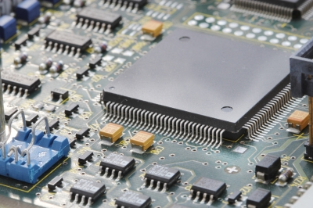
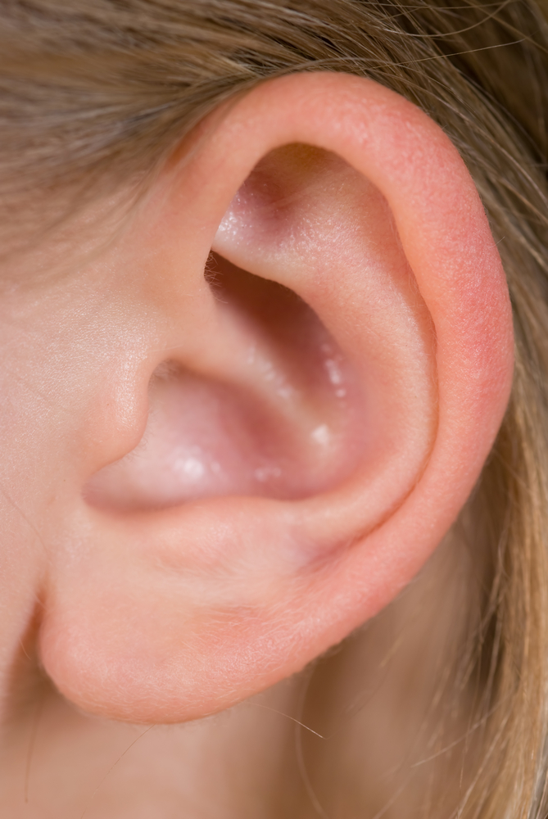
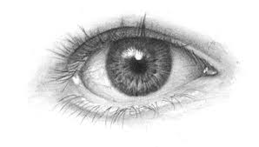


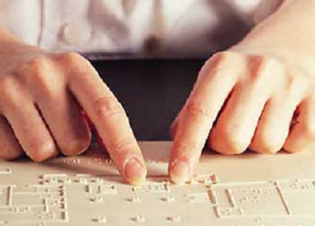
Computer as Information Processor
Input → information processing → output
Human as Information Processor
Input (sensation) → information processing → output (control)

Slide 3
Human as an Information Processor
Human information processing can be thought of as:
A general pattern recogniser
With limited human information processing capacity
Using heuristics (rule of thumb) to simplify information processing load
And act as a ‘satisficer’ rather than optimiser.
  Tendency to seek pragmatic solutions, not optimal solutions, trading off costs and benefits of alternative actions.
  Introduction to Ergonomics, R Bridger, 2013.
Look around. You see lots of things but only pay attention to some of the surroundings, and only in sufficient detail for your immediate purpose.

Slide 4
Human Information Processing
Perceptual Encoding
Central Processing
Responding
Attention Resources
Cues:
visual, auditory, tactile
Short term Sensory Register
Response Selection
Response Execution
Environment
Perception
Thought/
Decision Making
Working Memory
Long-term Memory
Hear what I say ,pay attention, understand, remember, decide what to do and how to do it, do it, remember this demonstration of HIP!

Slide 5
Human Information Processing
Perceptual Stage
Gather information through our senses
Comparing it with existing knowledge from (long term) memory to give it meaning (make sense of it).
Central Processing Stage
Thinking stage where we work on the information in our working memory
Mental activities such as rehearse, plan, understand, visualise, decide, problem solve.
As working memory (like RAM) is temporary, we are also try to create a more permanent representation in our LTM (ie. File it into our ‘hard drive’) (ie. Learning) for later retrieval.
Responding Stage
Selects a response and then coordinates/ sends motor signals to act.
Tell your partner your phone number and have them store it in their phone
Wickens, et al, An Introduction to HF Engineering, Pearson Education Intl. 2004.

Slide 6
AGRE
VLSB
NKBT

Slide 7
Short Term Sensory Register
Brief visual impression or memory trace
Gives you opportunity to further process stimuli
Psychologists believe we have a sensory register for each sense.
  Visual stimuli held in Iconic Storage < 1 seconds.
    Iconic memory allows us to perceive imagery in a film as seamless.
  Auditory stimuli held in Echoic Storage <= 3 seconds.
    Echoes last longer than icons. That’s why we rehearse information to retain them.
Wave your finger in front of your eyes.
Do you see the trace?

Slide 8

Short Term Sensory Store

Slide 9

Attention
Attract the attention of someone at the other side of the room.
How did you do it?

Slide 10
Attention
Attention - enables us to process information about the world around us.
  We can only be aware of things around us if we pay attention to them.
Attentional resources are very limited.
  We can only select some sensory information for further processing – cannot deal with all inputs.
We have to divide attention (resources) for different tasks – cannot do everything at the same time
Spotlight metaphor :
  Think of attention as a spotlight that we shine on things in the world around us to make them stand out – make us notice it, i.e. bring into our awareness. Information then get processed and interpreted.

Slide 11
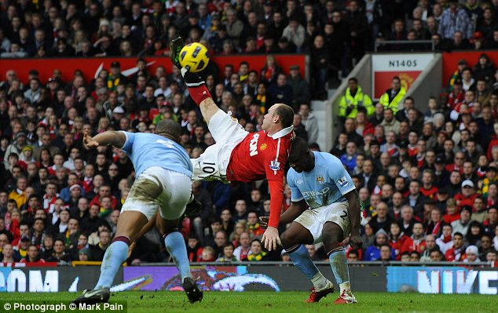
Look at this picture
Turn the page and list what you saw, compare your list with that of your partners. Did you attend to different things?

Slide 12
Write down a short sentence. Everybody read their sentence at once. Write down what you heard.. Check for capacity (amount) and accuracy.
Available capacity
Enduring
Dispositions
Allocation
Policy
Momentary
intentions
Evaluation of
demands on
capacity
Possible Activities
Capacity Model
Of Attention
Responses

Slide 13
Arousal
Miscellaneous
Manifestations of
Arousal
Available capacity
Enduring
Dispositions
Allocation
Policy
Momentary
intentions
Possible Activities
Evaluation of
demands on
capacity
Capacity Model
Of Attention
Responses

Slide 14
Allocation policy
Selection of channels to attend to (and filtering channel to ignore) driven by the following factors:
  SALIENCE: How attention grabbing an event is.
    Distinct stimuli, abrupt onset, high intensity : alarms, alerts to capture attention
  EXPECTANCY: How likely is it that a valuable event will happen at the location you are turning your attention to.
    Sample (look at) the world where we EXPECT to find information (e.g. radiologist look at areas of x-ray where abnormalities most likely to occur, pilots look at instrument most likely to change)
Flip through your notes or look around the room; write down three things; compare your list with that of your partners. Explain the differences.
Wickens, et al ,2004

Slide 15
Allocation policy
VALUE: What would you gain by attending that that event?
      Frequency of looking depends on how valuable it is to look at –e.g. cost of not looking may cost lives.
EFFORT: How much effort is required?
    Selection attention may be inhibited if it is effortful.
    we scan short distances rather than long ones.
    prefer not to move our heads when scanning.
        E.g. scan visual displays that are close together, does not require head movement.
Imagine changing MRT lines at City Hall (or any other intersection).
Wwhat do you attend to as you change trains? Your route, other passengers, direction signs, advertisements, announcements?
Wickens, et al, An Introduction to HF Engineering, Pearson Education Intl. 2004.

Slide 16
Attention: Top Down and Bottom-up
Experience
Expectancy
Knowledge
Top Down
Processing
(Expectancies
and Desires)
Perception
The Senses
Stimulus
World
Salience
Bottom-Up
Processing
Sometimes you look for something, sometimes it looks for you
Wickens, et al, An Introduction to HF Engineering, Pearson Education Intl. 2004.

Slide 17

Attention
Different forms of attention:
  Selective attention
  Focused attention
  Sustained attention (vigilance)
  Divided attention
Wickens, et al, An Introduction to HF Engineering, Pearson Education Intl. 2004.

Slide 18

Selective Attention
While monitoring different sources of information, person choose to attend only to selected source
  Example cocktail party effect
  Flight crew talking to each other and monitoring ATC – attend to information when the hear their callsign
Over here!!!
Everybody talk – give out some instructions, only pay attention to one source

Slide 19
Problems with selective attention
Information overload
  Too much sources of information to monitor at the same time for appropriate selection of information to attend to
  Reduce sources or channels of information that need to be monitored
  Place sources of information that need to be monitored closer to each other
Information presented too quickly for selection
  Example – information presented way too quickly by ATC
  Information on dials changes so fast that one is unable to process the information
Give examples of selection attention problems at the workplace

Slide 20
Focused Attention
Referred to as ‘attentiveness’
Ability to just to focus on one source of information while excluding others in the environment.
Narrowing of beam to concentrate on one source.
But information (that we should be attending to instead) is sometimes outside of beam
Focus!!
See how long you can watch the second hand / digit on your watch. Call out the numbers to distract the other class members

Slide 21
Look at this picture
Count the spectators

Slide 22
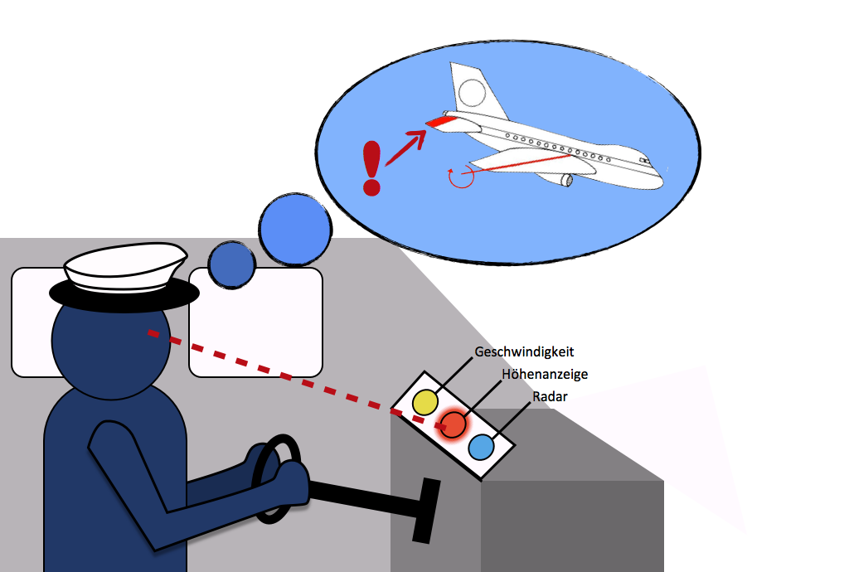
Problems with focussed attention
Cognitive tunneling– overly fixated with one source of information, ignoring other more relevant or important information
Name one example of Cognitive Tunnel Vision in the workplace

Slide 23
Case Example: Cognitive Tunneling
An L-1011 went down at night in the Florida Everglades in 1972 killing 99 passengers and crew members. The accident sequence was initiated by a burned-out light bulb in the system indicating that the landing gear was down and locked; a problem which occupied all three crew members’ attention to the extent that no one noticed that the autopilot had become disengaged. As a result, the aircraft slowly drifted down into the swamp without anyone noticing. The air traffic controller noticed on his radar display that the aircraft was losing altitude and queried the flight crew by asking, “how are things comin’ along there?” The crew probably thought that he was inquiring about the landing-gear problem and responded by saying that everything was alright.
Did you ever get so focused on what you were doing that you missed an important activity or appointment?

Slide 24
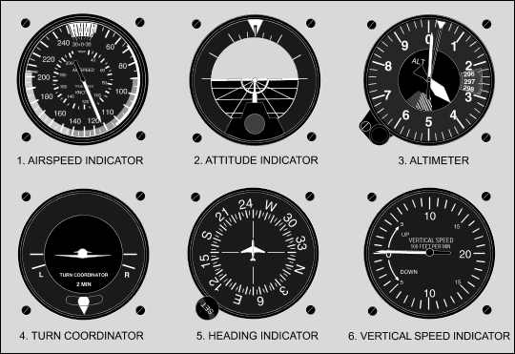
Aviation Instruments
Fixations and scanning – how would you use this information?

Slide 25
Scanning pattern (expert vs. novice)

Slide 26
Sustained Attention
Maintaining attention and remaining alert for prolonged duration.
Affected by arousal level, tiredness, fatigue, distraction, boredom.
Overcome by:
  Varying the tasks
  Increase signal salience
  Reduce uncertainty of signals
  Provide proper work-rest cycles
  Train operators Inject artificial signals and provide feedback
  Maintain optimal arousal level – noise, temperature, lighting
What else?
How many of you in this class have been thinking about something else during the past half hour?
How can a teacher maintain the interest in a class?

Slide 27
Divided Attention
Having to attend to more than one source of information at the same time – Time sharing/ Multi-tasking
Two theories about attention:
  Single Resource Theory
  Multiple Resource Theory
Can you drive a car and talk on your mobile phone?
Can you drive a car and listen to music?
Can you drive a car and send a text message?
Discuss the differences between these activities.

Slide 28
Kahneman Limited Capacity Model (1973)
A single limited resource / bottleneck
Single undifferentiated capacity
Task Performance

Slide 29
Time Sharing: Multiple Resource Theory
STAGES
Ambient
Focal
Perception Cognition Response
RESPONSES
Manual Spatial
Vocal Verbal
MODALITIES
Visual
Auditory
Spatial
Verbal
CODES
Discuss how many things you can do at once
Explain how you do it
Wickens, et al, An Introduction to HF Engineering, Pearson Education Intl. 2004.

Slide 30

Time-Sharing
Time-sharing efficiency depends on what type of resources required
We can time-share if two or more activities use different resources
Discuss the multiple activities or tasks that workers are doing in their workplace that has the potential to lead to errors / accidents

Slide 31
Multiple resources
STAGES
Resource for cognitive processing – perceptual and working memory (think)– is separate from resources for response selection and execution (do)
No problem walking and talking on the phone at the same time.
Cannot talk on the phone and read a book
Associated with brain structures:
  Motor function (controlled by frontal region of brain)
  Perceptual and language comprehension (posterior region of brain)
Wickens, et al, An Introduction to HF Engineering, Pearson Education Intl. 2004.

Slide 32
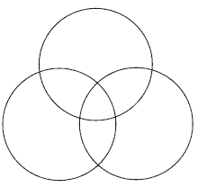
In practice it works like this
Discuss, eyes, ears, attending, memory, deciding and walking

Slide 33
Multiple resources
MODALITIES
We can divide attention between the eye and ear (AV)– better than the 2 Auditory (AA) channels and the 2 Visual (VV) channels
CROSS MODAL TIME SHARING better than INTRA MODAL TIME SHARING
Intra modal sharing is hard due to other factors:
  2 competing visual channels, if placed far apart require visual scanning – added cost
  Two AA channels, too close, problem with confusion and masking.
Wickens, et al, An Introduction to HF Engineering, Pearson Education Intl. 2004.

Slide 34
Multiple resources
VISION: FOCAL-AMBIENT
Focal vision – always foveal – for fine details and pattern recognition.
Ambient vision – mostly peripheral – for sensing orientation and ego motion.
Can be time shared effectively
  e.g. walk down corridor while reading a book
Think about driving and looking for a road sign
Wickens, et al, An Introduction to HF Engineering, Pearson Education Intl. 2004.

Slide 35
Multiple resources
PROCESSING CODES
Spatial codes (processes)
Verbal or symbolic codes (processes)
  E.g. Ambient vision – processes spatial codes
  Focal vision- processes verbal or symbolic codes
Efficient time sharing between these 2 codes
  E.g. tracking (spatial manual) task can be efficiently time shared with a verbal task.
Draw a pair of concentric circles. Next track between the lines while you sing a song or read a book or tap with your free hand
Wickens, et al, An Introduction to HF Engineering, Pearson Education Intl. 2004.

Slide 36
Multiple resources
Marvelous feat:
  Sight reading piano music
    involve different stages: perception and responding
    use both modalities: visual and auditory
    processes both codes: verbal and spatial
    require manual responses
How do they do that?
Can you type without looking at the keyboard?
Can you type without looking at the keypad?

Slide 37
Application
  Where possible, the number of potential sources of information should be minimized.
  Where time-sharing is likely to stress a person’s capacity, the person should be provided with information about the relative priorities of the
  tasks so that an optimum strategy of dividing attention can be formulated.
  Efforts should be made to keep the difficulty level of the tasks as low as possible
  Tasks should be made as dissimilar as possible in terms of demands on processing stages, input and output modalities, and memory codes.
  When manual tasks are time-shared with sensory or memory tasks, the greater the learning of the manual task, the less will be its effect on the sensory or memory tasks.
In practice attention lapses are the most common cause of errors, which, depending on the situation, may result in an accident.
Describe the last time you made a mistake due to an attention lapse

Slide 38
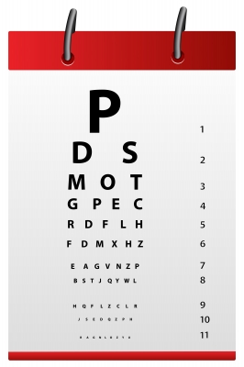
Perception

Slide 39

Perception
Perception occurs with 3 simultaneous process:
  Bottom-up feature analysis
    Analyse raw feature of a stimulus or events.
    Features that form letters and words, symbols on map (colour, shape, size) sound (phonemes or loudness or pitch)
  Unitization
    We have learnt from the past features that occur together and the co-occurrence of features is familiar (stored in LTM)
    Sets of features are known to have been unitised – so perception is more automatic and rapid (no need to think about what they are)
  Top-down processing
    Can guess what a stimulus or event is, even when physical (bottom-up) features are degraded (poor contrast, masking noise, etc.)
    Guesses are based on expectations, which are based on past experience.
    Also based on associations of past events with present events and context.
Identifying a Word
  Bottom-up feature analysis
    A:
    Features→ letters→ words → sentences
  Unitization
    process occur automatically if see the words enough times
  Top-down processing
Wickens, et al, An Introduction to HF Engineering, Pearson Education Intl. 2004.

Slide 40
Perception
Perception requires
  Sensing – a signal through your eyes or ears
  Attention
  A framework (in memory) to interpret the signal
  Sometimes the signal is weak or blurred
  Sometimes the framework is insufficiently developed
What happens when you see writing in a foreign language?
What happens when you see a familiar face in a crowd?

Slide 41



Perception - Top Down Processing
http://youruisucks.tumblr.com/
http://www.jaist.ac.jp

Slide 42
Pweor of the Hmuan Mnid
  The paomnnehil pweor of the hmuan mnid.
    Aoccdrnig to a rscheearch at Cmabrigde Uinervtisy, it deosn't mttaer in waht oredr the ltteers in a wrod are, the olny iprmoetnt tihng is that the frist and lsat ltteer be at the rghit pclae. The rset can be a total mses and you can sitll raed it wouthit porbelm. Tihs is bcuseae the
    huamn mnid deos not raed ervey lteter by istlef, but the wrod as a wlohe.
    Amzanig huh? ”
Look for similar examples on the Internet

Slide 43

Perception biased by Expectations
Search the Internet for examples of illusions
Discuss the role of frameworks and expectancy

Slide 44

Top-down processing is supported by Context
The word in which a character appears may affect how we identify the character.
The same character is perceived as H or A depending on the surrounding letters.

Slide 45

Perception biased by Experience

Slide 46
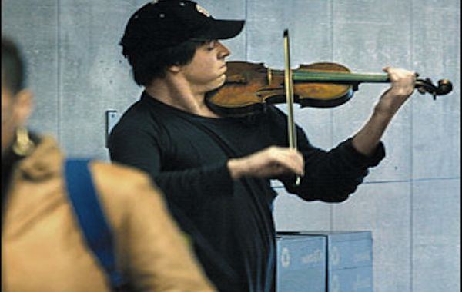
Perception biased by Expectations
http://www.getthefive.com/articles/the-in-crowd/joshua-bell-performs-in-the-subway-as-a-social-exp/

Slide 47
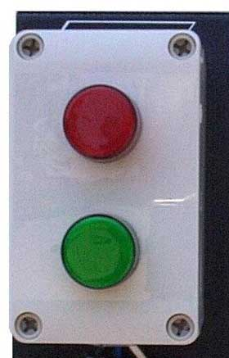
Case Example
Top down processing supports by:
Frequency
Context
You see what you expect to see
You hear what you expect to hear

Slide 48
HF Guidelines
Maximise bottom-up processing:
  Make things visible, legible, audible, clear
  Reduce confusion – minimise similarity
Maximise automaticity and unitization
Maximise top-down processing
  Create context
  Don’t confuse – be consistent
  Be mindful of expectations
Design an innovative pedestrian crossing signal
Design the controls for a cook top
Design a TV remote control

Slide 49
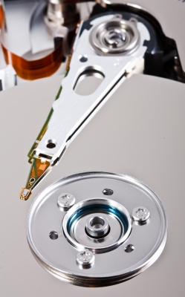
Memory

Slide 50
Stages of Memory
3 stage representation of ST or LT Memory:
Stage 1: Encoding- put things into memory system
  Encoding information in the WM
  Transferring information from WM to LTM (learning, training)
Stage 2: Storage – the way in which information is represented/held in the 2 memory systems
  For WM: emphasize spatial or verbal codes
  For LTM : emphasize declarative and procedural knowledge and mental models
Stage 3: Retrieval – the ability to access information in the memory.
  Successful retrieval or retrieval failure (Forgetting)
  Incorrect retrieval – mix up steps in a procedure.
Storage
Working Memory
Visual
Spatial
Retrieval
Encoding
Encoding
Retrieval
Long Term Memory
Procedural, Declarative organisation, Mental models
Storage
What did I just say? Can you repeat it accurately and exactly?
Wickens, et al, An Introduction to HF Engineering, Pearson Education Intl. 2004.

Slide 51
Working Memory
Sometimes known as Short Term Memory
Baddeley and Hitch model of WM (1986, 2000)
Central Executive Component :
  Master controller of the WM system
  Function includes:
    switching attention between tasks
    selecting/ignoring stimuli
    activating necessary information from long-term memory.
Central Executive
Phonological Loop
Episodic Buffer
Visuo-Spatial Sketchpad
Think of a cup of water, if you keep on adding more some will overflow and be lost (but you may be able to scrape some up from the floor

Slide 52
Working Memory
Visuosketchpad:
  Holds information of what we see
  Used as temporary storage and manipulation of spatial and visual information.
    Example: remembering shapes and colours, or the location or speed of objects in space.
  It is also involved in tasks which involve planning of spatial movements, like planning one's way through a complex building.
  Images perceived from senses or retrieved from LTM.
    Example: ATC uses visual-spatial sketchpad to store information on where planes are located in the airspace.
Central Executive
Phonological Loop
Episodic Buffer
Visuo-Spatial Sketchpad
View Baddeley talks about Rehearsal in the visuosketchpad
http://gocognitive.net/interviews/rehearsal-visual-spatial-sketchpad
Rehearsal is key

Slide 53
Working Memory
Phonological Loop:
  Represents verbal information in acoustical form (store words and sounds)
  Information in the phonological store starts to decay after a few seconds
  Kept active through rehearsal
    Example: keep rehearsing a phone number until we manage to write it down.
Central Executive
Phonological Loop
Episodic Buffer
Visuo-Spatial Sketchpad
View Baddeley talks about Phonological Loop
http://gocognitive.net/interviews/introduction-phonological-loop
Discuss, describe and demonstrate decay and interference theories

Slide 54
Working Memory
Episodic Buffer
  Holds information temporarily
  Does it in multi-dimensional way - Store visual and verbal information and combine them
  Episodic – binds things into episodes
  Links to Central Executive
Central Executive
Phonological Loop
Episodic Buffer
Visuo-Spatial Sketchpad
View Baddeley talks about Episodic Buffer
http://gocognitive.net/interviews/introduction-episodic-buffer

Slide 55
Limitations of Working Memory
Ability to keep information in working memory is dependent on:
Capacity
  how much information must be kept active
Time
  how long it must be kept active
Similarity
  how similar the to-be remembered material is to other elements in working memory
Attention
  how much attention is required to keep the material active
Demonstrate the role of interference (distraction) in short term memory by interjecting similar information during the retention period
Wickens, et al, An Introduction to HF Engineering, Pearson Education Intl. 2004.

Slide 56
Spatial Memory Demonstrations
Draw a line on your paper
Close your eyes
Draw a series of lines the same size under your standard line
Explain the change in line lengths
Draw two, three, four and five sided figures with the objective of returning to the starting point
Repeat the exercise under controlled time conditions – fast (2 seconds)and slow (5 seconds)
Explain the effect of figure size and speed on accuracy

Slide 57
Limitations of Working Memory
Capacity
Miller’s Magic Number 7 + 2:
  Upper limit for WM is 7 + 2 CHUNKS of information
A chunk is a unit (1 bit of info) of working memory space defined by properties that bind items together.
Physical and Cognitive Properties bind items into a meaningful chunk.
Due to familiarity, unitisation, past experience, association
Unrelated items: 8 4 7 9 → 4 chunks of information
Meaningful item (phone): 84 28 78 92 → 4 chunks of information
DOOR → 1 chunk of information
    Oh My God → 7 letters, 3 words, or 1 chunk?
    What is your name? → Songhami ottoke toeshimnikka?
Describe to your partner your journey to this class
Have your partner repeat the instructions
Wickens, et al, An Introduction to HF Engineering, Pearson Education Intl. 2004.

Slide 58
Perceptual chunks
Perceptual chunks are formed by providing spatial separation between chunks.
MRTPIEAYEKJECTE
MRT PIE AYE KJE CTE
Words, words, words
Sentences
Paragraphs
Stories
Discuss literal and semantic retention

Slide 59
Chunking
Increases the capacity of WM
Makes use of meaningful associates in LTM – helps in retention of information
Reduced number of items in WM – less load on WM – easier to rehearse – easier to transfer to LTM
Experts (people who have had more practice) develop bigger chunks
Visualize and describe your home, a friends home a stranger’s home
Write down a series of instructions for:
Getting on a bus
Getting on the MRT
Getting on an airplane
Wickens, et al, An Introduction to HF Engineering, Pearson Education Intl. 2004.

Slide 60
Time
Strength of information in WM decays quickly unless it is periodically ‘reactivated’
Process is called Maintenance Rehearsal
  Usually by repeating, rehearsing aloud of mentally
The bigger the chunks, the harder it is for rehearsal.
Write down some lists ( three to seven items) of animals, cars, places, and people,
Present the lists singly, in pairs and in threes to your partner
Have them write down the lists in the order in which you presented them
Observe the type and locations of the errors between and within lists
Repeat the exercise with sets of instructions for making a Facebook post, making a sandwich,
Wickens, et al, An Introduction to HF Engineering, Pearson Education Intl. 2004.

Slide 61
Primacy and Recency
Serial position effect
  First and last items in a series are usually better remembered/ recalled
    Primacy effect – first items are usually rehearsed more often
    Recency effect – items are recently rehearsed
Write down sets of 5 to 10 numbers or letters on your piece of paper
In turn read them to your partner and, when you have finished have them write down the numbers or letters
Observe the locations of the errors in the sequences

Slide 62
Confusability and Similarity
Items that are more similar will decay faster in STM.
Example:
    TBXLFNTSDK
    recalled as
    TVXLFNTSTK
  E G B D V C sounds more similar acoustically than E N W R U J
  Confusability
    8553 easily confused with 8335
List some confusing words in English and Chinese
Discuss how errors could be made with these words in a communication or instruction
Wickens, et al, An Introduction to HF Engineering, Pearson Education Intl. 2004.

Slide 63
Attention and Similarity
Working memory is resource limited.
DISTRACTION
  If resource diverted to a concurrent task, rehearsal will stop and decay is rapid.
  Example: attention diverted to listening to football scores while trying to remember a phone number
  New information displaces old information
Search the Internet for Interference theory
How does similarity affect interference
Compare interference theory with decay theory
Develop an experiment to investigate these two theories

Slide 64
Memory – Summary
Info in WM decays unless reactivated or through maintenance rehearsal
More chunks, more likely to decay:
  Only holds so much, Only processes so fast
Maintenance rehearsal (simple repeating)
Elaborative rehearsal (relating to other concepts in your long term memory)
Turn attention elsewhere? Bye-bye chunks!
  New info pushes old information out
But limited capacity forces us to synthesize, condense, and organize!
Why do we forget?
What would happen if we didn’t forget?
Is forgetting useful?
How can we remember the important stuff?

Slide 65
Human Factors Implications
Minimise working memory load
  Avoid having people to remember long string of arbitrary items during task performance
  Allow people to ‘off-load’ these information - jot it down
Provide ‘place-holders’ for sequential tasks
Exploit chunking
  Provide meaningful sequences of information to be remembered
  User spaces to create physical chunks
  Separate numbers and letters - if possible group them
Minimise confusability
Consider WM limits in writing instructions
  Use positive assertions rather than negative in instructions
Replace memory with information – knowledge in the world
  Recognition better than recall
Beware of Mode Error
  do not require user to remember temporary operating states and labels

Slide 66
Exercise
Identify accidents and incidents in the workplace which could be due to memory problems.
Identify ways in which these can be mitigated.
Describe and discuss the last time you forgot something
Was it important?
Will you make the same mistake again
How should we design systems to prevent memory errors?

Slide 67
Design Implications
Key Principle: Reduce demands on WM
Minimise amount of arbitrary items people have to keep in WM
    Exploit chunking
Replace memory with information – knowledge in the world
  Recognition better than recall
Be Consistent
Beware of Mode Error
  do not require user to remember temporary operating states and labels
Help the user remember how far the current task has progressed
Help the user remember what the system expects them to do next

Slide 68
Minimise Working Memory Load
Minimise both TIME and NUMBER of alphanumeric items operators have to retain in WM when performing task
  Avoid use of long codes of arbitrary digit or numerical strings
    Airline reservation system
    Check seat availability for flight on August 21, from Washington’s National Airport (DCA) to New York’s La Guardia Airport (LGA) at about 3.00pm
A0821DCALGA0300P
Describe and discuss some situations where design induced memory errors may occur
Offer solutions

Slide 69
Long Term Memory
Mechanism for storing information and retrieving it later
Learning is the process of storing information in the LTM
How difficult or easy to retrieve information from LTM depends on strength and association
Do you remember your primary school? Your last holiday? Your mathematics theory? The names of birds? How to ride a bike? Where to find Beijing and New York? The names of all the stations on the MRT? Your first day at school?
We have enormous memories; the challenge is to retrieve the right information at the right time.

Slide 70
Long Term Memory
Strength: depends on frequency and recency of use
  Password that are used everyday can be easily recalled
  A recently used item is easier to recall than one that hasn’t been used for a while.
Association:
  Items from LTM may be linked or associated with other items
  The more associations, the better the information can be retrieved
Rote memory :
  rehearsing items through repetitions without any associations (meaning). Quickly forgotten.
Describe and discuss some strong and weak memories for the information you learned in school

Slide 71
Forgetting
Retrieval fails because of:
  Weak strength due to frequency or recency
  Weak or few associations with other information
  Interfering associations
Increase likelihood of recall by:
  Process in WM frequently with other information in a meaningful way (create new associations)
Recall – retrieve required item
Recognition – perceptual cue provide in environment – triggers an association with the required item to be retrieved
  Recognition is easier than recall
Discuss, with examples the difference between recognition and recall

Slide 72
Organisation of Information in LTM
Schema and Scripts
Information in LTM is organised around central concepts or topics
Our knowledge structure about a particular topic is called a SCHEMA
  Example: The knowledge structure about Human Information Processing
Schemas that describe a sequence of activities are called Scripts
Mental Models: schema that describes our understanding of how a system works
From these models we generate as set of expectancies about how the system will behave
Our MM of systems varies in how complete or correct/accurate they are
We can have personal MM or shared
  MM shared by a large group of people is called population stereotypes
Describe and discuss the frameworks, schemas and mental models that you use to remember places, people, procedures and products

Slide 73
Organisation of Information in LTM
Cognitive Maps
Mental representations of spatial information (e.g., layout of a city, room, workplace)
Similar to visual-sketchpad in WM.
Often not a exact version of space they represent
Orientation usually reflects our preferred view point – e.g. map of classroom depends on where you like to sit
Reorientating one’s perspective through mental rotation takes up mental effort.
Create a concept map to describe your family, your home, your school, your job or a vacation

Slide 74
Episodic Memory
Memory acquired through a single experience– an episode
  E.g. witness a particular accident, first meeting with spouse.
Episodic memory is often based on visual imagery – but not faithful representations of event.
Problems with Episodic memory: Person witnessed an event:
  Selection of what information was attended to might have been plagued by top-down biases of expectancy
  As time passed, memory may have been degraded (forgotten) or information distorted by intervening events
  Degraded visual recollection replaced by LTM schemas of what (a crime, or accident scene) should typically look like
  May also be affected by questions used during interview session.
Think of a very special event tor incident hat occurred ten years ago, describe to your partner in as much detail as you can

Slide 75
Prospective Memory
Failure in prospective memory is forgetting to do something in the future.
Sometimes called ‘absentmindedness’.
Mitigate problems with prospective memory by:
  Providing checklist
  Buddy system – share what one or the other is to do to avoid both forgetting
  Provide reminders
Plan a journey to work or to the airport. Plan a report or examination answer. How do you get through your day without forgetting to do something? How can we prevent doctors from making mistakes?

Slide 76
Implications for design
Encourage regular use of information
  For safety systems, conduct regular safety exercises
Recognition easier than Recall
Standardise and ensure consistency in design
Use memory aids
  Develop step-by-step process guide to help users through difficult or tasks that are performed infrequently.
Design information so that it will be remembered:
  Provide personal and semantic meaning for information
    Allow people to set meaningful password reminder
Design to support the mental models:
  Principle of Pictorial Realism
  Principle of Moving Parts
  Use good metaphors
Design an interface for an ATM or a system for secure but accessible computer passwords

Slide 77
Decision Making

Slide 78
The Problem of Operational Limited Capacity
Experience
Anticipation
Prejudice
Habit
Long Term
Memory
Execution
Attention
Operational Memory
Decisions
External Information
Limited capacity
Limited information
We have very large amounts of available information externally and in our long term memory; in practice, because of time restrictions, we do not use all the available information to contribute to our decisions. Discuss grocery, car or shoe shopping.

Slide 79
Decision Making
Decision making tasks involve the following:
There are more than one options which the person must select one
Information is available for the various options
Time is given for option selection
Some degree of uncertainty is involved – no clear indication which is the best option
Very quick decision needed
Few options
Slow deliberation
Many options
Perceive yellow light –
Slow to stop or accelerate?
Allocation of marketing resources
to different heads of programmes
Who should be athlete of the year? Who should get an Oscar? Who is the best gymnast?
Wickens, et al, An Introduction to HF Engineering, Pearson Education Intl. 2004.

Slide 80
Three Phases of Decision Making
Cues perception
Generate and select hypothesis
Plan and select option
Discuss this model and add some more stages. Use examples from medical diagnosis or house hold equipment malfunction
Wickens, et al, An Introduction to HF Engineering, Pearson Education Intl. 2004.

Slide 81
Models of Decision Making
Normative / Rational Decision Models
Multi-attribute utility theory, Expected value theory, Subjective expected utility theory
Assumptions:
  People make rational decisions
  They weigh costs and benefits of the different options or calculate probabilities of winning /losing
  Select optimal choice to maximise the benefits while minimising cost or risks
  Handphone purchase – what attributes would you use to make a decision:
    Cost
    OS
    Number of apps available
    Usability
    Aesthetics
    “Cool factor”
Discuss the role of affect in decision making with examples from clothing purchase

Slide 82
Descriptive Decision Models
Normative decision models describe how people SHOULD make decisions
Descriptive decision modes describe how people actually make decisions:
  People rely simpler, less complex means of selecting among choices
  Rules of thumb or Heuristics
  “Good enough” rule or Satisficing
  Naturalistic decision making
Should we walk or take a bus? Is there really a difference between different brands of grocery items?
Wickens, et al, An Introduction to HF Engineering, Pearson Education Intl. 2004.

Slide 83
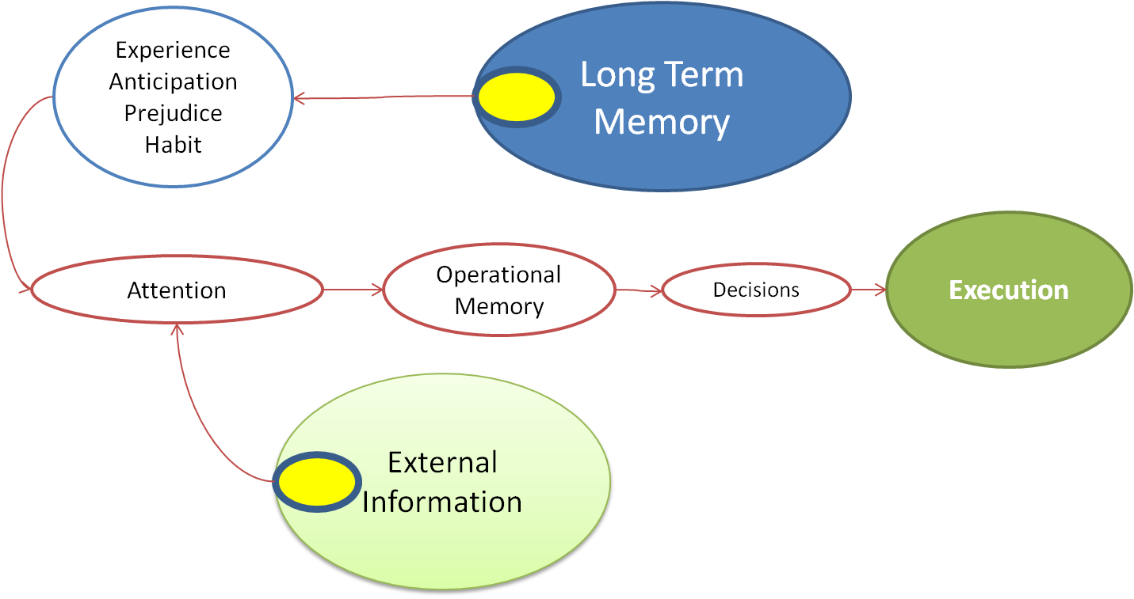
Descriptive Decision Models
If time is unlimited and the amount of available information is small, one can go through all the analysis of options.
Real world decision scenarios:
  Ill structured problem
  Uncertain, dynamic environment
  Situation changes rapidly
  Multiple and conflicting goals
  Time constraints
  High risk
  More than one person involved
  Information rich
Describe and discuss 5 everyday decisions with reference to these conditions
Wickens, et al, An Introduction to HF Engineering, Pearson Education Intl. 2004.

Slide 84
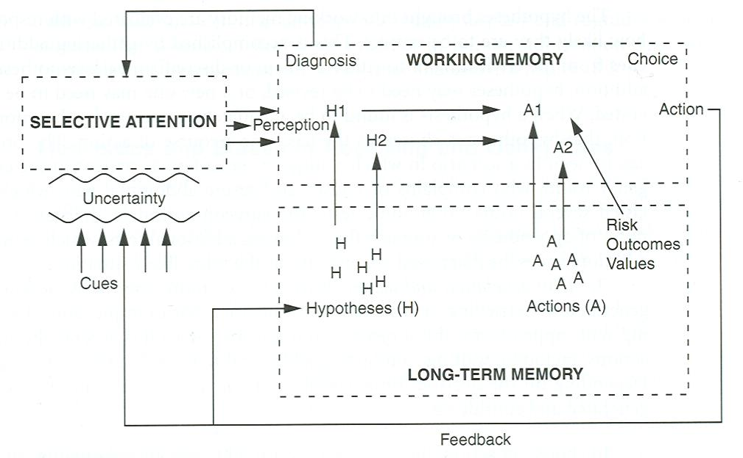
Heuristics and Biases:
Info Processing Limits in Decision Making
Trace these pathways using the decision on what to eat for dinner
Wickens, et al, An Introduction to HF Engineering, Pearson Education Intl. 2004.

Slide 85
Heuristics and Biases:
Info Processing Limits in Decision Making
Cues reception and integration
  Selectively attend to cues
  Interpret and integrate cues
  Cues are fuzzy, incomplete, erroneous
Crossing the road when the green light is flashing
Generate Hypotheses & Selection
  Retrieve info from LTM to make inferences, educated guesses
  Situation assessment
  Hypotheses brought to WM to evaluate how likely it is to be correct
  Gather extra information – generate new hypotheses
  Hypothesis adequately supported by information – hypothesis chosen as basis for course of action
Wickens, et al, An Introduction to HF Engineering, Pearson Education Intl. 2004.

Slide 86
Heuristics and Biases:
Info Processing Limits in Decision Making
Generate plan & action choice
  Generate one of more alternative actions by retrieving possibilities from LTM
  Choose action – evaluate possible outcomes – positive and negative
  Monitors environment to update situation assessment
Play backhand or forehand at table tennis
Wickens, et al, An Introduction to HF Engineering, Pearson Education Intl. 2004.

Slide 87
Heuristics and Biases:
Info Processing Limits in Decision Making
Due to limited cognitive resources (e.g. limited WM) → result in various heuristics and biases
  Shortcuts or Rules-of-Thumbs (easy ways of making decisions)
  Very powerful and efficient, but don’t guarantee the best solution
  Because they are simplifications, heuristics occasionally lead to systematic flaws and errors (deviations from normative model called Biases)
Should I take an umbrella?
Wickens, et al, An Introduction to HF Engineering, Pearson Education Intl. 2004.

Slide 88
Heuristics and Biases
Receiving and Using Cues
  1. Attention to a limited number of cues
  - Limited WM – only use small number of cues to develop picture of world
  2. Cue primacy and anchoring
  - Preliminary information given more weight (more influential) –anchor hypothesis on this first impression.
  3. Inattention to later cues
  - Ignore cues that come later or those that had changed; attributable to attentional factors
  4. Cue salience
  - Salient cues =- very loud, bright, prominent given more attention and significance.
  5. Overweighting of unreliable cues
  - Simplify process – thus treat all cues or information as equally reliable
  - Gives weight to unreliable information
How does advertising work?
Wickens, et al, An Introduction to HF Engineering, Pearson Education Intl. 2004.

Slide 89
Heuristics and Biases
Hypothesis Generation, Evaluation and Selection
Process cues in WM → Generate hypotheses by retrieving them from LTM:
1. Generation of a limited number of hypotheses
  Generate only small number of hypotheses due to limited WM.
  Under stress, most generate only 1 – more likely to be an accurate one for experts, but not novice.
2. Availability heuristic
  Retrieve recently considered or easily accessible hypotheses.
  May not be the right one.
3. Representativeness heuristic
  Diagnose a situation because the pattern of cues ‘look like’ a typical example of the situation. E.g. flu-like symptoms may not be flu.
4. Overconfidence
  People think they are correct more often than they are
  Do not look for evidence for alternative hypotheses – do not consider they might just be wrong.
Buying a new mobile phone
Wickens, et al, An Introduction to HF Engineering, Pearson Education Intl. 2004.

Slide 90
Heuristics and Biases
Hypothesis Generation, Evaluation and Selection
Bring hypotheses into WM→ evaluate with additional cues.
Can be affected by cognitive limitations
1. Cognitive Tunneling or Fixation
  Fixate on a single hypothesis
  Fail to look at new information.
  Proceed with a solution consistent with the hypothesis, assuming it is correct, even when presenting information contradicts hypothesis.
2. Confirmation Bias
  Look out for information that confirm their hypothesis or beliefs.
  Ignore information that debunk their hypothesis.
  Happens especially during stressful environment
Do you prefer Apple or Android? Why? Which would you buy given a price difference?
Wickens, et al, An Introduction to HF Engineering, Pearson Education Intl. 2004.

Slide 91
Heuristics and Biases
Action Selection
Retrieve only a small number of actions
  Couldn’t retrieve many of the possible actions in LTM due to limited WM.
Availability heuristic for actions
  Retrieve most “available” actions from LTM
  Relate to recency, frequency, and how strongly they are associated with hypothesis
Availability of possible outcomes
  Does not see negative outcome – hence assume it is not there (e.g. safety hard hats)
  Hindsight bias – cannot understand why people made an error of judgment when it was SO obvious after the fact.
Framing bias
  If people are rational decision makers, how a problem is presented should have not impact on decision.
  Decisions are often made based on how the problem is presented or delivered
  People make riskier decisions when presented as choice between losses (sunk cost bias)
  People make conservative decision when presented as choice between gains
Discuss the conflicts between advertising and price of a pair of shoes
Wickens, et al, An Introduction to HF Engineering, Pearson Education Intl. 2004.

Slide 92
Effects of Framing
How a problem or situation is “framed” can affect the outcome of choice problems in a way that violates assumptions of rational choice theory
Framed as a gain vs Framed as a loss
  If asked to choose between a certain loss of $50 or having a 50% chance of losing $100 or breaking even, which would you choose?
  If asked to choose between a certain gain of $50 or having a 50% chance of making $100, which would you choose?
Wickens, et al, An Introduction to HF Engineering, Pearson Education Intl. 2004.

Slide 93
Effects of Framing
One group of participants are presented with a choice between:
Program A: "200 people will be saved"
Program B: "there is a one-third probability that 600 people will be saved, and a two-thirds probability that no people will be saved"
72 percent preferred program A
28 percent preferred program B
Another group of participants are presented with the choice between:
Program C: "400 people will die"
Program D: "there is a one-third probability that nobody will die, and a two-third probability that 600 people will die"
22 percent preferred program C
78 percent opting for program D
What would be your decision? Why?
Wickens, et al, An Introduction to HF Engineering, Pearson Education Intl. 2004.

Slide 94
Skill, Rule, and Knowledge-Based Behavior
Skill-based behavior
- If extremely experienced with task, information is processed at the skill-based level
Rule-based behavior
- If familiar with task but do not have extensive experience, information is processed at the rule-based level
Knowledge-based behavior
- When situation is novel, information is processed at the
knowledge-based level
Teaching someone to fly a kite, ride a bike or drive a car, discuss
Wickens, et al, An Introduction to HF Engineering, Pearson Education Intl. 2004.
Notes:
Different decision-making processes that people can adopt depending on their level of expertise and decision situation

Slide 95
Improving Human Decision Making
Task Redesign
Change aspects of the system such as the task, equipment, or work environment for better performance
Doing so supports better decision making, thereby eliminating the need to change the person making the decisions, train the person, or provide support
How could we redesign the lights at an intersection to improve traffic and pedestrian flow with regard to speed and avoidance of error?
Wickens, et al, An Introduction to HF Engineering, Pearson Education Intl. 2004.

Slide 96
Improving Human Decision Making
Decision-Support Systems
Extend the user’s cognitive decision-making abilities through help of various forms
Decision Matrices and Tress
Spreadsheets
Simulation
Expert Systems
Displays
Will not be used if complexity is too high
How should a teacher grade a set of exam papers or projects?
Wickens, et al, An Introduction to HF Engineering, Pearson Education Intl. 2004.

Slide 97
Improving Human Decision Making
Training
Can address decision making at each of the 3 SRK levels
Train people to overcome heuristics/biases and use normative methods
Enhance perceptual and pattern-recognition skills
Repetitions to create strong associations for automaticity
Important for decision maker to receive feedback for each cognitive step and outcome of decision as a whole
How should we train elementary school teachers? Safety officers?
Wickens, et al, An Introduction to HF Engineering, Pearson Education Intl. 2004.

