Slide 1
NIOSH Lift Equation
Brian Peacock
for
Pitney Bowes Inc

Slide 2
Should not be used for:
One handed lifts
More than 8 hours
Seated or kneeling
Restricted work space
Unstable Objects
Carrying, pushing or pulling while lifting
Wheelbarrows or shovels
High speed motion
Unreasonable foot/floor coupling
Unfavorable environment

Slide 3
1991 Version
RWL = LC x HM x VM x DM x AM x FM x CM
Lift Index = LOAD / RWL
A Discounting Equation

Slide 4
Definition of Terms
RWL = Recommended weight limit
LC = Load constant
HM = Horizontal multiplier
VM = Vertical multiplier
DM = Distance multiplier
AM = Asymmetric multiplier
FM = Frequency multiplier
CM = Coupling multiplier

Slide 5
1991 Multipliers
LC = 51 Pounds Load Constant
HM = 10/H Horizontal Distance
VM = 1-.0075 x / V-30/ I Vertical Distance – 30”I
DM = .82 + (1.8/D) Vertical Distance moved
AM = 1 – (.0032 x A) Asymmetry

Slide 6
Frequency Multiplier

Slide 7
Coupling Multiplier

Slide 8
Asymmetry Multiplier

Slide 9
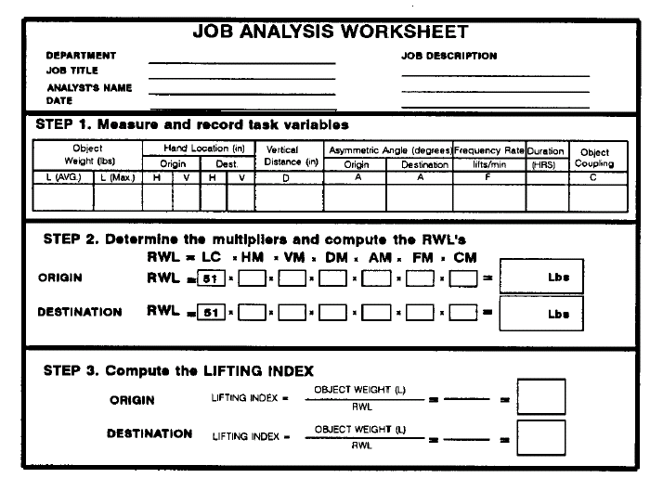
NIOSH Worksheet

Slide 10
Sources on the Internet
http://www.cdc.gov/niosh/docs/94-110/
http://www.emcins.com/losscontrol/quick_links/employee_safety_health/ergonomicsNIOSH.aspx
http://www.ergoweb.com/news/detail.cfm?id=566
http://www.ccohs.ca/oshanswers/ergonomics/niosh/calculating_rwl.html

