Slide 1
Occupational Biomechanics
Brian Peacock
for
Pitney Bowes Inc

Slide 2
Trigonometry
A
b c
C a B
Triangles
Pythagoras’ theorem (right angle)
Sine, cosine, tangent
c² = a² + b²
Triangles are useful in structures, biomechanics and soccer

Slide 3
Mechanical Units
What happens when the bus starts to leave the bus stop?
Scalars – Magnitude
- e.g. mass, time, energy, speed
Vectors – Magnitude and Direction
- e.g. force, velocity
Movement
- Displacement (s) - distance
- Velocity (v)– distance / time ds /dt
- Acceleration (a) velocity / time dv /dt
- Jerk da /dt d²v/dt² d³s / dt³

Slide 4
Angular Movement
Velocity
ω = (θ₂ - θ₁) / (t₂ – t₁) = Δ θ / Δt
Degrees, radians or revolutions per second
1 Radian = 180 / Π degrees
Acceleration
α = Δ ω / Δt
Radians per second squared
t₂
t₁
θ₂
θ₁

Slide 5
Force
Force = mass X acceleration
mass = Force / acceleration
Acceleration due to gravity - g
- 9.8066 meters per second squared
Weight = mass X g (Force)
Pressure = Force / area

Slide 6
Resultant Force Vectors
F_{y}
F_{R}
θ
θ
F_{x}
Magnitude F_{R} = √( F_{x}² + F_{y}²), Direction = F_{x} cos(θ)

Slide 7
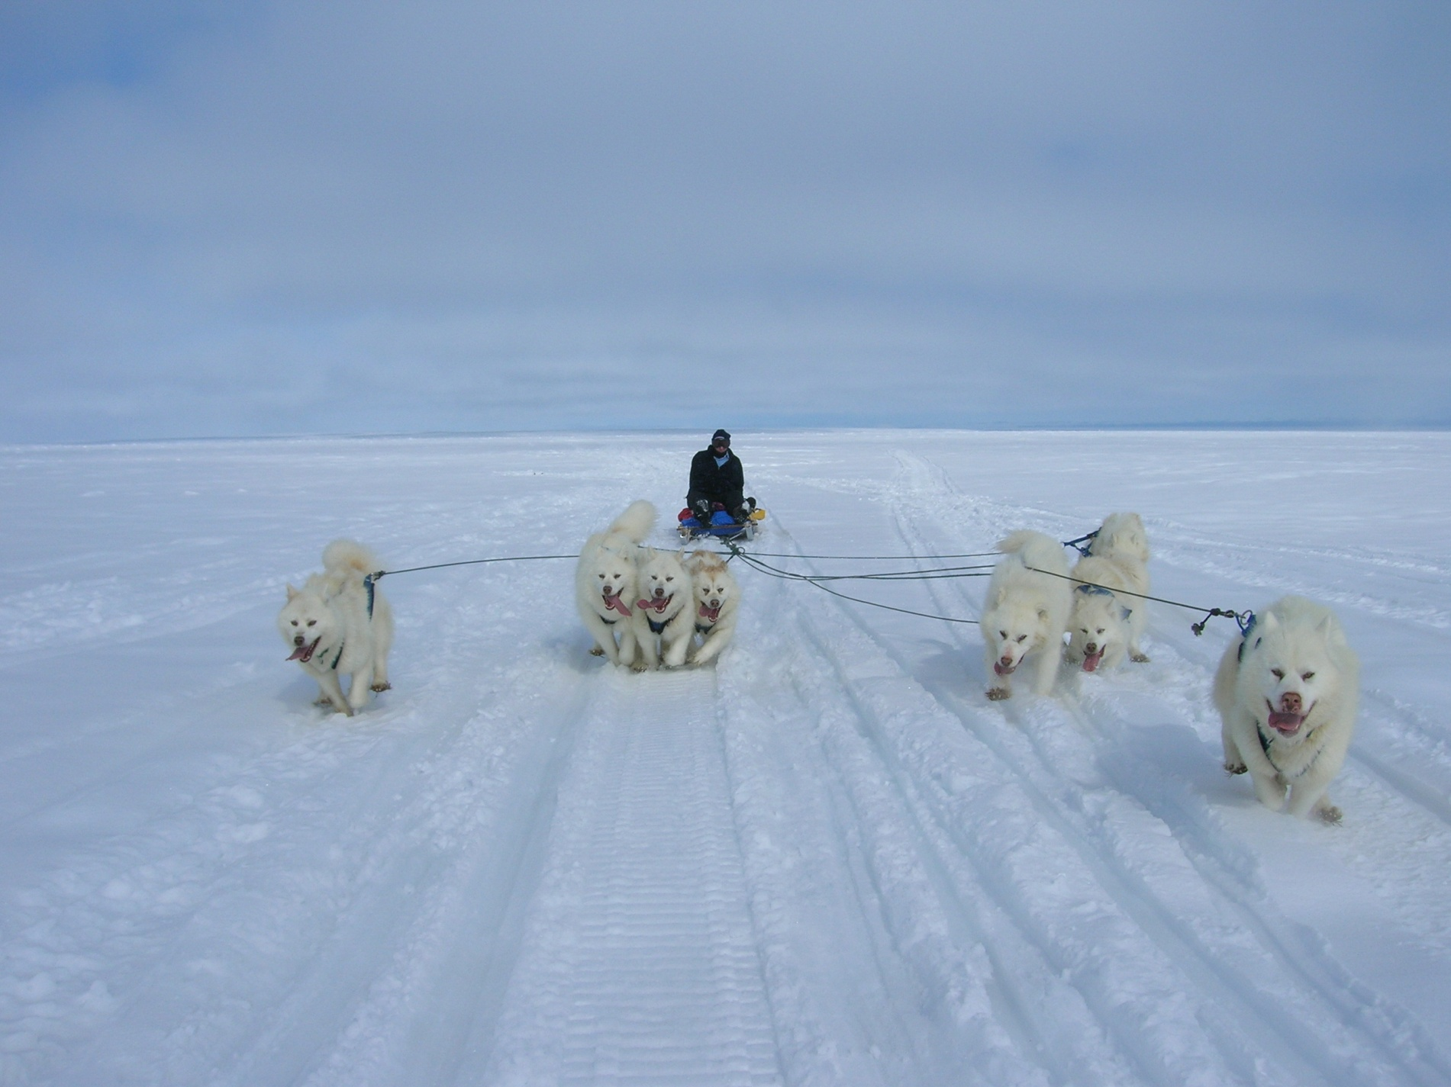

Slide 8
Moments
Moment = Force x Distance
Distance
Load (Force, Weight, Mass x g

Slide 9
Levers
DD
DD
DD

Slide 10
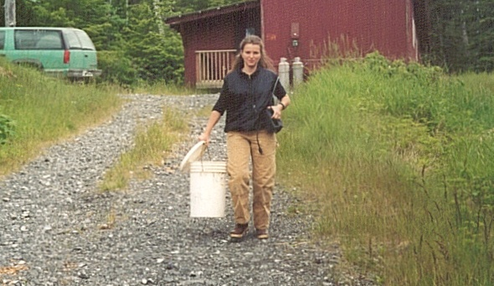


Moments

Slide 11
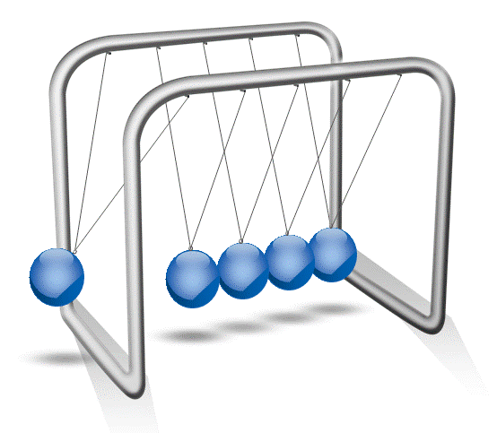
Momentum mass x velocity

Slide 12
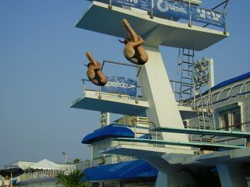
Moment of Inertia
Force = mass x acceleration
Torque – moment of inertia x angular acceleration

Slide 13
Newton’s Laws
I – A particle stays at rest or moves in a straight lie at a constant velocity if there is no unbalanced force acting on it.
II – The acceleration of a particle is proportional to the resultant force acting on it and is the direction of the force
III – Action and reaction are equal and opposite.

Slide 14
More Mechanical Concepts
Friction – Walking on ice
Elasticity – A golf ball
Compression – Joints
Tension – Tendons and ligaments
Shear – Intervertebral discs

Slide 15
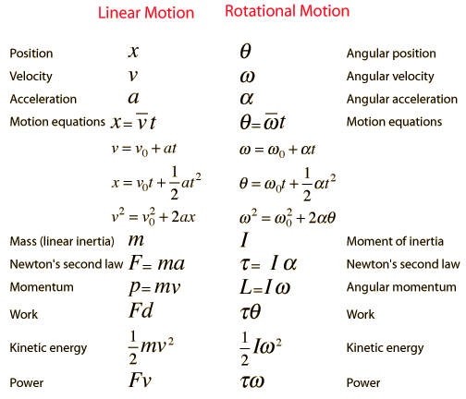

Slide 16
Statics
Free body diagram (Force vector diagram)
  Remove from surrounding structures
  Resolve forces into components
  Represent vectors by line length and direction
  Draw whole structure then separate diagrams
Static Equilibrium
  Sum of horizontal, vertical and rotational (moments) forces equals zero

Slide 17
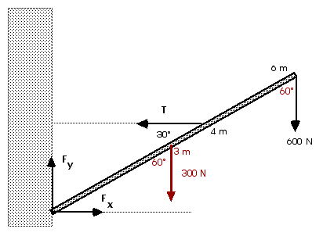
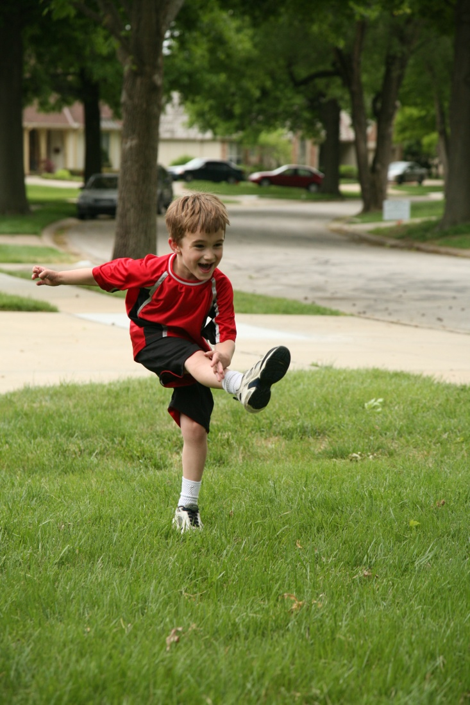

Free Body Diagram and Equilibrium

Slide 18
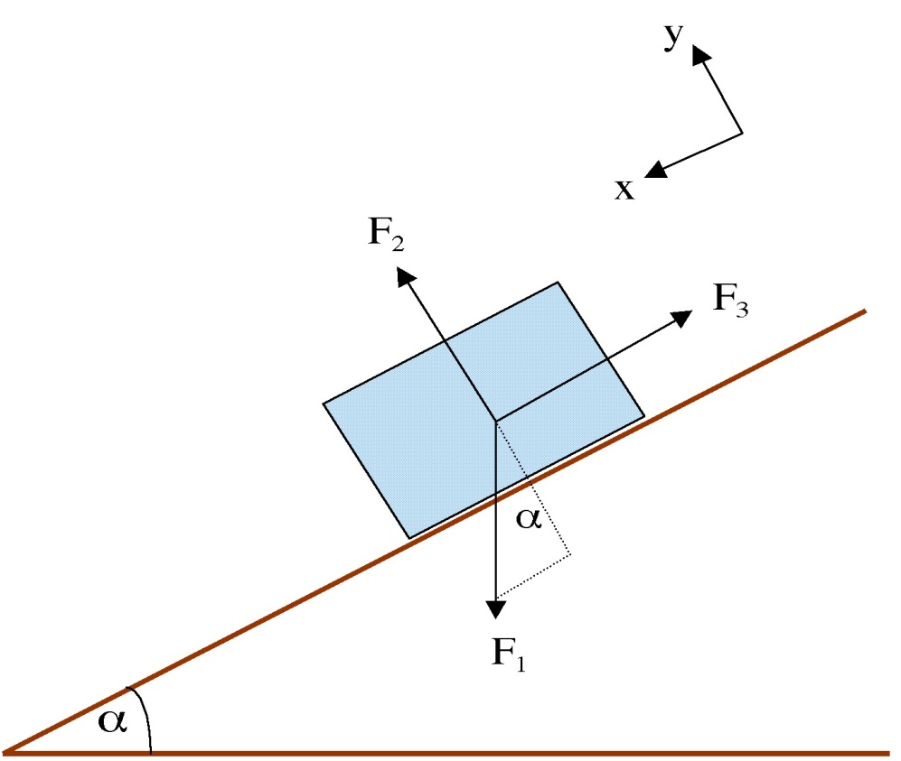
Static Equilibrium

Slide 19
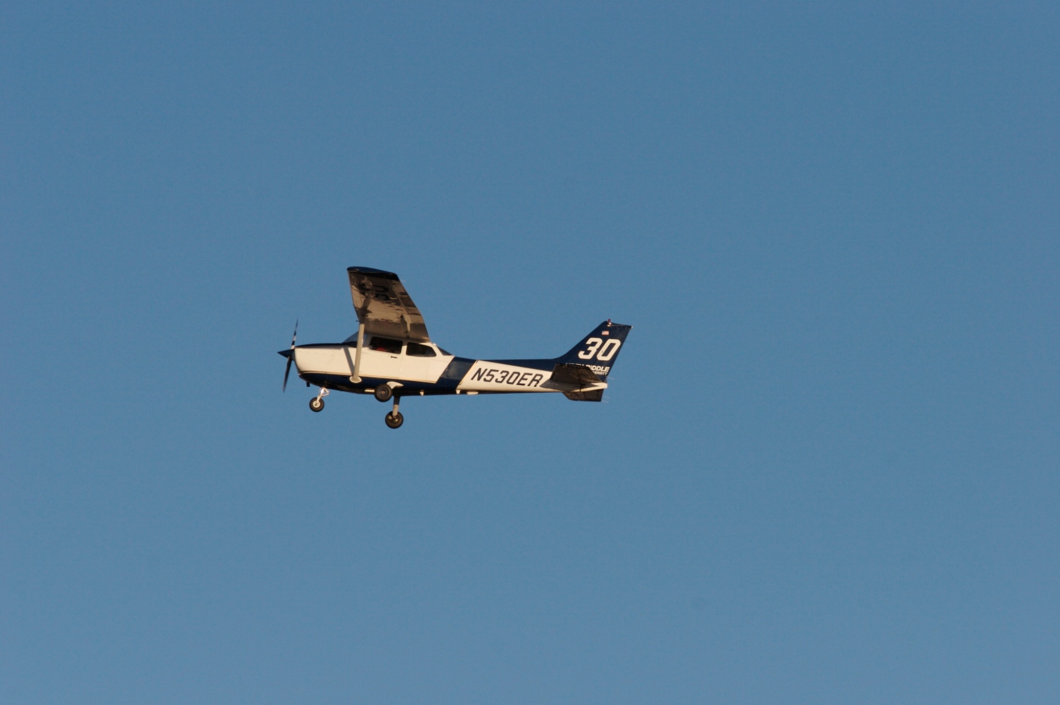
Flying
Lift
Thrust
Drag
Weight
Constant speed

Slide 20
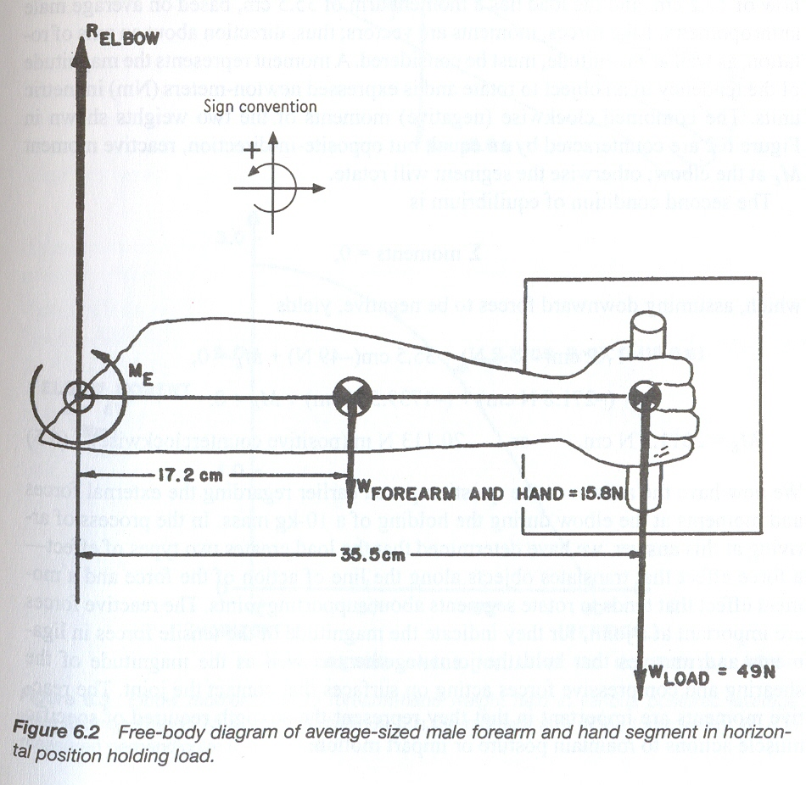

Slide 21
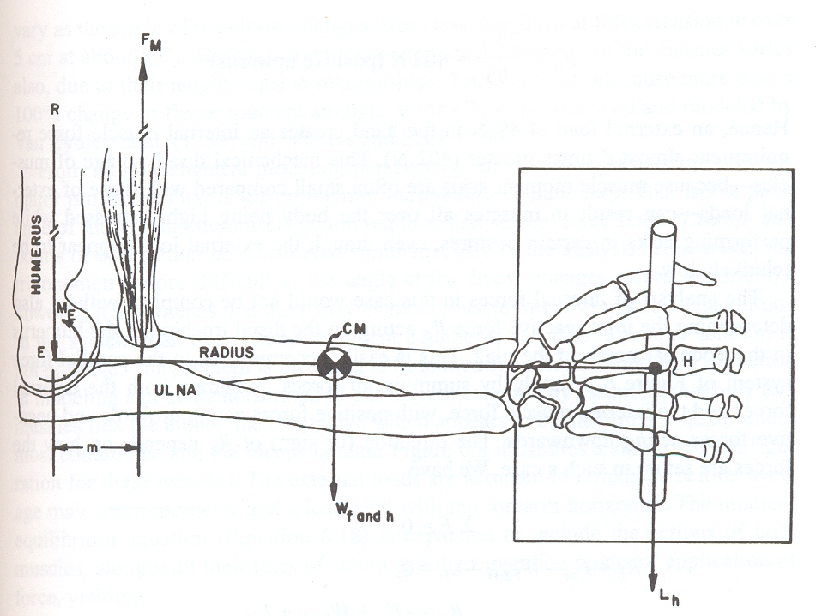

Slide 22
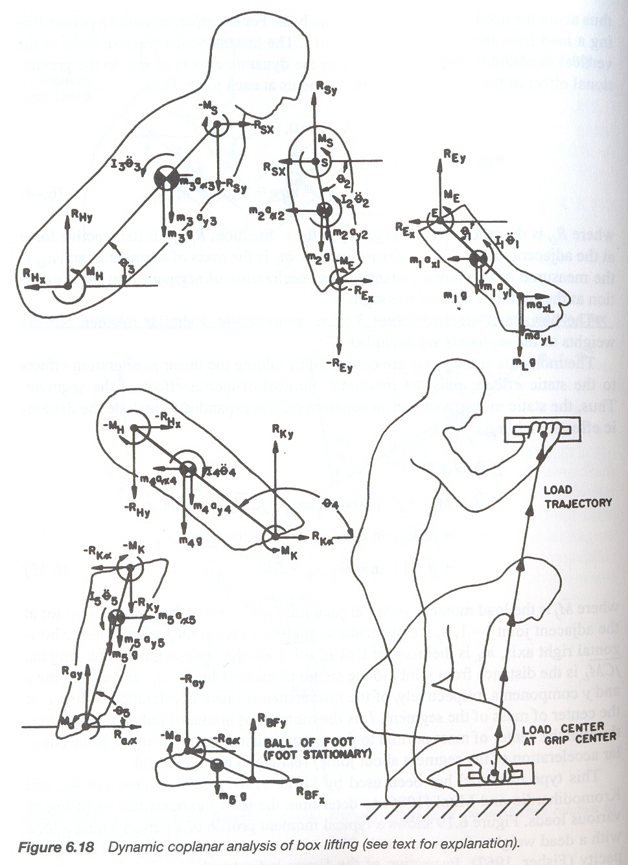

Slide 23
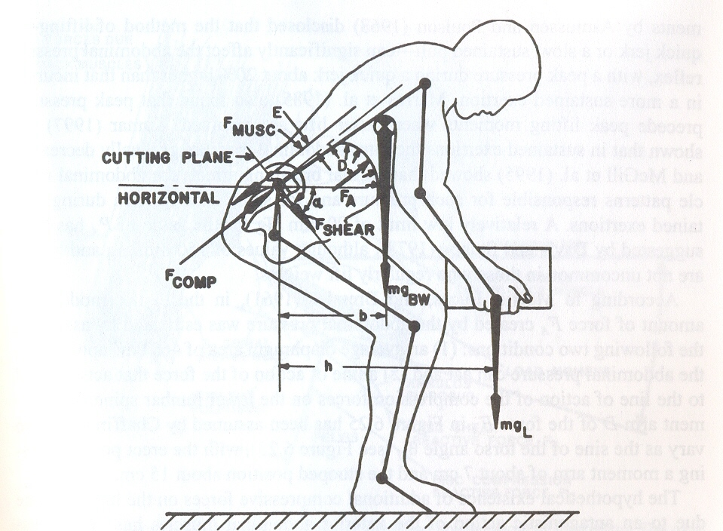

Slide 24

Kinematics

Slide 25
Standard Movements
Movement Type | Plane of Motion | Notes
Flexion | Saggital | Hip, Shoulder, Wrist, Knee, Ankle, Spine
Extension | Saggital | Hip, Shoulder, Wrist, Knee, nkle, Spine
Abduction | Frontal | Hip, Shoulder, Wrist, Carpo-metacarpal
Adduction | Frontal | Hip, Shoulder, Wrist, Carpo-metacarpal
Side Flexion | Frontal | Spine
Rotation | Spine | Horizontal
Medial Rotation | Horizontal | Hip, Shoulder, Knee
Lateral Rotation | Horizontal | Hip, Shoulder, Knee
Circumduction | All | Hip, Shoulder, Wrist, Ankle
Pronation | Horizontal | Forearm
Supination | Horizontal | Forearm
Inversion | Frontal | Ankle
Eversion | Frontal | Ankle
Opposition | All | Thumb
Sliding | All | Fingers, Toes, Spinal Facets

Slide 26
Range of Motion
Movement Type | Plane of Motion | Range of Motion
Flexion | Saggital
Extension | Saggital
Abduction | Frontal
Adduction | Frontal
Side Flexion | Frontal
Rotation | Spine
Medial Rotation | Horizontal
Lateral Rotation | Horizontal
Circumduction | All
Pronation | Horizontal
Supination | Horizontal
Inversion | Frontal
Eversion | Frontal
Opposition | All
Sliding | All
Demonstrate these movements

Slide 27
Angle - Time Diagrams
Flexion
Joint
Angle
Time
Extension

Slide 28
Velocity-Time Diagrams
Velocity (angular)
Acceleration
Deceleration
Time

Slide 29
Angle - Angle - Time Diagrams
Flexion
Joint 1
Flexion
Extension
Joint 2
Extension

Slide 30
Angle - Angle - Time Diagrams
F
Joint 1
E
F
Joint 2
E

Slide 31
Kinetics

Slide 32
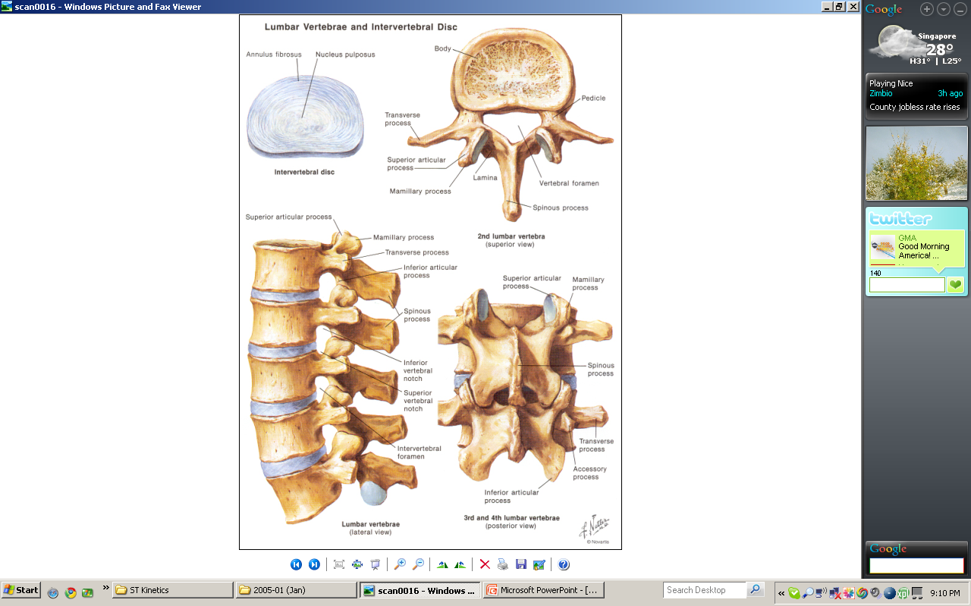

Slide 33
Compression
Tension
Shear

Slide 34
Angle - Force - Time Diagrams
F
Angle
E
Joint 2
Force
Time

Slide 35
Dynamics
Force (at a joint) = f(gravity, inertia)
- Inertia = mass x distance squared
Swing a heavy and light hammer
In cricket, big hitters use “the long handle”, why?
Figure skating
Stopping an articulating arm with a heavy load

Slide 36
Checklists and Operational Models
Checklists
- Range of motion limits / ranges
- Weight and force limits / ranges
- Moment and torque limits / ranges
- Single and complex engineering measures
Discounting model NIOSH Lift Equation
- RWL = LC*HM*VM*DM*AM*CM*FM
- Various durations 1 – 8 hours
- Lift index – what should be the upper limit?

Slide 37
Checklist Exercises
Create a consensus checklist for:
- manual materials handling
- assembling push fasteners (clips, hoses, electrical connectors)
- different types of screw / nut / bolt runners
Create a discounting equation for repetitive upper limb activity

Slide 38
Motion Analysis - Goniometry
  Electrogoniometers
• Orthogonal potentiometers mounted close to joint
  Optical goniometers
• Reflective joint center markers
  • Video

Slide 39
Video Analysis
Analyst, Date, Place, Job Description etc.
Subjects, Views, Durations and Replications
Lighting
Distances, Weights, Forces, Frequencies
Analysis – Motions, Forces, Indices
Reporting – Annotated Video

Slide 40
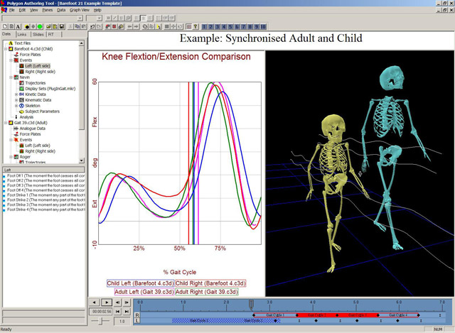
Peak – Vicon Motion Analysis

Slide 41
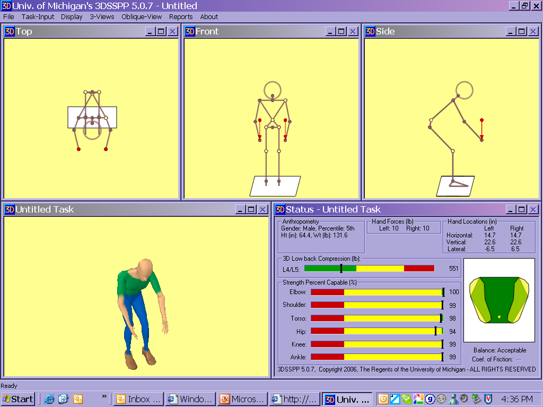

Slide 42
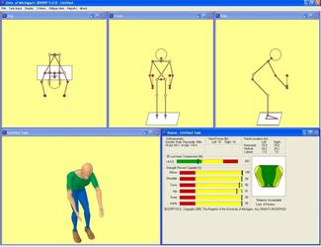
University of Michigan 3DSSPP

Slide 43
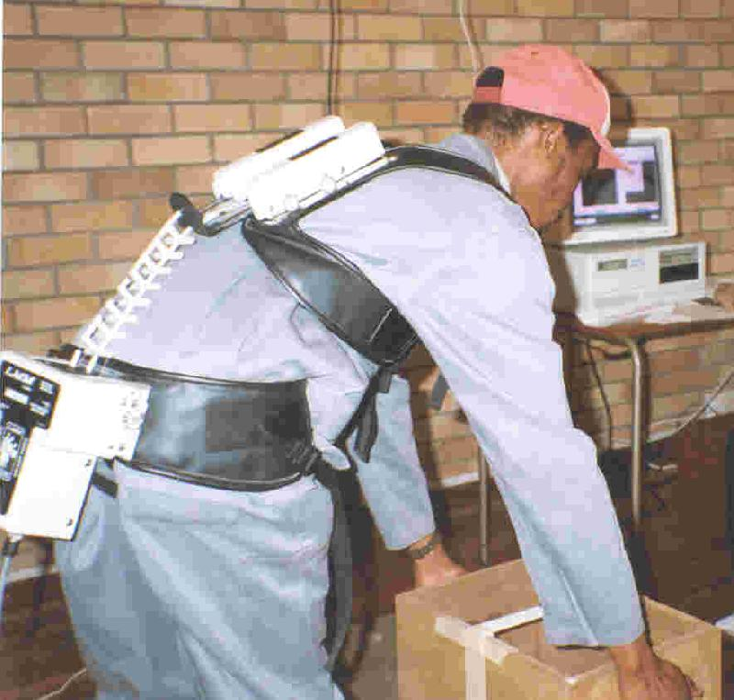
Lumbar Motion Monitor

Slide 44
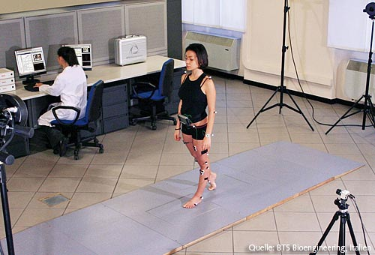
Kistler Force Platforms

Slide 45
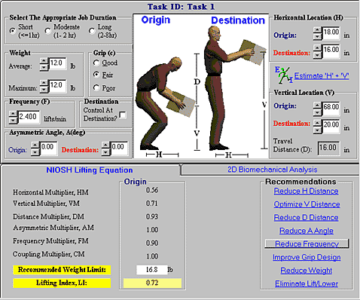
NEXGEN Ergonomics

Slide 46
Checklists and Operational Models
Checklists
- Range of motion limits / ranges
- Weight and force limits / ranges
- Moment and torque limits / ranges
- Single and complex engineering measures
Discounting model NIOSH Lift Equation
- RWL = LC*HM*VM*DM*AM*CM*FM
- Various durations 1 – 8 hours
- Lift index – what should be the upper limit?

Slide 47
Mapping
Probability of accident, process failure or user rejection
Black
Purple
Red
Orange
Yellow
Green
White
Engineering Dimension

Slide 48
Different User Populations and Conditions
Probability of accident, process failure or user rejection
Black
Purple
Red
Orange
Yellow
Green
White
Engineering Dimension

Slide 49
Policy Decisions
Common Currency
Outcome Scale
1
2
3
4
5
6
7
Policy Statements
Unacceptable
Range
7
6
5
4
3
2
1
Region of Interactions and Continuous Improvement
Ideal Range
Engineering Variable or Composite Index

