Slide 1
Train The Trainer OH Masterclass For Ergonomics: Noise and Hearing Prof. Brian Peacock & A. Prof. Chui Yoon Ping

Slide 2
Environmental Factors Effects
Extreme Environmental Stress
Direct Destructive Effects
Eyes, Ears, Skin, Circulation etc.
Moderate Environmental Stress
Increased Effort to Perform Primary Task - Fatigue
Increased Likelihood of Performance Failures - Errors, Accidents
Long Exposures have Destructive Effects
Mild Stress, Combinations and Variation
Increased Stimulation
Sometimes Enhanced Performance
Discuss as Noise, Light, Heat, and Vibration and their effects on human physical, sensory and cognitive performance

Slide 3
General Environmental Effects Exercise
Describe jobs with Extreme, Moderate and Mild Environmental Stress
Describe Primary Task Factors and Performance Measures
Describe Environmental Stress Modalities and Measures
Describe Human Responses to these Stresses
Describe System Outcomes
Choose jobs with Heat, Light, Noise and Vibration as stressors

Slide 4
The Physics of Sound
Intensity
Sound Pressure Level - Decibels
20 (Hearing Threshold) - 140 (Pain Threshold)
Frequency range
20 Hz to 20,000 Hz
http://en.wikipedia.org/wiki/Audio_frequency
http://hypertextbook.com/facts/2003/ChrisDAmbrose.shtml
Qualitative Factors
Change in intensity or pitch
Meaningfulness speech / language, music and auditory signals
Explore intensity and frequency.
Find an application for your smart phone or tablet to measure sound

Slide 5
Typical Sound Levels
Jet engine – 150 dB
Rock band – 140 dB
Busy street – 90 dB
Busy office – 60 dB
Quiet home – 30 dB
http://www.airportsites.net/lambert-stl/workshop1/nc_b29.aspx
http://www.sengpielaudio.com/TableOfSoundPressureLevels.htm
Make and measure some sounds with your tablet app

Slide 6
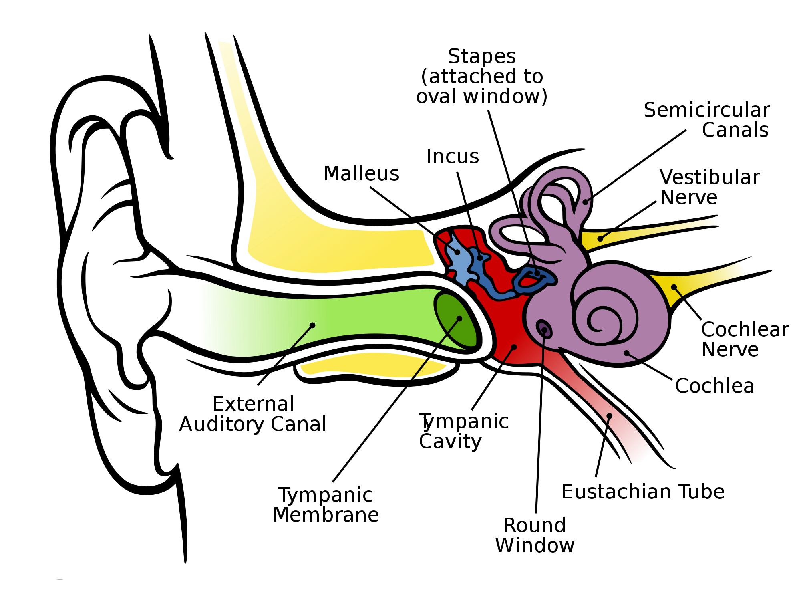
The Outer, Middle and Inner Ear
What does the vestibular nerve do?
Where does the Eustachian tube go to?
Track the pathway of a sound through the outer, middle and inner ear and on to the brain for perception

Slide 7
Hearing Measurement
Audiometry – testing sound intensity perception at different frequencies
Psychophysical methods using Ascending and Descending Intensities at range of frequencies
Presbycusis - normal hearing loss with age
Download an app to your iPad and test your own hearing

Slide 8
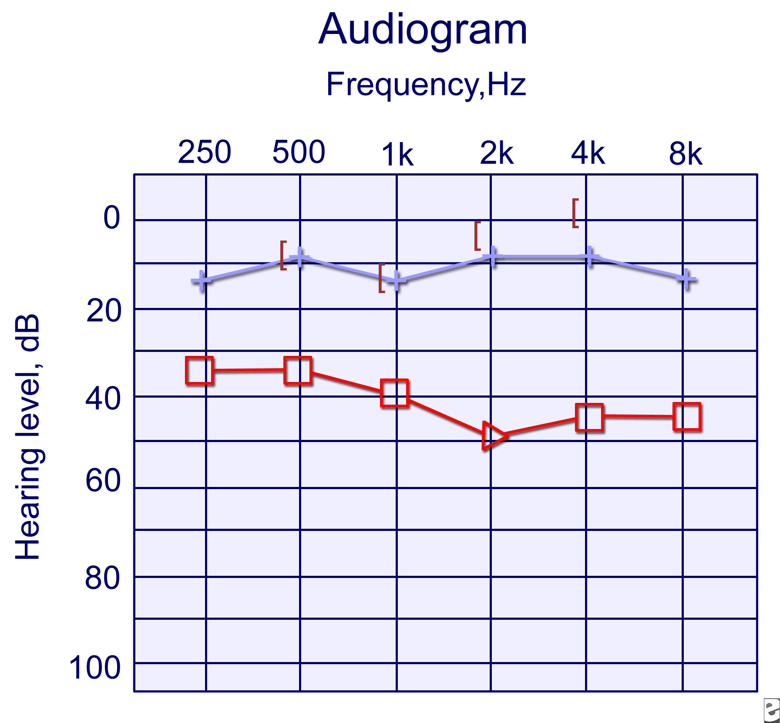
Audiometry
Interpret this audiogram, Look for other examples of occupational hearing loss
http://www.nlm.nih.gov/medlineplus/ency/article/003341.htm

Slide 9
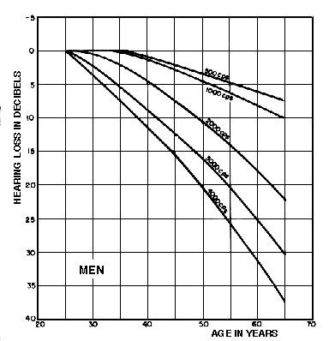
Hearing loss and age
Discuss some work and social effects of presbycusis

Slide 10
The Effects of Sound
Communication
Language, Other Codes
Warnings, Annunciators
Entertainment
Masking where the signal and the background have similar features
Distraction – anything novel, of high intensity or potentially interesting
Annoyance – anything distracting, unpleasant or uninteresting
Temporary Threshold Shift – temporary deafness after exposure to loud noises
Permanent Threshold Shift – deafness in certain ranges after prolonged exposure to high intensity noise
Describe and discuss some auditory communication failure modes and examples

Slide 11
Sound Environment Design
System Substitution
Sound Cancellation
Source Isolation - Transmission Pathway Interference - Barriers
Reflection and Absorption
Personal Protective Equipment
Exposure Reduction
The WDA has a comprehensive guide to Hearing Conservation Programs:
https://www.wshc.sg/wps/themes/html/upload/infostop/file/HCP_Guidelines_2012.pdf
Describe and discuss some examples of each of these design opportunities to reduce the unwanted effects of the noise environment

