Slide 1
The Spatial Aspects of Work
Brian Peacock
for
Pitney Bowes Inc

Slide 2
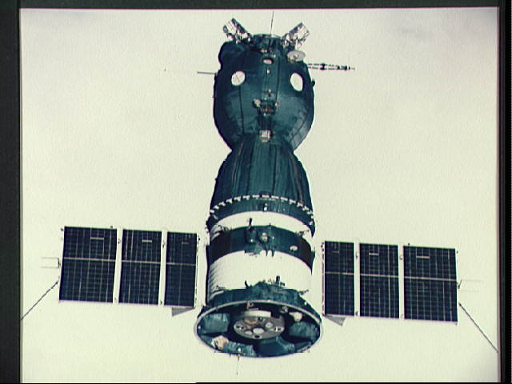
Soyuz capsule
For launch and landing astronauts are strapped into their body molded reclining seats.
The controls are out of reach
They are given a little stick with which to press the buttons

Slide 3
Rounded English – Metric Conversions
Inches | Centimeters |  | Centimeters | Inches |  | Pounds | kg |  | kg | Pounds
5 | 13 |  | 10 | 4 |  | 5 | 2 |  | 2 | 4
10 | 25 |  | 20 | 8 |  | 10 | 5 |  | 4 | 9
15 | 38 |  | 30 | 12 |  | 15 | 7 |  | 6 | 13
20 | 51 |  | 40 | 16 |  | 20 | 9 |  | 8 | 18
25 | 64 |  | 50 | 20 |  | 25 | 11 |  | 10 | 22
30 | 76 |  | 60 | 24 |  | 30 | 14 |  | 12 | 26
35 | 89 |  | 70 | 28 |  | 35 | 16 |  | 14 | 31
40 | 102 |  | 80 | 31 |  | 40 | 18 |  | 16 | 35
45 | 114 |  | 90 | 35 |  | 45 | 20 |  | 18 | 40
50 | 127 |  | 100 | 39 |  | 50 | 23 |  | 20 | 44
55 | 140 |  | 110 | 43 |  | 55 | 25 |  | 22 | 48
60 | 152 |  | 120 | 47 |  | 60 | 27 |  | 24 | 53
65 | 165 |  | 130 | 51 |  | 65 | 30 |  | 26 | 57
70 | 178 |  | 140 | 55 |  | 70 | 32 |  | 28 | 62
75 | 191 |  | 150 | 59 |  | 75 | 34 |  | 30 | 66
80 | 203 |  | 160 | 63 |  | 80 | 36 |  | 32 | 70
 |  |  | 170 | 67 |  | 85 | 39 |  | 34 | 75
 |  |  | 180 | 71 |  | 90 | 41 |  | 36 | 79
 |  |  | 190 | 75 |  | 95 | 43 |  | 38 | 84
 |  |  | 200 | 79 |  | 100 | 45 |  | 40 | 88
 |  |  |  |  |  |  |  |  | 42 | 92
 |  |  |  |  |  |  |  |  | 44 | 97

Slide 4
Anthropometry

Slide 5
Anthropometry Measures
Stature
Segment lengths
Widths
Girths
Weight
Body Mass Index
Somatotypes

Slide 6
Body Mass Index and Health Risk for Singapore (MARCH 16, 2005)
BMI (kg/m²) for Adults | Health Risk
27.5 and above | High Risk
23 – 27.4 | Moderate Risk
18.5 – 22.9 | Low Risk (healthy range)
Below 18.5 | Risk of nutritional deficiency diseases and osteoporosis

Slide 7
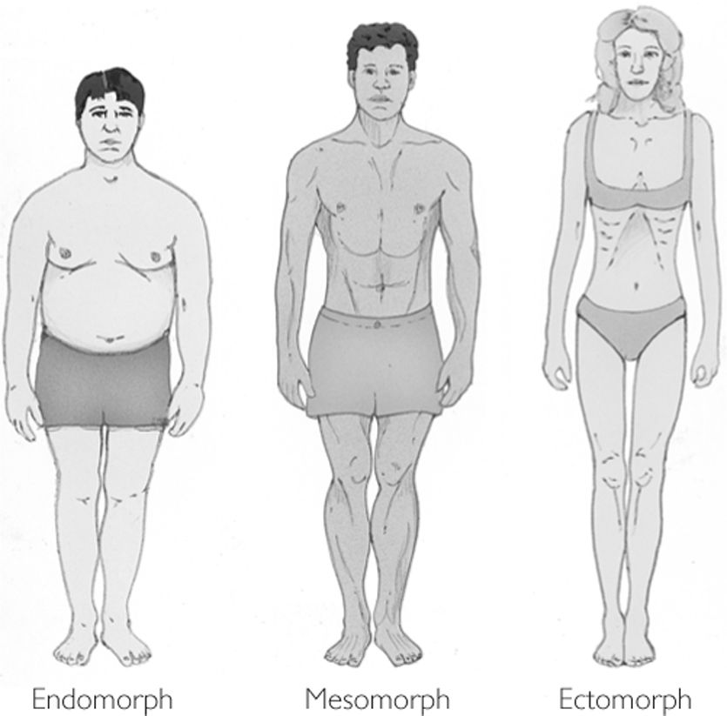
Somatotypes (William Sheldon (1898-1977)
Rate yourselves and your colleagues on 1-7 scales (1 low, 7 high) on each dimension – the “average person” would be a 4-4-4

Slide 8
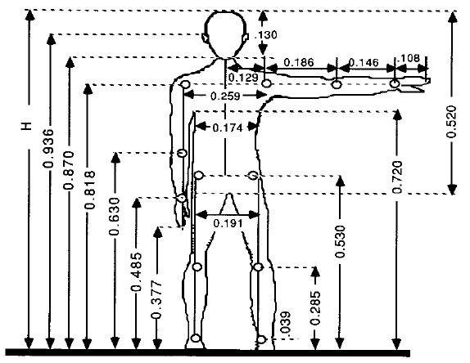
Drillis and Contini estimates of segment lengths based on stature

Slide 9
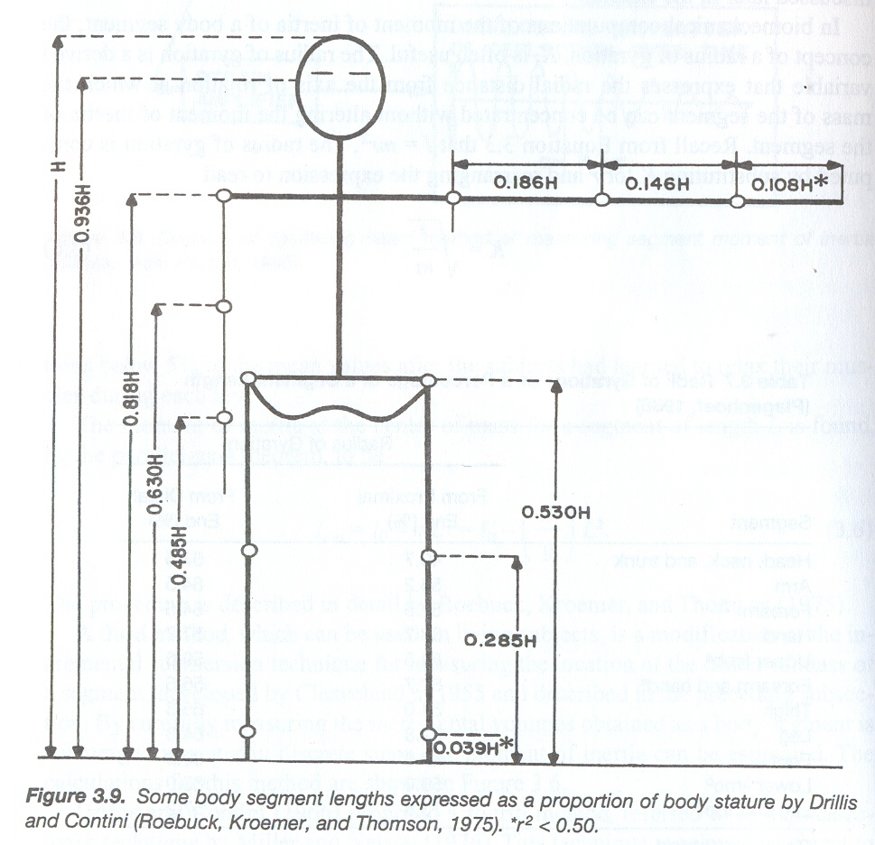

Slide 10
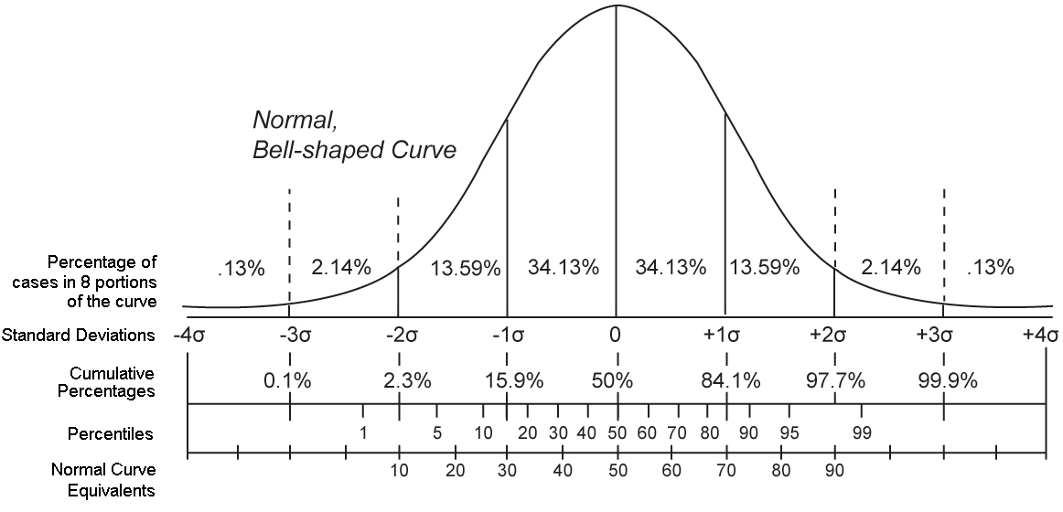
Statistics

Slide 11
Anthropometric Data based on Drillis and Contini Ratios From USA stature data (Sanders and McCormick)
 |  | 5th Percentile |  | 50th Percentile |  | 95th Percentile
 |  | Male | Female | Male | Female | Male | Female
 | Proportion | 163.6 | 151.1 | 175.3 | 161.8 | 187 | 172.2
Stature | 1 | 64.4 | 59.5 | 69.0 | 63.7 | 73.6 | 67.8
Ankle | 0.039 | 2.5 | 2.3 | 2.7 | 2.5 | 2.9 | 2.6
Foot Length | 0.152 | 9.8 | 9.0 | 10.5 | 9.7 | 11.2 | 10.3
Foot Breadth | 0.055 | 3.5 | 3.3 | 3.8 | 3.5 | 4.0 | 3.7
Knee | 0.285 | 18.4 | 17.0 | 19.7 | 18.2 | 21.0 | 19.3
Crotch | 0.485 | 31.2 | 28.9 | 33.5 | 30.9 | 35.7 | 32.9
Hip | 0.53 | 34.1 | 31.5 | 36.6 | 33.8 | 39.0 | 35.9
Navel | 0.63 | 40.6 | 37.5 | 43.5 | 40.1 | 46.4 | 42.7
Shoulder | 0.818 | 52.7 | 48.7 | 56.5 | 52.1 | 60.2 | 55.5
Eye | 0.936 | 60.3 | 55.7 | 64.6 | 59.6 | 68.9 | 63.5
Upper Arm | 0.186 | 12.0 | 11.1 | 12.8 | 11.8 | 13.7 | 12.6
Forarm | 0.146 | 9.4 | 8.7 | 10.1 | 9.3 | 10.7 | 9.9
Hand | 0.108 | 7.0 | 6.4 | 7.5 | 6.9 | 8.0 | 7.3
Arm | 0.44 | 28.3 | 26.2 | 30.4 | 28.0 | 32.4 | 29.8
Trunk Shoulder to Hip) | 0.288 | 18.5 | 17.1 | 19.9 | 18.3 | 21.2 | 19.5

Slide 12
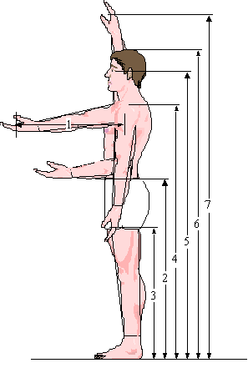
Typical Anthropometric Data
 | Percentile
 | Male |  | Female
Measurement | 95 | 5 | 95 | 5
1. Forward Reach | 26.9 | 24.0 | 25.1 | 22.2
2. Elbow Height | 44.6 | 39.5 | 41.5 | 36.1
3. Knuckle Height | 31.0 | 27.2 | 28.6 | 24.8
4. Shoulder Height | 60.1 | 53.2 | 55.8 | 48.8
5. Eye Height | 68.4 | 60.9 | 63.7 | 56.0
6. Stature | 73.2 | 64.4 | 67.7 | 59.5
7. Overhead Reach | 84.8 | 75.2 | 78.8 | 69.2

Slide 13
Workplace Design

Slide 14
You can change posture by changing the work environment

Slide 15
In the 1970s I developed the “box”
Shoulder height of the 5th percentile female
Knuckle height of the 95th percentile male
Forward functional reach of the 5th percentile female
Elbow width

Slide 16
The box can be very simple to remember
25/65
25/65
It is very useful for many practical purposes
50/125
(40/100 for sitting)
30/75(20/50 for sitting)

Slide 17
More on “the box”
It deals with both back, leg and arm posture
It is in the design domain - it does not measure posture
It’s zones are
Hand(s) inside the box
At the edge of the box
Outside the box
Outside the box in two dimensions
You can add time to the discussion
5 secs, 10 secs, 50% of job cycle etc
The corners may be an issue - so round them!
The box moves to the sitting base posture

Slide 18
How high should a computer screen be?

Slide 19
How high should a work bench be?
Close visual work
Elbow height - the rule of thumb
Heavy work

Slide 20
Whose Elbow are we Talking About?
5%
10%
50%
95%
99%

Slide 21
More Rules of Thumb
5%
10%
50%
95%
99%
Reach
Fit

Slide 22
How much headroom should there be in the back seat of a sports car?

Slide 23
To Reach, Raise or Tilt?
Cars and trucks need gas tanks, fuel lines, brake lines, exhaust pipes and heat shields etc. - they are generally located on the underbody.

Slide 24
To Reach, Raise or Tilt?
Overhead work can be a pain, but you can work overhead for short periods without any untoward effects. - what about 1/3 of the job cycle?
On frame vehicles - trucks - much of this work is done with the frame rotated
It may be better to build up a sub assembly and use automation to raise it up
Another alternative is to tilt the vehicle - 30º, 45⁰, 60º or 90º
$$$$$$$$$$$$$$$$$$$$$$$$$$$$$$$$$$$$

Slide 25
Beyond Fit and Reach Location to Orientation
The body works by first moving to the point of interest, adjusting the base posture and then using the arms, wrists and fingers to fine tune.
On Top
In Front
Behind
Under

Slide 26
Orientation Problems cause Posture Problems that Interact with Force and Time
On Top
In Front
Behind
Under

Slide 27
Posture, Force and Time
Posture = f(Location, Orientation)
Force = f(Person, Posture, Time, Interactions etc.)
F_{max}
_{varies}
_{too}
Get Carry Insert Walk Rest
Time

Slide 28
Grasping and Manipulating
Fingers have postures too
How big are your hands?
How big should handles be?
How big should keyboards be?
Length, Width, Circumference, Shape

Slide 29
The Theater and Stadium Problem
X = ?
Y = ?

Slide 30
Seat Width – measure the MRT seats
W = ?
Hips, Shoulders, Elbows, Clothes, Bags and Personal Space

Slide 31
Rules of Bum
“It was normal to erect temporary viewing stands (bleachers) along the route in London of a royal procession. The official directive to the builders of stands was, for some centuries, to allow 18” for each aristocratic behind and 17” for commoners.” - the Toronto Transit Commission chose 17” for their subway.
The rules brought to the table for the Hong Kong Mass Transit design were 16” to the bum, 16 bums to the ton”

Slide 32
The Storage Problem
How many bottles of beer in a pack?
Racks
Pallets
Containers
Space
$$$$$$$
Moments and Moments

Slide 33
Question “it all depends……”
Should we set weight limits for packages or should we wait until we can analyze the conditions of manual materials handling?

Slide 34
Storage Rack Guidelines

Slide 35
Racks
70
60
50
40
30
20
10

Slide 36
Questions
How close should you sit to the air bag?
How long are your arms?
How long are your legs?
Are these lengths correlated?
What seat back angle do you prefer?
How much do you tilt your wheel
Should we have adjustable pedals?

Slide 37
Fitting Trials
First we use anthropometry to get to the ball park
Then we design an adjustable physical mockup
We bring in a representative sample of subjects to adjust the mockup to their liking as they go through a series of functional trials
We use an appropriate experimental design and psychophysical methods of adjustment
method of limits, just noticeable differences
Sometimes the anthropometric evidence and the fitting trials evidence don’t match - why?

Slide 38
Ergonomics Contributions to the Design of the Hong Kong Mass Transit Railway
Compare the Singapore MRT

Slide 40
The Opportunities
Passenger Compartment
Seats
Grab Rails
Entry / Egress
Operators Cab
Seat
Instrument Panel
Emergency Systems
Thermal Environment
Control Room Design
Turnstiles
Transport for the Handicapped

Slide 41
The Passenger Compartment
Short Journeys, Most Passengers Stand
Maximize Pay Load, Stability and Mobility
Get 25 Passengers On and Off in 25 seconds

Slide 42
The Seat Design
Aluminum, Scalloped Seats
Seat Centers - 500 mm (19.7”)
Seat Height - 400 mm (15.7”)
Seat Depth - 380 mm (15”)
3 degrees upward inclination of seat surface
Lumbar Curve - 230 mm (9”) 250 mm (9.8”) radius
Head contact with side wall and encroachment on standing area / capacity

Slide 43
The Seats
96 “ (2438 mm)
How many passengers per seat?
5 - Anthropometry - elbow width -19.9” (500mm)
6 - Traditional Rules - 16” (406 mm)
7 - Fitting Trials - 13.7” (348 mm)

Slide 44
The Fire Department and the Transportation Department
Hot aluminum gives of noxious fumes
Helicopter pad material for floors
Stainless steel seats, no padding, no scallops
Sometimes cold
Sliding
Easy to clean
Durable
Stainless steel grab rails

Slide 45
Grab Rails
Reach for short passengers (including children)
Fit (for tall passengers - head clearance)
Horizontal Bars (above the seats)
3” set back
Vertical Poles
Straps

Slide 46
The Grab Rails
x
x
x
x
x
x
x
x
x
x
x
x
x
x
x
x
x
x
x
x
x
Criteria:
Accessibility
Stability
Mobility
Safety
Clusters
Pathways

Slide 47
Entry / Egress
Headway
Dwell time
Passenger flow through doors
Physical mock ups (Bamboo)
Timed Trials
Old, Young, Big, Small, Packages, etc.

Slide 48
Operator’s Cab
Seat
Entry - Egress (Every 90 seconds)
Control Panel
Brake, Speed Control
Communications
Doors
Emergency Stop
Lighting and Thermal Environment
Coffee Cups

Slide 49
Operator’s Seat
Sitting
Flip Up - Standing - Emergency and Routine Exit
Padded Front Edge
Most Common Posture
Monks, Sit Stand, Hip Angle and Pelvic Tilt

Slide 50
Conclusions
Ergonomics starts with Anthropometry
Then it deals with all the other human characteristics
Sometimes there are conflicts and tradeoffs
Always we must deal with variability
If it isn’t design it isn’t ergonomics

Slide 51
Design Exercise
Measure the seat heights and pole / rail / strap locations on the Singapore MRT
Discuss the workplace design

Slide 52
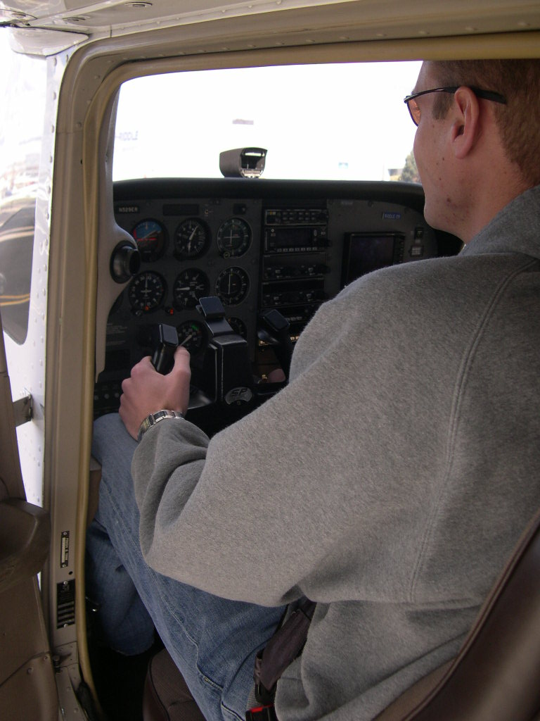
Who fits in a Cessna? Who can reach the controls?

Slide 53
Design Exercise
Eye Ellipse
Range of
Movement
Vertical
Adjustment
Horizontal Adjustment
Z = 0
Y = 0
X = 0
Range of
Movement
Heel Point
“H” Point

Slide 54
Design Exercise
Measure the fixed interior dimensions of the vehicle cockpit
Measure the range of movement of the seat, pedals and yoke / steering wheel
Obtain population segment lengths (use spreadsheet data and Drillis and Contini proportions if you wish)
Assume that the seat angles (seat pan and back rest) are fixed
Use a reference point at floor level at the front of the airplane
Develop an Excel spreadsheet model for the anthropometric and workspace dimensions
Create reach and fit tables for Male and Female 5th, 50th and 95th percentiles
Assess the population fit and reach proportions with the seat in the full forward / full rearward / full up / full down positions.
Discuss the model assumptions and shortcomings.
Discuss how anthropometric dimensions, cabin dimensions and seat adjustment ranges can affect the driver / pilot’s ability to safely perform required tasks.
Discuss how you would create a Three Dimensional Model
Check the literature (and car / airplane manuals) for recommended seated workplace dimensions

