Slide 1
Surface and Functional Anatomy for Ergonomics
Brian Peacock
for
Pitney Bowes Inc

Slide 2
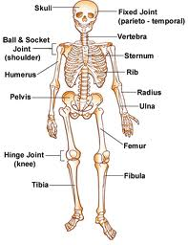

Slide 3
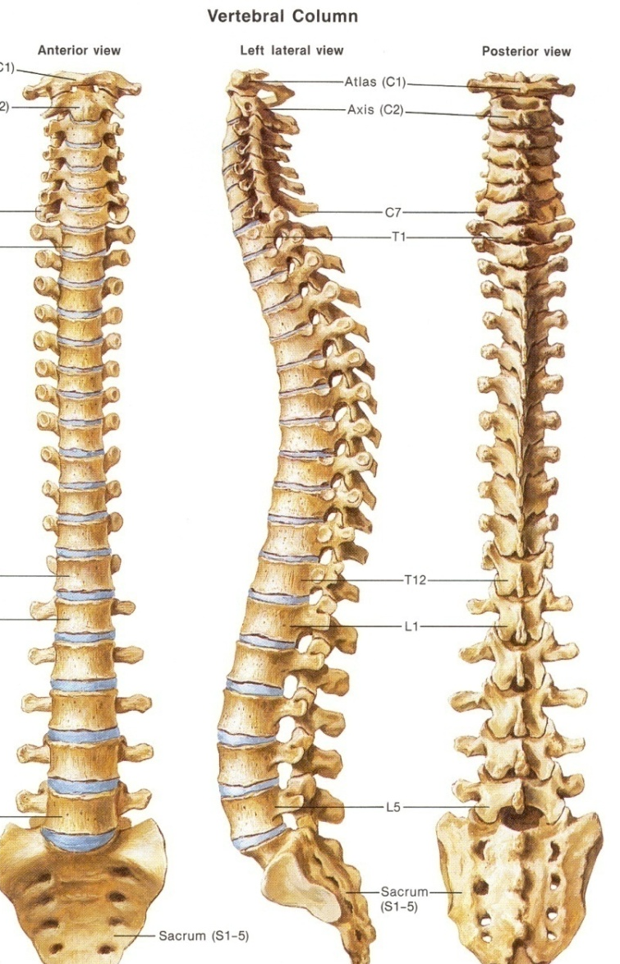

Slide 4
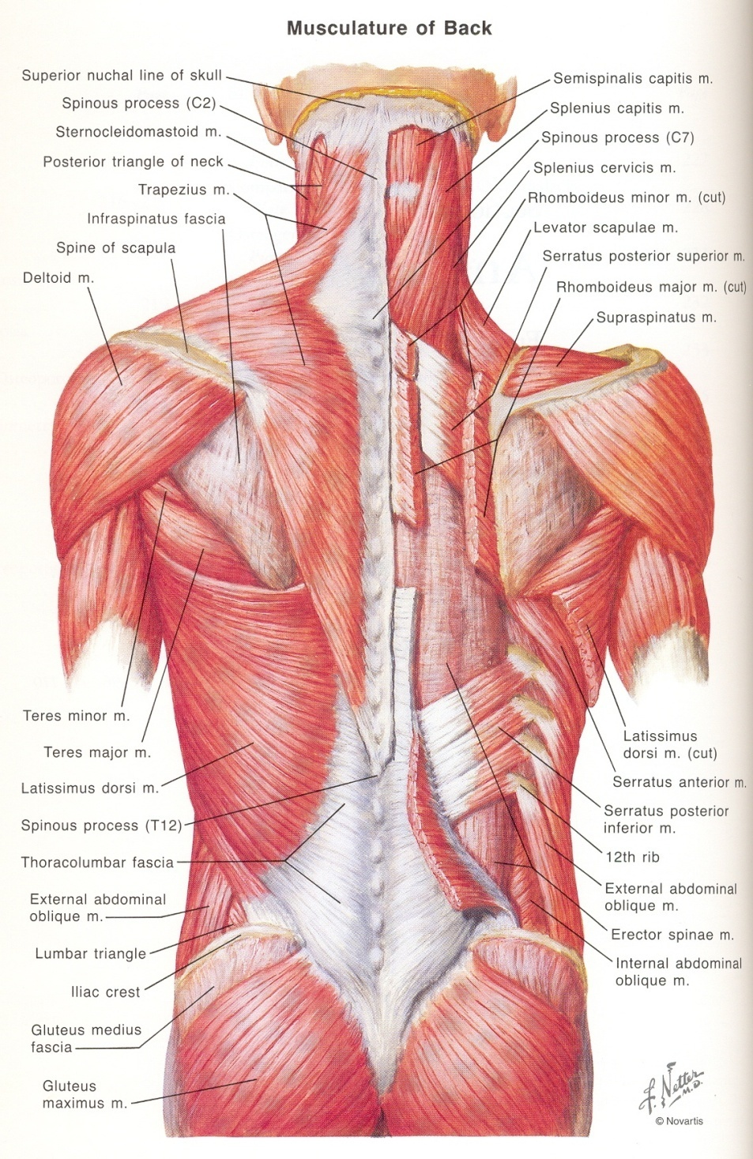

Slide 5
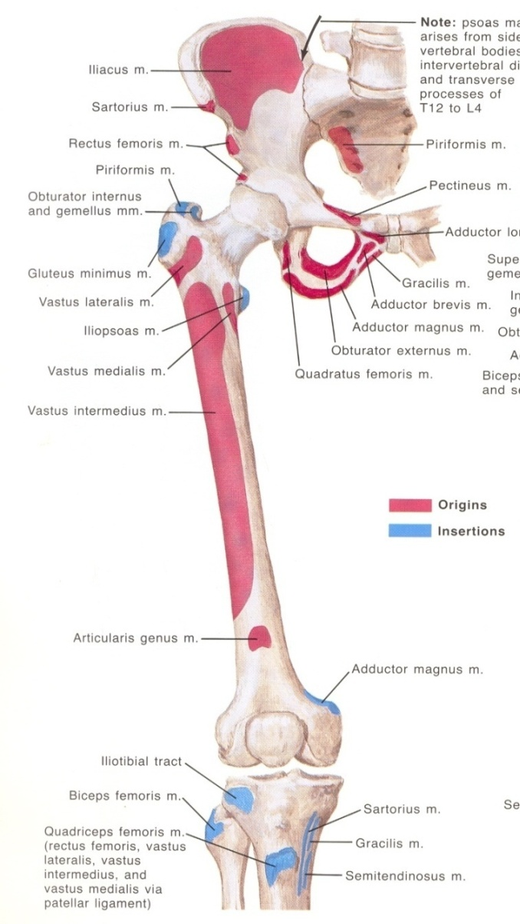
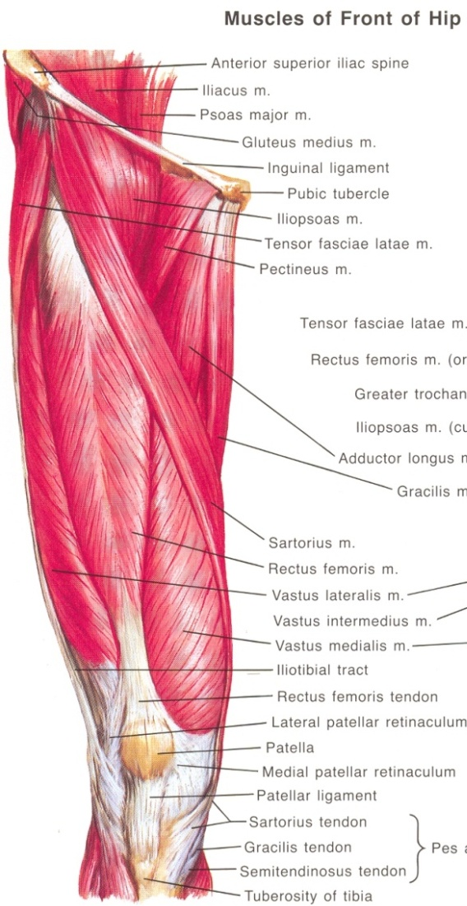

Slide 6
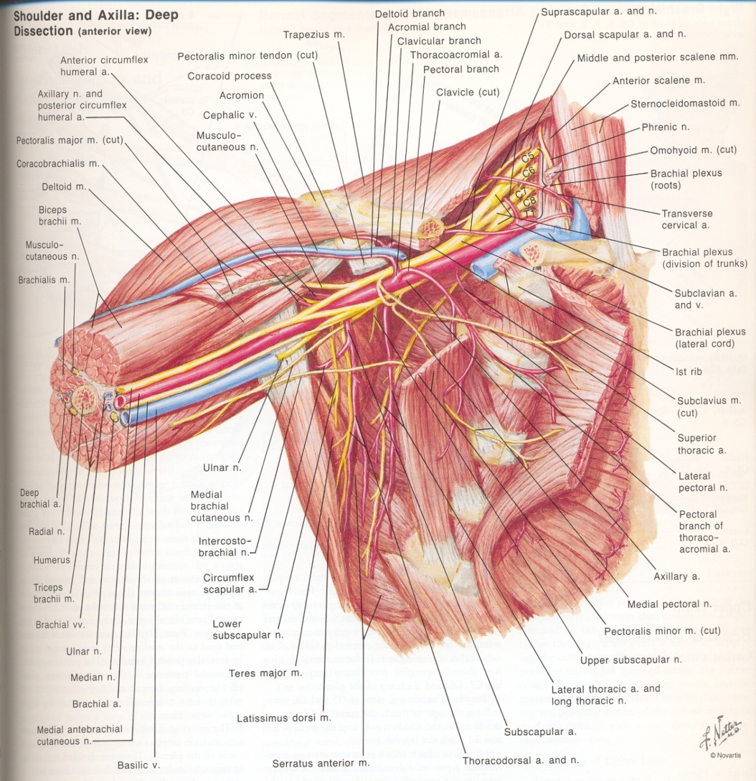

Slide 7
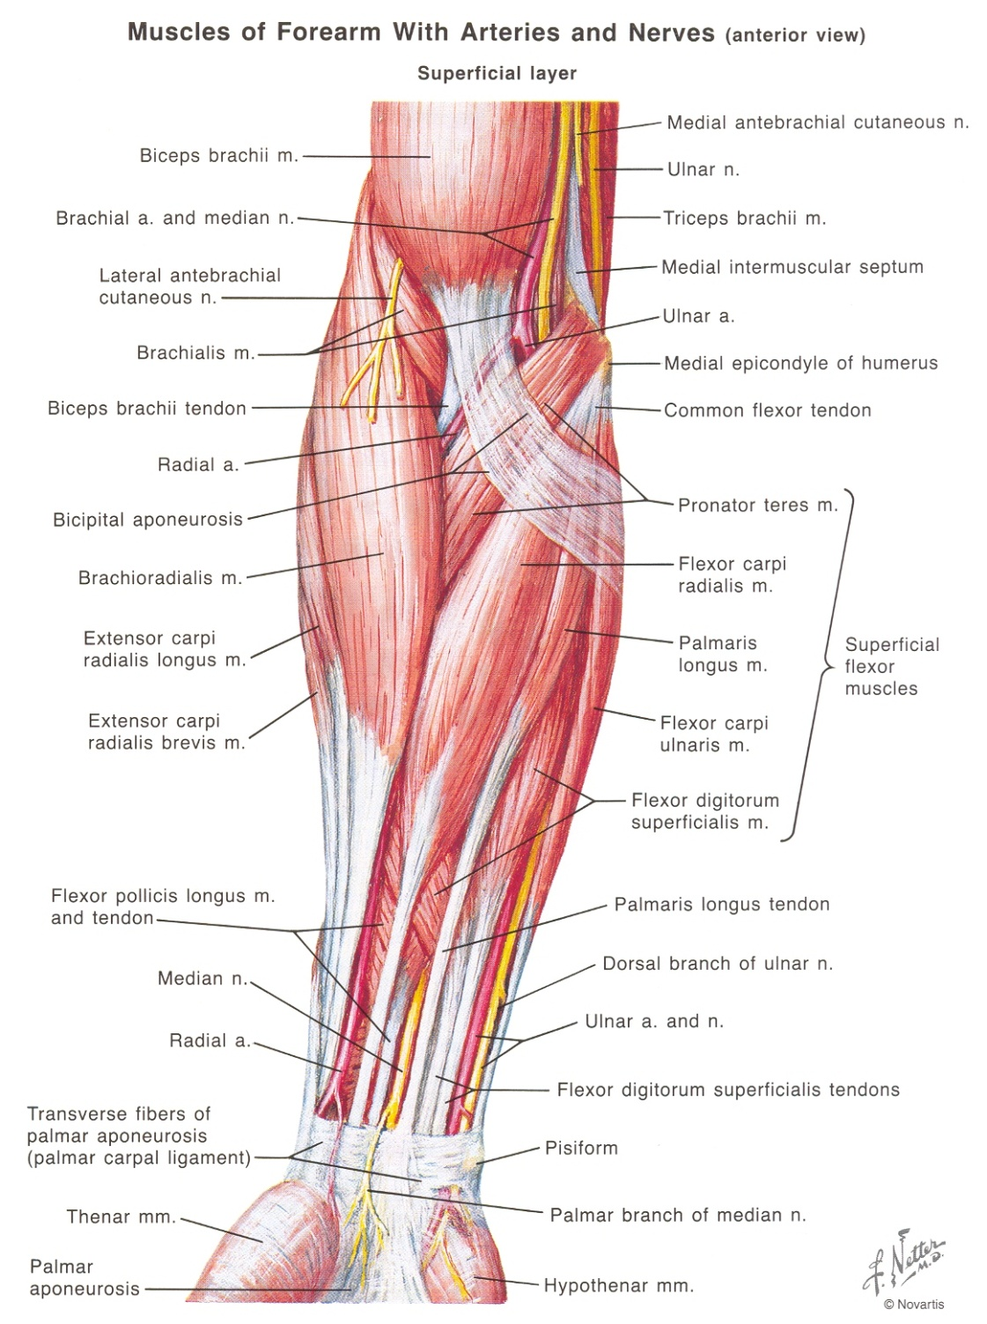
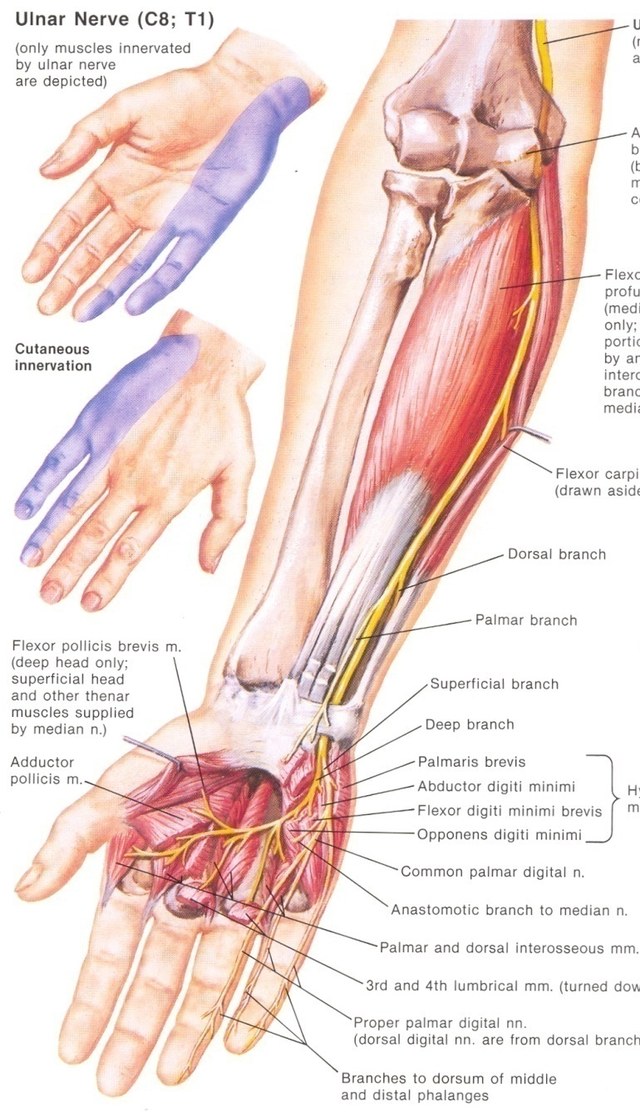

Slide 8
Functional Anatomy
Muscle contraction is Controlled by the Nervous System to Cause Coordinated Joint Movement
  Static – isometric
  Dynamic
    Concentric
    Eccentric
What happens when we jump ( and land) and walk up and down stairs?

Slide 9
How Muscles Coordinate
  Prime movers / agonists
    Do the work
  Antagonists
    Pay out slowly to prevent jerky movement
  Fixators
    Hold the proximal joint steady
  Synergists
    Prevent unwanted movement
Why do we rest our wrist when we wish to make fine finger movements as in writing?

Slide 10
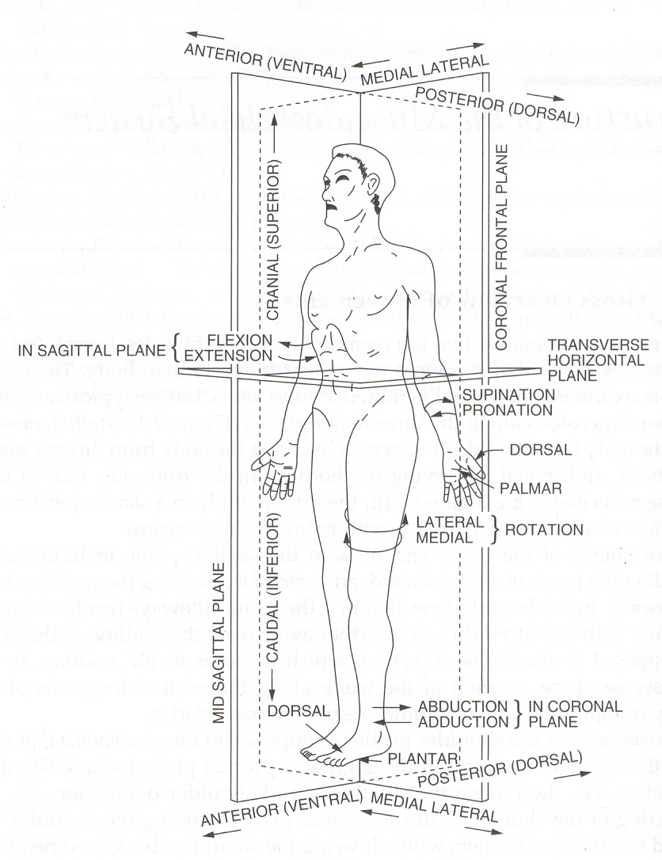
Planes of Motion
Flexion
Extension
Abduction
Adduction
Lateral Rotation
Medial Rotation
Circumduction
Sliding

Slide 11
Standard Movements
 | Plane of Motion | Notes
Flexion | Saggital | Hip, Shoulder, Wrist, Knee, Ankle, Spine
Extension | Saggital | Hip, Shoulder, Wrist, Knee, Ankle, Spine
Abduction | Frontal | Hip, Shoulder, Wrist, Carpo-metacarpal
Adduction | Frontal | Hip, Shoulder, Wrist, Carpo-metacarpal
Side Flexion | Frontal | Spine
Rotation | Spine | Horizontal
Medial Rotation | Horizontal | Hip, Shoulder, Knee
Lateral Rotation | Horizontal | Hip, Shoulder, Knee
Circumduction | All | Hip, Shoulder, Wrist, Ankle
Pronation | Horizontal | Forearm
Supination | Horizontal | Forearm
Inversion | Frontal | Ankle
Eversion | Frontal | Ankle
Opposition | All | Thumb
Sliding | All | Fingers, Toes, Spinal Facets

Slide 12
Range of Motion
Movement Type | Plane of Motion | Range of Motion
Flexion | Saggital
Extension | Saggital
Abduction | Frontal
Adduction | Frontal
Side Flexion | Frontal
Rotation | Spine
Medial Rotation | Horizontal
Lateral Rotation | Horizontal
Circumduction | All
Pronation | Horizontal
Supination | Horizontal
Inversion | Frontal
Eversion | Frontal
Opposition | All
Sliding | All
Demonstrate these movements

Slide 13
Most muscles pass over two joints
Therefore the position of one joint often affects the range of an adjacent joint
  Knee and Hip
  Wrist and Fingers
Try some movements

Slide 14

But Joints don’t normally work in Standard Planes!!!!
Most movements involve multiple joints
Most movements involve rotation
Watch Tai Chi
Typical patterns involving the shoulder and hip, but the trunk also participates.
  Flexion-Adduction-Lateral rotation – eating, pushing
  Flexion-Adduction-Medial Rotation – throwing
  Flexion-Abduction-Lateral rotation - pulling
  Extension-Abduction-Lateral rotation - pulling
  Extension-Adduction-Medial rotation – pulling
  Etc
  You describe some everyday functional movements and the motion of each contributing joint

Slide 15
Walking
(On the level and up and down stairs)
Flex
Extend
Knee Angle
Draw an angle – time diagram
Time

Slide 16




Gripping
(Full Hand, Finger and Thumb)

Slide 17
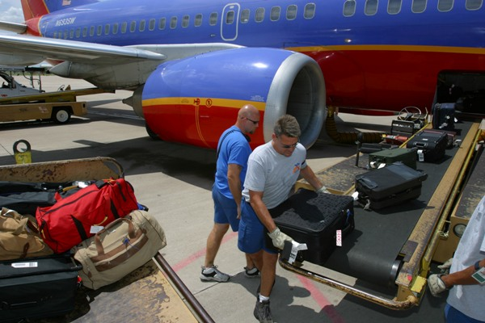
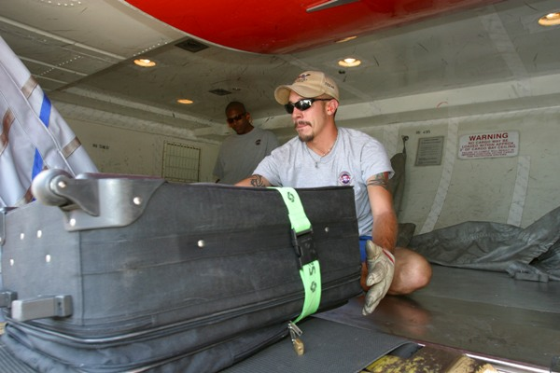
Lifting
(Knees Bent and Knees Straight)
What happens when you lift with your knees straight or with them bent?

Slide 18
Working Overhead
How long can you hold a heavy weight above your head? What happens? Why?

Slide 19
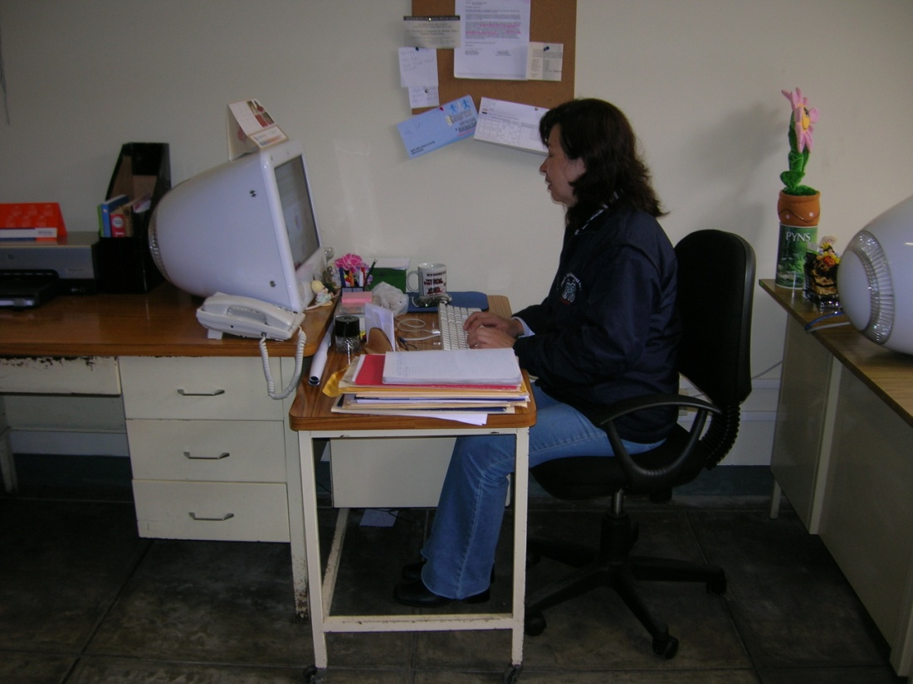
Typing
All we’re trying to do is get our hands and eyes in the right location, but what happens to the rest of our body? What is the answer to this world wide problem?

Slide 20
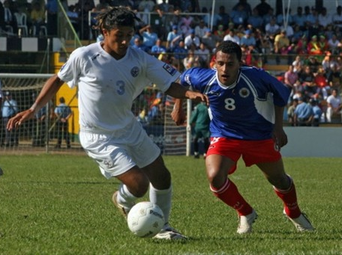
Demonstrate:
Prime movers, antagonists, fixators and synergists
Kicking
Lifting
Grasping

