Slide 1
Train The Trainer OH Masterclass For Ergonomics: Medical Management of Work Related Cumulative Trauma Disorders Prof. Brian Peacock

Slide 2
Management Plan
Periodic workplace walkthrough
Symptoms questionnaire
Identification of restricted duty Jobs
Analysis of official records
Appropriate medical care
Record keeping
Periodic program evaluation
Employee training and education
Discuss each of these steps in a medical management program; describe the processes and the tools

Slide 3
Pathophysiology
Inflammatory reaction of muscles, tendons, tendon sheaths, bursae, fascia
Most commonly at interfaces between
Bone – tendon
Muscle – tendon
WRMSDs usually involve these anatomical structures; identify a number of common injury sites

Slide 4
Pathophysiology
CTD, RSI, WRMSD
Inflammatory reaction of nerves, muscles, tendons, bursae, ligaments and / or fascia
Compression and shearing at bone interfaces
Force and velocity
Pressure – distribution of stress
Thickening, fibrocyte formation, fibrosis
Static loads
Cumulative local fatigue
Lactic acid build up
Diminished circulation – insufficient replenishment / recovery
Repeated / sustained stress over days, weeks, months, years
Discuss and describe these causes and physiological / pathological responses

Slide 5
Cumulative Trauma Disorders
Sustained Exertions or Mechanical Stresses
Not an exact diagnosis
A general class of ailments
Often work related
May be hobby related
Variable symptoms reporting thresholds
Discuss the complexity of causes of these disorders

Slide 6
Work-relatedness of musculoskeletal disorders
Enumerated by CDC/NIOSH in 1997
Multifactorial
May occasionally be difficult to identify a condition as work-related
Diagnoses of health-care provider used as an indicator
carpal tunnel syndrome – 33% work-related
tendonitis – 28% work related
How would you investigate the “work relatedness” of these disorders?

Slide 7
Common Forms of CTDs
Bursitis
Rotator Cuff Syndrome
Carpal Tunnel Syndrome
Cubital Tunnel Syndrome
De Quervain’s Disease
Epicondilitis (Tennis and Golfers elbow)
Low Back Strain
Pre patellar bursitis (Carpet Layers Knee)
Trigger Finger
Tension Neck Syndrome
Describe, from your previous course module, these disorders. Check your descriptions by search on the Internet.

Slide 8
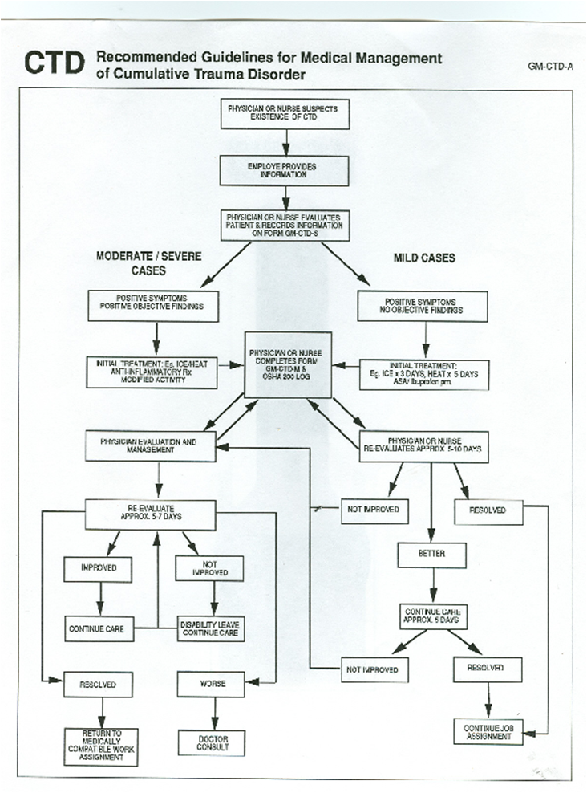
Discuss the process by which the medical community should deal with a WRMSD

Slide 9
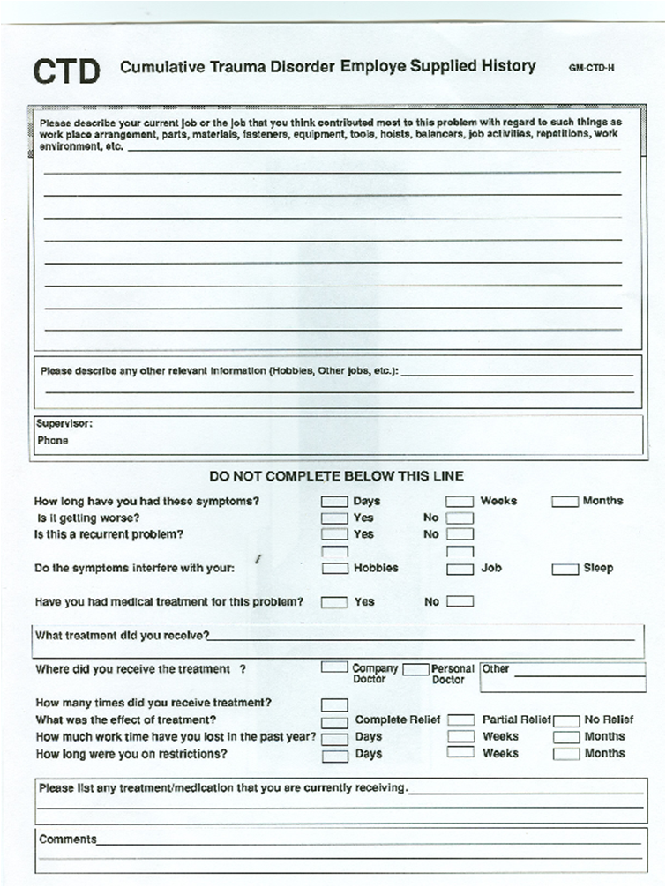
First the patient describes his or her symptoms and the possible causes, then the medical practitioner explores the history
Discuss each of these elements of the history gathering process

Slide 10
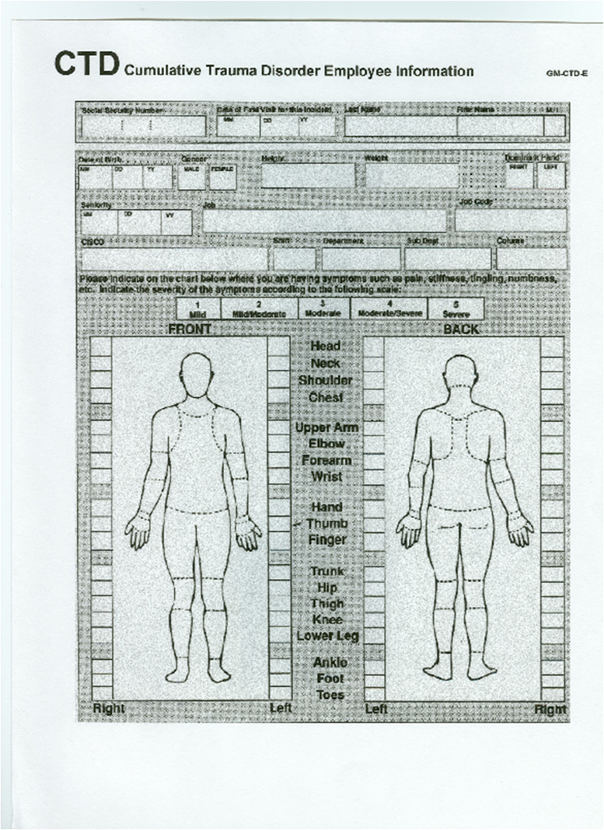
The patient identifies the location and intensity of the pain / discomfort on this symptoms questionnaire
Use this form to identify the sites of common cumulative trauma disorders

Slide 11
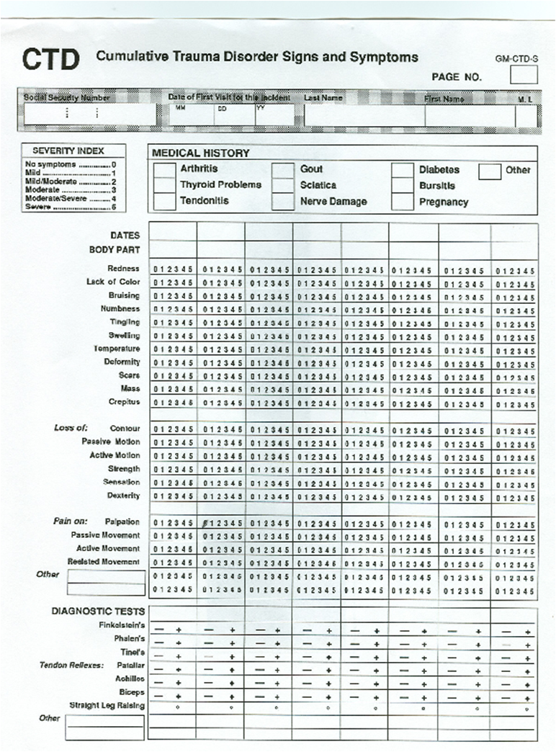
The medical practitioner records the medical history, the occurrence and level of severity of the symptoms and signs and the results of standard diagnostic tests. These observations are repeated on subsequent visits.
Discuss each of these elements of the history gathering process

Slide 12
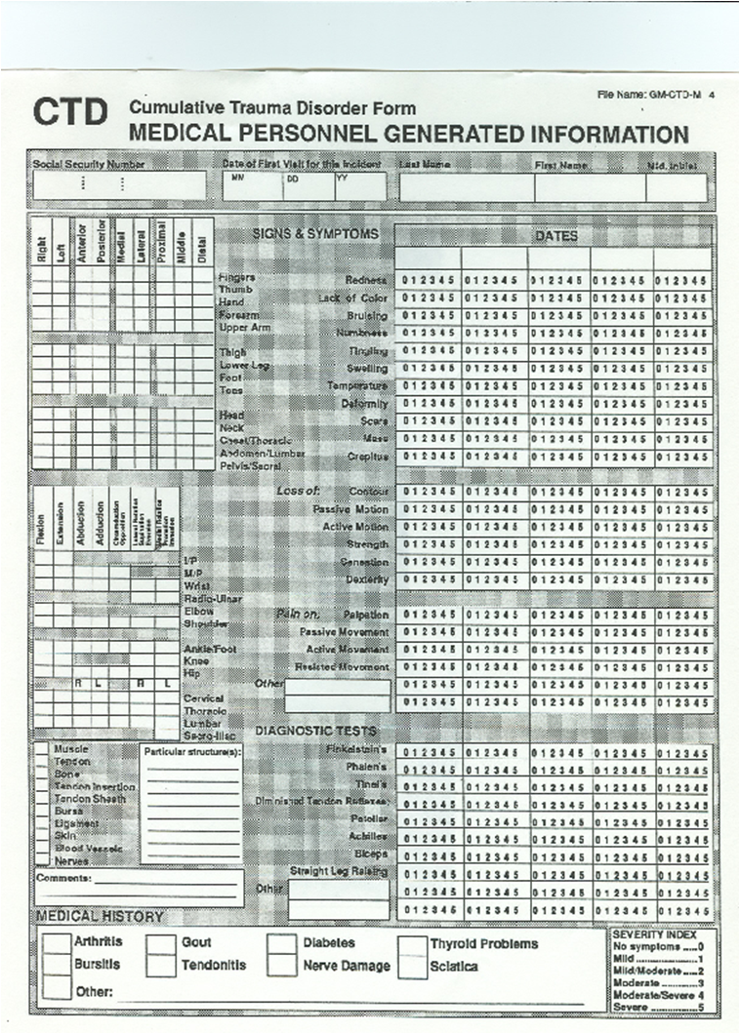
The medical practitioner records greater detail of the signs and symptoms, and diagnostic tests.
Use this form to describe some cumulative trauma disorders

Slide 13
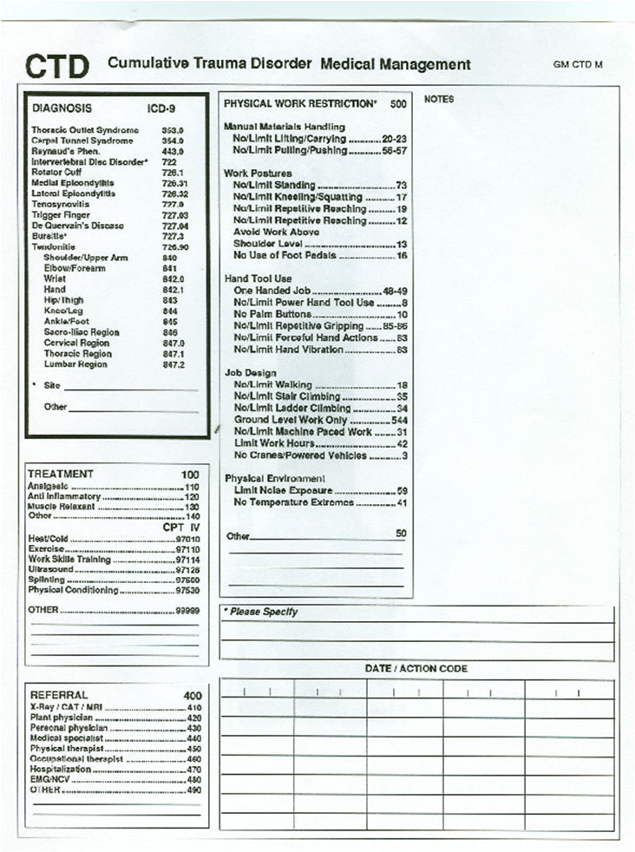
The medical practitioner provides a diagnosis, prescribes a course of treatment / referral and identifies specific work restrictions.
Identify the treatment / physical work restriction for a selection of cumulative trauma disorders

Slide 14
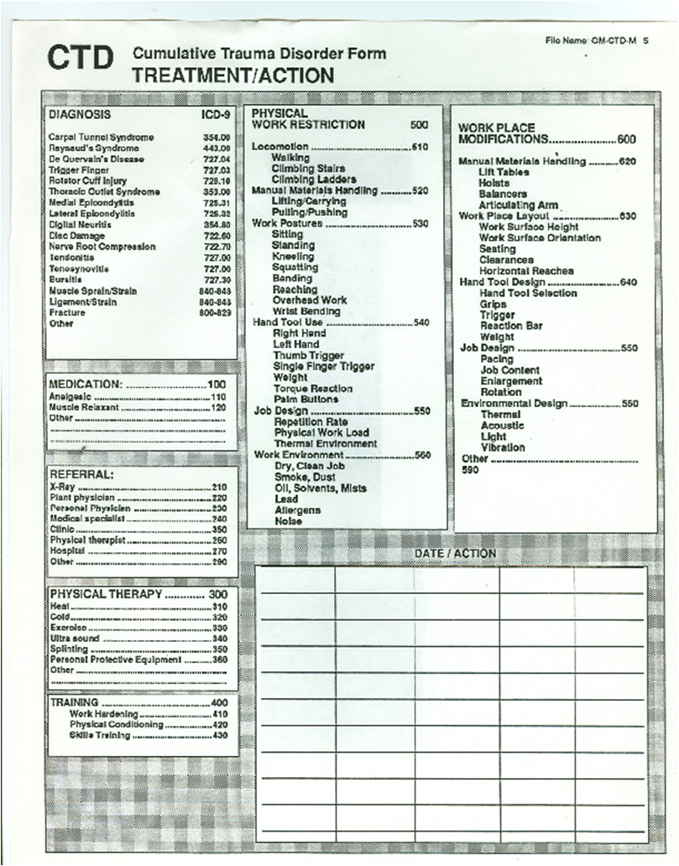
The medical practitioner provides greater detail of diagnosis, treatment work restriction and suggestions for workplace modification
How would you implement the suggested work place modifications and work restrictions?

Slide 15
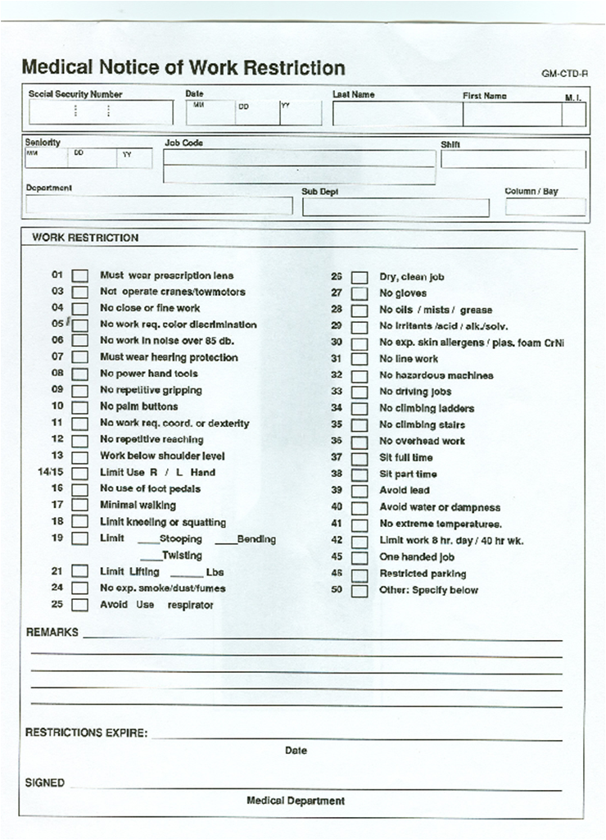
The medical practitioner communicates the required work restriction to the patients supervisor
How would you implement these workplace restrictions?

Slide 16
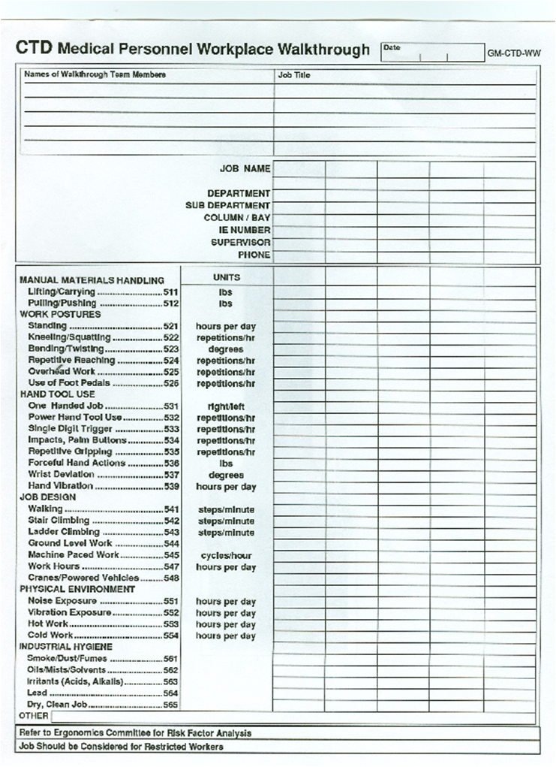
Periodically the medical practitioner walks trough the workplaces, identifies the task demands and discusses these risk factors with the supervisor or ergonomics practitioner
Describe how you would walk through a workplace with a medical practitioner and describe the CTD risk factors

Slide 17
The Medical Management Process
In practice the medical management process is considerably simpler than this although each step occurs either explicitly or implicitly.
This process provides a training tool for occupational medical practitioners, therapists and ergonomics practitioners
Develop a simpler / leaner medical management process for WRMSDs

