Slide 1
Train The Trainer OH Master Class For Ergonomics: Shiftwork Professor Brian Peacock

Slide 2
Industry
Transportation
Assembly
Public Utilities
Security
Police
Fire
Ambulance
Hospitals
Utilities
Transportation
Food
Maintenance
Military
Space operations
Etc
Discuss the experiences of someone you know that does shift work

Slide 3
Reasons for Shift work
To meet customer requirements
Greater resource / facility utilization
Lower tooling costs
Increased profits
Reduction of management and support staff
Discuss, with examples the reasons for shift work

Slide 4
Organizational Factors
Production demands
Personnel availability
Support services
Transportation
Discuss the various organizational factors that are associated with shift work

Slide 5
Production
Productivity
Fatigue – lower physical / cognitive / motor performance
Increased error – error correction
Quality
Attention / vigilance decrement
Inspection performance
Increased error / uncorrected defects
How does shift work affect productivity and quality? Give some examples

Slide 6
Maintenance
Access to production equipment
night / third shift
Breaks between shifts
Weekends
Discuss, with examples, and describe the relationship between production and maintenance operations and the implications for shift work.

Slide 7
Management
Materials supply – JIT
Personnel
Supervision
Support services
Security, food, supervision, materials
Communication between shifts
Changeover
Overlap, especially supervision
What are the management / organizational implications for shift work?

Slide 8
Transportation
Parking lots and changeover
Driving during physiological “low”
(Avoid) Fighting peak hour traffic
Public transportation availability
Distance / time
Mode of transport (public , personal)
Crowding
Flex time
Competition with regular daily demands
Discuss and describe the personal and public transportation implications of shift work

Slide 9
Support Services Planning
Food
Medical
Counseling, family support
Supervision
Transportation
Materials
Maintenance
Security
Financial
How would you plan the support services for shift work?

Slide 10
Individual considerations
Volunteers
Seniority
Training
Task assignment
Consider total person issues
Transportation, domestic, social
“Moonlighting” – two jobs
What factors should be considered from the individual viewpoint?

Slide 11
Employee Preference
Vary
Some people like the night shift
Less supervision
Domestic and social factors very importatnt
Wage premiums as incentive
Allow volunteers for night shift
Avoid fighting the Zeitgebers
Why does people chose jobs that involve shift work? What are the incentives / constraints?

Slide 12
Research methods
Surveys, Focus groups
Questionnaires
Performance / output measures
Productivity, quality, health and safety
(Sleep) Laboratory research
Epidemiology
How would you investigate shift work from the operational and individual viewpoints?
Discuss and describe in detail the methods you would employ.

Slide 13
Field Studies
Production / Performance
Quality / Safety
Physiological measures
Body Temperature
Critical Flicker Fusion Frequency
Subjective measures
Sleep quantity, quality
Activity diaries
Discuss the methods that could be employed in field studies of shift work

Slide 14
Circadian Rhythms
Cyclical, quantitative physiological changes that occur over a 24 hour period
Temperature
Heart rate
Blood pressure
Metabolism
Pain tolerance
Response to drugs / medicine
Blood and urine constituents
Develop a diary of your own Circadian rhythms and link it to activities such as sleep, meals and work

Slide 15
Human Effects
Performance
Fatigue
Accidents, errors increase
Attention
Behavior
Supervisory climate
Relaxed behaviors
Health
Short term sleep disruption
Long term physical, digestive, cardiovascular illness
Psychological illness / mood swings
Satisfaction
Conflicts with domestic / social activity
Explore, discuss and describe the experiences of someone you know who does shift work

Slide 16
Zeitgebers
Internal clock and External Drivers
Light / dark cycles
Social, Domestic and Work activities
Meals
Exercise routine
Sleep habits
Look up the definition of a Zeitgeber. Describe how the different drivers of the sleep / wake cycle have their effects

Slide 17
Biological Rhythms
Body temperature, heart rate, blood pressure, excretion patterns coincide with sleep / activity cycle
Higher physical activity during day
Slow adaptations with rotating shifts
Develop a personal diary of your daily activities and the biological parameters

Slide 18
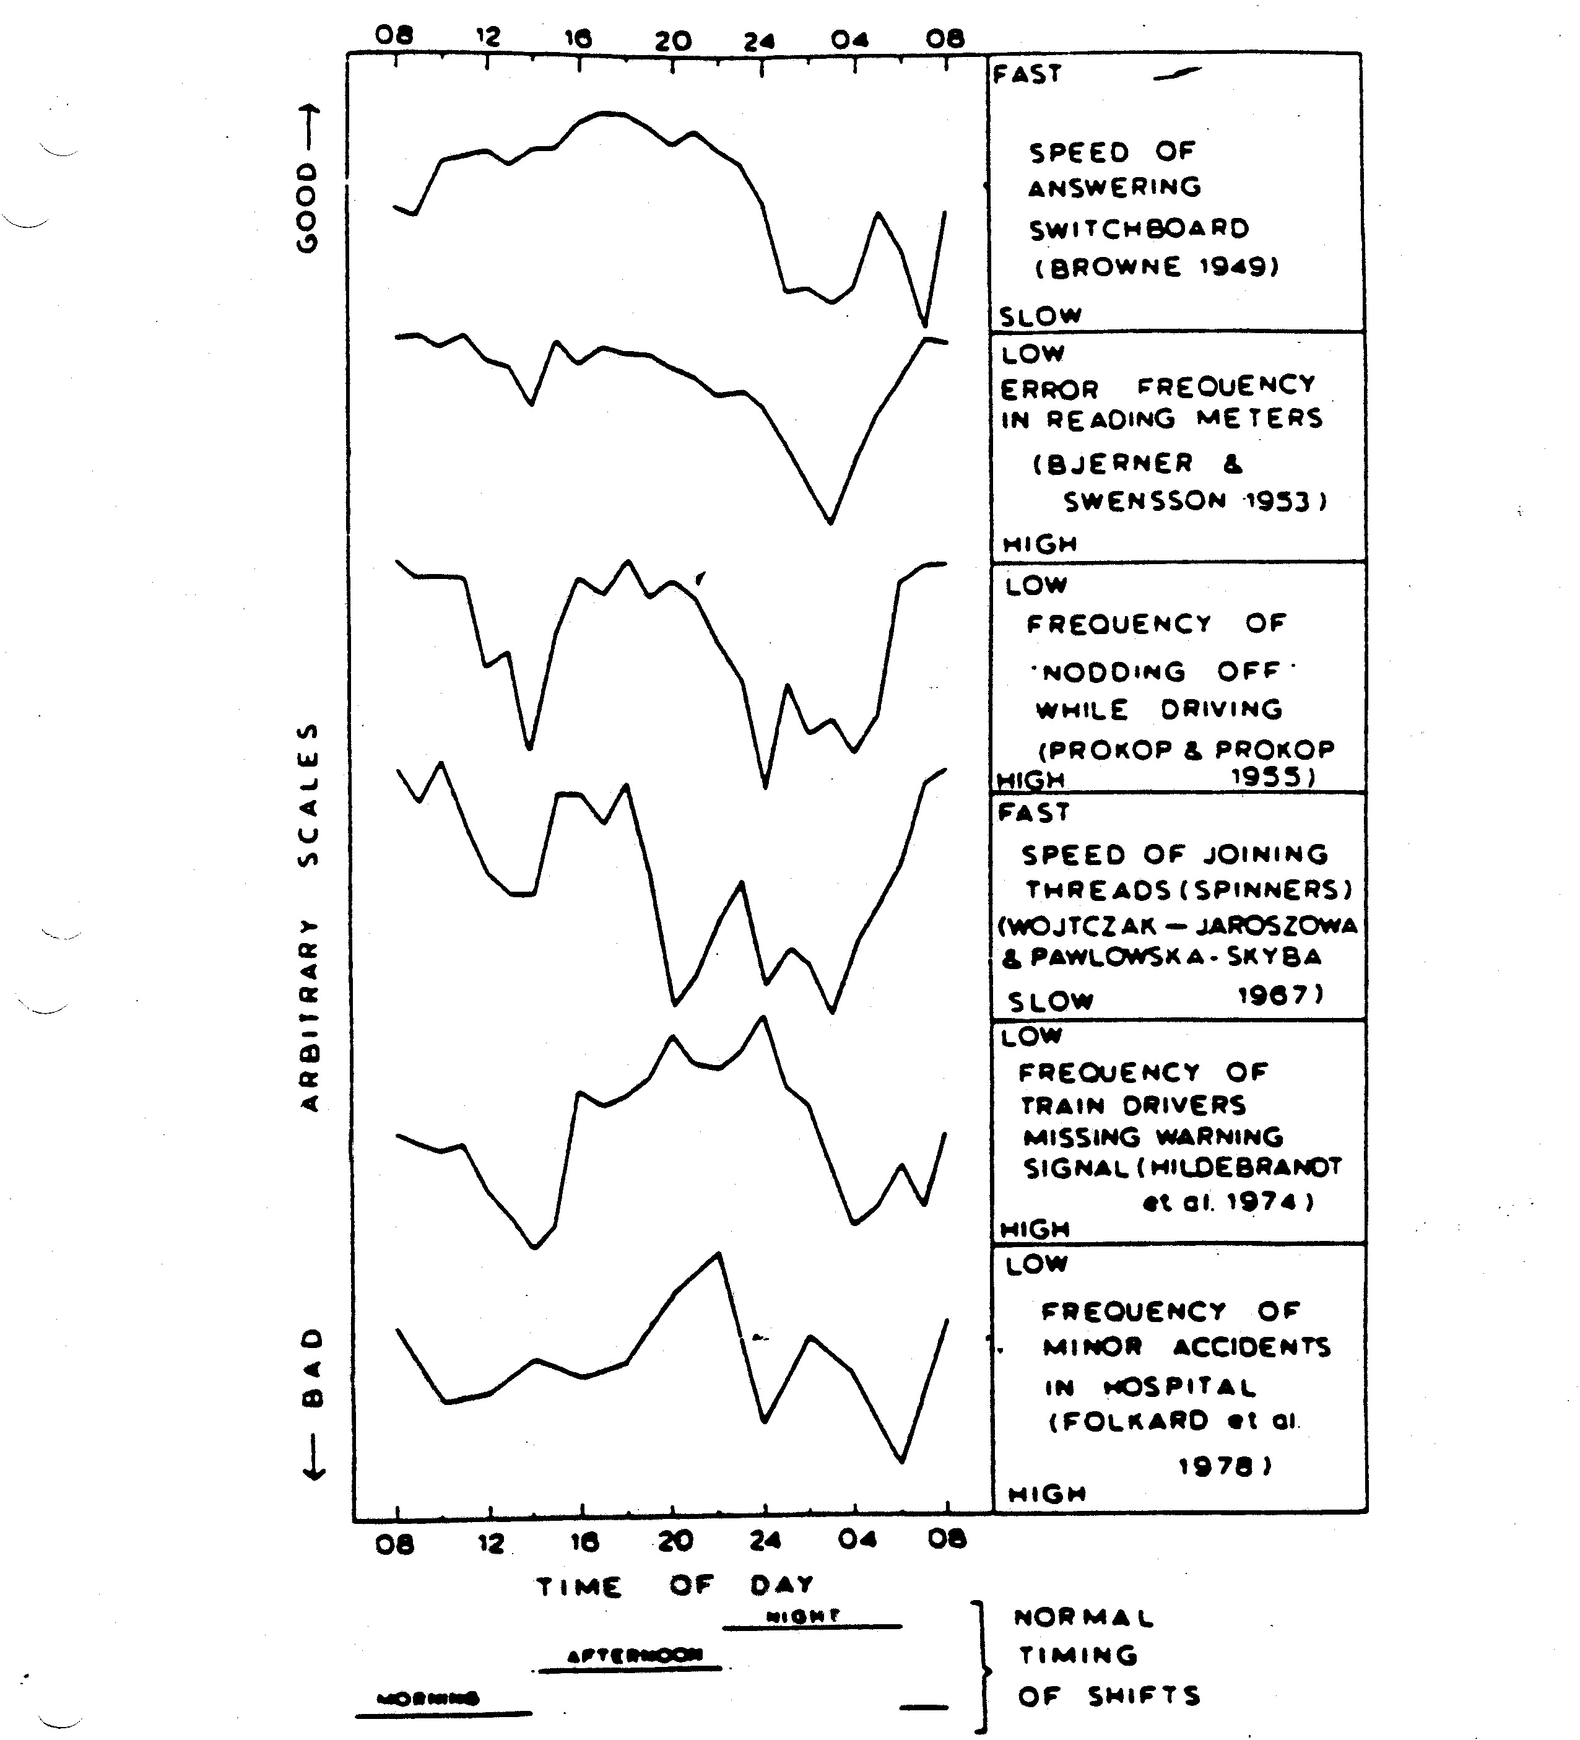
Performance
Permanent shifts show less performance decrements
Attention, memory, decision making
Rotating shifts show performance and health and safety decrements
Describe some arrangements for permanent, semi permanent and slow and fast rotating shift systems

Slide 19
Sleep Patterns
Biological clock disruption
Sleep loss / duration
Sleep quality
Meal times
All affected by zeitgebers
Light, family
Add these factors to your diary

Slide 20
Sleep Loss and Health Effects
Sleep is an important physiological / psychological need
Lack of sleep causes fatigue, but recovery is quick given opportunity to sleep later
Chronic sleep loss and fatigue lead to physical, behavioral and psychological disorders
Digestive disorders high among shift workers
“Nervous” disorders – depression etc higher
Chemical dependence – alcohol
Social and domestic strain may compound biological strain
Explore the topic of sleep and sleep disorders

Slide 21
Circadian Rhythms
Document your own oral temperature variation over the day / night cycle

Slide 22
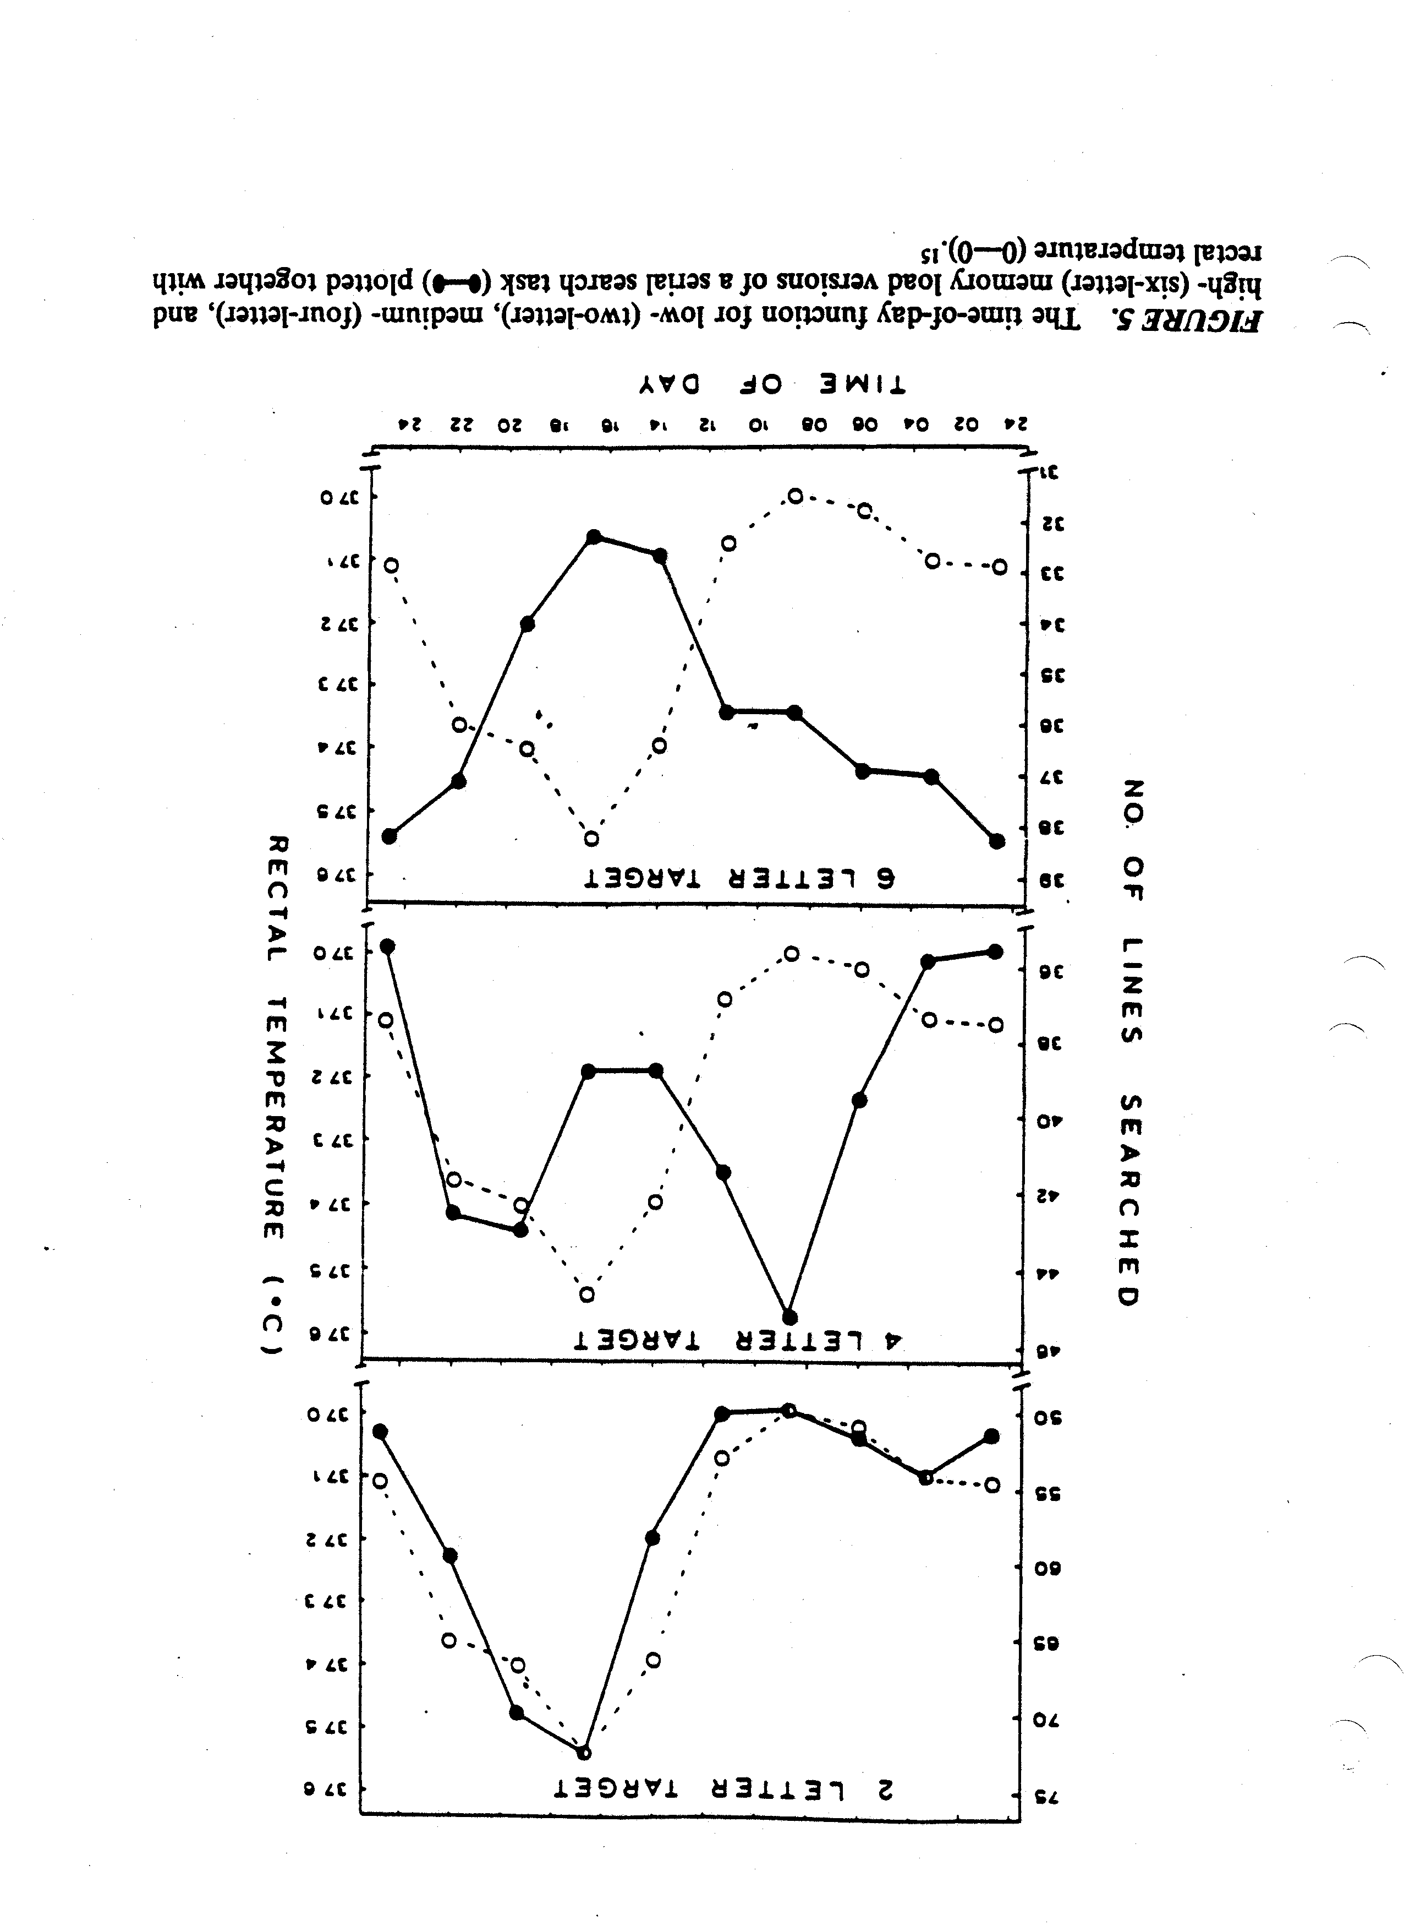
Memory Tests
Discuss how you would apply a memory test to shift workers

Slide 23
Subjective Alertness
From your own diary discuss the relationship between body temperature and subjective alertness

Slide 24
Inversion of Circadian Rhythms
Complete inversion requires a few weeks
Does not occur if not synchronized with Zeigtgebers
Inversion disrupted by light, noise, family and social activity
Partial inversions with 4 – 7 day cycles
Biological rhythms “flatten”
Discuss your experience with intercontinental travel.
How long did it take you to adapt? Readapt?

Slide 25
Adjustment
Biological rhythms take 2 – 3 weeks to completely invert
Adjust sleep patterns gradually where possible
Keep meal times regular – strong biological rhythm drivers
Third (night) shift should change meal patterns
Develop a guide for shift workers

Slide 26
Personal Factors
Large individual variation in adaptation / tolerance
“Morning” and “Night” persons
Morning types have greater adaptation problems
Age – older people adapt more slowly
Health – existing illnesses exacerbated
Are you a “night” or a “morning” person?
Compare your experiences with those of your colleagues

Slide 27
Performance
Physical strength, reaction time, dexterity correlated with biological rhythms
Baddeley Grammatical Reading Test correlated with biological rhythms
AB
A is not preceded by B
T / F
Describe the process of Baddeley’s Grammatical Reasoning test.
Discuss this test as an indicator of job performance.

Slide 28
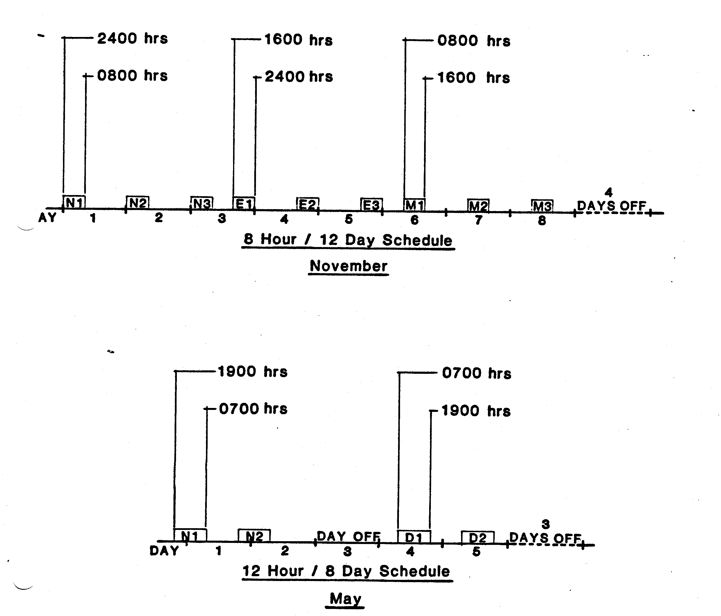
Case Study 8 H /12 D and 12 H / 8 D
Police Service
These charts describe the actual timings of the shift work plan before and after a change.
Map out some similar shift schedules

Slide 29
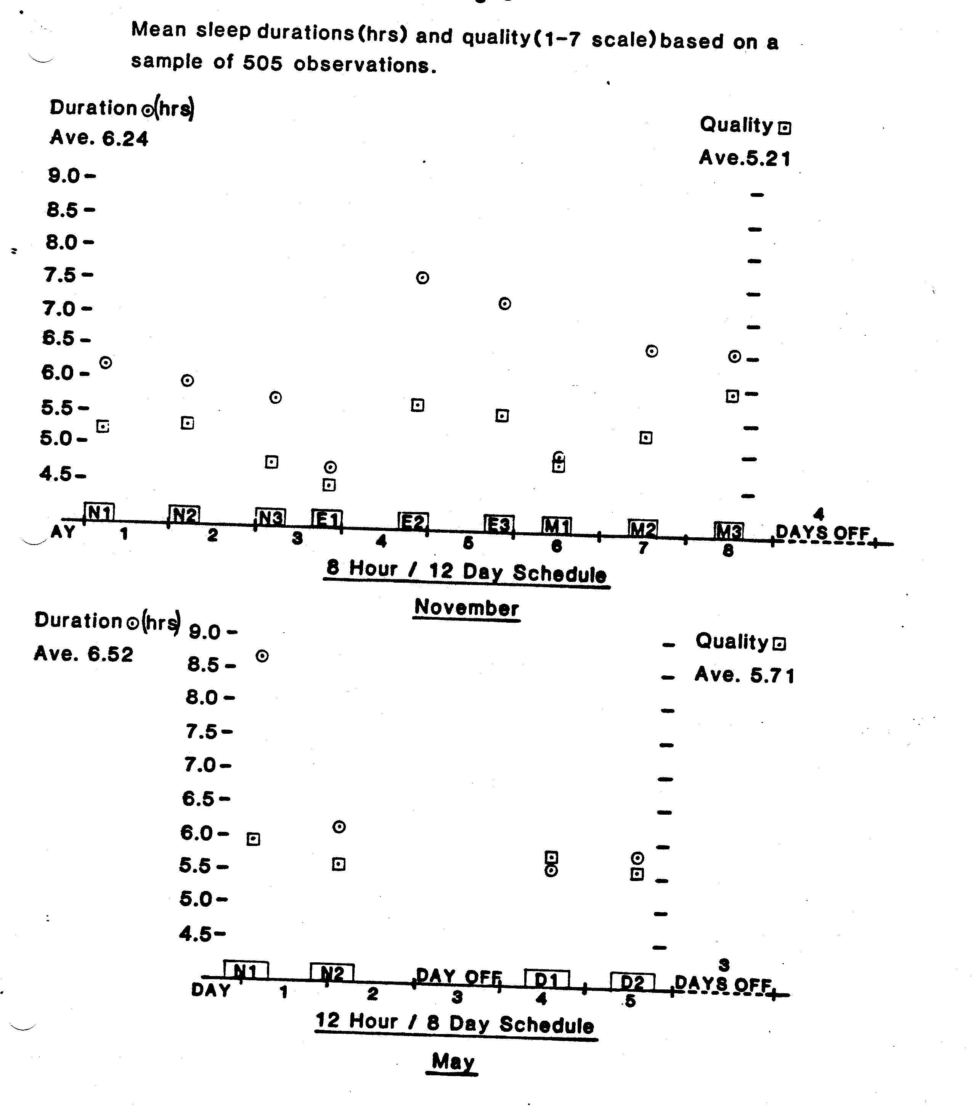
Sleep Duration and Sleep Quality
Discuss these observations
of sleep quality and duration before and after the schedule change

Slide 30
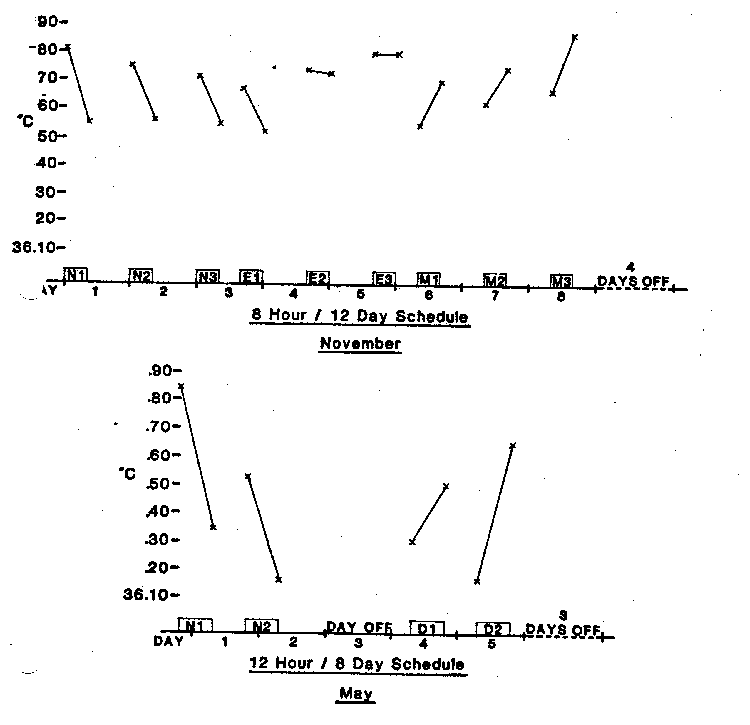
Oral Temperature
These graphs represent body temperature at the beginning and end of each shift in the old and new schedule

Slide 31
Critical Flicker Fusion Frequency
The rate of flicker at which a person perceives a light as continuous
CFF approximately 40Hz
Individual variation
CFF 10% lower with fatigue
ie CFF = 35Hz
CFF is cyclical – higher in morning than evening
Correlated with other biological rhythms
CFF indicates level of alertness / information processing ability
CFF can be used to indicate a person’s tolerance / adaptaptation to shift rotation

Slide 32
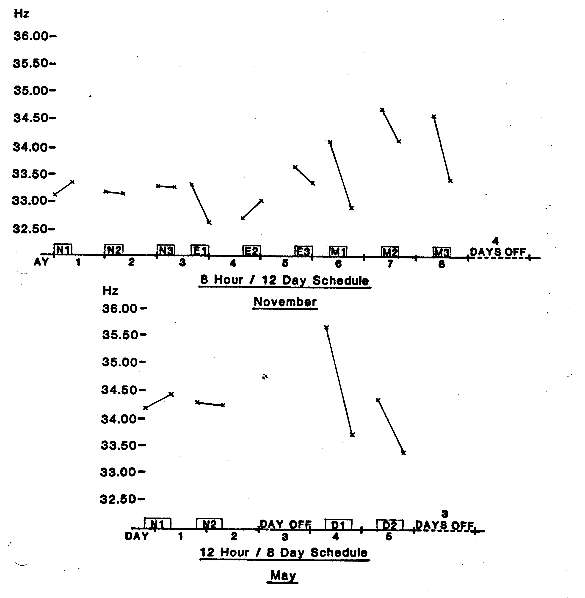
Critical Flicker Fusion Frequency
Critical Flicker Fusion Frequency at the beginning and end of each shift before and after the shift schedule change

Slide 33
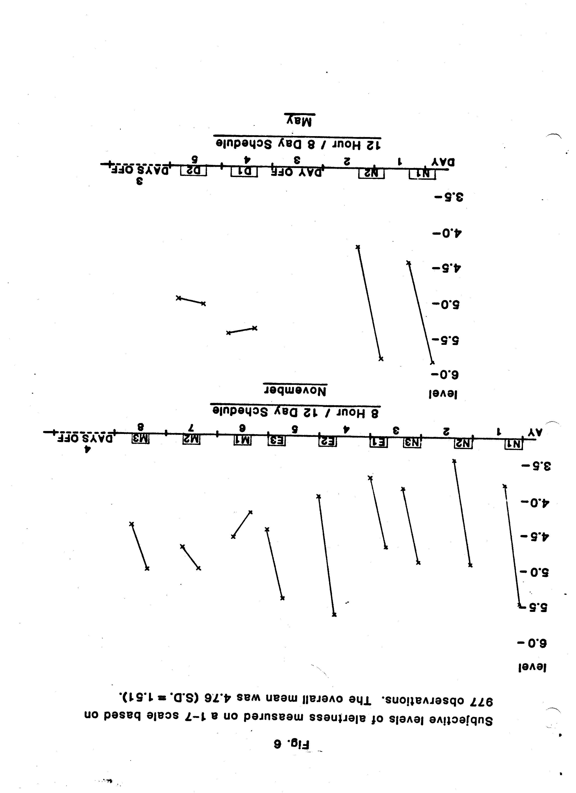
Subjective Alertness
Subjective alertness before and after each shift

Slide 34
Adaptation
Large individual variation
Some people do not adjust well – especially “Morning” people and older people
Good general health / physical fitness helps
Note that performance / productivity / quality suffers during adaptation period
How would you help people to adapt to shift work or changes within a shift cycle?

Slide 35
Monitoring
Health and Safety
Medical surveillance
Productivity
Quality
Mood / behavior
Personal preferences
It is necessary to monitor shift workers from the health, medical, subjective, social and performance viewpoints. How would you implement a monitoring system?

Slide 36
Shift System Design
Shift work is bad for a body!
But necessary for many reasons
Permanent shifts least disruptive
Or use 1 month rotations
Short cycle less disruptive than 1 week cycle
Minimize consecutive nights
1 or 2
Include days off
Keep system simple
Consider worker preferences
There are good and bad schedules.
Discuss these strategies for different shift work applications

Slide 37
Alternative Shift Formats
Permanent shifts
Very slow rotation – 3 – 6 months
Biological rhythms invert
Slow rotations – one month
Biological rhythms flatten
Avoid 1 week rotations
Saturn (fairness)
“Chase the sun” – forward rotation
Day to Evening to Night
There are good and bad schedules.
Discuss these strategies for different shift work applications

Slide 38
4 crew (A, B, C, D) 3 Shift (M, A, N) Rapid Rotation Pattern
Shift /Day | 1 | 2 | 3 | 4 | 5 | 6 | 7 | 8 | 9 | 10
Morning 0600 - 1400 | A | A | D | D | C | C | B | B | A | A
Afternoon 1400 - 2200 | B | B | A | A | D | D | C | C | B | B
Night 2200 - 0600 | C | C | B | B | A | A | D | D | C | C
Off | D | D | C | C | B | B | A | A | D | D
There are many variants of shift systems, some better than others!

Slide 39
Shiftwork Homework
Personal diary
Activities, meals, sleep, temperature, subjective measures
Shift work planning
McDonalds, Police, Security, Transportation, Emergency room, Utilities, Manufacturing etc – your choice
Short (2 – 3 days), medium (7 – 10 days) and long (> 4 weeks) rotations
2, 4, 8, 10, 12, 24 hour shift durations
2,3,4 crews
Production, maintenance / support, management
Commuting, food and other support services
Social and domestic constraints
Develop annotated spreadsheet for at least 3 different systems
Explain your reasons
Consider the physical and cognitive demands of the job
Consider social, domestic, transport, meal etc factors

Slide 40
Conclusions
Shift work is bad for a body
Shift work is necessary
Some patterns are better than others
Need t monitor performance, health, satisfaction

