Slide 1
Train The Trainer OH Masterclass For Ergonomics: Socio Technical Systems Professor Brian Peacock

Slide 2
Socio Technical Systems >>> Macroergonomics
Large scale systems may fail because of failure to consider the multiple requirements of multiple stakeholders
There is a long history of serious failures and efforts to include stakeholder requirements in the design process
Even contemporary systems managers often argue that the cause of failure is failure “to educate or train the user”
A “system” may be developed through many stages, each with different stakeholders and their different requirements
Consider a public transport system (trains, boats, buses or airplanes), describe all the stakeholders – managers, vehicle manufacturers, passengers, maintainers, other road users etc.
How do transportation systems fail?
What defines success or failure for the different stakeholders

Slide 3
Multiple Purposes / Requirements of Design
Effectiveness
Meets functional requirements
“quality”
Efficiency
Optimal use of resources
“productivity”
Ease of Use
Intended users
Comfort and Convenience
Prevention of misuse
Elegance
Esthetic / emotional appeal
Affective Design
Safety
Prevention or mitigation of system failures
For participants and third parties
Security
Inadvertent or malicious misuse
Satisfaction
Of ALL customers and stakeholders
Sustainability
Reliability
Under intended contexts over the life cycle
Resilience
Under unintended, unexpected and harsh conditions
E4S4
There WILL be tradeoffs
A system may fail on any one or more of these purposes
Compare and contrast public transport systems on each of these criteria

Slide 4
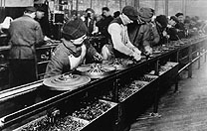
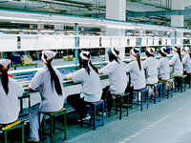
Henry Ford (1913) The Production Line
1913
2013
“Bring the work to the worker”, eliminate wasteful activity; enormous increases in productivity
Search the Internet for production or assembly lines
Discuss how production lines improve productivity

Slide 5
Frederick Winslow Taylor (1856 – 1915)
Standardized Work
Man is a rational economic animal concerned with maximizing his economic gain;
People respond as individuals, not as groups
People can be treated in a standardized fashion, like machines
The implications
The main form of motivation is money linked to output (piece work)
A manager's job is to tell employees what to do
A worker's job is to do what they are told and get paid accordingly
Discuss the motivation to work
Was Taylor right?

Slide 6
Frank and Lillian Gilbreth (1920s and onward)
Time and Motion Study (Therbligs)
Efficiency
Fatigue, Job satisfaction
Work measurement (ergonomics?)
Predetermined Motion Time Systems
MTM, Work Factor, MOST etc
The birth of Industrial Engineering
Discuss and describe an analysis process for the operations of a food stall
Quality, Productivity, Safety, Elegance, Sustainability?

Slide 7
Hawthorne Studies (1924)
The Studies
Hawthorne Works of Western Electric Company
Relation of quality and quantity of illumination to efficiency in industry
The Findings
An increase in lighting resulted in an increase in productivity
A later decrease in lighting also resulted in an increase in productivity
Conclusions
The changes were not due to the lighting per se but rather to the response of workers to being observed – the informal human relations effect
Discuss the pitfalls in subjective surveys of work

Slide 8
Abraham Maslow (1908 – 1970) The Hierarchy of Needs
Physiological Needs
Needs that are vital to survival - air, water, food, and sleep.
Safety and Security Needs
Security needs are important for survival, but they are not as demanding as the physiological needs. Examples of security needs include a desire for steady employment, health insurance, safe neighborhoods, and shelter from the environment.
Social Needs
These include needs for belonging, love, and affection - such as friendships, romantic attachments, families, community or religious groups.
Esteem Needs
The need for things that reflect on self-esteem, personal worth, social recognition, and accomplishment.
Self-actualizing Needs
This is the highest level of Maslow’s hierarchy of needs. Self-actualizing people are self-aware, concerned with personal growth, less concerned with the opinions of others.
Consider your own job; describe how it satisfies your needs as articulated by Maslow.

Slide 9
The Tavistock Institute of Human Relations (founded in1947)
Socio-technical systems design approach to job, task and organization design for joint optimization of both technical and psycho-social resources.
English coalmines (Trist & Bamforth, 1951) and Indian textile mills (Rice & Miller, 1953)
Culture change and organization development,
Quality of Working Life movements
Discuss top down and bottom up job design
Should employees have a say in how their work is done?

Slide 10
Frederick Herzberg (1923 – 2000) Motivation – Hygiene Theory
Motivating Factors
Work Itself
Achievement
Recognition
Responsibility
Promotion
Growth
Hygiene Factors (Demotivators)
Pay and Benefits
Company Policy and Administration
Relationships with co-workers
Physical Environment
Supervision
Status
Job Security
Salary
Working Conditions
Personal life
List the motivators and demotivators in your job according to Herzberg’s theory

Slide 11
Fitts List (1951)
Humans excel at:
Detecting small amounts of visual or acoustic energy
Perceiving patterns of light or sound
Improvising and using flexible procedures
Storing very large amounts of information for long periods and recalling relevant facts at the appropriate time
Reasoning inductively
Exercising judgment
Machines excel at:
Responding quickly to control signals, and applying great force smoothly and precisely
Performing repetitive, routine tasks
Storing information briefly and then erasing it completely
Reasoning deductively, including computational ability
Handling complex operations, i.e. doing many different things at once
Analyze the banking services from the point of view of Fitts list

Slide 12
Deming (1980s)
Statistical Quality Control
Common causes
Special causes
Continuous improvement
Japanese automobile manufacturing
The “honest worker”
What is Statistical Quality Control? Give examples of special causes and common causes with regard to service time in a food court or at a bus stop.

Slide 13
Toyota Production System (1990s)
Back to standardized work
Lean production
Agile production
Six Sigma
Quality circles
5s
Kaizen engineering
Andon cord
Visual controls
Search the Internet on each of these words. Discuss how these processes improved the quality and productivity of a production line.

Slide 14
The Ergonomics Furor of the 1990s
Meat packers, nursing homes
Tripartite agreements
Big 3 automobile manufacturers
UAW
OSHA
Production with protection
Ergonomics standards
Politics
Job Rotation and Enlargement
Discuss the tradeoffs between productivity, job satisfaction and health and safety in the context of production lines.
How are ergonomics standards developed?

Slide 15
Hendrick, Kleiner, Imada and others (1990s)
Coined the term Macroergonomics
Human centered design
Predicted and demonstrated improved quality, productivity and job satisfaction
Search the Internet for discussions of Macro Ergonomics

Slide 16
Usability (2000s)
Ergonomics
Human Factors
User centered design
Universal design
What, if any, are the differences among these professions? Identify other overlapping processes.

Slide 17
Question
What is the purpose of an organization?
What are the constraints?
The employment of people?
or
Making a profit (for the company and shareholders)?
Multiple customers with different requirements
Discuss these questions:
What is the purpose of an organization? What are the constraints?
Why do we work?

Slide 18
Models of System Design
There are many models of system design that address complexity, multiple stakeholders and time. Here are few.
Go through each of the following models and the examples in groups and identify their implications for design

Slide 19
Multiple Purposes / Requirements of Design
Effectiveness
Meets functional requirements
“quality”
Efficiency
Optimal use of resources
“productivity”
Ease of Use
Intended users
Comfort and Convenience
Prevention of misuse
Elegance
Esthetic / emotional appeal
Affective Design
Safety
Prevention or mitigation of system failures
For participants and third parties
Security
Inadvertent or malicious misuse
Satisfaction
Of ALL customers and stakeholders
Sustainability
Reliability
Under intended contexts over the life cycle
Resilience
Under unintended, unexpected and harsh conditions
E4S4
There WILL be tradeoffs
A system may fail on any one or more of these purposes
Compare and contrast border security systems on each of these criteria

Slide 20
The 6Us and 2Ms of Usability
Utility
Is the system useful?
Usage and Misusage
How and in what context will the system be used?
What possible extreme contexts may be predicted
Usability
Is the system easy to use or misuse?
Utilization
How often and by how many people is the system used?
Users and Misusers
Who are the users and possible misusers?
User Error
What kinds of error can be made, when and how will they be made, how frequently and what are the possible consequences?
6U
2M
All these questions must be asked in the system design process

Slide 21
Factors in System Design
E4S4
Operations
Technology
Integration
Interfaces
Interactions Interferences
Interdependencies
People
Environment
Describe, using a concept map, your house or apartment with regard to each of these factors.
6U
2M

Slide 22
The System Design Process
Definition of Purposes (E4S4)
E4S4 There will be tradeoffs
Description of Constraints
Environmental, Social, Financial, Temporal
Definition and Exploration of Functions
6Us, Simulation
Allocation of Functions
Between People and Technology
Definition / Development of Systems
Design
E4S4
Technological Systems
Development
6U
2M
Human Systems
Selection, Training, Assignment
Operational Systems
Times, Rules
Development of Interfaces
Technological-Human-Operational-Contextual
Construction and Verification of Systems
Testing, Quality Management
Implementation and Validation of Processes
Evaluation, Investigation
Continuous Improvement
Research, Analysis

Slide 23
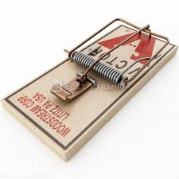
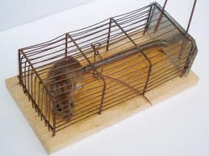
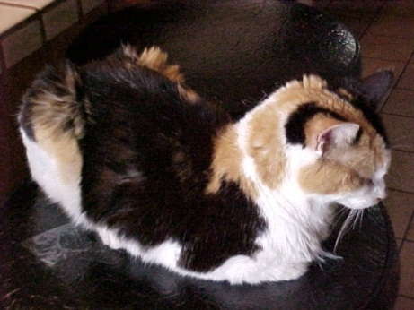
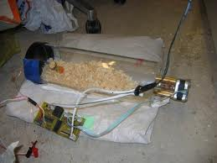
Design a Better Mouse Trap
Definition of Purposes (E4S4)
Description of Constraints
Definition and Exploration of Functions
Allocation of Functions
E4S4
Definition / Development of Systems
6U
2M
Technological Systems
Human Systems
Operational Systems
Development of Interfaces
Construction and Verification of Systems
Implementation and Validation of Processes
Continuous Improvement

Slide 24
Life Cycle and Stakeholders in Design
Mission / Purpose
Requirements and Specifications
Concept design
Concept evaluation and testing
Concept selection
Design and evaluation for use (Usability Testing)
Design and evaluation for manufacturing and assembly
Design and evaluation for service and maintenance
Design and evaluation for disposal
Design and evaluation for SAFETY
Manufacturing and Production Design
Production
Distribution and Sales
Use
Service and Maintenance
Disposal
Verification of specifications
Adjectives
Validation of requirements
Adverbs
E4S4
6U
2M
Notes:
Develop a life cycle model for a paper airplane and a training airplane
Use a CPM / PERT model for the times
How do you do verification and validation?

Slide 25
Product Life Cycle
Many Requirements
Feedforward (Anticipation)
Requirements
Concept
Development
Concept
Selection
Many Customers
(including the shareholders)
Specifications
Tooling
Feedback, Technical Memory
Production
E4S4
6U
2M
Marketing
Design and evaluation for use (Usability Testing)
Design and evaluation for manufacturing and assembly
Design and evaluation for service and maintenance
Design and evaluation for disposal
Design and evaluation for SAFETY
Use and
Misuse
Maintenance
Disposal
Consider a manned Mars mission or a neighborhood beach barbeque

Slide 26
Examples of Socio Technical System Design
The following examples are offered for your discussion
Apply the system development tools to a group based analysis of these systems
What are
User centered design
Human Factors
Macro Ergonomics
Ergonomics
Socio technical system design
Big Picture Engineering
Invent a new name for what we do
P
B
E

Slide 27
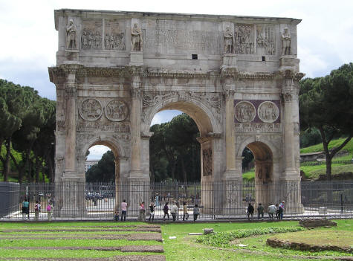
Design and Manufacturing Timelines
Rome wasn’t built in a day

Slide 28
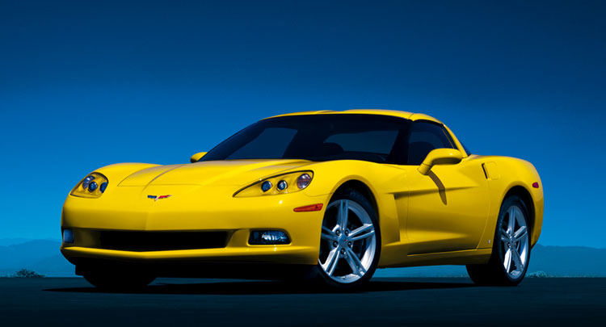
Beautiful Design

Slide 29
Design for Construction

Slide 30
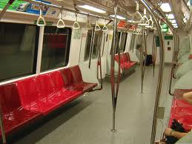
Design for Crowds

Slide 31
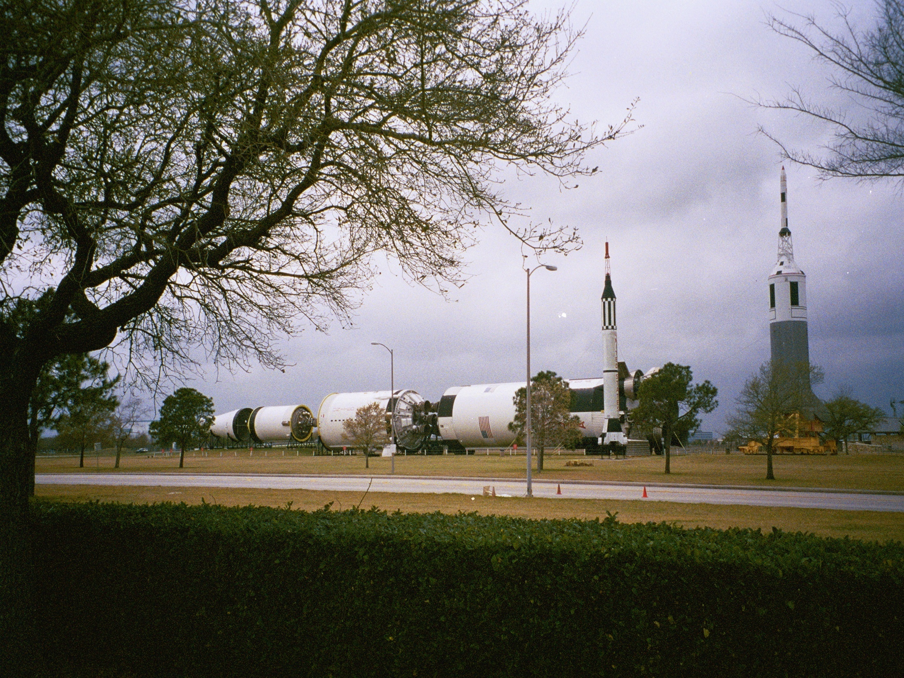
The Atlas Rocket to take astronauts to the moon

Slide 32
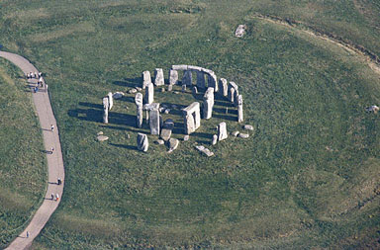
Design for Manufacturing?

Slide 33
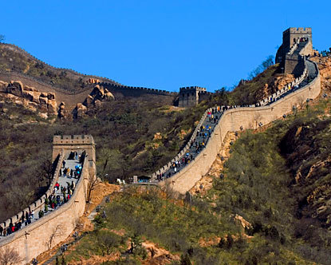
Design for Tourists?

Slide 34
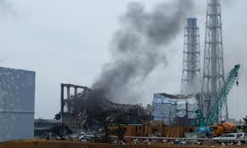
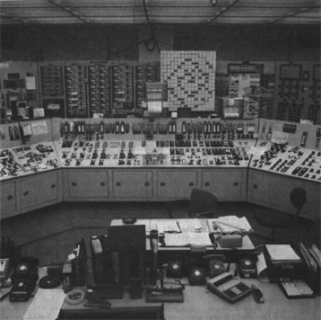
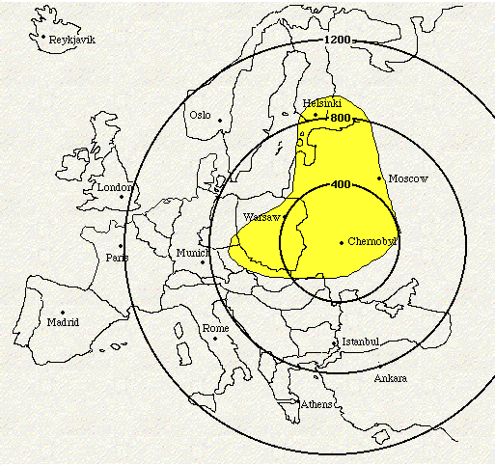
Fukushima, Three Mile Island Chernobyl

Slide 35
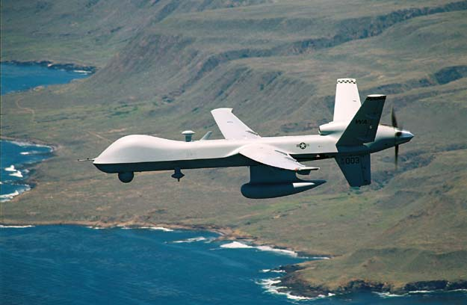
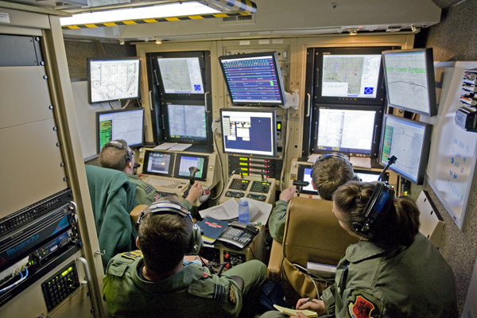
The Future of Warfare

Slide 36
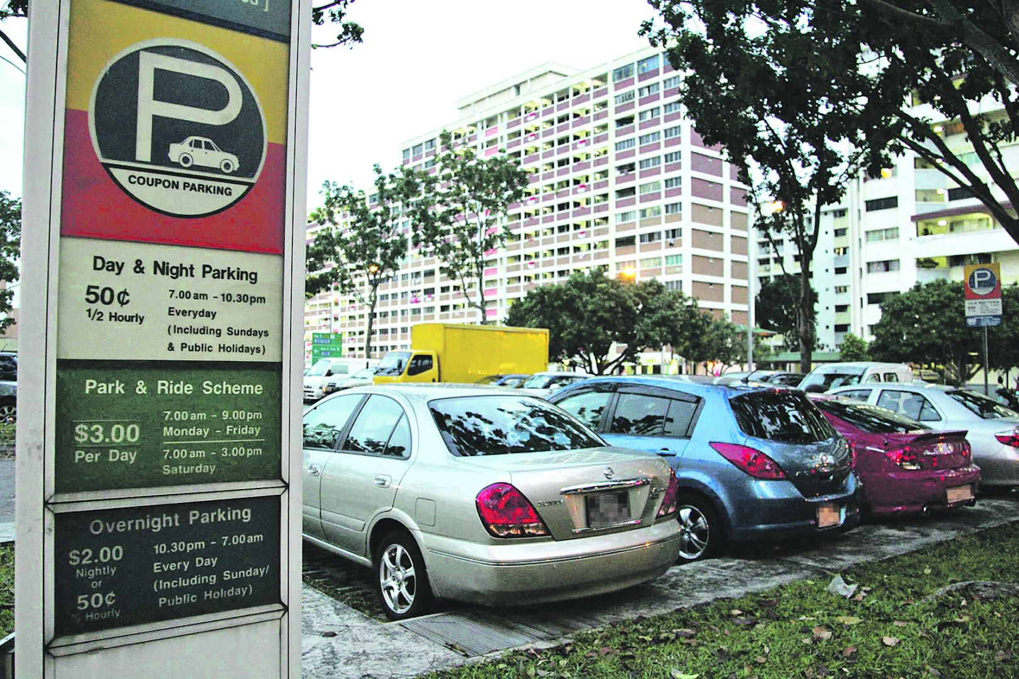
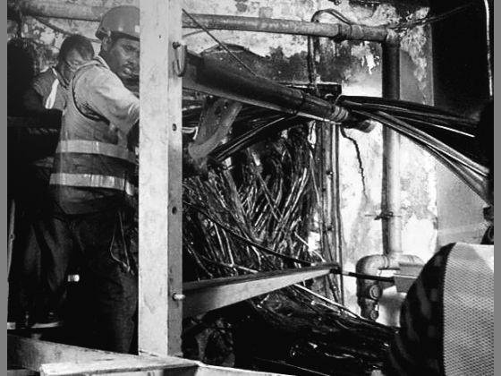
From TODAY’s Newspaper
Singapore
An ‘epic fail’ for network resilience
Operators TODAY spoke to warned that heavier traffic and non-savvy users could lead to routine technical glitches, breakdowns and parking delays.

Slide 37
UniSIM Blackboard Stakeholders
Managers
Computer staff
Students
Program Heads
Teachers
System designers
etc
When the system failed recently a response from one manager was “we will have to train the teachers”
Discuss some Computer Information Systems with which you interact, such as airline booking, banking, online shopping, work HR processes. Describe some shortcomings from the user’s point of view

Slide 38
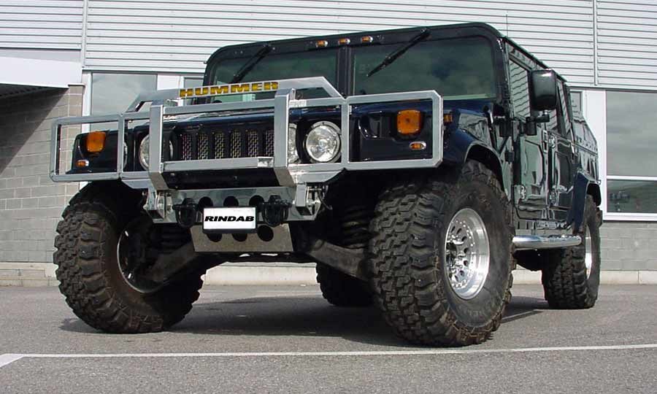
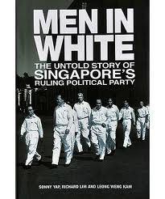
System Sustainability
E4S4
Reliability
Under intended contexts over the life cycle
Resilience
Under unintended, unexpected and harsh conditions
6U
2M
Consider the life of a car, nuclear power plant, political party or a pair of shoes

