Slide 1
Train The Trainer OH Masterclass For Ergonomics: Vision and Lighting Prof. Brian Peacock & A. Prof. Chui Yoon Ping

Slide 2
The Physics of Light
Light Intensity
Luminance - light source
Illumination - light arriving at a surface
Reflection
Direction
Shadows
Color
Refraction
Chromatic Charts
Contrast between object and background
Discuss and describe these characteristics of light.
How would you measure them?
What are the implications for human performance ?

Slide 3
Light Sources
Sunlight
Windows
Sky lights
Artificial Light
Tungsten, Fluorescent, Mercury, Sodium, Argon, Neon etc.
LEDs
Color characteristics
Reflection
Dispersion
Light and Heat
Search the Internet for descriptions of different light sources

Slide 4
The Measurement of Light
Luminance:
Light emitted from a source
Illumination:
Light arriving at a surface
Light Meter
Lux (10 - 2000)
Spot Meter
Color temperature measurement
Use your iPad app to measure the light intensity at different locations, inside and outside

Slide 5
The Physiology of Vision
Cornea, Lens, Pupil, Eye Muscles
Retina
Rods and Cones, Fovea
Color vision
The Optic Nerve
Light and Dark Adaptation
Accommodation, Focus
Monocular and Binocular Vision
Presbyopia - age
Explore the Internet for descriptions of the functions of each of these structures
Describe and discuss these functions

Slide 6
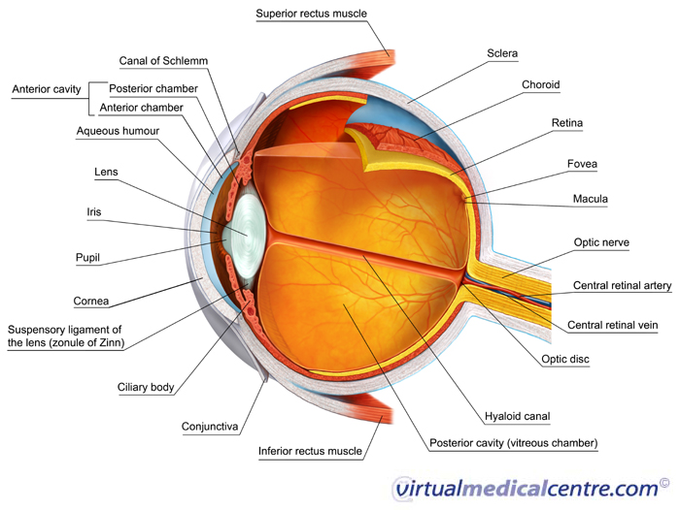
What do all these structures do??

Slide 7
Visual Performance Measurement
Orthorator - Vision Screening
Visual Acuity
Visual Angle
Near and Far Vision
Contrast Sensitivity
Depth Perception
Color Perception, Color Deficiency
Critical Flicker Fusion
How do we measure vision?
Download an app for visual acuity and color vision measurement
Explain Critical Flicker Fusion Frequency.

Slide 8
The Effects of Poor Lighting
Reduction in Visual Acuity
Glare
Discomfort Glare
Disability Glare
Glare Index
Color Discrimination
Visual Fatigue
Identify, discuss and describe some occupations where visual performance is important

Slide 9
Visual Environment Design
Ambient Lighting
Task Lighting
Reflectors
Dispersors
Directional Lighting, Modeling
Glare Elimination
Identify a visually demanding task and describe the management of the light environment

Slide 10
Case Studies in Vision and Lighting
Inspection of flaws in sheet metal
Flaws vary - dings, scratches, scuffs
Increase general lighting
Introduce directional lighting
Create movement - change
Consider effects of search pattern and pacing
Consider effects of visual capabilities and experience
Discuss the challenges and solutions to the inspection of car bodies that have emerged from the paint shop and been conveyed through general assembly

Slide 11
Exercises in Vision and Lighting
Describe the light sources in a CAD room
Describe the characteristics of vision that must be considered in screen content and format design
Give recommendations for ambient and local lighting
Describe alternative interventions
Discuss the lighting issues in a large computer room where people work all day

Slide 12
Reflections
Vision and Lighting are important human factors challenges
Discuss the vision and lighting aspects of your day

