Slide 1
Case Studies in Design
Brian Peacock
for
Pitney Bowes Inc

Slide 2
A Few
Ergonomics Applications
6Us
E4S4

Slide 3
Management is Responsible
Management is responsible for deciding which purpose should get the most attention

Slide 4
The Design Cycle
E4S4
Guidelines
and
Constraints
Decisions
Policy
Money
Analysis
Requirements
Outcomes
Analysis
Analysis
Tools
Analyses
The Process,
Job, Task,
Transaction
or Simulation
Specifications
Design
Equipment
Context
Humans
Operations
6U
2M
Uncontrollable
Conditions / Context
Prediction
SHELL

Slide 5
DESIGN DECISIONS
Policy
TRADEOFFS!
Science
Consensus:
  HF Experts
  Engineers
  Managers
  Customers
Design
Requirements
and
Specifications
Implementation
Experience
Data
History
6U
2M
Predictions
Evaluation
  Verification
  Validation
E4S4
Notes:
Design around the table
Paper airplane design
Use different hats in the design meeting

Slide 6
How Ergonomics Works
Voice of the customer(s)
Consensus
Requirements
Validation
Specifications
Verification
Design and Build

Slide 7
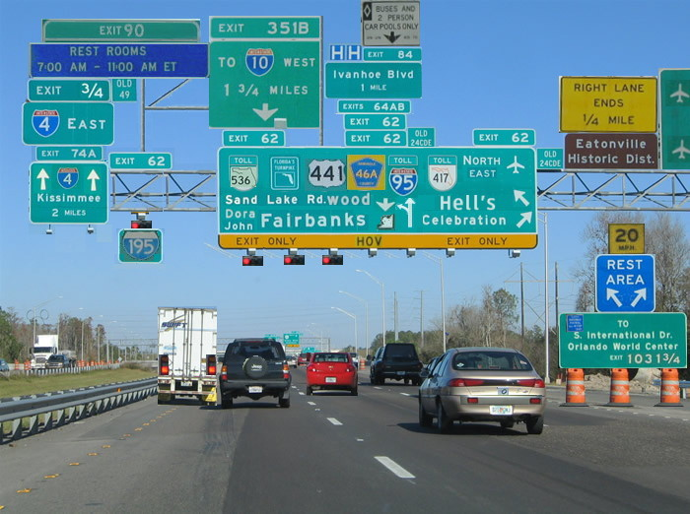
Mental workload?

Slide 8
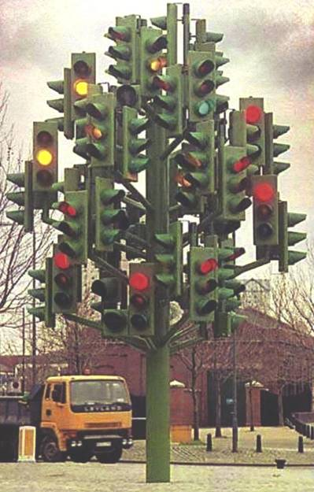
Wow!!!!

Slide 9
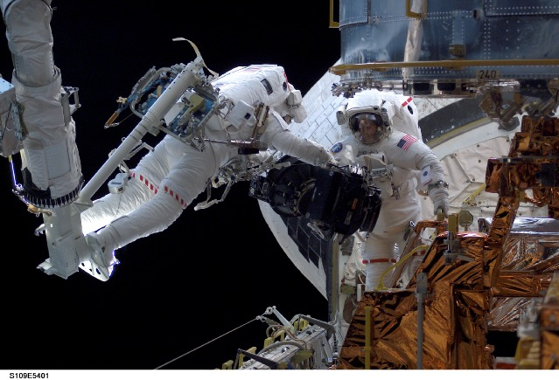
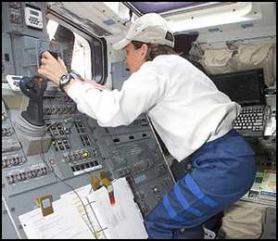
Space Operations
How do you sit still and concentrate all day in space?

Slide 10
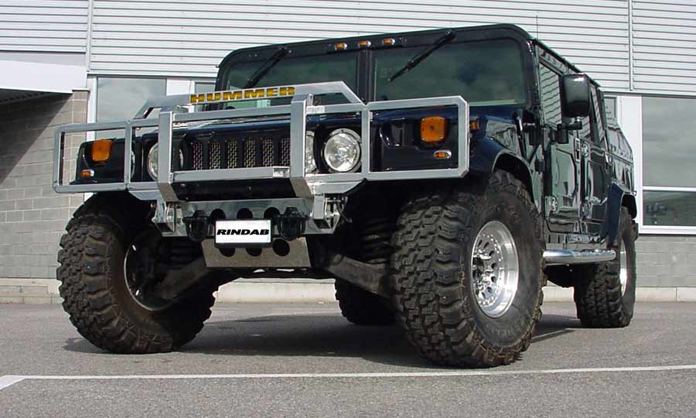
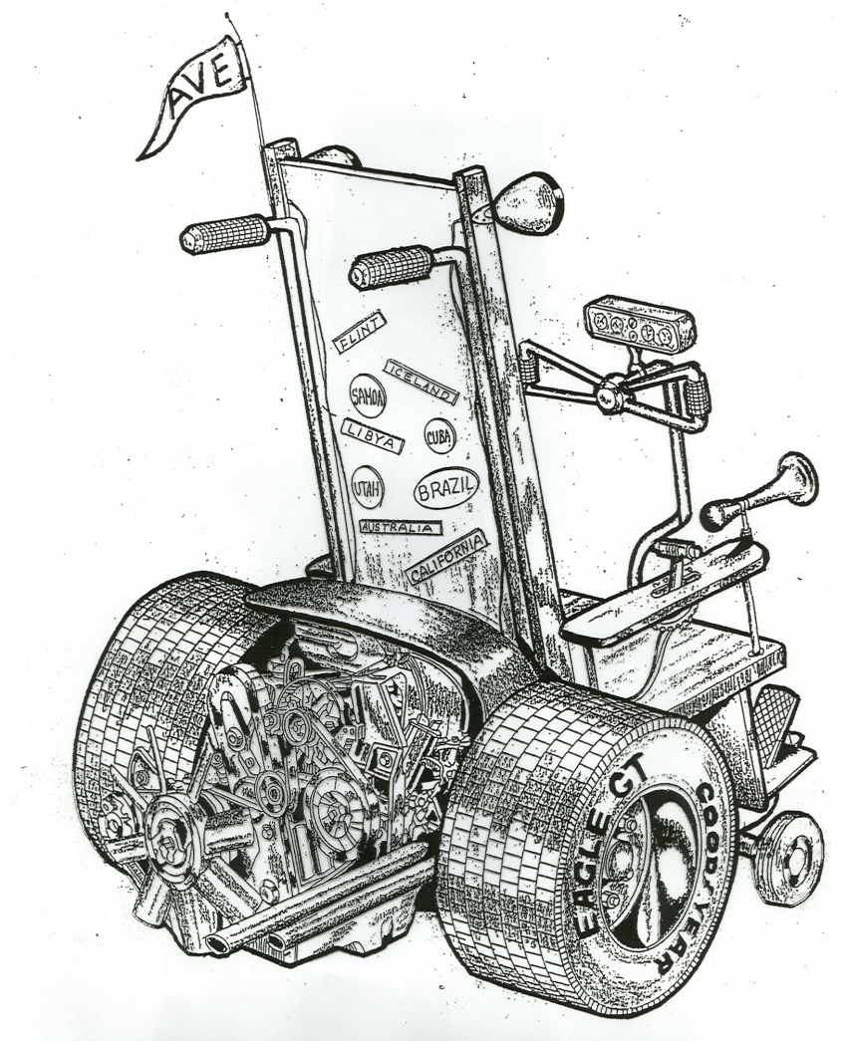

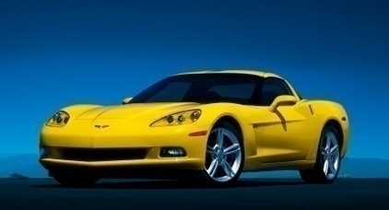
Which will you drive when you are 80?

Slide 11
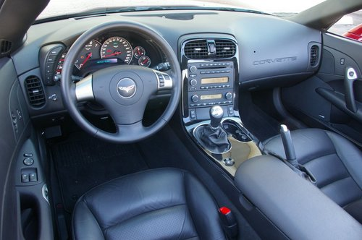
Vehicle Design
Form or Function?

Slide 12
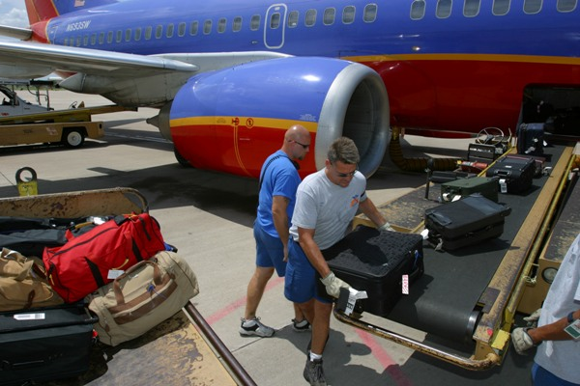
Heavy and Hurried

Slide 13
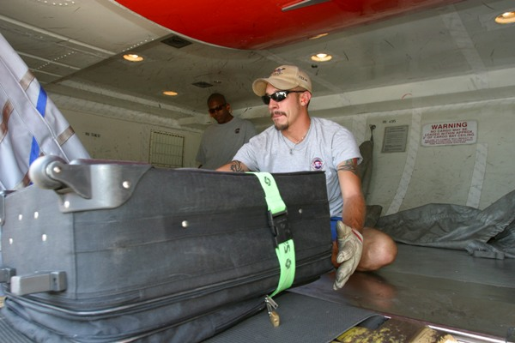
Backs, Knees, Fingers and Shoulders

Slide 14
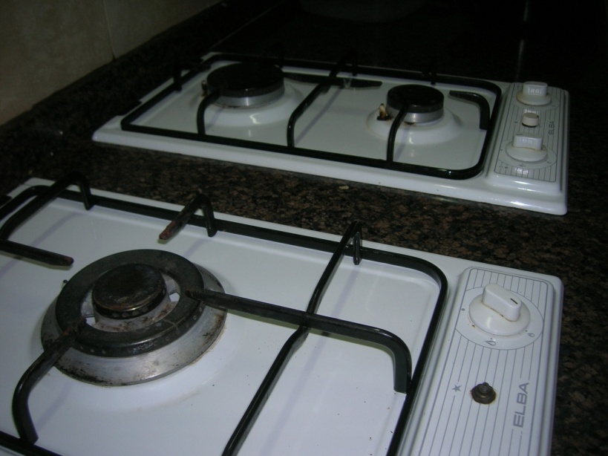
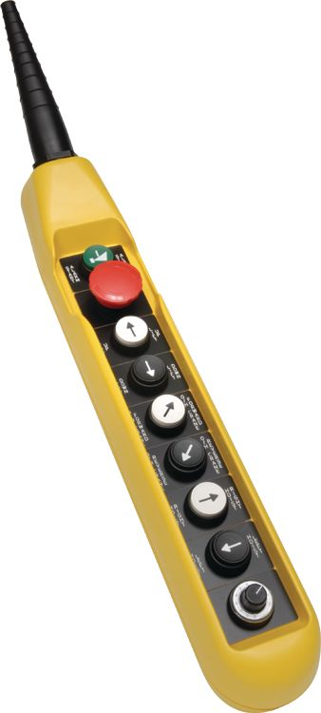
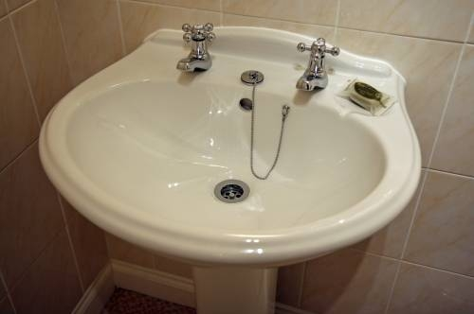
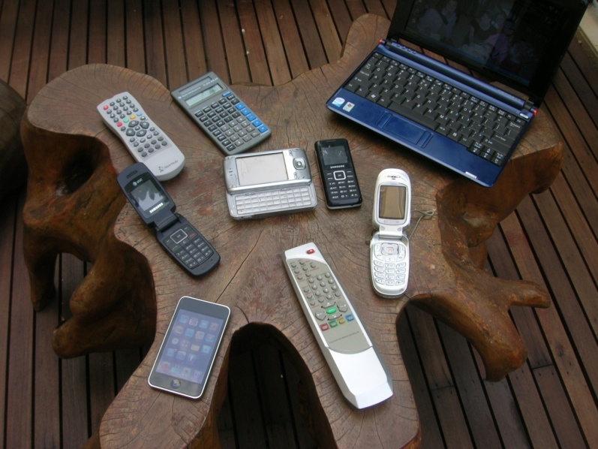

Slide 15
Manufacturing
Why are these components at floor level?

Slide 16

Agriculture
Can tools or mechanization / automation help with the design of this job?

Slide 17
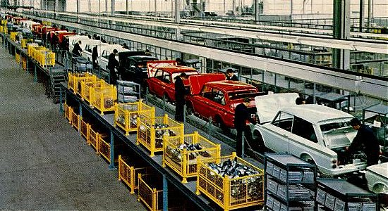

Slide 18
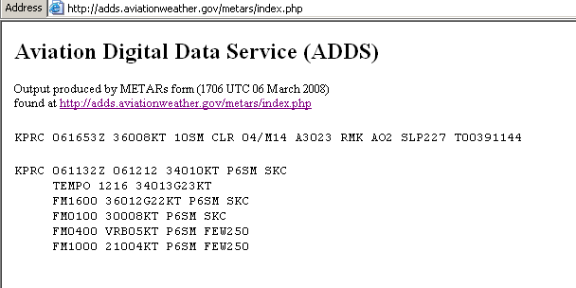
What does this mean?
Why do pilots have to learn this jargon?

Slide 19
Wrong Number
(just read the summary points)
FAA probes FedEx near-miss
Planes were much too close; may be worst local error in 10 years
Federal investigators are studying a near-miss between two FedEx planes over Memphis last Thursday that likely is the most serious air traffic control error here in 10 years.
Officials say both the pilot and controller believed the other had transposed numerals in the flight number. Because the crew did not read the number back as it was heard -- which is standard procedure -- the tower issued directions meant for another plane, putting flights 527 and 257 within 100 feet of each other vertically and less than a mile apart laterally.
The latest incident in Memphis happened shortly before 4p.m. Feb. 21 as FedEx flights 527 and 257 were preparing for simultaneous takeoff on parallel runways.
Controllers say the margin for error was increased because the pilot called in on the wrong radio frequency.
"Westbound FedEx 257 crew checked in on the frequency for the east departure controller," Sufka said.
The east departure controller, who had just seen data on eastbound 527 on his screen, thought the pilot had transposed the numbers and told FedEx 527 to turn left and climb.
"FedEx 257 hears this and answers to it," said Sufka, who listened to a replay of the conversation and said the crew read-back on the flight number was unintelligible.
"This is where our controller makes the mistake," Sufka said. "He didn't catch the erroneous read-back."

Slide 20
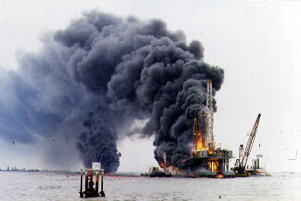

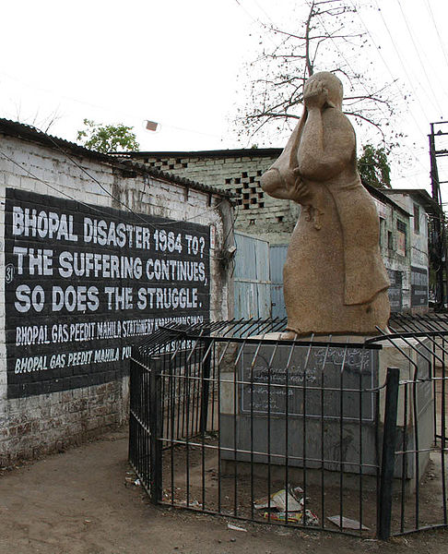
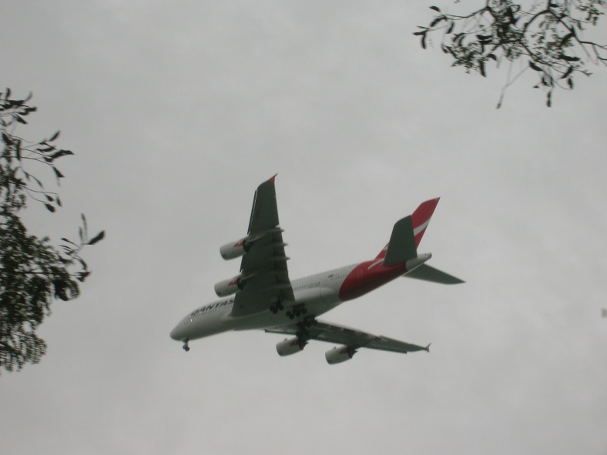
Large concentrations of Energy
(or people or money)

Slide 21
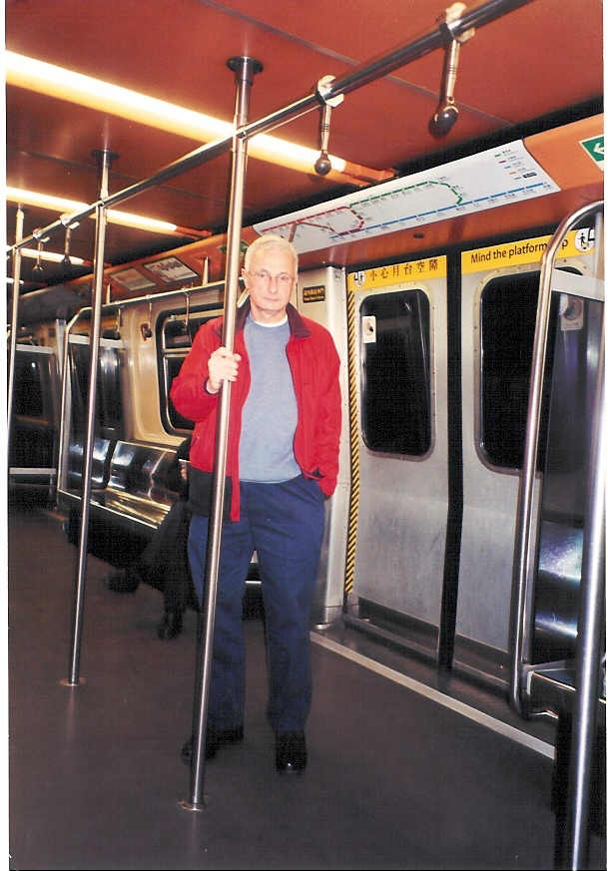
HK MTR 1978

Slide 22

Sport and Recreation
(a great place for ergonomics)
Safety standard
(1) The product safety standard prescribed for moveable soccer goals is that they must comply with the requirements of subclause (2).(2) A moveable soccer goal, when set up in accordance with the manufacturer’s instructions on a flat level surface without pegs, stakes or other forms of temporary anchoring device:(a) must not fall over, or fail to return to an upright position, when subjected to a horizontal pull force of 2,000 newtons to the centre of the crossbar for no less than 60 and no more than 70 seconds, and (b) must have all exposed corners and edges rounded with a radius of no less than 3 millimetres, and (c) must have permanently marked clearly and legibly in a conspicuous position on the crossbar or an upright post:(i) the name or trademark of the manufacturer, retailer or importer of the moveable soccer goal, and (ii) the words “WARNING—ALWAYS ANCHOR GOAL—NEVER CLIMB OR HANG ON CROSSBAR. Unanchored goals can tip over causing serious injury or death.” with upper case letters at least 25 millimetres high and lower case letters at least 12.5 millimetres high, and (d) if part of the structure of the moveable soccer goal joins the base of an upright post and runs along the ground (a ground frame), the moveable soccer goal must not have any gap greater than 5 millimetres at the point where the ground frame joins the upright post, and no part of the ground frame must extend past the front or sides of the upright post.

Slide 23
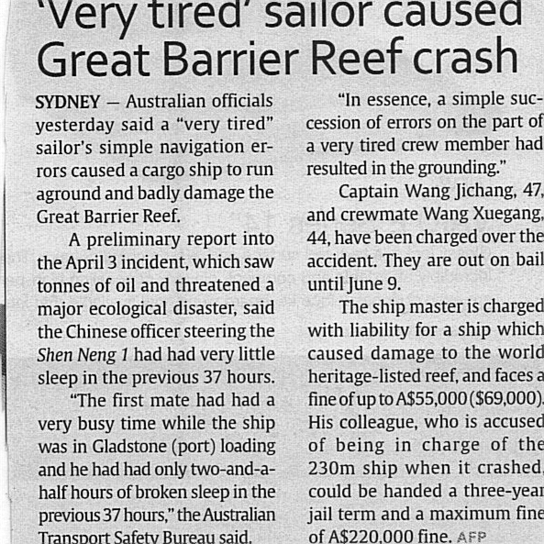
2010

Slide 24
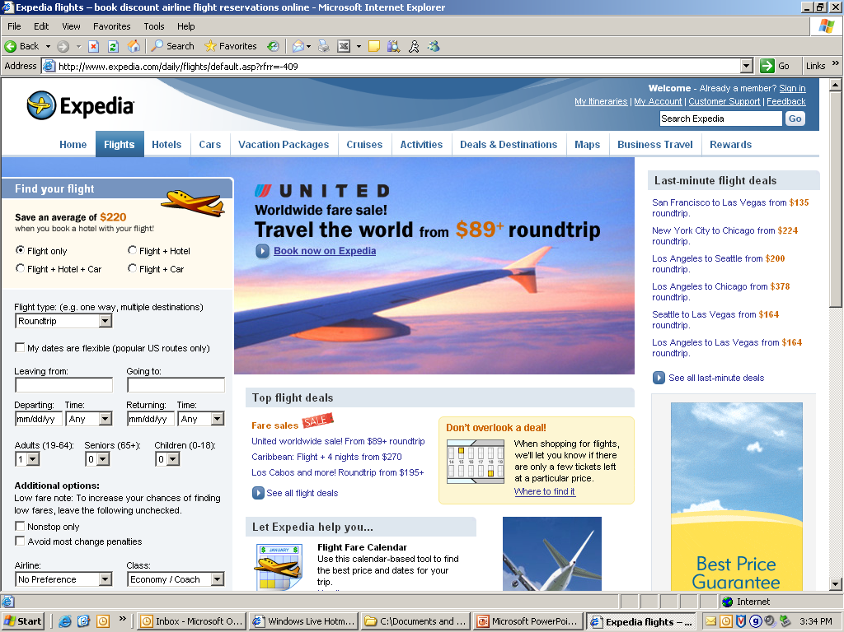
Computer Interfaces
I once accidentally bought 2 tickets instead of one!

Slide 25
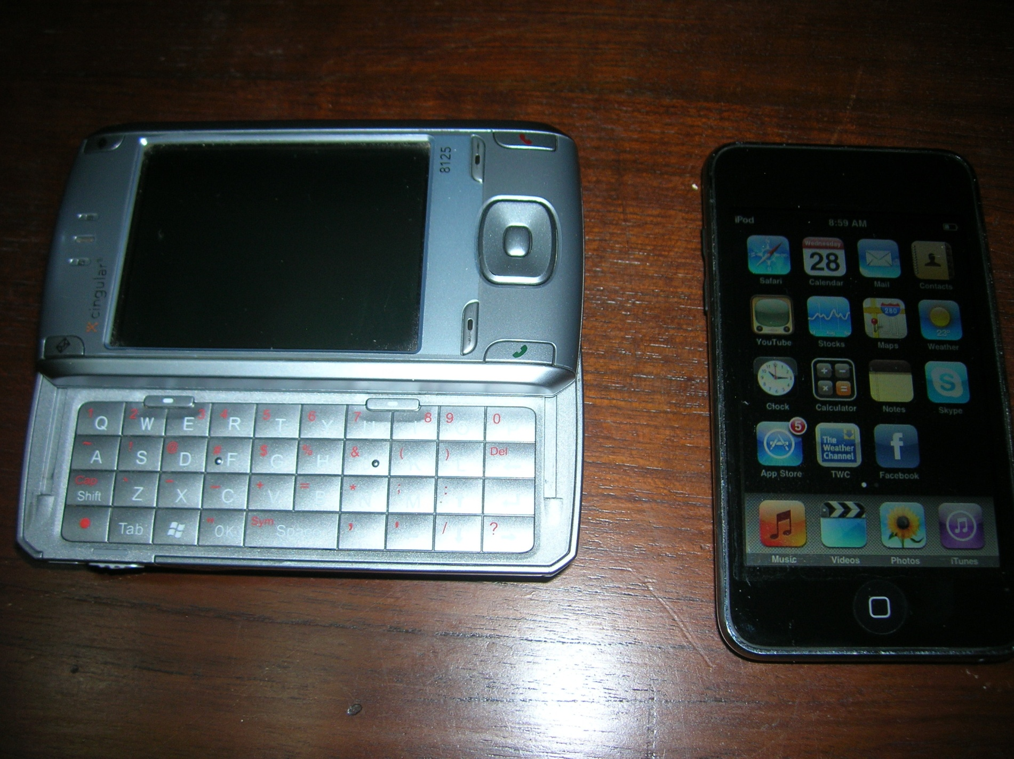
Hand held Electronic Devices
Hard or Soft Keys?
T9
Blackberry
Nokia
Samsung
I Phone
HTC
Let’s have an SMS race – one types the other times:
The quick brown fox jumps over the lazy dog
Time and errors?

Slide 26
Human Centered Design
For expected use
For foreseeable misuse
by the intended user
And by
  Amy who is old
  Bobby who is young
  Cora who is drunk
  Dick who is blind
  Emily who is clumsy
  Fred who is in a hurry
  Gladys who doesn’t agree with the system
  Harry who wants to destroy the system
Accidents don’t happen to normal people in normal circumstances
They happen to abnormal people or in abnormal circumstances

