Slide 1
Human Factors in Manufacturing:
Introduction, Purpose and Scope
Brian Peacock
for
Pitney Bowes Inc

Slide 2

Prescott Arizona

Slide 3
The Internet knows much more about Ergonomics than I do!!
Use it wisely!!

Slide 4
Most of the World
Ergonomics = Human Factors
HFE
USA

Slide 5
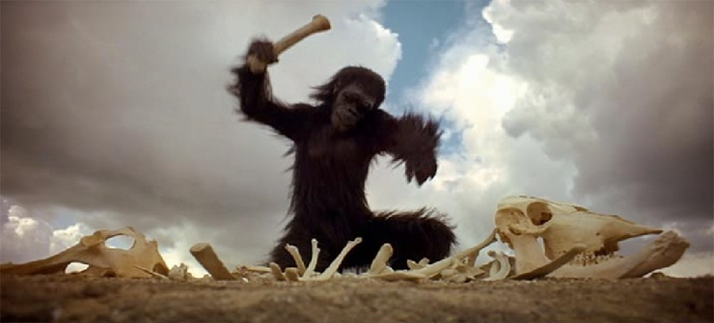
The History of Ergonomics
Tools

Slide 6
Course Objectives
To train product / process / manufacturing / industrial engineers in the applications of Ergonomics and Human Factors foundations, tools and techniques in manufacturing and maintenance.

Slide 7
Structure
The course will comprise six 3 hour sessions consisting of lectures, demonstrations, case studies, small group discussions and classroom exercises.

Slide 8
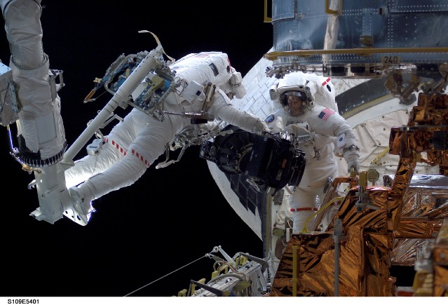
EasyErgoLab
  Class members as subjects
  Materials and artefacts in the classroom
  Materials and artefacts brought by the class members
  Workplace equipment, processes and tools
  Pictures and videos
  Systems and Processes in the environment
  Web based artefacts
Participation
Please bring pictures, sketches, descriptions, problems of your jobs

Slide 9
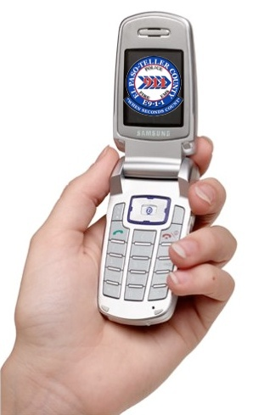
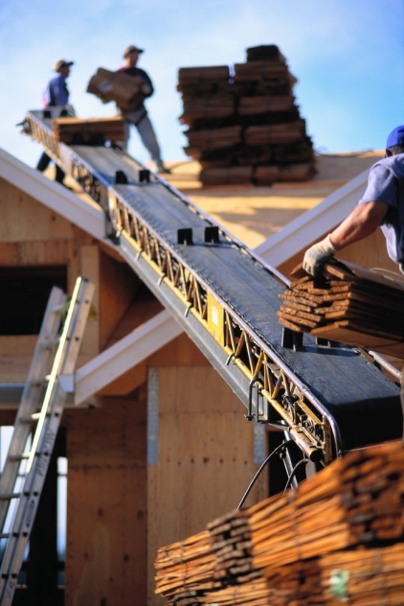
The Six Us of Usability
Utility
  Is the system useful?
Users and misusers
  Who are the users?
  What kind of misusers are possible?
Usage and Misusage
  How is the system used?
  What is the normal context?
  What possible extreme contexts may be predicted
Utilization
  How often and by how many people?
Usability
  Is the system easy to use or misuse?
User Error
  What kinds of error can be made, how frequently and what are the consequences?
6Us

Slide 10
Scope of Ergonomics
The Analysis of
Human Physical, Sensory, Cognitive, Social, Integrated Characteristics, Capabilities, Limitations, Requirements
Applied to
  Design, Evaluation, Usability testing, Accident investigation
  In any human domain such as manufacturing, aerospace, agriculture, consumer products, health care and so on

Slide 11
If it isn’t applied to the design of something it isn’t Ergonomics
(but it might be one of the related basic sciences – psychology, physiology, biomechanics etc)

Slide 12
Ergonomics is Everywhere

Slide 13

Agriculture

Slide 14
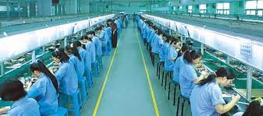
Manufacturing

Slide 15
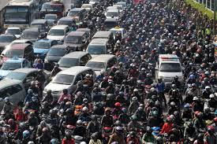
Traffic

Slide 16
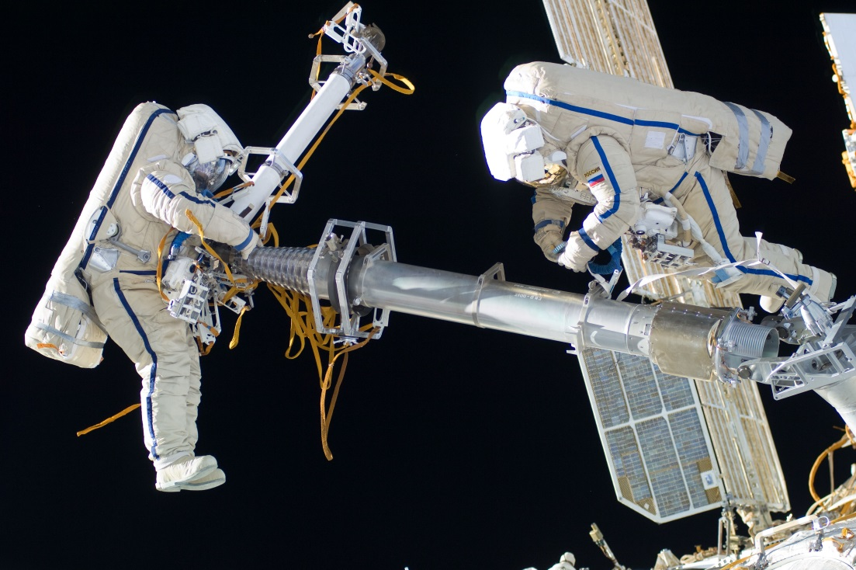
Space

Slide 17
Complexity is Everywhere
Rules and Regulations
S
Technology
H
Integration
Interfaces
Interactions
Intra actions Interferences
Interdependencies
People
L
Context
(Environment)
E
An adaptation of the Edwards “SHEL” model

Slide 18
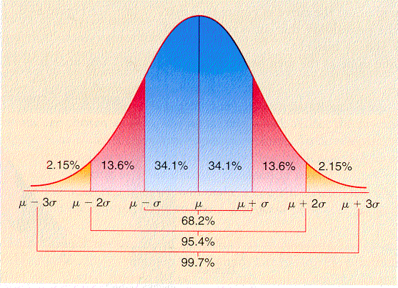
Variability is Everywhere
Temporal
Cognitive
Affective
Sensory
Social
Physical
Context
Ergonomics Purpose and Achilles' Heel

Slide 19
Outcomes - Multiple Purposes of Design
Effectiveness
  Meets functional requirements
  “quality”
Efficiency
  Optimal use of resources
  “productivity”
Ease of Use
  Intended users
  Comfort and Convenience
  Prevention of misuse
Elegance
  Esthetic / emotional appeal
  Affective Design
Safety and Health
  Prevention or mitigation of system failures
  For participants and third parties
Security
  Inadvertent or malicious misuse
Satisfaction
  Of ALL customers and stakeholders
Sustainability
  Reliability
    Under intended contexts over the life cycle
  Resilience
    Under unintended, unexpected and harsh conditions
E4S4
There WILL be tradeoffs

Slide 20
Tradeoffs
E4S4
Security
Efficiency
Satisfaction
Safety
Ease of Use
Sustainability
Effectiveness
Esthetics

Slide 21
The Design Cycle
E4S4
Guidelines
and
Constraints
Decisions
Policy
Money
Analysis
Requirements
Outcomes
Analysis
Analysis
Tools
Analyses
The Process,
Job, Task,
Transaction
or Simulation
Specifications
Design
Equipment
Context
Humans
Operations
6U
2M
Uncontrollable
Conditions / Context
Prediction
SHELL

Slide 22
DESIGN DECISIONS
Policy
TRADEOFFS!
Science
Consensus:
  HF Experts
  Engineers
  Managers
  Customers
Design
Requirements
and
Specifications
Implementation
Experience
Data
History
6U
2M
Predictions
Evaluation
  Verification
  Validation
E4S4
Notes:
Design around the table
Paper airplane design
Use different hats in the design meeting

Slide 23
How Ergonomics Works
Voice of the customer(s)
Consensus
Requirements
Validation
Specifications
Verification
Design and Build

Slide 24
The Ergo Cop Problem
Calling the designer’s baby ugly!
Ergonomics
Evaluation
The Ergocop
Performance
Requirements
Design
Specifications
Design
Performance
Review
(waivers by management)
Clear
Performance
Requirements
Precise
Design
Specifications
Design
Performance
Review
Time to
Market
Ergonomics
Support

Slide 25
Lifecycle
Feedforward (Anticipation)
Requirements
Concept
Development
Stakeholders
(including the shareholders)
Concept
Selection
Specifications
Tooling
Feedback, Technical Memory
Production
Many Requirements
Marketing
Use and
Misuse
Design Team
Maintenance
Disposal

Slide 26
The Process of Ergonomics
Measurement and Analysis
Screening
In depth Research
$
Decisions
Benefits, Costs,
Risks, Tradeoffs
Outcomes
Quality
Productivity
Health, Safety
Ease of Use
Security
Satisfaction
Sustainability
Design
Tools, Equipment, Workplaces, Tasks, Procedures, Assignments.
The Job
Contexts
Spatial, Physical, Mechanical, Chemical, Biological, Geographical, Social, Political, Economic

Slide 27
The Design Problem
Who and what are these?
Feed Forward
External Factors and Customers
What are the tradeoffs?
How?
E4S4
Design
The System
Feedback
How?

Slide 28
When Ergonomics Works
RASDEI
Research
Analysis
Design
Evaluation
Outcome Investigation
Simulation
Success
Ergonomics Projects need some or all these Skills
Failure

Slide 29
Ergonomics Practice Requirements
Knowledge of human characteristics, capabilities and limitations
Domain Knowledge
Measurement and analysis tools

Slide 30
Physical Ergonomics
Shape
Size
Strength
Skill
Stamina
Speed

Slide 31
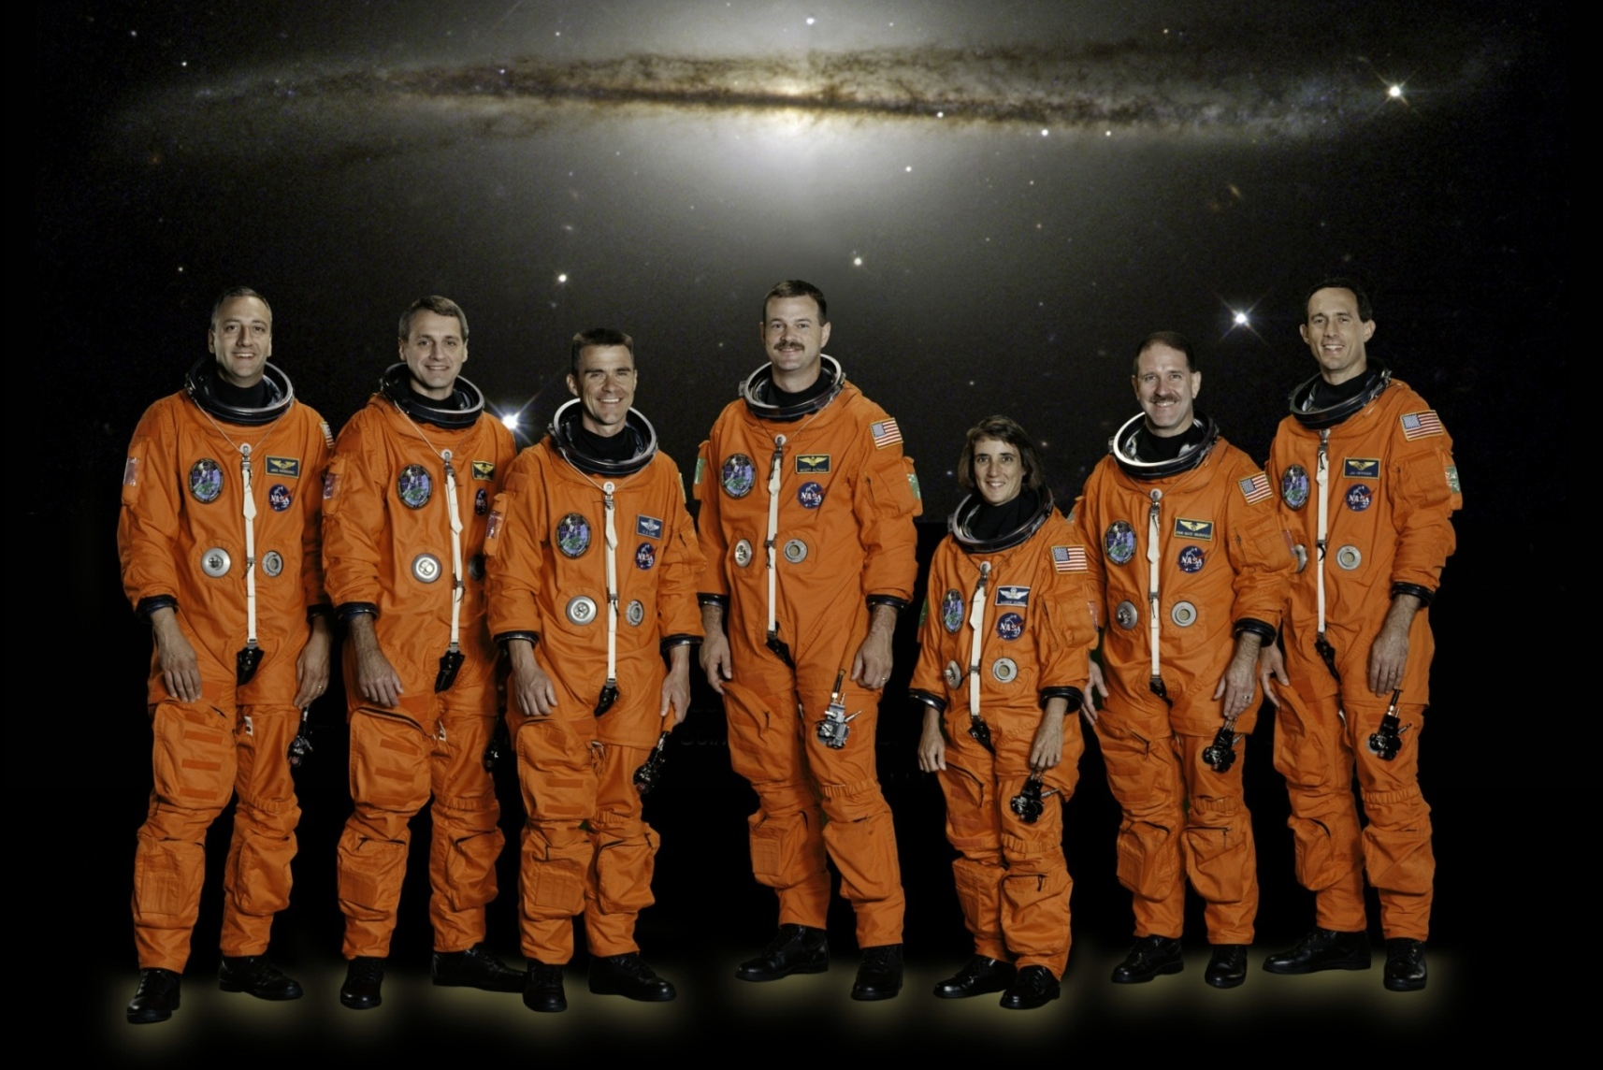
People vary in Shape and Size

Slide 32
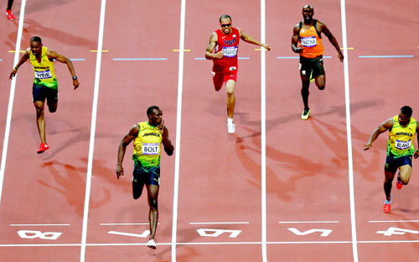
People vary in their Speed

Slide 33
Sensory Factors
Taste
Hearing
Proprioception
Touch
Vision
Smell

Slide 34
The Challenge of Design
Control and Resilience
Will your system design inputs make the process resilient to uncontrollable factors?
Feed forward
Uncontrollable Factors
Inputs
The Process
Outputs
Feedback

Slide 35

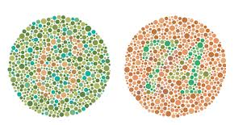
Vision Varies

Slide 36
Cognitive Factors
Forgetting
Attending
Perceiving
Understanding
Calculating
Sensing
Deciding
Planning
Controlling
Remembering
Communicating
Learning

Slide 37
Cognition is complex
Goals
Understanding
Diagnosing
Analyzing
Judging
Cognition
Learning
Synthesizing
Deciding
Problem Solving
Planning
Investigating
Evaluating
Interpolating and Extrapolating
Predicting

Slide 38
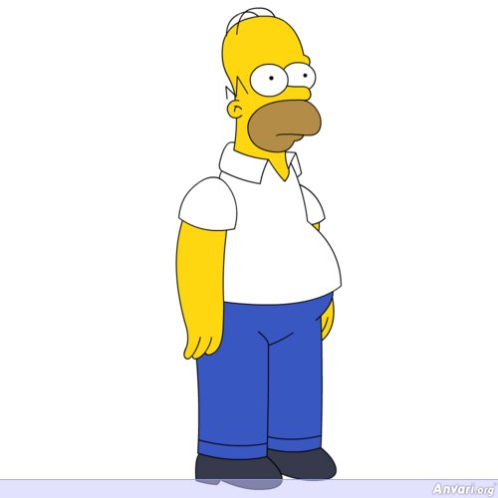
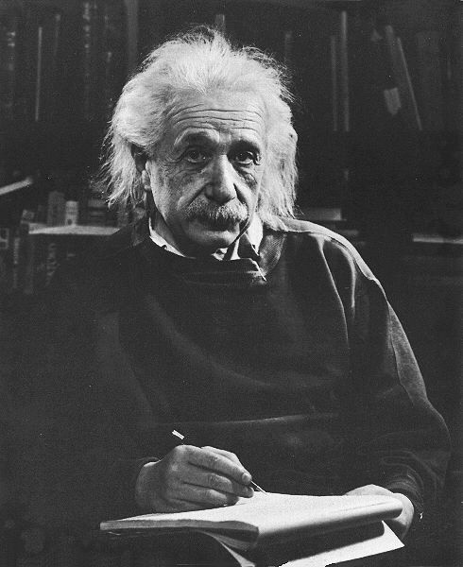
People vary in their Cognitive abilities

Slide 39
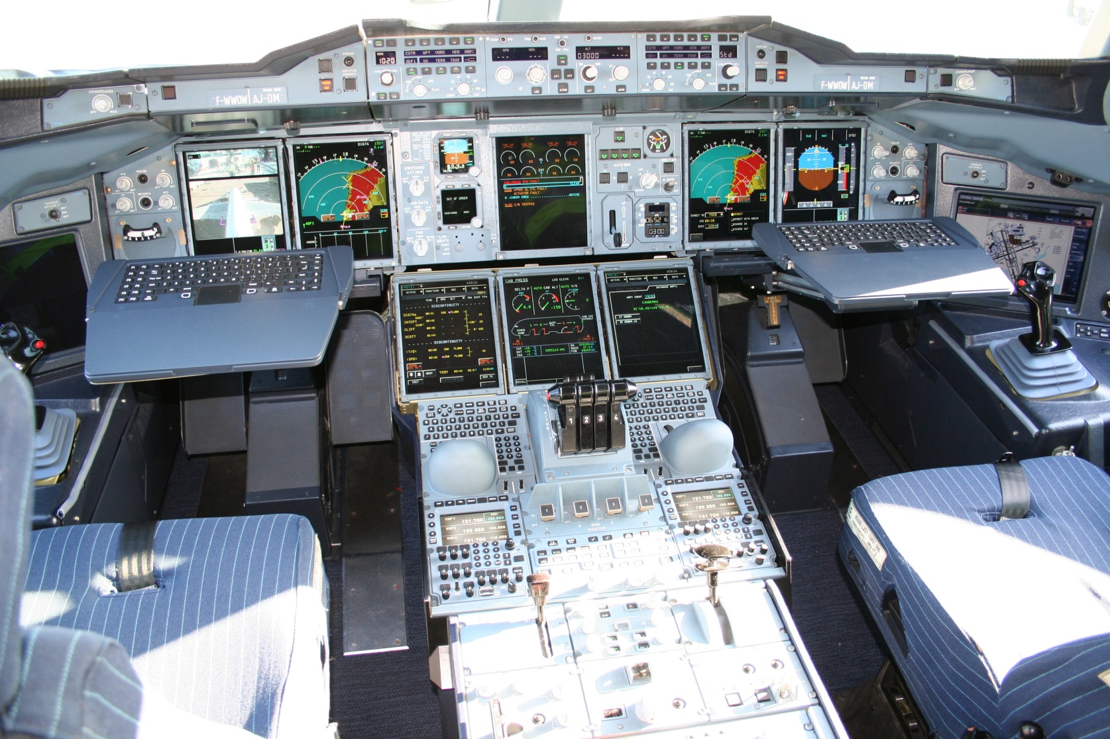
A380 Cockpit

Slide 40
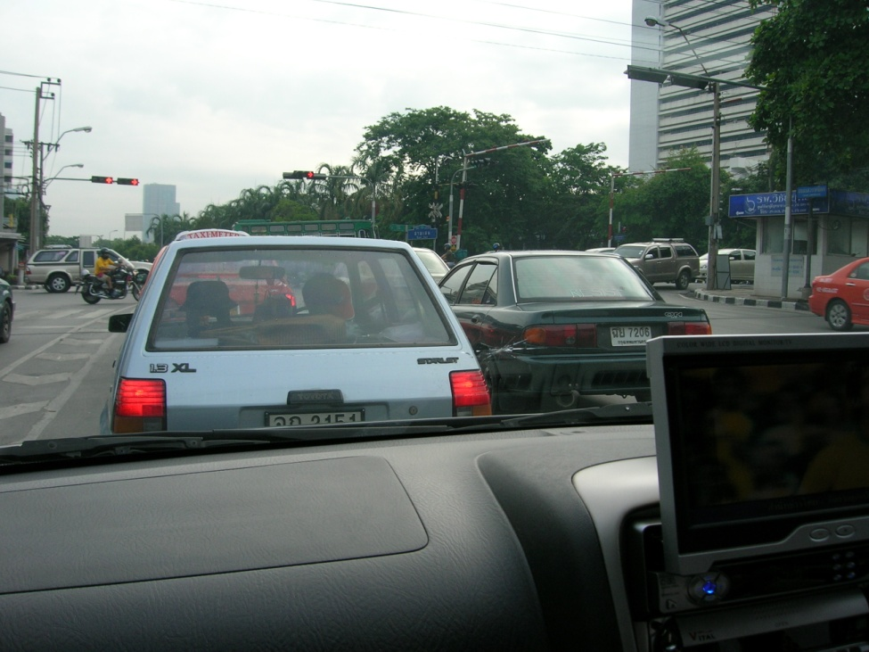
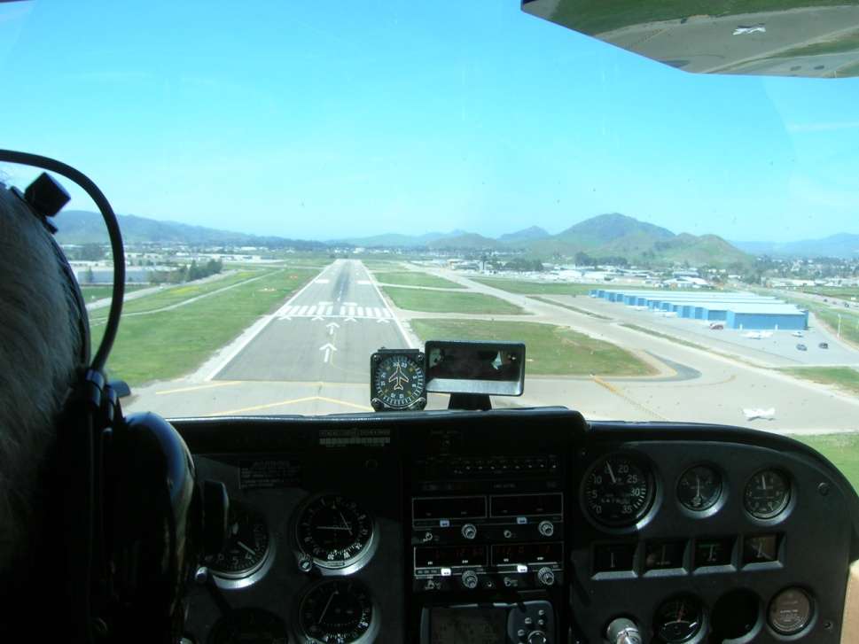
Mental Workload
Mental Workload = Information / (Time * Training)
People vary
Stress is important

Slide 41
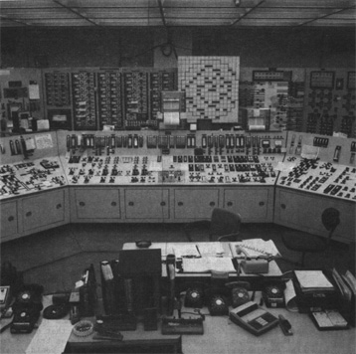
Three Mile Island

Slide 42


Affective Factors
Esthetics
Elegance
Emotion
Motivation
Excitement
Mood
Attitude

Slide 43
Environmental Factors
Gravitational
Space
Chemical and Biological
Pressure
Under Water
Altitude
Thermal
Heat
Humidity
Cold
Air movement
Acoustic
Communication
Hearing loss
Light and Dark
Vision
Contrast
Color
Vibration
Hand / Arm
Whole body

Slide 44
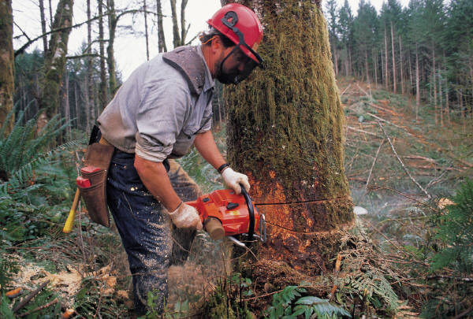

Environmental Factors

Slide 45
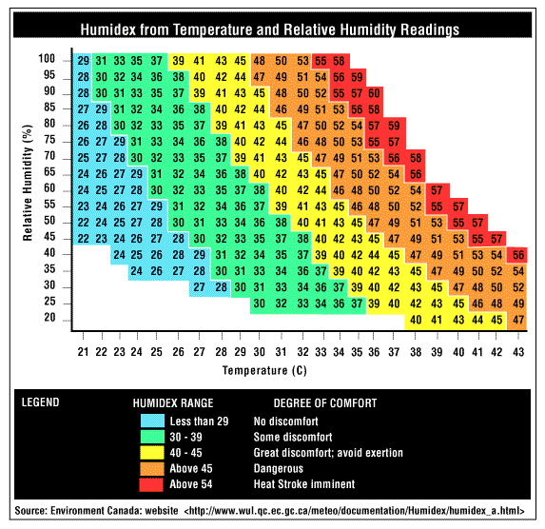
Heat and Humidity

Slide 46
Social Factors
Roles
Jobs
Supervision
Language
and
Jargon
Communication
Groups
and
Teams
Cooperation
Customers
Competition
Hierarchies
Businesses and Companies

Slide 47
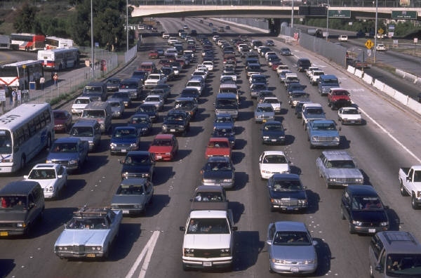
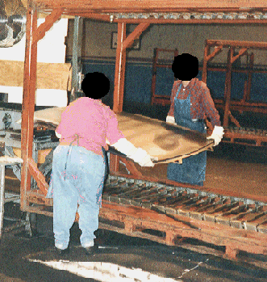
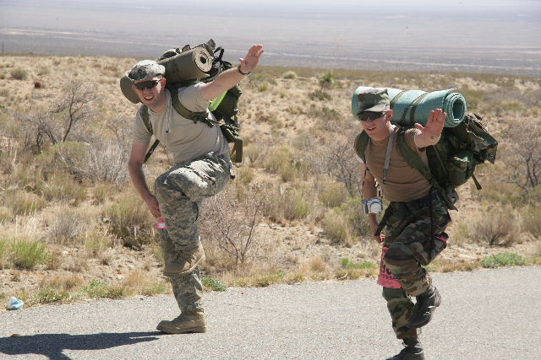
Social Factors

Slide 48
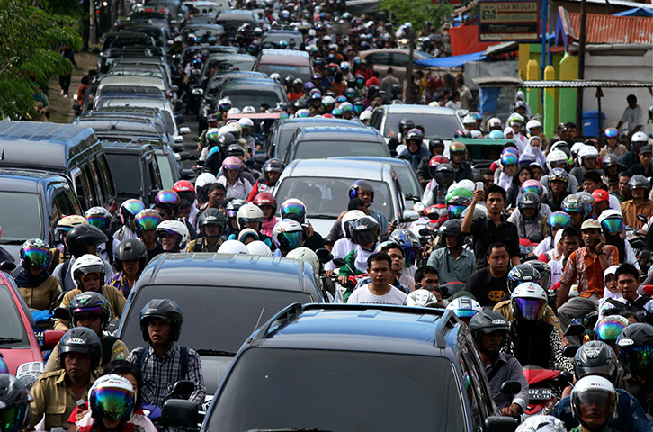

Slide 49
Time Factors
Age
Velocity
Circadian Rhythms
History
Task Pacing
Acceleration
Decision Time
Psychological Refractoriness
Mental Workload
Job Cycle Time
Shift Length
Reaction Time
Duty Cycle
Fatigue
Movement Time
Timing
Remembering
Vigilance

Slide 51
Time Factors
Time Pressure
Fatigue
Vigilance
Learning
Aging
Forgetting
Reaction time
MT = a + b log₂ (2A/W) Fitts Law
where:
MT = Movement Time
a, b = Individual and Situational Constants
A = Amplitude of Movement
W = Width of Target
2A/W = Index of Difficulty (ID)

Slide 52

Jet Lag

Slide 53
The 6Us and 2Ms of Usability
Utility
  Is the system useful?
Usage and Misusage
  How and in what context will the system be used?
  What possible extreme contexts may be predicted
Usability
  Is the system easy to use or misuse?
Utilization
  How often and by how many people is the system used?
Users and Misusers
  Who are the users and possible misusers?
User Error
  What kinds of error can be made, when and how will they be made, how frequently and what are the possible consequences?
6U
2M

Slide 54
Design Requirements - Voice Of the Customers
Who is the customer?
  End user?
  Maintainer?
  Procurement department?
  Shareholders?
  Manufacturing employees?
  Your manager?
  Others?
What are their requirements?
Different customers have different requirements!
E4S4
6Us

Slide 55
Complexity is Everywhere
Rules and Regulations
S
Technology
H
Integration
Interfaces
Interactions
Intra actions Interferences
Interdependencies
People
L
Context
(Environment)
E
An adaptation of the Edwards “SHEL” model

Slide 56
Variability is Everywhere
Temporal
Cognitive
Affective
Sensory
Social
Physical
Context
Ergonomics Purpose and Achilles' Heel

