Slide 1
Train The Trainer OH Masterclass For Ergonomics: Anthropometry and Workplace Design Professor Brian Peacock

Slide 2
Anthropometry
Measurement of body size and shape
Segments
Length, width, girth, volume, composition, mass
Joint angles, postures
Standard methods
Work place design oriented
Sport, recreation and rehabilitation oriented
Reference points
Boney prominences
Error
Random, systematic, blunders
This is the first step in ergonomics, people and their spatial environment, people vary in size and shape, sometimes one size fits all, sometimes we need tailor made fittings and sometimes we try to accommodate the majority. Give examples of each of these situations

Slide 3
Workplace design
Fit
Reach
Vision
Access
Movement
Communication
Clothing
Discuss and describe some work place design situations where each of these criteria must be considered

Slide 4
What is a workplace?
You tell me!

Slide 5
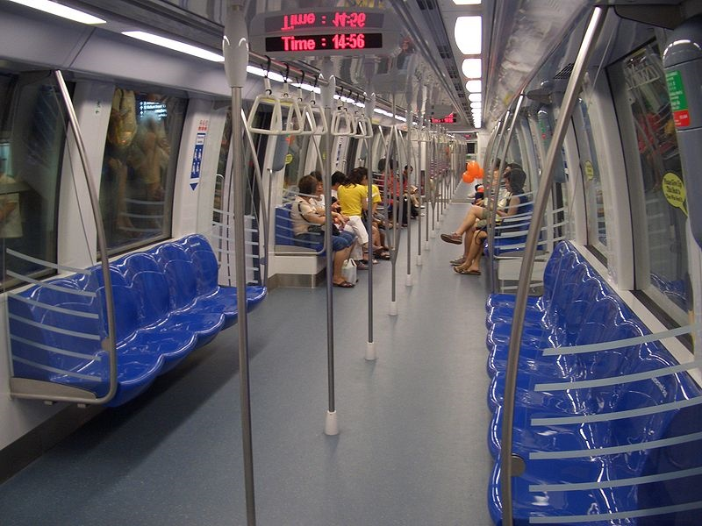
Singapore
What spatial factors and human accommodations should be made in public transport?
Hong Kong (1978)

Slide 6
Reach and Fit
What is / should be the height of the overhead hand rails and straps?
Why?

Slide 7
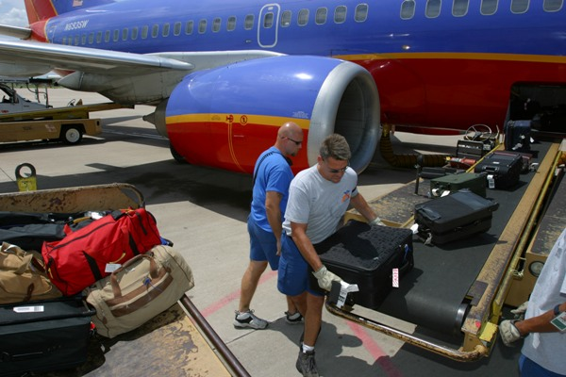
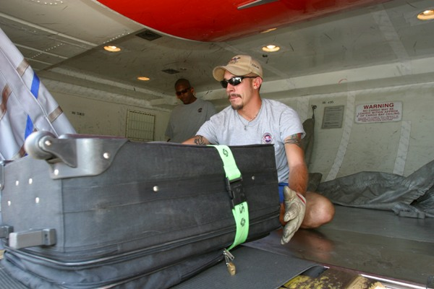
Analyze these workplaces from the spatial layout viewpoint

Slide 8
How are cars designed? What spatial factors need to be considered?

Slide 9
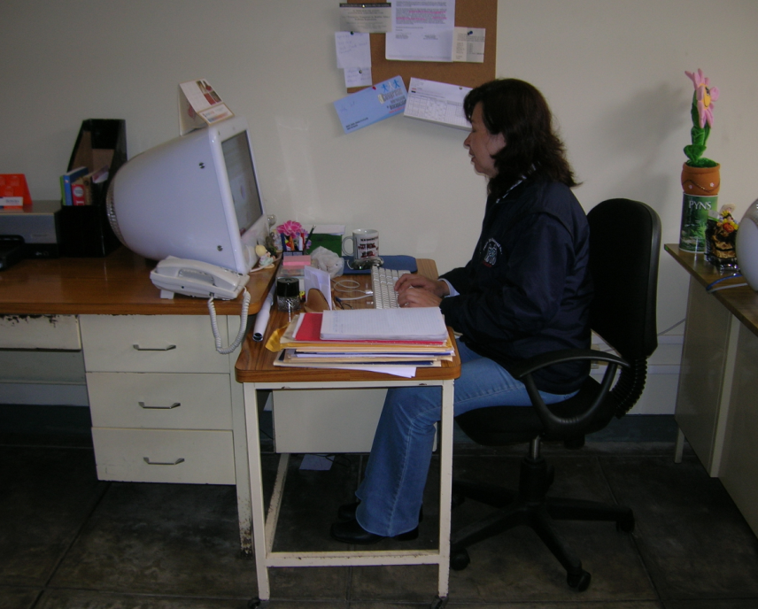
How should we design a simple computer workstation?

Slide 10
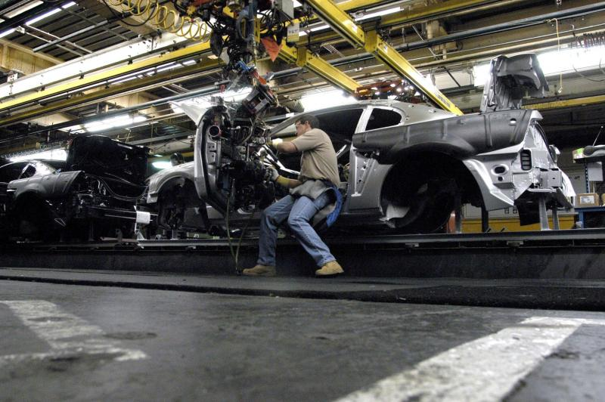
What should / can be considered in the design of this workstation?

Slide 11
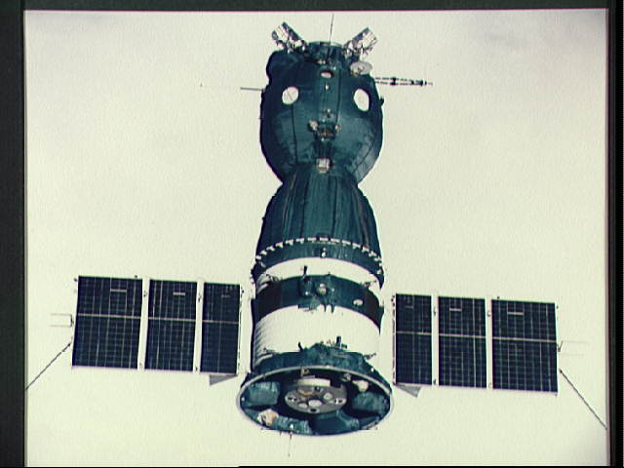
Soyuz capsule
For launch and landing astronauts are strapped into their body molded reclining seats.
The controls are out of reach
They are given a little stick with which to press the buttons
Search the Internet for pictures of cosmonauts in the Soyuz capsule. How long is a journey from the launch pad to the International Space Station?

Slide 12
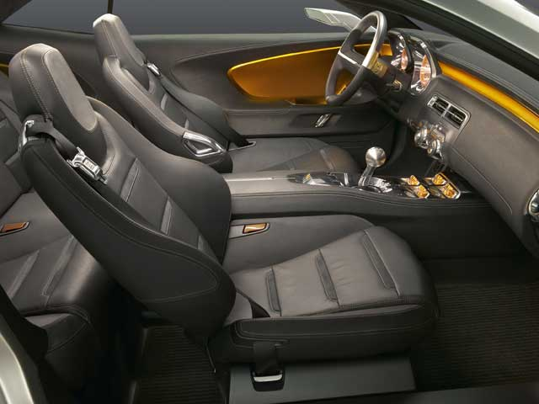
Discuss and describe seat recline purposes, constraints and designs

Slide 13
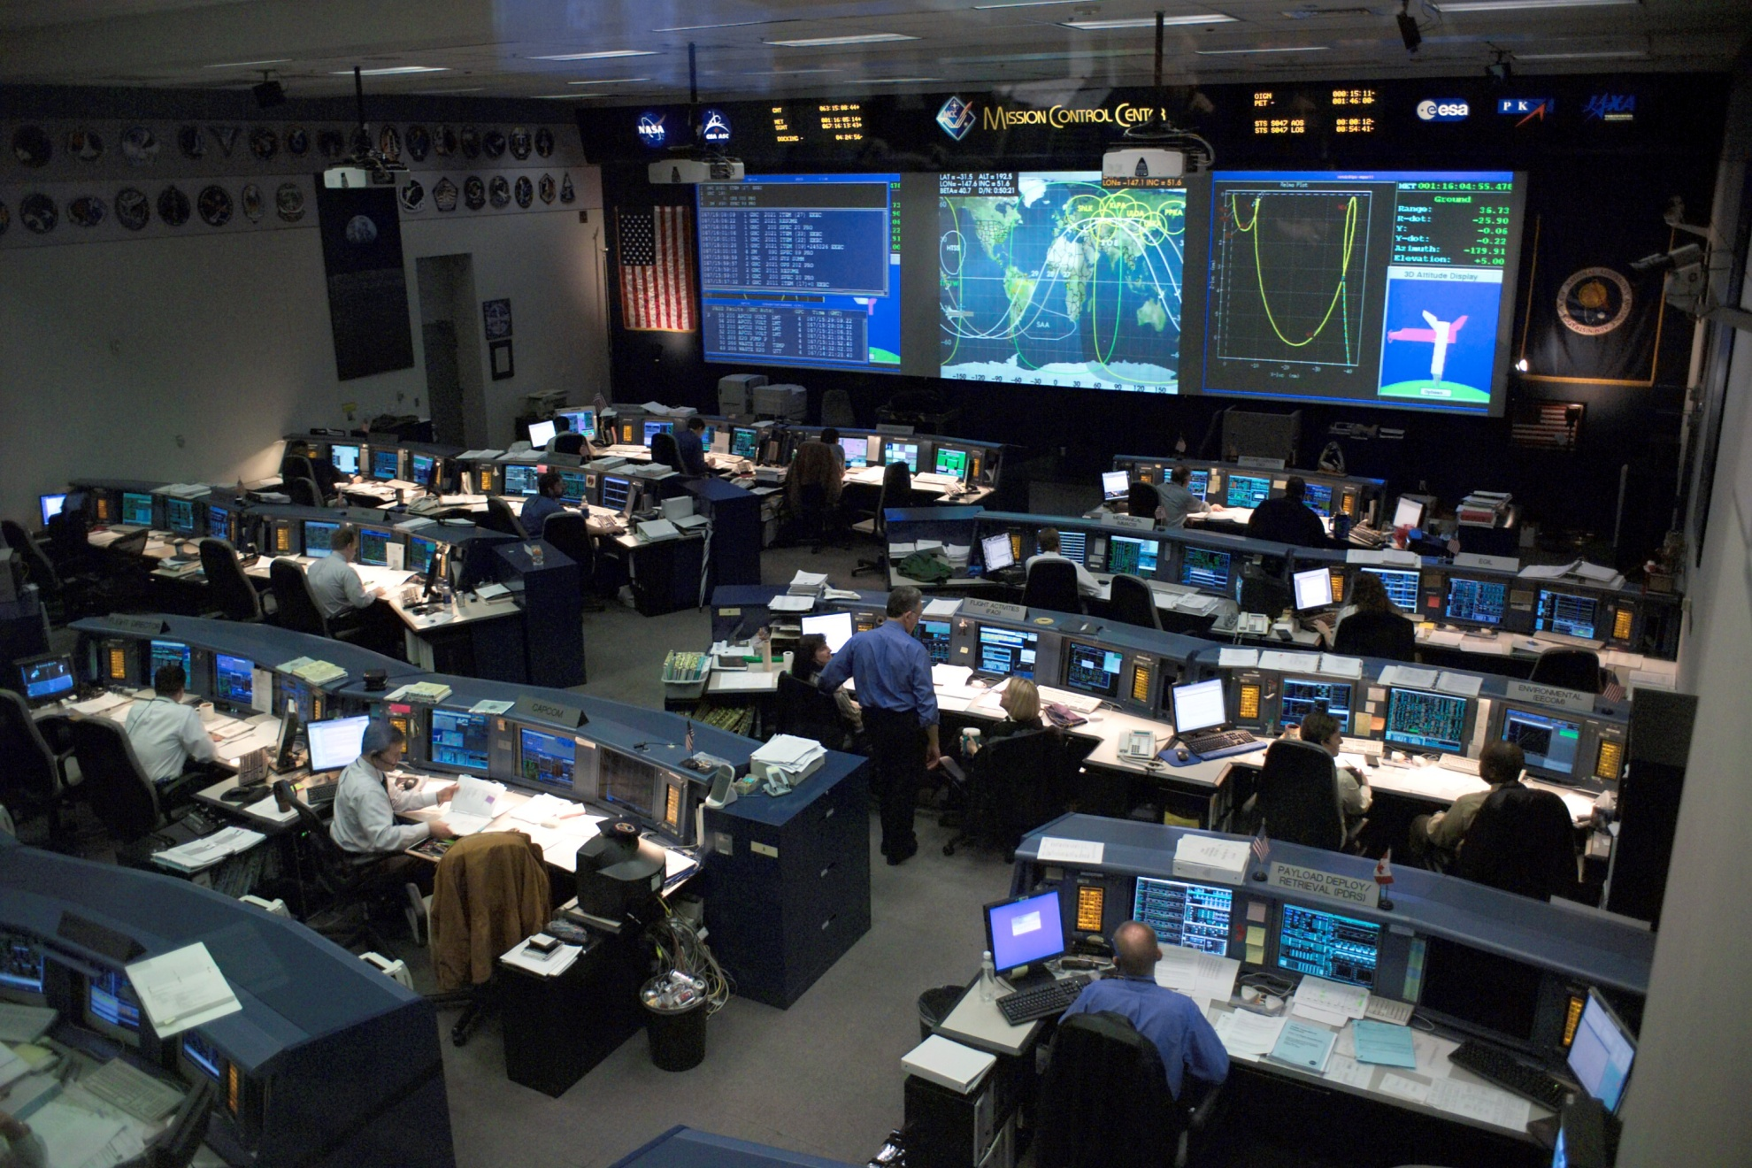
How would you design a large control room from the spatial viewpoint?

Slide 14
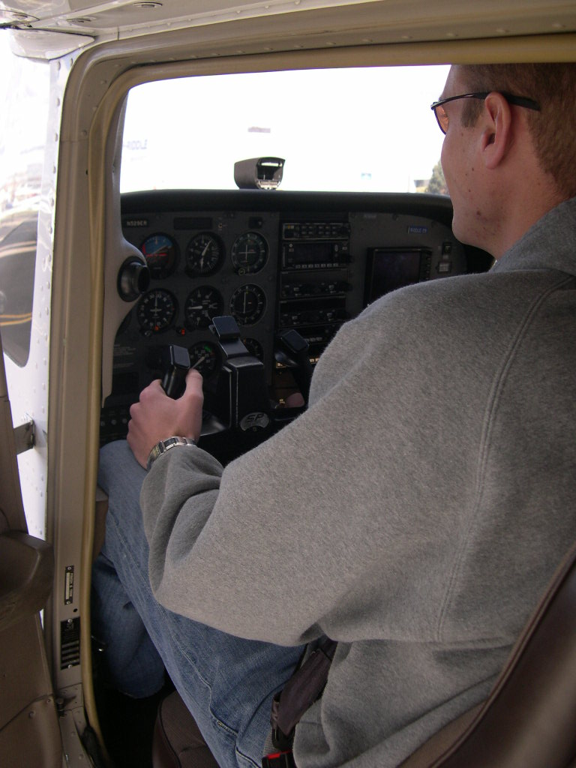
Who fits in a Cessna? Who can reach the controls? Discuss airplane cockpit design requirements

Slide 15
Design Exercise
Eye Ellipse
Range of
Movement
Vertical
Adjustment
Horizontal Adjustment
Z = 0
Y = 0
X = 0
Range of
Movement
Heel Point
“H” Point
Suggest design specifications for each of these critical dimensions

Slide 16
Rounded English – Metric Conversions
Inches | Centimeters |  | Centimeters | Inches |  | Pounds | kg |  | kg | Pounds
5 | 13 |  | 10 | 4 |  | 5 | 2 |  | 2 | 4
10 | 25 |  | 20 | 8 |  | 10 | 5 |  | 4 | 9
15 | 38 |  | 30 | 12 |  | 15 | 7 |  | 6 | 13
20 | 51 |  | 40 | 16 |  | 20 | 9 |  | 8 | 18
25 | 64 |  | 50 | 20 |  | 25 | 11 |  | 10 | 22
30 | 76 |  | 60 | 24 |  | 30 | 14 |  | 12 | 26
35 | 89 |  | 70 | 28 |  | 35 | 16 |  | 14 | 31
40 | 102 |  | 80 | 31 |  | 40 | 18 |  | 16 | 35
45 | 114 |  | 90 | 35 |  | 45 | 20 |  | 18 | 40
50 | 127 |  | 100 | 39 |  | 50 | 23 |  | 20 | 44
55 | 140 |  | 110 | 43 |  | 55 | 25 |  | 22 | 48
60 | 152 |  | 120 | 47 |  | 60 | 27 |  | 24 | 53
65 | 165 |  | 130 | 51 |  | 65 | 30 |  | 26 | 57
70 | 178 |  | 140 | 55 |  | 70 | 32 |  | 28 | 62
75 | 191 |  | 150 | 59 |  | 75 | 34 |  | 30 | 66
80 | 203 |  | 160 | 63 |  | 80 | 36 |  | 32 | 70
 |  |  | 170 | 67 |  | 85 | 39 |  | 34 | 75
 |  |  | 180 | 71 |  | 90 | 41 |  | 36 | 79
 |  |  | 190 | 75 |  | 95 | 43 |  | 38 | 84
 |  |  | 200 | 79 |  | 100 | 45 |  | 40 | 88
 |  |  |  |  |  |  |  |  | 42 | 92
 |  |  |  |  |  |  |  |  | 44 | 97
For your convenience

Slide 17
Anthropometry Measures
Stature
Segment lengths
Widths
Girths
Weight
Body Mass Index
Somatotypes
Discuss and list some key body measurements

Slide 18
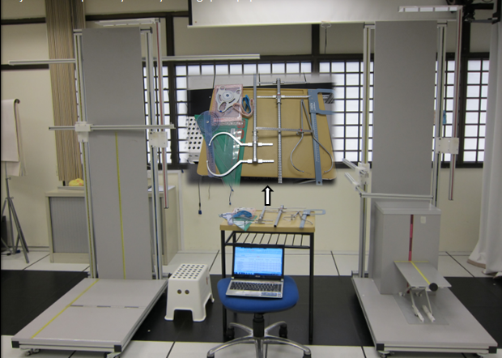
This is what anthropometry equipment looks like

Slide 19
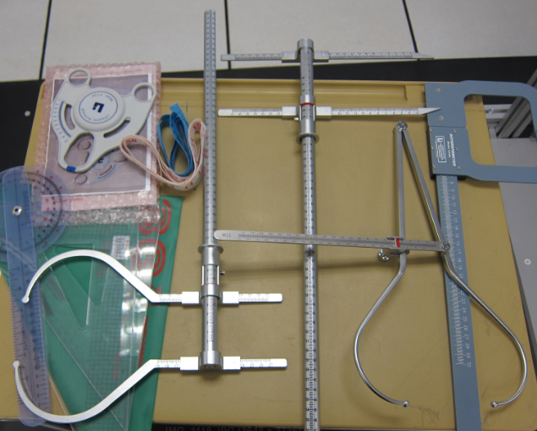
What measurements would we take with these instruments?

Slide 20
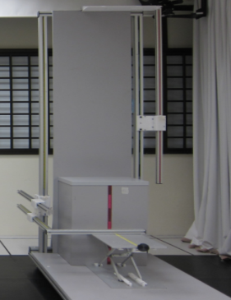
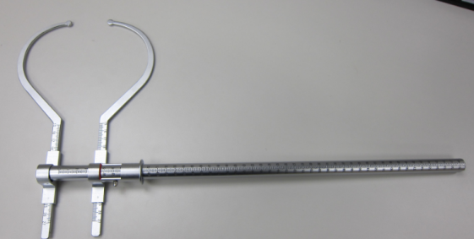
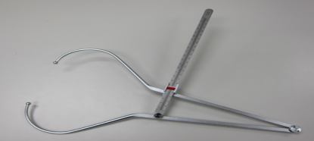
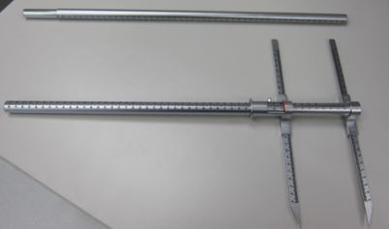

Slide 21
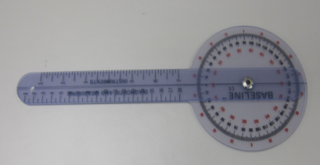
Goniometry- Joint Angles and Range of Motion
What are the ranges of motion of your hips, knees, wrist and thumb?

Slide 22
Measurements must be taken carefully

Slide 23
Body Mass Index and Health Risk for Singapore
BMI (kg/m²) for Adults | Health Risk
27.5 and above | High Risk
23 – 27.4 | Moderate Risk
18.5 – 22.9 | Low Risk (healthy range)
Below 18.5 | Risk of nutritional deficiency diseases and osteoporosis
What errors are there in the use of BMI as a health index?

Slide 24
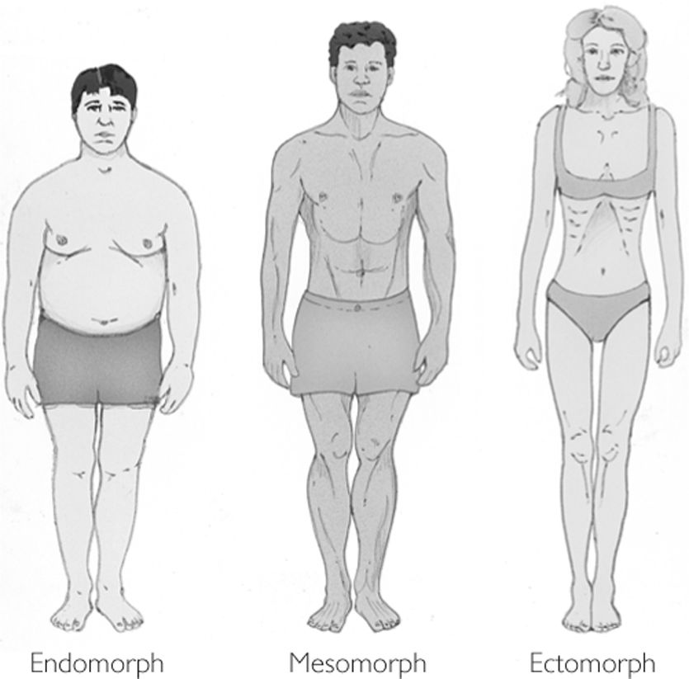
Somatotypes (William Sheldon (1898-1977)
People come in different shapes.
Search for references to Sheldon’s publications.
Are you a mesomorph, ectomorph or endomorph?
How are somatotypes measured?

Slide 25
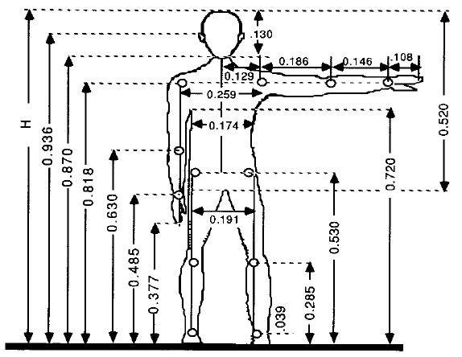
Drillis and Contini estimates of segment lengths based on stature
Can all dimensions be predicted reliably from stature?

Slide 26
Anthropometric Data based on Drillis and Contini Ratios From USA stature data (Sanders and McCormick)
 |  | 5th Percentile |  | 50th Percentile |  | 95th Percentile
 |  | Male | Female | Male | Female | Male | Female
 | Proportion | 163.6 | 151.1 | 175.3 | 161.8 | 187 | 172.2
Stature | 1 | 64.4 | 59.5 | 69.0 | 63.7 | 73.6 | 67.8
Ankle | 0.039 | 2.5 | 2.3 | 2.7 | 2.5 | 2.9 | 2.6
Foot Length | 0.152 | 9.8 | 9.0 | 10.5 | 9.7 | 11.2 | 10.3
Foot Breadth | 0.055 | 3.5 | 3.3 | 3.8 | 3.5 | 4.0 | 3.7
Knee | 0.285 | 18.4 | 17.0 | 19.7 | 18.2 | 21.0 | 19.3
Crotch | 0.485 | 31.2 | 28.9 | 33.5 | 30.9 | 35.7 | 32.9
Hip | 0.53 | 34.1 | 31.5 | 36.6 | 33.8 | 39.0 | 35.9
Navel | 0.63 | 40.6 | 37.5 | 43.5 | 40.1 | 46.4 | 42.7
Shoulder | 0.818 | 52.7 | 48.7 | 56.5 | 52.1 | 60.2 | 55.5
Eye | 0.936 | 60.3 | 55.7 | 64.6 | 59.6 | 68.9 | 63.5
Upper Arm | 0.186 | 12.0 | 11.1 | 12.8 | 11.8 | 13.7 | 12.6
Forarm | 0.146 | 9.4 | 8.7 | 10.1 | 9.3 | 10.7 | 9.9
Hand | 0.108 | 7.0 | 6.4 | 7.5 | 6.9 | 8.0 | 7.3
Arm | 0.44 | 28.3 | 26.2 | 30.4 | 28.0 | 32.4 | 29.8
Trunk Shoulder to Hip) | 0.288 | 18.5 | 17.1 | 19.9 | 18.3 | 21.2 | 19.5

Slide 27
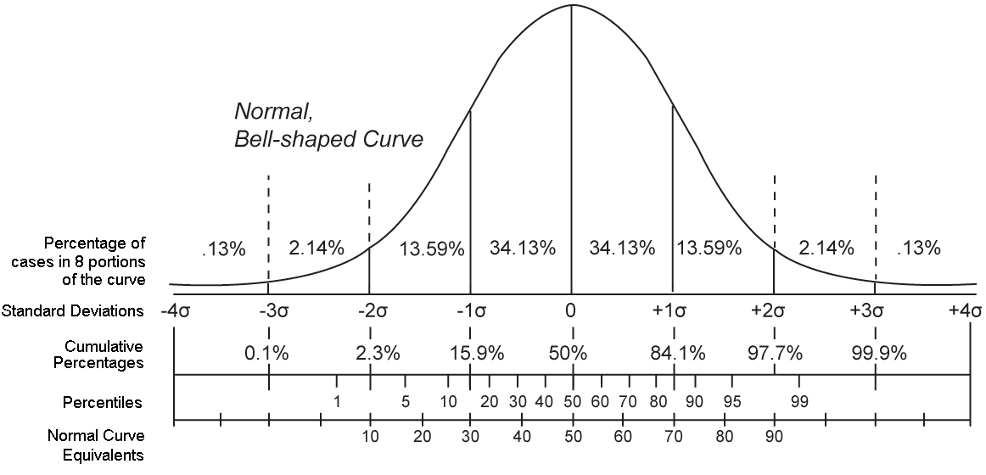
Statistics
Body dimensions from a large population are usually distributed Normally

Slide 28
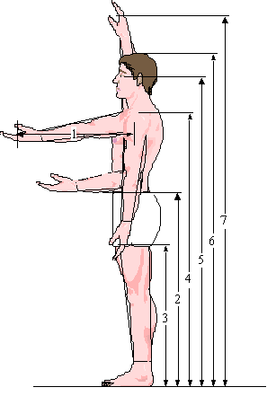
Typical Anthropometric Data
 | Percentile
 | Male |  | Female
Measurement | 95 | 5 | 95 | 5
1. Forward Reach | 26.9 | 24.0 | 25.1 | 22.2
2. Elbow Height | 44.6 | 39.5 | 41.5 | 36.1
3. Knuckle Height | 31.0 | 27.2 | 28.6 | 24.8
4. Shoulder Height | 60.1 | 53.2 | 55.8 | 48.8
5. Eye Height | 68.4 | 60.9 | 63.7 | 56.0
6. Stature | 73.2 | 64.4 | 67.7 | 59.5
7. Overhead Reach | 84.8 | 75.2 | 78.8 | 69.2
Where do you fit in?

Slide 29
You can change posture by changing the work environment

Slide 30
In the 1970s I developed the “box”
Shoulder height of the 5th percentile female
Knuckle height of the 95th percentile male
Forward functional reach of the 5th percentile female
Elbow width
What is your “box”?

Slide 31
The box can be very simple to remember
25/65
25/65
It is very useful for many practical purposes
50/125
(40/100 for sitting)
30/75(20/50 for sitting)

Slide 32
More on “the box”
It deals with both back, leg and arm posture
It is in the design domain - it does not measure posture
It’s zones are
Hand(s) inside the box
At the edge of the box
Outside the box
Outside the box in two dimensions
You can add time to the discussion
5 secs, 10 secs, 50% of job cycle etc
The corners may be an issue - so round them!
The box moves to the sitting base posture
Perhaps we should use a large ball instead of a box. Where would the center of the ball be located? What would be its diameter?

Slide 33
How high should a computer screen be?

Slide 34
How high should a work bench be?
Close visual work
Elbow height - the rule of thumb
Heavy work

Slide 35
More Rules of Thumb
5%
10%
50%
95%
99%
Reach
Fit

Slide 36
How much headroom should there be in the back seat of a sports car?

Slide 37
Beyond Fit and Reach - Orientation
The body works by first moving to the point of interest, adjusting the base posture and then using the arms, wrists and fingers to fine tune.
On Top
In Front
Behind
Under
Where does anthropometry fit in?

Slide 38
Grasping and Manipulating
Fingers have postures too
How big are your hands?
How big should handles be?
How big should keyboards be?
Length, Width, Circumference, Shape

Slide 39
The Theater and Stadium Problem
What should X and Y equal?
X = ?
Y = ?

Slide 40
Seat Width – how wide should a train / bus seat be?
W = ?
Hips, Shoulders, Elbows, Clothes, Bags and Personal Space

Slide 41
Rules of Bum
“It was normal to erect temporary viewing stands (bleachers) along the route in London of a royal procession. The official directive to the builders of stands was, for some centuries, to allow 18” for each aristocratic behind and 17” for commoners.” - the Toronto Transit Commission chose 17” for their subway.
The rules brought to the table for the Hong Kong Mass Transit design were 16” to the bum, 16 bums to the ton”

Slide 42
Storage racks
70
60
Measure some storage racks and see if they comply with these rules
50
40
30
20
10

Slide 43
Questions on car design
How close should you sit to the air bag?
How long are your arms?
How long are your legs?
Are these lengths correlated?
What seat back angle do you prefer?
How much do you tilt your wheel
Should we have adjustable pedals in cars?

Slide 44
Fitting Trials
First we use anthropometry to get to the ball park
Then we design an adjustable physical mockup
We bring in a representative sample of subjects to adjust the mockup to their liking as they go through a series of functional trials
We use an appropriate experimental design and psychophysical methods of adjustment
method of limits, just noticeable differences
Sometimes the anthropometric evidence and the fitting trials evidence don’t match - why?

Slide 45
Design Exercise
Measure the fixed interior dimensions of a vehicle cockpit
Measure the range of movement of the seat, pedals and yoke / steering wheel
Obtain population segment lengths (use spreadsheet data and Drillis and Contini proportions if you wish)
Assume that the seat angles (seat pan and back rest) are fixed
Use a reference point at floor level at the front of the airplane
Develop an Excel spreadsheet model for the anthropometric and workspace dimensions
Create reach and fit tables for Male and Female 5th, 50th and 95th percentiles
Assess the population fit and reach proportions with the seat in the full forward / full rearward / full up / full down positions.
Discuss the model assumptions and shortcomings.
Discuss how anthropometric dimensions, cabin dimensions and seat adjustment ranges can affect the driver / pilot’s ability to safely perform required tasks.
Discuss how you would create a Three Dimensional Model
Check the literature (and car / airplane manuals) for recommended seated workplace dimensions

Slide 46
Design Exercise
Measure the fixed interior dimensions of a vehicle cockpit
Measure the range of movement of the seat, pedals and yoke / steering wheel
Obtain population segment lengths (use spreadsheet data and Drillis and Contini proportions if you wish)
Assume that the seat angles (seat pan and back rest) are fixed
Use a reference point at floor level at the front of the airplane
Develop an Excel spreadsheet model for the anthropometric and workspace dimensions
Create reach and fit tables for Male and Female 5th, 50th and 95th percentiles
Assess the population fit and reach proportions with the seat in the full forward / full rearward / full up / full down positions.
Discuss the model assumptions and shortcomings.
Discuss how anthropometric dimensions, cabin dimensions and seat adjustment ranges can affect the driver / pilot’s ability to safely perform required tasks.
Discuss how you would create a Three Dimensional Model
Check the literature (and car / airplane manuals) for recommended seated workplace dimensions

Slide 47
Case study – Store shelves
A young woman, of average adult female height, but above average weight entered a store to buy cosmetics. As the intended purchase was out of her reach she stood on the bottom shelf which immediately collapsed, bringing the shelving unit on top of her and breaking her leg. Measurement of the shelving unit indicated that the item was beyond the reach of more than half of the adult female population. The only shelf was about a foot high and 15 inches deep and the products were hung on hooks connected to the rear wall of the unit. The shelf had a continuous metal edge which looked like a step. There was no warning regarding the lack of structural integrity of the shelf, although the erection manual cautioned people setting up the units not to step on the shelf. The defense expert told the court that the customer behaved in an unusual and unpredictable manner. The plaintiff’s expert argued the importance of “foreseeable misuse” being considered in structural design and, failing that, the need for a strong indication that “the shelf was not designed to bear the weight of a person” by the incorporation of a small guard or prominent warnings, that are commonly seen in other similar stores.

Slide 48
Reflections
Should we use one size fits all, tailor made spatial designs or accommodate a chosen percentage of the population
Give examples of each of these strategies
What are the costs and benefits of anthropometric accommodation?

