Slide 1
Train The Trainer OH Masterclass For Ergonomics: Manual Materials Handling Professor Brian Peacock

Slide 2
Manual Materials Handling
Modify and expand the concept map on the topic of manual materials handling
Add in links to sub maps and Internet references
Epidemiology
such as
NIOSH Lift Equation
Measurement
Workplace Design
Back Injuries
Snook Tables
is measured by
requires
Manual Materials Handling
such as
Acute and Cumulative Trauma
Upper Limb Injuries
Examples
has
leads to

Slide 3
Manual Materials Handling Analysis
Space, Force, Time, Individual capability
Force, weight
Location, distance
Moments
Frequency and repetitions
Lifting, holding, carrying, pulling, pushing
Individual training, capabilities and history
Use sketches to describe these mechanical principles with regard to some manual materials handling tasks
Search the Internet for Ergonomics and Manual Materials Handling evaluation tools

Slide 4
Examples
Construction
Warehousing
Manufacturing
Maintenance
Retail
Package transportation (UPS, FedEx etc.)
Airline baggage handling
Add to this list. Describe and discuss your examples using sketches and concept maps

Slide 5
Measurement – The NIOSH Lift Equation
The NIOSH Lift equation addresses
Object weight and by implication size, shape and center of mass
Workplace spatial arrangement – horizontal and vertical locations, distance moved
Task features – twisting (asymmetry) and coupling
Time – frequency and shift duration
It was developed by a panel of experts using anthropometry, biomechanics, work physiology , psychophysics and epidemiology evidence
There are 1981 and 1991 versions
It is a discounting approach in which a maximum load is reduced by multipliers (<1) to produce a Recommended Weight Limit. This is compared with the actual load to calculate a Lift Index (usually between 1 and 5)
http://www.cdc.gov/niosh/docs/94-110/pdfs/94-110.pdf
Search the Internet for descriptions and computational tools

Slide 6
The variables
RWL = Recommended weight limit
LC = Load constant
HM = Horizontal multiplier
VM = Vertical multiplier
DM = Distance multiplier
AM = Asymmetric multiplier
FM = Frequency multiplier
CM = Coupling multiplier
Make a sketch or view a picture of a manual materials handling task and identify the different variables
Search the Internet for a precise description of the multipliers

Slide 7
1991 Version
RWL = LC x HM x VM x DM x AM x FM x CM
Lift Index = LOAD / RWL
A Discounting Equation

Slide 8
1991 Multipliers
LC = 51 Pounds Load Constant
HM = 10/H Horizontal Distance
VM = 1-.0075 x / V-30/ I Vertical Distance – 30”I
DM = .82 + (1.8/D) Vertical Distance moved
AM = 1 – (.0032 x A) Asymmetry
Examine and discuss these multipliers
Search for metric versions

Slide 9
Frequency Multiplier

Slide 10
Coupling Multiplier

Slide 11
Asymmetry Multiplier

Slide 12
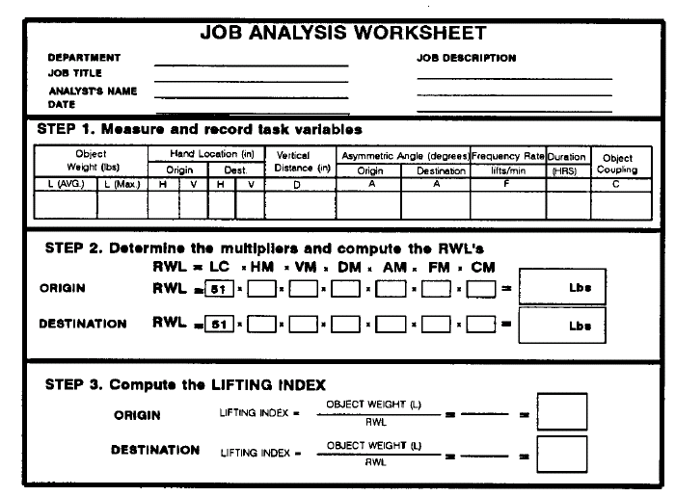
NIOSH Worksheet

Slide 13
Should not be used for:
One handed lifts
More than 8 hours
Seated or kneeling
Restricted work space
Unstable Objects
Carrying, pushing or pulling while lifting
Wheelbarrows or shovels
High speed motion
Unreasonable foot/floor coupling
Unfavorable environment
Discuss these restrictions with reference to real world manual materials handling tasks
Mimic the tasks and explain why the NLE may be an inaccurate or invalid measure
Discuss why, if used intelligently, the NLE approach may be used to assess these situations

Slide 14
Sources on the Internet
http://www.cdc.gov/niosh/docs/94-110/
http://www.emcins.com/losscontrol/quick_links/employee_safety_health/ergonomicsNIOSH.aspx
http://www.ergoweb.com/news/detail.cfm?id=566
http://www.ccohs.ca/oshanswers/ergonomics/niosh/calculating_rwl.html
Search for iPad / Android applications

Slide 15
Measurement – The Liberty Mutual (Snook) Tables
These tables address lifting carrying, pulling and pushing
They were developed using psychophysics – in which a spatial and operational scenarios were presented to representative samples of volunteers who were asked to estimate the loads that they could manage under prescribed repetition and shift duration conditions
The results are presented as tables of “percent of the population capable of performing the prescribed task”
Search the Internet for a description of psychophysical methods
Search the Internet for descriptions and tables
Discuss the applicability of these tables to different populations
Describe how you would use a psychophysical approach to the assessment of a manual materials handling task
http://libertymmhtables.libertymutual.com/CM_LMTablesWeb/taskSelection.do?action=initTaskSelection

Slide 16
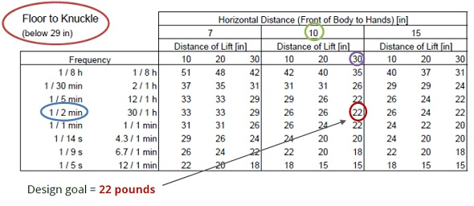
The Liberty Mutual Tables
A psychophysical approach to indicate the percent of the population capable of lifting / pushing / pulling an object under various distance and time conditions

Slide 17
Manual Materials Handling
Manual materials handling is a very common labor intensive occupation all over the world
Mechanization and automation can help but there are often manual activities within the whole system
Manual materials handling is a major cause of back and upper limb injuries
Carry out an end to end system analysis of an activity such as airline baggage handling or parcel transportation and identify the mechanized and manual tasks; Describe in detail the manual tasks and interfaces. Discuss where full automation or additional mechanization may be possible. Discuss the advantages and disadvantages of alternative approaches.
Discuss engineering and administrative controls

