Slide 1
Train The Trainer OH Masterclass For Ergonomics: History of Ergonomics Prof. Brian Peacock & A. Prof. Chui Yoon Ping

Slide 2
The Information (Computer) Revolution
The industrial revolution a century and a half ago greatly supplemented human capabilities by the harnessing of power and machinery.
One operational result was the production line, which in many cases increased worker productivity tenfold.
It also helped to stimulate the consumer revolution with a considerable increase in trade and standard of living.
Unfortunate outcomes however were the physical, cognitive and social stresses of specialized repetitive work.
The ergonomics developments of latter part of the 20th century brought perceptive and effective solutions to production line work, through both engineering and administrative interventions.
Discuss and describe the production lines for car and computer assembly and food processing

Slide 3
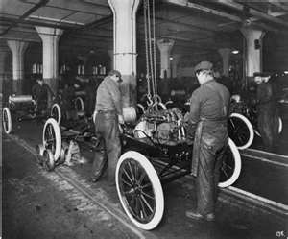
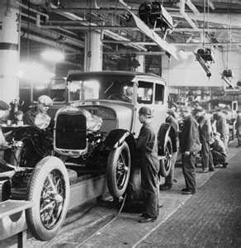
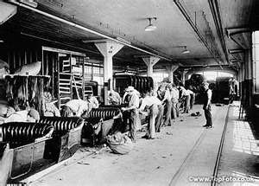

Slide 4
The Information (Computer) Revolution
Contemporary computers and telecommunications have had a similar major impact on business productivity.
However, the computer workstation is the new production line in terms of its stressful static physical demands and narrow job specializations.
Fortunately the ergonomics lessons learned from the manufacturing production line can be brought to bear on the design of workplaces, tasks and jobs in the office.
Design of the physical arrangements of workplaces to allow postural variety is an initial step.
The next step is the use of administrative interventions, such as self directed work teams, job rotations and enlargements to create a more flexible, effective, efficient workforce.
Discuss how the computer and smart phone / tablet have changed your physical activities

Slide 5
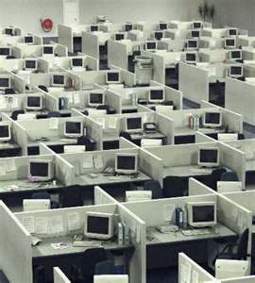
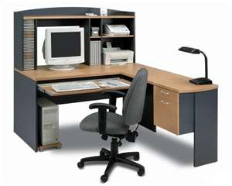
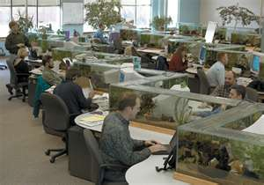
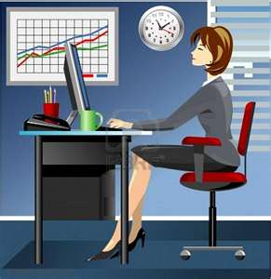

Slide 6
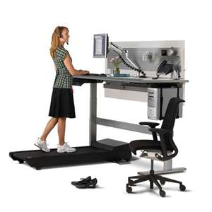
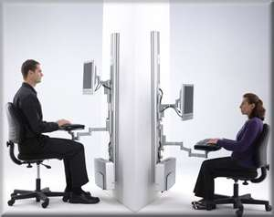

Slide 7
Technological Determinism
How does technology dictate the way in which we think and act?
In what ways are technologies beneficial or harmful?
Discuss the harmful effects of energy and information technology on people and the environment
How can ergonomics help?

Slide 8
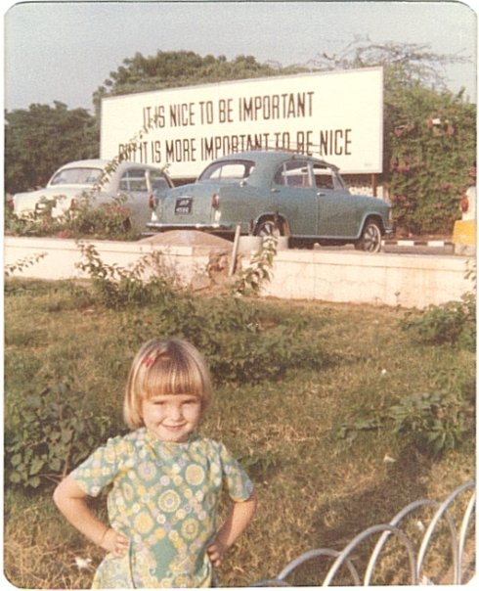
Once upon a time there was a little girl who grew up to be a…………..

Slide 9
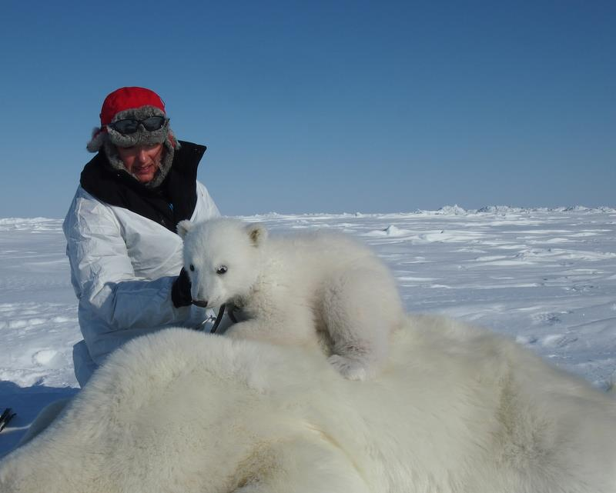
Polar Bear Biologist

Slide 10
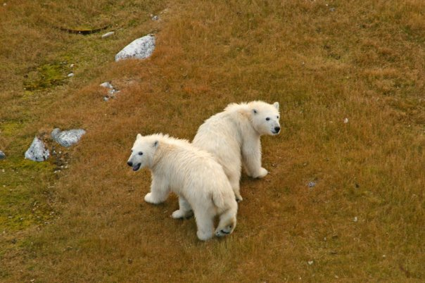
her job was to count and measure polar bears

Slide 11
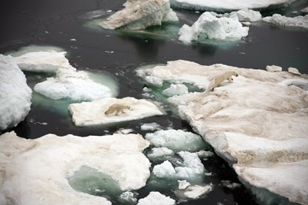
while they hunted for seals on the flow ice

Slide 12
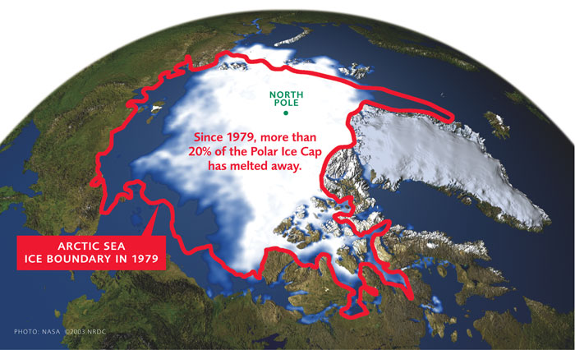
but the ice is melting

Slide 13
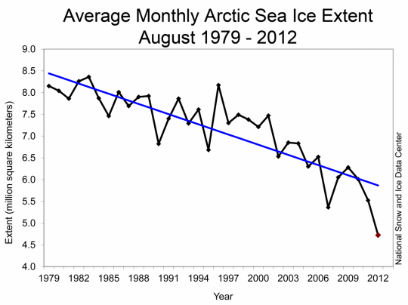
a little more each year

Slide 14
so the polar bears move further north to hunt for food

Slide 15
Why is the ice melting?
Technology and Tradeoffs!

Slide 16
One big people problem
An effect of sedentary work on production lines, offices and many service occupations
Coupled with the widespread availability of inexpensive tasty food in the developed and developing nations
Sedentary pastimes rather than physical exercise
Metabolic disorders are increasing at an alarming rate – obesity, diabetes, heart and circulatory disease etc. etc.
Why are people getting fatter?
Technology and Tradeoffs

Slide 17
Tradeoffs in Design
Effectiveness
Meets functional requirements
“quality”
Efficiency
Optimal use of resources
“productivity”
Ease of Use
Intended users
Comfort and Convenience
Prevention of misuse
Elegance
Esthetic / emotional appeal
Affective Design
Safety and Health
Prevention or mitigation of system failures
For participants and third parties
For the environment
Security
Inadvertent or malicious misuse
Satisfaction
Of ALL customers and stakeholders
Sustainability
Reliability
Under intended contexts over the life cycle
Resilience
Under unintended, unexpected and harsh conditions
E4S4
Discuss these tradeoffs with regard to cars and computers

Slide 18
People
Technology
Activities
Business
Environments
Engineers design Technology for use by People
But sometimes Technology causes problems like
Climate Change
Obesity
E4S4

Slide 19
Here are some Tradeoffs
E4 S4
Discuss the pros and cons and the tradeoffs you would make

Slide 20
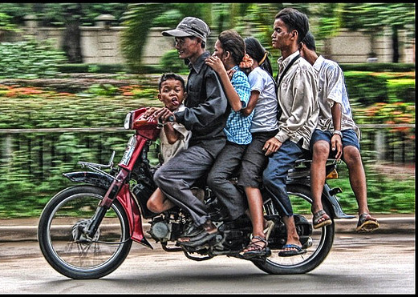
Efficiency
Safety
Tradeoffs
E4S4

Slide 21
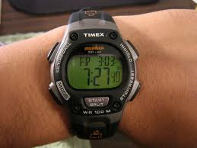
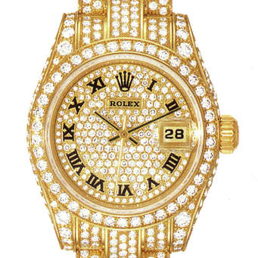
Effectiveness
Esthetic appeal
Tradeoffs
E4S4

Slide 22
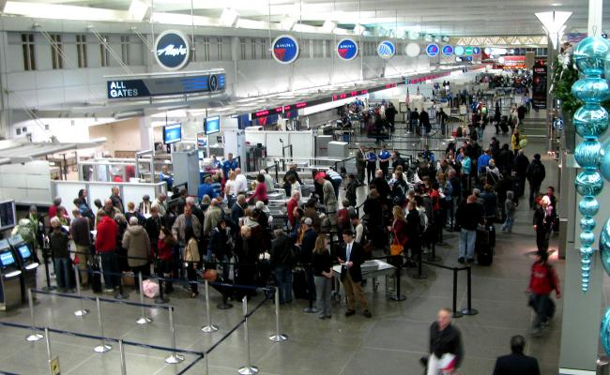
Ease of Use
Security
Tradeoffs
E4S4

Slide 23
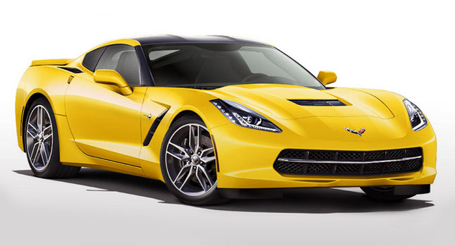
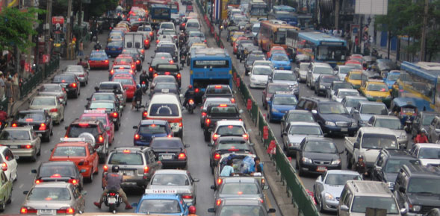
Esthetic appeal
Sustainability?
Tradeoffs
E4S4

Slide 24
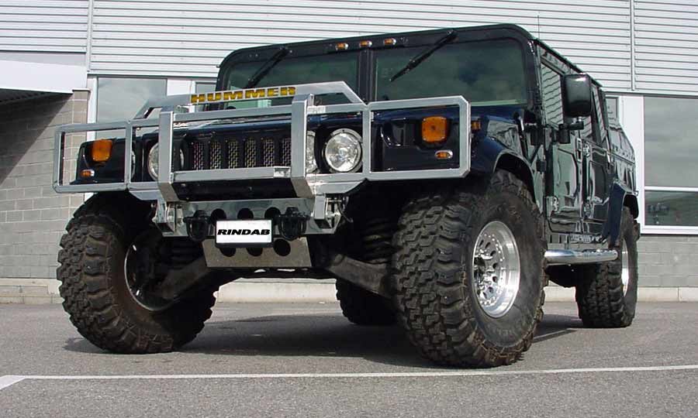
Efficiency
Effectiveness
Tradeoffs
E4S4

Slide 25
E4S4
Short and Long Term Tradeoffs are not always easy
Tomorrow
Next Century
Tradeoffs
Discuss the tradeoffs between personal and public transport

Slide 26
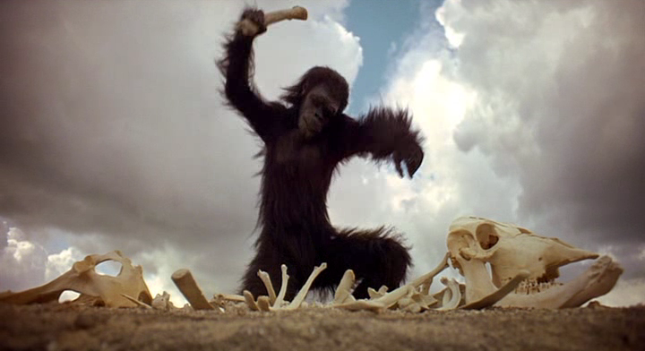
Primitive technology expanded our capabilities
E4S4

Slide 27
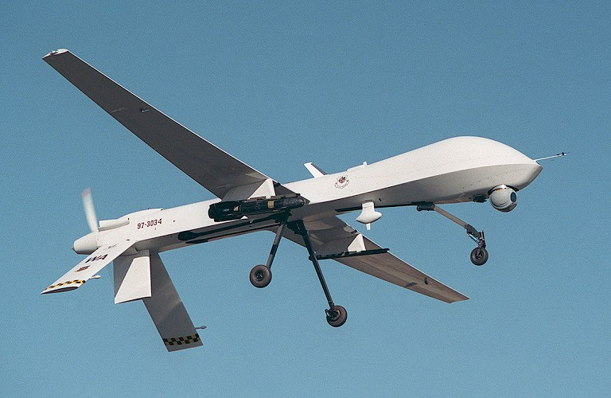
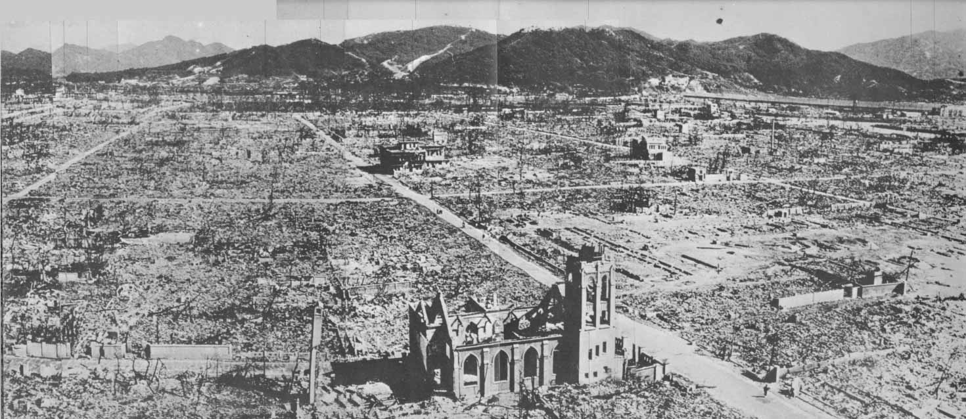
Powerful technology is used to end wars
E4S4

Slide 28
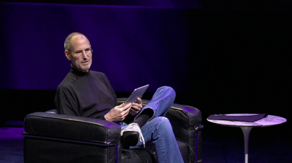
Beautiful technology can help us manage our lives
E4S4

Slide 29
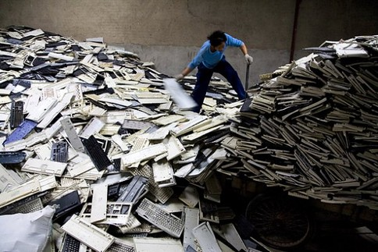
Obsolete technology and packaging are filling our landfills and oceans
E4S4

Slide 30
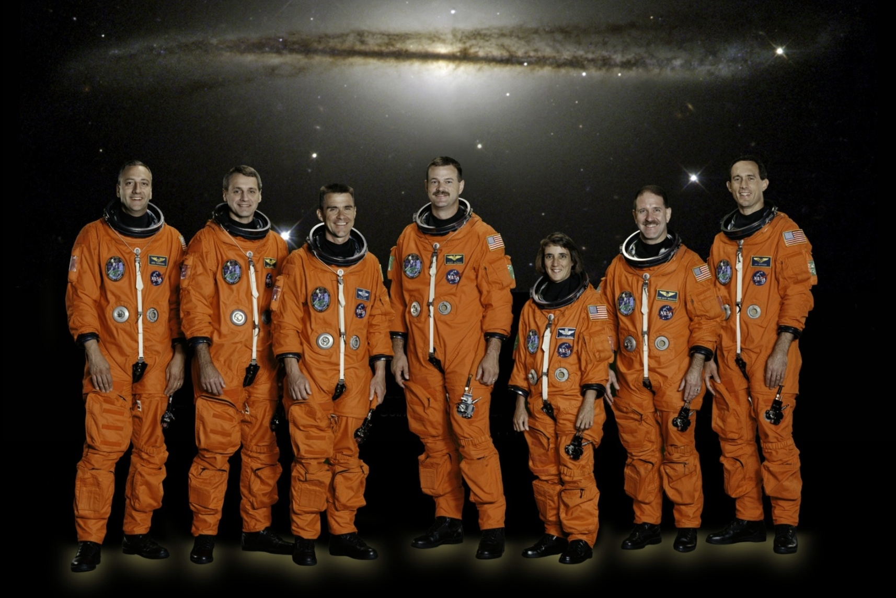
Physical Difference Assessment
Size
Shape
Flexibility
Strength
Speed
Stamina
Skill
E4S4
One size fits all?

Slide 31
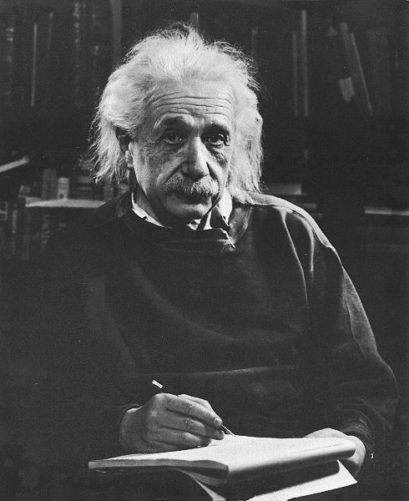
Cognitive Difference Evaluation
E4S4
One design fits all?

Slide 32
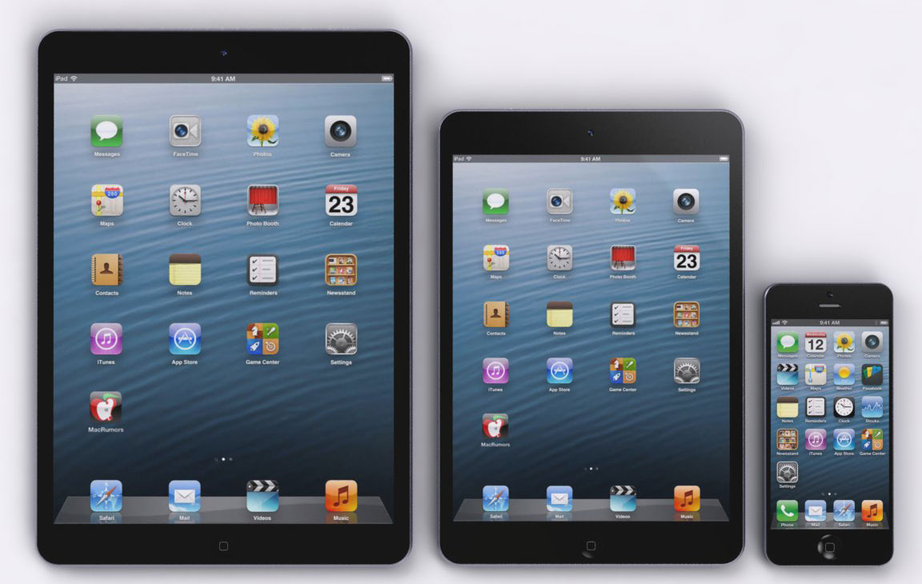
Usability Testing
E4S4
One size fits all?

Slide 33
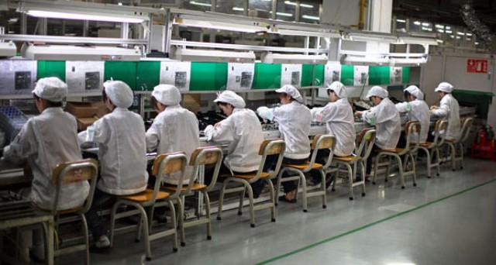
Manufacturing Process Design
What are back rests for?
E4S4

Slide 34
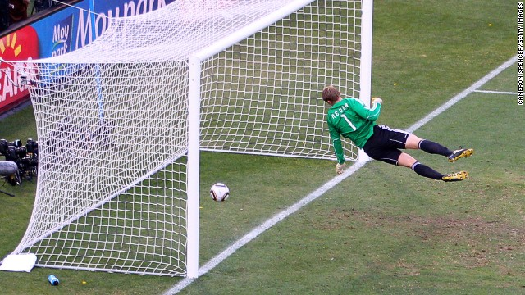
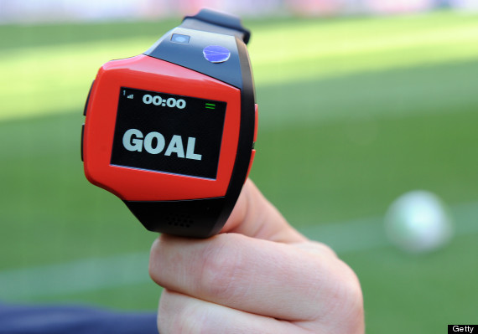
Playing Games
Goal Line Technology
E4S4
Is technology ruining or helping sport?

Slide 35
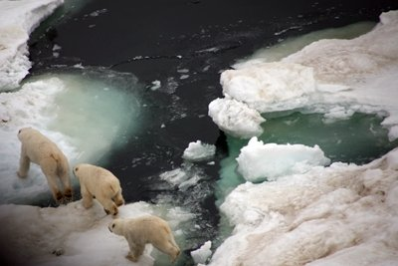
Managing Environments
Climate change is real!
Population weight gain is real and unhealthy
Body Mass Index = Weight(kg) / Height(m) ²
What are the inaccuracies of BMI?

Slide 36
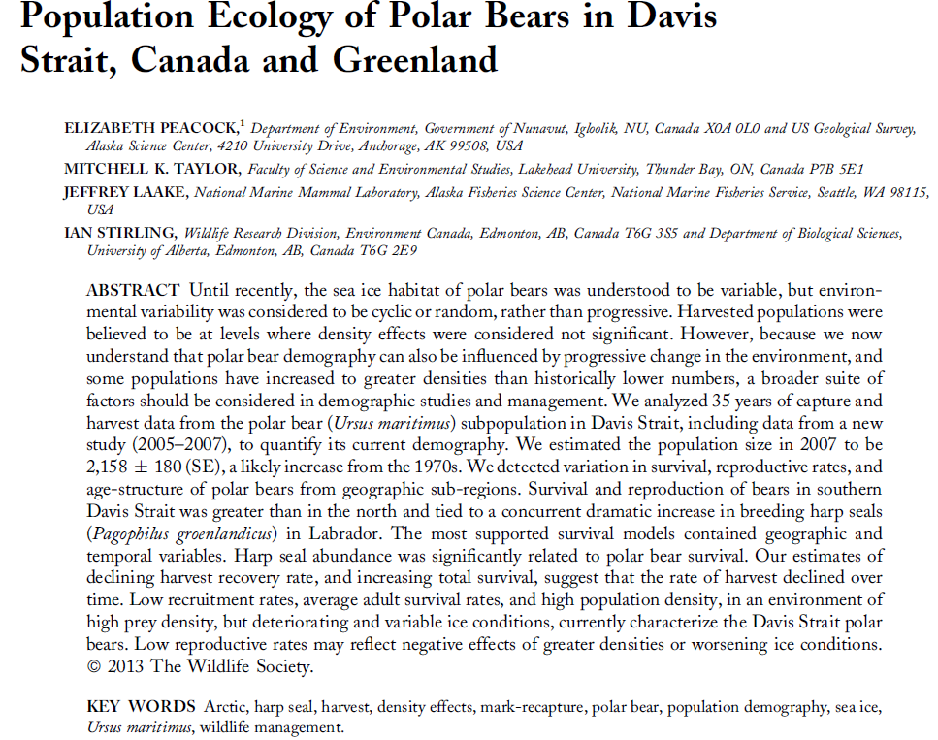

Slide 37
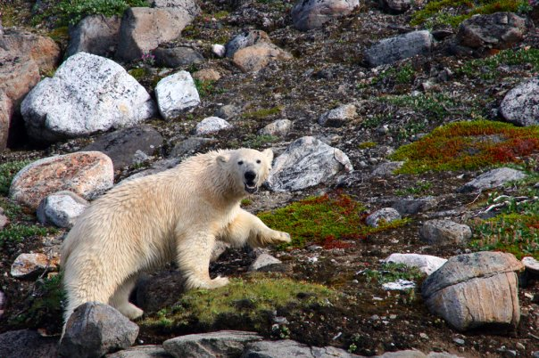
Please Protect the Polar Bears
An address your health through ergonomics analysis and design

Slide 38
Long History of Ergonomics and Human Factors Professor Brian Peacock

Slide 39
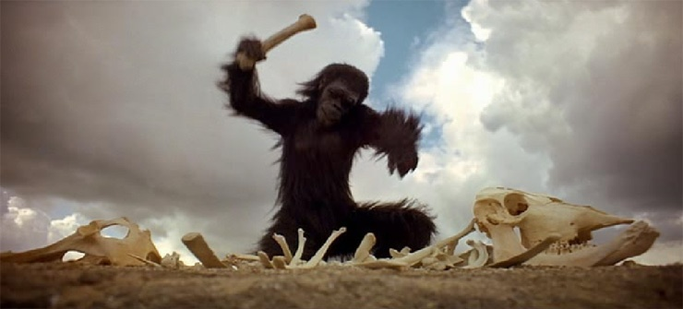
Weapons and Tools

Slide 40
Ergonomics
The term ‘ergonomics’ is composed of two words from Ancient Greek, ‘ergon’ (= work) and ‘nomos’ (= law). Thus, from its original meaning, ergonomics can be defined as the science of work. However, since Wojciech Bogumil Jastrzebowski from Poland created this term in 1857, the discipline has undergone substantial changes, especially with regard to its scope: according to the official definition, adopted by the International Ergonomics Association (IEA) in 2000, the field of ergonomics now extends across all aspects of human activity.

Slide 41
ERGON is more difficult than NOMOS
Discuss the differences between analysis and design / intervention, Which is harder?
Two trends:
Reductionist research
Complex applications

Slide 42
1800s onward
The Industrial Revolution
Harnessing of power for manufacturing and public services
Telecommunications
Alexander Graham Bell
Transportation
Surface and Air
Computers
Data storage and calculation, word and image processing
The Internet
Global communications
Microelectronics
Portability of information
Global warming
How did these technologies affect the users and the producers?

Slide 43
Early 1900s
Henry Ford – the production line
Great increases in productivity
Frederick Taylor – scientific management
The worker should work, not think, that is the job of management
Frank and Lillian Gilbreth
Time and Motion Study
Industrial Psychology
Hawthorne studies, Maslow, Herzberg
Motivation to work
Occupational medicine
Fatigue, illness and injury
The parents of ergonomics

Slide 44
1940s
Aviation
Controls and Displays
Anthropometry
Cockpits, chairs and tables
Socio-technical Systems
Human centered organization design
Ineffective mechanization
The stimuli for the growth of ergonomics

Slide 45
1950s
The Ergonomics Research Society
The Ergonomics Society
The Institute of Ergonomics and Human Factors
The Human Factors Society
The Human Factors and Ergonomics Society
Ergonomics and Human Factors becomes formalized.
Look at the web sites for these societies

Slide 46
1960s
1967 - The International Ergonomics Association
1964 - First Undergraduate course in Ergonomics and Cybernetics at Loughborough University in the UK
The space program
Psychologists, Industrial Engineers, Health Scientists
Ergonomics becomes a formal university course

Slide 47
1970s
Socio-technical systems
Quality of Work Life
Formal recognition of Work Related Musculo Skeletal Disorders
Over use disorders
Repetitive strain injuries
Cumulative trauma disorders
All results of the production line and the pursuit of productivity
Discuss the different descriptions of these widespread occupational diseases

Slide 48
1980s
Diversification of ergonomics into many fields
Military
Industrial
Consumer products
Health services
Aviation
Surface transportation
Gas and oil exploration, transportation, processing
Agriculture
Discuss how ergonomics can be applied in these different domains

Slide 49
1990s
The (physical) ergonomics explosion
Cumulative trauma disorders (backs and upper limbs)
Meat packing
Parcel transportation
Automotive manufacturing
Tripartite agreements
Trade union involvement
Socio technical systems becomes “Macroergonomics”
Ergonomics standards proliferation
OSHA
ILO
SAE
ISO
Board of Certification in Professional Ergonomics (CPE, CHFP)
Production with Protection
Discuss the explosive growth of physical ergonomics and the labor – management – government viewpoints

Slide 50
2000s
Usability
Spread of the tools and techniques of HFE to other professional groups
Human computer interaction
Consumer products
Proliferation of forensics applications
Hand held smart phones
Interface design
Ergonomics for children and the elderly
Application of brain electrical activity studies
An explosive growth of usability – discuss the many approaches to usability

